Slide 1
Sorting
Sorting includes internal sorting and external sorting
Internal sorting: the entire sort can be done in main memory, i.e., all elements needed to be sorted can be stored entirely in main memory.
External sorting: Sorts that cannot be performed in main memory and must be done on disk or tape are known as external sorting.
We will focus on internal sorting.
Several simple algorithms, such as insertion sort, perform in O(N²) time.
Shellsort that is very simple to code, first breaks Ω( N² ) barrier, and is efficient in practice.
Slightly more complicated sorting algorithms, such as heap sort, merge sort, quick sort, take O(NlogN) time.
Linear time sorting algorithms, such as bucket sort.

Slide 2
Preliminaries
The efficiency of data handling can often be substantially increased
if the data are sorted according to some criteria of order.
We assume:
The objects being sorted are elements of an array.
The objects being sorted are of type Comparable, which is just a synonym for whatever class of object we wish to place in the array.
If necessary, the Comparable class overloads the standard C++ operators =, > and < that used by the sort algorithms. That is, = is used for copying elements, while > and < compare two elements with respect to the defined criteria. This enables sort criteria to vary from one element type to another.

Slide 3
Insertion Sort
Insertion sort is one of the simplest sorting algorithms.
The algorithm
Insertion sort consists of N-1 passes.
For pass p = 1 through N-1, insertion sort ensures that the elements in positions 0 through p are in sorted order.
Insertion sort makes use of the fact that elements in positions 0 through p-1 are already known to be in sorted order, and move the element in position p left until its correct place is found among the first p+1 elements.

Slide 4
Insertion Sort ⎯ Examples
Sort 34, 8, 64, 51, 32, and 21
position: 0 1 2 3 4 5
34 8 64 51 32 21
First pass: 34 8 64 51 32 21
p = 1 8 34 64 51 32 21
second pass: 8 34 64 51 32 21
p = 2 8 34 64 51 32 21
third pass: 8 34 64 51 32 21
p = 3 8 34 51 64 32 21
8 34 51 64 32 21
fourth pass: 8 34 51 64 32 21
p = 4 8 34 51 32 64 21
8 34 32 51 64 21
8 32 34 51 64 21
8 32 34 51 64 21

Slide 5
Insertion Sort ⎯ Examples
Sort 34, 8, 64, 51, 32, and 21 (cont.)
position: 0 1 2 3 4 5
fifth pass: 8 32 34 51 64 21
p = 5 8 32 34 51 21 64
8 32 34 21 51 64
8 32 21 34 51 64
8 21 32 34 51 64
8 21 32 34 51 64

Slide 6
Insertion Sort ⎯ C++ code
template <class comparable>
void InsertionSort (vector<comparable> & a)
{
int j;
for (int p=1; p < a. size( ); p++) // perform N-1 passes
{ // for each iteration p, a[0 .. p-1] in sorted order.
comparable tmp = a[p];
for (j = p; j > 0 && tmp < a[j-1]; j--)
a[j] = a[j-1];
a[j] = tmp;
}
}
move the element in position p left until its correct place is found among the first p+1 elements.
8 34 64 51 32 21
j
p

Slide 7
Insertion Sort ⎯ Performance
InsertionSort() includes two nested loops.
The inner loop can be executed at most p+1 times for each value of p.
p iterates from 1 to N-1
The number of iterations of the inner loop is given by:
2+3+ … +N = N(N+1)/2 - 1
The running time of InsertionSort is O(N²).

Slide 8
Insertion Sort ⎯ Best Cases
If the input data elements are in increasing order, the inner loop is terminated immediately and thus the running time is O(N).
For example: sort 8 21 32 34 51 64
position: 0 1 2 3 4 5
8 21 32 34 51 64
First pass: 8 21 32 34 51 64
p = 1 8 21 32 34 51 64
second pass: 8 21 32 34 51 64
p = 2 8 21 32 34 51 64
third pass: 8 21 32 34 51 64
p = 3 8 21 32 34 51 64
fourth pass: 8 21 32 34 51 64
p = 4 8 21 32 34 51 64
fifth pass: 8 21 32 34 51 64
p = 5 8 21 32 34 51 64

Slide 9
Insertion Sort ⎯ Worst Cases
If the input data elements are in decreasing order, the inner loop is executed p+1 times for each value of p and thus the running time is O(N²).
For example: sort 64 51 34 32 21 8
position: 0 1 2 3 4 5
64 51 34 32 21 8
fourth pass: 32 34 51 64 21 8 j=4
p = 4 32 34 51 21 64 8 j=3
32 34 21 51 64 8 j=2
32 21 34 51 64 8 j=1
21 32 34 51 64 8 j=0
21 32 34 51 64 8

Slide 10
Shellsort
Shellsort was one of the first algorithms to break the quadratic barrier.
Shellsort works by comparing elements that are distant; the distance between comparisons decreases as the algorithm runs until the last phase, in which adjacent elements are compared.
Basic ideas
Choose a sequence, h₁=1, h₂, …, h_{t}, called the increment sequence.
For each h_{k} = h_{t} , …, h₂, h₁, sort all elements spaced h_{k} apart. (After a phase, using some increment h_{k}, for every i, we have a[i] <= a[i+h_{k}]; all elements spaced h_{k} apart are in sorted order. The file is then said to be h_{k}-sorted.)
In each phase, use insertion sort to sort all elements spaced h_{k} apart. For example,
Original: 80 93 60 12 42 30 68 85 10
after 3-sort: 12 42 10 68 85 30 80 93 60

Slide 11
Shellsort ⎯ Example
Suppose we have an array containing the following integers:
80 93 60 12 42 30 68 85 10
Choose {3, 2, 1} as the increment sequence.
For each h_{k} = 3, 2, 1, sort all elements spaced h_{k} apart using insertion sort.
For h_{k} = 3, divide the original array into three segments (all elements in each segment are spaced h_{k} apart in the original array).
80 12 68 ⎯ segment 1
93 42 85 ⎯ segment 2
60 30 10 ⎯ segment 3
(80 93 60 12 42 30 68 85 10)
and sort each segment using insertion sort:
12 68 80
42 85 93
10 30 60
The original array, partially sorted, now appears as
12 42 10 68 85 30 80 93 60

Slide 12
Shellsort ⎯ Example
For each h_{k} = 3, 2, 1, sort all elements spaced h_{k} apart using insertion sort.
(After 3-sort: 12 42 10 68 85 30 80 93 60)
For h_{k} = 2, divide the 3-sorted array into two segments (all elements in each segment are spaced h_{k} apart in the 3-sorted array).
12 10 85 80 60 ⎯ segment 1
42 68 30 93 ⎯ segment 2
(12 42 10 68 85 30 80 93 60)
and sort each segment using insertion sort:
10 12 60 80 85
30 42 68 93
The array takes the form:
10 30 12 42 60 68 80 93 85 (after 2-sort)
For h_{k} = 1, sort the 2-sorted array using insertion sort.
10 12 30 42 60 68 80 85 93

Slide 13
How to Choose the Increment Sequence
Any increment sequence will do as long as h₁ = 1, but some choices are better than others.
Shell’s increments: h_{t} = ⎣N/2⎦ and h_{k} = ⎣h_{k+1}/2⎦
Ex. N = 9: 1, 2, 4
N = 21: 1, 2, 5, 10
Hibbard’s increments: 1, 3, 7, …, 2^{k}-1 (such that 2^{k}-1 <= N and 2^{k+1}-1 > N)
Ex. N = 9: 1, 3, 7
N = 21: 1, 3, 7, 15
Sedgewick’s increments: 1, 5, 19, 41, 109 …, in which the terms are either of the form 9*4^{i}-9*2^{i}+1 or 4^{i}-3*2^{i}+1.
Ex. N = 9: 1, 5
N = 21: 1, 5, 19

Slide 14
C++ code for Shellsort
/**
* Shellsort, using Shell’s (poor) increments.
*/
template <class Comparable>
void shellsort( vector<Comparable> & a )
{
int j;
for ( int gap = a.size() / 2; gap > 0; gap /= 2 )
for ( int i = gap; i < a.size(); i ++)
{
Comparable tmp = a[ i ];
for ( j = i; j >= gap && tmp < a[ j – gap ]; j -= gap )
a [j ] = a[ j – gap ];
a [ j ] = tmp;
}
}
//Shell’s increments
Use insertion sort to sort
elements in each segments
in sorted order. That is, for
each position, i, in gap,
gap+1, …, N-1, place the
element in the correct spot
among i, i-gap, i-2*gap,
i-3*gap, …, etc.

Slide 15
Shellsort Using Shell’s Increments - Example
Original : 81 99 11 96 12 98 17 95
gap = 4 : 81 99 11 96 12 98 17 95 → 81 99 11 96 12 98 17 95
→ 12 99 11 96 81 98 17 95
→ 12 98 11 96 81 99 17 95
→ 12 98 11 96 81 99 17 95
→ 12 98 11 95 81 99 17 96
i
Place the element at i in the
the correct spot among the
elements in the same segment
and at the positions before i.
i
i
i
i
gap = 2 : 12 98 11 95 81 99 17 96 → 11 98 12 95 81 99 17 96
→ 11 98 12 95 81 99 17 96
→ 11 95 12 98 81 99 17 96
→ 11 95 12 98 81 99 17 96
→ 11 95 12 98 81 99 17 96
→ 11 95 12 98 17 99 81 96
→ 11 95 12 96 17 98 81 99
i
i
i
i
i

Slide 16
Shellsort ⎯ Running Time
The running time of Shellsort depends on the choice of increment sequence.
The worst-case running time of Shellsort, using Shell’s increments, is O(N²).
The worst-case running time of Shellsort using Hibbard’s increments is O(N^{3/2}).
The worst-case running time of Shellsort using Sedgewick’s increments is O(N^{4/3}).
The average-case running time of Shellsort, using Hibbard’s increments, is thought to be O(N^{5/4}), based on simulations, but nobody has been able to prove this.
The average running time is conjectured to be O(N^{7/6}).

Slide 17
Heapsort
Binary heaps can be used to sort in O(NlogN) time.
Basic ideas
Step 1: Build a binary heap of N elements
Step 2: Remove the root and reheap (perform the deleteMin operation)
Step 3: Repeat step 2 until empty.

Slide 18
Binary heaps (review)
What is a binary heap?
Complete binary tree: a binary tree that is completely filled, with the possible exception of the bottom level, which is filled from left to right.
Heap-order property: for every node x, the key in the parent of x is smaller than (or equal to) the key in x, with the exception of the root.
How to build a binary heap for N elements?
build a complete binary tree first
ignore the heap-order property at the moment
apply percolate-down for each node starting at the last non-leaf node.
97
26
53
59
41
31
26
41
58
31
53
97
58
59
97
53
59
26
41
58
31
26
41
31
53
97
58
59
0
1
2
3
4
5
6
7
8
9
10
0
1
2
3
4
5
6
7
8
9
10

Slide 19
Binary heaps (review)
deleteMin:
Remove the element in the root and create a hole in the root.
Percolate the hole down so that the last element in the heap can be placed in the hole.
26
41
31
41
31
53
97
58
59
53
97
58
59
26
41
31
53
97
58
59
41
31
53
97
58
59
0
1
2
3
4
5
6
7
8
9
10
0
1
2
3
4
5
6
7
8
9
10
31
31
41
41
58
53
97
58
59
53
97
59
31
41
53
97
58
59
31
41
58
53
97
59
0
1
2
3
4
5
6
7
8
9
10
0
1
2
3
4
5
6
7
8
9
10

Slide 20
Heapsort ⎯ Example
Sort 97 53 59 26 41 58 31
Build a binary heap for 97 53 59 26 41 58 31
Remove root 26 and reheap:
26
41
31
53
97
58
59
26
41
31
53
97
58
59
0
1
2
3
4
5
6
7
31
41
58
53
97
59
31
41
58
53
97
59
26
0
1
2
3
4
5
6
7
0
1
2
3
4
5
6
7

Slide 21
Heapsort ⎯ Example
Sort 97 53 59 26 41 58 31
Remove root 31 and reheap:
Remove root 41 and reheap:
41
53
58
59
97
41
53
58
59
97
26
31
0
1
2
3
4
5
6
7
0
1
2
3
4
5
6
7
53
59
58
97
53
59
58
97
26
31
41
0
1
2
3
4
5
6
7
0
1
2
3
4
5
6
7

Slide 22
Heapsort ⎯ Example
Sort 97 53 59 26 41 58 31
Remove root 53 and reheap:
Remove root 58 and reheap:
58
59
97
58
59
97
26
31
41
53
0
1
2
3
4
5
6
7
0
1
2
3
4
5
6
7
59
97
59
97
26
31
41
53
58
0
1
2
3
4
5
6
7
0
1
2
3
4
5
6
7

Slide 23
Heapsort ⎯ Example
Sort 97 53 59 26 41 58 31
Remove root 59 and reheap:
Remove root 97:
97
97
26
31
41
53
58
59
0
1
2
3
4
5
6
7
0
1
2
3
4
5
6
7
26
31
41
53
58
59
97
0
1
2
3
4
5
6
7
0
1
2
3
4
5
6
7

Slide 24
Heapsort ⎯ Running Time
To build a binary heap takes O(N) time.
Performing N deleteMin operations takes O(NlogN) time.
Total running time is O(NlogN).
Drawback: need to use an extra array.

Slide 25
Heapsort ⎯ Improving Space Efficiency
A clever way to avoid using a second array makes use of the fact that after each deleteMin, the heap shrinks by 1.
The cell that was last in the heap can be used to store the element that was just deleted.
31
41
58
After remove the smallest element 26.
53
97
59
31
41
58
53
97
59
26
0
1
2
3
4
5
6
7
0
1
2
3
4
5
6
7
31
41
58
53
97
59
31
41
58
53
97
59
26
0
1
2
3
4
5
6
7

Slide 26
Improving Space Efficiency ⎯ Example
Sort 97 53 59 26 41 58 31
Build a binary heap for 97 53 59 26 41 58 31
Remove root 26 and reheap:
26
41
31
53
97
58
59
26
41
31
53
97
58
59
0
1
2
3
4
5
6
7
31
41
58
53
97
59
31
41
58
53
97
59
26
0
1
2
3
4
5
6
7

Slide 27
Improving Space Efficiency ⎯ Example
Sort 97 53 59 26 41 58 31
Remove root 31 and reheap:
Remove root 41 and reheap:
41
53
58
59
97
41
53
58
59
97
31
26
0
1
2
3
4
5
6
7
53
59
58
97
53
59
58
97
41
31
26
0
1
2
3
4
5
6
7

Slide 28
Improving Space Efficiency ⎯ Example
Sort 97 53 59 26 41 58 31
Remove root 53 and reheap:
Remove root 58 and reheap:
58
59
97
58
59
97
53
41
31
26
0
1
2
3
4
5
6
7
59
97
59
97
58
53
41
31
26
0
1
2
3
4
5
6
7

Slide 29
Improving Space Efficiency ⎯ Example
Sort 97 53 59 26 41 58 31
Remove root 59 and reheap:
Remove root 97 and reheap:
97
97
59
58
53
41
31
26
0
1
2
3
4
5
6
7
97
59
58
53
41
31
26
0
1
2
3
4
5
6
7
The resulting array contains the elements in
decreasing sorted order.
If we want the elements in the more typical
increasing sorted order, how to solve?

Slide 30
(max)Heap
In the original heap, the parent has a smaller element than its children.
(max)Heap
A complete binary tree
Heap order property: for every node x, the key in the parent of x is larger than (or equal to) the key in x, with the exception of the root.

Slide 31
Heapsort Using (max)Heap ⎯ Example
Sort 97 53 59 26 41 58 31
Build a (max)heap for 97 53 59 26 41 58 31
Remove root 97 and reheap:
97
53
59
26
41
58
31
97
53
59
26
41
58
31
0
1
2
3
4
5
6
7
59
53
58
26
41
31
59
53
58
26
41
31
97
0
1
2
3
4
5
6
7

Slide 32
Heapsort Using (max)Heap ⎯ Example
Sort 97 53 59 26 41 58 31
Remove root 59 and reheap:
Remove root 58 and reheap:
58
53
31
26
41
58
53
31
26
41
59
97
0
1
2
3
4
5
6
7
53
41
31
26
53
41
31
26
58
59
97
0
1
2
3
4
5
6
7

Slide 33
Heapsort Using (max)Heap ⎯ Example
Sort 97 53 59 26 41 58 31
Remove root 53 and reheap:
Remove root 41 and reheap:
41
26
31
41
26
31
53
58
59
97
0
1
2
3
4
5
6
7
31
26
31
26
41
53
58
59
97
0
1
2
3
4
5
6
7

Slide 34
Heapsort Using (max)Heap ⎯ Example
Sort 97 53 59 26 41 58 31
Remove root 31 and reheap:
Remove root 26 and reheap:
26
26
31
41
53
58
59
97
0
1
2
3
4
5
6
7
26
31
41
53
58
59
97
0
1
2
3
4
5
6
7

Slide 35
Mergesort
Mergesort runs in O(NlogN) worst-case running time.
The number of comparisons used is nearly optimal.
Mergesort is a fine example of a recursive algorithm.
We give two implementations: recursive one and non-recursive one.

Slide 36
Merging Two Sorted Lists
The fundamental operation in this algorithm is merging two sorted lists.
Basic ideas
Takes two input arrays A and B in sorted order, and an output array C.
Three counters, Actr, Bctr, and Cctr, which are initially set to the beginning of their respective arrays.
The smaller of A[Actr] and B[Bctr] is copied to the next entry in C (i.e., C[Cctr]), and the appropriate counters are advanced.
When either input list is exhausted, the remainder of the other list is copied to C.
A
1
13
24
26
B
2
15
27
38
C
Actr
Bctr
Cctr

Slide 37
Merging Two Sorted Lists ⎯ Example
Suppose we want to merge array A containing 1, 13, 24, 26, and array B containing 2, 15, 27, 38
A
1
13
24
26
B
2
15
27
38
C
1
Actr
Bctr
Cctr
A
1
13
24
26
B
2
15
27
38
C
1
2
Actr
Bctr
Cctr
A
1
13
24
26
B
2
15
27
38
C
1
2
13
Actr
Bctr
Cctr
A
1
13
24
26
B
2
15
27
38
C
1
2
13
15
Actr
Bctr
Cctr

Slide 38
Merging Two Sorted Lists ⎯ Example
Suppose we want to merge array A containing 1, 13, 24, 26, and array B containing 2, 15, 27, 38 (cont.)
A
1
13
24
26
B
2
15
27
38
C
1
2
13
15
24
Actr
Bctr
Cctr
A
1
13
24
26
B
2
15
27
38
C
1
2
13
15
24
26
Actr
Bctr
Cctr
A
1
13
24
26
B
2
15
27
38
C
1
2
13
15
24
26
Actr
Bctr
Cctr
Now the array A is exhausted. Then the remainder of the array B is copied to C
A
1
13
24
26
B
2
15
27
38
C
1
2
13
15
24
26
27
38
Actr
Bctr
Cctr

Slide 39
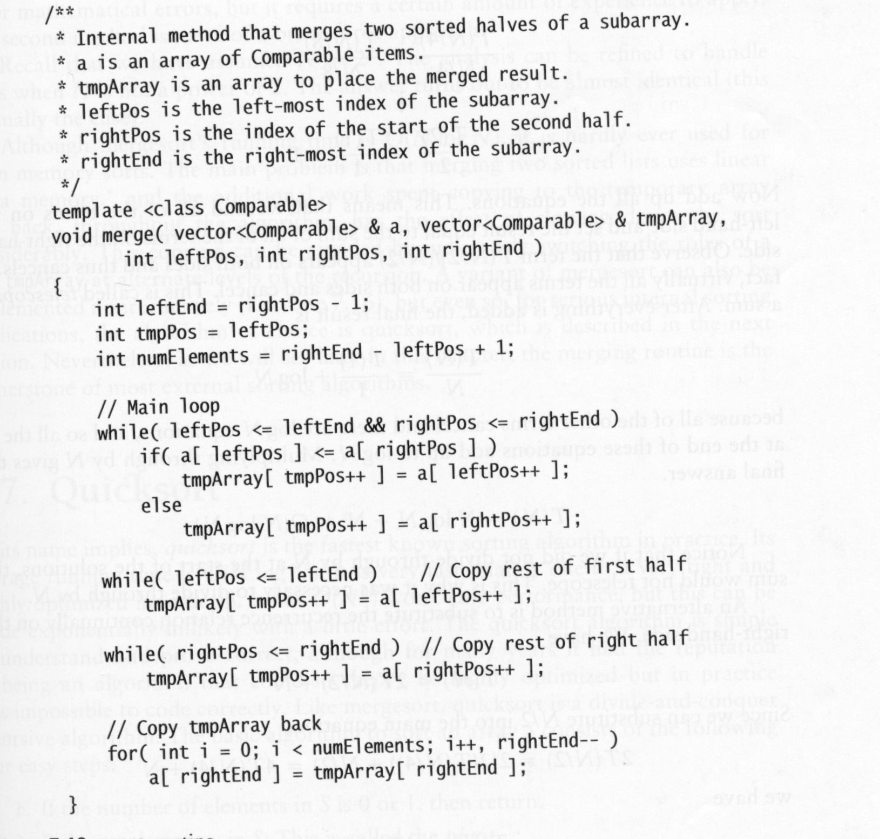
Merging Two Sorted Lists ⎯ C++ Code
A
B
a
leftPos
rightPos
rightEnd
leftEnd points to the last position of subarray A; tmpPos is the next
available position in array tmpArray to place the merged result.
One pass traversal of A and B; make sure not to go
Beyond the end position of A or B.
If current element in A is no larger than current element
In B, place the current element in A into tmpArray, and
advance leftPos and tmpPos by one.
If we exhaust array B, copy the remainder of
array A to tmpArray.
If we exhaust array A, copy the remainder of
array B to tmpArray.

Slide 40
Recursive Mergesort
The basic idea
If N = 1, there is only one element to sort, and the answer is at hand.
Otherwise,
Recursively mergesort the first half;
Recursively mergesort the second half;
This gives two sorted halves, which can then be merged together using the merging algorithm.
For instance, suppose to sort the eight-element array
24 13 26 1 2 27 38 15
Recursively sort the first four elements:
24 13 26 1 → 1 13 24 16
Recursively sort the second four elements:
2 27 38 15 → 2 15 27 38
Merge the two halves
1 2 13 15 24 26 27 38

Slide 41
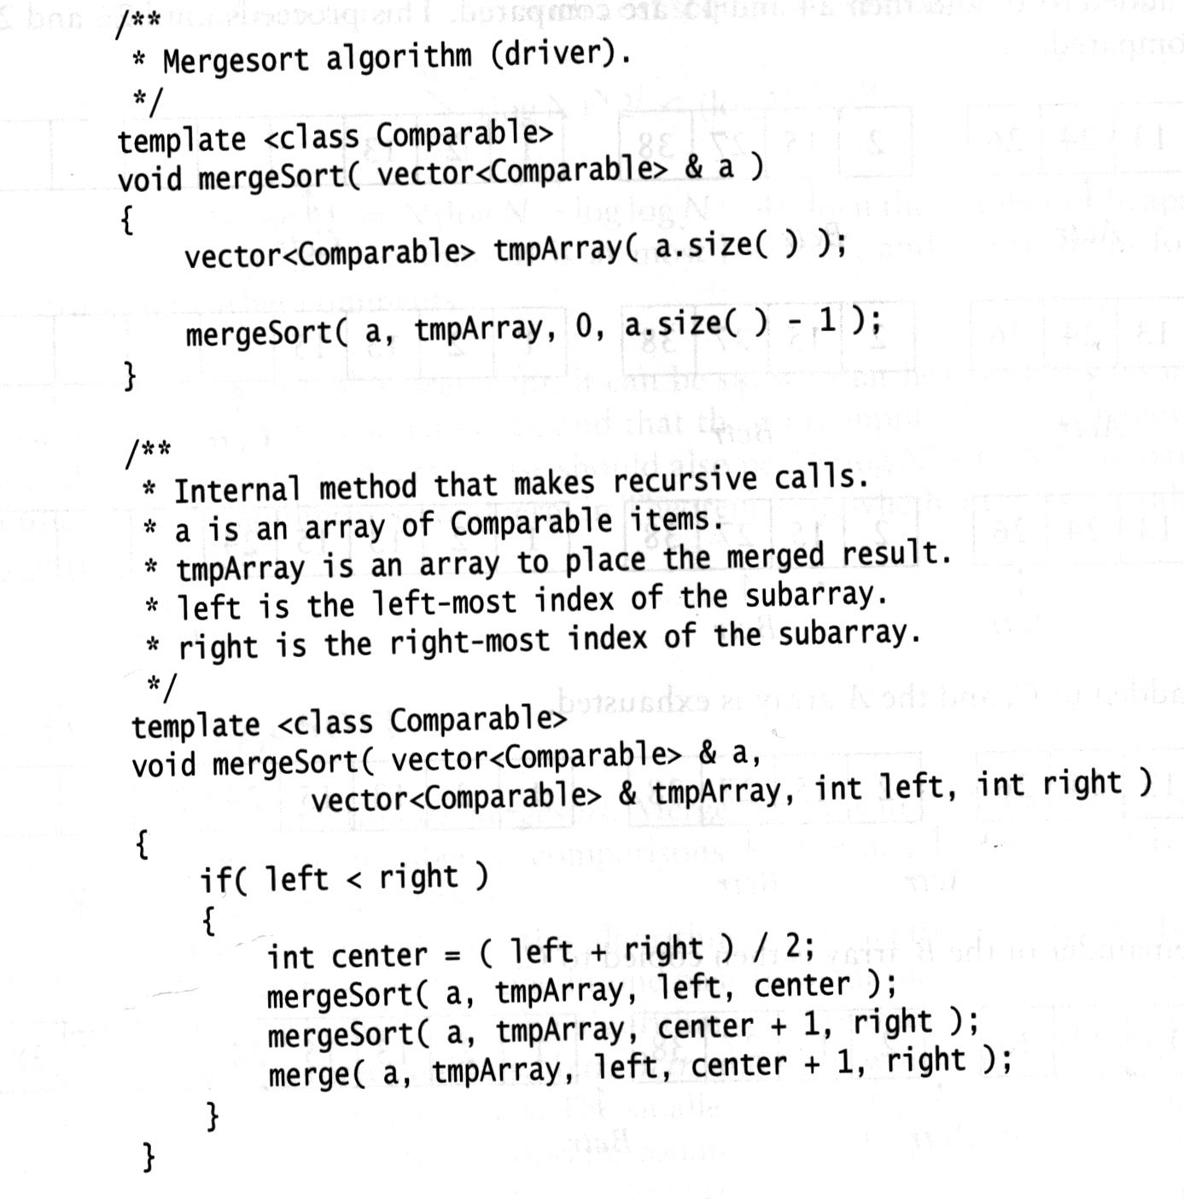
Recursive Mergesort ⎯ C++ Code
…
…
a
left
center
right

Slide 42
Execution of the Recursive mergeSort
Suppose to sort the following integers
0
1
2
3
4
5
6
7
a
24
13
26
1
2
27
38
15
1 2 13 15 24 26 27 38
mS(a, 0, 7)
24 13 26 1 2 27 38 15
1 13 24 26
2 15 27 38
mS(a, 0, 3)
mS(a, 4, 7)
24 13 26 1
2 27 38 15
13 24
1 26
2 27
15 38
mS(a, 0, 1)
mS(a, 2, 3)
mS(a, 4, 5)
mS(a, 6, 7)
24 13
26 1
2 27
38 15
24
13
26
1
2
27
38
15
mS(a, 0, 0)
mS(a, 1, 1)
mS(a, 2, 2)
mS(a, 3, 3)
mS(a, 4, 4)
mS(a, 5, 5)
mS(a, 6, 6)
mS(a, 7, 7)
24
13
26
1
2
27
38
15

Slide 43
Divide-and-Conquer
mergeSort is a classic devide-and-conquer strategy.
Basic ideas:
Break the problem into several subproblems that are similar to the original problem but smaller in size, solve the subproblems recursively, and then combine these solutions to create a solution to the original problem.
The divide-and-conquer paradigm involves three steps at each level of the recursion:
Divide the problem into a number of subproblems.
Conquer the subproblems by solving them recursively. If the subproblems sizes are small enough, however, just solve the subproblems in a straightforward manner.
Combine the solutions to the subproblems into the solution for the original problem.

Slide 44
Divide-and-Conquer ⎯ mergeSort
The merge sort algorithm closely follows the divide-and-conquer paradigm.
Divide: Divide the n-element array to be sorted into two subarrays of n/2 elements each.
Conquer: Sort the two subarrays recursively using mergeSort.
Combine: Merge the two sorted subarrays to produce the sorted answer.
5 2 4 6 1 3 2 6
1 2 2 3 4 5 6 6
5 2 4 6
1 3 2 6
2 4 5 6
1 2 3 6
5 2
4 6
1 3
2 6
2 5
4 6
1 3
2 6
5
2
4
6
1
3
2
6
5
2
4
6
1
3
2
6

Slide 45
Analysis of mergeSort
mergeSort works correctly when the number of elements is not even.
Our analysis is simplified. We assume that the original problem size is a power of two, so that we always split into even halves.
Assume the size of the input sequence is N and the time to sort the sequence is T(N).
Merge sort on just one element takes constant time. When we have N > 1 elements, we break down the running time as follows.
Divide: The divide step just computes the middle of the subarray, which takes constant time.
Conquer: We recursively solve two subproblems, each of size N/2, which takes 2T(N/2) time.
Combine: We have already noted that merging two sorted subarrays takes time O(N).
Therefore, we get the recurrence
T(N) =
O(1) if N = 1,
2T(N/2) + O(N) if N > 1.

Slide 46
How to Compute T(N)?
Telescoping
T(1) = 1
T(N) = 2T(N/2) + N
Divide the recurrence relation through by N. This yields
This equation is valid for any N that is a power of 2, so we may also write
and
Add up all the equations (add all of the terms on the left-hand side and set the result equal to the sum of all of the terms on the right-hand side).
There are logN equations and so all the 1s at the end of these equations add up to logN.

Slide 47
How to Compute T(N)?
Telescoping (cont.)
Multiplying through by N gives the final answer.
T(N) = NlogN + N = O(NlogN)

Slide 48
How to Compute T(N)?
The iteration method
T(1) = 1
T(N) = 2T(N/2) + N
Since we can substitute N/2 into the main equation,
2T(N/2) = 2(2T(N/4) + N/2) = 4T(N/4) + N
we have
T(N) = 4T(N/4) + 2N
Again, by substituting N/4 into the main equation, we see that
4T(N/4) = 4(2T(N/8) + N/4) = 8T(N/8) + N
So we have
T(N) = 8T(N/8) + 3N
Continuing in this manner, we obtain
T(N) = 2^{k}T(N/2^{k}) + k.N
Using k = logN, we obtain
T(N) = NT(1) + NlogN = NlogN + N = O(NlogN)

Slide 49
Non-Recursive Mergesort
Basic idea
Perform m = ⎡logN⎤ passes
In each pass, merge pairs of sorted subarrays into bigger subarrays; at last, we get one sorted array.
The base observation is that each single element of the input array can be viewed as a subarray in sorted order.
Suppose to sort the following integers
0
1
2
3
4
5
6
7
a
24
13
26
1
2
27
38
15
1 2 13 15 24 26 27 38
1 13 24 26
2 15 27 38
13 24
1 26
2 27
15 38
24
13
26
1
2
27
38
15

Slide 50
Drawback of Mergesort
Although mergesort’s running time is O(NlogN), it is hardly ever used for main memory sorts.
The main problem is that merging two sorted lists used linear extra memory, and the additional work spent copying to the temporary array and back, throughout the algorithm, has the effect of slowing down the sort considerably.
It is theoretically possible to use less extra memory, but the resulting algorithm is complex and impractical.
The copying can be avoided by judiciously switching the roles of the input array a and tmpArray at alternate levels of the recursion.
For serious internal sorting applications, the algorithm of choice is quicksort.

Slide 51
Quicksort
Quicksort is the fastest known sorting algorithm in practice.
Its average running time is O(NlogN).
Quicksort is a divide-and-conquer recursive algorithm.
The algorithm
If the number of elements in input array S is 0 or 1, then return.
Pick any element v in S. This is called the pivot.
Partition S-{v} (the remaining elements in S) into two disjoint groups:
S₁ = {x ∈ S – {v} | x <= v}, and S₂ = {x ∈ S – {v} | x > v}
Return {quicksort(S₁) followed by v followed by quicksort(S₂)}.

Slide 52
Quicksort ⎯ Example
Sort 13, 81, 43, 92, 31, 65, 57, 26, 75, 0
The pivot is chosen by chance to be 65.
13 81 43 92 31 65 57 26 75 0
select pivot
13 81 43 92 31 65 57 26 75 0
partition
13 43 31 57 26 0 65 81 92 75
quicksort small
quicksort large
0 13 26 31 43 57 65 75 81 92
0 13 26 31 43 57 65 75 81 92

Slide 53
Issues in Quicksort
How to choose the pivots?
The choices of pivots affect the performance of quicksort a lot!
If the pivots being chosen are in sorted order, quicksort degenerates to selectionSort.
For instance, sort 13, 81, 43, 92, 31, 65, 57, 26, 75, 0
Pivots we choose happen to be: 0 13 26 31 43 57 65 75 81 92
We hope that by using the pivot, we can partition the array into two subarrays with nearly equal size.
13 81 43 92 31 65 57 26 75 0
partition using 0
0 13 81 43 92 31 65 57 26 75
partition using 13
0 13 81 43 92 31 65 57 26 75
partition using 26
0 13 26 81 43 92 31 65 57 75
partition using 31
0 13 26 31 81 43 92 65 57 75

Slide 54
Issues in Quicksort
How to partition the array?
Like mergesort, quicksort recursively solves two subproblems and requires linear additional work (partitioning step), but, unlike mergesort, the subproblems are not guaranteed to be of equal size, which is potentially bad.
The reason that quicksort is faster is that the partitioning step can actually be performed in place and very efficiently. This efficiency more than makes up for the lack of equal-sized recursive calls.

Slide 55
Picking the Pivot
A wrong way
Using the first element as the pivot
The choice is acceptable if the input is random.
If the input is presorted or in reverse order, then the pivot provides a poor partition, because either all the elements go into S₁ or they go into S₂.
The poor partition happens consistently throughout the recursive calls if the input is presorted or in reverse order.
The practical effect is that if the first element is used as the pivot and the input is presorted, then quicksort will take quadratic time to do essentially nothing at all.
92 81 75 65 57 43 31 26 13 0
partition using 92
81 75 65 57 43 31 26 13 0 92
81 75 65 57 43 31 26 13 0
partition using 81
75 65 57 43 31 26 13 0 81

Slide 56
Picking the Pivot
A wrong way
Using the first element as the pivot (cont.)
Moreover, presorted input (or input with a large presorted section) is quite frequent, so using the first element as pivot is an absolutely horrible idea and should be discarded immediately.
Choosing the larger of the first two distinct elements as pivot
This has the same bad properties as merely choosing the first elements.
Do NOT use that pivoting strategy either.

Slide 57
Picking the Pivot
A safe maneuver
A safe course is merely to choose the pivot randomly.
This strategy is generally perfectly safe, since it is very unlikely that a random pivot would consistently provide a poor partition.
However, random number generation is generally an expensive commodity and does not reduce the average running time of the rest of the algorithm at all.
Using median
The median of a group of N numbers is the ⎡N/2⎤^{th} largest number.
The best choice of pivot would be the median of the array, since it gives two subarrays with nearly equal size (actually, can be different by at most 1).
Theoretically, the median can be found in linear time, thus would not affect the running time of quicksort; but in practice, it would slow down quicksort considerably.
13 81 43 92 31 65 57 26 75 0
partition using 57
13 43 31 26 0 57 81 92 65 75

Slide 58
Picking the Pivot
Median-of-Three partitioning
Pick three elements randomly and use the median of these three as pivot. (Random numbers are expensive to generate.)
The common course is to use as pivot the median of the left, right, and center (in position ⎣(left + right)/2⎦)elements.
Using median-of-three partitioning clearly eliminates the bad case for sorted input (the partitions become equal in this case) and actually reduces the running time of quicksort by about 5%.
92 81 75 65 57 43 31 26 13 0
partition using 57
43 31 26 13 0 57 92 81 75 65

Slide 59
Partitioning Strategy
Objective: to move all the small elements to the left part of the array and all the large elements to the right part. “Samll” and “large” are, of course, relative to the pivot.
The basic idea
Swap the pivot with the last element; thus the pivot is placed at the last position of the array.
i starts at the first element and j starts at the next-to-last element.
While i is to left of j, we move i right, skipping over elements that are smaller than the pivot; we move j left, skipping over elements that are larger than the pivot.
When i and j have stopped, i is pointing at a large element and j is pointing at a small element.
If i is to the left of j, those elements are swapped. (The effect is to push a large element to the right and a small element to the left.)
8 1 4 9 0 3 5 2 7 6
i
j

Slide 60
Partitioning Strategy ⎯ Example
Input: 81 13 43 92 31 65 57 26 75 0
Pivot: 57
81 13 43 92 31 65 57 26 75 0
81 13 43 92 31 65 0 26 75 57
i stopped
i
move j left
j
81 13 43 92 31 65 0 26 75 57
i
j
j stopped
swap
26 13 43 92 31 65 0 81 75 57
i
move i right
j
26 13 43 92 31 65 0 81 75 57
i stopped
i
j
move j left
26 13 43 92 31 65 0 81 75 57
i
j
j stopped

Slide 61
Partitioning Strategy ⎯ Example
Input: 81 13 43 92 31 65 57 26 75 0
Pivot: 57 (cont.)
26 13 43 92 31 65 0 81 75 57
i
swap
j
j stopped
26 13 43 0 31 65 92 81 75 57
i
j
move i right
26 13 43 0 31 65 92 81 75 57
i stopped
i
j
move j left
26 13 43 0 31 65 92 81 75 57
j stopped
j
i
i and j have crossed. Swap the element
at position i with the pivot.
26 13 43 0 31 57 92 81 75 65

Slide 62
Small Arrays
For very small arrays (N <= 20), quicksort does not perform as well as insertion sort.
Because quicksort is recursive, these cases will occur frequently.
A common solution is not to use quicksort recursively for small arrays, but instead use a sorting algorithm that is efficient for small arrays, such as insertion sort.
Using this strategy can actually save about 15% in the running time. A good cutoff range is N=10.
This also saves nasty degenerate cases, such as taking the median of three elements when there are only one or two.

Slide 63
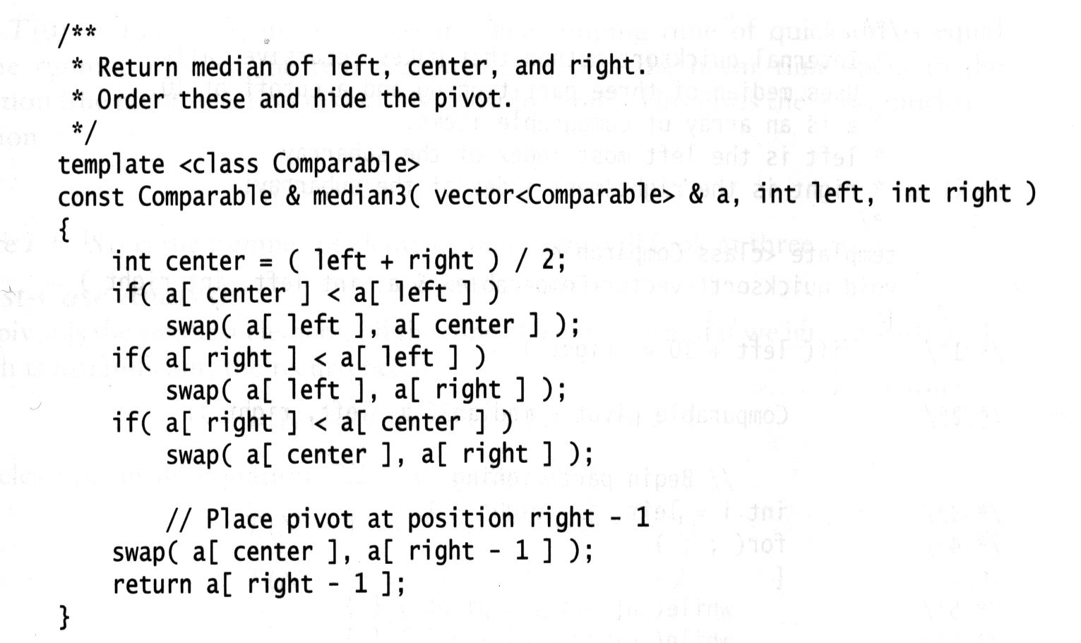
Quicksort ⎯ C++ code
a
left
center
right
Sort elements
at positions
left, right, and
center.
small
median
large
a
left
center
right
small
a[right-1]
median
a
left
center
right

Slide 64
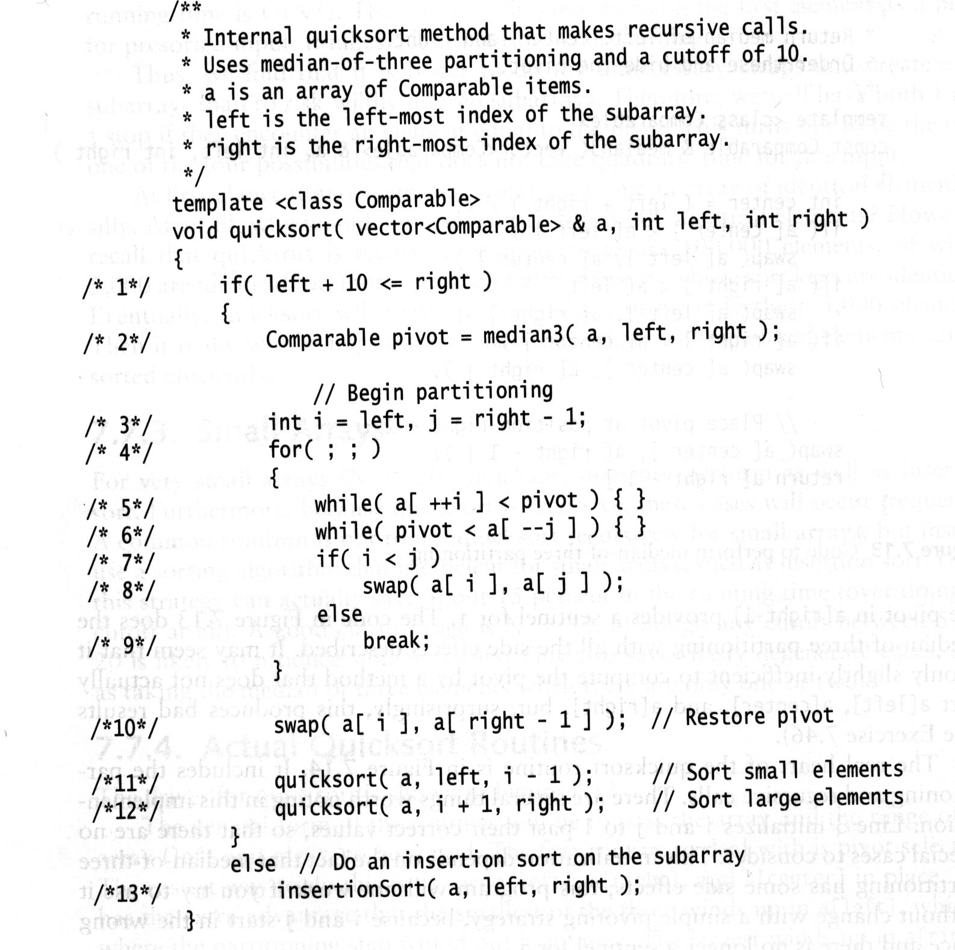
Quicksort ⎯ C++ code
a
left
right
small
a[right-1]
pivot
a
left
i
center
j
right
Partition the input array into two subarrays: one contains
small elements; the other contains large elements.

Slide 65
Analysis of Quicksort
We will do the analysis for a quicksort, assuming a random pivot (no median-of-three partitioning) and no cutoff for small arrays.
We take T(0) = T(1) = 1.
The running time of quicksort is equal to the running time of the two recursive calls plus the linear time spent in the partition (the pivot selection takes only constant time). This gives the basic quicksort relation
T(N) = T(i) + T(N-i-1) + cN
where i = |S₁| is the number of elements in S₁.

Slide 66
Analysis of Quicksort
Worst-Case Analysis
The pivot is the smallest element, all the time. Then i = 0 and if we ignore T(0) = 1, which is insignificant, the recurrence is
T(N) = T(N-1) + cN, N > 1
We telescope, using equation above repeatedly. Thus
T(N-1) = T(N-2) + c(N-1)
T(N-2) = T(N-3) + c(N-2)
………..
T(3) = T(2) + c(3)
T(2) = T(1) + c(2)
Adding up all these equations yields

Slide 67
Analysis of Quicksort
Best-Case Analysis
In the best case, the pivot is in the middle.
To simply the analysis, we assume that the two subarrays are each exactly half the size of the original. Although this gives a slight overestimate, this is acceptable because we are only interested in a Big-Oh notation.
T(N) = 2T(N/2) + cN
Divide both sides of the equation by N.
We will telescope using this equation.
Adding up all equations, we have
which yields T(N) = cNlogN + N = O(NlogN)

Slide 68
Analysis of Quicksort
Average-Case Analysis
Recall that T(N) = T(i) + T(N–i–1) + cN (1)
The average value of T(i), and hence T(N-i-1), is
Equation (1) then becomes
(2)
If Equation (2) is multiplied by N, it becomes
(3)
We telescope with one more equation.
(4)
(3) – (4), we obtain
NT(N) – (N-1)T(N-1) = 2T(N-1) + 2cN – c
We rearrange terms and drop the insignificant –c on the right, obtaining
NT(N) = (N+1)T(N-1) + 2cN (5)
Divide Equation (5) by N(N+1):
(6)

Slide 69
Analysis of Quicksort
Average-Case Analysis (cont.)
(6)
Now we can telescope.
Adding them up yields
Thus, we have
and so T(N) = O(NlogN)
This is the sum of harmonic series, which is O(logN).

Slide 70
The Selection Problem
The problem: Given a list S of N elements and integer k > 0, find the k^{th} smallest element.
O(NlogN)-time algorithm
Sort the N elements
Pick up the k^{th} element
O(N + klogN)-time algorithm
Build a heap on the N elements (O(N) time)
Perform k deleteMin operations (O(klogN) time)
The last element extracted from the heap is the answer.

Slide 71
A Linear-Expected-Time Algorithm
The algorithm (quickselect(S, k))
If |S| = 1, then k =1 and return the element in S as the answer. If a cutoff for small arrays is being used and |S| <= CUTOFF, then sort S and return the k^{th} smallest element.
Pick a pivot element, v ∈ S
Partition the remaining elements in S (i.e., S-{v}) into S1 and S2, as was done with quicksort. Each elements in S1 is no larger than the pivot v; each elements in S2 is no smaller than the pivot v.
If k <= |S1|, then the k^{th} smallest element must be in S1. In this case, return quickselect(S1, k).
If k = 1 + |S1|, then the pivot is the k^{th} smallest element and we can return it as the answer.
Otherwise, the k^{th} smallest element lies in S2, and it is the (k-|s1|-1)^{st} smallest element in S2. We make a recursive call and return quickselect(S2, k-|S1|-1).

Slide 72
Examples (1)
Suppose we want to find the 3rd smallest element in the list of 10 elements: 13, 81, 43, 92, 31, 65, 57, 26, 75, 0
In this example, k = 3, N = 10
13 81 43 92 31 65 57 26 75 0
select pivot
13 81 43 92 31 65 57 26 75 0
partition
13 43 31 26 0 57 65 81 92 75
S1
S2
0 13 26 31 43 57 65 75 81 92
3rd smallest element
Since k <= |S1|, recursively find the 3rd smallest element on S1,
i.e.,call quickselect(S1, k).

Slide 73
Examples (2)
Suppose we want to find the 6th smallest element in the list of 10 elements: 13, 81, 43, 92, 31, 65, 57, 26, 75, 0
In this example, k = 6, N = 10
13 81 43 92 31 65 57 26 75 0
select pivot
13 81 43 92 31 65 57 26 75 0
partition
13 43 31 26 0 57 65 81 92 75
S1
S2
Since k = |S1|+1, we found the 6th smallest element, i.e. 57

Slide 74
Examples (3)
Suppose we want to find the 8th smallest element in the list of 10 elements: 13, 81, 43, 92, 31, 65, 57, 26, 75, 0
In this example, k = 8, N = 10
13 81 43 92 31 65 57 26 75 0
select pivot
13 81 43 92 31 65 57 26 75 0
partition
13 43 31 26 0 57 65 81 92 75
S1
S2
0 13 26 31 43 57 65 75 81 92
8th smallest element
Since k > |S1|+1, the kth smallest element lies in S2, and it is the
(k-|S1|-1)^{st} smallest element in S2. Thus, we recursively find the 2nd
(8 – 5 – 1 = 2) smallest element on S2, i.e., call quickselect(S2, 2).

Slide 75
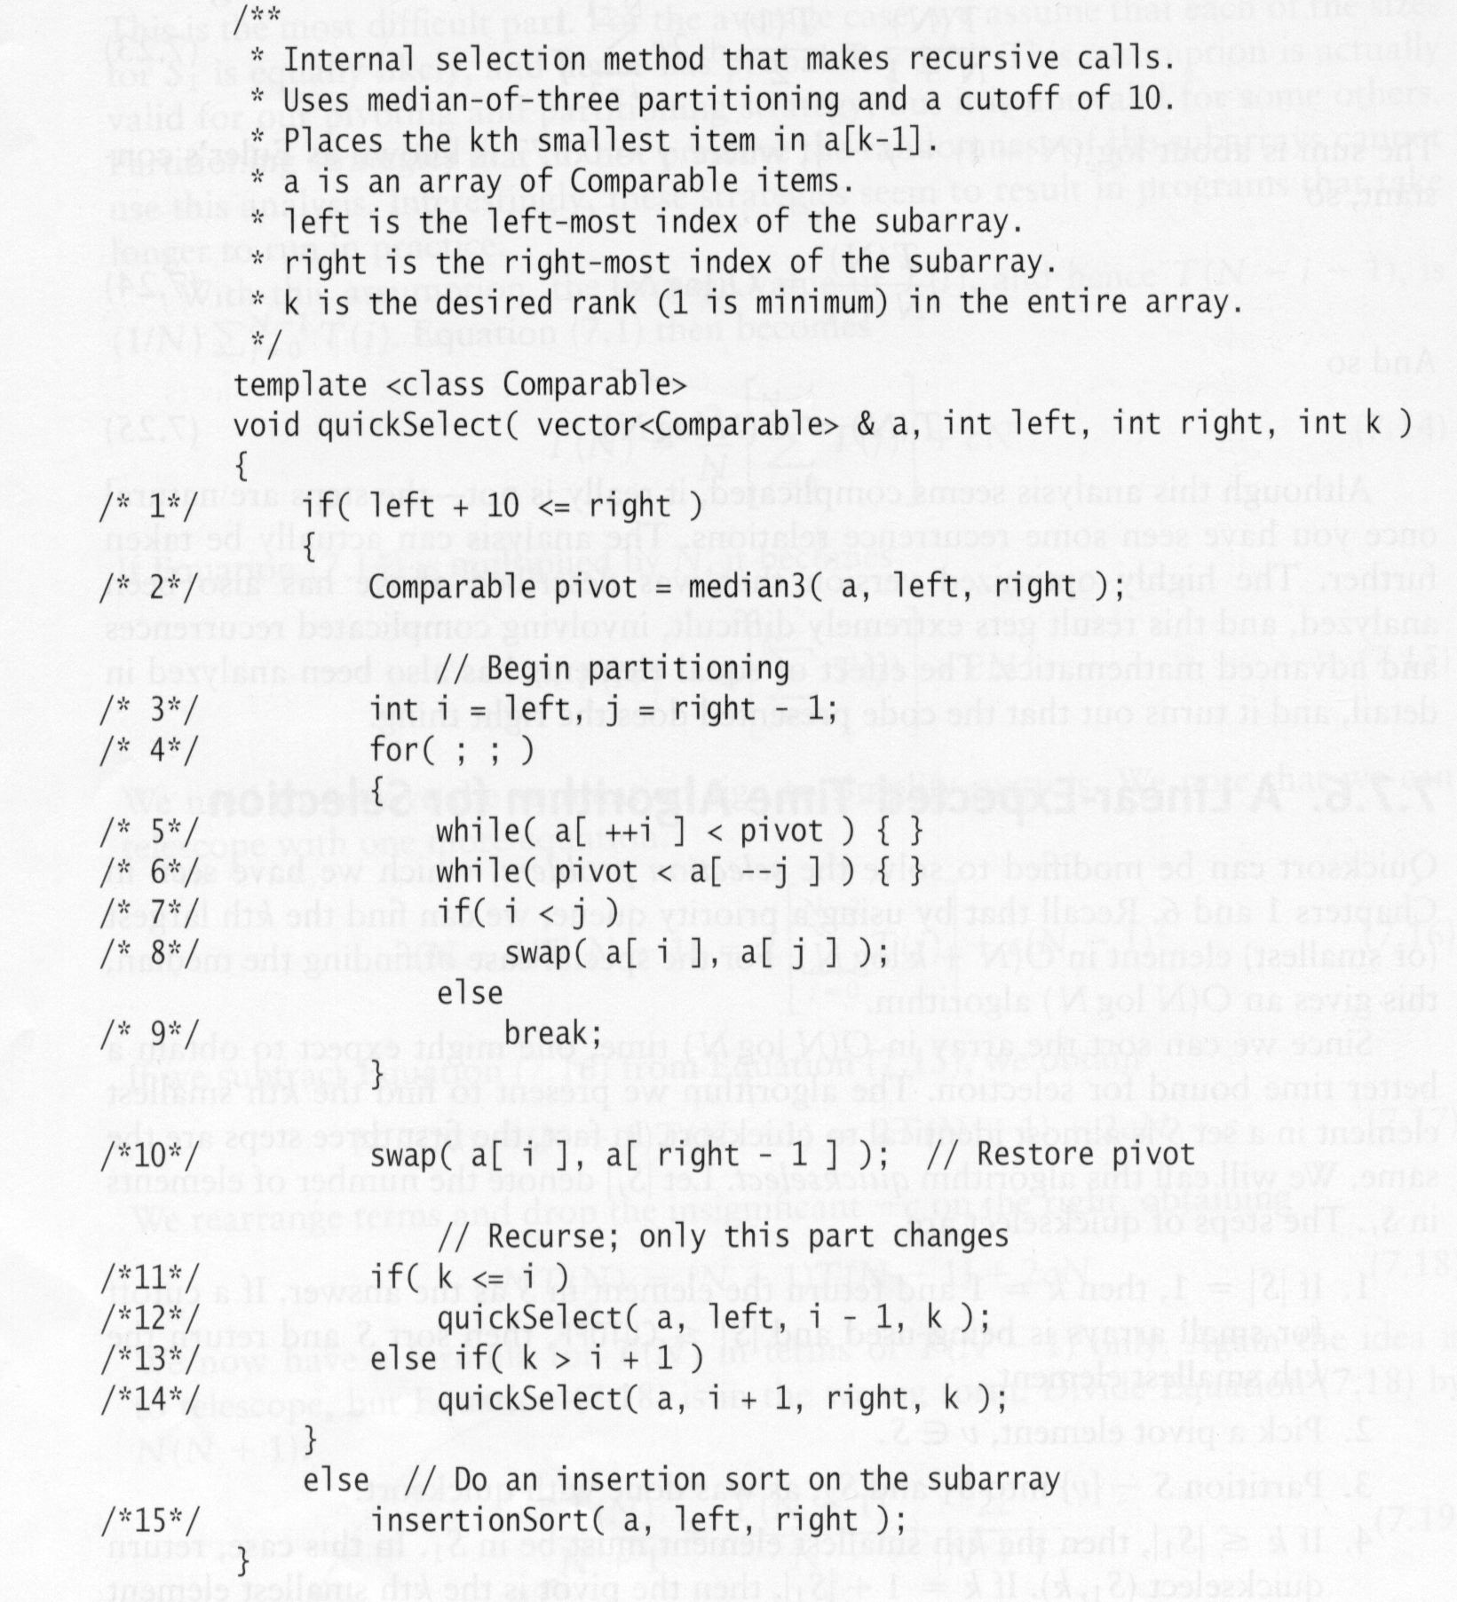
Quickselect ⎯ C++ code
0
1
2
3
4
5
6
7
8
9
10
a
left
right
pivot
After partitioning
0
1
2
3
4
5
6
7
8
9
10
a
left
i
right
S1 includes small
elements
S2 include large
elements
k-i-1
When the algorithm terminates, the k^{th} smallest
element is in position k-1 (because arrays start
at index 0).

Slide 76
Analysis of Quickselect
Like quicksort, we do the analysis for a quickselect, assuming a random pivot (no median-of-three partitioning) and no cutoff for small arrays.
We take T(0) = T(1) = 1.
The running time of quickselect is equal to the running time of one recursive call plus the linear time spent in the partition (the pivot selection takes only constant time). This gives the basic quickselection relation
T(N) = T(i) + cN
where i is the number of elements in the subarray on which we need to perform a recursive call.

Slide 77
Analysis of Quickselect
Worst-Case Analysis
The pivot is the smallest (resp., largest) element, all the time, and k = N (resp., 1). Then, we need to perform a recursive call on a subarray with size of N-1. Thus, the recurrence is
T(N) = T(N-1) + cN, N > 1
We telescope, using equation above repeatedly. Thus
T(N-1) = T(N-2) + c(N-1)
T(N-2) = T(N-3) + c(N-2)
………..
T(3) = T(2) + c(3)
T(2) = T(1) + c(2)
Adding up all these equations yields

Slide 78
Analysis of Quickselect
Average-Case Analysis
Recall that T(N) = T(i) + cN (1)
where i is the number of elements in the subarray on which we need to perform a recursive call.
For the average case, we assume that each of the sizes for the subarray on which we need to perform a recursive call is equally likely, and hence has probability 1/N. Thus, the average value of T(i), is
Equation (1) then becomes
(2)
If Equation (2) is multiplied by N, it becomes
(3)
We telescope with one more equation.
(4)
(3) – (4), we obtain
NT(N) – (N-1)T(N-1) = T(N-1) + 2cN – c

Slide 79
Analysis of Quickselect
Average-Case Analysis (cont.)
We rearrange terms and drop the insignificant –c on the right, obtaining
NT(N) = NT(N-1) + 2cN (5)
Divide Equation (5) by N:
T(N) = T(N-1) + 2c (6)
Now we can telescope.
T(N-1) = T(N-2) + 2c
T(N-2) = T(N-3) + 2c
…………………
T(3) = T(2) + 2c
T(2) = T(1) + 2c
Adding them up yields
T(N) = T(1) + 2c*(N-1)
Thus, we have
T(N) = O(N)

Slide 80
Bucket Sort
Although any general sorting algorithm that uses only comparisons requires Ω(NlogN) time in the worst case, in some special cases, it is still possible to sort in linear time.
For bucket sort, the input A₁, A₂, …, A_{N} must consist of only positive integers smaller than M.
The algorithm
Keep an array called count, of size M, which is initialized to all 0’s. Thus, count has M cells, or buckets, which are initially empty.
While A_{i} is read, increment count[A_{i}] by 1.
After all the input is read, scan the count array, printing out a representation of the sorted list.

Slide 81
Bucket Sort ⎯ Example
Suppose we want to sort: 3 6 4 1 3 4 1 4
0
1
2
3
4
5
6
7
3
6
4
1
3
4
1
4
0
1
2
3
4
5
6
count
0
0
0
0
0
0
0
Scan the input array and increase the corresponding bucket of count
0
1
2
3
4
5
6
7
0
1
2
3
4
5
6
7
3
6
4
1
3
4
1
4
3
6
4
1
3
4
1
4
0
1
2
3
4
5
6
0
1
2
3
4
5
6
count
0
0
0
1
0
0
0
count
0
0
0
1
0
0
1
0
1
2
3
4
5
6
7
0
1
2
3
4
5
6
7
3
6
4
1
3
4
1
4
3
6
4
1
3
4
1
4
0
1
2
3
4
5
6
0
1
2
3
4
5
6
count
0
0
0
1
1
0
1
count
0
1
0
1
1
0
1

Slide 82
Bucket Sort ⎯ Example
Suppose we want to sort: 3 6 4 1 3 4 1 4
Scan the input array and increase the corresponding bucket of
count (cont.)
0
1
2
3
4
5
6
7
0
1
2
3
4
5
6
7
3
6
4
1
3
4
1
4
3
6
4
1
3
4
1
4
0
1
2
3
4
5
6
0
1
2
3
4
5
6
count
0
1
0
2
1
0
1
count
0
1
0
2
2
0
1
0
1
2
3
4
5
6
7
0
1
2
3
4
5
6
7
3
6
4
1
3
4
1
4
3
6
4
1
3
4
1
4
0
1
2
3
4
5
6
0
1
2
3
4
5
6
count
0
2
0
2
2
0
1
count
0
2
0
2
3
0
1

Slide 83
Bucket Sort ⎯ Example
Suppose we want to sort: 3 6 4 1 3 4 1 4
0
1
2
3
4
5
6
count
0
2
0
2
3
0
1
Print out the sorted list (scan the array count)
0
1
2
3
4
5
6
0
1
2
3
4
5
6
7
count
0
2
0
2
3
0
1
No 0’s
output
0
1
2
3
4
5
6
0
1
2
3
4
5
6
7
count
0
2
0
2
3
0
1
Two 1’s
1
1
output
0
1
2
3
4
5
6
0
1
2
3
4
5
6
7
count
0
2
0
2
3
0
1
No 2’s
1
1
output
0
1
2
3
4
5
6
0
1
2
3
4
5
6
7
count
0
2
0
2
3
0
1
Two 3’s
1
1
3
3
output
0
1
2
3
4
5
6
0
1
2
3
4
5
6
7
count
0
2
0
2
3
0
1
Three 4’s
1
1
3
3
4
4
4
output
0
1
2
3
4
5
6
0
1
2
3
4
5
6
7
count
0
2
0
2
3
0
1
No 5’s
1
1
3
3
4
4
4
output
0
1
2
3
4
5
6
0
1
2
3
4
5
6
7
count
0
2
0
2
3
0
1
One 6
1
1
3
3
4
4
4
6
output

Slide 84
Bucket Sort ⎯ Running Time
Initializing array count to all 0s takes O(M) time
Scanning the input array and increasing the corresponding element of count takes O(N) time
Scanning array count and printing out the representation of the sorted list takes O(M+N) time
Totally, bucket sort takes O(M+N) time
In practice, we usually use bucket sort when we have M = O(N), in which case the running time is O(N).

