Slide 1
Trees
Basic concepts of trees
Implementation of trees
Traversals of trees
Binary trees
Binary search trees
AVL trees
B-trees

Slide 2
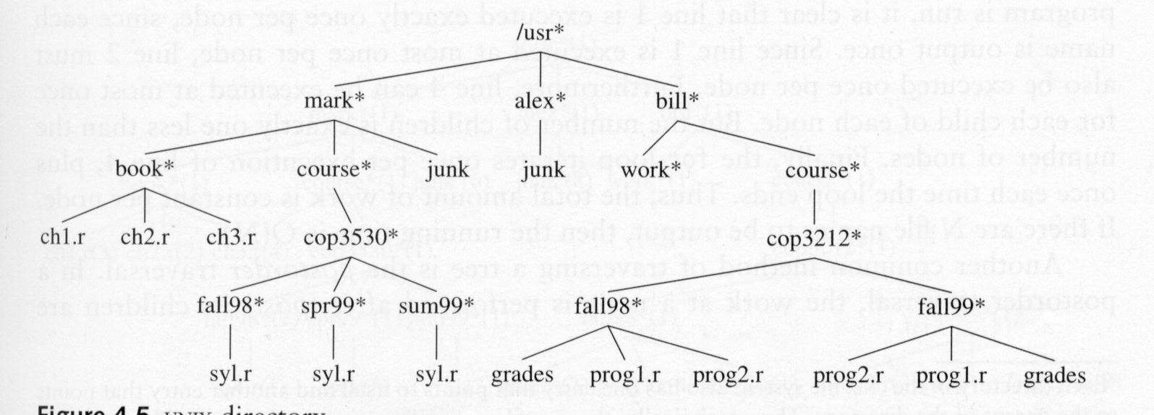
Examples: Trees
A tree represents a hierarchy
Organization structure of a corporation
A UNIX file system
NOMOS Inc.
R&D
Sales
Purchasing
Manufacturing
Domestic
International
Africa
Europe
Asia
Australia
A
B

Slide 3
What Is a Tree?
A tree is a collection of nodes.
The collection may be empty, i.e., without any node.
A non-empty tree has a node r, called the root, and zero or more nonempty (sub)trees T₁, T₂, …, T_{k}. The root of each subtree is connected by a directed edge from r.

Slide 4
Children and Parents
The root of each subtree is said to be a child of r
r is the parent of each subtree root.
From the recursive definition, we know that a tree is a collection of N nodes, one of which is the root, and N-1 edges. (Why N-1 edges?)
Each edge connects some node to its parent,
and every node except the root has one parent.

Slide 5
Leaves and Siblings
Each node may have an arbitrary number of children, possibly zero.
Nodes with no children are known as leaves.
Nodes with the same parent are siblings.

Slide 6
Paths
A path from node n₁ to n_{k} is defined as a sequence of nodes n₁, n₂, …, n_{k} such that n_{i} is the parent of n_{i+1} for 1 <= i < k.
The length of a path is the number of edges on the path.
There is a path of length zero from every node to itself.
How many paths are there from the root to each node in a tree?

Slide 7
Depth and Height
For any node n_{i}, the depth of n_{i} is the length of the unique path from the root to n_{i}.
The depth of the root is 0.
The height of n_{i} is the length of the longest path from n_{i} to a leaf.
All leaves are at height 0.
The height of a tree is equal to the height of the root.
The depth of a tree is equal to the depth of the deepest leaf; this is always equal to the height of the tree.

Slide 8
Ancestors and Descendants
If there is a path from n₁ to n₂, then n₁ is an ancestor of n₂ and n₂ is a descendant of n₁.
If there is a path from n₁ to n₂ and n₁ ≠ n₂, then n₁ is an proper ancestor of n₂ and n₂ is a proper descendant of n₁.

Slide 9
Implementation of Trees
One way to implement a tree would be to have in each node, besides its data, a link to each child of the node. (Any problem?)
Wasted space: Since the number of children per node can vary so greatly and is not known in advance, it might be infeasible to make the children direct links in the data structure.

Slide 10
Implementation of Trees (cont.)
Another solution: Keep the children of each node in linked list of tree nodes.
struct TreeNode
{
Object element;
TreeNode *firstChild
TreeNode *nextSibling;
}
element
firstChild
nextSibling
Node E has both a link to a
sibling (F) and a link to a child (I)
Arrows that point downward are firstChild links.
Arrows that go left to right
are nextSibling links.
Leaf nodes have no children.

Slide 11
Implementation of Trees (cont.)
A
/
B
/
C
/
D
E
F
G
/
N
/
/
H
/
/
I
/
J
/
K
/
L
/
M
/
/
P
/
Q
/
/

Slide 12
Tree Traversals
Preorder traversal: In a preorder traversal, the work at a node is performed before (pre) its children are processed.
Postorder traversal: In a postorder traversal, the work at a node is performed after (post) its children are evaluated.

Slide 13
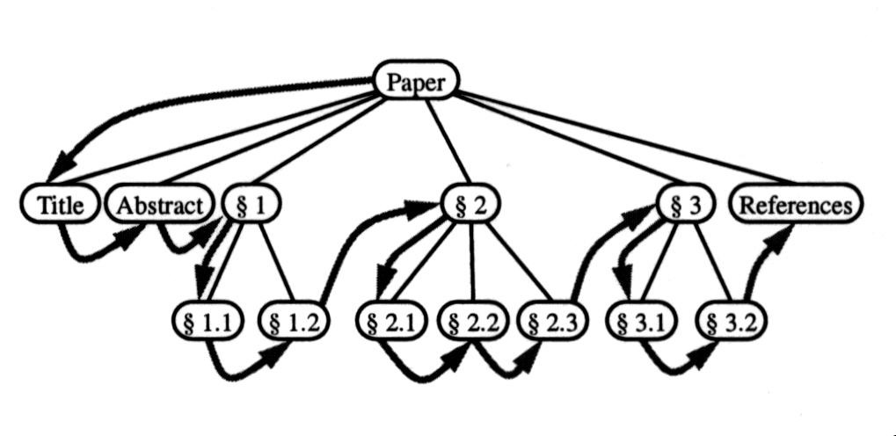
Preorder Traversal
In a preorder traversal, the work at a node is performed before (pre) its children are processed.
PreOrder ( r ) {
“visit” node r; //do what we need to do
for each child w of r do
recursively perform PreOrder(w);
}
Reading a document from beginning to end

Slide 14
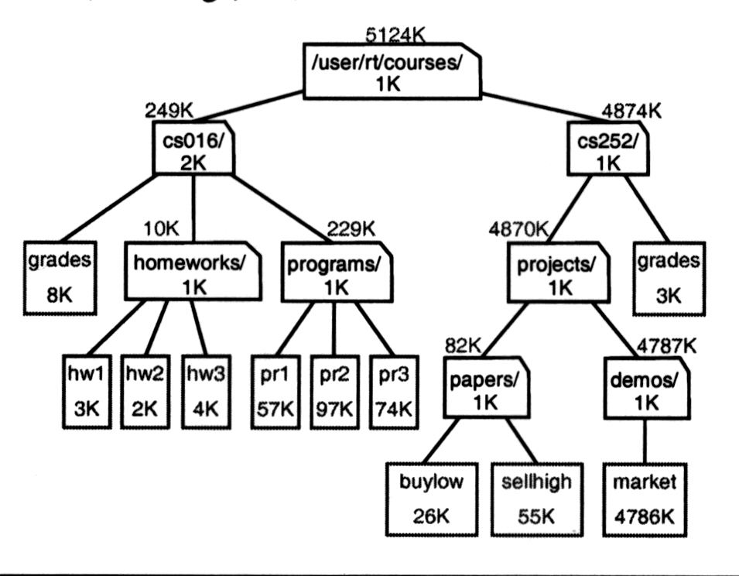
Postorder Traversal
In a postorder traversal, the work at a node is performed after (post) its children are evaluated.
PostOrder ( r ) {
for each child w of r do
recursively perform PostOrder(w);
“visit” node r; //do what we need to do
}
du (disk usage) command in UNIX

Slide 15
Binary Trees
A binary tree is a tree in which no nodes can have more than two children.
An important property of a binary tree is that the average depth of a binary tree is considerably smaller than N.
The average depth of a binary tree is O( ).
The average depth of a binary search tree is O(logN).
In the worst case, the depth can be as large as N-1.
root
T_{L}
T_{R}
Both T_{L} and T_{R} could be possibly empty.
A
B
C
D
E

Slide 16
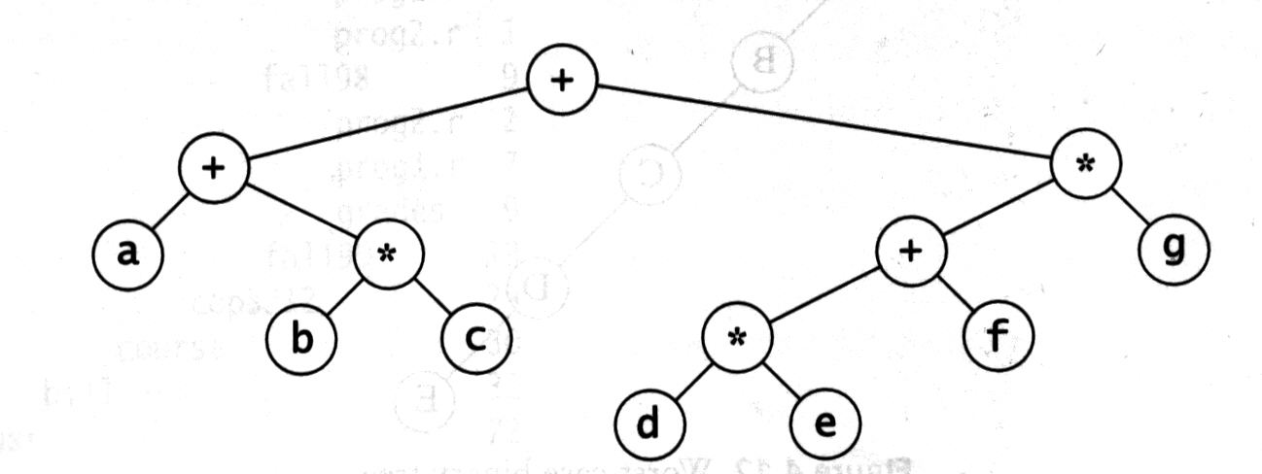
Implementation of Binary Trees
Since a binary tree has at most two children, we can keep direct links to them.
struct BinaryNode
{
Object element; // The data in the node
BinaryNode * left; // Left child
BinaryNode * right; // Right child
}
Applications:
Binary expression trees
Binary search trees
left
element
right
How many NULL links are there in a binary tree with N nodes?
2N links; N-1 edges each corresponding one non-NULL link
→ N+1 NULL links

Slide 17
An Example: Expression Trees
An expression tree for (a+b*c)+((d*e+f)*g)
The leaves of an expression tree are operands (constants or variable names).
The internal nodes contain operators.
We can evaluate an expression tree, T, by applying the operator at the root to the values obtained by recursively evaluating the left and right subtrees.
The left subtree evaluates to a+(b*c).
The right subtree evaluates to ((d*e)+f)*g.

Slide 18
Inorder Traversal of Binary Trees
Inorder traversal of a binary tree
InOrder ( r ) {
recursively perform InOrder( left child of r );
“visit” node r;
recursively perform InOrder( right child of r );
}
Producing an infix expression
We can produce an (overly parenthesized) infix expression by recursively producing a parenthesized left expression, then printing out the operator at the root, and finally recursively producing a parenthesized right expression.
ProduceInfixExp ( r ) {
if r is a leaf
then print (r->element);
else
print( ‘(‘ );
ProduceInfixExp( r->left );
print( r->element );
ProduceInfixExp( r->right );
print( ‘)’ );
}
((a+(b*c))+(((d*e)+f)*g))

Slide 19
Traversals of Expression Trees
An inorder traversal of an expression tree produces its infix expression.
A postorder traversal of an expression tree produces its postfix expression.
A preorder traversal of an expression tree produces its prefix expression (the less useful).
(a+b*c)+((d*e+f)*g)
Postfix expression:
abc*+de*f+g*+

Slide 20
Converting a Postfix Expression into an Expression Tree
The algorithm is similar to the postfix evaluation algorithm.
The algorithm
Read the postfix expression one symbol at a time.
If the symbol is an operand, create a one-node tree and push a pointer to it onto a stack.
If the symbol is an operator, pop (pointers) to two trees T₁ and T₂ (T₂ is popped first) from the stack and form a new tree whose root is the operator and whose left and right children point to T₁ and T₂, respectively. A pointer to this new tree is then push onto the stack.

Slide 21
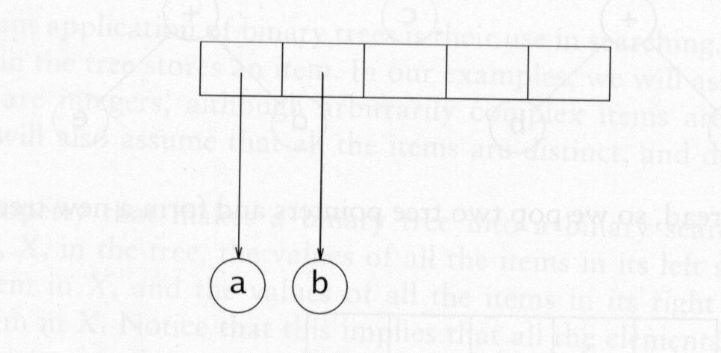
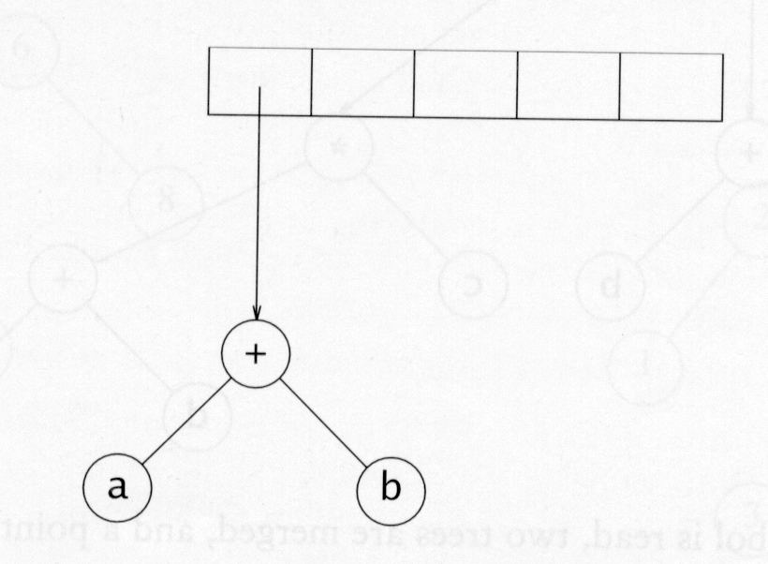
An Example: Constructing an Expression Tree
Input: ab+cde+**
The first two symbols are operands, so we create one-node trees and push pointers to them onto a stack.
Next, a + is read, so two pointers to trees are popped, a new tree is formed, and a pointer to it is pushed onto the stack.

Slide 22
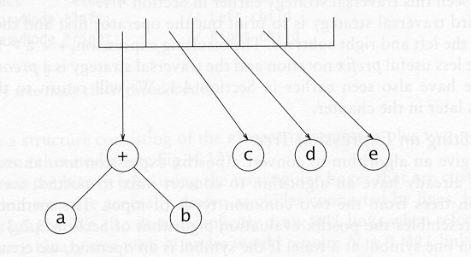
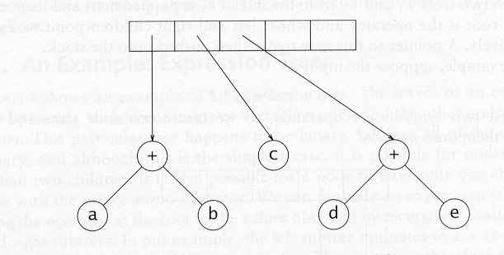
An Example: Constructing an Expression Tree (cont.)
Input: ab+cde+**
Next, c, d, and e are read, and for each a one-node tree is created and a pointer to the corresponding tree is pushed onto the stack.
Now a + is read, so two trees are merged

Slide 23
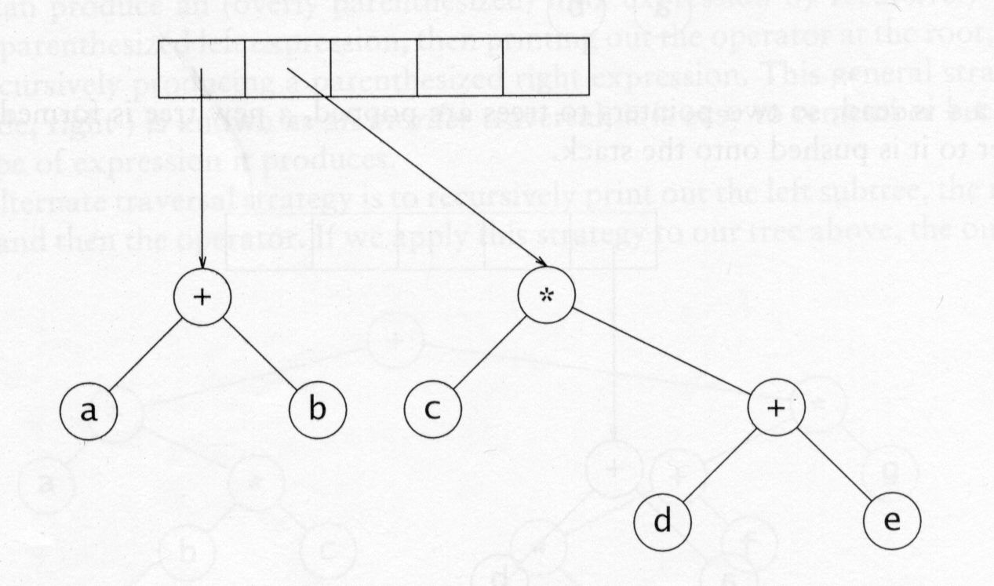
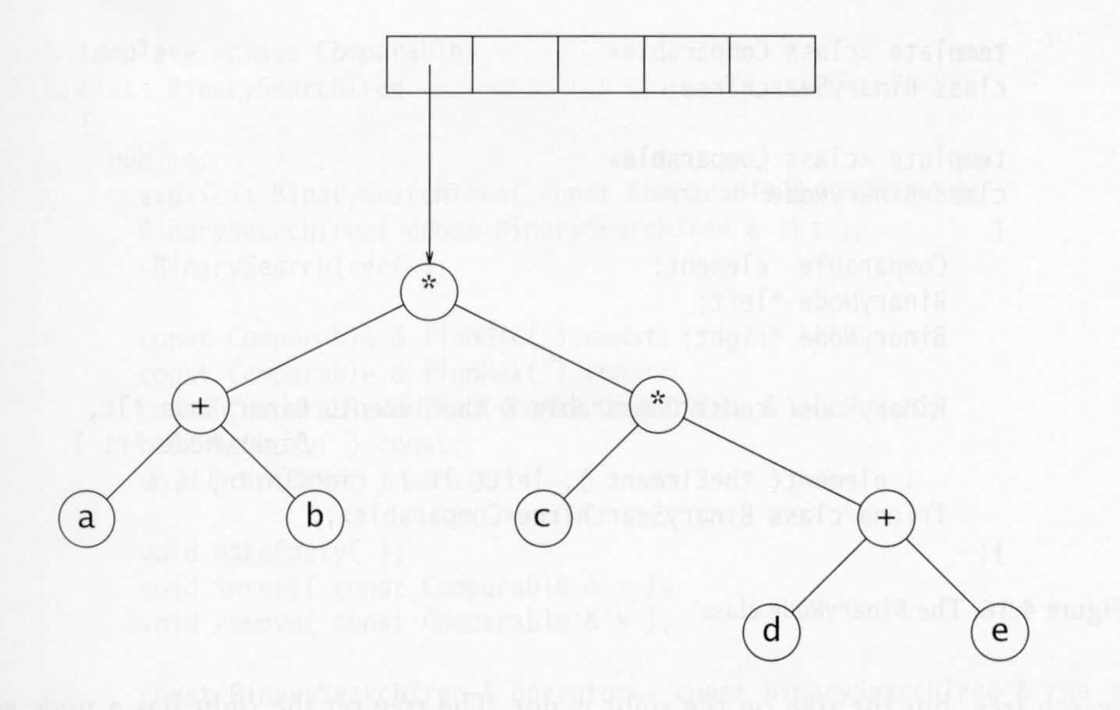
An Example: Constructing an Expression Tree (cont.)
Input: ab+cde+**
Continuing, a * is read, so we pop two tree pointers and form a new tree with a * as root.
Finally, the last symbol is read, two trees are merged, and a pointer to the final tree is left on the stack.

Slide 24
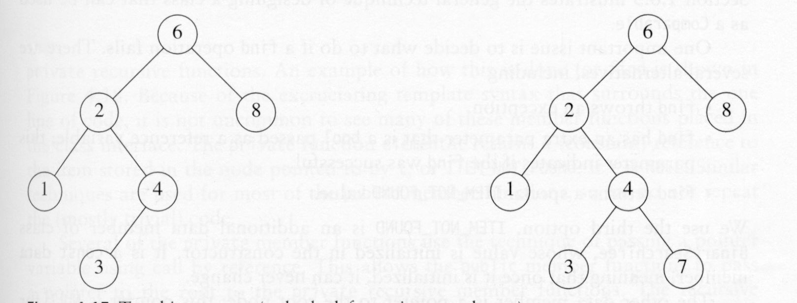
Binary Search Trees
A Binary search tree is a binary tree such that any node has a key which is no less than the keys in its left subtree and no more than the keys in its right subtree.
A binary search tree
Not a binary search tree
What is good about a binary search tree?

Slide 25
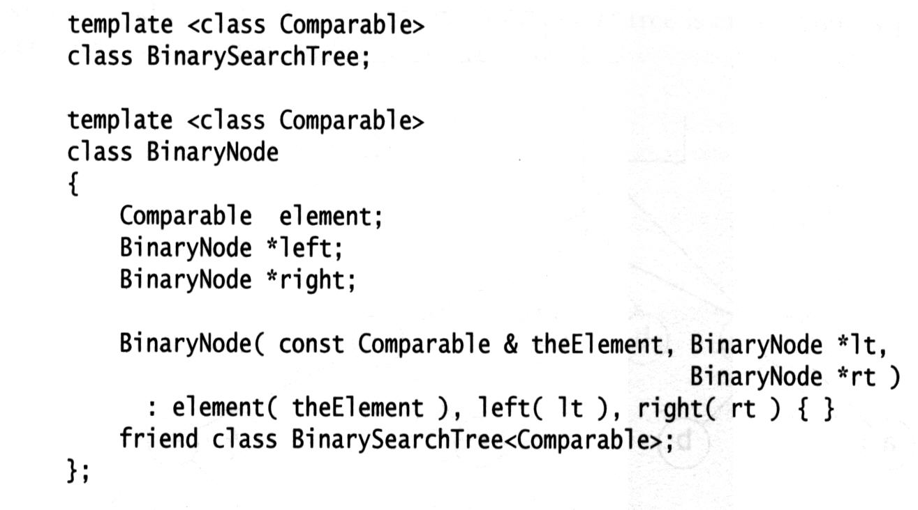
The BinaryNode Class
Constructor. Initializing the object as
lt
theElement
rt
Grant the binary search tree class access to
BinaryNode’s private data members.

Slide 26
BinarySearchTree class
// ******************PUBLIC OPERATIONS*********************
// void insert(Comparable x ) --> Insert x
// void remove(Comparable x ) --> Remove x
// Comparable find(Comparable x ) --> Return item that matches x
// Comparable findMin( ) --> Return smallest item
// Comparable findMax( ) --> Return largest item
// boolean isEmpty( ) --> Return true if empty; else false
// void makeEmpty( ) --> Remove all nodes in the tree
// void printTree( ) --> Print tree in sorted order
/** The tree root. */
private
BinaryNode<Comparable> * root;
const Comparable ITEM_NOT_FOUND; -> used if find operation fails
// **PRIVATE OPERATIONS: Mostly Recursive*********************
// Comparable elementAt( BinaryNode t) -> return the item (element) of node t
// BinaryNode insert(Comparable x, BinaryNode t) -> insert x into the subtree
whose root is t
// BinaryNode remove(Comparable x, BinaryNode t)
// BinaryNode find(Comparable x, BinaryNode t )
// BinaryNode findMin(BinaryNode t)
// BinaryNode findMax(BinaryNode t)
// void printTree(BinaryNode t )
A pointer to the root node;
NULL for empty trees.

Slide 27
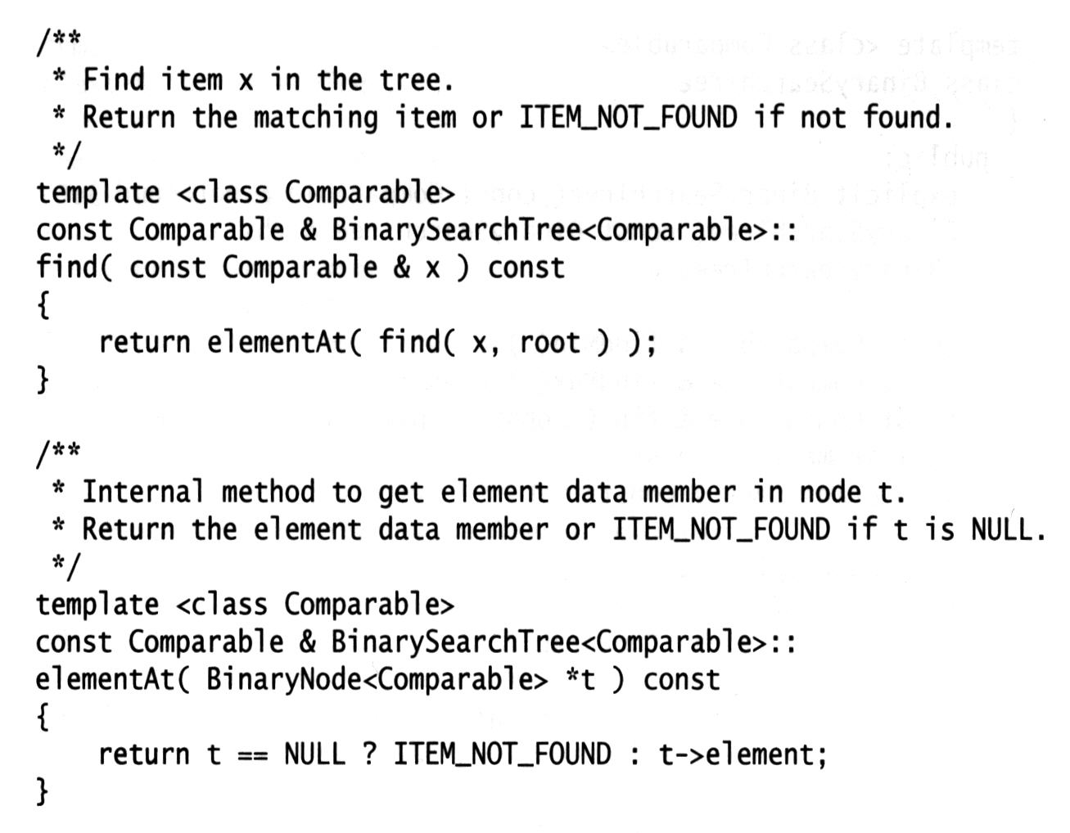
The Find Operation
The public member functions call private recursive functions to perform the operation.
Call the internal find() to find the node
containing x, return the item in that node
by calling elementAt().

Slide 28
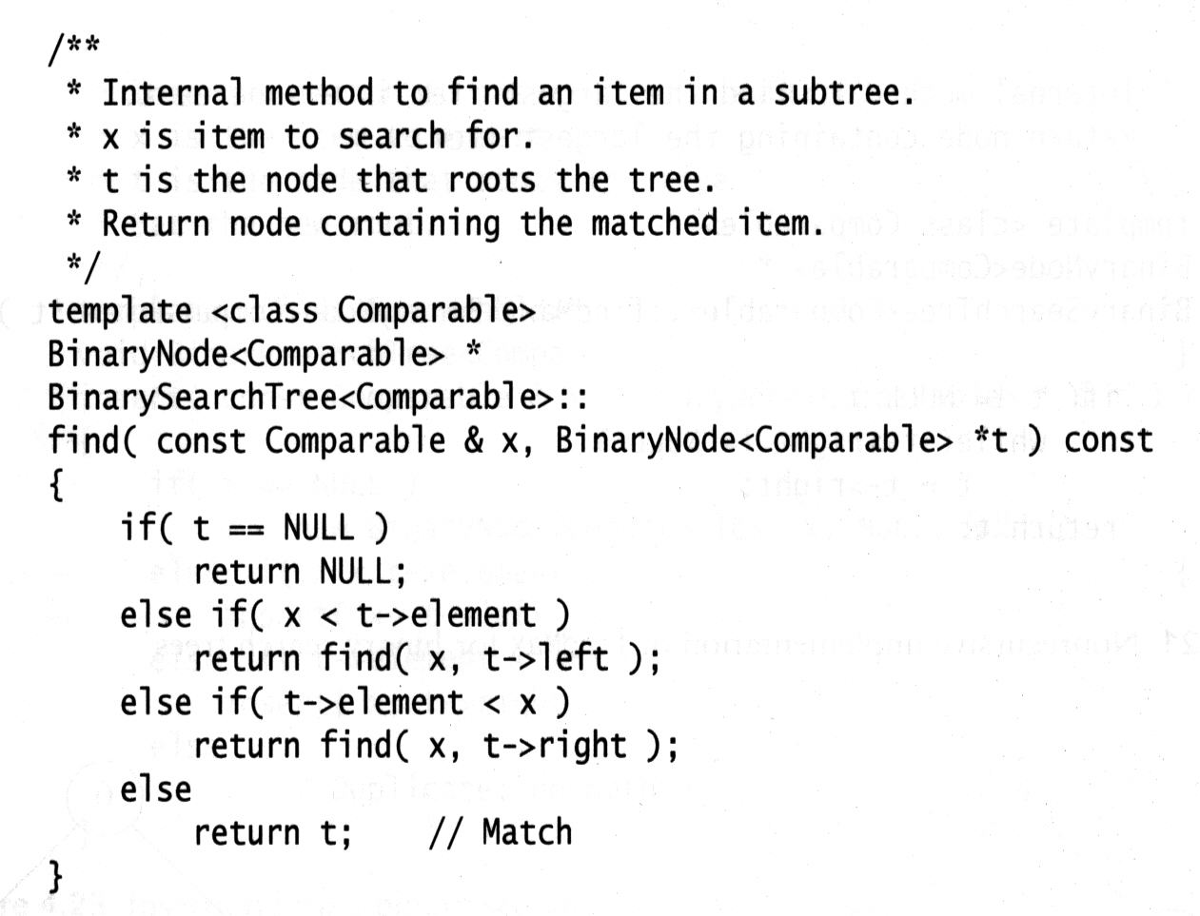
find()---Internal Member Function
This operation requires returning a pointer to the node in tree T that has item x, or NULL if there is no such node.
Recursively find x in the left subtree.
Recursively find x in the right subtree.

Slide 29
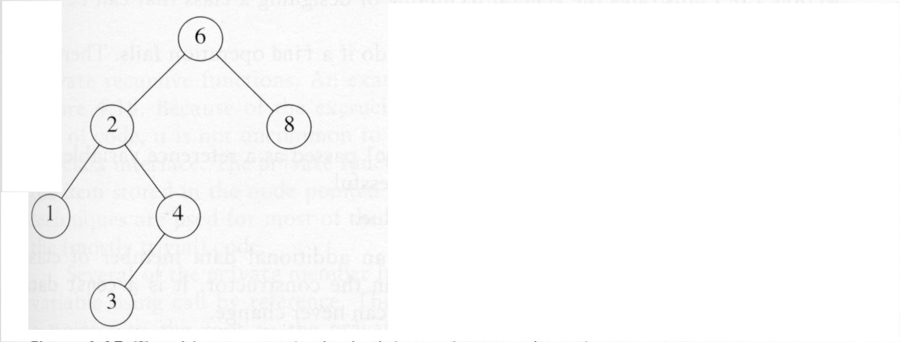
findMin() and findMax()
Return a pointer to the node containing the smallest and largest elements in the tree, respectively.
To perform a findMin, start at the root and go left as long as there is a left child. The stopping point is the smallest element.
To perform a findMax, start at the root and go right as long as there is a right child. The stopping point is the largest element.

Slide 30
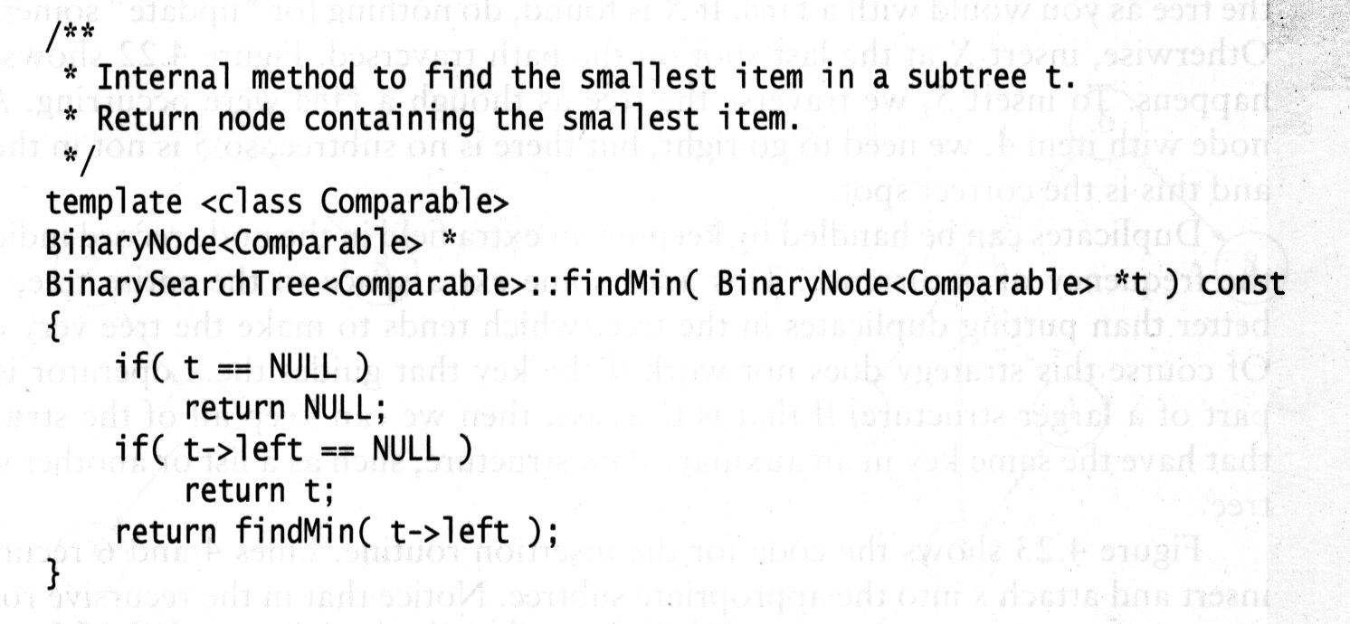
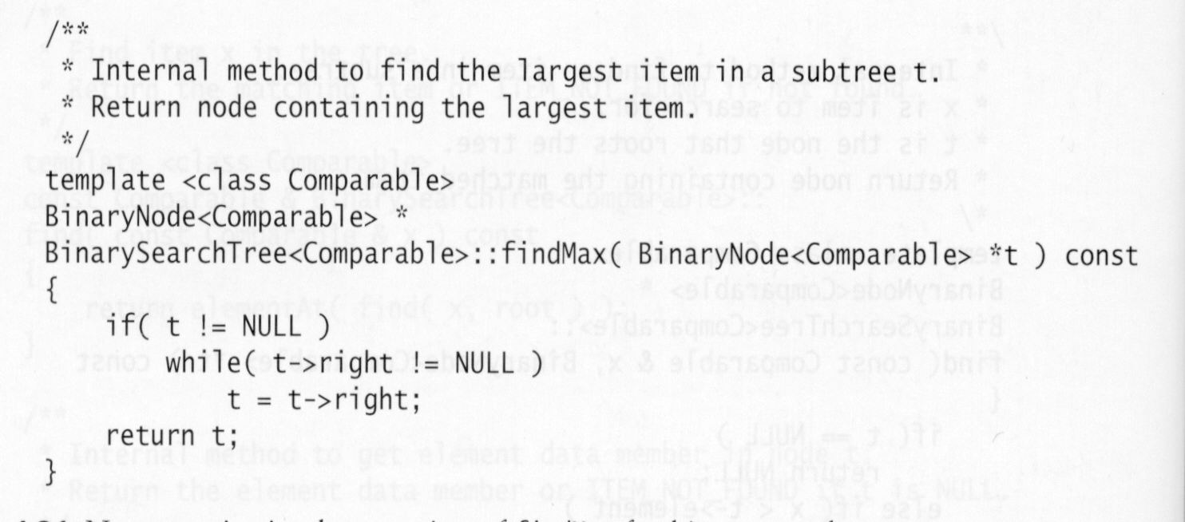
findMin() and findMax()
Recursive implementation of findMin()
Non-recursive implementation of findMax()
t is the left most node.
Find the smallest item in the left subtree.
Traverse down to the right most node.

Slide 31
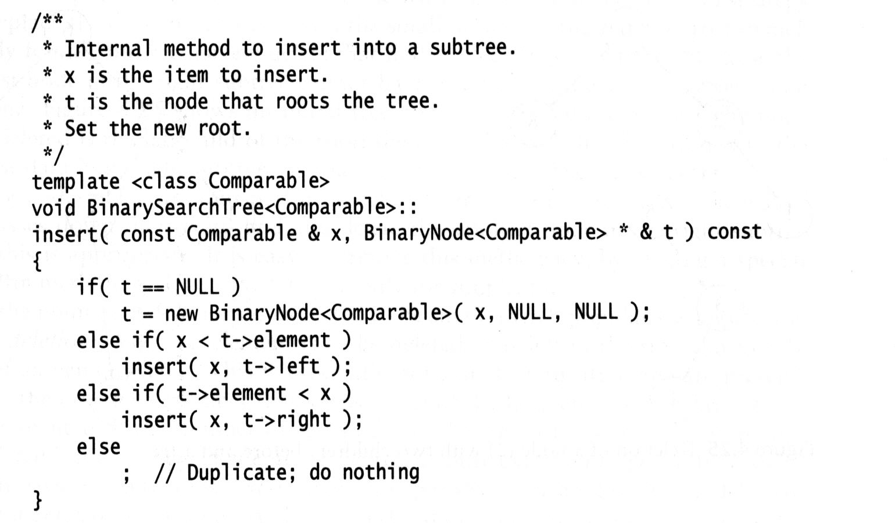
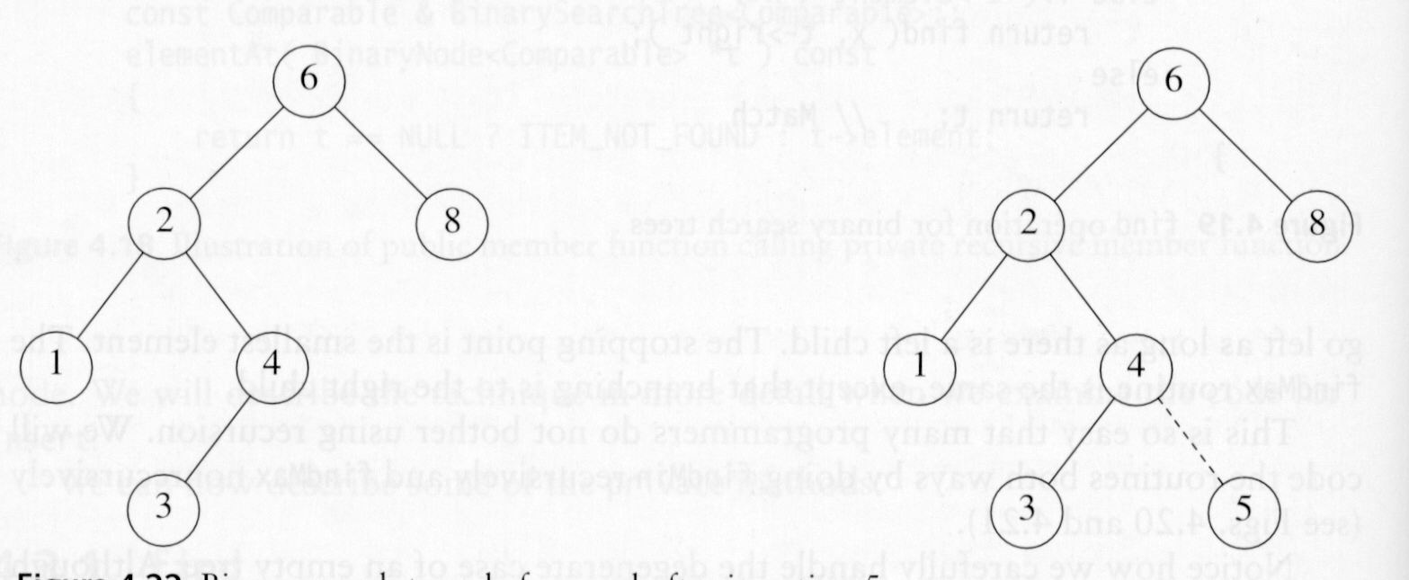
insert()
Insert item x into the subtree whose root is t.
Set the new root.
Recursively insert into the left subtree.
Recursively insert into the right subtree.

Slide 32
Issues about Insertion
Duplicates
Duplicates can be handled by keeping an extra field in the node record indicating the frequency of occurrence.
If the key is only part of a larger structure (data items may have the same key), we can keep all of the structures that have the same key in an auxiliary data structure, such as a list or another search tree.

Slide 33
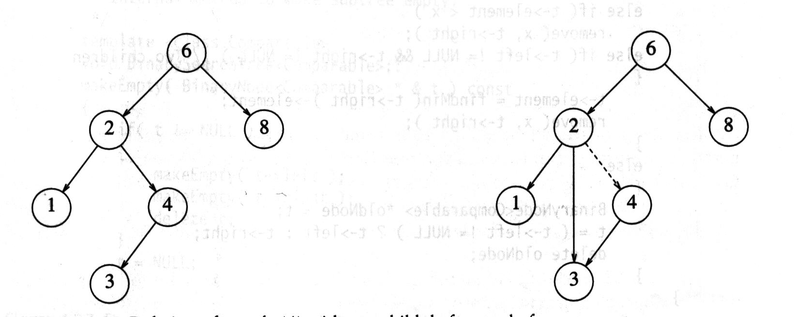
remove()
If the node is a leaf, it can be deleted immediately.
If the node has one child, the node can be deleted after its parent adjusts a link to bypass the node.

Slide 34
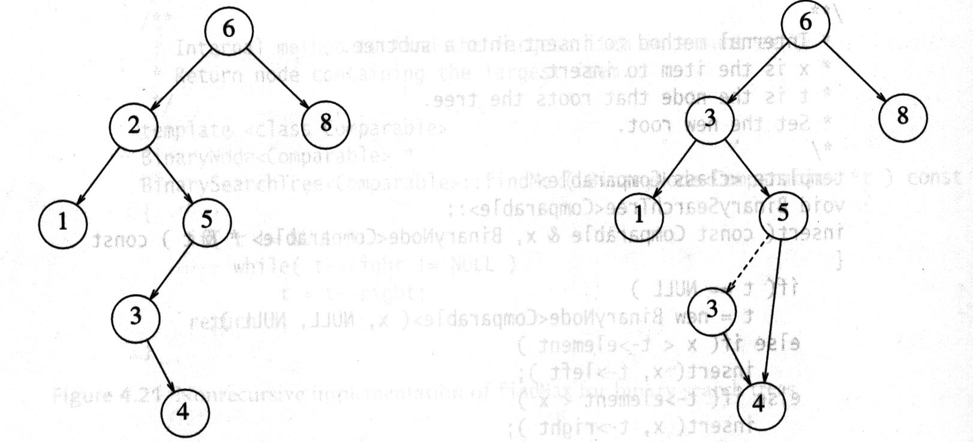
remove()
If the node has two children, the general strategy is to replace the data of this node with the smallest data of the right subtree and recursively delete that node from the right subtree.
Lazy deletion: When an element is to be deleted, it is left in the tree and merely marked as being deleted. It is useful when the number of deletions is expected to be small.
The node contains the
smallest data of the
right subtree.
This node can be either
a leaf node or a node
with one child.

Slide 35
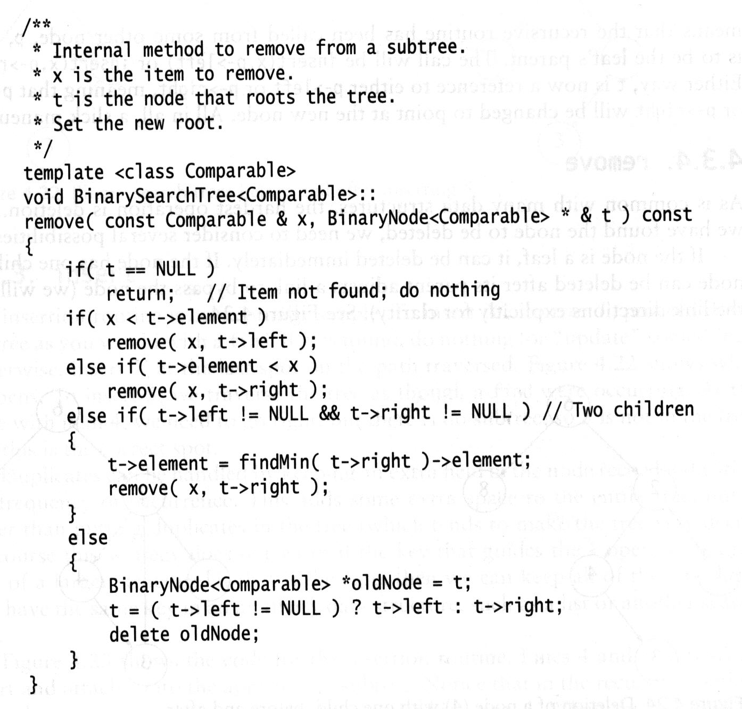
remove()
Find the smallest item in the right
subtree and replace the data item
in node t with this item.
t->element
Deal with the cases when the item is
in a leaf node or in a node with one
child.

Slide 36
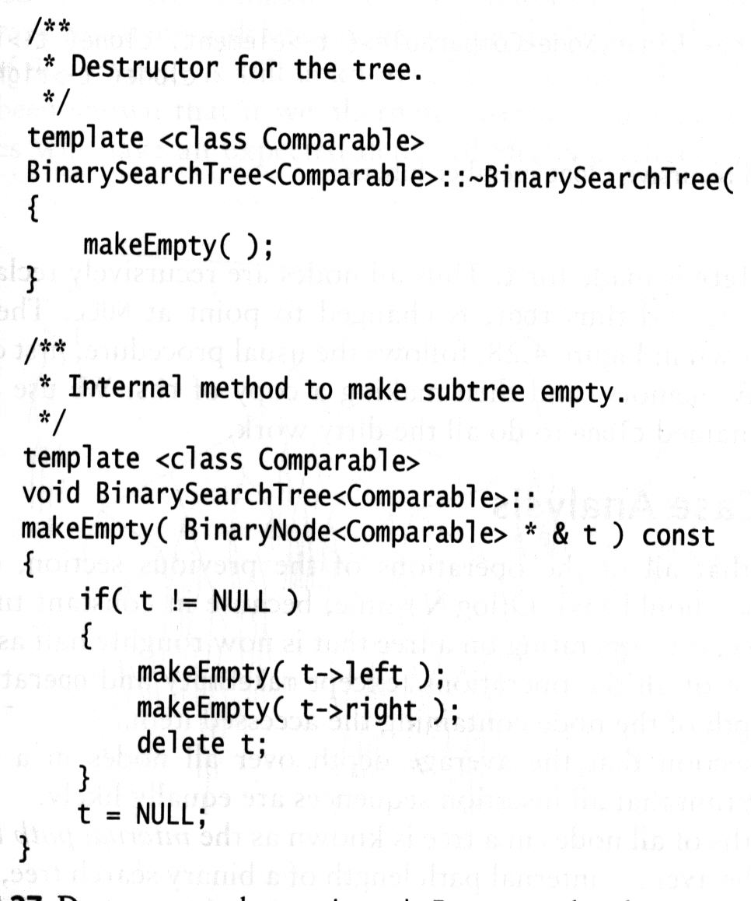
Destructor
We need to reclaim all memory occupied by the tree.
Remove all nodes in the tree.

Slide 37
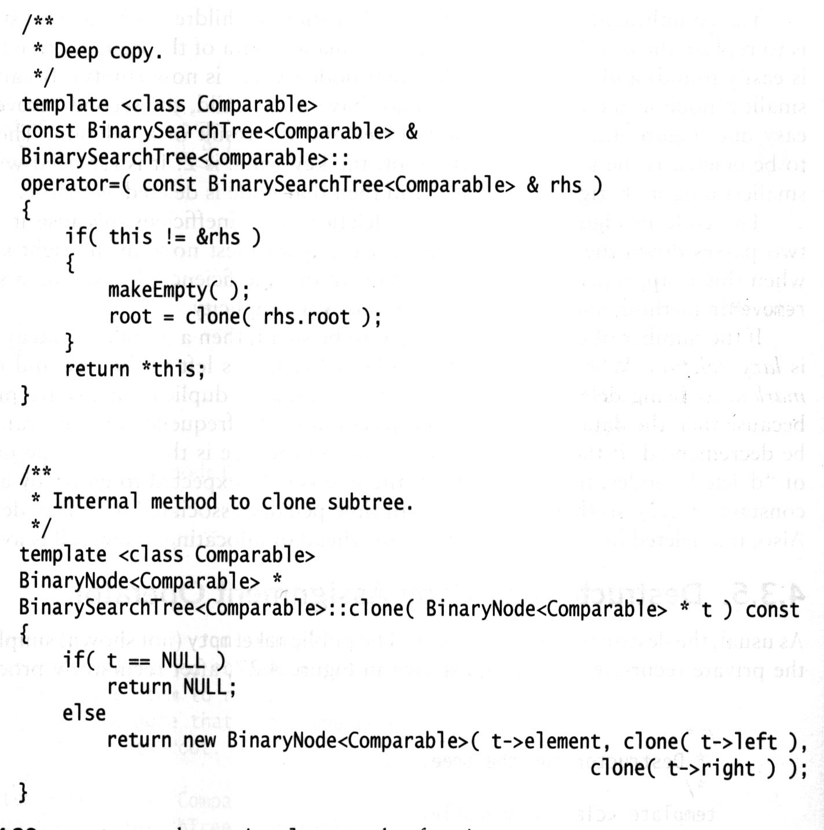
Copy Assignment Operator
Reclaim all memory occupied by the tree
Clone the tree of the right hand side of the assignment
1. Clone the left subtree.
2. Clone the right subtree.
3. Create a new node with left pointing to the left subtree and with right pointing to right subtree.

Slide 38
Average-Case Analysis for Binary Search Trees
Expect that all of the operations on binary search trees, except makeEmpty and operator=, should take O(lonN) time.
In constant time we descend a level in the tree
Operating on a tree is now roughly half as large
The running time of all operations (expect makeEmpty and operator=) is O(d), where d is the depth of the node containing the accessed item.
The average depth over all nodes in a tree is O(logN) on the assumption that all insertion sequences are equally likely.
The average running time of all operations (expect makeEmpty and operator=) is O(logN)

Slide 39
Average Depth of Binary Search Trees
internal path length : The sum of the depths of all nodes in a tree.
Let D(N) be the internal path length for some tree T of N nodes. D(1) = 0.
An N-node tree consists of an i-node left subtree and (N-i-1)-node right subtree, plus a root at depth zero for 0 <= i < N.
D(i) is the internal path length of the left subtree w.r.t its root. In the main tree, all these nodes are one level deeper.
D(N-i-1) is the internal path length of the right subtree w.r.t its root. In the main tree, all these nodes are one level deeper.
D(N) = D(i) + D(N-i-1) + N-1
root
T_{L}
T_{R}

Slide 40
Average Depth of Binary Search Trees (cont.)
Let D(N) be the internal path length for some tree T of N nodes. D(1) = 0.
D(N) = D(i) + D(N-i-1) + N-1
The average value of both D(i)
and D(N-i-1) is
Solving the above, we obtain
D(N) = O(NlogN)
This implies that the expected depth is O(logN).
root
T_{L}
T_{R}

Slide 41
Solving D(N)
Drop the insignificant –2 on the right, and divide the equation by N(N+1):

Slide 42
Solving D(N) (cont.)
We obtain
Then worst case:
0
3
6
8
9

Slide 43
AVL Trees
An AVL (Adelson-Velskii and Landis) tree is a binary search tree and for every node in the tree, the height of the left and right subtrees can differ by at most 1.
Recall : The height of a tree is the length of the longest path from
the root to a leaf. The height of an empty subtree is defined to be
-1.
5
7
8
2
8
2
2
8
1
1
4
7
1
4
9
3
3
5
10

Slide 44
Building AVL Trees
What is the problem?
Inserting a node could violate the AVL tree property: for every node in the tree, the height of the left and right subtrees can differ by at most 1.
The property has to be restored before the insertion step is considered over. How?
Apply rotations to “balance” the tree
5
5
2
8
2
8
1
4
7
1
4
7
3
3
6
Inserting 6

Slide 45
Detect the Unbalanced Node
Nodes that are on the path from the insertion point to the root might have their balance altered.
Only those nodes have their subtrees altered.
Follow the path up to the root and update the balancing information, then we may find a node whose new balance violates the AVL condition.
Rebalance the tree at the first such node by rotations.
5
1
5
2
8
1
2
8
2
1
4
7
0
1
4
7
1
3
3
6
0
Inserting 6

Slide 46
Four Violation Cases
Denote by α the node that must be rebalanced
An insertion into the left subtree of the left child of α.
An insertion into the right subtree of the left child of α.
An insertion into the left subtree of the right child of α.
An insertion into the right subtree of the right child of α.
5
5
α
α
2
8
2
2
8
2
1
4
7
1
4
7
1
1
3
6
3
7.5
0
0
Inserting 6
Inserting 7.5

Slide 47
Single Rotation: fixes case 1)
Case 1): An insertion into the left subtree of the left child of α.
Node k₂ is the first node on the path up to the root that violates the AVL balance property.
Node k₂ satisfies the AVL property before an insertion but violate it afterwards.
After insertion, subtree X has grown to an extra level, causing it to be exactly two levels deeper than Z.
Y cannot be at the same level as the new X because then k₂ would have been out of balance before the insertion.
Y cannot be the same level as Z because then k₁ would be the first node that violates the AVL balancing condition.
k₂
k₂
k₁
k₁
k₁
k₂
Z
Z
X
Y
Y
X
Y
Z
before insertion
X
after insertion
after rotation
The dashed lines mark the level

Slide 48
Single Rotation: fixes case 1) (cont.)
Performing the single rotation:
k₁ becomes the new root.
Since k₂ >= k₁, k₂ becomes the right child of k₁.
Z remains the right child of k₂
X remains the left child of k₁
Subtree Y is placed as k₂’s left child
k₂
k₂
k₁
k₁
k₁
k₂
Z
Z
X
Y
Y
X
Y
Z
before insertion
X
after insertion
after rotation
The dashed lines mark the level

Slide 49
Single Rotation: fixes case 1) (cont.)
Essentially, X moves up one level, Y stays at the same level, and Z moves down one level.
k₂ and k₁ satisfy the AVL balance property, and have subtrees that are exactly the same height.
The new height of the entire subtrees is exactly the same as the height of the original subtree prior to the insertion that caused X to grow.
No further updating of heights on the path to the root is needed, and consequently no further rotations are needed.
k₂
k₂
k₁
pivot
k₁
k₁
k₂
Z
Z
Y
Y
X
Y
Z
X
X
after rotation
The dashed lines mark the level

Slide 50
Examples: fixes case 1)
5
1
k₂
k₁
2
8
1
k₁
k₂
Z
1
4
7
0
Y
X
Y
Z
3
X
after rotation
5
5
1
2
k₂
8
2
2
k₁
7
0
1
4
k₁
k₂
7
1
1
4
X
6
8
0
0
3
X
6
0
3
Inserting 6

Slide 51
Single Rotation: fixes case 4)
Case 4) An insertion into the right subtree of the right child of α.
Node k₁ is the first node on the path up to the root that violates the AVL balance property.
Node k₁ satisfies the AVL property before an insertion but violate it afterwards.
After insertion, subtree Z has grown to an extra level, causing it to be exactly two levels deeper than X.
Y cannot be at the same level as the new Z because then k₁ would have been out of balance before the insertion.
Y cannot be the same level as X because then k₂ would be the first node that violates the AVL balancing condition.
k₁
k₁
k₂
k₂
k₂
k₁
X
X
Y
Z
Y
X
Y
Z
before insertion
after insertion
Z
after rotation
The dashed lines mark the level

Slide 52
Single Rotation: fixes case 4) (cont.)
Case 4) An insertion into the right subtree of the right child of α.
Performing the single rotation:
k₂ becomes the new root.
Since k₂ >= k₁, k₁ becomes the left child of k₂.
Z remains the right child of k₂
X remains the left child of k₁
Subtree Y is placed as k₁’s right child
k₁
k₁
k₂
k₂
k₂
k₁
X
X
Y
Z
Y
X
Y
Z
before insertion
after insertion
Z
after rotation
The dashed lines mark the level

Slide 53
Single Rotation: fixes case 4) (cont.)
Case 4) An insertion into the right subtree of the right child of α.
Essentially, Z moves up one level, Y stays at the same level, and X moves down one level.
k₂ and k₁ satisfy the AVL balance property, and have subtrees that are exactly the same height.
The new height of the entire subtrees is exactly the same as the height of the original subtree prior to the insertion that caused Z to grow.
No further updating of heights on the path to the root is needed, and consequently no further rotations are needed.
k₁
k₁
k₂
pivot
k₂
k₂
k₁
X
X
Y
Z
Y
X
Y
Z
before insertion
after insertion
Z
after rotation
The dashed lines mark the level

Slide 54
Examples: Single Rotation
Start with an initially empty AVL tree and insert the items 3, 2, 1, 4, 5, 6, 7
k₂
k₁
Insert 3:
3
k₁
k₂
Z
Insert 2:
Y
X
Y
Z
1
3
X
after rotation
0
2
Insert 1:
2
3
0
2
1
2
0
1
0
3
0
1

Slide 55
Examples: Single Rotation (cont.)
Start with an initially empty AVL tree and insert the items 3, 2, 1, 4, 5, 6, 7
k₁
k₂
Insert 4:
1
2
k₂
k₁
X
0
1
1
3
Y
X
Y
Z
Z
after rotation
0
4
Insert 5:
1
2
1
2
0
1
2
3
0
1
0
4
1
4
0
3
0
5
0
5

Slide 56
Examples: Single Rotation (cont.)
Start with an initially empty AVL tree and insert the items 3, 2, 1, 4, 5, 6, 7
k₁
k₂
k₂
k₁
X
Y
X
Y
Z
Z
after rotation
Insert 6:
2
2
0
4
0
1
1
4
0
2
1
5
0
3
1
5
0
1
0
3
0
6
0
6

Slide 57
Examples: Single Rotation (cont.)
Start with an initially empty AVL tree and insert the items 3, 2, 1, 4, 5, 6, 7
k₁
k₂
k₂
k₁
X
Y
X
Y
Z
Z
after rotation
Insert 7:
0
4
0
4
0
2
2
5
0
2
0
6
0
1
0
3
1
6
0
1
0
3
5
0
0
7
0
7

Slide 58
Double Rotation: fixes case 2)
Case 2): An insertion into the right subtree of the left child of α.
Single rotation does not work.
k₃
k₃
k₁
pivot
k₁
k₁
k₃
D
D
A
k₂
k₂
k₂
A
A
D
B
C
B
C
B
C

Slide 59
Double Rotation: fixes case 2) (cont.)
Case 2): An insertion into the right subtree of the left child of α.
Place k₂ as a new root. Force k₁ to be k₂’s left child and k₃ to be its right child. Completely determine the resulting locations of the four subtrees
Restore the height to what it was before the insertion, thus guarantee that all rebalancing and height updating is complete.
k₃
k₃
k₃
k₁
k₁
k₂
D
pivot
D
D
k₂
k₂
k₁
A
A
C
B
C
B
C
A
B
pivot
k₃
k₂
k₂
k₁
k₃
D
k₁
C
A
B
C
D
A
B

Slide 60
Double Rotation: fixes case 3)
Case 3): An insertion into the left subtree of the right child of α.
Place k₂ as a new root. Force k₁ to be k₂’s left child and k₃ to be its right child. Completely determine the resulting locations of the four subtrees
Restore the height to what it was before the insertion, thus guarantee that all rebalancing and height updating is complete.
k₁
k₁
k₁
k₃
k₃
k₂
A
A
pivot
A
k₂
k₂
k₃
D
D
B
B
C
B
C
C
D
k₁
pivot
k₂
k₂
k₁
k₃
A
k₃
B
A
B
C
D
C
D

Slide 61
Examples: Double Rotation
Insert the items 16, 15, 14, 13, 12, 14.5
0
4
0
2
0
6
0
1
0
3
5
0
0
7
Insert 16:
1
4
0
2
1
6
0
1
0
3
5
0
1
7
0
16

Slide 62
Examples: Double Rotation
Insert the items 16, 15, 14, 13, 12, 14.5
k₁
k₂
k₃
k₁
k₃
Right-left double rotation
A
k₂
D
A
B
C
D
Insert 15:
B
C
1
4
1
4
1
4
0
2
1
6
0
2
1
6
0
2
1
6
0
k₁
0
0
1
0
3
5
2
7
7
k₁
1
0
3
5
0
0
15
k₂
0
1
0
3
5
2
0
1
16
k₃
15
k₂
1
16
7
k₁
k₃
0
0
0
15
k₂
0
16
k₃

Slide 63
Examples: Double Rotation
Insert the items 16, 15, 14, 13, 12, 14.5
k₁
k₂
k₃
k₁
k₃
Right-left double rotation
A
k₂
D
A
B
C
D
Insert 14:
B
C
1
4
1
4
1
4
k₁
k₁
k₂
0
2
2
6
2
0
2
0
7
0
6
k₃
k₂
k₁
k₃
0
1
0
3
5
0
1
15
1
3
7
0
1
0
3
6
1
0
15
0
0
5
0
k₂
k₃
7
0
16
0
15
0
5
0
14
0
16
1
0
14
0
14
0
16

Slide 64
Examples: Double Rotation
Insert the items 16, 15, 14, 13, 12, 14.5
k₁
k₂
k₂
k₁
X
Y
X
Y
Z
Insert 13:
Z
after rotation
2
4
0
7
0
2
7
1
0
4
1
15
0
1
0
3
6
1
1
15
0
2
1
6
14
1
0
16
0
5
0
14
0
16
0
1
3
5
13
0
13

Slide 65
Examples: Double Rotation
Insert the items 16, 15, 14, 13, 12, 14.5
k₂
k₁
k₁
k₂
Z
Y
X
Y
Z
Insert 12:
X
after rotation
0
7
0
7
0
4
1
15
4
0
1
15
0
2
1
6
14
2
0
16
2
6
0
16
0
1
13
0
1
0
1
3
5
13
1
3
5
0
12
14
0
12

Slide 66
Examples: Double Rotation
Insert the items 16, 15, 14, 13, 12, 14.5
k₃
k₂
k₁
k₁
k₃
Left-right double rotation
D
k₂
A
A
B
C
D
Insert 14.5:
B
C
0
7
0
7
0
7
k₃
k₃
k₂
0
4
2
15
0
4
15
0
4
0
14
k₁
k₂
k₁
k₃
0
2
1
6
13
1
0
16
0
2
1
6
14
16
0
2
1
6
13
1
0
15
k₂
k₁
0
1
3
5
12
14
1
0
1
3
5
13
14.5
0
1
3
5
12
14.5
16
0
14.5
12

Slide 67
In Summary
Case 1): An insertion into the left subtree of the left child of α.
k₂
k₂
k₁
pivot
k₁
k₁
k₂
Z
Z
Y
Y
X
Y
Z
X
X
after rotation
Case 4): An insertion into the right subtree of the right child of α.
k₁
k₁
k₂
pivot
k₂
k₂
k₁
X
X
Y
Z
Y
X
Y
Z
before insertion
after insertion
Z
after rotation

Slide 68
In Summary
Case 2): An insertion into the right subtree of the left child of α.
k₃
k₃
k₃
k₁
k₁
k₂
D
pivot
D
D
k₂
k₂
k₂
A
A
C
B
C
B
C
A
B
pivot
k₃
k₂
k₂
k₁
k₃
D
k₂
C
A
B
C
D
A
B

Slide 69
In Summary
Case 3): An insertion into the left subtree of the right child of α.
k₁
k₁
k₁
k₃
k₃
k₂
A
A
pivot
A
k₂
k₂
k₃
D
D
B
B
C
B
C
C
D
k₁
pivot
k₂
k₂
k₁
k₃
A
k₃
B
A
B
C
D
C
D

Slide 70
struct AvlNode
{
Comparable element;
AvlNode * left;
AvLNode * right;
int height;
AvlNode (const Comparable & theElement,
AvlNode *lt, AvlNode *rt, int h=0): element(theElement),
left (lt), right(rt), height(h){ }
};
/*return the height of node t to -1 if null*/
int height(AvlNode * t)
{
return t==NULL? -1 : t->height;
}

Slide 71
/*AVL tree insert*/
Void insert(const Comparable & x, AvlNode *&t)
{
if(t==NULL)
t=new AvlNode(x, NULL, NULL);
else if ( x < t->element )
{
insert(x, t->left);
if (height(t->left) – height(t->right)==2)
if (x < t->left->element)
rotateWithLeftChild(t);
else
DoubleRotateWithLeftChild(t);
}
else if ( t-> element <x)
{
insert(x, t->right);
if (height(t->right) – height(t->left)==2)
if (x < t->right->element)
rotateWithRightChild(t);
else
DoubleRotateWithRightChild(t);
}
else ; //duplication. Do nothing.
t -> height = max(height(t->left), height(t->right))+1;
}

Slide 72
/* single left rotation*/
void rotateWithLeftChild(AvlNode *&k2)
{
AvlNode *k1=k2->left;
k2->left=k1->right;
k1->right=k2;
k2->height=max(height(k2->left, height(k2->right)) + 1;
k1->height=max(height(k1->left),
k2->height) + 1;
K2=k1;
}

Slide 73
/*single right rotation*/
void rotateWithRightChild(AvlNode *&k2)
{
AvlNode *k1=k2->right;
k2->right=k1->left;
k1->left=k2;
k2->height=max(height(k2->left, height(k2->right)) + 1;
k1->height=max(height(k1->right),
k2->height) + 1;
K2=k1;
}

Slide 74
/*double left rotation*/
void doubleWithLeftChild(AvlNode *&k3)
{
rotateWithRightChild(k3->left);
rotateWithLeftChild(k3);
}

Slide 75
/*double right rotation*/
void doubleWithRightChild(AvlNode *&k3)
{
rotateWithLeftChild(k3->left);
rotateWithRightChild(k3);
}

Slide 76
B-Trees
Aim at reducing disk accesses for large data sets that cannot be loaded into main memory.
The goal to limit disk accesses to 3 or 4 times.
Binary trees and AVL trees won’t work.
Solution:
Make a tree flat and shallow, with about 3 to 4 layers.

Slide 77
B-Tree Definition
A B-tree of order M is an M-ary tree with the following properties:
The data items are stored at leaves.
The nonleaf nodes store up to M – 1 keys to guide the searching; key i represents the smallest key in subtree i + 1.
The root is either a leaf or has between two to M children.
All nonleaf nodes (except the root) have between
and M children
All leaves are at the same depth and have between
and L data items, for some L.

Slide 78
How to Choose M and L?
Disk block size: dbs = 8,192 bytes
Key size: ks = 32 bytes
Record size: rs = 256 bytes
Record number: N = 10,000,000
Address size: as = 4 bytes
Calculation:

Slide 79
A B-tree with M=5, L =5
All nonleaf nodes must have at least 3 children nodes
All leaves are at the same depth
All leaves have between 3 and 5 data items

Slide 80
Search is easy
Starting at the root, do binary search at each internal node to get to a leave and then search for the target in the leave.

Slide 81
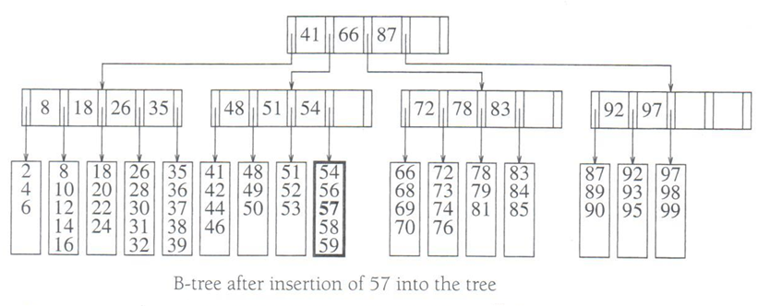
Insertion – no node splitting
First search for the leave to add a new data item. If the leave is not full, then just insert the item.
See figure below.

Slide 82
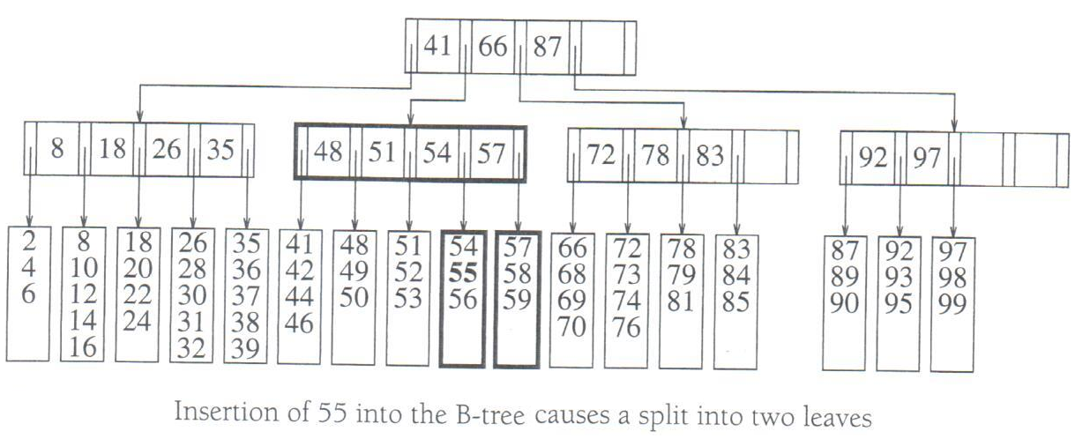
Insertion – node splitting
If the leave is full, then split it into two, first one with and the second one with data items.
Update the parent node. If the parent node becomes full, then split it.
Continue the above until no more splitting is needed. (The worse case is to split the root.)
Example 1: No parent splitting after insertion.

Slide 83
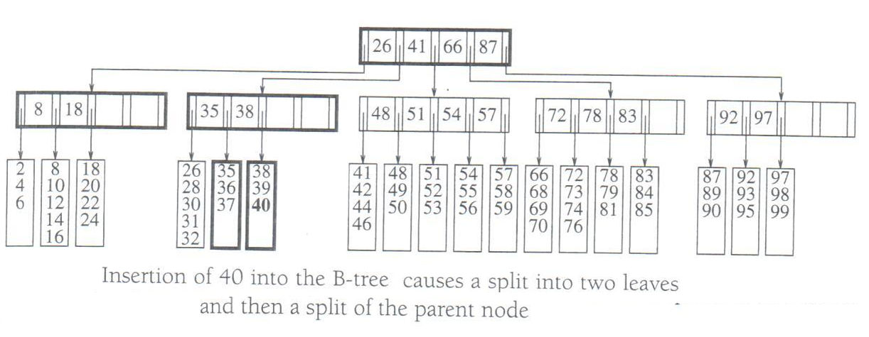
Insertion – node splitting
Example: parent splitting after insertion

Slide 84
Deletion – no node merging vs no merging
Use binary search to find the leave and find the data item to delete.
If items in the leave is still between and L items, then no merge is needed.
If the leave is below , then need to merge it with the previous leave. After merging, need to update the parent. Parent merge may also needed.

Slide 85
Deletion – an example

Slide 86
Sets
Sorted associative containers
Set
A sorted associative container that does not allow duplicates
Stores objects
Unimodal: duplicate objects not allowed

Slide 87
The STL Set Template
set() // Creates an empty set.
set(const key_compare& comp) //Creates an empty set, use comp for key comparison
pair<iterator, bool> insert(const value_type& x)
iterator insert(iterator pos, const value_type& x)
Inserts x into the set, using pos as a hint to where it will be inserted.
void erase(iterator pos)
Erases the element pointed to by pos.
size_type erase(const key_type& k)
Erases the element whose key is k
void erase(iterator first, iterator last)
Erases all elements in a range
iterator find(const key_type& k) const
Finds an element whose key is k
Logarithmic complexity for insertion, remove, search

Slide 88
An Example
set<int> s;
int i;
set<int>::iterator itr;
for (i =0; i<10; i++)
s.insert(s.end(), i);
for (itr=s.begin(); itr !=s.end(); itr++)
cout<<*itr<<endl;
cout<<endl;
s.insert(108);
s.insert(s.end(), 222);
for (auto x=s.begin(); x!=s.end(); x++)
cout<<*x<<endl;
s.erase(222);
for (auto x=s.begin(); x!=s.end(); x++)
cout<<*x<<endl;

Slide 89
Maps
Associative container that associates objects of type Key with objects of type Data
Sorted according to keys
Map
Stores (key, object) pairs
Unimodal: duplicate keys not allowed
AKA: table, associative array

Slide 90
The STL Map Template
map()
map(const key_compare& comp)
pair<iterator, bool> insert(const value_type& x)
Inserts x into the map
iterator insert(iterator pos, const value_type& x)
Inserts x into the map, using pos as a hint to where it will be inserted
void insert(iterator, iterator)
Inserts a range into the map

Slide 91
STL Map Template
void erase(iterator pos)
Erases the element pointed to by pos
size_type erase(const key_type& k)
Erases the element whose key is k
void erase(iterator first, iterator last)
Erases all elements in a range
iterator find(const key_type& k)
Finds an element whose key is k.
data_type& operator[](const key_type& k)
Returns a reference to the object that is associated with a particular key.
If the map does not already contain such an object, operator[] inserts the default object data_type()

Slide 92
An Example
map<string, double> salaries;
salaries["Pat"] = 75000.00;
cout<<salaries["Pat"]<<endl;
cout<<salaries["Jan"]<<endl;
map<string,double>::const_iterator itr;
itr = salaries.find("Chris");
if (itr==salaries.end())
cout<<"Not an employee of this company!"<<endl;
else
cout<<itr->second<<endl;

