Slide 1
Lists, Stacks, and Queues
Abstract Data Types (ADTs)
The List ADT
The Stack ADT
The Queue ADT

Slide 2
Abstract Data Types (ADTs)
Definition: An abstract data type (ADT) is a set of objects together with a set of operations for processing the objects. Examples:
Objects such as lists, sets, and graphs, along with their operations, can be viewed as abstract data types.
Integers, real, and Booleans have operations associated with them, and so are abstract data types.
The definition of an ADT makes no mention of how the set of operations is implemented.
There is no rule telling us which operations must be supported for each ADT; this is a design decision.
The C++ class allows for the implementation of ADTs, with appropriate hiding of implementation details. That is, any other part of the program that needs to perform an operation on the ADT can do so by calling the appropriate function.

Slide 3
The List ADT
A list is a dynamic ordered sequence of homogeneous elements: A₁, A₂, …, A_{N}, where A_{i} is the i-th element of the list.
The size of the list is N. A list of size 0 is an empty list.
The position of element A_{i} is i; positions range from 1 to N.
For any list except the empty list, we say that A_{i+1} succeeds A_{i} (i<N) and that A_{i-1} precedes A_{i} (i>1). We will not define the predecessor of A₁ or the successor of A_{N}.
Some popular operations for a list
printList and makeEmpty
find: returns the position of the first occurrence of an element
insert and remove: generally inserts and removes some element from some position in the list
findKth: returns the kth element in the list.

Slide 4
Array Implementation of Lists
Use an array to implement a list. Need to know or to estimate the maximum size of the list in advance.
Allows printList and find to be carried out in linear time.
findKth takes constant time.
insert and remove operations, in general, are of order O(N).
Since the running time for insertion and deletions is considerable large (and also the size of the array must be know in advance), array implementation of a list is not very suitable.

Slide 5
Linked Lists
Stores a list of elements non-contiguously.
Allows insertion or deletion of elements in the middle of the list with only a constant amount of data movement.
General ideas:
Each element in the list is stored with an indication of where the next element is.
Must know where first element is.
The list will be a chain of objects of type ListNode that contain the data and a link to the next ListNode in the list.
A₁
A₂
A₃
A₄
of type ListNode
the next link

Slide 6
Operations in Linked Lists
printList() or find(x): start at the first node in the list and then traverse the list by following the next links. Clearly, it takes O(N) time.
findKth(i): takes O(i) time and works by traversing down the list in the obvious manner.
remove(): can be executed in one next pointer change.
insert(): requires obtaining a new node from the system by using a new call and then executing two next pointer maneuvers.
A₁
A₂
A₃
A₄
A₁
A₂
A₃
A₄
X

Slide 7
Header Nodes
Deletion of first element and insertion of new first element are special case (since we must know where first element is).
Can avoid by using header node; contains no data, but serves to ensure that first "real" node in linked list has a predecessor.
Searching routines will skip header.
header
A₁
A₁
A₂
A₃
header
an empty list with header

Slide 8
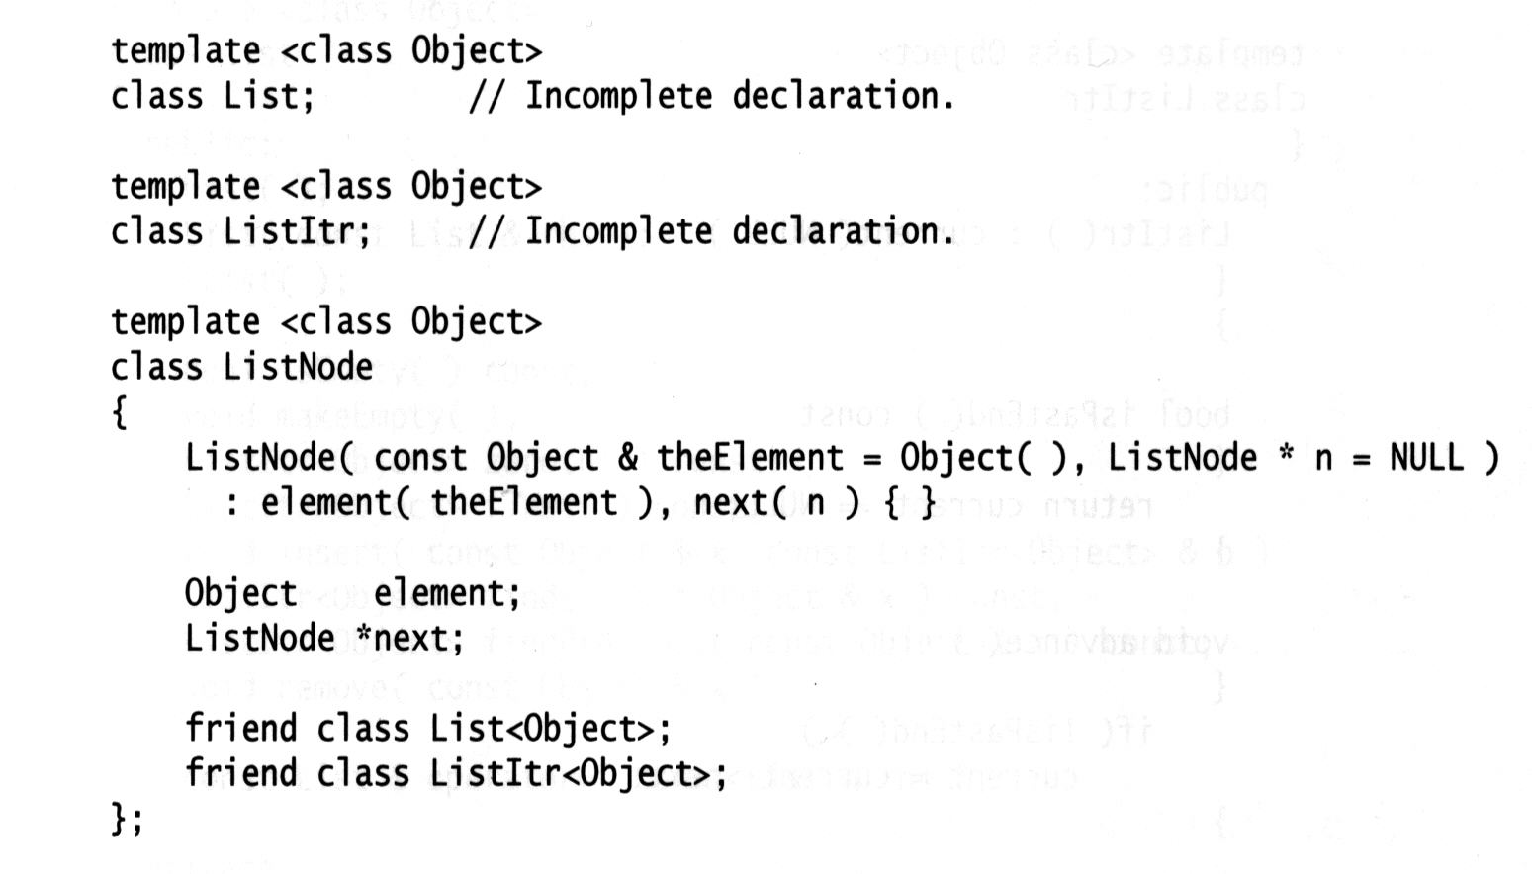
Illustration of a Complete List ADT
The list ADT is implemented as three separate classes: one class is the list itself (List), another represents the node (ListNode), and the third represents the position (ListItr).
ListNode class
To help the compiler to understand what
the friend declaration means, we provide
an incomplete class declaration prior to
the ListNode definition.
The only method is the constructor.
The data members of ListNode are private.
Since List and ListItr need access to these data
member, ListNode declares that the List and ListItr
classes are friends. A friend of a class is granted
access to the class’ private section.

Slide 9
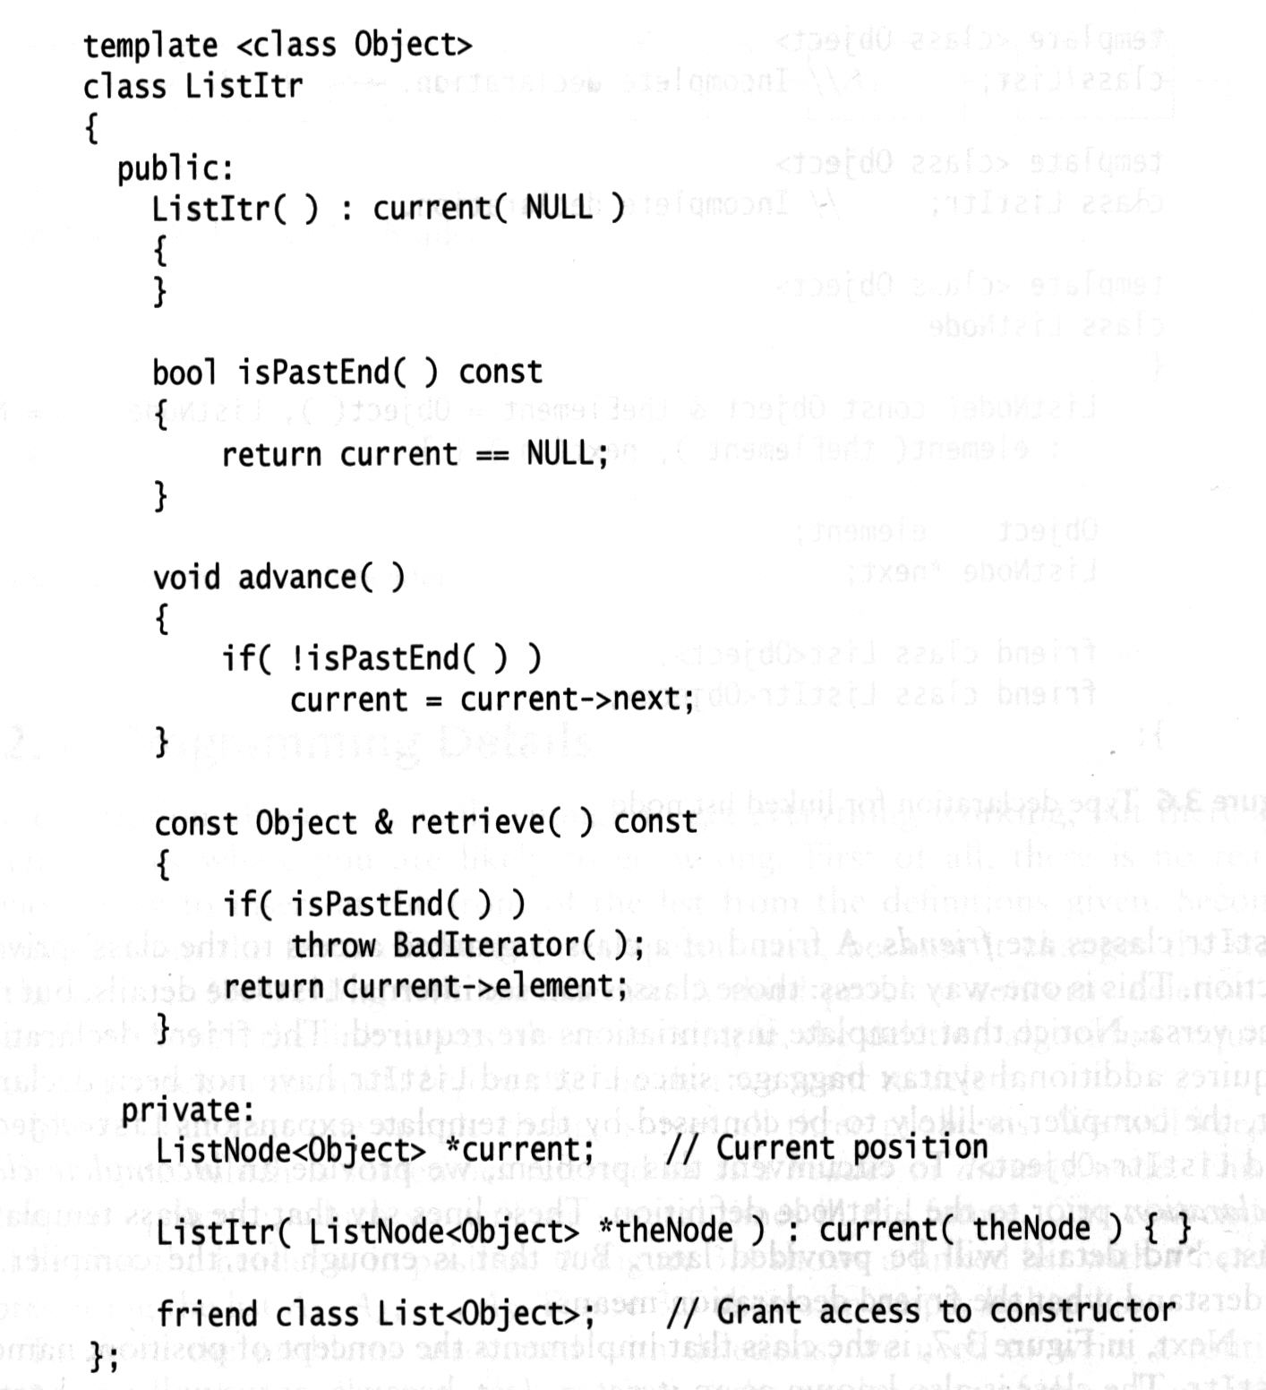
Iterator class (ListItr)
ListItr implements the concept of position, i.e., maintains notion of the current position.
ListItr provides methods such as Advance, Retrieve, isPastEnd, which act on the current position stored in the iterator.
ListItr stores a pointer to a ListNode, representing the current
position of the iterator.
Default constructor.
isPastEnd is true if the position is past the end of the list.
advance advances the current position to the next node.
retrieve returns the element stored in the current position.
This constructor for ListItr requires a pointer
to a node that is to be the current node.
List is a friend of ListItr.

Slide 10
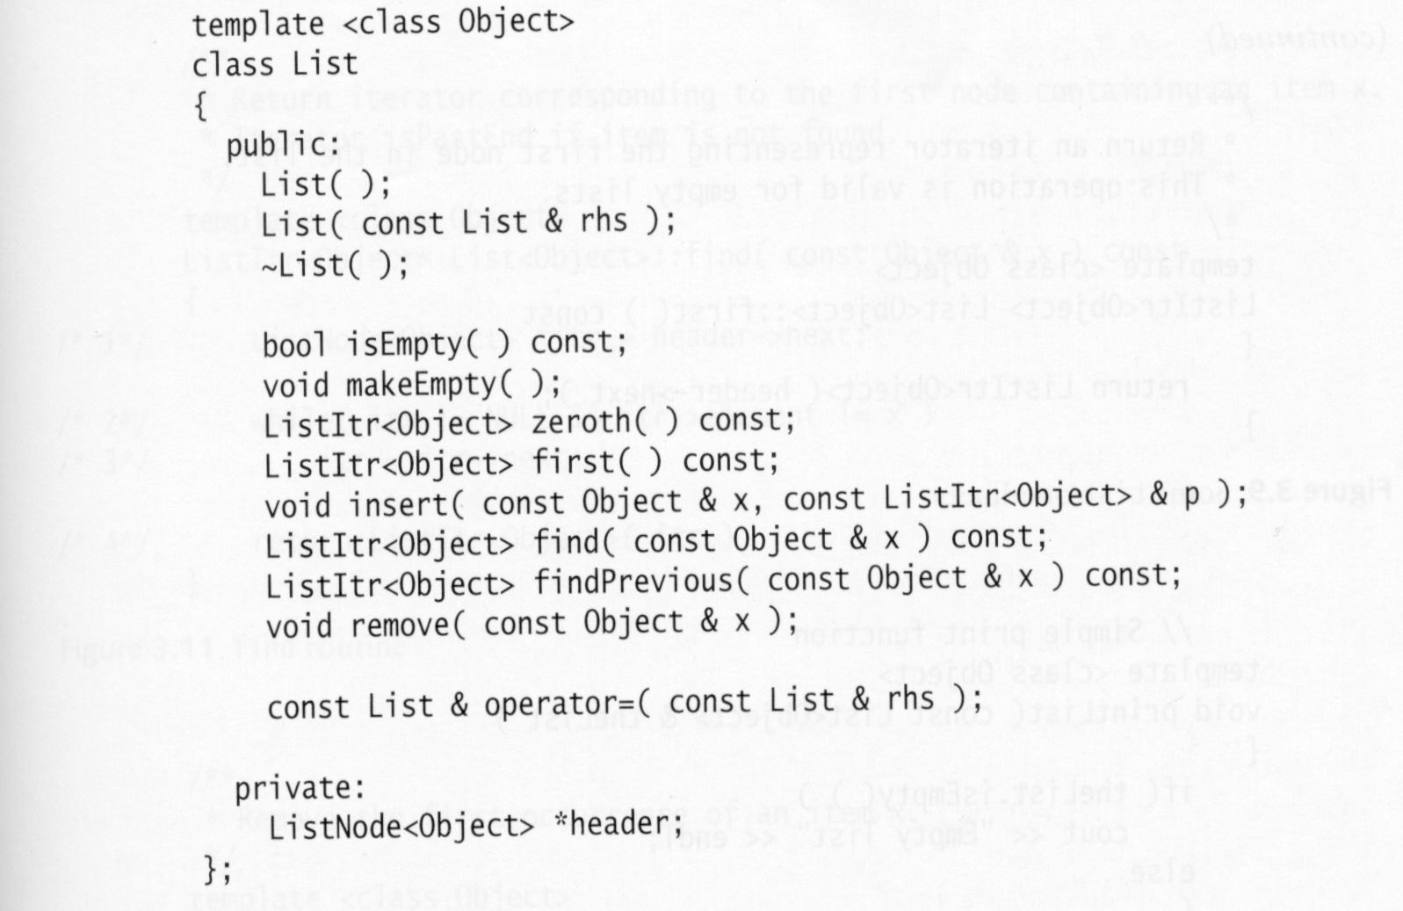
List class interface
Default constructor.
copy constructor.
Destructor.
Test if the list is logically empty.
Return an iterator corresponding to the header.
Return an iterator corresponding to the first element.
The data member is a pointer to the header node
that is allocated by the constructor.

Slide 11
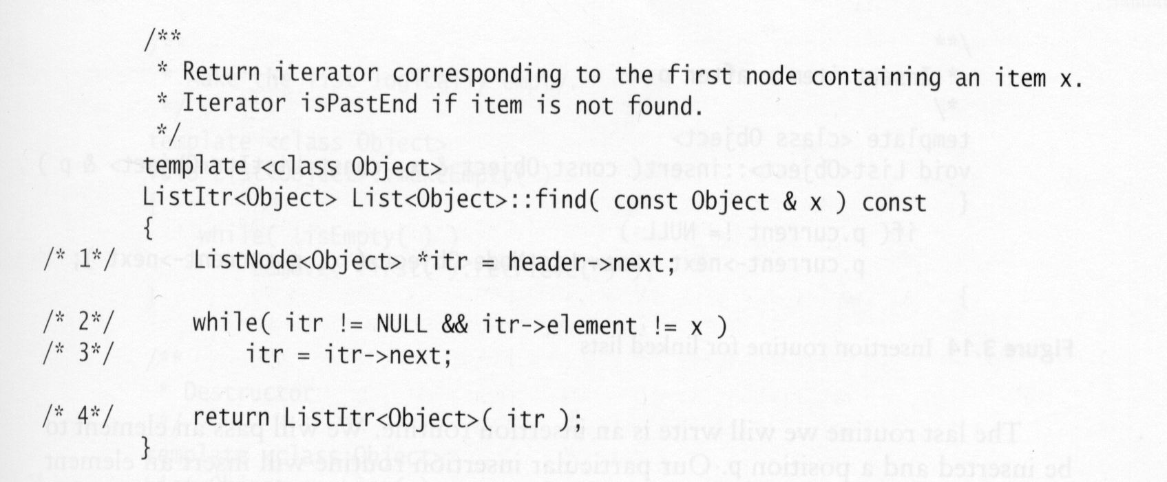
find method
Find the first node containing an item x.
Searching from the first node in
the list.
Traversing the list until we occur the
first node containing the item x, or
reach the end of the list.
Return the corresponding iterator.

Slide 12
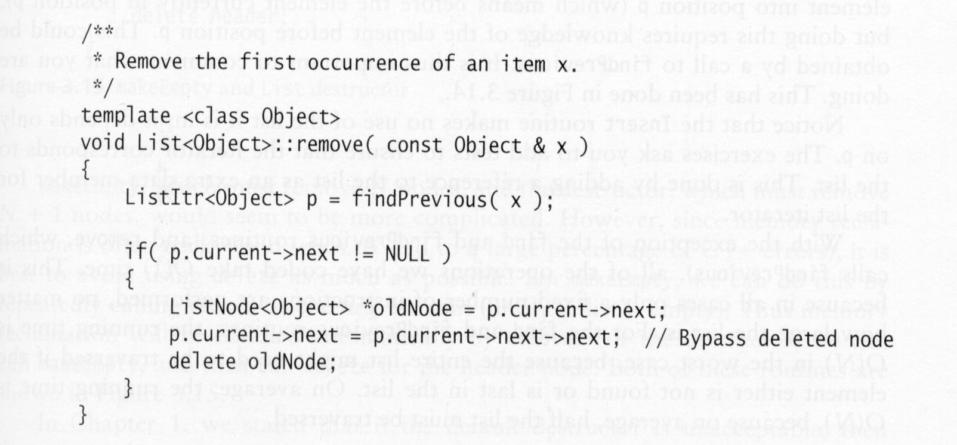
remove method
Remove some element x from the list L.
Consideration: what to do if x occurs more than once or not at all.
Our routine removes the first occurrence of x and does nothing if x is not in the list.
Find the element prior to the one containing x
via a call to findPrevious. Note that findPrevious
Return the corresponding iterator.
Reclaim oldNode.
header
A₁
A₂
A₃
p.current
oldNode
p.current->next->next

Slide 13
Insert method
Insert an element x after the position p.
header
A₁
A₂
A₃
p.current
X

Slide 14
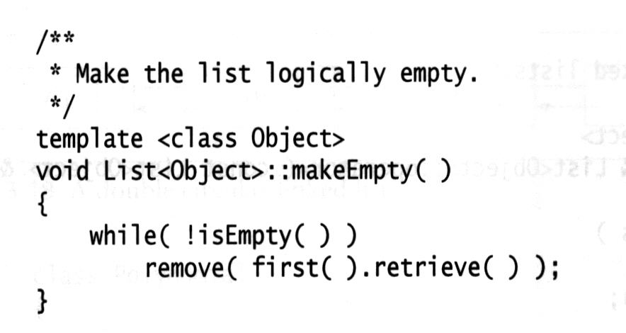
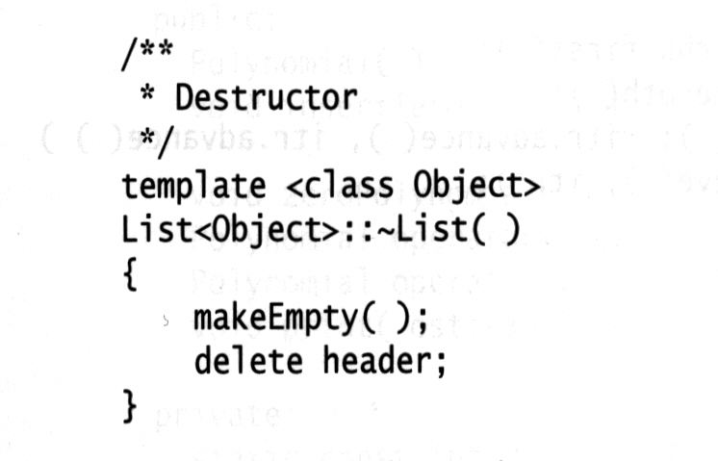
makeEmpty and List destructor
Since the insertion routines consistently allocate ListNode objects via calls to new, it it important that these objects be reclaimed when they are no longer referenced.
makeEmpty remove N nodes in the list, and the destructor remove N+1 nodes.
Default destructor is unacceptable.
header

Slide 15
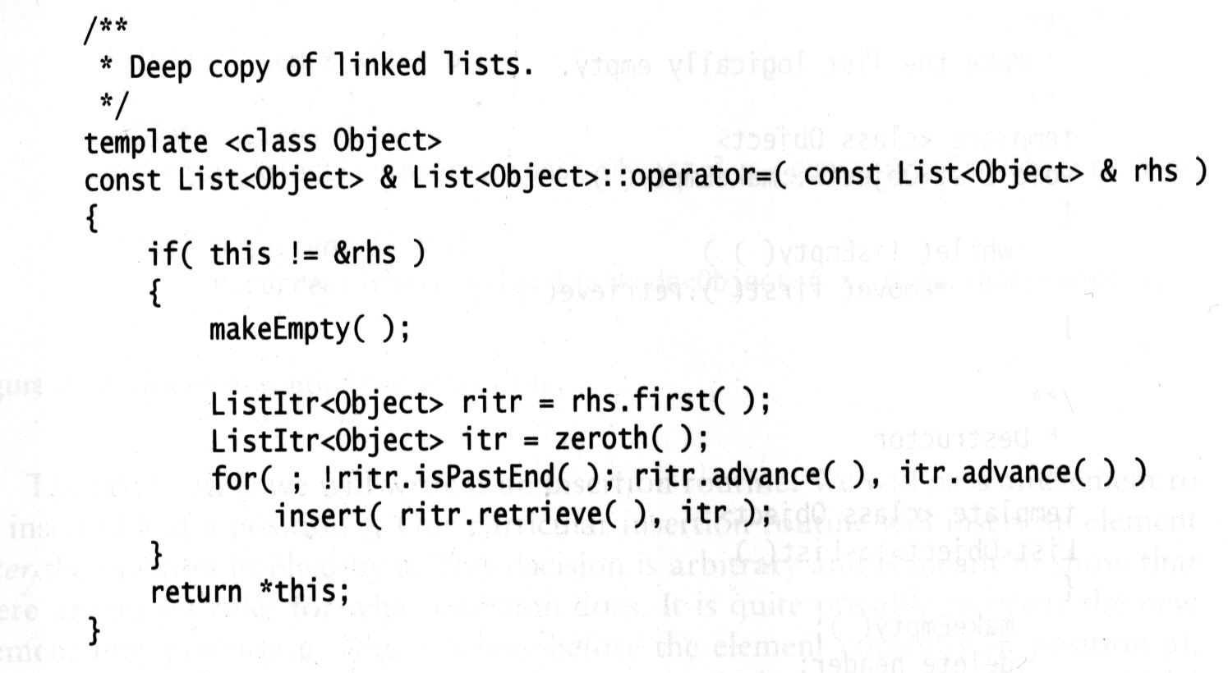
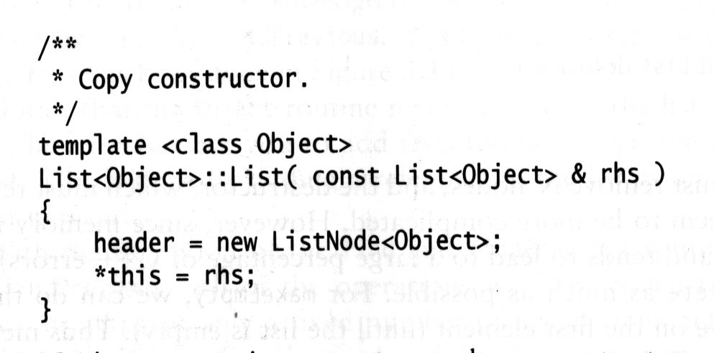
operator= and copy constructor
The default operator= and copy constructor are unacceptable.
Do the usual aliasing test.
Make the current list empty to avoid leaking memory previously
allocated for the list.
Create the first node and
then go down rhs, appending
new ListNodes to the end of
the target list.
Create an empty list by calling new to allocate a header node.
Using operator= to copy rhs.

Slide 16
Doubly Linked Lists
Sometimes it is convenient to traverse lists backwards.
How?: add to the node an extra data member that stores a link to the previous node.
Increases the space requirement and doubles the cost of insertions and deletions as there are more links to fix.
It simplifies deletion as no longer needs to find the previous node.
A₁
A₂
A₃
A₄

Slide 17
Circular Linked Lists
A popular convention is to have the last node keep a link back to the first.
This can be done with or without a header (if the header is present, the last node links to it)
It can also be done with doubly linked lists (the first cell’s previous link is to the last cell).
A₁
A₂
A₃
A₄
header
A₁
A₂
A₃
A₁
A₂
A₃
A₄

Slide 18
Radix sort
Radix sort is the algorithm used by the card-sorting machines you now find only in computer museums.
Bucket sort
Given N integers in the range 1 to M (M = Θ(N)), find a sorted order for these N integers.
a₁, a₂, a₃, … a_{n}
If a_{i} = k, then throw it to bucket count[k].
After all the input is read, scan the count array, printing out a representation of the sorted list.
The algorithm takes O(M+N) time.
……
count[1]
count[2]
count[3]
count[M-1]
count[M]

Slide 19
Radix sort is a generalization of bucket sort.
Examples: Suppose we have 10 (N) numbers, in the range of 0 to 999 (M), that we would like to sort.
In general, this is N numbers in the range 0 to N^{p}-1 for some constant P.
Too many buckets to use bucket sort.
Basic ideas:
Perform bucket sorts on the least significant digit first.
The numbers are then combined into a single sequence, with the numbers in the bucket 1 preceding the the numbers in the bucket 2, and so on.
Then the entire number sequence is sorted again on the second least-significant digit and recombined in a like manner.
The process continues until the numbers have been sorted on the most significant digit.
More than one number could fall into the same bucket and, unlike the original bucket sort, these numbers could be different, so we keep them in a linked list.
Using an array to store the list for each bucket is not suitable. Why?

Slide 20
Examples
64 8 216 512 27 729 0 1 343 125
Buckets after first step of radix sort
Buckets after the second pass of radix sort
Buckets after the second pass of radix sort
Correctness: The only possible failure would occur if two numbers came out of the same bucket in the wrong order. But the previous passes ensure that when several numbers enter a bucket, they enter in sorted order.

Slide 21
Running Time
When each digit is in the range 1 to M, each pass over N d-digit numbers then takes time O(N+M). There are d passes, so the total time for radix sort is O(d(N+M)). When d is constant and M = O(N), radix sort runs in linear time.

Slide 22
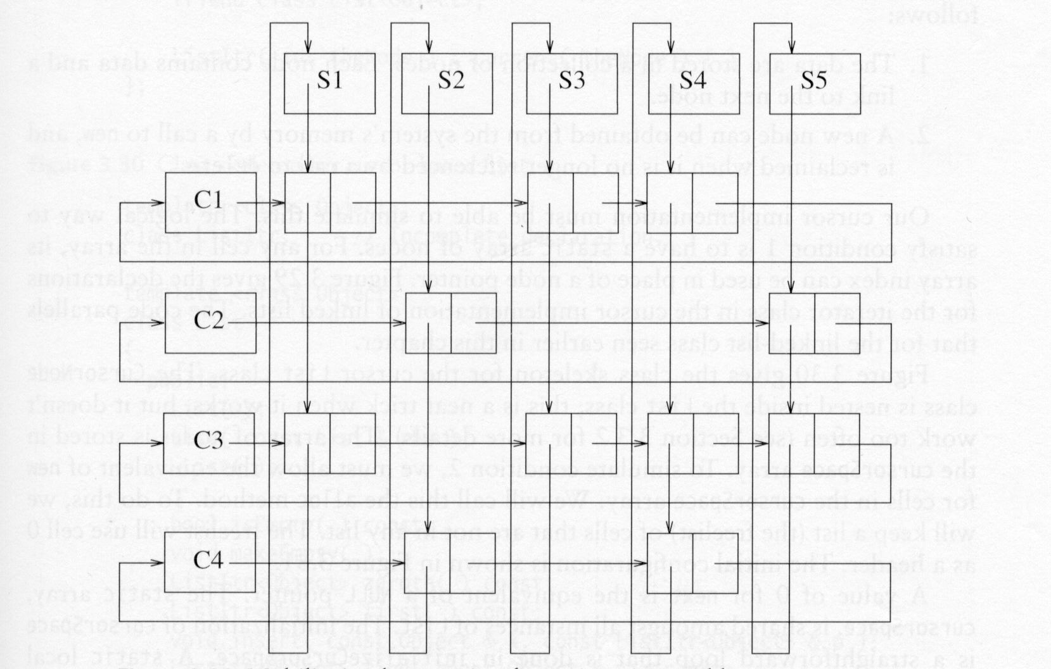
Multilists
A university with 40,000 students and 2,500 courses needs to be able to generate two types of reports.
Lists the registration for each class
Lists the classes that each student is registered for
Using a two-dimensional
array is not a good idea.
such an array would have
100 million entries, and
most entries are empty.
For each class, there is a list
containing the students in
the class.
For each student, there is a
list containing the classes
the student is registered for.

Slide 23
All lists use a header and are circular.
To list all of the students in class C3, we start at C3 and traverse its list (by going right). The first cell belongs to student S1. This can be determined by following the student’s linked list until the header is reached. Then return to C3’s list and find another cell, and so on.
In a similar way, we can list all classes that a student is registered for.
Each of the (nonheader) cell could have links directly back to the
student and class header. This would double the space requirement
but would simplify and speed the implementation.

Slide 24
The Stack ADT
A stack is a list with the restriction that insertions and deletions can be performed in only one position, that is the end of the list, called the top.
Fundamental operations
push: insert an element to the top of the stack.
pop: deletes the most recently inserted element.
top: reads the most recently inserted element.
A pop or top on an empty stack is generally considered an error in the stack ADT.
But running out of space when performing a push is an implementation limit but not an ADT error.
Stacks are sometimes known as LIFO (last in, first out) lists.
push
pop

Slide 25
Implementation of stacks
Linked list implementation of stacks.
Array implementation of stacks
Associated with each stack is theArray and topOfStack, which is –1 for an empty stack. To push some element x onto the stack, we increment topOfStack and then set theArray[topOfStack] = x. To pop, we set the return value to theArray[topOfStack] and then decrement of topOfStack.
template <class Object>
class Stack
{
public:
………
private:
vector<Object> theArray;
int topOfStack;
};

Slide 26
The Queue ADT
Queues are lists with insertion done at one end, whereas deletion performed at the other end. Maintain two positions: Front and Back.
Dequeue: advance Front. (Same as pop).
Enqueue: add at the end of queue, adjust Back.
Front
Back
A
B
C
D
Front
Back
A
B
C
D
Front
Back
A
B
C
D
X

Slide 27
Infix Expressions
Example: 1 + 2 * ( 3 + 4 )
Operands appear both before and after operator.
When there are several operators, precedence and associativity determine how operators are processed.

Slide 28
Precedence and Associativity
Precedence: used to decide which of two operators should be processed.
Exponentiation
Multiplication/Division
Addition/Subtraction
Associativity: used to decide which of two operators should be processed when both operators have same precedence.
Exponentiation: Right to Left
Multiplication/Division: Left to Right
Addition/Subtraction: Left to Right

Slide 29
Examples
4-4-4 evaluates to -4
2^2^3 evaluates to 256 (exponentiation)
Parenthesis override precedence and associativity.

Slide 30
Difficulty of Infix Evaluation
Infix evaluation is difficult because of precedence rules: when an operator is seen, it may or may not need to be deferred.
2 + 3 – 4
2 – 4 / 5
Even if operator needs to be used, the second operand has still not been processed.
1 + 2 * …
Alternate form is the postfix expression.

Slide 31
Postfix Expression
A postfix expression is a series of operators and operands. The operands are always known when an operator is about to be processed. A postfix expression requires no knowledge of precedence or associativity.
Example of a postfix expression:
1 2 3 * +
Use a stack to evaluate a postfix expression.

Slide 32
Postfix Machine
When an operand is seen it is pushed onto a stack.
When an operator is seen the operands are popped, the operators is evaluated, and the result is pushed onto the stack. We assume binary operators.
For binary operators, first popped item is second operand (matters for subtraction).

Slide 33
Postfix Example
1 2 3 * +
Push 1, Push 2, Push 3.
When * is seen, Pop 3, Pop 2, evaluate 2 * 3, and Push the result 6.
When + is seen, Pop 6, Pop 1, evaluate 1 + 6, and Push the result 7.
At end of expression, stack should have one item, which is the answer.

Slide 34
Postfix Example, Continued
1 2 3 * +
3
2
2
6
1
1
1
1
7
Push 1
Push 2
Push 3
Pop 3
Pop 6
Pop 2
Pop 1
Push 6
Push 7

Slide 35
Infix to Postfix Conversion
Converts infix expression to postfix expression, which is then easily evaluated.
Basic algorithm is operator precedence parsing.
When an operand is seen, it is immediately output.
What happens when an operator is seen?

Slide 36
Infix Operators
When an operator is seen it can never be output immediately, because the second operand has not been seen yet.
Therefore, operator must be saved, and eventually will be output.
A stack is used to store operators that have been seen but not yet output.

Slide 37
Operator Stack
In expression such as 1+2*3^4+5, postfix expression is 1 2 3 4 ^ * + 5 +.
In expression such as 1*2+3^4+5, postfix expression is 1 2 * 3 4 ^ + 5 +.
In both cases, when the second operator is about to be processed, we have output 1 2, and there is one operator on the stack. The question is: How operators exit the stack?
2
1
2
1
+
*
*
+
1+2*3^4+5
1*2+3^4+5

Slide 38
Exiting the Operator Stack
An operator exits the stack if the precedence and associativity rules indicate that it should be processed instead of the current operator.
Basic rule: If current operator has a lower precedence than the operator on the top of the stack, then the top of stack operator exits the stack.
*
2
1
2
1
*
+
2
1
2
1
+
*
^
*
+
+
^
1+2*3^4+5
1+2*3^4+5
1*2+3^4+5
1*2+3^4+5

Slide 39
Equal precedence
Associativity rules decide what to do if current operator has same precedence as operator on the top of stack.
If operators are left associative, stack operator is popped
4-4-4 => 4 4 - 4 -
If operator are right associative, stack operator is not popped.
2^2^3 => 2 2 3 ^ ^
-
4
4
4
4
2
2
2
2
^
^
-
-
-
^
^
4-4-4
4-4-4
2^2^3
2^2^3

Slide 40
Multiple Stack Exits
In expression such as 1+2*3^4+5, with postfix equivalent
1 2 3 4 ^ * + 5 +
when second + is seen, ^ * + are all popped.
Thus, several exits can occur on one symbol.
4
3
2
1
^
*
+
+

Slide 41
Parentheses
Left parenthesis is a high precedence operator when it is an input symbol (meaning that nothing comes off the operator stack). Left parenthesis is a low precedence operator when it is on the stack.
Right parenthesis pops the operator stack until a left parenthesis exits the stack. Operators are written, but parentheses are not.

Slide 42
Algorithm Summary
Operands: Immediately output.
Right parenthesis: Pop stack symbols until an left parenthesis is seen.
Operator: Pop all stack operators until we see an operator of lower precedence, or a right-associative operator of equal precedence. Then push the operator.
End of input: Pop all remaining operators.

Slide 43
Infix to Postfix Example
Infix: 1-2^3^3-(4+5*6)*7
Postfix: 1 2 3 3 ^ ^ - 4 5 6 * + 7 * -
^
1
2
^
^
3
^
-
-
-
-
-
1
-
2
^
3
^
^
+
+
^
3
^^-
(
(
4
(
(
5
-
-
-
-
-
-
3
-
(
4
+
5
*
*
+
+
(
(
6
*+
*
*
7
*-
-
-
-
-
-
*
6
)
*
7

