Slide 1
CSCI 4333 Database Design and Implementation
Review for Midterm Exam I
Xiang Lian
The University of Texas Rio Grande Valley
Edinburg, TX 78539
xiang.lian@utrgv.edu

Slide 2
Review
Chapters 1 ~ 5 in your textbook
Lecture slides
In-class exercises
Assignments
Projects

Slide 3
Review (cont'd)
Question Types
  Q/A
    Basic concepts of databases
    E-R diagrams
    Relational algebra
    SQL
5 Questions (100 points) + 1 Bonus Question (20 extra points)

Slide 4
Chapter 1 Overview of Databases and Transaction Processing
Database
Database Management System (DBMS)
Transaction Processing System

Slide 5
What is a Database?
Collection of data central to some enterprise
Essential to operation of enterprise
  Contains the only record of enterprise activity
An asset in its own right
  Historical data can guide enterprise strategy
  Of interest to other enterprises
State of database mirrors state of enterprise
  Database is persistent

Slide 6
What is a Database Management System?
A Database Management System (DBMS) is a program that manages a database:
  Supports a high-level access language (e.g. SQL).
  Application describes database accesses using that language.
  DBMS interprets statements of language to perform requested database access.

Slide 7
What is a Transaction Processing System?
Transaction execution is controlled by a TP monitor
  Creates the abstraction of a transaction, analogous to the way an operating system creates the abstraction of a process
  TP monitor and DBMS together guarantee the special properties of transactions
A Transaction Processing System consists of TP monitor, databases, and transactions

Slide 8
Chapter 2 The Big Picture
Database models
Relational tables
Operations
  Insertion, deletion, update
  Union, join Cartesian product
SQL
Properties of Transactions

Slide 9
Database Models
Hierarchical Model.
Network Model.
Relational Model.
Object/Relational Model.
Object-Oriented Model.
Semistructured Model.
Associative Model, EAV Model, Context Model, Concept-oriented Model, Multi-dimensional Model, Star Schema Model, etc.

Slide 10
Table
Set of rows (no duplicates)
Each row describes a different entity
Each column states a particular fact about each entity
  Each column has an associated domain
    Domain of Status = {fresh, soph, junior, senior}
Id Name Address Status
1111 John 123 Main fresh
2222 Mary 321 Oak soph
1234 Bob 444 Pine soph
9999 Joan 777 Grand senior

Slide 11
Operations
Operations on relations are precisely defined
  Take relation(s) as argument, produce new relation as result
  Unary (e.g., delete certain rows)
  Binary (e.g., union, Cartesian product)
Corresponding operations defined on tables as well
Using mathematical properties, equivalence can be decided
  Important for query optimization:
?
op1(T1,op2(T2)) = op3(op2(T1),T2)

Slide 12
Structured Query Language (SQL)
SELECT <attribute list>
FROM <table list >
WHERE <condition>
Language for constructing a new table from argument table(s).
  FROM indicates source tables
  WHERE indicates which rows to retain
    It acts as a filter
  SELECT indicates which columns to extract from retained rows
    Projection
The result is a table.

Slide 13
Transactions
Transactions are not just ordinary programs
Additional requirements are placed on transactions (and particularly their execution environment) that go beyond the requirements placed on ordinary programs.
  Atomicity
  Consistency
  Isolation
  Durability
  (explained next)
ACID properties

Slide 14
Chapter 3 Relational Data Model
3 levels of database schema
Integrity constraints
  Primary key, foreign key, inclusion property
SQL
  Declaration of tables
  NULL values
  Default values
  Constraints
    CHECK, Assertion, Domain, Foreign key constraints, Triggers
    Handling foreign key violations upon deletion and updates
  Creation of views

Slide 15
Levels of Abstraction
payroll
billing
records
View 1
View 2
View 3
External
schemas
Conceptual schema
Physical schema

Slide 16
Data Model
Model: tools and language for describing:
  Conceptual and external schema
    Data definition language (DDL)
  Integrity constraints, domains (DDL)
  Operations on data
    Data manipulation language (DML)
  Directives that influence the physical schema (affects performance, not semantics)
    Storage definition language (SDL)

Slide 17
Key Constraint
A key constraint is a sequence of attributes A₁,…,A_{n} (n=1 possible) of a relation schema, S, with the following property:
  A relation instance s of S satisfies the key constraint iff at most one row in s can contain a particular set of values, a₁,…,a_{n}, for the attributes A₁,…,A_{n}
  Minimality: no subset of A₁,…,A_{n} is a key constraint
Key
  Set of attributes mentioned in a key constraint
    e.g., Id in Student,
    e.g., (StudId, CrsCode, Semester) in Transcript
  It is minimal: no subset of a key is a key
    (Id, Name) is not a key of Student

Slide 18
Foreign Key Constraint (Example)
A₂
v3
v5
v1
v6
v2
v7
v4
A₁
v1
v2
v3
v4
null
v3
R1
R2
Foreign key
(or key reference)
Candidate key

Slide 19
Inclusion Dependency
Referential integrity constraint that is not a foreign key constraint
Teaching(CrsCode, Semester) references Transcript(CrsCode, Semester)
(no empty classes allowed)
Target attributes do not form a candidate key in Transcript (StudId missing)
No simple enforcement mechanism for inclusion dependencies in SQL (requires assertions -- later)

Slide 20
Table Declaration
CREATE TABLE Student (
Id INTEGER,
Name VARCHAR(20),
Address VARCHAR(50),
Status VARCHAR(10)
);
Oracle Datatypes:
http://www.ss64.com/orasyntax/datatypes.html
INSERT INTO Student (Id, Name, Address, Status)
VALUES (10122233, 'John', '10 Cedar St', 'Freshman');
INSERT INTO Student
VALUES (234567890, ‘Mary', ’22 Main St', ‘Sophmore');

Slide 21
Primary/Candidate Keys
CREATE TABLE Course (
CrsCode CHAR(6),
CrsName CHAR(20),
DeptId CHAR(4),
Descr CHAR(100),
PRIMARY KEY (CrsCode),
UNIQUE (DeptId, CrsName) -- candidate key
)
Comments start with 2 dashes

Slide 22
Null
Problem: Not all information might be known when row is inserted (e.g., Grade might be missing from Transcript)
A column might not be applicable for a particular row (e.g., MaidenName if row describes a male)
Solution: Use place holder – null
  Not a value of any domain (although called null value)
    Indicates the absence of a value
  Not allowed in certain situations
    Primary keys and columns constrained by NOT NULL

Slide 23
Default Value
Value to be assigned if attribute value in a row
is not specified
CREATE TABLE Student (
Id INTEGER,
Name CHAR(20) NOT NULL,
Address CHAR(50),
Status CHAR(10) DEFAULT ‘freshman’,
PRIMARY KEY (Id) )

Slide 24
Semantic Constraints (cont’d)
Used for application dependent conditions
Example: limit attribute values
Each row in table must satisfy condition
CREATE TABLE Transcript (
StudId INTEGER,
CrsCode CHAR(6),
Semester CHAR(6),
Grade CHAR(1),
CHECK (Grade IN (‘A’, ‘B’, ‘C’, ‘D’, ‘F’)),
CHECK (StudId > 0 AND StudId < 1000000000) )

Slide 25
Assertion
Element of database schema (like table)
Symmetrically specifies an inter-relational constraint
Applies to entire database (not just the individual rows of a single table)
  hence it works even if Employee is empty
CREATE ASSERTION DontFireEveryone
CHECK (0 < SELECT COUNT (*) FROM Employee)

Slide 26
Domains
Possible attribute values can be specified
  Using a CHECK constraint or
  Creating a new domain
Domain can be used in several declarations
Domain is a schema element
CREATE DOMAIN Grades CHAR (1)
CHECK (VALUE IN (‘A’, ‘B’, ‘C’, ‘D’, ‘F’))
CREATE TABLE Transcript (
….,
Grade: Grades,
… )

Slide 27
Foreign Key Constraint
CREATE TABLE Teaching (
ProfId INTEGER,
CrsCode CHAR (6),
Semester CHAR (6),
PRIMARY KEY (CrsCode, Semester),
FOREIGN KEY (CrsCode) REFERENCES Course,
FOREIGN KEY (ProfId) REFERENCES Professor (Id) )

Slide 28
Triggers
A more general mechanism for handling events
  Not in SQL-92, but is in SQL:1999
Trigger is a schema element (like table, assertion, …)
CREATE TRIGGER CrsChange
AFTER UPDATE OF CrsCode, Semester ON Transcript
WHEN (Grade IS NOT NULL)
ROLLBACK

Slide 29
Views
Schema element
Part of external schema
A virtual table constructed from actual tables on the fly
  Can be accessed in queries like any other table
  Not materialized, constructed when accessed
  Similar to a subroutine in ordinary programming

Slide 30
Chapter 4 Database Design I: The Entity-Relationship Model
Entity
  Entity type
Relationship
  Attributes and roles
  Relationship type
Entity type hierarchy
  IsA relationship
ER-diagram
  Integrity constraints

Slide 31
Entities
Entity: an object that is involved in the enterprise
  Ex: John, CSCI4333
Entity Type: set of similar objects
  Ex: students, courses
Attribute: describes one aspect of an entity type
  Ex: name, maximum enrollment

Slide 32
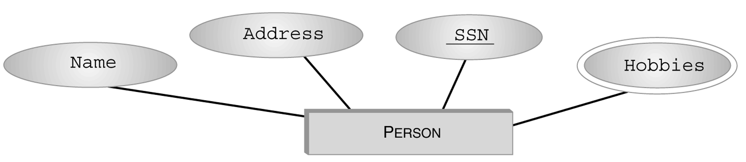
Entity Type (con’t)
Graphical Representation in E-R diagram:
Set valued

Slide 33
Relationships
Relationship: relates two or more entities
  John majors in Computer Science
Relationship Type: set of similar relationships
  Student (entity type) related to Department (entity type) by MajorsIn (relationship type).
Distinction:
  relation (relational model) - set of tuples
  relationship (E-R Model) – describes relationship between entities of an enterprise
  Both entity types and relationship types (E-R model) may be represented as relations (in the relational model)

Slide 34
Attributes and Roles
Attribute of a relationship type describes the relationship
  e.g., John majors in CS since 2000
    John and CS are related
    2000 describes relationship - value of SINCE attribute of MajorsIn relationship type
Role of a relationship type names one of the related entities
  e.g., John is value of Student role, CS value of Department role of MajorsIn relationship type
  (John, CS; 2000) describes a relationship

Slide 35
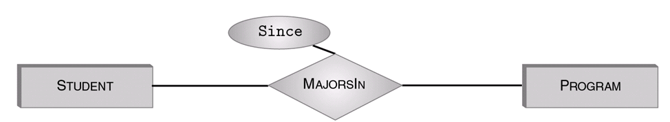
Relationship Type
Described by set of attributes and roles
  e.g., MajorsIn: Student, Department, Since
  Here we have used as the role name (Student) the name of the entity type (Student) of the participant in the relationship, but ...

Slide 36
IsA
Student
Represents 4
relationship types
IsA
Freshman
Sophmore
Junior
Senior

Slide 37
Single-role Key Constraint
If, for a particular participant entity type, each entity participates in at most one relationship, corresponding role is a key of relationship type
  E.g., Professor role is unique in WorksIn
Representation in E-R diagram: arrow
Professor
WorksIn
Department

Slide 38
Participation Constraint
If every entity participates in at least one relationship, a participation constraint holds:
  A participation constraint of entity type E having role ρ in relationship type R states that for e in E there is an r in R such that ρ(r) = e.
  e.g., every professor works in at least one department
Reprsentation in E-R
Professor
WorksIn
Department

Slide 39
Participation and Key Constraint
If every entity participates in exactly one relationship, both a participation and a key constraint hold:
  e.g., every professor works in exactly one department
E-R representation: thick line
Professor
WorksIn
Department

Slide 40
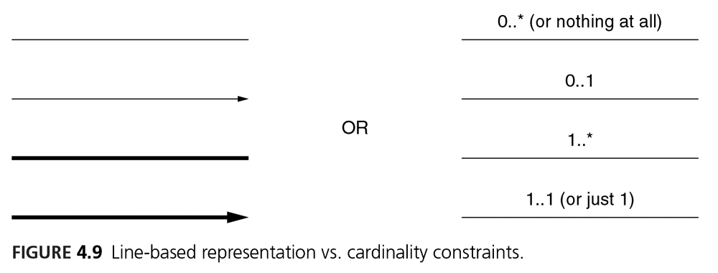
Cardinality Constraints

Slide 41
Chapter 5 Relational Algebra and SQL
Relational algebra
  Select, project, set operators, union, cartesian product, (natural) join, division
SQL
  SQL for operators above
  Aggregates
  Group by … Having
  Order by

Slide 42
Select Operator
Produce table containing subset of rows of argument table satisfying condition
σ_{condition} (relation)
Example:
Person σ_{Hobby=‘stamps’}(Person)
Id Name Address Hobby
Id Name Address Hobby
1123 John 123 Main stamps
1123 John 123 Main coins
5556 Mary 7 Lake Dr hiking
9876 Bart 5 Pine St stamps
1123 John 123 Main stamps
9876 Bart 5 Pine St stamps

Slide 43
Project Operator
Produces table containing subset of columns of argument table
  π_{attribute list}(relation)
Example:
  Person π_{Name,Hobby}(Person)
Id Name Address Hobby Name Hobby
1123 John 123 Main stamps
1123 John 123 Main coins
5556 Mary 7 Lake Dr hiking
9876 Bart 5 Pine St stamps
John stamps
John coins
Mary hiking
Bart stamps

Slide 44
Set Operators
Relation is a set of tuples, so set operations should apply: ∩, ∪, − (set difference)
Result of combining two relations with a set operator is a relation => all its elements must be tuples having same structure
Hence, scope of set operations limited to union compatible relations

Slide 45
Union Compatible Relations
Two relations are union compatible if
  Both have same number of columns
  Names of attributes are the same in both
  Attributes with the same name in both relations have the same domain
Union compatible relations can be combined using union, intersection, and set difference

Slide 46
Cartesian Product
If R and S are two relations, R × S is the set of all concatenated tuples <x,y>, where x is a tuple in R and y is a tuple in S
  R and S need not be union compatible
R × S is expensive to compute:
  Factor of two in the size of each row
  Quadratic in the number of rows
A B C D A B C D
x1 x2 y1 y2 x1 x2 y1 y2
x3 x4 y3 y4 x1 x2 y3 y4
x3 x4 y1 y2
R S x3 x4 y3 y4
R× S

Slide 47
Derived Operation: Join
A (general or theta) join of R and S is the expression
R _{join-condition} S
where join-condition is a conjunction of terms:
A_{i} oper B_{i}
in which A_{i} is an attribute of R; B_{i} is an attribute of S; and oper is one of =, <, >, ≥ ≠, ≤.
The meaning is:
σ _{join-condition´} (R × S)
where join-condition and join-condition´ are the same, except for possible renamings of attributes (next)

Slide 48
Natural Join
Special case of equijoin:
  join condition equates all and only those attributes with the same name (condition doesn’t have to be explicitly stated)
  duplicate columns eliminated from the result
Transcript (StudId, CrsCode, Sem, Grade)
Teaching (ProfId, CrsCode, Sem)
Transcript
Teaching =
πStudId, Transcript.CrsCode, Transcript.Sem, Grade, ProfId
( Transcript
_{CrsCode=CrsCode AND Sem=Sem} Teaching )
[StudId, CrsCode, Sem, Grade, ProfId ]

Slide 49
Division
Goal: Produce the tuples in one relation, r, that match all tuples in another relation, s
  r (A₁, …A_{n}, B₁, …B_{m})
  s (B₁ …B_{m})
  r/s, with attributes A₁, …A_{n}, is the set of all tuples <a> such that for every tuple <b> in s, <a,b> is in r
Can be expressed in terms of projection, set difference, and cross-product

Slide 50
Set Operators
SQL provides UNION, EXCEPT (set difference), and INTERSECT for union compatible tables
Example: Find all professors in the CS Department and all professors that have taught CS courses
(SELECT P.Name
FROM Professor P, Teaching T
WHERE P.Id=T.ProfId AND T.CrsCode LIKE ‘CS%’)
UNION
(SELECT P.Name
FROM Professor P
WHERE P.DeptId = ‘CS’)

Slide 51
Division in SQL
Query type: Find the subset of items in one set that are related to all items in another set
Example: Find professors who taught courses in all departments
  Why does this involve division?
ProfId DeptId
DeptId
Contains row
<p,d> if professor
p taught a
course in
department d
All department Ids
π_{ProfId,DeptId}(Teaching Course) / π_{DeptId}(Department)

Slide 52
Aggregates
Functions that operate on sets:
  COUNT, SUM, AVG, MAX, MIN
Produce numbers (not tables)
Not part of relational algebra (but not hard to add)
SELECT COUNT(*)
FROM Professor P
SELECT MAX (Salary)
FROM Employee E

Slide 53
Grouping
But how do we compute the number of courses taught in S2000 per professor?
  Strategy 1: Fire off a separate query for each professor:
SELECT COUNT(T.CrsCode)
FROM Teaching T
WHERE T.Semester = ‘S2000’ AND T.ProfId = 123456789
    Cumbersome
    What if the number of professors changes? Add another query?
  Strategy 2: define a special grouping operator:
SELECT T.ProfId, COUNT(T.CrsCode)
FROM Teaching T
WHERE T.Semester = ‘S2000’
GROUP BY T.ProfId

Slide 54
HAVING Clause
Eliminates unwanted groups (analogous to WHERE clause, but works on groups instead of individual tuples)
HAVING condition is constructed from attributes of GROUP BY list and aggregates on attributes not in that list
SELECT T.StudId,
AVG(T.Grade) AS CumGpa,
COUNT (*) AS NumCrs
FROM Transcript T
WHERE T.CrsCode LIKE ‘CS%’
GROUP BY T.StudId
HAVING AVG (T.Grade) > 3.5

Slide 55
ORDER BY Clause
Causes rows to be output in a specified order
SELECT T.StudId, COUNT (*) AS NumCrs,
AVG(T.Grade) AS CumGpa
FROM Transcript T
WHERE T.CrsCode LIKE ‘CS%’
GROUP BY T.StudId
HAVING AVG (T.Grade) > 3.5
ORDER BY DESC CumGpa, ASC StudId
Descending
Ascending

