Slide 1
CSCI 4333 Database Design and Implementation
Review for Final Exam
Xiang Lian
The University of Texas – Pan American
Edinburg, TX 78539
lianx@utpa.edu

Slide 2
Review
Chapters 5, 6, 9, and 10 in your textbook
Lecture slides
In-class exercises
Assignments
Projects

Slide 3
Review (cont'd)
Question Types
  Q/A
    Relational algebra & SQL
    Normalization theory
      attribute closure, lossless decomposition, dependency preserving
    Physical data organization & indexing
      Heap file, sorted file, (un)clustered index, B⁺-tree, hash index
    Query Processing
5 Questions (100 points) + 1 Bonus Question (20 extra points)

Slide 4
Time, Location, and Event
Time
  8am - 9:45am, Dec. 11 (Thursday)
  Note: starting time: 8am, different from class time!
Place
  ACSB 1.104 (classroom)
Event
  Closed-book exam

Slide 5
Chapter 5 Relational Algebra and SQL
Relational algebra
  Select, project, set operators, union, cartesian product, (natural) join, division
SQL
  SQL for operators above
  Aggregates
  Group by … Having
  Order by

Slide 6
Select Operator
Produce table containing subset of rows of argument table satisfying condition
σ_{condition} (relation)
Example:
Person σ_{Hobby=‘stamps’}(Person)
Id Name Address Hobby
Id Name Address Hobby
1123 John 123 Main stamps
1123 John 123 Main coins
5556 Mary 7 Lake Dr hiking
9876 Bart 5 Pine St stamps
1123 John 123 Main stamps
9876 Bart 5 Pine St stamps

Slide 7
Project Operator
Produces table containing subset of columns of argument table
  π_{attribute list}(relation)
Example:
  Person π_{Name,Hobby}(Person)
Id Name Address Hobby Name Hobby
1123 John 123 Main stamps
1123 John 123 Main coins
5556 Mary 7 Lake Dr hiking
9876 Bart 5 Pine St stamps
John stamps
John coins
Mary hiking
Bart stamps

Slide 8
Set Operators
Relation is a set of tuples, so set operations should apply: ∩, ∪, − (set difference)
Result of combining two relations with a set operator is a relation => all its elements must be tuples having same structure
Hence, scope of set operations limited to union compatible relations

Slide 9
Union Compatible Relations
Two relations are union compatible if
  Both have same number of columns
  Names of attributes are the same in both
  Attributes with the same name in both relations have the same domain
Union compatible relations can be combined using union, intersection, and set difference

Slide 10
Cartesian Product
If R and S are two relations, R × S is the set of all concatenated tuples <x,y>, where x is a tuple in R and y is a tuple in S
  R and S need not be union compatible
R × S is expensive to compute:
  Factor of two in the size of each row
  Quadratic in the number of rows
A B C D A B C D
x1 x2 y1 y2 x1 x2 y1 y2
x3 x4 y3 y4 x1 x2 y3 y4
x3 x4 y1 y2
R S x3 x4 y3 y4
R× S

Slide 11
Derived Operation: Join
A (general or theta) join of R and S is the expression
R _{join-condition} S
where join-condition is a conjunction of terms:
A_{i} oper B_{i}
in which A_{i} is an attribute of R; B_{i} is an attribute of S; and oper is one of =, <, >, ≥ ≠, ≤.
The meaning is:
σ _{join-condition´} (R × S)
where join-condition and join-condition´ are the same, except for possible renamings of attributes (next)

Slide 12
Natural Join
Special case of equijoin:
  join condition equates all and only those attributes with the same name (condition doesn’t have to be explicitly stated)
  duplicate columns eliminated from the result
Transcript (StudId, CrsCode, Sem, Grade)
Teaching (ProfId, CrsCode, Sem)
Transcript
Teaching =
πStudId, Transcript.CrsCode, Transcript.Sem, Grade, ProfId
( Transcript
_{CrsCode=CrsCode AND Sem=Sem} Teaching )
[StudId, CrsCode, Sem, Grade, ProfId ]

Slide 13
Set Operators
SQL provides UNION, EXCEPT (set difference), and INTERSECT for union compatible tables
Example: Find all professors in the CS Department and all professors that have taught CS courses
(SELECT P.Name
FROM Professor P, Teaching T
WHERE P.Id=T.ProfId AND T.CrsCode LIKE ‘CS%’)
UNION
(SELECT P.Name
FROM Professor P
WHERE P.DeptId = ‘CS’)

Slide 14
Chapter 6 Relational Normalization Theory
Normalization theory
  Functional dependencies
  Attribute closure
  Lossless decomposition
    Conditions? R = R₁ R₂ … R_{n}
  Dependency preserving
    Conditions? F⁺ = (F1 ∪ F2 ∪ ... ∪ F_{n})⁺

Slide 15
Functional Dependencies
Definition: A functional dependency (FD) on a relation schema R is a constraint of the form
X → Y, where X and Y are subsets of attributes of R.
Definition: An FD X → Y is satisfied in an instance r of R if for every pair of tuples, t and s: if t and s agree on all attributes in X then they must agree on all attributes in Y
  Key constraint is a special kind of functional dependency: all attributes of relation occur on the right-hand side of the FD:
    SSN → SSN, Name, Address

Slide 16
Armstrong’s Axioms for FDs
This is the syntactic way of computing/testing the various properties of FDs
Reflexivity: If Y ⊆ X then X → Y (trivial FD)
  Name, Address → Name
Augmentation: If X → Y then X Z→ YZ
  If Town → Zip then Town, Name → Zip, Name
Transitivity: If X → Y and Y → Z then X → Z

Slide 17
Computation of Attribute Closure X⁺_{F}
closure := X; // since X ⊆ X⁺_{F}
repeat
old := closure;
if there is an FD Z → V in F such that
Z ⊆ closure and V ⊆ closure
then closure := closure ∪ V
until old = closure
– If T ⊆ closure then X → T is entailed by F

Slide 18
Example: Computation of Attribute Closure
Problem: Compute the attribute closure of AB with
respect to the set of FDs :
AB → C (a)
A → D (b)
D → E (c)
AC → B (d)
Solution:
Initially closure = {AB}
Using (a) closure = {ABC}
Using (b) closure = {ABCD}
Using (c) closure = {ABCDE}

Slide 19
Lossless Schema Decomposition
A decomposition should not lose information
A decomposition (R₁,…,R_{n}) of a schema, R, is lossless if every valid instance, r, of R can be reconstructed from its components:
where each r_{i} = π_{Ri}(r)
r = r₁
r₂
……
r_{n}

Slide 20
Testing for Losslessness
A (binary) decomposition of R = (R, F) into R₁ = (R₁, F₁) and R₂ = (R₂, F₂) is lossless if and only if :
  either the FD
    (R₁ ∩ R₂ ) → R₁ is in F⁺
  or the FD
    (R₁ ∩ R₂ ) → R₂ is in F⁺

Slide 21
Dependency Preservation
Consider a decomposition of R = (R, F) into R₁ = (R₁, F₁) and R₂ = (R₂, F₂)
  An FD X → Y of F⁺ is in F_{i} iff X ∪ Y ⊆ R_{i}
  An FD, f ∈F⁺ may be in neither F₁, nor F₂, nor even (F₁ ∪ F₂)⁺
    Checking that f is true in r₁ or r₂ is (relatively) easy
    Checking f in r₁ r₂ is harder – requires a join
    Ideally: want to check FDs locally, in r₁ and r₂, and have a guarantee that every f ∈F holds in r₁ r₂
The decomposition is dependency preserving iff the sets F and F₁ ∪ F₂ are equivalent: F⁺ = (F₁ ∪ F₂)⁺
  Then checking all FDs in F, as r₁ and r₂ are updated, can be done by checking F₁ in r₁ and F₂ in r₂

Slide 22
Chapter 8 Physical Data Organization and Indexing
Heap file
Sorted file
Integrated file containing index and rows
  Clustered index vs. unclustered index
  Dense index vs sparse index
  Concrete indices
    ISAM (Index-Sequential Access Method)
      Multilevel index
    B+ tree
    Hash

Slide 23
Chapter 8 Physical Data Organization and Indexing (cont'd)
  Clustered index vs. unclustered index
  What are clustered and unclustered indices?
  I/O cost of accessing data files and indices
B⁺-tree index
  How to handle insertion?
    If the leaf node is full, split nodes, re-distribute tuples, promote the index entry to the index node
Hash index
  Extendable hash index

Slide 24
Heap Files
Rows appended to end of file as they are inserted
  Hence the file is unordered
Deleted rows create gaps in file
  File must be periodically compacted to recover space

Slide 25
Transcript Stored as a Heap File
666666 MGT123 F1994 4.0
123456 CS305 S1996 4.0 page 0
987654 CS305 F1995 2.0
717171 CS315 S1997 4.0
666666 EE101 S1998 3.0 page 1
765432 MAT123 S1996 2.0
515151 EE101 F1995 3.0
234567 CS305 S1999 4.0
page 2
878787 MGT123 S1996 3.0

Slide 26
Sorted File
Rows are sorted based on some attribute(s)
  Access path is binary search
  Equality or range query based on that attribute has cost log₂F to retrieve page containing first row
  Successive rows are in same (or successive) page(s) and cache hits are likely
  By storing all pages on the same track, seek time can be minimized
Example – Transcript sorted on StudId :
SELECT T.Course, T.Grade
FROM Transcript T
WHERE T.StudId = 123456
SELECT T.Course, T.Grade
FROM Transcript T
WHERE T.StudId BETWEEN
111111 AND 199999

Slide 27
Transcript Stored as a Sorted File
111111 MGT123 F1994 4.0
111111 CS305 S1996 4.0 page 0
123456 CS305 F1995 2.0
123456 CS315 S1997 4.0
123456 EE101 S1998 3.0 page 1
232323 MAT123 S1996 2.0
234567 EE101 F1995 3.0
234567 CS305 S1999 4.0
page 2
313131 MGT123 S1996 3.0

Slide 28
Index Structure
Contains:
  Index entries
    Can contain the data tuple itself (index and table are integrated in this case); or
    Search key value and a pointer to a row having that value; table stored separately in this case – unintegrated index
  Location mechanism
    Algorithm + data structure for locating an index entry with a given search key value
  Index entries are stored in accordance with the search key value
    Entries with the same search key value are stored together (hash, B- tree)
    Entries may be sorted on search key value (B-tree)

Slide 29
Index Structure
S
Search key
value
Location Mechanism
Location mechanism
facilitates finding
index entry for S
S
Index entries
Once index entry is found, the row can be directly accessed
S, …….

Slide 30
Storage Structure
Structure of file containing a table
  Heap file (no index, not integrated)
  Sorted file (no index, not integrated)
  Integrated file containing index and rows (index entries contain rows in this case)
    ISAM (Index-Sequential Access Method)
      Multilevel index
    B⁺ tree
    Hash

Slide 31
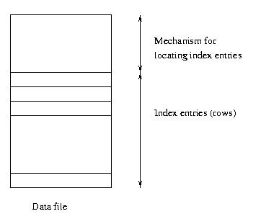
Clustered Main Index
Storage structure
contains table
and (main) index;
rows are contained
in index entries

Slide 32
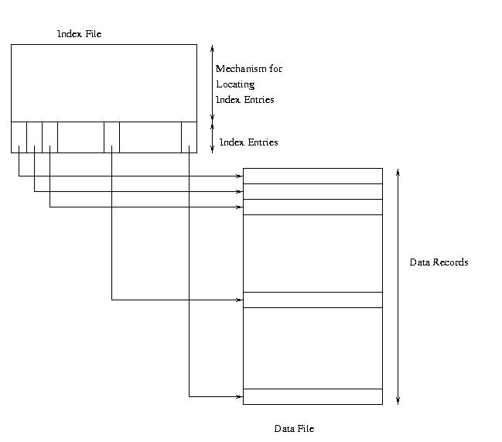
Clustered Secondary Index

Slide 33
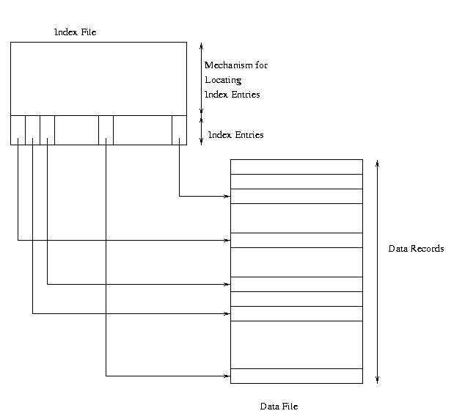
Unclustered Secondary Index

Slide 34
Example – Cost of Range Search
Data file has 10,000 pages, 100 rows in search range
Page transfers for table rows (assume 20 rows/page):
  Heap: 10,000 (entire file must be scanned)
  File sorted on search key: log₂ 10000 + (5 or 6) ≈ 19
  Unclustered index: ≤ 100
  Clustered index: 5 or 6
Page transfers for index entries (assume 200 entries/page)
  Heap and sorted: 0
  Unclustered secondary index: 1 or 2 (all index entries for the rows in the range must be read)
  Clustered secondary index: 1 (only first entry must be read)

Slide 35
Sparse vs. Dense Index
Dense index: has index entry for each data record
  Unclustered index must be dense
  Clustered index need not be dense
Sparse index: has index entry for each page of data file

Slide 36
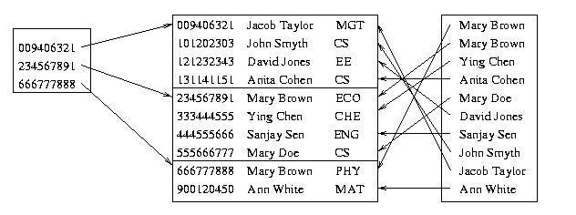
Sparse Vs. Dense Index
Id Name Dept
Sparse,
clustered
index sorted
on Id
Data file sorted on Id
Dense,
unclustered
index sorted
on Name

Slide 37
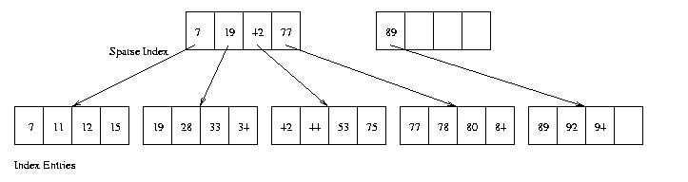
Two-Level Index
– Separator level is a sparse index over pages of index entries
– Leaf level contains index entries
– Cost of searching the separator level << cost of searching index level
since separator level is sparse
– Cost or retrieving row once index entry is found is 0 (if integrated) or 1 (if not)

Slide 38
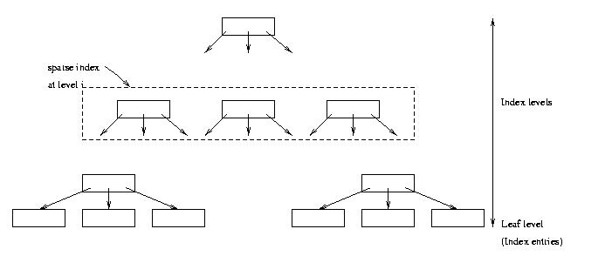
Multilevel Index
– Search cost = number of levels in tree
– If Φ is the fanout of a separator page, cost is log_{Φ} Q + 1
– Example: if Φ = 100 and Q = 10,000, cost = 3
(reduced to 2 if root is kept in main memory)

Slide 39
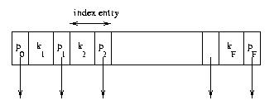
Index Sequential Access Method (ISAM)
Generally an integrated storage structure
  Clustered, index entries contain rows
Separator entry = (k_{i} , p_{i}); k_{i} is a search key value; p_{i} is a pointer to a lower level page
k_{i} separates set of search key values in the two subtrees pointed at by p_{i-1} and p_{i.}

Slide 40
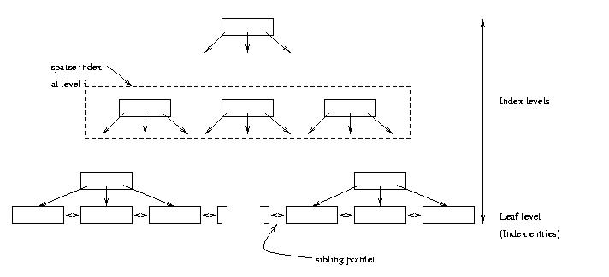
B⁺ Tree Structure
– Leaf level is a (sorted) linked list of index entries
– Sibling pointers support range searches in spite of
allocation and deallocation of leaf pages (but leaf
pages might not be physically contiguous on disk)

Slide 41
Insertion and Deletion in B⁺ Tree
Structure of tree changes to handle row insertion and deletion – no overflow chains
Tree remains balanced: all paths from root to index entries have same length
Algorithm guarantees that the number of separator entries in an index page is between Φ/2 and Φ
  Hence the maximum search cost is log_{Φ/2}Q + 1 (with ISAM search cost depends on length of overflow chain)

Slide 42
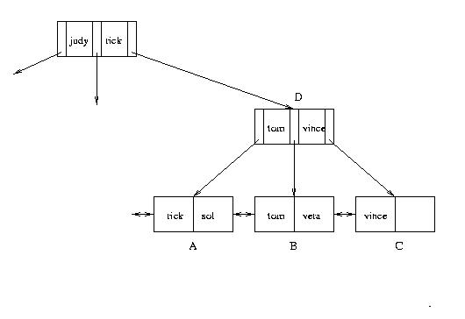
Handling Insertions (cont’d)
– Insert “vera”: Since there is no room in leaf page:
1. Create new leaf page, C
2. Split index entries between B and C (but maintain
sorted order)
3. Add separator entry at parent level

Slide 43
Hash Index
Index entries partitioned into buckets in accordance with a hash function, h(v), where v ranges over search key values
  Each bucket is identified by an address, a
  Bucket at address a contains all index entries with search key v such that h(v) = a
Each bucket is stored in a page (with possible overflow chain)
If index entries contain rows, set of buckets forms an integrated storage structure; else set of buckets forms an (unclustered) secondary index

Slide 44
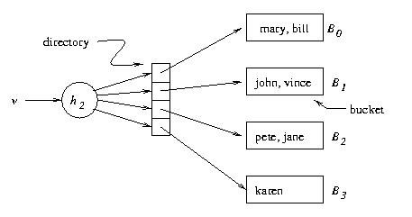
Extendable Hashing – Example
v h(v)
pete 11010
mary 00000
jane 11110
bill 00000
john 01001
vince 10101
karen 10111
Location
mechanism
Extendable hashing uses a directory (level of indirection) to
accommodate family of hash functions
Suppose next action is to insert sol, where h(sol) = 10001.
Problem: This causes overflow in B₁

Slide 45
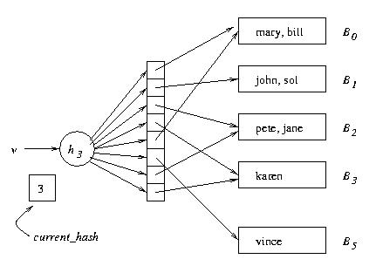
Example (cont’d)
Solution:
1. Switch to h₃
2. Concatenate copy of old
directory to new directory
3. Split overflowed bucket, B,
into B and B′, dividing
entries in B between the
two using h₃
4. Pointer to B in directory
copy replaced by pointer
to B′
Note: Except for B′ , pointers in directory copy refer to original
buckets.
current_hash identifies current hash function.

Slide 46
Chapter 9 Query Processing
External Sorting
Join
  Block-Nested Loop Join*
  Index-Nested Loop Join*
  Sort-Merge Join
  Hash-Join
  Star Join
What are the I/O costs of the sorting/join operations above?

Slide 47
Simple Sort Algorithm
M = number of main memory page buffers
F = number of pages in file to be sorted
Typical algorithm has two phases:
  Partial sort phase: sort M pages at a time; create F/M sorted runs on mass store, cost = 2F
Original file
5 3
2 6
1 10
15 7
20 11
8 4
7 5
Partially sorted file
2 3
5 6
1 7
10 15
4 8
11 20
5 7
run
Example: M = 2, F = 7

Slide 48
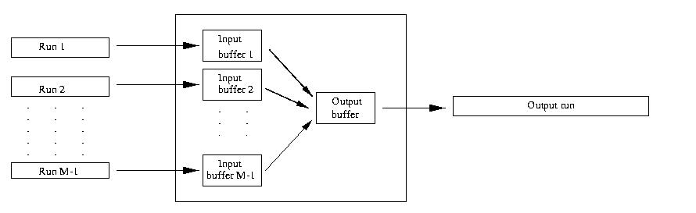
Simple Sort Algorithm
  – Merge Phase: merge all runs into a single run using M-1 buffers for input and 1 output buffer
  • Merge step: divide runs into groups of size M-1 and merge each group into a run; cost = 2F
  each step reduces number of runs by a factor of M-1
Buffer
M pages

Slide 49
Simple Sort Algorithm
Cost of merge phase:
  (F/M)/(M-1)^{k} runs after k merge steps
  ⎡Log _{M-1}(F/M)⎤ merge steps needed to merge an initial set of F/M sorted runs
  cost = ⎡ 2F Log _{M-1}(F/M) ⎤ ≈ 2F(Log _{M-1}F -1)
Total cost = cost of partial sort phase + cost of merge phase ≈ 2F Log _{M-1}F

Slide 50
Computing Joins
The cost of joining two relations makes the choice of a join algorithm crucial
Simple block-nested loops join algorithm for computing r _{A=B} s
foreach page p_{r} in r do
foreach page p_{s} in s do
output p_{r} _{A=B} p_{s}

Slide 51
Block-Nested Loops Join
If β_{r} and β_{s} are the number of pages in r and s, the cost of algorithm is
    β_{r} + β_{r} ∗ β_{s} + cost of outputting final result
  If r and s have 10³ pages each,
  cost is 10³ + 10³ * 10³
  Choose smaller relation for the outer loop:
    If β_{r} < β_{s} then β_{r} + β_{r}∗ β_{s} < β_{s} + β_{r}∗ β_{s}
Number of scans of relation s

Slide 52
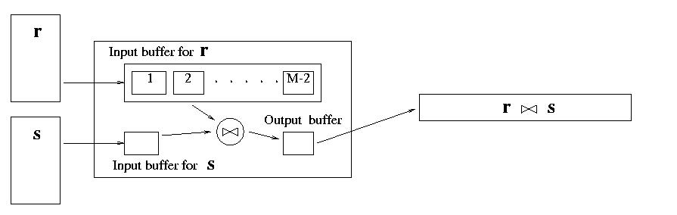
Block-Nested Loops Join
Number of scans of relation s
Cost can be reduced to
β_{r} + (β_{r}/(M-2)) ∗ β_{s} + cost of outputting final result
by using M buffer pages instead of 1.

Slide 53
Block-Nested Loop Illustrated
Input buffer for r
r
r s
s
… and so on
Input buffer for s
Output buffer

Slide 54
Index-Nested Loop Join r _{A=B} s
Use an index on s with search key B (instead of scanning s) to find rows of s that match t_{r}
  Cost = β_{r} + τ_{r} ∗ ω + cost of outputting final result
  Effective if number of rows of s that match tuples in r is small (i.e., ω is small) and index is clustered
  avg cost of retrieving all rows in s that match t_{r}
Number of rows in r
foreach tuple t_{r} in r do {
use index to find all tuples t_{s} in s satisfying t_{r}.A=t_{s}.B;
output (t_{r}, t_{s})
}

Slide 55
Cost of Sort-Merge Join
Cost of sorting assuming M buffers:
2 β_{r} log _{M-1} β_{r} + 2 β_{s} log _{M-1} β_{s}
Cost of merging:
  Scanning σ_{A=c}(r) and σ_{B=c} (s) can be combined with the last step of sorting of r and s --- costs nothing
  Cost of σ_{A=c}(r)×σ_{B=c} (s) depends on whether σ_{A=c}(r) can fit in the buffer
    If yes, this step costs 0
    In no, each σ_{A=c}(r)×σ_{B=c} (s) is computed using block-nested join, so the cost is the cost of the join. (Think why indexed methods or sort-merge are inapplicable to Cartesian product.)
Cost of outputting the final result depends on the size of the result

Slide 56
Good Luck!
Q/A

