Slide 1
Predicting the Length of Hospital Treatment for COVID-19 Patients
Oscar A Alvarez

Slide 2
Context
The COVID-19 pandemic has made a tremendous change in people lifestyles. Due to its highly contagious and, in some cases, lethal characteristics, hospitals and healthcare centers have experience one of the highest demands in history. The number of patients has grown so much to the point where the resources become insufficient, and the needed care that each patient requires it is sometimes not provided. As per today, it is strongly believed that the time of treatment provided to an individual is related to the age and special conditions of the patient. However, due to several exceptions to these rules, assuming that the severity of the disease is just related to these two conditions is highly risky and innacurate. Therefore, a study that includes more variables that could affect the outcome has been done. However, a proper model that can predict how much time of treatment would a patient need have not been defined.

Slide 3
Purpose
To define a proper software tool that can predict the length of stay for each patient entered the healthcare system based on the information provided in Kaggle.com.
This tool should assist healthcare centers to optimize the use of available resources and provide better services to patients.

Slide 4
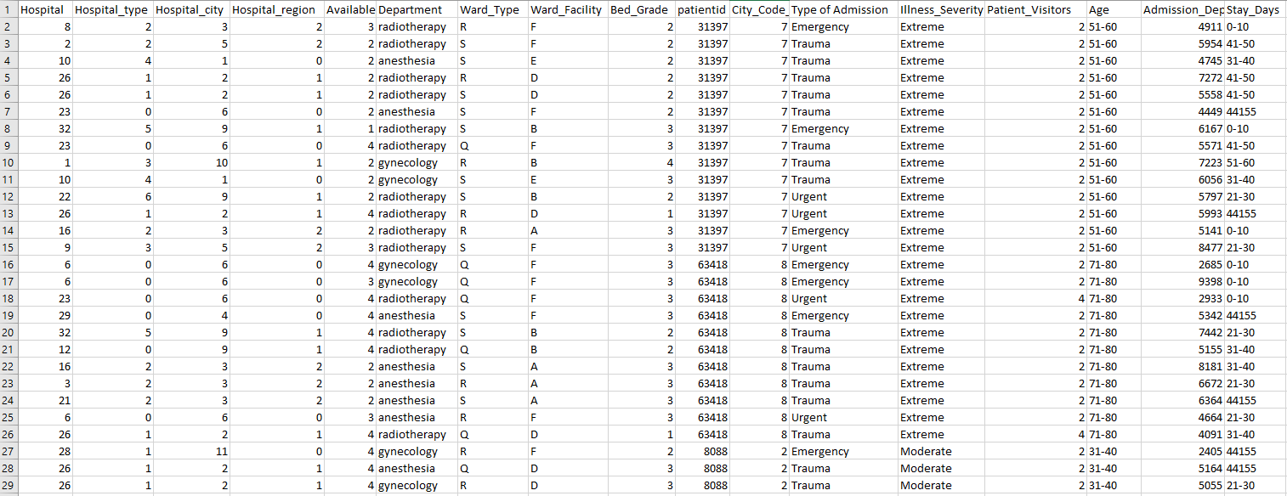
Dataset
The length of stay is divided into 11 different classes ranging from zero to ten days and ending in the case where more than a hundred days are needed.
The dataset consists of 17 features and 11 different classes.
There are over 318,439 records of people who recovered from COVID-19

Slide 5
Method Proposed
MULTI-CLASS CLASSIFICATION USING LOGISTIC REGRESSION

Slide 6
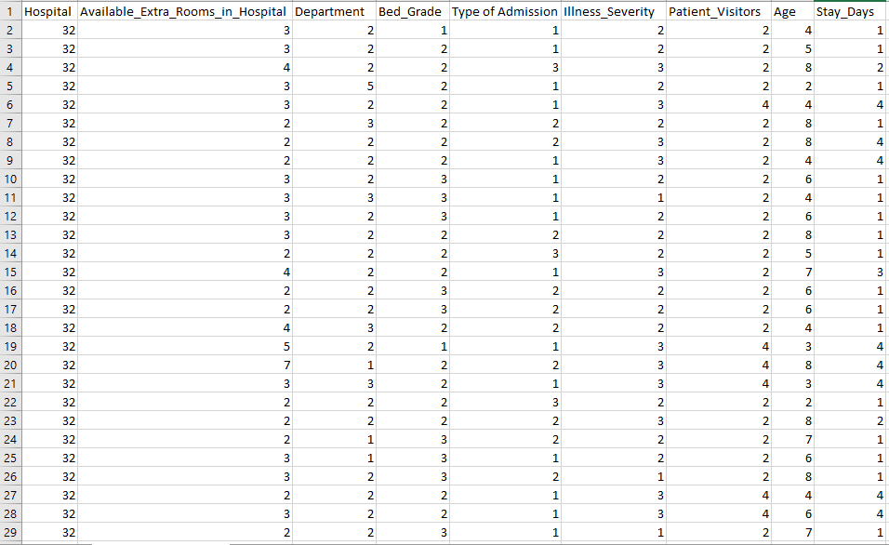
DATASET CLEANUP
The first approach ended with a low accuracy of 27%
The second approach was done by first cleaning up the dataset of information that was not considered critical for the study. Also, in order to avoid noise within code execution, numerical values were assigned to represent the different cases within the same feature.
Finally, the eleven categories were reduced to 4 were the first three are the same as before, but the fourth one consisted of length of stay longer than a month.
Features removed were case id, hospital type, hospital city, hospital region, ward type, ward facility, patient id, city code patient, and admission deposit.
New dataset consisted of 8 features and 4 unique classes

Slide 7
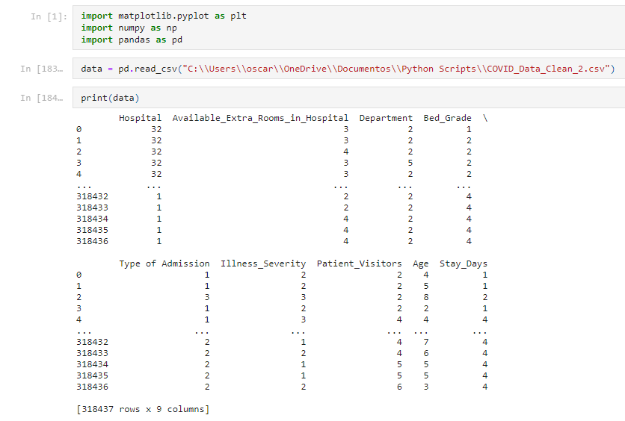
Prediction Program (1/4)

Slide 8
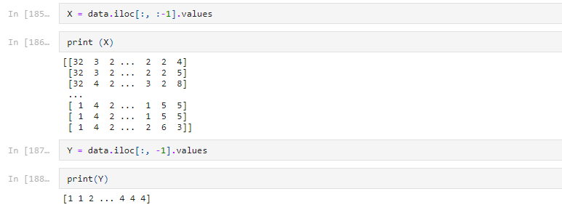
Prediction Program (2/4)

Slide 9
Prediction Program (3/4)

Slide 10
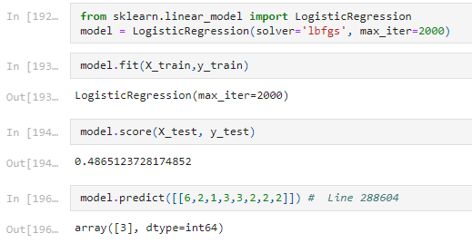
Prediction Program (4/4)

Slide 11
RESULTS & CONCLUSION
The model accuracy was 48.6% which is considered poor.
After running several different tests seeking to improve accuracy it was concluded that the data provided does not have a concrete pattern or boundary lines cannot be determined.
Test were done using only one or two of the most critical features (age & illness severity) and gave an outcome of 40% to 42%
Conclusion: the data is not sufficient to determine the length of stay of patients.

Slide 12
Future Studies
This dataset could be improved if future studies detect more conditions that can impact the length of stay of patients.
The method can be changed to implement neural networks using the softmax activation function.

Slide 13
THANK YOU!

