Slide 1
Exploration of Machine Learning Framework RDkit for Chemistry Research
ELEE 4333 – Topics in ELEE – Machine Learning
12/10/2020
By Ivan Morado

Slide 2
Overview
Introduction
How a Computer Understands Chemistry
RDkit for Lipophilicity
Conclusion
References

Slide 3
Introduction

Slide 4
Introduction
Machine Learning useful for classifying various chemical properties
Useful for investigating poorly understand structures
Easier than classical methods for chemistry research
Computers no longer a passive tool for research

Slide 5
How a Computer Understands Chemistry
SMILES (Simplified Molecular Input Line Entry System)
Simplest way to represent chemical data using lines, capital letters for atoms
Can write the information yourself
Can be processed as string data
Not accurate space info of molecule
Lots of formulas for single molecule
Figure 1. Representation of Molecule using SMILES data format

Slide 6
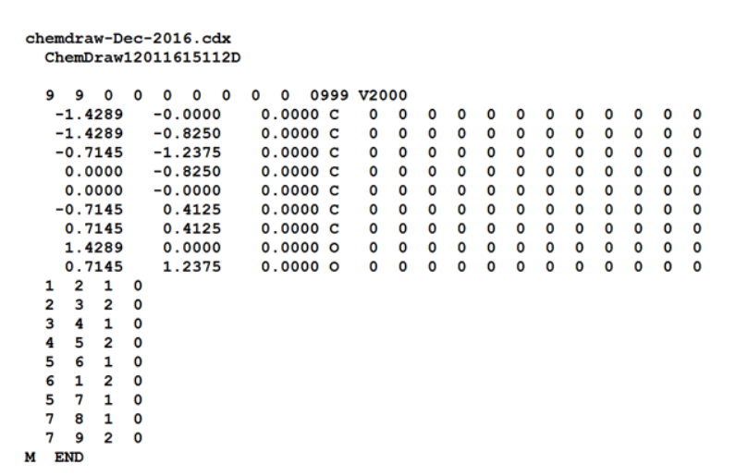
How a Computer Understands Chemistry
MDL Molfile
keeps information about the atoms, bonds, connectivity and coordinates of a molecule
the Connection Table contains atom info, bond connections and types, followed by sections for more complex information
Acceptable by most software
Represents 2D and 3D molecules
Larger data sets
Hard to write data by yourself
Figure 2. Representation of Molecule using Molfile

Slide 7
RDkit Framework for Lipophilicity

Slide 8
RDkit Framework cont.
RDkit is machine learning tools written in C++ and Python for chemistry
Useful for many reasons, in our case property prediction task
Lipophilicity dataset – chemical property related to ability of a compound dissolving in lipids, oils, fats
Useful to design novel drugs
Evaluated via distribution coefficient p
Represented as a log
Experimentally expensive to find p of a chemical compound
Model will be trained with ridge regression

Slide 9
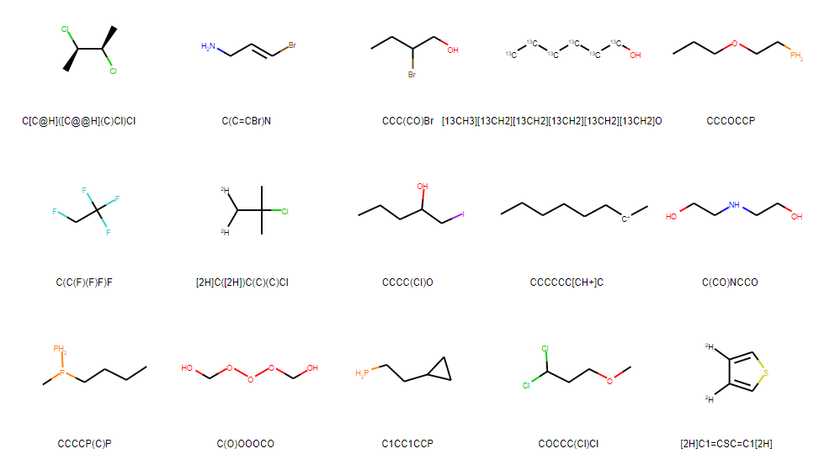
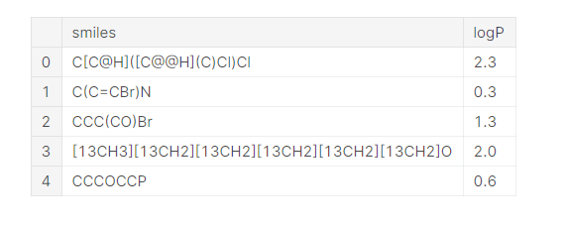
RDkit Framework cont.
Figure 3. SMILE dataset for Lipophilicity Property Prediction Task
Figure 4. RDkit visualization of MOL Data

Slide 10
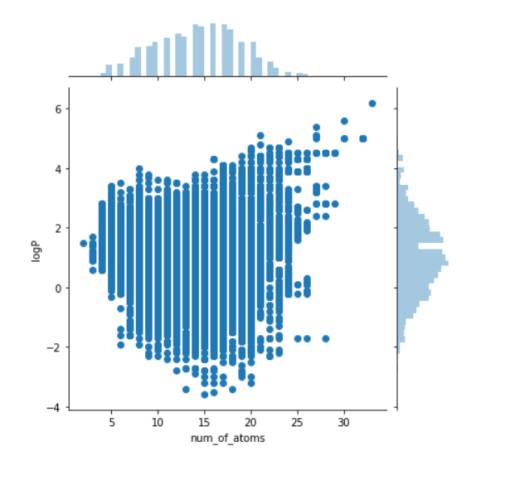
RDkit Framework Cont.
Figure 5. Number of Hydrogen Atoms

Slide 11
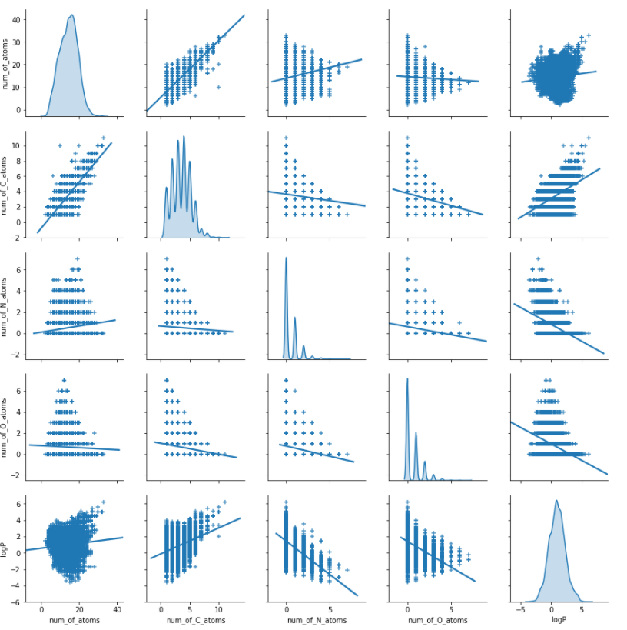
RDkit framework cont.
Some linear dependence in lower row
Figure 6. Count of Commonly Occurring Atoms

Slide 12
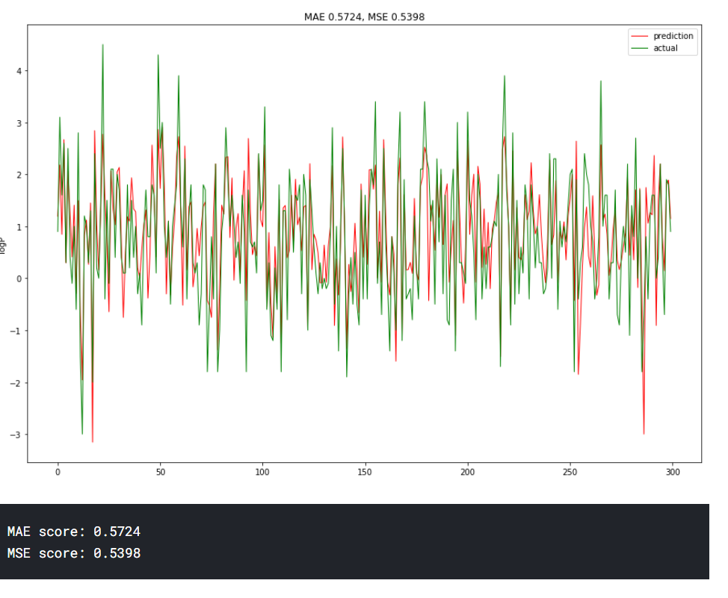
RDKit framework cont.
Figure 7. Trained Model with Ridge Regression

Slide 13
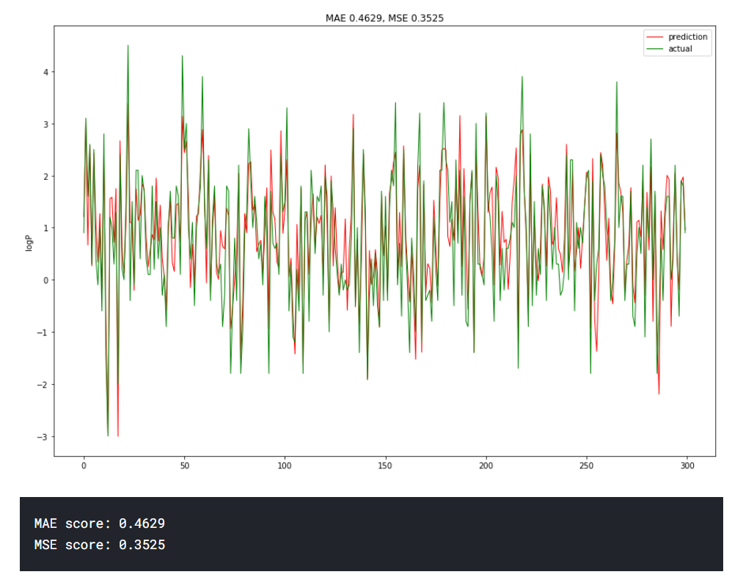
RDkit framework cont.
Figure 8. Trained Model with added Descriptors with Ridge Regression

Slide 14
Conclusion

Slide 15
Conclusion
RDkit can effectively work with chemical data types, SMILES and Molfiles
We looked at a simple property prediction task, but complex tasks can be designed using built in functions
Can help reduce cost of experiments by predicting outcomes for effective using materials, equipment, etc.

Slide 16
Questions?

Slide 17
References
Kaggle Datasets: LogP of Chemical Structures. https://www.kaggle.com/matthewmasters/chemical-structure-and-logp
https://www.kaggle.com/vladislavkisin/tutorial-ml-in-chemistry-research-rdkit-mol2vec#Representation-of-chemical-data
https://www.statisticshowto.com/ridge-regression/#:~:text=Ridge%20regression%20is%20a%20way,(correlations%20between%20predictor%20variables).

