Slide 1
Machine Learning: Gender Recognition
By: Javier Suarez Moreno & Patrick Nnaji

Slide 2
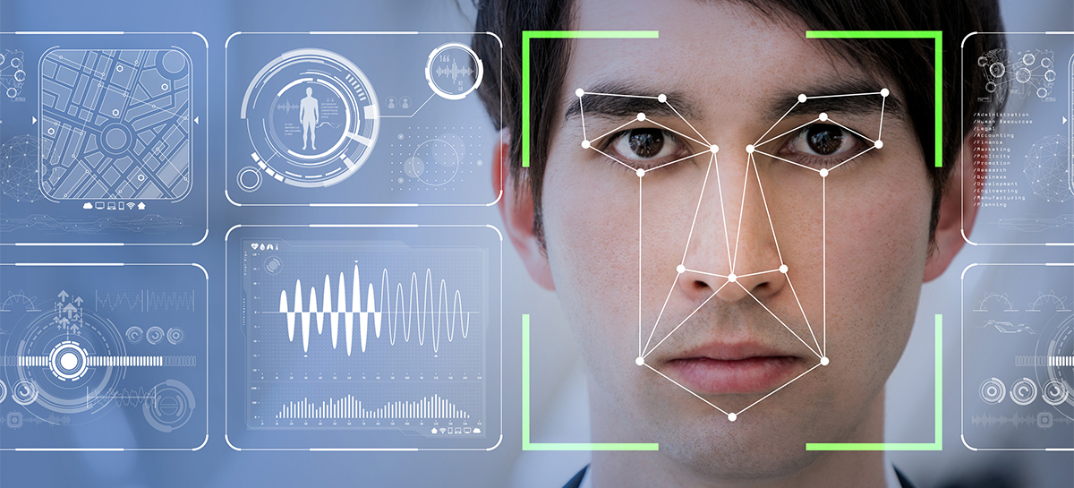
Overview
In this project we seek to implement facial recognition to determine gender
We will cover its importance here
How we were able to accomplish this project
Covering the results and our thoughts on the project

Slide 3
Importance of Facial Recognition
A popular component of computer vision and deep learning revolves around identifying faces
From logging into your phone with your face or searching through surveillance images for a particular suspect
Using facial recognition is an amazing tool for not only information gathering, but for security purposes as well
Distinguishing between a male or female can be distinctly difficult for a computer

Slide 4
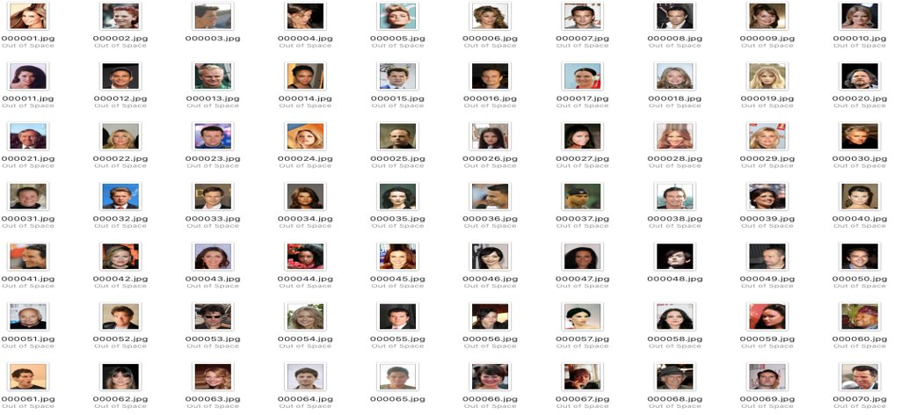
For the project we are using the CelebA dataset consisting of 202,599 celebrity images available on Kaggle.​

Slide 5
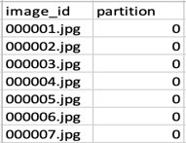
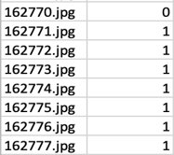
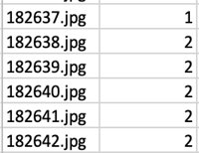
list_eval_partition.csv: ​
TRAINING SET------ Images 1 – 162770(0)​
​
​
TESTING SET -------Images 162771 to 182637(1)​
​
​
​
TESTING SET -------Images 182638 to 202599(2)​
​

Slide 6
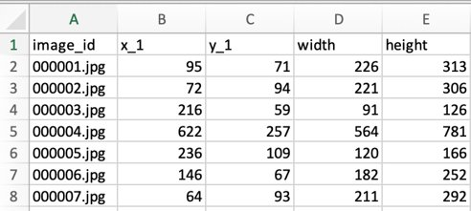
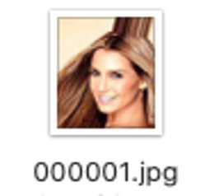
list_bbox_celeba.csv:​
"x_1" and "y_1" represent the upper left point coordinate of bounding box.​
"width" and "height" represent the width and height of bounding box​
​

Slide 7
list_landmarks_align_celeba.csv:​
Image landmarks and their respective coordinates.​
There are 5 landmarks:​
Left eye​
Right eye​
Nose​
Left mouth​
Right mouth

Slide 8
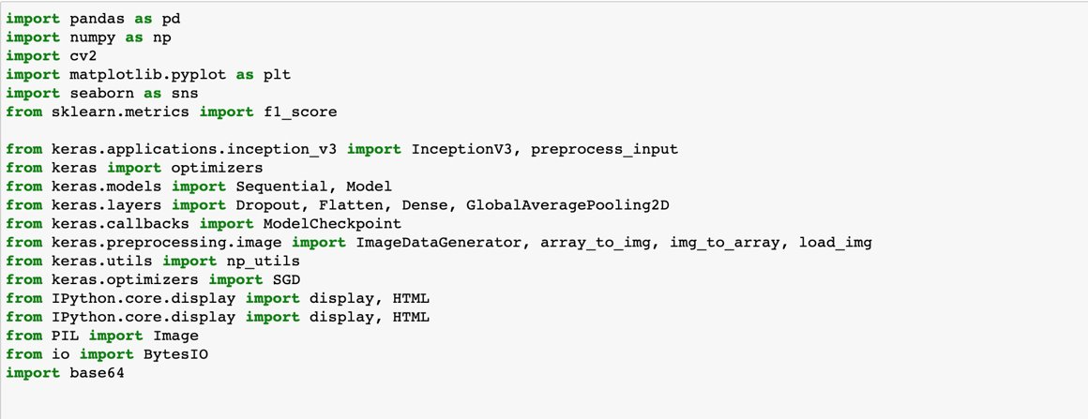
Importing dependent libraries​

Slide 9
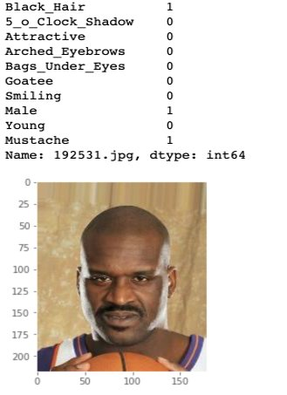
DATA EXPLORATION​

Slide 10
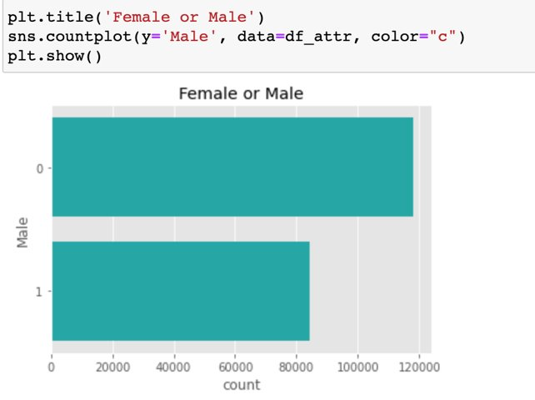
Visualizing Male to Female​

Slide 11
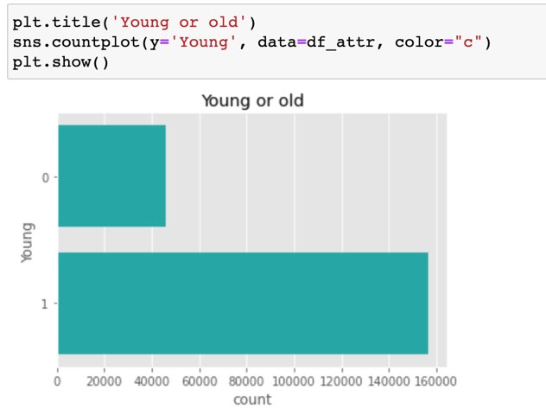
Visualizing Young vs Old​

Slide 12
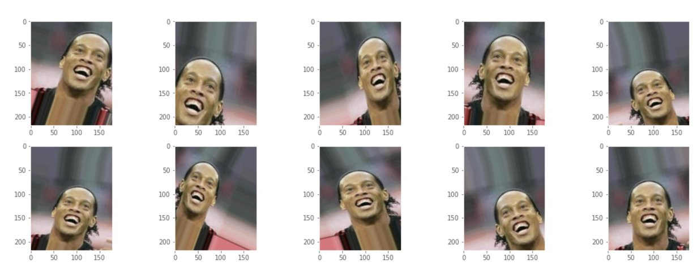
Data Augmentation​

Slide 13
LOSS FUNCTION GRAPH​

Slide 14
ACCURACY PLOT​

Slide 15
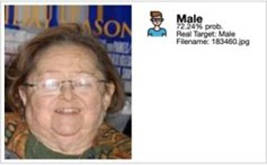
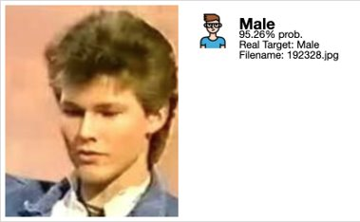
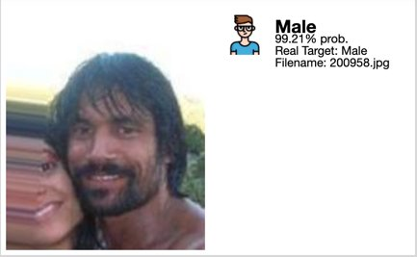
CASES WITH EXCEPTIONAL PREDICTION ACCURACY​

Slide 16
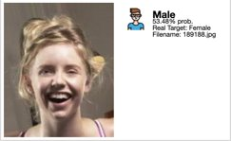
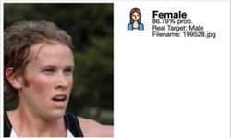
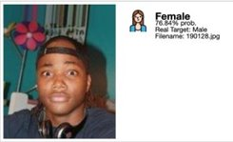
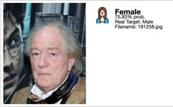
CASES WHERE THE NETWORK MADE THE WRONG PREDICTION​

Slide 17
How we accomplished it
With the help of previously made projects we had access to the following:
202,599 number of face images of various celebrities
10,177 unique identities,
Names of identities are not given
40 binary attribute annotations per image
5 landmark locations

Slide 18
THE ACCURACY ON TEST SET IS 93.6000%
For almost all the test set, the network was able to differentiate between a male and a female celebrity. However, in some cases as shown below, the network prediction failed.

Slide 19
Results
We were able to obtain results with certainty percentages ranging from ~85% and ~100%
Pictures were able to be described as containing a male or a female for the most part
The program, however, took almost 8 hours to train and run
This made it a problem to deal with, since making small changes would require hours in order to determine whether the change was positive.

Slide 20
IMPROVEMENT​
INCREASE TRAIN SET TO INCREASE ACCURACY​
USE DIFFERENT CNN STRUCTURE( LIMITED RESOURSES THOUGH)​
DIDN’T CONSIDER NON CLOSE-UP PICTURES​
DIDN'T CONSIDER MULTIPLE SUBJECTS ​
​

Slide 21
Image citation
https://newsroom.cisco.com/documents/10157/14740/facial-recognition-feature_1200x675_hero_090418.jpg/eba19a1c-4b85-413d-a1fc-2590fcd7e1ee?t=1535745284920
https://rapidapi.com/blog/wp-content/uploads/2017/11/t01a5ed8aab97b460c9.jpg
https://www.women-in-technology.com/hs-fs/hubfs/FACIAL-RECOGNITION-compressor.png?width=1920&name=FACIAL-RECOGNITION-compressor.png

Slide 22
Thank you for listening

