Slide 1
Chapter 8 Classic Architecture of CNNs

Slide 2
Outline
Popular datasets
AlexNet
VGG: networks using blocks
GoogLeNet
ResNet
Pretrained models

Slide 3
MNIST dataset
Training: 60000 images
Testing: 10000 images
Image: 28x28 gray-scale
import torch
import torchvision
import torchvision.transforms as transforms
import matplotlib.pyplot as plt
import numpy as np
batch_size = 128
mnist_trainset = torchvision.datasets.MNIST(root='C:/Users/weido/ch11/data',
train=False, download=True, transform=transforms.ToTensor())
Mnist = torch.utils.data.DataLoader(mnist_trainset, batch_size=batch_size,
shuffle=True, num_workers=1)
def imshow_grey(img):
plt.imshow(img.permute(1,2,0),cmap="Greys")
plt.show()
# get some random training images
dataiter= iter(Mnist) # return an iterator assigned to dataiter
images, labels = dataiter.next()
# get the current iteration on dataiter: [batch_size, C, H, W]
# show images in one batch, "255-images"
imshow_grey(torchvision.utils.make_grid(255-images, nrow=16, normalize=True))

Slide 4
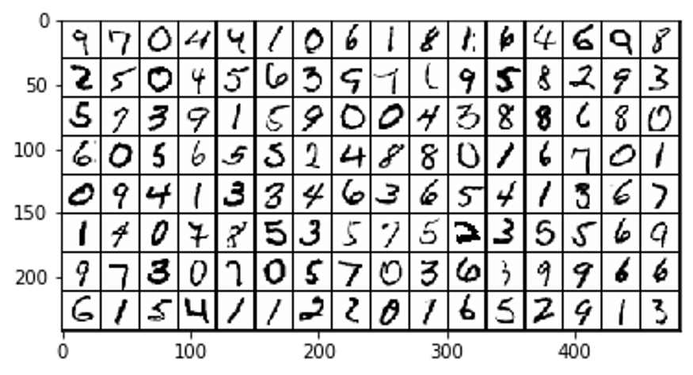
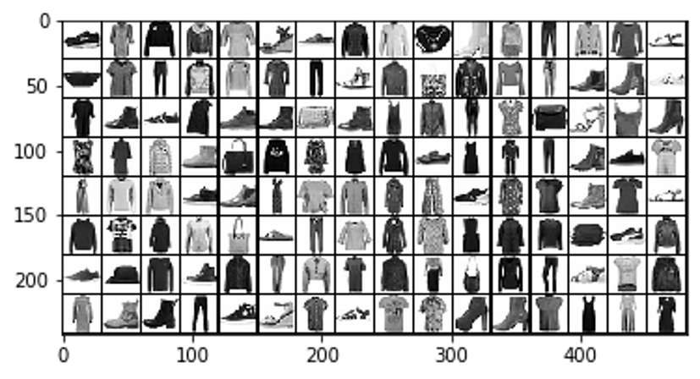
Fashion-MNIST labels:
0: T-shirt/top, 1: Trouser,
2: Pullover, 3: Dress,
4: Coat, 5: Sandal,
6: Shirt, 7: Sneaker,
8: Bag, 9: Ankle boot.
torchvision.datasets.FashionMNIST()

Slide 5
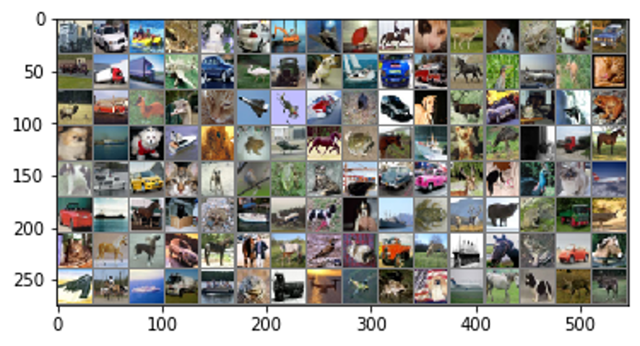
CIFAR-10
CIFAR: Canadian Institute For Advanced Research
CIFAR-10 dataset: 32x32 color images
  Training: 50000 images (5000 images per class)
  Testing: 10000 images (1000 images per class)
  Ten classes: airplane (0), automobile (1), bird (2), cat (3), deer (4), dog (5), frog (6), horse (7), ship (8), and truck (9).
torchvision.datasets.CIFAR10()

Slide 6
Other popular datasets
CIFAR-100
  20 superclasses, 5 classes per superclass. Totally 100 classes.
  600 images per class (500 for training, 100 for testing).
ImageNet (https://image-net.org/index.php)
  14,197,122 annotated images
  ImageNet Large Scale Visual Recognition Challenge (ILSVRC) image classification and localization dataset: 1000 object classes and contains 1,281,167 training images, 50,000 validation images and 100,000 test images.
  ILSVRC annotations fall into one of two categories: (1) image-level annotation of a binary label for the presence or absence of an object class in the image, and (2) object-level annotation of a tight bounding box and class label around an object instance in the image.
COCO Dataset (https://cocodataset.org/#home)
  contains 80 object categories with over 1.5 million object instances for context recognition, object detection, and segmentation.
Cityscapes (https://www.cityscapes-dataset.com/ )
  It includes high-quality pixel-level annotations of 5,000 frames in addition to a larger set of 20,000 weakly annotated frames.
  It is used for major tasks of semantic urban scene understanding

Slide 7
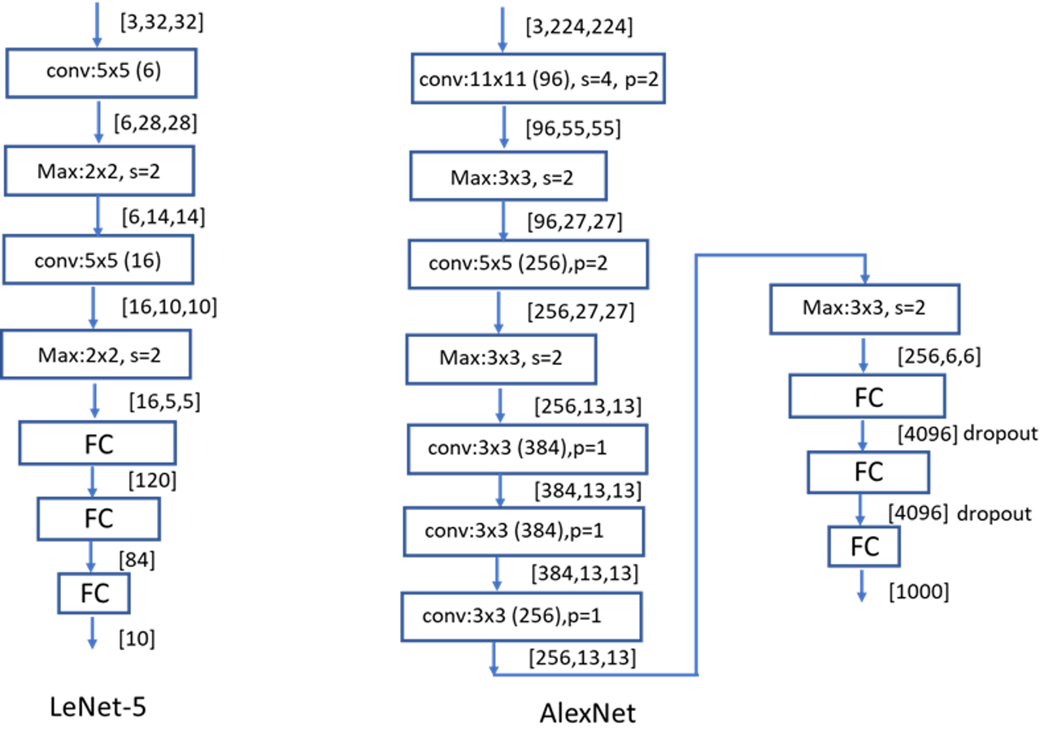
AlexNet
won ILSVRC 2012
top-1 and top-5 error rates of 36.7% and 15.3%

Slide 8
import torch.nn as nn
import torch.nn.functional as F
class AlexNet(nn.Module):
# define self functions for all layers with learning parameters
def __init__(self):
super(AlexNet, self).__init__()
# define function sefl.conv1 for Conv layer1
self.conv1 = nn.Conv2d(3,96,11, stride=4, padding=2)
self.conv2 = nn.Conv2d(96,256,5, padding=2)
self.conv3 = nn.Conv2d(256,384,3, padding=1)
self.conv4 = nn.Conv2d(384,384,3, padding=1)
self.conv5 = nn.Conv2d(384,256,3, padding=1)
self.fc1 = nn.Linear(256*6*6, 4096)
self.fc2 = nn.Linear(4096,4096)
self.fc3 = nn.Linear(4096,1000)
def forward(self, x):
x = self.conv1(x)
x = F.relu(x)
x = F.max_pool2d(x,3,2)
x = self.conv2(x)
x = F.relu(x)
x = F.max_pool2d(x,3,2)
x = self.conv3(x)
x = F.relu(x)
x = self.conv4(x)
x = F.relu(x)
x = self.conv5(x)
x = F.relu(x)
x = F.max_pool2d(x,3,2)
x = x.view(-1, 256*6*6)
x = self.fc1(x)
x = F.relu(x)
x = F.dropout(x,0.5)
x = self.fc2(x)
x = F.relu(x)
x = F.dropout(x,0.5)
x = self.fc3(x)
return x

Slide 9
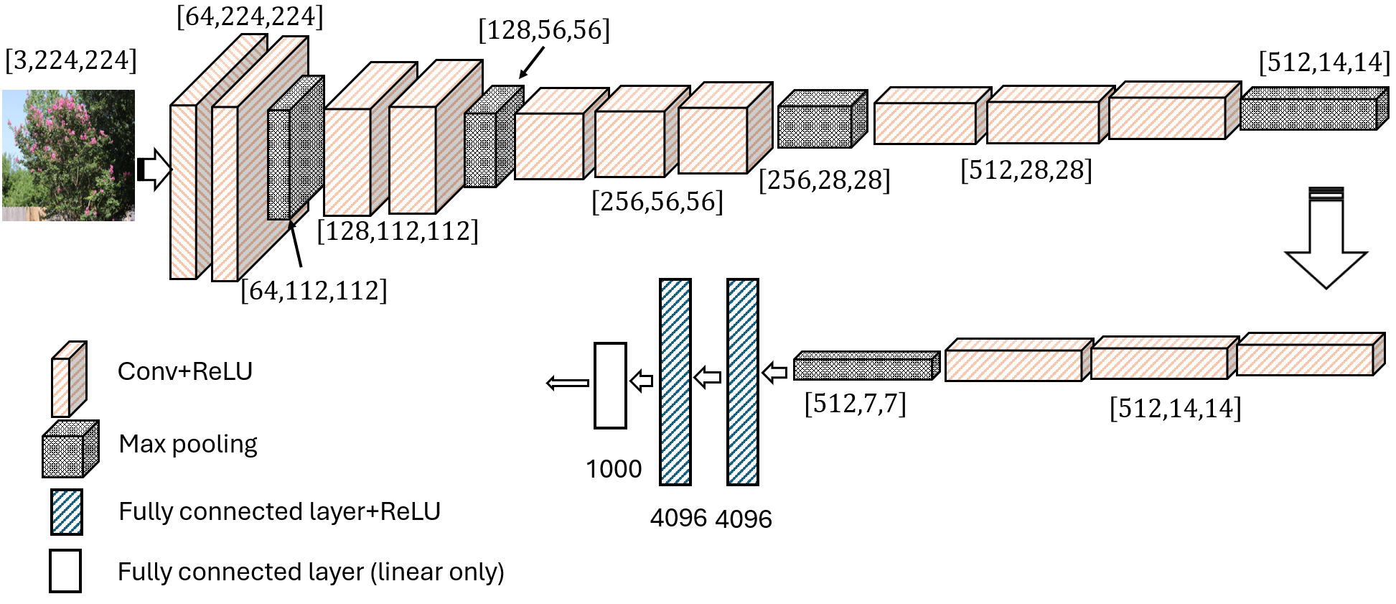
VGG: networks using blocks
VGG16-B

Slide 10
Table 8.1 VGG architectures
VGG11 | VGG13 | VGG16-A | VGG16-B | VGG19
Input image [3,224,224]
Conv3 (64) | Conv3 (64) Conv3 (64) | Conv3 (64) Conv3 (64) | Conv3 (64) Conv3 (64) | Conv3 (64) Conv3 (64)
Max pool (2x2, stride=2) → [64, 112, 112]
Conv3 (128) | Conv3 (128) Conv3 (128) | Conv3 (128) Conv3 (128) | Conv3 (128) Conv3 (128) | Conv3 (128) Conv3 (128)
Max pool (2x2, stride=2) → [128, 56, 56]
Conv3 (256) Conv3 (256) | Conv3 (256) Conv3 (256) | Conv3 (256) Conv3 (256) Conv1 (256) | Conv3 (256) Conv3 (256) Conv3 (256) | Conv3 (256) Conv3 (256) Conv3 (256) Conv3 (256)
Max pool (2x2, stride=2) → [256, 28, 28]
Conv3 (512) Conv3 (512) | Conv3 (512) Conv3 (512) | Conv3 (512) Conv3 (512) Conv1 (512) | Conv3 (512) Conv3 (512) Conv3 (512) | Conv3 (512) Conv3 (512) Conv3 (512) Conv3 (512)
Max pool (2x2, stride=2) → [512, 14, 14]
Conv3 (512) Conv3 (512) | Conv3 (512) Conv3 (512) | Conv3 (512) Conv3 (512) Conv1 (512) | Conv3 (512) Conv3 (512) Conv3 (512) | Conv3 (512) Conv3 (512) Conv3 (512) Conv3 (512)
Max pool (2x2, stride=2) → [512, 7, 7]
FC-4096 (with optional dropout)
FC-4096 (with optional dropout)
FC-1000
Soft-max
5 blocks
Conv3(256): filter 3x3, channel 256
Conv1(256): filter 1x1, channel 256
Stride =1
Zero-padding =0 or 1 to maintain shape
2nd place in ILSVRC 2014
Top-5 error rate: 7.3%
Python code: see textbook

Slide 11
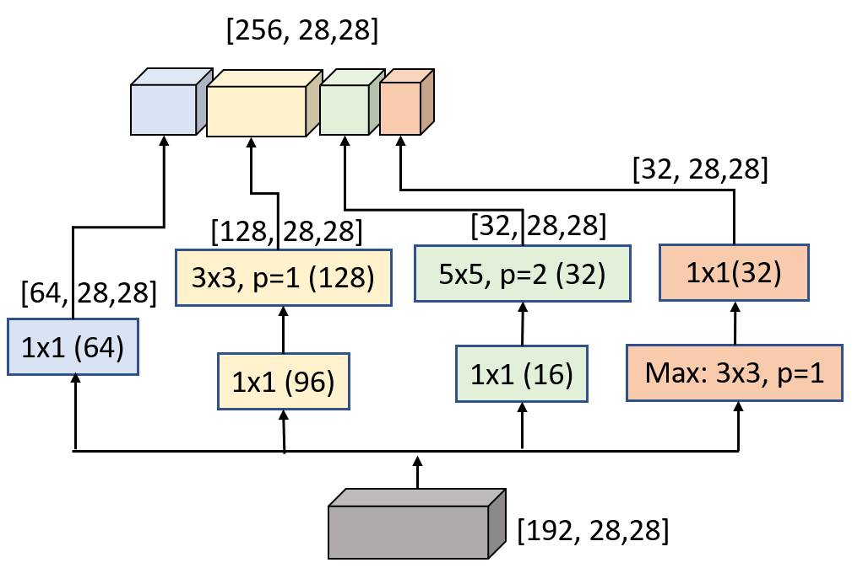
GoogLeNet: won ILSVRC 2014
output
Filter size
channel
concatenation
3x3
5x5
1x1
Pool
projection
1x1
3x3
reduce
1x1
5x5
reduce
1x1
Max: 3x3
input
A specific inception block (as an example)
General inception block

Slide 12
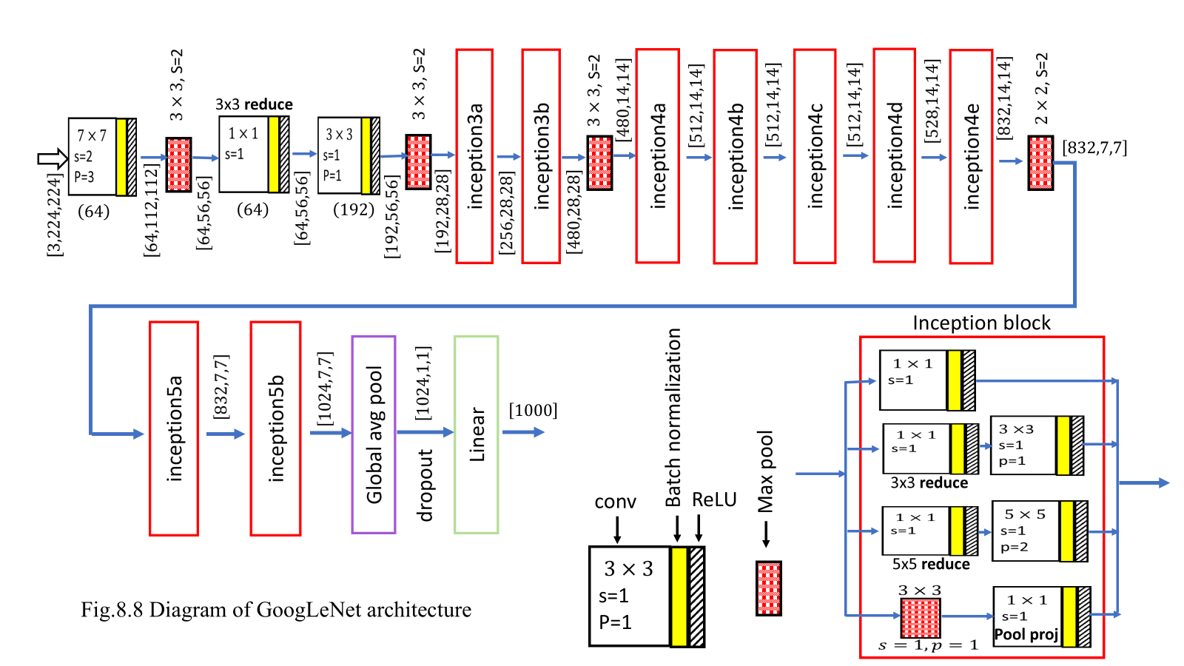
GoogLeNet architecture

Slide 13
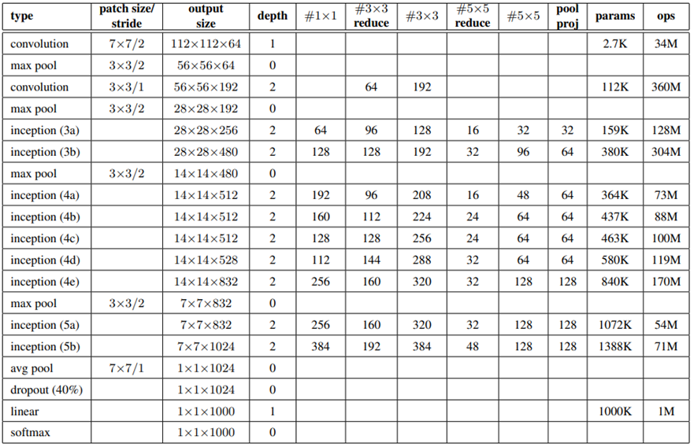
Table 8.2 GoogLeNet architecture (from Szegedy, et al. 2015)
# of channels

Slide 14



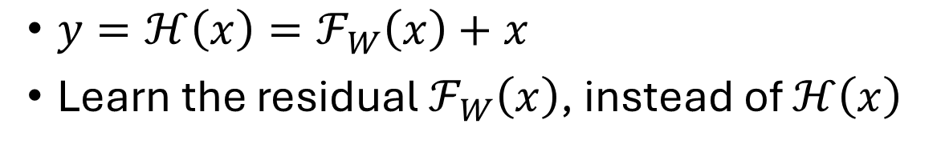




ResNet: won ILSVRC 2015
$$x$$
$y=ℋ\left(x\right)=ℱ_{W}\left(x\right)+x$
Learn the residual $ℱ_{W}\left(x\right)$, instead of $ℋ\left(x\right)$
$$ℱ_{W}\left(x\right)$$
[256,N,N]
[64,N,N]
1x1, 64
$$⊕$$
[64,56,56]
3x3, 64, p=1
BN
3x3, 128,s=2
ReLU
$$y$$
BN
ReLU
BN
3x3, 64
ReLU
1x1,128,s=2
3x3, 64,p=1
BN
3x3, 128
BN
ReLU
BN
1x1,256
[64,N,N]
$$⊕$$
BN
[128,28,28]
$$⊕$$
BN
[128,28,28]
[256,N,N]
$$⊕$$
ReLU
ReLU
Same size, same channel
half size, double channel
ReLU
Same size, same channel
Three types of residual blocks

Slide 15
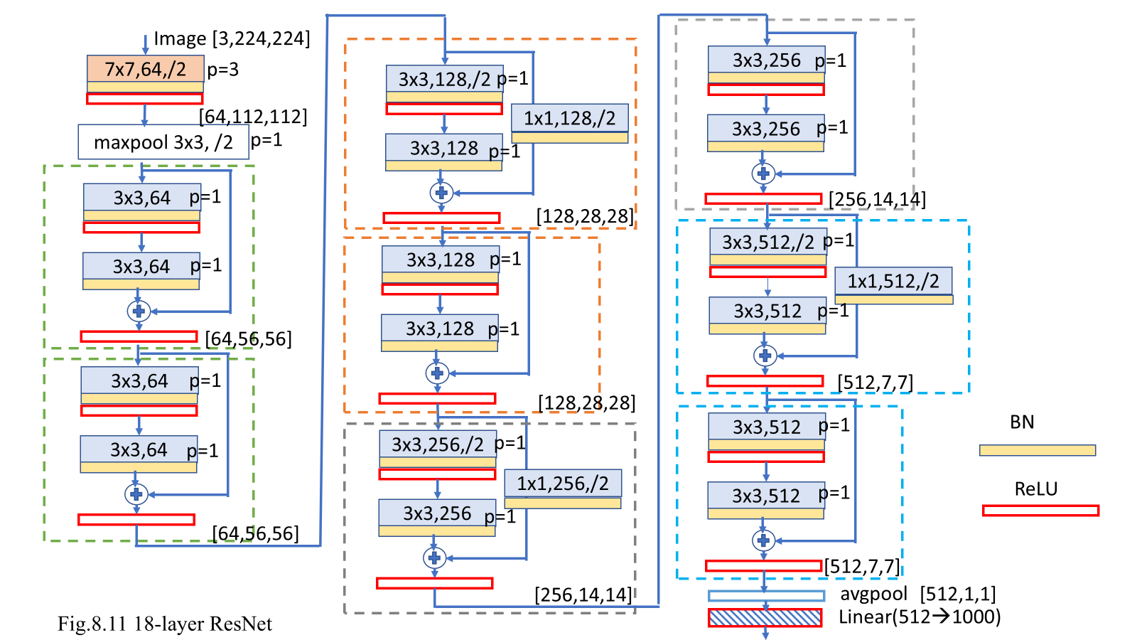

Slide 16
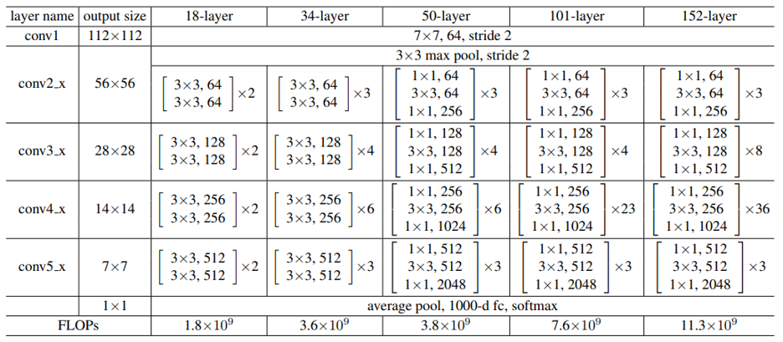
ResNet
Residual block
Table 8.3 Architectures of ResNet (from He, et al. 2015)

Slide 17
Pretrained models: load pretrained model
Find what models are available
from torchvision import models # import package models
dir(models) # display different models
Instantiate alexnet
# instantiate a pretrained model alexnet
alexnet = models.alexnet(pretrained=True)
print(alexnet) # print the architecture of Alexnet
see the data shape after each layer and the number of parameters
from torchsummary import summary
summary (alexnet, (3,224, 224))

Slide 18
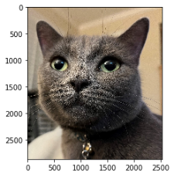
Image Classification using Pretrained AlexNet
Prepare input data
from PIL import Image
img = Image.open("cat.jpg")
plt.imshow(img)
transform = transforms.Compose([
transforms.Resize(256),
transforms.CenterCrop(224),
transforms.ToTensor(),
transforms.Normalize(
mean=[0.485, 0.456, 0.406],
std=[0.229, 0.224, 0.225]
)])
img_t = transform(img)
batch_t = torch.unsqueeze(img_t, 0)
Find the top-1 result
with open('imagenet_classes.txt') as f:
classes = [line.strip() for line in f.readlines()]
_, index = torch.max(out, 1)
percentage = torch.nn.functional.softmax(out, dim=1)[0] * 100
print(classes[index[0]], percentage[index[0]].item())
Egyptian cat 21.715721130371094
Find the top-5 results
_, indices = torch.sort(out, descending=True)
[(classes[idx], percentage[idx].item()) for idx in indices[0][:5]]
[('Egyptian cat', 21.715721130371094),
('Siamese cat', 20.509252548217773),
('lynx', 20.28806495666504),
('tabby', 11.527338027954102),
('bow tie', 7.61397647857666)]
Run the model
alexnet.eval()
out = alexnet(batch_t)
print(out.shape)
torch.Size([1, 1000]

Slide 19
Fine-tuning: instantiate
import torch
import torch.nn as nn
import torch.nn.functional as F
from torchvision import models
# Instantiate a pretrained model alexnet
alexnet = models.alexnet(pretrained=True)

Slide 20
Print architecture
# print the modules at children level
for (name, module) in alexnet.named_children():
print(name, module)
features Sequential(
(0): Conv2d(3, 64, kernel_size=(11, 11), stride=(4, 4), padding=(2, 2))
(1): ReLU(inplace=True)
(2): MaxPool2d(kernel_size=3,stride=2,padding=0,dilation=1,ceil_mode=False)
(3): Conv2d(64, 192, kernel_size=(5, 5), stride=(1, 1), padding=(2, 2))
(4): ReLU(inplace=True)
(5): MaxPool2d(kernel_size=3,stride=2,padding=0,dilation=1,ceil_mode=False)
(6): Conv2d(192, 384, kernel_size=(3, 3), stride=(1, 1), padding=(1, 1))
(7): ReLU(inplace=True)
(8): Conv2d(384, 256, kernel_size=(3, 3), stride=(1, 1), padding=(1, 1))
(9): ReLU(inplace=True)
(10): Conv2d(256, 256, kernel_size=(3, 3), stride=(1, 1),padding=(1, 1))
(11): ReLU(inplace=True)
(12): MaxPool2d(kernel_size=3,stride=2,padding=0,dilation=1,ceil_mode=False)
)
avgpool AdaptiveAvgPool2d(output_size=(6, 6))
classifier Sequential(
(0): Dropout(p=0.5, inplace=False)
(1): Linear(in_features=9216, out_features=4096, bias=True)
(2): ReLU(inplace=True)
(3): Dropout(p=0.5, inplace=False)
(4): Linear(in_features=4096, out_features=4096, bias=True)
(5): ReLU(inplace=True)
(6): Linear(in_features=4096, out_features=1000, bias=True)
)

Slide 21
Fine-tuning: modify the model architecture
Print the parameter values
for (name, module) in alexnet.named_children():
if name == 'classifier':
for layer in module:
print(layer)
for param in layer.parameters():
print(param)
Change the output features from 1000 to 10
in_features = alexnet._modules['classifier'][-1].in_features
out_features = 10
alexnet._modules['classifier'][-1] = nn.Linear(in_features, out_features, bias=True)
print(alexnet._modules['classifier'])
Sequential(
(0): Dropout(p=0.5, inplace=False)
(1): Linear(in_features=9216, out_features=4096, bias=True)
(2): ReLU(inplace=True)
(3): Dropout(p=0.5, inplace=False)
(4): Linear(in_features=4096, out_features=4096, bias=True)
(5): ReLU(inplace=True)
(6): Linear(in_features=4096, out_features=10, bias=True)
)

Slide 22
Fine-tuning: freeze some layers
for (name, module) in alexnet.named_children():
print(name)
for (layer_name,layer) in module.named_children():
if name == 'classifier' and layer_name =="6":
for param in layer.parameters():
param.requires_grad = True
print('{} {} {} was NOT frozen!'.format(name, layer_name, layer))
else:
for param in layer.parameters():
param.requires_grad = False
print('{} {} {} was frozen!'.format(name, layer_name, layer))
features
features 0 Conv2d(3, 64, kernel_size=(11, 11), stride=(4, 4), padding=(2, 2)) was frozen!
…
classifier 5 ReLU(inplace=True) was frozen!
classifier 6 Linear(in_features=4096, out_features=10, bias=True) was NOT frozen!

Slide 23
Fine-tuning: prepare data loader CIFAR10
batch_size=32
#transform = transforms.Compose([transforms.ToTensor(),
#transforms.Normalize((0.5,0.5,0.5), (0.5, 0.5, 0.5))])
transform = transforms.Compose([ #[1]
transforms.Resize(256), #[2]
transforms.CenterCrop(224), #[3]
transforms.ToTensor(), #[4]
transforms.Normalize( #[5]
mean=[0.485, 0.456, 0.406], #[6]
std=[0.229, 0.224, 0.225] #[7]
)])
trainset = torchvision.datasets.CIFAR10(root='C:/Users/weido/ch11/data', train=True, download=True, transform=transform)
trainloader = torch.utils.data.DataLoader(trainset, batch_size=batch_size,
shuffle=True, num_workers=2)
testset = torchvision.datasets.CIFAR10(root='C:/Users/weido/ch11/data', train=False, download=False, transform=transform)
testloader = torch.utils.data.DataLoader(testset, batch_size=batch_size,
shuffle=False, num_workers=2)

Slide 24
Test the pretrained model before fine-tuning
correct = 0
total = 0
counter=0
with torch.no_grad():
for data in testloader:
counter=counter+1
print(counter)
images, labels = data
outputs = alexnet(images)
_, predicted = torch.max(outputs.data, 1)
total += labels.size(0)
correct += (predicted == labels).sum().item()
print('Accuracy of the network on the 10000 test images: %d %%' % (
100 * correct / total))
Accuracy of the network on the 10000 test images: 8 %

Slide 25
Fine-tuning and test on CIFAR10
import torch.optim as optim
criterion = nn.CrossEntropyLoss()
optimizer = optim.Adam(filter(lambda p: p.requires_grad, alexnet.parameters()), lr=0.001)
for epoch in range(2): # loop over the dataset multiple times
running_loss = 0.0
for i, data in enumerate(trainloader,0):
# get the inputs; data is a list of [inputs, labels]
inputs, labels = data
# zero the parameter gradients
optimizer.zero_grad()
# forward + backward + optimize
outputs = alexnet(inputs)
loss = criterion(outputs, labels)
loss.backward()
optimizer.step()
# print statistics
running_loss += loss.item()
if i % 100 == 99: # print every 100 mini-batches
print('[%d, %5d] loss: %.3f' %
(epoch + 1, i + 1, running_loss / 100))
running_loss = 0.0
print('Finished Training')
# Run the code in previous slide
Accuracy of the network on the 10000 test images: 80 %

Slide 26
Summary
Datasets are essential for deep learning. We present a few benchmark datasets for computer visions, such as MNIST, CIFAR10, ImageNet, COCO, etc.
Many datasets can be downloaded via torchvision.datasets.
By describing the architecture of a few classic CNNs, we show a rough evolution path of deep learning models for computer vision, from several layers (e.g., LeNet-5) to more than 100 layers (e.g. ResNet).
Residual learning (introduced in ResNet) is applied to transformer architecture later.
We demonstrated how to fine-tune a pretrained model.

