Slide 1
Chapter 7 Convolutional Neural Networks

Slide 2
Outline
Why CNNs?
Operation of convolution layer
  Shift, multiply, add
  Filter size
  Stride and zero-padding
  Shapes of input and output
Pooling layer: max and average
Batch normalization
Architecture of CNNs
Implementation of examples using PyTorch

Slide 3
Motivation of CNNs
Image properties
  Local correlation: local features depend only on a small subregion of the image.
  Global duplication: similar pixel pattens may show up in different regions of the image.
Fully connected networks → sparsely connected networks
  Local correlation → Only weights for a small region of input pixels are non-zero.
  Global duplication → weights can be shared for different output nodes.
  CNNs is a subset of fully connected networks with regularization via regional connection and weight sharing.

Slide 4


A convolution layer with 4 channels
Four filters
W0
Four output feature maps
Three input feature maps
depth
ReLU(z)
W1
height
W2
width
$$a^{[1]}$$
$$a^{[0]}$$
W3

Slide 5
A simple CNN
Input image
Convolution
Activation (e.g.ReLU)
pooling
Input layer
Convolution layer
Pooling layer
Fully connected layers
Feature extract
Prediction

Slide 6
Convolution layer: basic convolution operation
Selected region
4 | 1
3 | 0
Output
(two channels)
Input X
(1 channel)
W0
Channel 0
1 | 0
0 | 1
4 | 6
10 | 8
4 | 1 | 2
3 | 0 | 5
6 | 7 | 8
 | 1 | 2
 | 0 | 5
*
W1
3 | 0
6 | 7
0 | 1
1 | 0
Channel 1
4 | 2
6 | 12
*
 | 0 | 5
 | 7 | 8
Convolution operation: Shift, multiply, add
One input channel, two output channels

Slide 7
Convolution layer: basic convolution operation
filters
1 | 1
0 | 0
Output
(2 channels)
Input X
(2 channels)
W0
12 | 12
16 | 20
4 | 1 | 2
3 | 0 | 5
6 | 7 | 8
0 | 0
1 | 1
*
4 | 12
16 | 24
0 | 1 | 2
3 | 4 | 5
6 | 7 | 8
0 | 1
0 | 1
W1
1 | 0
1 | 0
Two input channels, two output channels

Slide 8
Stride and zero-padding
filter
Input feature map
0
0
0
0
0
0
0
0
Zero-padding = 1
Stride = 2

Slide 9



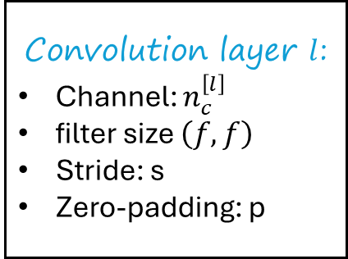

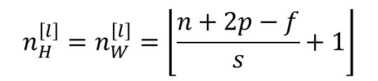


Output shape
Assume input feature map is square
$$\left(n_{c}^{\left[l−1\right]},n,n\right)$$
Convolution layer $l$:
Channel: $n_{c}^{\left[l\right]}$
filter size $\left(f,f\right)$
Stride: s
Zero-padding: p
$$\left(n_{c}^{\left[l\right]},n_{H}^{\left[l\right]},n_{W}^{\left[l\right]}\right)$$
$$n_{H}^{\left[l\right]}$$
$$n$$
$$n_{W}^{\left[l\right]}$$
$$n$$
$$n_{H}^{\left[l\right]}=n_{W}^{\left[l\right]}=\left\lfloor \frac{n+2p−f}{s}+1\right\rfloor$$
Floor function

Slide 10
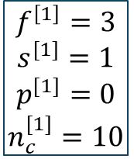

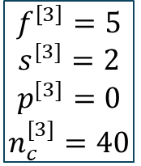

Examples: shapes of input and output
3
10
20
40
37
1960
$$\hat{y}$$
17
17
7
39
7
Logistic/softmax
17
39
37
$$f^{\left[1\right]}=3$$
$$s^{[1]}=1$$
$$p^{[1]}=0$$
$$n_{c}^{[1]}=10$$
$$f^{\left[2\right]}=5$$
$$s^{[2]}=2$$
$$p^{[2]}=0$$
$$n_{c}^{[2]}=20$$
$$f^{\left[3\right]}=5$$
$$s^{[3]}=2$$
$$p^{[3]}=0$$
$$n_{c}^{[3]}=40$$

Slide 11
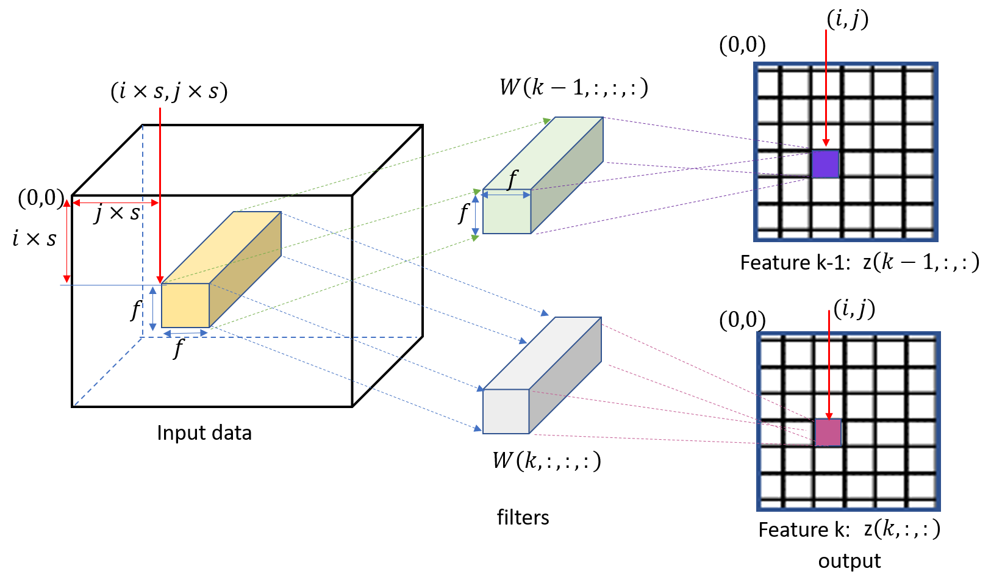
Mathematical equation for convolution
bias
$$z\left(k,i,j\right)=b\left(k\right)+\sum_{k^{′}=0}^{n_{c}^{\left[l−1\right]}}{\sum_{v=0}^{f−1}{\sum_{u=0}^{f−1}{x\left(k^{′},i^{′}, j^{′}\right)W\left(k,k^{′},u,v\right),}}} i^{′}=i×s+u,j^{′}=j×s+v$$

Slide 12
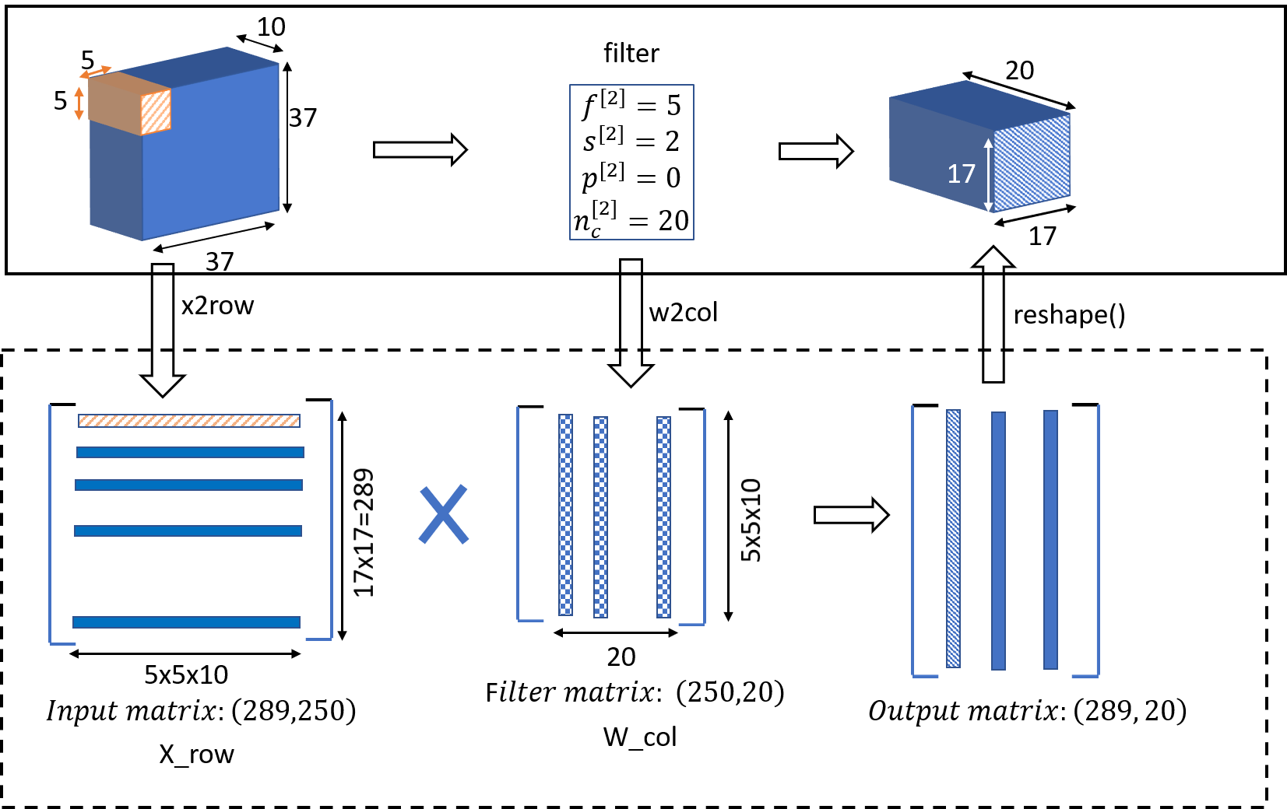
Convolution: matrix multiplication

Slide 13
Pooling layer
Pooling layer reduces the spatial size of the representation and extract the high-level features.
Two types: max and average
9 | 2
6 | 3
1 | 3 | 2 | 1
2 | 9 | 1 | 1
1 | 3 | 2 | 3
5 | 6 | 1 | 2
Max pool
Average pool
3.75 | 1.25
4 | 2
Fig.7.10 Pool layer with f=2, s=2.

Slide 14
Summary of different layers in CNNs

Slide 15
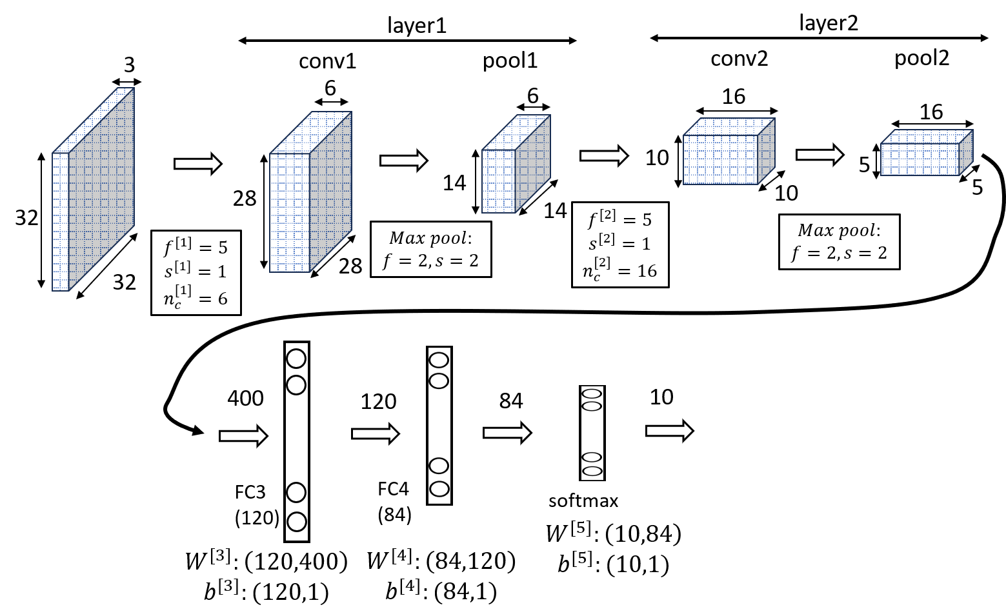
CNN example: LeNet-5 (LeCun, et. al., 1998)
Hand-written digit recognition

Slide 16
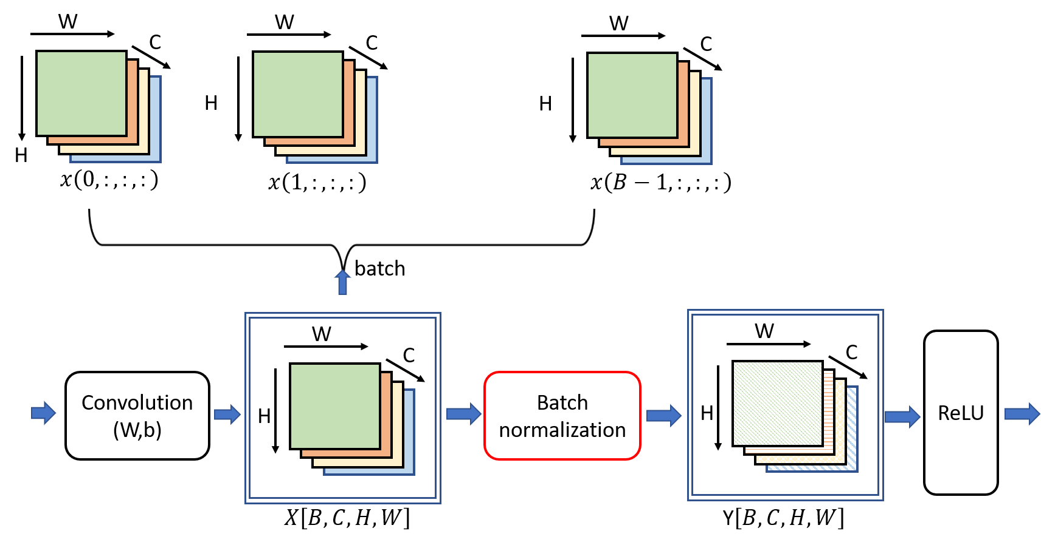
Batch normalization for CNNs
Batch normalization
  Fully connected networks: normalization per node across a batch.
  CNNs: normalization per channel across a batch.

Slide 17
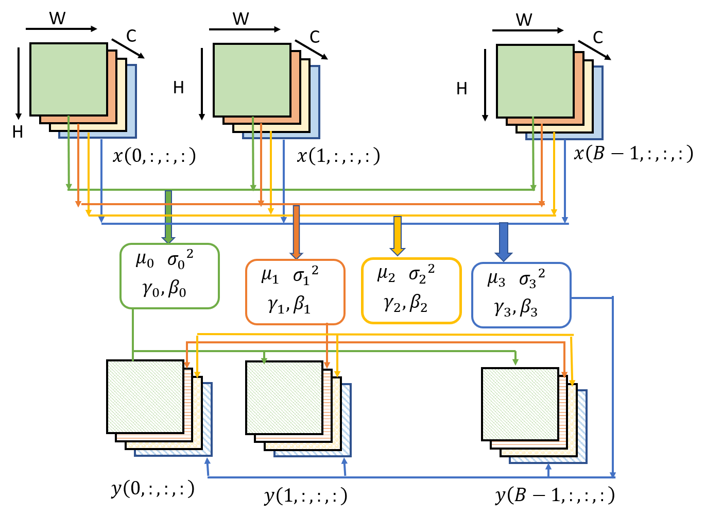
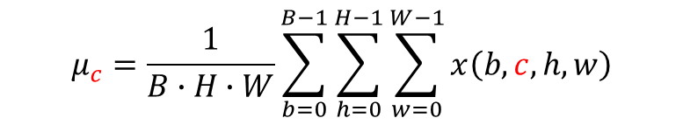

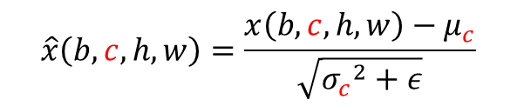
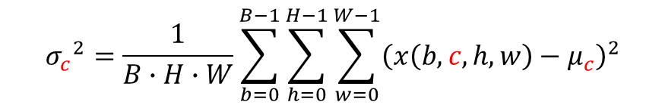
Batch normalization
Normalize channel c
Batch mean
$$μ_{c}=\frac{1}{B∙H∙W}\sum_{b=0}^{B−1}{\sum_{h=0}^{H−1}{\sum_{w=0}^{W−1}{x\left(b,c,h,w\right)}}}$$
Batch variance
$${σ_{c}}^{2}=\frac{1}{B∙H∙W}\sum_{b=0}^{B−1}{\sum_{h=0}^{H−1}{\sum_{w=0}^{W−1}{{\left(x\left(b,c,h,w\right)−μ_{c}\right)}^{2}}}}$$
Normalize
$$\hat{x}\left(b,c,h,w\right)=\frac{x\left(b,c,h,w\right)−μ_{c}}{\sqrt{{σ_{c}}^{2}+ε}}$$
Scale and shift
$$y\left(b,c,h,w\right)=γ_{c}∙\hat{x}\left(b,c,h,w\right)+β_{c}$$

Slide 18
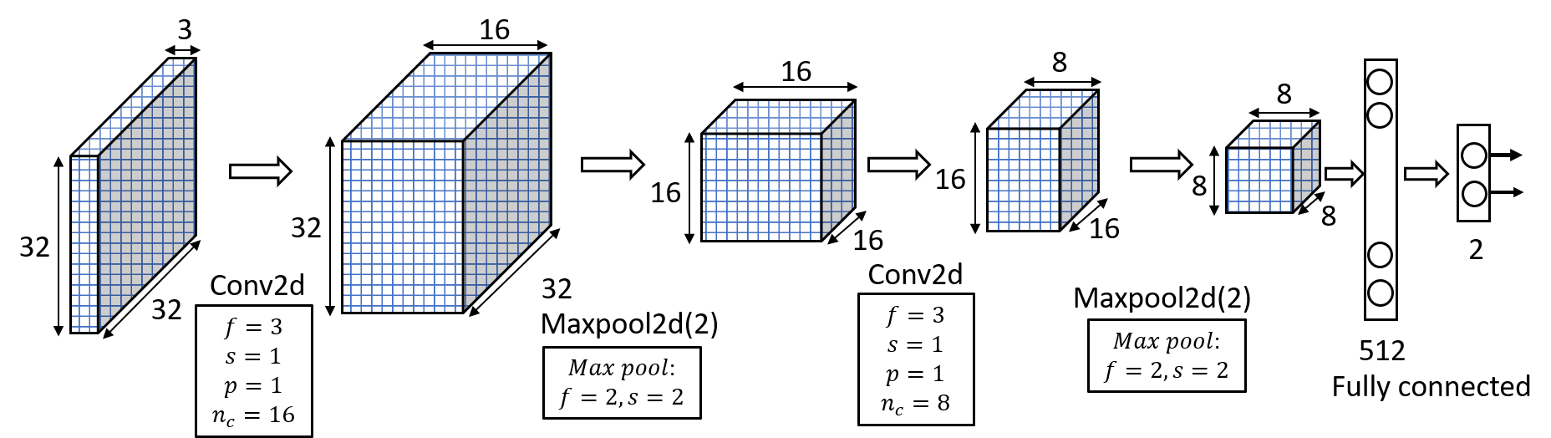
Implement CNNs using PyTorch
Dataset: two classes from CIFAR-10 (e.g., airplane and bird)

Slide 19
Data preparation
CIFAR-10 consists of 60,000 (32 × 32) color (RGB) images (50000 in train set and 10000 in test set), labeled with an integer corresponding to 1 of 10 classes: airplane (0), automobile (1), bird (2), cat (3), deer (4), dog (5), frog (6), horse (7), ship (8), and truck (9).
import torch
import torchvision.transforms as transforms
from torchvision import datasets
import torch.nn.functional as F
import torch.nn as nn
import torch.optim as optim
data_path = '../torch_tutorial/data'
transform=transforms.Compose([
transforms.ToTensor(),
transforms.Normalize((0.5, 0.5, 0.5),(0.5,0.5,0.5))
])
cifar10 = datasets.CIFAR10(data_path,train=True,download=False,transform=transform)
cifar10_test=datasets.CIFAR10(data_path,train=False,download=False,
transform=transform )
label_map = {0: 0, 2: 1}
class_names = ['airplane', 'bird']
cifar2 = [(img, label_map[label]) for img, label in cifar10 if label in [0, 2]]
cifar2_test = [(img, label_map[label]) for img, label in cifar10_test if label in [0, 2]]

Slide 20
Build CNN
Input channel
class Net(nn.Module):
def __init__(self):
super().__init__()
#define layers with learnable parameters
self.conv1 = nn.Conv2d(3, 16, kernel_size=3, padding=1)
self.conv2 = nn.Conv2d(16, 8, kernel_size=3, padding=1)
self.fc1 = nn.Linear(8 * 8 * 8, 32)
self.fc2 = nn.Linear(32, 2)
def forward(self, x):
out = self.conv1(x)
out = torch.tanh(out) # function
out = F.max_pool2d(out,2) # function
out = self.conv2(out)
out = torch.tanh(out) # function
out = F.max_pool2d(out,2) # function
out = out.view(-1, 8 * 8 * 8) # function
out = self.fc1(out)
out = torch.tanh(out) # function
out = self.fc2(out)
return out
Output channel

Slide 21
Training loop
model = Net()
numel_list = [p.numel() for p in model.parameters()]
sum(numel_list), numel_list
(18090, [432, 16, 1152, 8, 16384, 32, 64, 2])
import datetime
def training_loop(n_epochs, optimizer, model, loss_fn, train_loader):
for epoch in range(1, n_epochs + 1):
loss_train = 0.0
for imgs, labels in train_loader:
outputs = model(imgs)
# imgs:[batch,C,H,W]accepted by conv2d
loss = loss_fn(outputs, labels)
optimizer.zero_grad()
loss.backward()
optimizer.step()
loss_train += loss.item()
if epoch == 1 or epoch % 10 == 0:
print('{} Epoch {}, Training loss {}'.format(
datetime.datetime.now(), epoch,
loss_train / len(train_loader)))

Slide 22
Train CNN
train_loader = torch.utils.data.DataLoader(cifar2, batch_size=64,
shuffle=True)
model = Net() #
optimizer = optim.SGD(model.parameters(), lr=1e-2) #
loss_fn = nn.CrossEntropyLoss()
training_loop(
n_epochs = 100,
optimizer = optimizer,
model = model,
loss_fn = loss_fn,
train_loader = train_loader,
)
2023-09-05 15:44:20.501572 Epoch 1, Training loss 0.643967665684451
2023-09-05 15:46:01.669627 Epoch 10, Training loss 0.37506938341316903
2023-09-05 15:47:47.958945 Epoch 20, Training loss 0.32019150741161057
2023-09-05 15:49:29.642442 Epoch 30, Training loss 0.2998704523037953
2023-09-05 15:52:55.265520 Epoch 40, Training loss 0.2842075728876576
2023-09-05 15:54:45.228890 Epoch 50, Training loss 0.2652401124026365
2023-09-05 15:56:25.186468 Epoch 60, Training loss 0.24640889541738353
2023-09-05 15:58:05.560932 Epoch 70, Training loss 0.23124178608132015
2023-09-05 15:59:46.228611 Epoch 80, Training loss 0.21609638830658737
2023-09-05 16:01:26.292905 Epoch 90, Training loss 0.20230945754962362
2023-09-05 16:03:07.255794 Epoch 100, Training loss 0.18751443300847034

Slide 23
Test the trained model
test_loader = torch.utils.data.DataLoader(cifar2_test, batch_size=64,
shuffle=False)
def validate(model, train_loader, test_loader):
for name, loader in [("train", train_loader), ("test", test_loader)]:
correct = 0
total = 0
with torch.no_grad():
for imgs, labels in loader:
outputs = model(imgs)
_, predicted = torch.max(outputs, dim=1)
total += labels.shape[0]
correct += int((predicted == labels).sum())
print("Accuracy {}: {:.2f}".format(name , correct / total))
validate(model, train_loader, test_loader)
Accuracy train: 0.92
Accuracy test: 0.89

Slide 24
Implement LeNet-5
Import packages
import torch
import torchvision
import torchvision.transforms as transforms
import matplotlib.pyplot as plt
import numpy as np
import datetime
Prepare data loader
batch_size=32
transform = transforms.Compose([transforms.ToTensor(),
transforms.Normalize((0.5,0.5,0.5), (0.5, 0.5, 0.5))])
trainset = torchvision.datasets.CIFAR10(root='./data', train=True,
download=True, transform=transform)
trainloader = torch.utils.data.DataLoader(trainset, batch_size=batch_size, shuffle=True, num_workers=2)
testset = torchvision.datasets.CIFAR10(root='./data', train=False,
download=False, transform=transform)
testloader = torch.utils.data.DataLoader(testset, batch_size=batch_size,
shuffle=False, num_workers=2)

Slide 25
import torch.nn as nn
import torch.nn.functional as F
class Net(nn.Module):
def __init__(self):
# define self functions for all layers with learning parameters
super(Net, self).__init__()
self.conv1 = nn.Conv2d(3,6,5)
# define function sefl.conv1 for Conv layer1
self.bn1 = nn.BatchNorm2d(6)
self.conv2 = nn.Conv2d(6,16,5)
self.fc1 = nn.Linear(16*5*5, 120)
self.fc2 = nn.Linear(120,84)
self.bn2 = nn.BatchNorm1d(84) # batch normalization
self.fc3 = nn.Linear(84,10)
def forward(self, x):
x = self.conv1(x)
x = F.relu(x)
x = F.max_pool2d(x,2,2)
x = self.bn1(x) # batch normalization
x = self.conv2(x)
x = F.relu(x)
x = F.max_pool2d(x,2,2)
x = x.view(-1, 16*5*5)
x = self.fc1(x)
x = F.relu(x)
x = self.fc2(x)
x = F.relu(x)
x = self.bn2(x) # batch normalization
x = self.fc3(x)
return x
LeNet-5 module

Slide 26
import torch.optim as optim
net = Net()
criterion = nn.CrossEntropyLoss()
#optimizer = optim.SGD(net.parameters(), lr=0.001, momentum=0.9)
optimizer = optim.Adam(net.parameters(), lr=0.001)
for epoch in range(5): # loop over the dataset multiple times
running_loss = 0.0
for i, data in enumerate(trainloader,0):
# get the inputs; data is a list of [inputs, labels]
inputs, labels = data
# zero the parameter gradients
optimizer.zero_grad()
# forward + backward + optimize
outputs = net(inputs)
loss = criterion(outputs, labels)
loss.backward()
optimizer.step()
# print statistics
running_loss += loss.item()
if i % 100 == 99: # print every 100 mini-batches
print('[%d, %5d] loss: %.3f' %
(epoch + 1, i + 1, running_loss / 100))
running_loss = 0.0
print('Finished Training')
LeNet-5 training
[1, 100] loss: 1.898
[1, 200] loss: 1.657
[1, 300] loss: 1.584
[1, 400] loss: 1.502
[1, 500] loss: 1.470
[1, 600] loss: 1.459
[1, 700] loss: 1.427
[1, 800] loss: 1.375
[1, 900] loss: 1.391
[1, 1000] loss: 1.331
[1, 1100] loss: 1.346
[1, 1200] loss: 1.336
[1, 1300] loss: 1.356
[1, 1400] loss: 1.321
[1, 1500] loss: 1.319
[2, 100] loss: 1.223
[2, 200] loss: 1.204
…
[5, 1400] loss: 0.991
[5, 1500] loss: 0.988
Finished Training

Slide 27
Test LeNet-5: overall accuracy
correct = 0
total = 0
with torch.no_grad():
for data in testloader:
images, labels = data
outputs = net(images)
_, predicted = torch.max(outputs.data, 1)
total += labels.size(0)
correct += (predicted == labels).sum().item()
print('Accuracy of the network on the 10000 test images: %d %%' % (
100 * correct / total))
Accuracy of the network on the 10000 test images: 63 %

Slide 28
Test LeNet-5: accuracy for each class
class_correct = list(0. for i in range(10))
class_total = list(0. for i in range(10))
with torch.no_grad():
for data in testloader:
images, labels = data
outputs = net(images)
_, predicted = torch.max(outputs, 1)
c = (predicted == labels).squeeze()
for i in range(len(labels)):
label = labels[i]
class_correct[label] += c[i].item()
class_total[label] += 1
for i in range(10):
print('Accuracy of %5s : %2d %%' % (
classes[i], 100 * class_correct[i] / class_total[i]))
Accuracy of plane : 68 %
Accuracy of car : 72 %
Accuracy of bird : 47 %
Accuracy of cat : 34 %
Accuracy of deer : 63 %
Accuracy of dog : 52 %
Accuracy of frog : 79 %
Accuracy of horse : 68 %
Accuracy of ship : 71 %
Accuracy of truck : 76 %

Slide 29
Summary
A convolutional neural network typically consists of convolutional layers with non-linear activation, pooling layers and fully connected (FC) layers.
  The convolution layers extract the features.
  The pooling layers down sample the feature maps.
  The FC layers perform prediction.
A convolution layer is specified by the number of input channels, the number of output channels, filter size, stride, and zero-padding.
CNNs are typically used to process images.
PyTorch provides convolution layer modules.

