Slide 1
Chapter 6 Introduction to PyTorch

Slide 2
Outline
What is PyTorch? Why PyTorch?
Tensor in PyTorch
  Attributes and Properties
  Basic operations
  Images stored in tensors
Autograd in PyTorch
Optimizers in torch.optim
Datasets in torchvision.datasets, torchvision.transforms
torch.utils.data.DataLoader
Build neural networks using torch.nn
Put all together: build, train and test a neural network using PyTorch

Slide 3
Why PyTorch?
PyTorch is a framework that provides abundant of packages for deep learning developers.
With PyTorch, a designer can construct and train a deep learning model very quickly, instead of from scratch.
One of the most important features is to automatically track the derivatives along the computation path. Thus, we don’t need to manually derive the gradient expression during the training process.
Another important feature is that it includes many modules and data utility functions, which dramatically speed up a project development process.

Slide 4
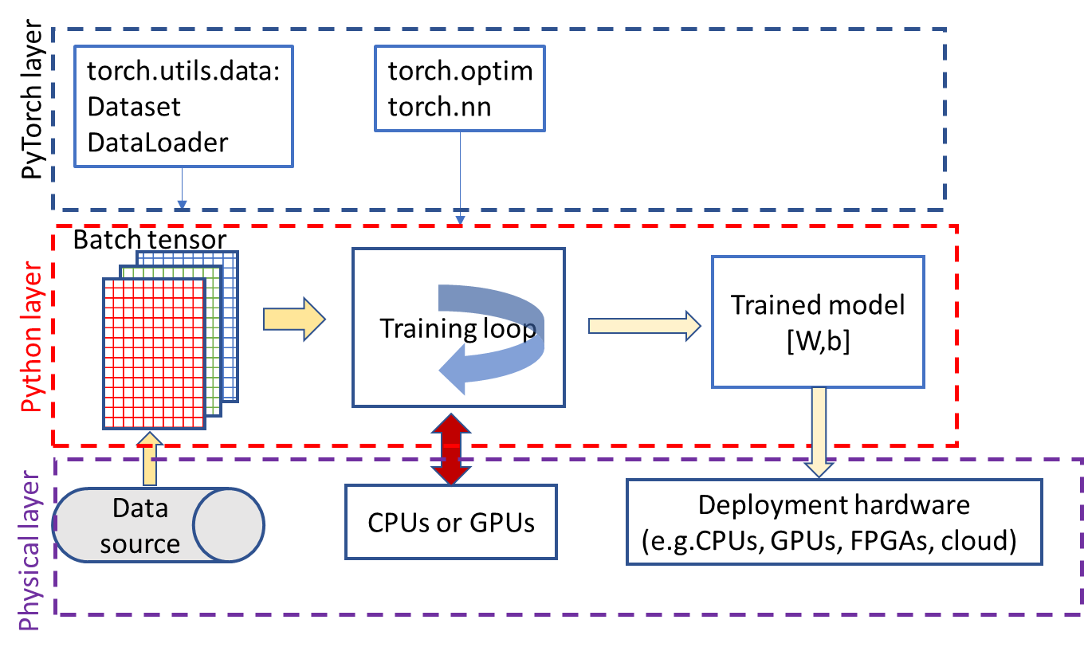
PyTorch framework
3 layers
  PyTorch layer: packages, utilities
  Python layer: build and train a model by calling functions from PyTorch layer.
  Physical layer: hardware to train or deploy the model.
We focus on PyTorch layer and Python layer.

Slide 5
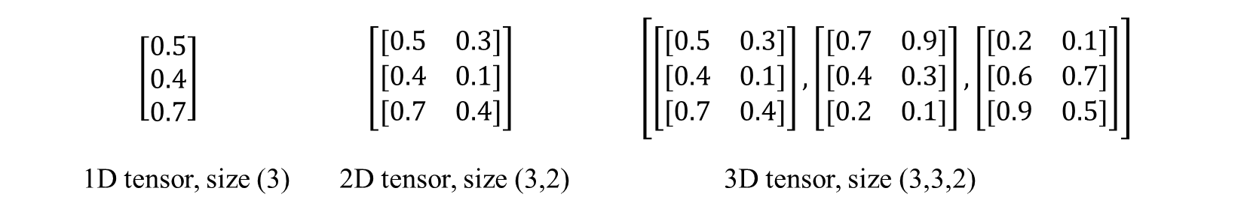
Tensor
Tensor in PyTorch is the fundamental, multi-dimensional data structure, like ndarray in numpy, but with two major advantages:
  It can run on hardware accelerators (e.g., GPUs).
  It tracks computation history to provide automatic differentiation (autograd) for training neural networks.
$\left[\begin{matrix}0.5 \\ 0.4 \\ 0.7\end{matrix}\right]$ $\left[\begin{matrix}[0.5 & 0.3] \\ [0.4 & 0.1] \\ [0.7 & 0.4]\end{matrix}\right]$ $\left[\left[\begin{matrix}[0.5 & 0.3] \\ [0.4 & 0.1] \\ [0.7 & 0.4]\end{matrix}\right],\left[\begin{matrix}[0.7 & 0.9] \\ [0.4 & 0.3] \\ [0.2 & 0.1]\end{matrix}\right],\left[\begin{matrix}[0.2 & 0.1] \\ [0.6 & 0.7] \\ [0.9 & 0.5]\end{matrix}\right]\right]$
1D tensor, size (3) 2D tensor, size (3,2) 3D tensor, size (3,3,2)

Slide 6
Three core attributes for tensors
Three core attributes define what data a tensor holds, its structure, and where its computations occur:
  dtype, specifies the underlying numerical data type (e.g., torch.float32, torch.int64, torch.bool), for example, x.dtype.
  shape, returns a tuple indicating the length of the tensor along each individual dimension, for example, x.shape.
  device, indicates the hardware allocation. For example, x.device.
cuda0 = torch.device('cuda:0')
torch.ones([2, 4], dtype=torch.float64, device=cuda0)

Slide 7
Computational & graph properties
Tensors are deeply integrated into its autograd engine for automatic gradient computation:
  requires_grad: a Boolean flag. When set to True, PyTorch tracks all operations on this tensor to construct a backward computation graph for gradient computation.
  grad: an attribute that stores the computed gradients after a .backward() call is executed on a scalar graph root.
  grad_fn: references the internal tracking function that generated this particular tensor in the computation graph.
See examples later in training examples.

Slide 8
Tensors: creating a tensor
Function | Description | Example
eye | Identity matrix | torch.eye(3)
from_numpy | Convert Numpy array to tensor | torch.from_numpy(a)
linspace | Linear space vector | torch.linspace(1, 10, steps=10)
logspace | Log scale space vector | torch.logspace(start=-10, end=10, steps=5)
ones | Filling with ones | torch.ones(2, 1, 2, 1)
ones_like | Filling with ones | torch.ones_like(eye)
arange | Return a 1-D tensor | torch.arange(1, 2.5, 0.5)
zeros | Filling with zeros | torch.zeros(2, 3)
zeros_like | Filling with zeros for a tensor shape | torch.zeros_like(input)
randn | Filling with random numbers | torch.randn(3,2)

Slide 9
import torch
import numpy as np
v_np = np.zeros([3,4])
v_tensor = torch.tensor(v_np)
# create tensor from list
v = torch.tensor([2,3]) # a tensor initialized with a list, int64
v = torch.Tensor([2,3]) # a tensor initialized with a list, float32
# create tensor from random numbers
torch.manual_seed(1)
points=torch.randn(3,2) # standard normal distribution
print(points)
points.shape
tensor([[ 0.6614, 0.2669],
[ 0.0617, 0.6213],
[-0.4519, -0.1661]])
torch.Size([3, 2])
# create by filling with 1 or 0
eye = torch.eye(3) # Create an identity 3x3 tensor
v = torch.ones(10) # A tensor of size 10 containing all ones
v = torch.ones(2, 1, 2, 1) # fill with 1, Size 2x1x2x1
v = torch.ones_like(eye) # A tensor with same shape as eye.Fill it with 1.
v = torch.zeros(10) # A tensor of size 10 containing all zeros

Slide 10
Examples: create a tensor
# create by arange
v = torch.arange(9)
print(v)
v = v.view(3, 3)
print(v)
tensor([0, 1, 2, 3, 4, 5, 6, 7, 8])
tensor([[0, 1, 2],
[3, 4, 5],
[6, 7, 8]])
v = torch.linspace(1, 10, steps=10)
print(v)
# Create a Tensor with 10 linear points for (1, 10) inclusively
v = torch.logspace(start=-10, end=10, steps=5)
# Size 5: 1.0e-10 1.0e-05 1.0e+00, 1.0e+05, 1.0e+10
print(v)
tensor([ 1., 2., 3., 4., 5., 6., 7., 8., 9., 10.])
tensor([1.0000e-10, 1.0000e-05, 1.0000e+00, 1.0000e+05, 1.0000e+10])
c = torch.ByteTensor([0, 1, 1, 0])
print(c)
tensor([0, 1, 1, 0], dtype=torch.uint8)

Slide 11
Indexing, slicing, joining, mutating operations
Function | Description | Example
torch.cat | Concatenation along a specified dimension | y=torch.cat([v,v,v,v],1)
x.view | Re-organize the tensor shape | v.view(3,3)
torch.stack | Add a dimension by stacking | y=torch.stack((v,v))
torch.gather | Gather values along an axis specified by dim. | t = torch.tensor([[1, 2], [3, 4]]) torch.gather(t, 0, torch.tensor([[0, 0], [1, 0]]))
torch.transpose | Transpose a tensor | y = torch.transpose(x, 0, 1)
torch.squeeze | Remove dimensions of size one | y = torch.squeeze(x)
torch.unsqueeze | Add a dimension with size one | y=torch.unsqueeze(x, 0)
torch.chunk | torch.chunk(input, chunks, dim=0) → List of Tensors: Attempts to split a tensor into the specified number of chunks. | y=torch.chunk(x,3,1)
torch.split | torch.split(tensor, split_size, dim=0) | y= torch.split(x, [1,2], 1) # [1,2] is the size of each section
Function | Description | Example
torch.index_select | torch.index_select(input, dim, index, *, out=None) → Tensor Returns a new tensor which indexes the input tensor along dimension dim using the entries in index | indices = torch.tensor([0, 2]) torch.index_select(x, 1, indices)
torch.masked_select | torch.masked_select(input, mask, *, out=None) → Tensor Returns a new 1-D tensor which indexes the input tensor according to the boolean mask mask which is a BoolTensor | mask = x.ge(0) y=torch.masked_select(x, mask)
torch.nonzero | returns a 2-D tensor where each row is the index for a nonzero value | y=torch.nonzero(v)
torch.take | torch.take(input, index) → Tensor Returns a new tensor with the elements of input at the given indices. | y=torch.take(x, torch.tensor([0, 2, 5]))

Slide 12
Examples: indexing
a=points[:, -1]
print(a)
a.shape
tensor([ 0.2669, 0.6213, -0.1661])
torch.Size([3])
# re-organize: view, cat, stack, gather, squeeze, unsqueeze
v=torch.arange(9)
v=v.view(3,3)
v
tensor([[0, 1, 2],
[3, 4, 5],
[6, 7, 8]])
y=torch.cat([v,v,v,v],1)
# concatenation along with 1 (column) dimension or 0 (row) dimension
#y.shape
y
tensor([[0, 1, 2, 0, 1, 2, 0, 1, 2, 0, 1, 2],
[3, 4, 5, 3, 4, 5, 3, 4, 5, 3, 4, 5],
[6, 7, 8, 6, 7, 8, 6, 7, 8, 6, 7, 8]])
y=torch.stack((v,v)) # add one more dimension
y.shape
torch.Size([2, 3, 3])

Slide 13
Examples: indexing
t = torch.tensor([[1, 2], [3, 4]])
torch.gather(t, 1, torch.tensor([[0, 0], [1, 0]]))
# gather along with column (axis 1)
tensor([[1, 1],
[4, 3]])
t = torch.tensor([[1, 2], [3, 4]])
torch.gather(t, 0, torch.tensor([[0, 0], [1, 0]])) # gather along with row (axis 0)
tensor([[1, 2],
[3, 2]])
x = torch.zeros(2, 1, 2, 1, 2)
print("original", x.size())
y = torch.squeeze(x)
# dimensions with size 1 will be removed
print("after squeeze", y.size())
original torch.Size([2, 1, 2, 1, 2])
after squeeze torch.Size([2, 2, 2])

Slide 14
Examples: indexing
x = torch.tensor([1, 2, 3, 4])
print(x.shape, x)
y=torch.unsqueeze(x, 0)
# Returns a new tensor with a dimension of size one
# inserted at the specified position.
print(y.shape, y)
y=torch.unsqueeze(x, 1)
print(y.shape, y)
torch.Size([4]) tensor([1, 2, 3, 4])
torch.Size([1, 4]) tensor([[1, 2, 3, 4]])
torch.Size([4, 1]) tensor([[1],
[2],
[3],
[4]])
# torch.transpose(input, dim0, dim1)
# Returns a tensor that is a transposed version of input.
# The given dimensions dim0 and dim1 are swapped.
x = torch.randn(2,3)
y = torch.transpose(x, 0, 1)
print(x)
print(y)
tensor([[-1.5228, 0.3817, -1.0276],
[-0.5631, -0.8923, -0.0583]])
tensor([[-1.5228, -0.5631],
[ 0.3817, -0.8923],
[-1.0276, -0.0583]])

Slide 15
y=torch.chunk(x,3,1) # 3 is the number of chunks
y= torch.split(x, [1,2], 1) # [1,2] is the size of each section
y[1]
tensor([[ 0.3817, -1.0276],
[-0.8923, -0.0583]])
indices = torch.tensor([0, 2])
torch.index_select(x, 1, indices) # select along dimension 1 by indices
tensor([[-1.5228, -1.0276],
[-0.5631, -0.0583]])
mask = x.ge(0)
print(mask)
tensor([[False, True, False],
[False, False, False]])
y=torch.masked_select(x, mask)
print(y.shape, y)
torch.Size([1]) tensor([0.3817])
y=torch.nonzero(v) # return the index for non-zero elements in v
print(y.shape, y)
torch.Size([8, 2]) tensor([[0, 1],
[0, 2],
[1, 0],
[1, 1],
[1, 2],
[2, 0],
[2, 1],
[2, 2]])
y=torch.take(x, torch.tensor([0, 2, 5]))
print(y)
tensor([-1.5228, -1.0276, -0.0583])

Slide 16
Point-wise operations
Function | Description | Example
abs | Absolute value | torch.abs(x)
acos | arc cosine | torch.acos(x)
add | Return: a+alpha*b | torch.add(a, alpha, b)
addcmul | t1+s*(t2*t3) | torch.addcmul(t1, t2, t3, value=s)
asin, atan, atan2 | arcsine and arctangent | torch.asin(x)
ceil | Round up to the integer | torch.ceil(x)
clamp | Clamp values in a tensor | torch.clamp(x, min=-0.5, max=0.5)
cos, cosh | Cosine, hyperbolic cosine | torch.cos(x)
div | Element-wise divide | torch.div(x, x2)
erf | Compute Gaussian error function | torch.erf(x)
erfinv | Inverse of erf | torch.erfinv(x)
exp | Exponential function | torch.exp(x)
expm1 | Computes exp(x)-1, but provides greater precision than exp(x) - 1 for small values of x. | torch.expm1(x)
floor | Round down to integer | torch.floor(x)
Function | Description | Example
fmod | Remainder of division | torch.fmod(x, 2)
frac | Get fraction part | torch.frac(x)
lerp | Linear interpolation | torch.lerp(start, end, 0.5)
log | Natural log | torch.log(x)
logp1 | Log(x+1) | torch.log(x)
mul | Element-wise multiply | torch.mul(x,x2)
neg | Return negative of elements | torch.neg(x)
pow | Take power of each element | torch.pow(x,x2)
reciprocal | 1/x | torch.reciprocal(x)
remainder | Remainder of division | torch.remainder(x,x2)
round | Rounds elements of input to the nearest integer. | torch.round(x)
sigmoid | Sigmoid function | torch.sigmoid(x)
sign | Returns a new tensor with the signs of the elements of input. (1 for positive, 0 for 0, -1 for negative) | torch.sign(x)
sin, sinh | sine, hyperbolic sine | torch.sin(x)
sqrt | Square root | torch.sqrt(x)
tan, tanh | Tangent, hyperbolic tangent | torch.tan(x)
trunc | Returns a new tensor with the truncated integer values of the elements of input. | torch.trunc(x)

Slide 17
Reduction operations
Function | Description | Example
cumprod | The cumulative product of elements of input in the dimension dim. | y=torch.cumprod(v,0)
cumsum | The cumulative sum of elements of input in the dimension dim. | y=torch.cumsum(v,1)
dist | torch.dist(input, other, p=2) Returns the p-norm of (input - other) | d=torch.dist(x, x2, p=2)
mean | Mean | d=torch.mean(v,0, True)
median | Median for all or a dimension | d=torch.median(v,0)
mode | Mode and index | d=torch.mode(v,1)
prod | Product of elements | d=torch.prod(v,0)
std | Standard deviation | d=torch.std(v,0)
sum | Sum | d=torch.sum(v, 1)
var | Variance of all elements | d=torch.var(v,0)

Slide 18
Comparison operations
Function | Description | Example
eq | Element-wise comparison. Return a tensor with Boolean elements (True or False) | y=torch.eq(x,x2)
equal | True if two tensors are the same | d=torch.equal(x,x2)
ge, gt | True if greater or equal, if greater, element-wise | d=torch.ge(x, x2)
kthvalue | Returns a namedtuple (values, indices) where values is the k-th smallest element of each row of the input tensor in the given dimension dim | d=torch.kthvalue(v,2, 0, True)
le, lt | True if less or equal, if less than, element-wise | d=torch.le(x,x2)
max | Maximal elements and indices | d=torch.max(v,0)
min | Minimal elements and indices | d=torch.min(v,0)
ne | True if not equal, element-wise | d=torch.ne(x,x2)
sort | Returns a sorted tensor and indices | d=torch.sort(v,0)
topk | Returns top k values along the dimension | d=torch.topk(v,2)

Slide 19
Matrix, vector multiplications
Function | Description | Example
dot | Computes the dot product of two 1D tensors. | d=torch.dot(torch.tensor([1,2]), torch.tensor([3,4]))
mv | Performs a matrix-vector product of the matrix input and the vector vec | d = torch.mv(input, vec)
addmv | Performs a matrix-vector product of the matrix mat and the vector vec. The vector input is added to the final result. input+matvec | d = torch.addmv(input, mat, vec)
mm | Performs a matrix multiplication of the matrices input and mat2. | d=torch.mm(input, mat2)
addmm | Performs a matrix multiplication of the matrices mat1 and mat2. The matrix input is added to the final result. | d=torch.addmm(input,mat1,mat2)
bmm | Batch matrix multiplication | d = torch.bmm(batch1, batch2)
addbmm | Performs a batch matrix-matrix product of matrices stored in batch1 and batch2, with a reduced add step (all matrix multiplications get accumulated along the batch dimension). input is added to the final result. | d = torch.addbmm(M, batch1, batch2)

Slide 20
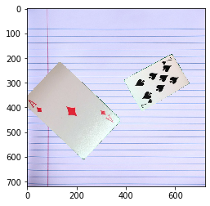
Images in tensor: [N,C,H,W]
import torch
import numpy as np
import imageio
import matplotlib.pyplot as plt
img_np = imageio.imread('../YOLO_v3_tutorial/my_imgs/IMG_card4.jpg')
print(img_np.shape)
(720, 720, 3)
# display the image
plt.imshow(img_np)
plt.show()
img_tensor=torch.from_numpy(img_np)
print(img_tensor.shape)
# torch with the same shape
torch.Size([720, 720, 3])
# display the image
plt.imshow(img_tensor)
plt.show()
out=img_tensor.permute(2,0,1) # Pytorch: Channelxheightxwidth =CxHxW
print(out.shape)
# PyTorch image: (3, H, W)
torch.Size([3, 720, 720])

Slide 21
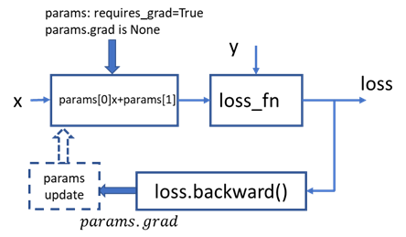
Autograd
Autograd can track and compute the derivatives of a tensor with respect to its source tensors.
Steps:
  Set the source tensor property require_grad to True.
  Compute loss.
  Run loss.backward().
  Get params.grad (accumulated)

Slide 22
Linear regression using autograd
# 1) define the linear model
def model_linear(x,w,b):
y=w*x+b
return y
# 2) define the loss function
def loss_fn(y, label):
se=(y-label)**2
mse=se.mean()
return mse
def training_loop_autograd(n_epochs, learning_rate, params, x, y):
loss_tensor=torch.zeros(n_epochs)
for epoch in range(1, n_epochs+1):
if params.grad is not None:
params.grad.zero_()
w,b=params
y_pred=model_linear(x,w,b)
loss=loss_fn(y_pred,y)
loss.backward()
with torch.no_grad(): # no grad computation involved
params -= learning_rate * params.grad
#params=params-learning_rate*grad
print('Epoch %d, Loss %f' % (epoch, float(loss)))
loss_tensor[epoch-1]=loss
return params, loss_tensor
# Zero gradient
# run backward()
# update parameters
# run the training loop
params, loss_tensor= training_loop_autograd(n_epochs = 100, learning_rate = 0.002,
params =torch.tensor([0.0,0.0], requires_grad=True),
x=x,
y=y)

Slide 23
Linear regression using autograd and optim
From the package torch.optim, we can select and instantiate an optimizer for updating parameters.
import torch.optim as optim
def training_loop_autograd_optim(optimizer, n_epochs, params, x, y):
loss_tensor=torch.zeros(n_epochs)
for epoch in range(1, n_epochs+1):
w,b=params # forward path
y_pred=model_linear(x,w,b)
loss=loss_fn(y_pred,y) # loss
optimizer.zero_grad() # zero grad
loss.backward() # calculate grad by autograd
optimizer.step() # update params by optimizer
print('Epoch %d, Loss %f' % (epoch, float(loss)))
loss_tensor[epoch-1]=loss
return params, loss_tensor
# argument optimizer
# zero gradient in optimizer
# .step() updates parameters
params = torch.tensor([0.0, 0.0], requires_grad=True)
learning_rate = 1e-2
optimizer = optim.RMSprop([params], lr=learning_rate)
params, loss_tensor = training_loop_autograd_optim(n_epochs = 100,optimizer = optimizer,
params = params, x = x, y = y)
# instantiate the optimizer

Slide 24
Datasets and pre-processing in PyTorch
torchvision.datasets
  https://pytorch.org/vision/stable/datasets.html
  download datasets: MNIST, CIFAR, COCO, VOC, CelebA, …
torchvision.transforms
  Pre-process data while downloading
torch.utils.data.DataLoader
  Batch schedule for training loop
import torch
import matplotlib.pyplot as plt
import torch.optim as optim
from torchvision import transforms, datasets
import torch.nn as nn
import torch.nn.functional as F
data_path = './data'
transform = transforms.Compose([transforms.ToTensor(),transforms.Normalize((0.5,0.5,0.5), (0.5, 0.5, 0.5))])
norm_cifar10 = datasets.CIFAR10(data_path, train=True, download=True,transform=transform)
norm_cifar10_test = datasets.CIFAR10(data_path, train=False, download=True,transform=transform)
# redefine labels: 0(airplane),2(bird)-->0(airplane),1(bird)
label_map = {0: 0, 2: 1}
class_names = ['airplane', 'bird']
norm_cifar2 = [(img, label_map[label]) for img, label in norm_cifar10 if label in [0, 2]]
norm_cifar2_test = [(img, label_map[label]) for img, label in norm_cifar10_test if label in [0, 2]]
# create a two-class dataset

Slide 25
Neural network model: two ways
model = nn.Sequential(
nn.Linear(3072,25),
nn.ReLU(),
nn.Linear(25,12),
nn.ReLU(),
nn.Linear(12,2)
)
# nn.Sequential()
# nn.Module()
class Net(nn.Module):
def __init__(self):
super().__init__()
#define layers with learnable parameters
self.fc1 = nn.Linear(3 * 32 * 32, 25)
self.fc2 = nn.Linear(25, 12)
self.fc3 = nn.Linear(12,2)
def forward(self, x):
out = self.fc1(x)
out = F.relu(out)
# function ( no learnable parameters)
out = self.fc2(out)
out = F.relu(out)
out = self.fc3(out)
return out
# 3x32x32
img_batch = img.view(-1).unsqueeze(0)
# shape torch.size [1,3072]
out=model(img_batch)
model=Net()
out = model(img_batch)

Slide 26
Train a neural network
train_loader = torch.utils.data.DataLoader(norm_cifar2, batch_size=64,shuffle=True)
# norm_cifar2: list[[tensor[3,32,32], label], [tensor[3,32,32], label],…]
model=Net()# Net() is used here
learning_rate = 1e-2
optimizer = optim.SGD(model.parameters(), lr=learning_rate)
loss_fn = nn.CrossEntropyLoss()
n_epochs = 100
for epoch in range(n_epochs):
for imgs, labels in train_loader:
batch_size = imgs.shape[0]
#64 for all, except 16 for the last batch, 10000/64=145.25
#print(labels.shape)
outputs = model(imgs.view(batch_size, -1))
# imgs.view(batch_size,-1): [64, 3072]
# outputs: [64,2]
loss = loss_fn(outputs, labels)
# labels: [64]
optimizer.zero_grad()
loss.backward()
optimizer.step()
print("Epoch: %d, Loss: %f" % (epoch, float(loss)))
# train loader
# instantiate the model
# specify optimizer
# define loss function
# loop on epoch
# loop on train loader
# outputs for a batch
# loss for a batch
# zero gradients in optimizer
# backward
# one step update

Slide 27
Validation by test set, access parameters
val_loader = torch.utils.data.DataLoader(norm_cifar2_test, batch_size=64,shuffle=False)
correct = 0
total = 0
with torch.no_grad():
for imgs, labels in val_loader:
batch_size = imgs.shape[0]
outputs = model(imgs.view(batch_size, -1))
values, predicted = torch.max(outputs, dim=1)
# return (values,indices)
#print(predicted)
total += labels.shape[0]
correct += int((predicted == labels).sum())
print("Accuracy: %f" % (correct / total))
# no gradient computation
# batch output
# total number of samples
# the number of corrects
model.parameters
for name, param in model.named_parameters():
if param.requires_grad:
print (name, param.data.shape, param.data)
numel_list = [p.numel() for p in model.parameters()]
sum(numel_list), numel_list
# the overall architecture of a model
# print name, shape, value
# count the number of parameters

Slide 28
Summary
PyTorch is an efficient platform for developing a deep learning model, because it provides:
  Autograd to automatically and numerically compute derivatives.
  Basic modules in neural networks
  Abundant datasets: torchvision.datasets
  Utilities for manipulating datasets: torchvision.transforms, torch.utils.data.DataLoader
With PyTorch, we can build a neural network model by calling the basic layer modules from the PyTorch packages.
With PyTorch, we can train a model without explicitly computing the backward propagation.

