Slide 1
Chapter 4 Basics of Neural Networks

Slide 2
Outline
Evolution from logistic regression to general neural networks
Mathematical representation of neural networks
  Notations
  Equations
  Architecture size
Forward propagation
Loss function for binary classification
Loss function for multi-class classification
Back propagation
Gradient descent algorithm for neural networks
Python examples

Slide 3
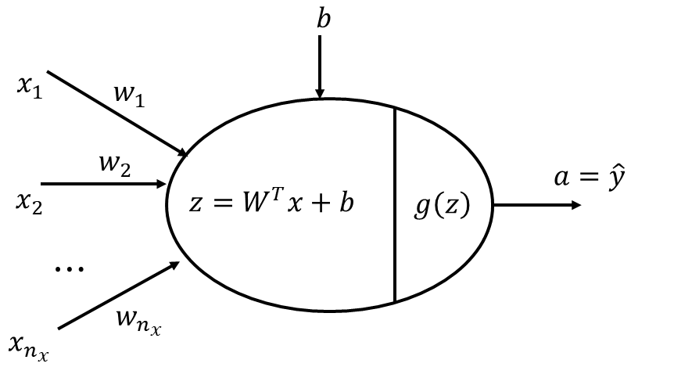
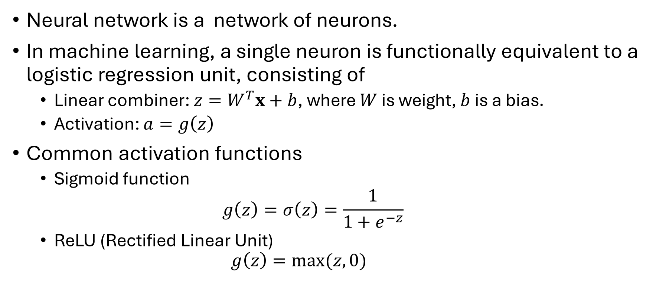
Neuron: a logistic regression model
Neural network is a network of neurons.
In machine learning, a single neuron is functionally equivalent to a logistic regression unit, consisting of
  Linear combiner: ${z=W}^{T}x+b$, where $W$ is weight, $b$ is a bias.
  Activation: $a=g\left(z\right)$
Common activation functions
  Sigmoid function
  $$g\left(z\right)=σ\left(z\right)=\frac{1}{1+e^{−z}}$$
  ReLU (Rectified Linear Unit)
    $$g\left(z\right)=max⁡(z,0)$$

Slide 4
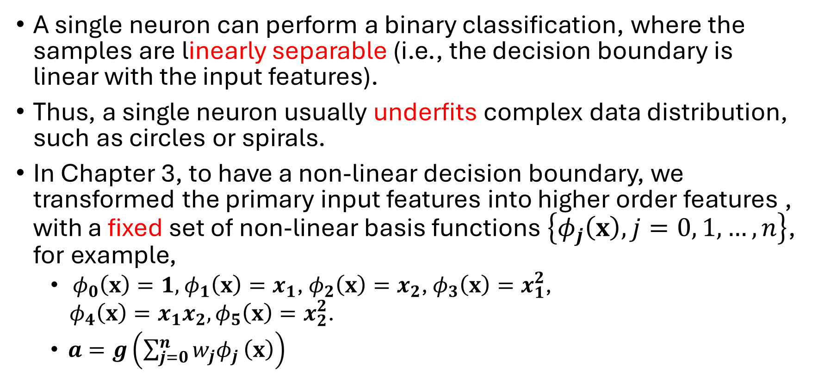
Limitation of a single neuron
A single neuron can perform a binary classification, where the samples are linearly separable (i.e., the decision boundary is linear with the input features).
Thus, a single neuron usually underfits complex data distribution, such as circles or spirals.
In Chapter 3, to have a non-linear decision boundary, we transformed the primary input features into higher order features , with a fixed set of non-linear basis functions $\left\{φ_{j}\left(x\right), j=0, 1, …,n\right\}$, for example,
  $φ_{0}\left(x\right)=1,$ $φ_{1}\left(x\right)=x_{1}$, $φ_{2}\left(x\right)=x_{2}$, $φ_{3}\left(x\right)=x_{1}^{2}$,
  $φ_{4}\left(x\right)=x_{1}x_{2},φ_{5}\left(x\right)=x_{2}^{2}$.
  $a=g\left(\sum_{j=0}^{n}{w_{j}φ_{j}}\left(x\right)\right)$

Slide 5
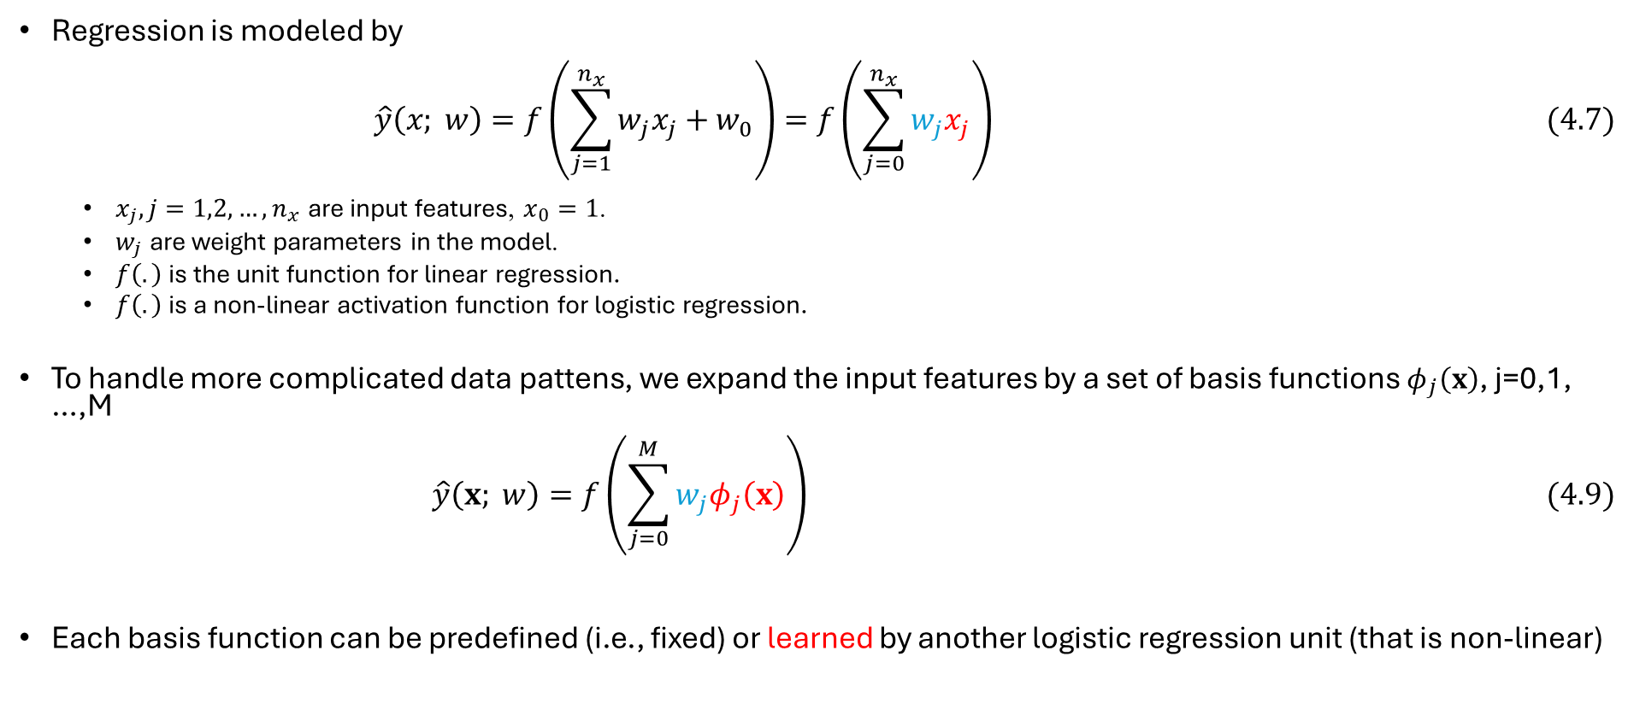
From regression to neural network
Regression is modeled by
$$\hat{y}\left(x; w\right)=f\left(\sum_{j=1}^{n_{x}}{w_{j}x_{j}}+w_{0}\right)=f\left(\sum_{j=0}^{n_{x}}{w_{j}x_{j}}\right) (4.7)$$
  $x_{j}, j=1,2,…, n_{x}$ are input features, $x_{0}=1$.
  $w_{j}$ are weight parameters in the model.
  $f\left(.\right)$ is the unit function for linear regression.
  $f\left(.\right)$ is a non-linear activation function for logistic regression.
To handle more complicated data pattens, we expand the input features by a set of basis functions $φ_{j}\left(x\right)$, j=0,1, …,M
$$\hat{y}\left(x; w\right)=f\left(\sum_{j=0}^{M}{w_{j}φ_{j}\left(x\right)}\right) (4.9)$$
Each basis function can be predefined (i.e., fixed) or learned by another logistic regression unit (that is non-linear)

Slide 6
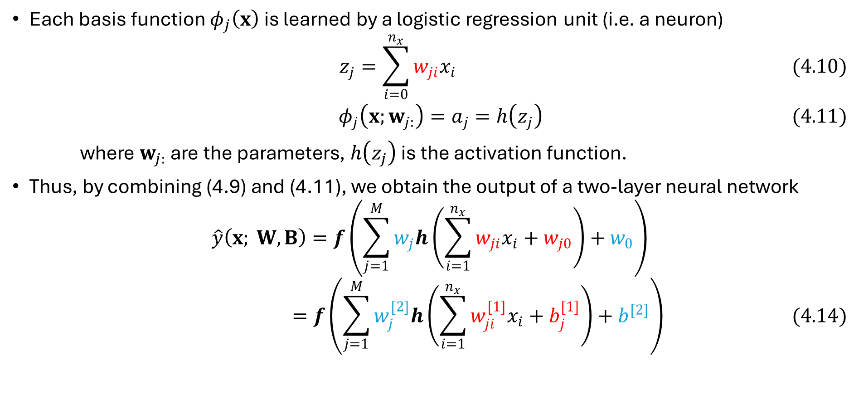
Two-layer neural network: math equation
Each basis function $φ_{j}\left(x\right)$ is learned by a logistic regression unit (i.e. a neuron)
$$z_{j}=\sum_{i=0}^{n_{x}}{w_{ji}x_{i}} (4.10)$$
$$φ_{j}\left(x;w_{j:}\right)=a_{j}=h\left(z_{j}\right) (4.11)$$
where $w_{j:}$ are the parameters, $h\left(z_{j}\right)$ is the activation function.
Thus, by combining (4.9) and (4.11), we obtain the output of a two-layer neural network
$$\hat{y}\left(x; W, B\right)=f\left(\sum_{j=1}^{M}{w_{j}h\left(\sum_{i=1}^{n_{x}}{w_{ji}x_{i}}+w_{j0}\right)}+w_{0}\right)$$
$$=f\left(\sum_{j=1}^{M}{w_{j}^{[2]}h\left(\sum_{i=1}^{n_{x}}{w_{ji}^{[1]}x_{i}}+b_{j}^{[1]}\right)}+b^{[2]}\right) (4.14)$$

Slide 7
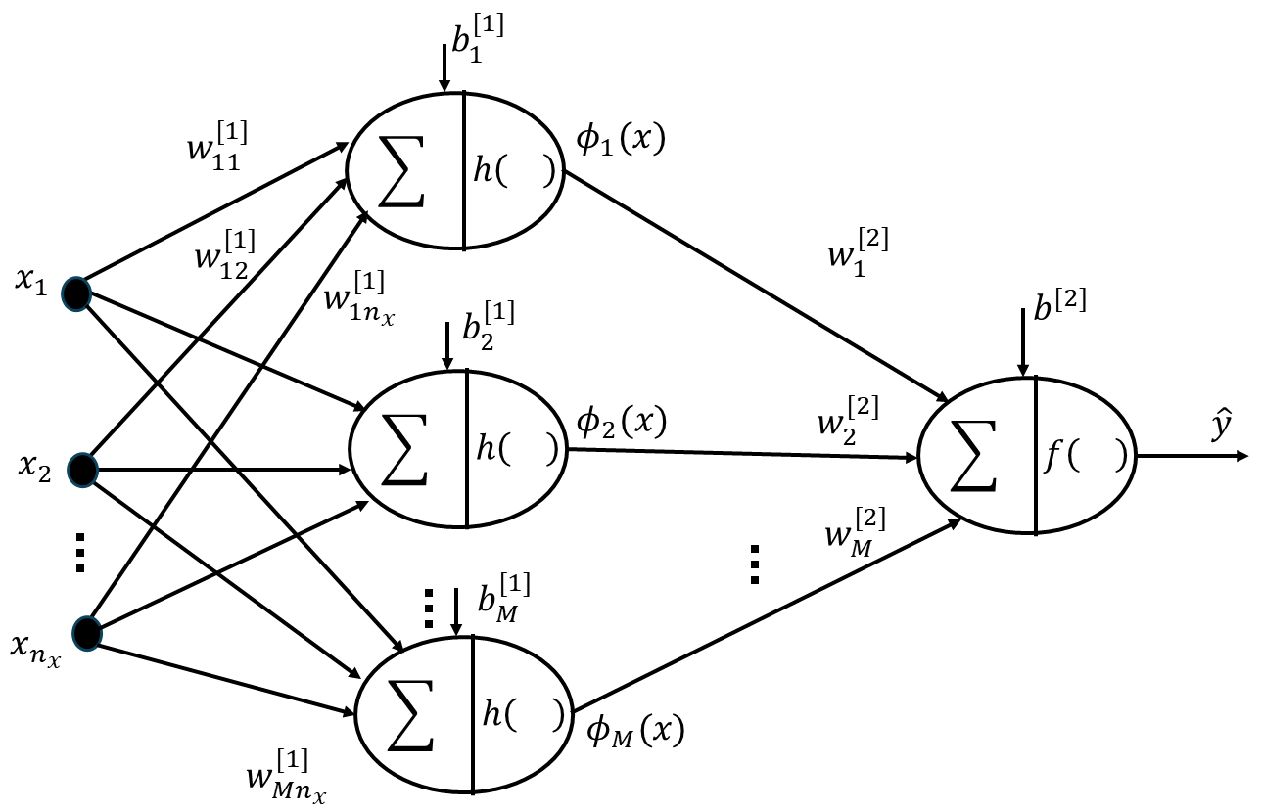
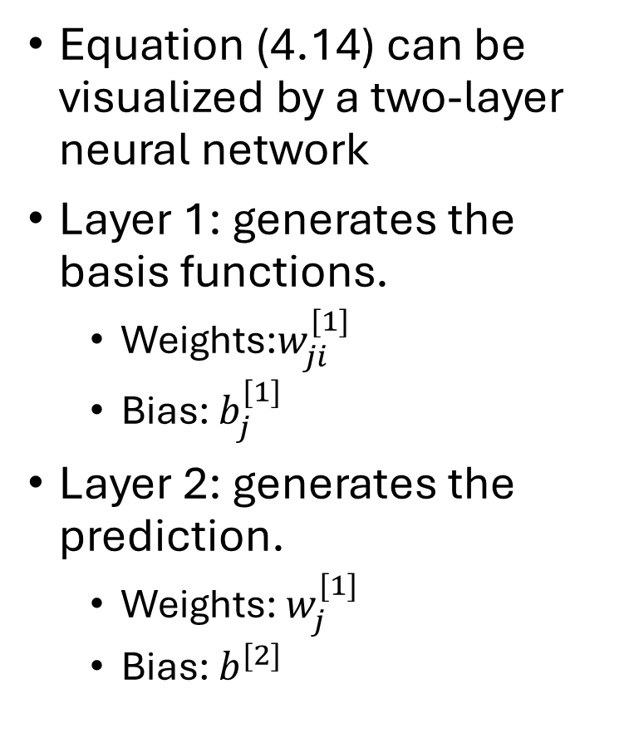
Two-layer neural network: diagram
Equation (4.14) can be visualized by a two-layer neural network
Layer 1: generates the basis functions.
  Weights:$w_{ji}^{[1]}$
  Bias: $b_{j}^{[1]}$
Layer 2: generates the prediction.
  Weights: $w_{j}^{[1]}$
  Bias: $b^{[2]}$

Slide 8
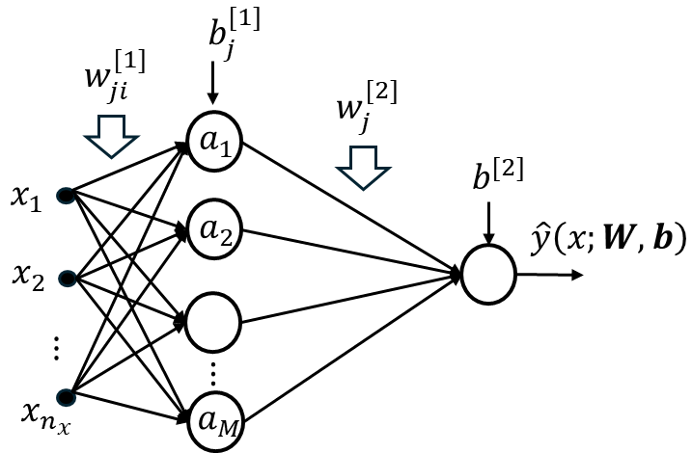
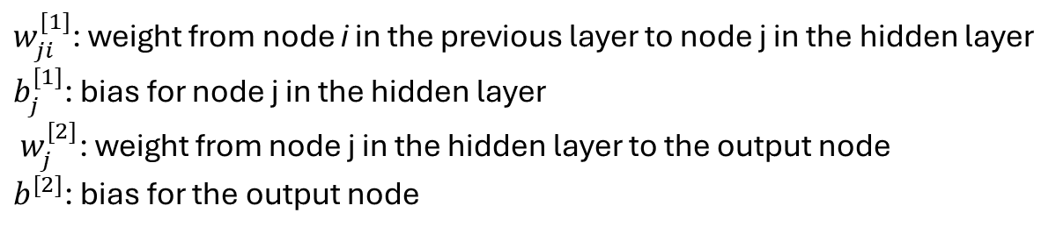
Two-layer neural network: concise diagram
$w_{ji}^{[1]}$: weight from node i in the previous layer to node j in the hidden layer
$b_{j}^{[1]}$: bias for node j in the hidden layer
$w_{j}^{[2]}$: weight from node j in the hidden layer to the output node
$b^{[2]}$: bias for the output node

Slide 9
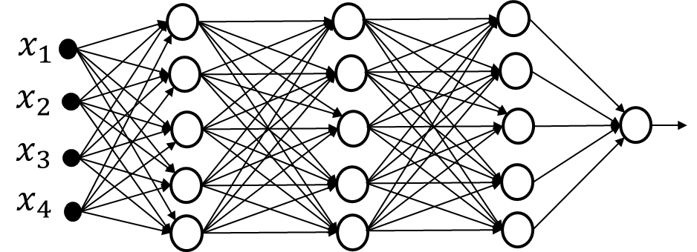
Multi-layer neural networks in general

Slide 10
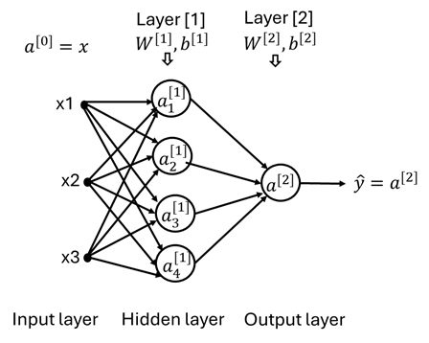
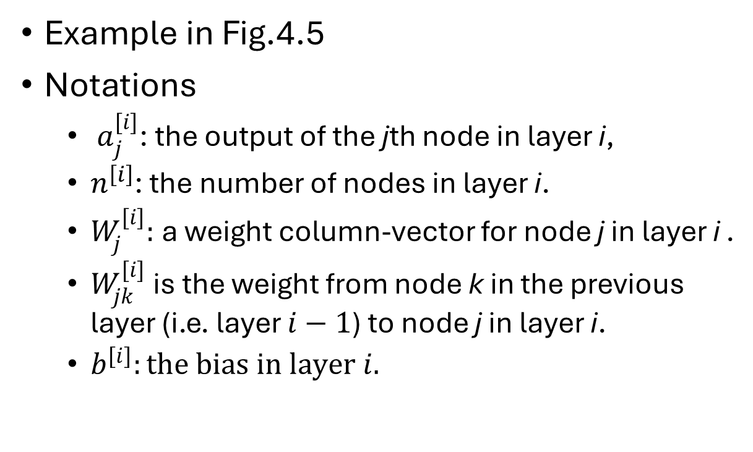
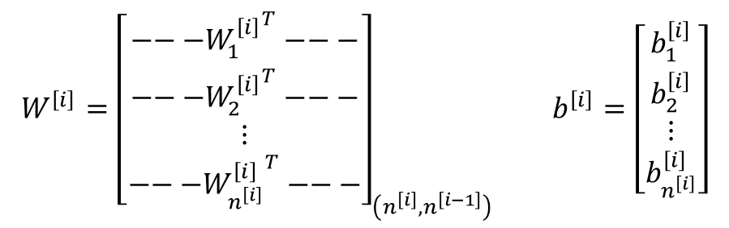
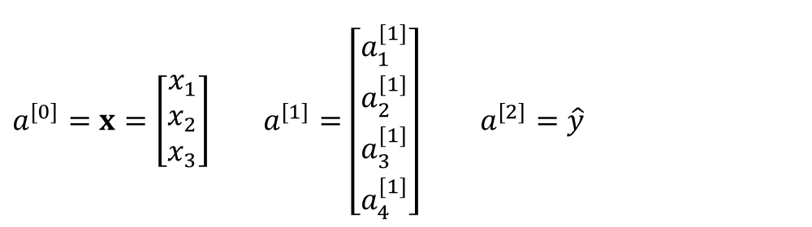
Mathematical notations for neural networks
Example in Fig.4.5
Notations
  $a_{j}^{[i]}$: the output of the jth node in layer i,
  $n^{\left[i\right]}$: the number of nodes in layer i.
  $W_{j}^{[i]}:$a weight column-vector for node j in layer i .
  $W_{jk}^{[i]}$ is the weight from node k in the previous layer (i.e. layer $i−1$) to node j in layer i.
  $b^{[i]}:the bias in layer i.$
Fig.4.5 A two-layer neural network
$$W^{\left[i\right]}={\left[\begin{matrix}{{−−−W}_{1}^{\left[i\right]}}^{T}−−− \\ \begin{matrix}{{−−−W}_{2}^{\left[i\right]}}^{T}−−− \\ ⋮\end{matrix} \\ {{−−−W}_{n^{\left[i\right]}}^{\left[i\right]}}^{T}−−−\end{matrix}\right]}_{\left(n^{\left[i\right]},n^{\left[i−1\right]}\right)} b^{\left[i\right]}=\left[\begin{matrix}b_{1}^{\left[i\right]} \\ \begin{matrix}b_{2}^{\left[i\right]} \\ ⋮\end{matrix} \\ b_{n^{\left[i\right]}}^{\left[i\right]}\end{matrix}\right]$$
$a^{[0]}=x=\left[\begin{matrix}x_{1} \\ x_{2} \\ x_{3}\end{matrix}\right]$ $a^{[1]}=\left[\begin{matrix}a_{1}^{[1]} \\ \begin{matrix}a_{2}^{[1]} \\ a_{3}^{[1]}\end{matrix} \\ a_{4}^{[1]}\end{matrix}\right]$ $a^{[2]}=\hat{y}$

Slide 11
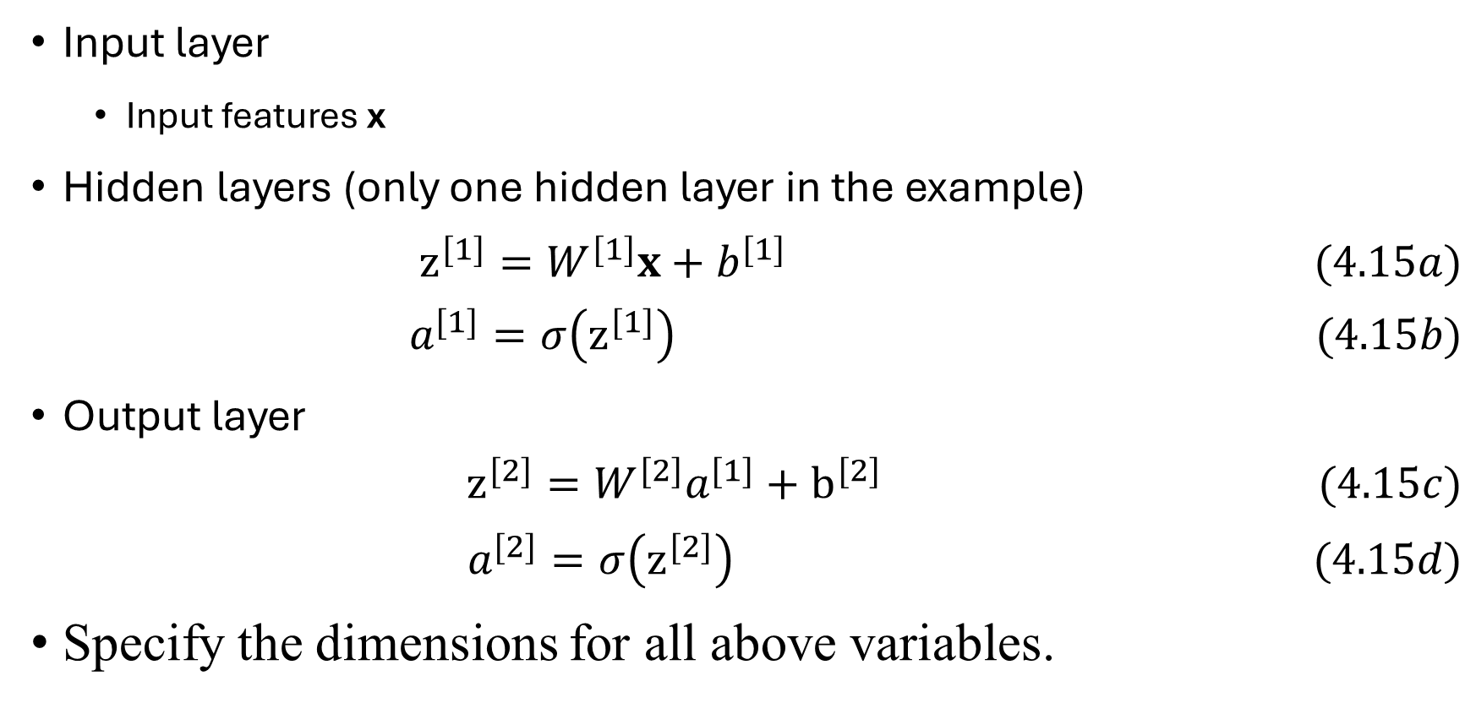
Forward propagation ( one sample)
Input layer
  Input features x
Hidden layers (only one hidden layer in the example)
$z^{[1]}=W^{[1]}x+b^{[1]} (4.15a)$
$$a^{[1]}=σ\left(z^{[1]}\right) (4.15b)$$
Output layer
$$z^{[2]}=W^{[2]}a^{[1]}+b^{[2]} (4.15c)$$
$$a^{[2]}=σ\left(z^{[2]}\right) (4.15d)$$
Specify the dimensions for all above variables.

Slide 12
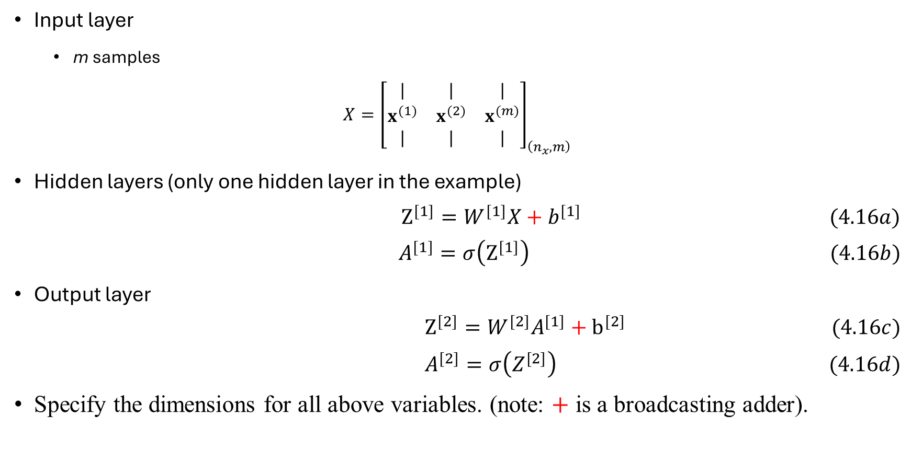
Forward propagation ( a batch of samples)
Input layer
  m samples
$$X={\left[\begin{matrix}| & | & | \\ x^{(1)} & x^{(2)} & x^{(m)} \\ | & | & |\end{matrix}\right]}_{\left(n_{x}, m\right)}$$
Hidden layers (only one hidden layer in the example)
$Z^{[1]}=W^{[1]}X+b^{[1]} (4.16a)$
$$A^{[1]}=σ\left(Z^{[1]}\right) (4.16b)$$
Output layer
$$Z^{[2]}=W^{[2]}A^{[1]}+b^{[2]} (4.16c)$$
$$A^{[2]}=σ\left(Z^{[2]}\right) (4.16d)$$
Specify the dimensions for all above variables. (note: $+$ is a broadcasting adder).

Slide 13
Network training: back propagation
How to find the optimal values for the parameters, given a training set?
  Define a loss function.
  Calculate the gradient of loss with respect to all parameters (W and b).
  Apply gradient descent algorithm for updating the parameters, iteratively.
  Note that the process of calculating the gradient starts with the output layer and proceeds backward towards to the first layer, using chain rule.
    Detailed in the next few slides

Slide 14
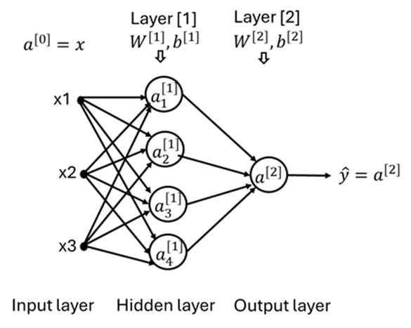
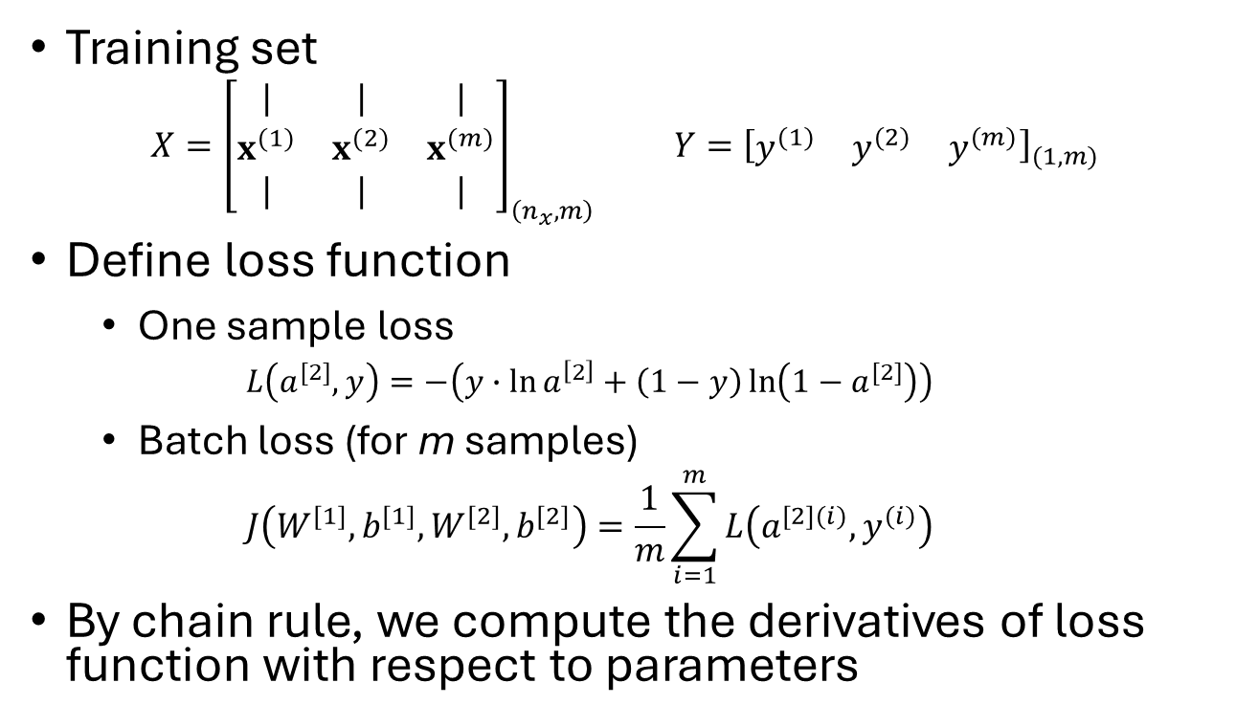
Back propagation (1/4)
Training set
$$X={\left[\begin{matrix}| & | & | \\ x^{(1)} & x^{(2)} & x^{(m)} \\ | & | & |\end{matrix}\right]}_{\left(n_{x}, m\right)} Y={\left[\begin{matrix}y^{(1)} & y^{(2)} & y^{(m)}\end{matrix}\right]}_{(1,m)}$$
Define loss function
  One sample loss
  $$L\left(a^{[2]}, y\right)=−\left(y∙\ln{a^{\left[2\right]}}+\left(1−y\right)\ln\left(1−a^{[2]}\right)\right)$$
  Batch loss (for m samples)
  $$J\left(W^{[1]},b^{[1]},W^{[2]},b^{[2]}\right)=\frac{1}{m}\sum_{i=1}^{m}{L\left(a^{[2](i)},y^{(i)}\right)}$$
By chain rule, we compute the derivatives of loss function with respect to parameters

Slide 15




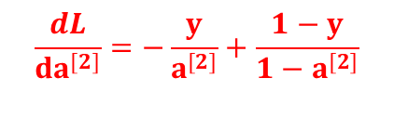












Back propagation (2/4)
$$z^{[1]}$$
$$a^{[1]}$$
$$z^{[2]}$$
$$a^{[2]}$$
$z^{[1]}=W^{[1]}x+b^{[1]}$
$$a^{[1]}=g^{[1]}\left(z^{[1]}\right)$$
$z^{[2]}=W^{[2]}a^{[1]}+b^{[2]}$
$$a^{[2]}=σ\left(Z^{[2]}\right)$$
$$L\left(a^{[2]},y\right)$$
$$\frac{dL}{dz^{[1]}}=\frac{dL}{da^{[1]}}∗{g^{[1]}}^{′}\left(z^{[1]}\right)$$
$$\frac{dL}{dz^{[2]}}=a^{[2]}−y$$
$$\frac{dL}{da^{[2]}}=−\frac{y}{a^{[2]}}+\frac{1−y}{1−a^{[2]}}$$
$$\frac{dL}{da^{[1]}}={W^{[2]}}^{T}\frac{dL}{dz^{[2]}}$$
$$\frac{dL}{dW^{\left[2\right]}}=\frac{dL}{dz^{[2]}}{a^{\left[1\right]}}^{T}$$
$$\frac{dL}{dW^{[1]}}=\frac{dL}{dz^{[1]}}x^{T}$$
$$\frac{dL}{db^{\left[2\right]}}=\frac{dL}{dz^{[2]}}$$
$$\frac{dL}{db^{[1]}}=\frac{dL}{dz^{[1]}}$$
Forward propagation
Derivative backpropagation

Slide 16
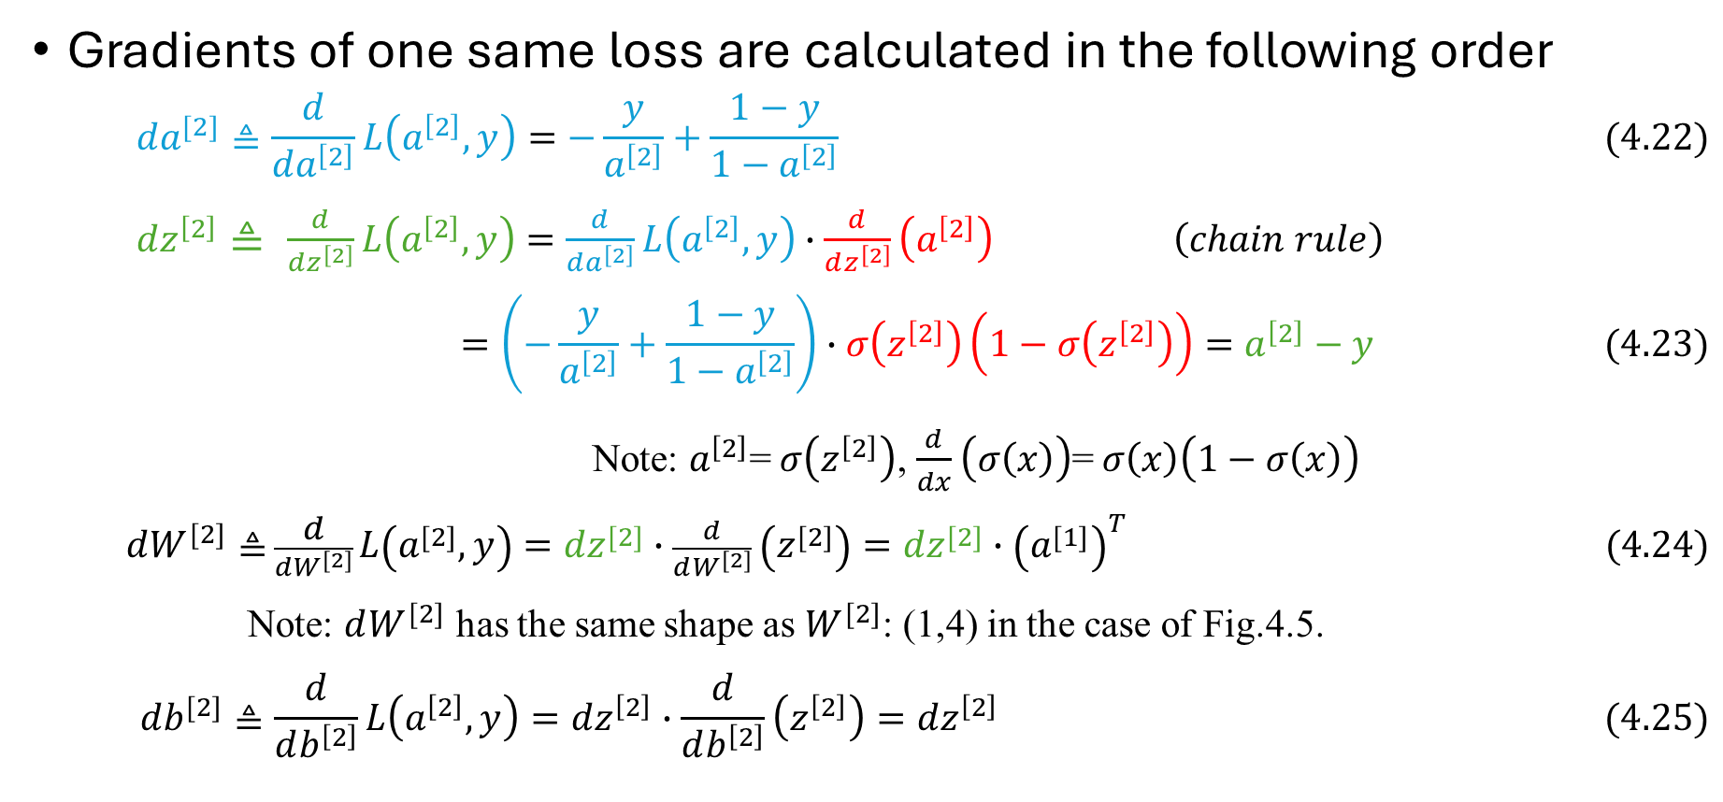
Back propagation (3/4)
Gradients of one same loss are calculated in the following order
  $$da^{[2]}≜\frac{d}{da^{\left[2\right]}}L\left(a^{\left[2\right]}, y\right)=−\frac{y}{a^{\left[2\right]}}+\frac{1−y}{1−a^{\left[2\right]}} (4.22)$$
$dz^{\left[2\right]}≜ \frac{d}{dz^{\left[2\right]}}L\left(a^{\left[2\right]}, y\right)=\frac{d}{da^{\left[2\right]}}L\left(a^{\left[2\right]}, y\right)∙\frac{d}{dz^{\left[2\right]}}\left(a^{\left[2\right]}\right) \left(chain rule\right)$
$$=\left(−\frac{y}{a^{\left[2\right]}}+\frac{1−y}{1−a^{\left[2\right]}}\right)∙σ\left(z^{\left[2\right]}\right)\left(1−σ\left(z^{\left[2\right]}\right)\right)=a^{\left[2\right]}−y (4.23)$$
Note: $a^{\left[2\right]}$= $σ\left(z^{\left[2\right]}\right)$, $\frac{d}{dx}\left(σ\left(x\right)\right)$= $σ\left(x\right)\left(1−σ\left(x\right)\right)$
  $dW^{[2]}≜$ $\frac{d}{dW^{\left[2\right]}}L\left(a^{\left[2\right]}, y\right)=dz^{\left[2\right]}∙\frac{d}{dW^{\left[2\right]}}\left(z^{\left[2\right]}\right)=dz^{\left[2\right]}∙{\left(a^{\left[1\right]}\right)}^{T} (4.24)$
Note: $dW^{[2]}$ has the same shape as $W^{[2]}$: (1,4) in the case of Fig.4.5.
$$db^{[2]}≜\frac{d}{db^{\left[2\right]}}L\left(a^{\left[2\right]}, y\right)=dz^{\left[2\right]}∙\frac{d}{db^{\left[2\right]}}\left(z^{\left[2\right]}\right)=dz^{\left[2\right]} (4.25)$$

Slide 17
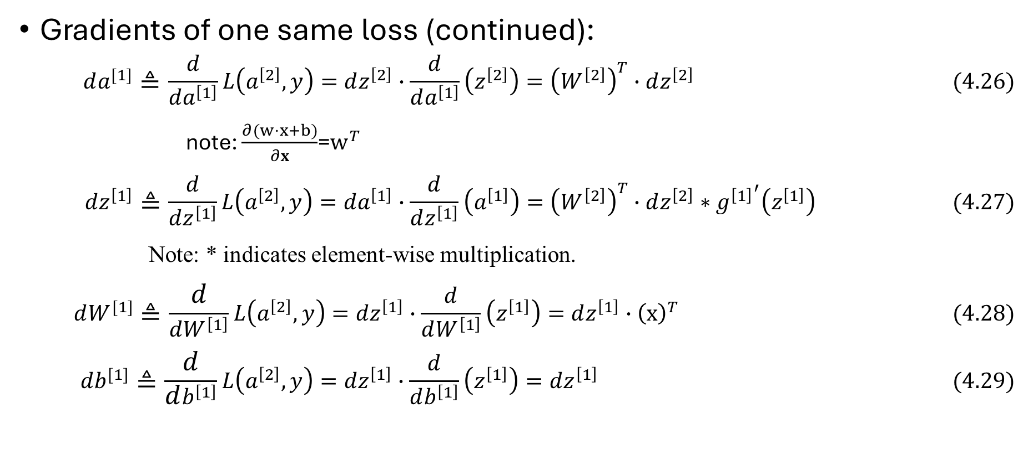
Back propagation (4/4)
Gradients of one same loss (continued):
  $$da^{[1]}≜\frac{d}{da^{\left[1\right]}}L\left(a^{\left[2\right]}, y\right)=dz^{\left[2\right]}∙\frac{d}{da^{\left[1\right]}}\left(z^{\left[2\right]}\right)={\left(W^{\left[2\right]}\right)}^{T}∙dz^{\left[2\right]} (4.26)$$
note: $\frac{∂(w⋅x+b)}{∂x}$=$w^{T}$
$$dz^{\left[1\right]}≜\frac{d}{dz^{\left[1\right]}}L\left(a^{\left[2\right]}, y\right)=da^{\left[1\right]}∙\frac{d}{dz^{\left[1\right]}}\left(a^{\left[1\right]}\right)={\left(W^{\left[2\right]}\right)}^{T}∙dz^{\left[2\right]}∗{g^{\left[1\right]}}^{′}\left(z^{\left[1\right]}\right) (4.27)$$
Note: * indicates element-wise multiplication.
$$dW^{[1]}≜\frac{d}{dW^{\left[1\right]}}L\left(a^{\left[2\right]}, y\right)=dz^{\left[1\right]}∙\frac{d}{dW^{\left[1\right]}}\left(z^{\left[1\right]}\right)=dz^{\left[1\right]}∙{\left(x\right)}^{T} (4.28)$$
$$db^{[1]}≜\frac{d}{db^{\left[1\right]}}L\left(a^{\left[2\right]}, y\right)=dz^{\left[1\right]}∙\frac{d}{db^{\left[1\right]}}\left(z^{\left[1\right]}\right)=dz^{\left[1\right]} (4.29)$$

Slide 18
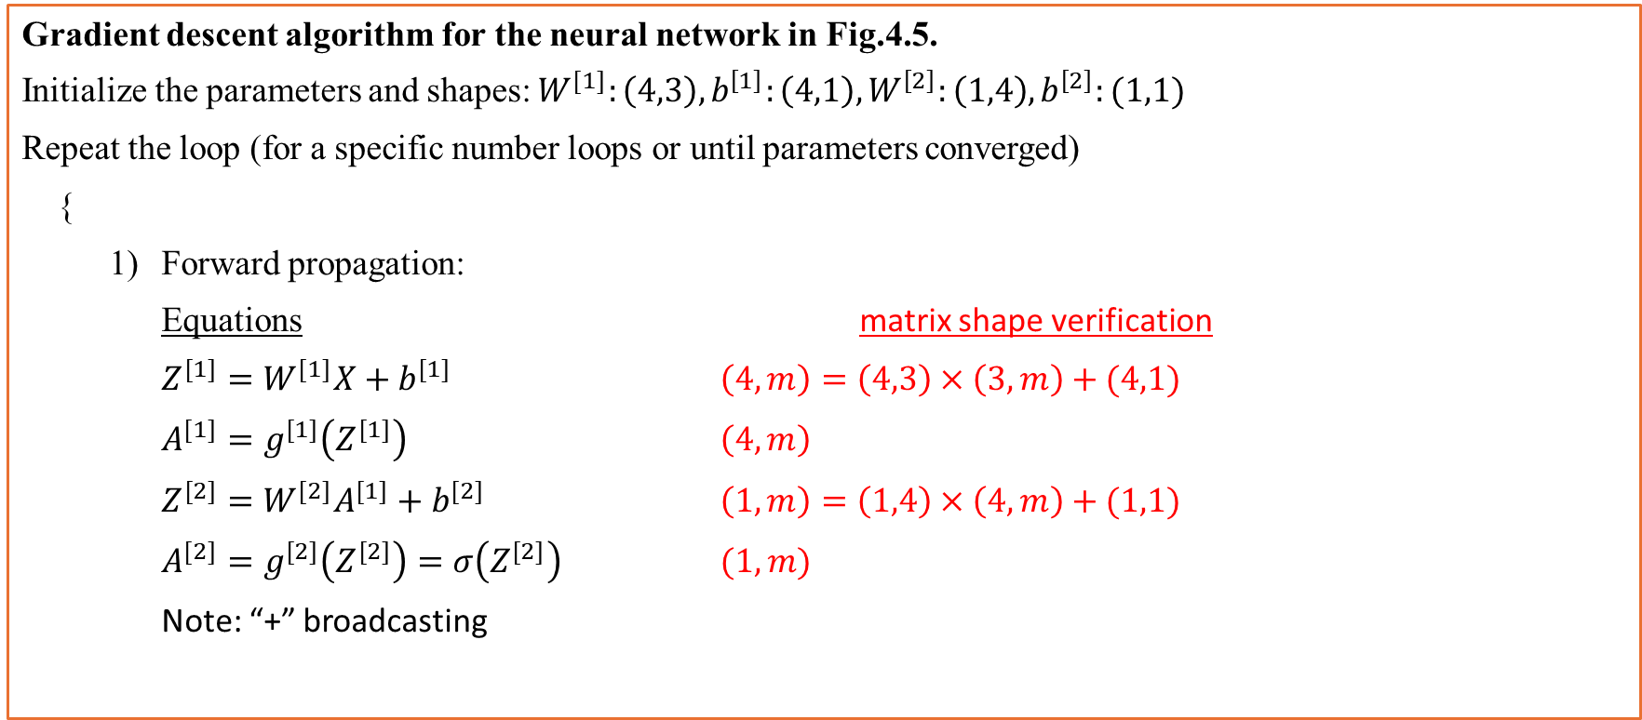
Gradient descent algorithm for NNs (1/2)
Gradient descent algorithm for the neural network in Fig.4.5.
Initialize the parameters and shapes: $W^{[1]}:\left(4,3\right),b^{\left[1\right]}:\left(4,1\right),W^{\left[2\right]}:\left(1,4\right),b^{\left[2\right]}:(1,1)$
Repeat the loop (for a specific number loops or until parameters converged)
{
Forward propagation:
Equations matrix shape verification
$Z^{[1]}=W^{[1]}X+b^{[1]}$ $\left(4,m\right)=\left(4,3\right)×\left(3,m\right)+(4,1)$
$A^{[1]}=g^{[1]}\left(Z^{[1]}\right)$ $\left(4,m\right)$
$Z^{[2]}=W^{[2]}A^{[1]}+b^{[2]}$ $\left(1,m\right)=\left(1,4\right)×\left(4,m\right)+(1,1)$
$A^{[2]}=g^{[2]}\left(Z^{[2]}\right)=σ\left(Z^{[2]}\right)$ $(1,m)$
Note: “+” broadcasting

Slide 19
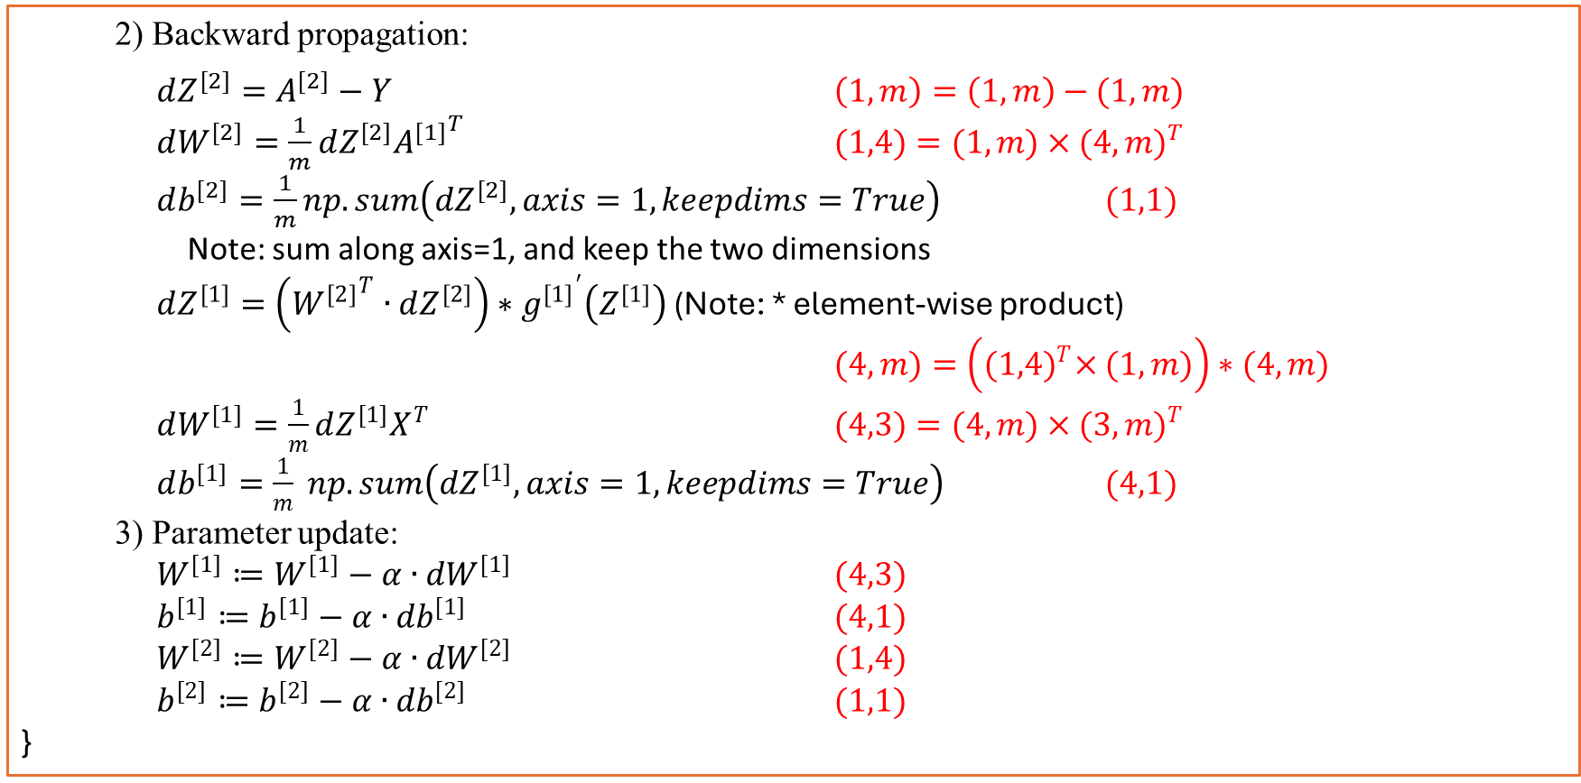
Gradient descent algorithm for NNs (2/2)
2) Backward propagation:
$dZ^{[2]}=A^{[2]}−Y$ $\left(1,m\right)=\left(1,m\right)−(1,m)$
$dW^{[2]}=\frac{1}{m}dZ^{[2]}{A^{[1]}}^{T}$ $(1,4)=(1,m)×{(4,m)}^{T}$
$db^{[2]}=\frac{1}{m}np.sum\left(dZ^{[2]},axis=1, keepdims=True\right)$ $(1,1)$
Note: sum along axis=1, and keep the two dimensions
$dZ^{[1]}=\left({W^{[2]}}^{T}∙dZ^{[2]}\right)∗{g^{[1]}}^{′}\left(Z^{[1]}\right)$ (Note: * element-wise product)
$(4,m)=\left({(1,4)}^{T}×(1,m)\right)∗(4,m)$
$dW^{[1]}=\frac{1}{m}dZ^{[1]}X^{T}$ $(4,3)=(4,m)×{(3,m)}^{T}$
$db^{[1]}=\frac{1}{m} np.sum\left(dZ^{[1]}, axis=1, keepdims=True\right)$ $(4,1)$
3) Parameter update:
$W^{[1]}≔W^{[1]}−{α∙dW}^{[1]}$ $(4,3)$
$b^{[1]}≔b^{[1]}−{α∙db}^{[1]}$ $(4,1)$
$W^{[2]}≔W^{[2]}−{α∙dW}^{[2]}$ $(1,4)$
$b^{[2]}≔b^{[2]}−{α∙db}^{[2]}$ $(1,1)$
}

Slide 20

Multi-class classification task
Inputs
$$X={\left[\begin{matrix}| & | & | \\ x^{(1)} & x^{(2)} & x^{(m)} \\ | & | & |\end{matrix}\right]}_{\left(n_{x}, m\right)}$$
Labels
${y=\left[1, 4, 2, …, 3\right]}_{\left(1, m\right)}$ 4-class classification
or $Y=\left[\begin{matrix}1 & 0 \\ 0 & 0 \\ \begin{matrix}0 \\ 0\end{matrix} & \begin{matrix}0 \\ 1\end{matrix}\end{matrix} \begin{matrix} 0… & 0 \\ 1 … & 0 \\ \begin{matrix} 0 … \\ 0 …\end{matrix} & \begin{matrix}1 \\ 0\end{matrix}\end{matrix}\right]$ (one –hot code)

Slide 21





















Multi-class classification network architecture
The output layer consists of multiple nodes; each node delivers the probability of one class for the input.
Layer 5
softmax
linear
Layer 2
$\frac{exp\left(z_{1}\right)}{\sum_{k=1}^{4}{exp\left(z_{k}\right)}}$
Layer 4
$a_{1}^{[5]}$=$P(y=1|x)$
Layer 1
Layer 3
$$z_{1}$$
$$z_{2}$$
$\frac{exp\left(z_{1}\right)}{\sum_{k=1}^{4}{exp\left(z_{k}\right)}}$
$$a^{[1]}$$
$$a^{[2]}$$
$$a^{[3]}$$
$$a^{[4]}$$
$a_{2}^{[5]}$=$P(y=2|x)$
$$x$$
$$z_{3}$$
$\frac{exp\left(z_{1}\right)}{\sum_{k=1}^{4}{exp\left(z_{k}\right)}}$
$a_{3}^{[5]}$=$P(y=3|x)$
$$z_{4}$$
$\frac{exp\left(z_{1}\right)}{\sum_{k=1}^{4}{exp\left(z_{k}\right)}}$
$a_{4}^{[5]}$=$P(y=4|x)$

Slide 22
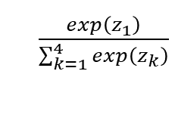



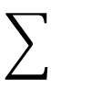


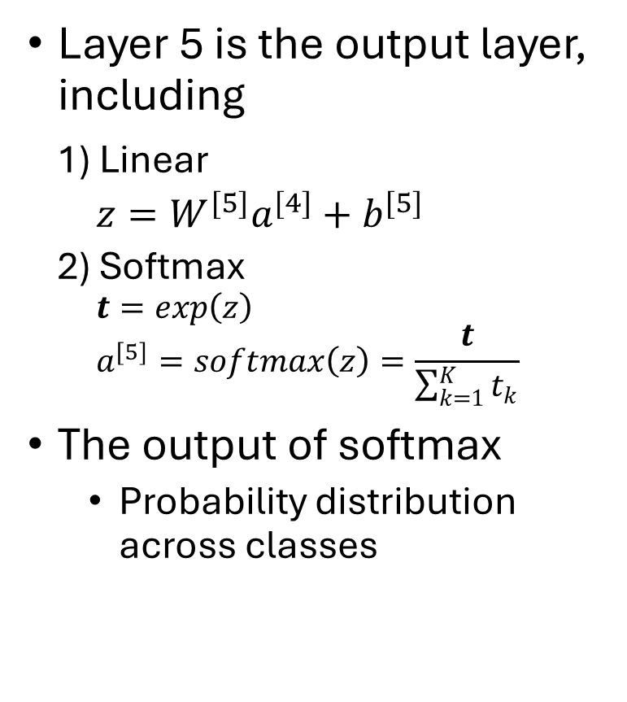

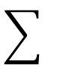
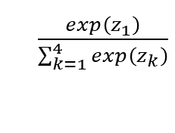


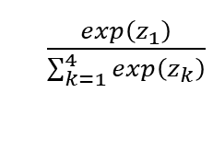

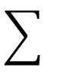
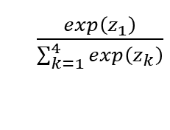

Softmax layer
Layer 5 is the output layer, including
1) Linear
  $z=W^{[5]}a^{[4]}+b^{[5]}$
  2) Softmax
$$t=exp\left(z\right)$$
$$a^{[5]}=softmax\left(z\right)=\frac{t}{\sum_{k=1}^{K}{t_{k}}}$$
The output of softmax
  Probability distribution across classes
Layer 5
softmax
linear
$\frac{exp\left(z_{1}\right)}{\sum_{k=1}^{4}{exp\left(z_{k}\right)}}$
$a_{1}^{[5]}$=$P(y=1|x)$
Layer 4
$$z_{1}$$
$$z_{2}$$
$\frac{exp\left(z_{1}\right)}{\sum_{k=1}^{4}{exp\left(z_{k}\right)}}$
$$a^{[4]}$$
$a_{2}^{[5]}$=$P(y=2|x)$
$$z_{3}$$
$\frac{exp\left(z_{1}\right)}{\sum_{k=1}^{4}{exp\left(z_{k}\right)}}$
$a_{3}^{[5]}$=$P(y=3|x)$
$$z_{4}$$
$\frac{exp\left(z_{1}\right)}{\sum_{k=1}^{4}{exp\left(z_{k}\right)}}$
$a_{4}^{[5]}$=$P(y=4|x)$

Slide 23
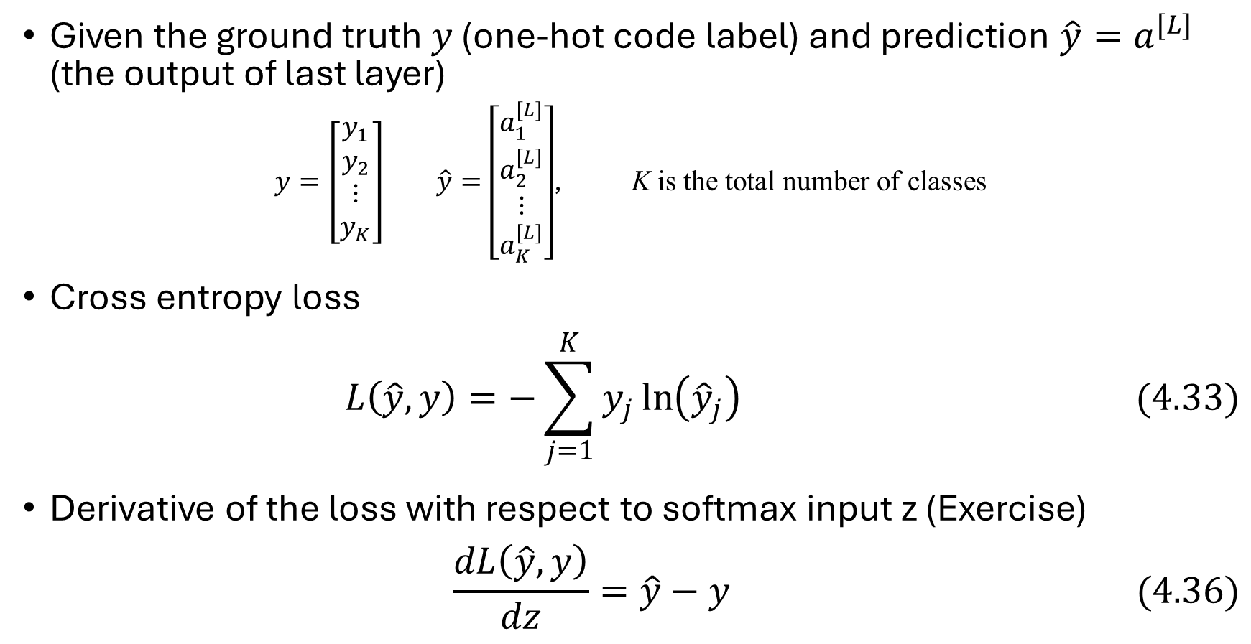
Loss function: cross entropy loss
Given the ground truth $y$ (one-hot code label) and prediction $\hat{y}=a^{[L]}$ (the output of last layer)
$y=\left[\begin{matrix}y_{1} \\ y_{2} \\ \begin{matrix}⋮ \\ y_{K}\end{matrix}\end{matrix}\right]$ $\hat{y}=\left[\begin{matrix}a_{1}^{[L]} \\ a_{2}^{[L]} \\ \begin{matrix}⋮ \\ a_{K}^{[L]}\end{matrix}\end{matrix}\right]$, K is the total number of classes
Cross entropy loss
$$L\left(\hat{y}, y\right)=−\sum_{j=1}^{K}{y_{j}\ln\left({\hat{y}}_{j}\right)} (4.33)$$
Derivative of the loss with respect to softmax input z (Exercise)
$$\frac{dL\left(\hat{y}, y\right)}{dz}=\hat{y}−y (4.36)$$

Slide 24








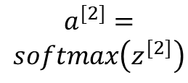




Forward and back propagation
$z^{[1]}=W^{[1]}x+b^{[1]}$
$$a^{[1]}=g^{[1]}\left(Z^{[1]}\right)$$
$z^{[2]}=W^{[2]}a^{[1]}+b^{[2]}$
$$a^{[2]}=$$
$$softmax\left(z^{[2]}\right)$$
$$L\left(a^{[2]},y\right)$$
$$dz^{[1]}={W^{[2]}}^{T}dz^{[2]}∗{g^{[1]}}^{′}\left(z^{[1]}\right)$$
$$da^{[2]}=−\frac{y}{a^{[2]}}$$
$$da^{[1]}={W^{[2]}}^{T}dz^{[2]}$$
$$dz^{[2]}=a^{[2]}−y$$
$$dW^{\left[2\right]}=dz^{\left[2\right]}{a^{\left[1\right]}}^{T}$$
$$dW^{\left[1\right]}=dz^{\left[1\right]}x^{T}$$
$$db^{\left[2\right]}=dz^{[2]}$$
$$db^{[1]}=dz^{[1]}$$

Slide 25
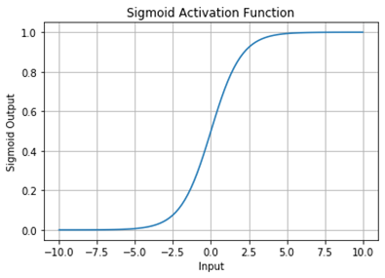
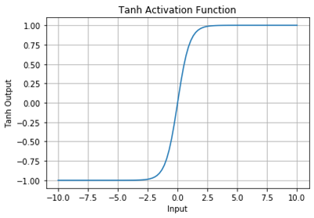
Activation functions

Slide 26
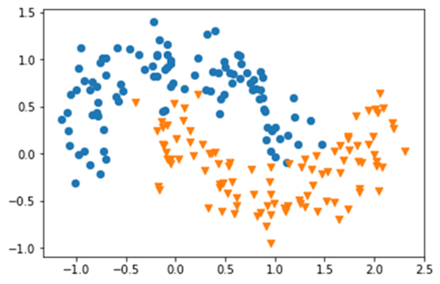











Practice in Python: binary classification
Dataset: sklearn.datasets.make_moons(n_samples=m, noise=.2)
Network architecture:
  Hidden layer: 4 nodes, tanh() activation
  Output layer: 1 node, sigmoid activation
Layer [1]
Layer [2]
$$W^{[1]}, b^{[1]}$$
$$W^{[2]}, b^{[2]}$$
$$a^{[0]}=\left[\begin{matrix}x_{1} \\ x_{2}\end{matrix}\right]$$
$$a_{1}^{[1]}$$
$$x_{1}$$
$$a_{2}^{[1]}$$
$$a^{[2]}$$
$$\hat{y}=a^{[2]}$$
$$x_{2}$$
$$a_{3}^{[1]}$$
$$a_{4}^{[1]}$$
Input layer
Output layer
Hidden layer

Slide 27

Practice in Python: binary classification
Note: see textbook for more details, or GitHub: https://github.com/weidongkuang/deep-learning-book
# Import packages
# Generate dataset
# define sigmoid function

Slide 28
# get the layer size from dataset dimension
# randomly initialize all weights, set bias to zero

Slide 29
# compute loss
# compute forward propagation

Slide 30

# update parameters using gradients
# compute gradients
$$\tanh{(z)′}⁡=1−{(\tanh{(z)})}^{2}$$

Slide 31
# predict labels given inputs X and parameters
# training loop

Slide 32
# a common function to plot decision boundary
# for binary classification
# train the model
# visualize the result

Slide 33
# the results

Slide 34
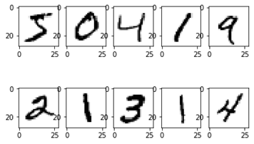
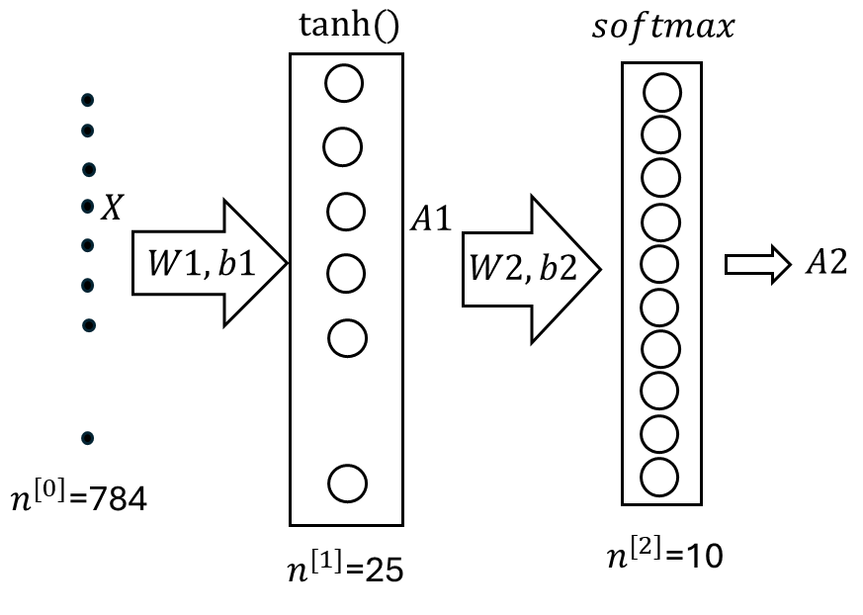
Practice in Python: multi-class classification
Dataset: MNIST
  Handwritten digits
  28x28 pixels, gray
  60000 training samples, 10000 testing samples
  Neural network
    784 input features
    Hidden layer 25 nodes
    Output layer 10 nodes
Python code:
  Textbook
  Book GitHub
samples

Slide 35
Summary
A neural network consists of multiple layers; each layer includes multiple neurons (or nodes).
In a fully connected neural network, each node in one layer is connected to every node in the next layer.
Forward propagation: a neural network can be represented by a sequence of equations; each layer is represented by a linear matrix equation followed by an activation function.
Back propagation: a neural network can be trained by a gradient descent algorithm where the gradient is computed in a backward direction using chain rule.
Implementations by Python have been provided.

