Slide 1
Chapter 3 Classification and Logistic Regression

Slide 2
Outline
Definition of classification
Logistic regression model
  Model equation
  Loss function: binary cross entropy loss
  Gradient
Gradient descent algorithm for logistic regression
Metrics of classification
Example in Python

Slide 3
Regression vs. Classification
In a regression task, the model predicts a continuous label, e.g., linear regression discussed in Chapter 2.
In a classification task, the model maps a specific input to a specific category, i.e., predicts a discrete label.
For example,
Logistic regression, regardless of the name “regression”, performs a classification task, though it evolves from linear regression.
Input (X) | Categorical label or class (y)
Email | y=0 (not spam), y=1 (spam)
Online Transaction | y=0 (not fraudulent), y=1 (fraudulent)
Tumor feature | y=0 (benign), y=1 (malignant)

Slide 4
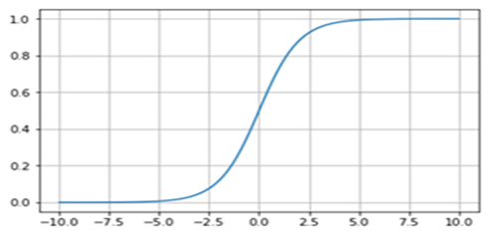




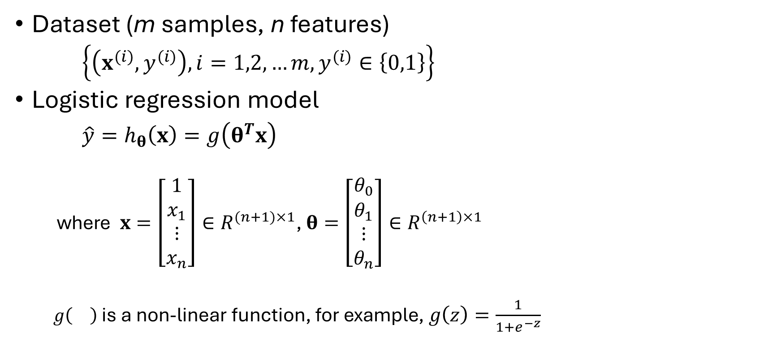








Logistic regression model
1
$$θ_{0}$$
$$x_{1}$$
$$θ_{1}$$
Dataset (m samples, n features)
$\left\{\left(x^{(i)},y^{(i)}\right), i=1,2,…m, y^{(i)}∈\left\{0,1\right\}\right\}$
Logistic regression model
${\hat{y}=h}_{θ}\left(x\right)=g\left(θ^{T}x\right)$
where $x=\left[\begin{matrix}\begin{matrix}1 \\ x_{1}\end{matrix} \\ ⋮ \\ x_{n}\end{matrix}\right]∈R^{(n+1)×1}$, $θ=\left[\begin{matrix}\begin{matrix}θ_{0} \\ θ_{1}\end{matrix} \\ ⋮ \\ θ_{n}\end{matrix}\right]∈R^{\left(n+1\right)×1}$
$g\left(\right)$ is a non-linear function, for example, $g\left(z\right)=\frac{1}{1+e^{−z}}$
$$θ_{2}$$
$$g\left(z\right)$$
$$x_{2}$$
$$z$$
$$h_{θ}(x)$$
$$⋯$$
$$x_{n}$$
$$θ_{n}$$

Slide 5


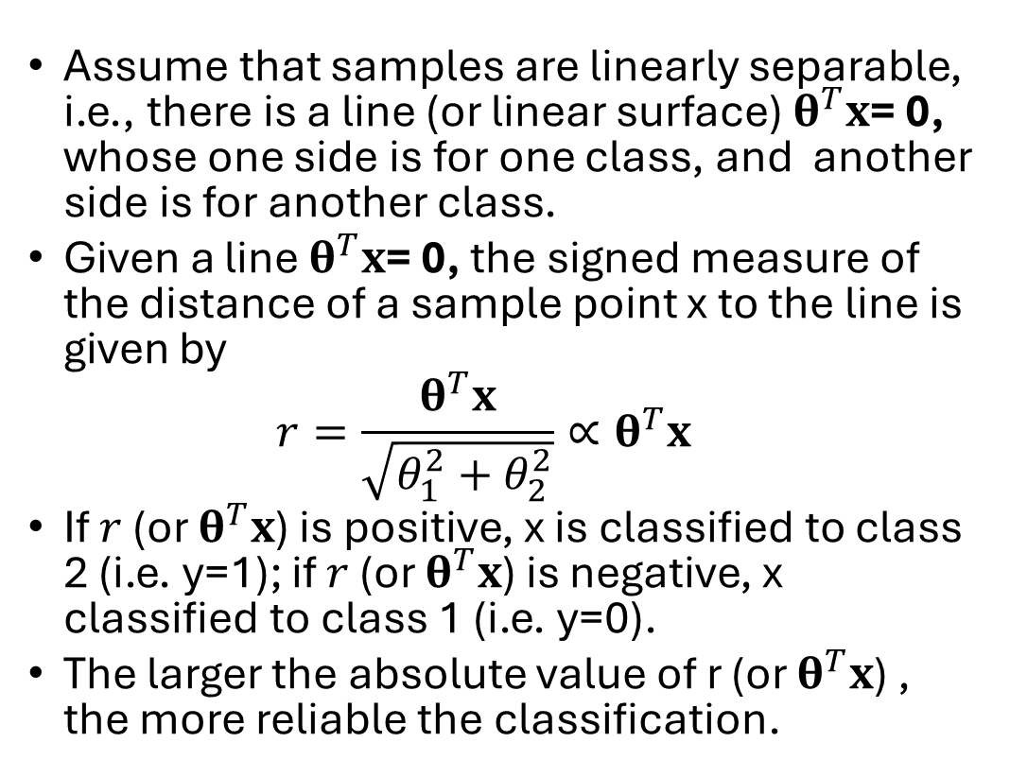



Understanding linear decision boundary
  Assume that samples are linearly separable, i.e., there is a line (or linear surface) $θ^{T}x$= 0, whose one side is for one class, and another side is for another class.
  Given a line $θ^{T}x$= 0, the signed measure of the distance of a sample point x to the line is given by
$$r=\frac{θ^{T}x}{\sqrt{θ_{1}^{2}+θ_{2}^{2}}}∝θ^{T}x$$
  If $r$ (or $θ^{T}x$) is positive, x is classified to class 2 (i.e. y=1); if $r$ (or $θ^{T}x$) is negative, x classified to class 1 (i.e. y=0).
  The larger the absolute value of r (or $θ^{T}x$) , the more reliable the classification.
$$x_{2}$$
Class 1
$$x$$
Class 2
$$r$$
$$x_{1}$$
$$θ_{1}x_{1}+θ_{2}x_{2}+θ_{0}=0$$

Slide 6
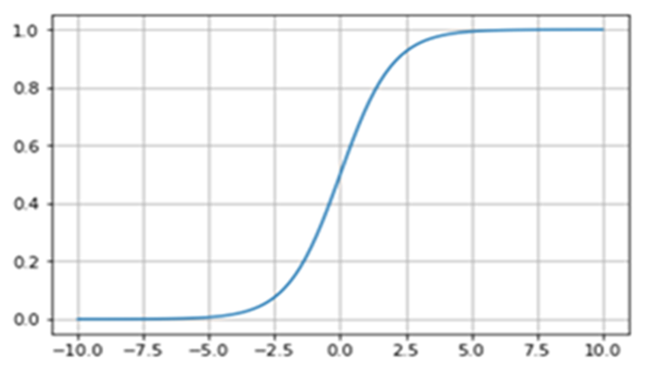



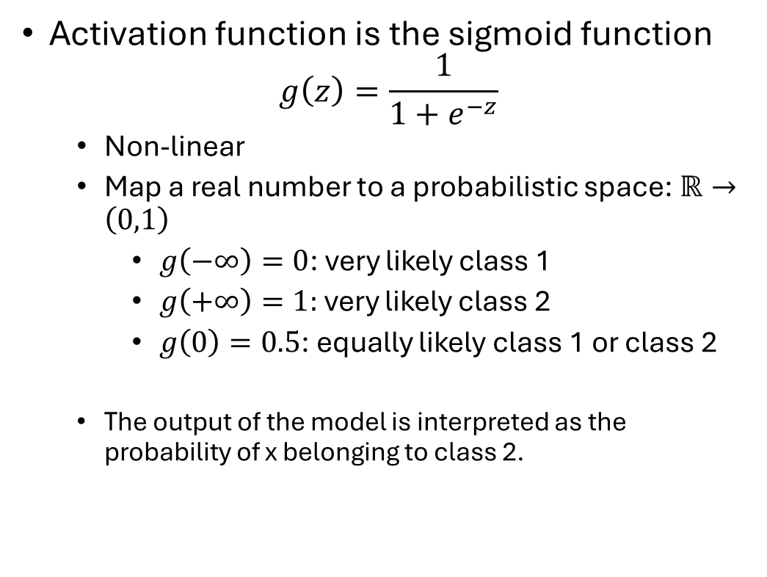



Understanding the activation function
$$x_{2}$$
Activation function is the sigmoid function
$$g\left(z\right)=\frac{1}{1+e^{−z}}$$
  Non-linear
  Map a real number to a probabilistic space: $ℝ→\left(0,1\right)$
  $g\left(−∞\right)=0$: very likely class 1
  $g\left(+∞\right)=1:$ very likely class 2
  $g\left(0\right)=0.5$: equally likely class 1 or class 2
  The output of the model is interpreted as the probability of x belonging to class 2.
Class 1
$$x$$
Class 2
$$r$$
$$x_{1}$$
$$θ_{1}x_{1}+θ_{2}x_{2}+θ_{0}=0$$
$p\left(y=1|x;θ\right)=h_{θ}\left(x\right)$ $=g\left(θ^{T}x\right)$
$$p\left(y=0|x;θ\right)=1−h_{θ}\left(x\right)$$

Slide 7
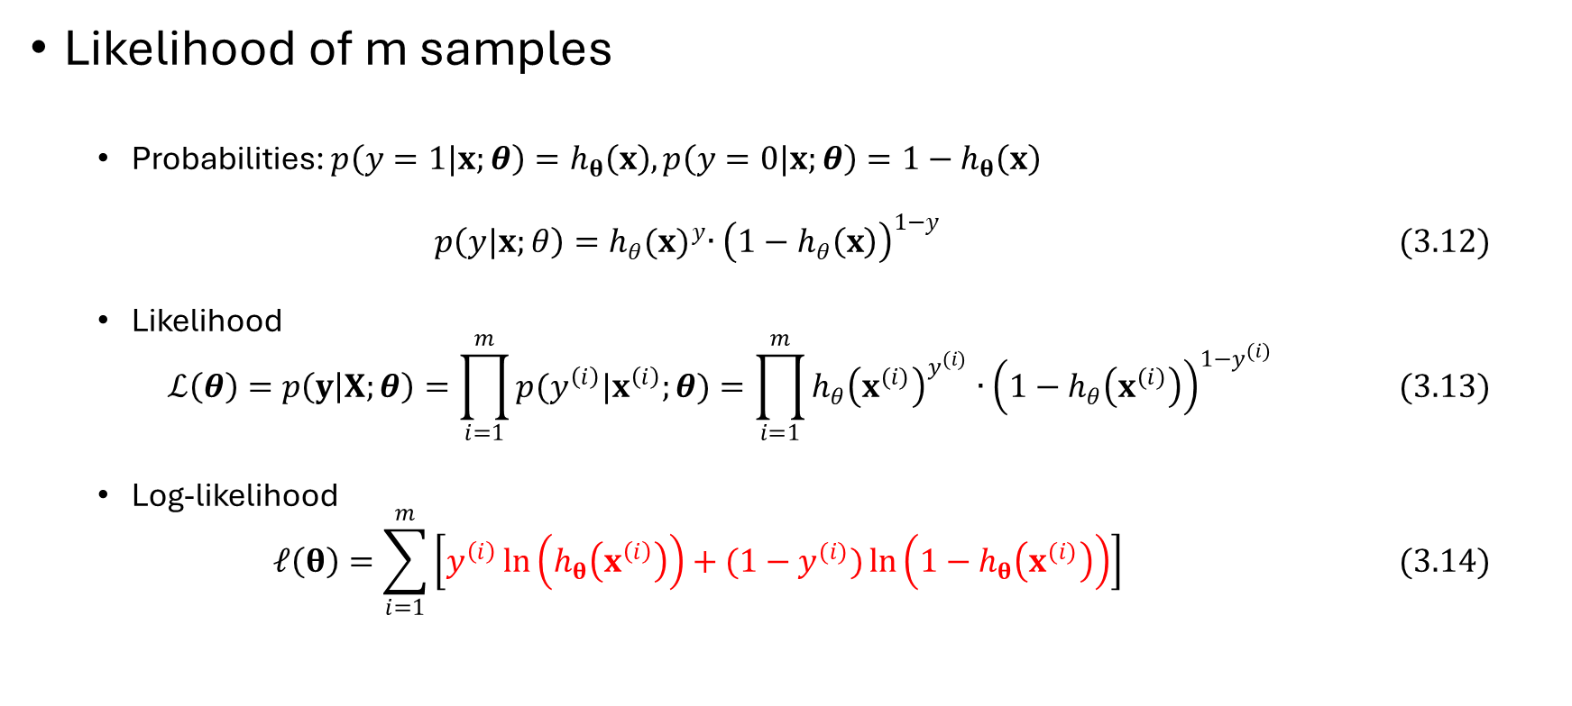
Likelihood function, given a dataset
Likelihood of m samples
  Probabilities: $p\left(y=1|x;θ\right)=h_{θ}\left(x\right), p\left(y=0|x;θ\right)=1−h_{θ}\left(x\right)$
  $$p\left(y|x;θ\right)=h_{θ}{(x)}^{y}∙{\left(1−h_{θ}\left(x\right)\right)}^{1−y} (3.12)$$
  Likelihood
  $$ℒ\left(θ\right)=p\left(y | X;θ\right)=\prod_{i=1}^{m}{p(y^{\left(i\right)}|x^{\left(i\right)};θ)}=\prod_{i=1}^{m}{h_{θ}{\left(x^{(i)}\right)}^{y^{(i)}}∙{\left(1−h_{θ}\left(x^{(i)}\right)\right)}^{1−y^{(i)}}} (3.13)$$
  Log-likelihood
  $$𝓁\left(θ\right)=\sum_{i=1}^{m}{\left[y^{\left(i\right)}\ln\left(h_{θ}\left(x^{\left(i\right)}\right)\right)+(1−y^{(i)})\ln\left(1−h_{θ}\left(x^{(i)}\right)\right)\right]} (3.14)$$

Slide 8
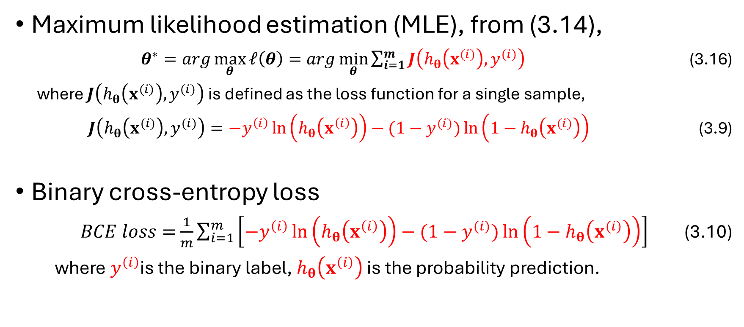
Loss function: binary cross-entropy loss
Maximum likelihood estimation (MLE), from (3.14),
$θ^{∗}=arg\max_{θ}{𝓁\left(θ\right)}=arg\min_{θ}{\sum_{i=1}^{m}{J\left(h_{θ}\left(x^{(i)}\right),y^{(i)}\right)}}$ (3.16)
where $J\left(h_{θ}\left(x^{(i)}\right),y^{(i)}\right)$ is defined as the loss function for a single sample,
$J\left(h_{θ}\left(x^{(i)}\right),y^{(i)}\right)={−y}^{\left(i\right)}\ln\left(h_{θ}\left(x^{\left(i\right)}\right)\right)−(1−y^{(i)})\ln\left(1−h_{θ}\left(x^{(i)}\right)\right)$ (3.9)
Binary cross-entropy loss
$BCE loss=$ $\frac{1}{m}\sum_{i=1}^{m}{\left[{−y}^{\left(i\right)}\ln\left(h_{θ}\left(x^{\left(i\right)}\right)\right)−(1−y^{(i)})\ln\left(1−h_{θ}\left(x^{(i)}\right)\right)\right]}$ (3.10)
where $y^{\left(i\right)}$is the binary label, $h_{θ}\left(x^{\left(i\right)}\right)$ is the probability prediction.

Slide 9
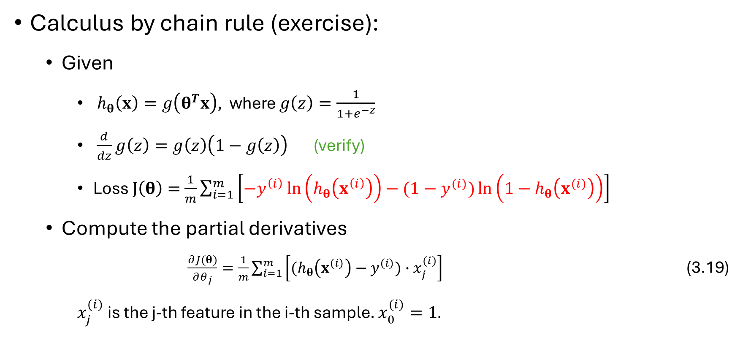
Partial derivatives of loss function
Calculus by chain rule (exercise):
  Given
    $h_{θ}\left(x\right)=g\left(θ^{T}x\right)$, where $g\left(z\right)=\frac{1}{1+e^{−z}}$
    $\frac{d}{dz}g\left(z\right)=g\left(z\right)\left(1−g\left(z\right)\right)$ (verify)
    Loss $J\left(θ\right)=$ $\frac{1}{m}\sum_{i=1}^{m}{\left[{−y}^{\left(i\right)}\ln\left(h_{θ}\left(x^{\left(i\right)}\right)\right)−(1−y^{(i)})\ln\left(1−h_{θ}\left(x^{(i)}\right)\right)\right]}$
    Compute the partial derivatives
    $\frac{∂J(θ)}{∂θ_{j}}=\frac{1}{m}\sum_{i=1}^{m}{\left[(h_{θ}\left(x^{\left(i\right)}\right)−y^{\left(i\right)})∙x_{j}^{(i)}\right]}$ (3.19)
    $x_{j}^{(i)}$ is the j-th feature in the i-th sample. $x_{0}^{(i)}=1.$

Slide 10
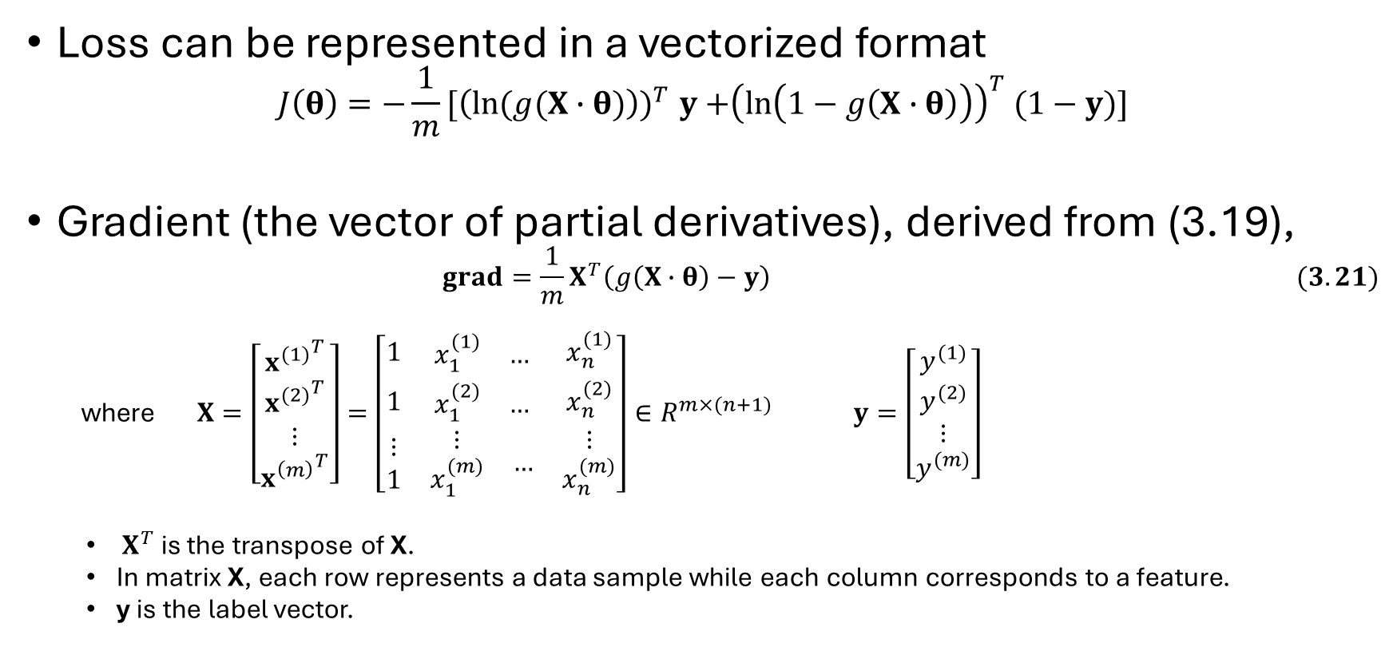
Gradient in a vectorized format
Loss can be represented in a vectorized format
$$J\left(θ\right){=−\frac{1}{m}[\left(ln⁡(g(X∙θ)\right))}^{T}y{+\left(\ln\left(1−g\left(X∙θ\right)\right)\right)}^{T}(1−y)]$$
Gradient (the vector of partial derivatives), derived from (3.19),
$$grad=\frac{1}{m}X^{T}\left(g\left(X∙θ\right)−y\right) (3.21)$$
where $X=\left[\begin{matrix}{x^{(1)}}^{T} \\ \begin{matrix}{x^{(2)}}^{T} \\ ⋮\end{matrix} \\ {x^{\left(m\right)}}^{T}\end{matrix}\right]=\left[\begin{matrix}1 & \begin{matrix}x_{1}^{(1)} & …\end{matrix} & x_{n}^{(1)} \\ 1 & \begin{matrix}x_{1}^{(2)} & …\end{matrix} & x_{n}^{(2)} \\ \begin{matrix}⋮ \\ 1\end{matrix} & \begin{matrix}\begin{matrix}⋮ \\ x_{1}^{(m)}\end{matrix} & …\end{matrix} & \begin{matrix}⋮ \\ x_{n}^{(m)}\end{matrix}\end{matrix}\right]∈R^{m×(n+1)}$ $y=\left[\begin{matrix}y^{(1)} \\ \begin{matrix}y^{(2)} \\ ⋮\end{matrix} \\ y^{(m)}\end{matrix}\right]$
  $X^{T}$ is the transpose of X.
  In matrix X, each row represents a data sample while each column corresponds to a feature.
  y is the label vector.

Slide 11
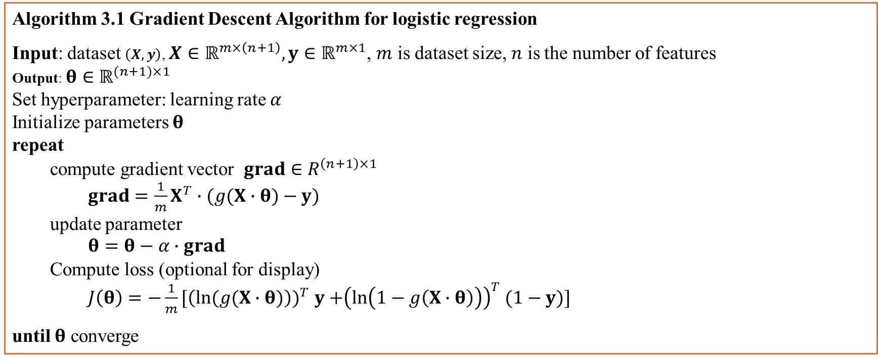
Gradient descent algorithm 3.1
Objective: to find the parameter values that minimize the loss function.
Algorithm 3.1 Gradient Descent Algorithm for logistic regression
Input: dataset $\left(X,y\right)$, $X∈ℝ^{m×\left(n+1\right)},y∈ℝ^{m×1}$, $m$ is dataset size, $n$ is the number of features
Output: $θ∈ℝ^{(n+1)×1}$
Set hyperparameter: learning rate $α$
Initialize parameters $θ$
repeat
compute gradient vector $grad∈R^{\left(n+1\right)×1}$
$grad=\frac{1}{m}X^{T}∙(g(X∙θ)−y)$
update parameter
$θ=θ−α∙grad$
Compute loss (optional for display)
$J\left(θ\right){=−\frac{1}{m}[\left(ln⁡(g(X∙θ)\right))}^{T}y{+\left(\ln\left(1−g\left(X∙θ\right)\right)\right)}^{T}(1−y)]$
until $θ$ converge

Slide 12







Non-linear decision boundaries
The decision boundary is linear with input features. This will severely limit its applications in practice.
  Fix: extend the basic features to higher order features.
  $h_{θ}\left(x\right)=g\left(θ_{0}+θ_{1}x_{1}+θ_{2}x_{2}+θ_{3}x_{1}^{2}+θ_{4}x_{2}^{2}+θ_{5}x_{1}x_{2}^{2}+θ_{6}x_{1}^{2}x_{2}+…\right)$
The model is limited to two-class classification tasks.
$$x_{2}$$
$$x_{2}$$
$$x_{2}$$
3
0
0
$$x_{1}$$
$$x_{1}$$
0
$$x_{1}$$
3
0

Slide 13

Metrics of classification (1)
Breakdown samples (in terms of each sample is classified) into
  TP: true positive
  FP: false positive
  TN: true negative
  FN: false negative
  $m=TP+FP+TN+FN$
  Note: class 1 is positive
Ground truth
Prediction
TP
TP
TP
FN
FP
FP
Class 1
Class 1
FN
TP: true positive
FN: false negative
FP: false positive
TN: true negative
FN
FP
TN
TN
TN
Class 2
Class 2

Slide 14
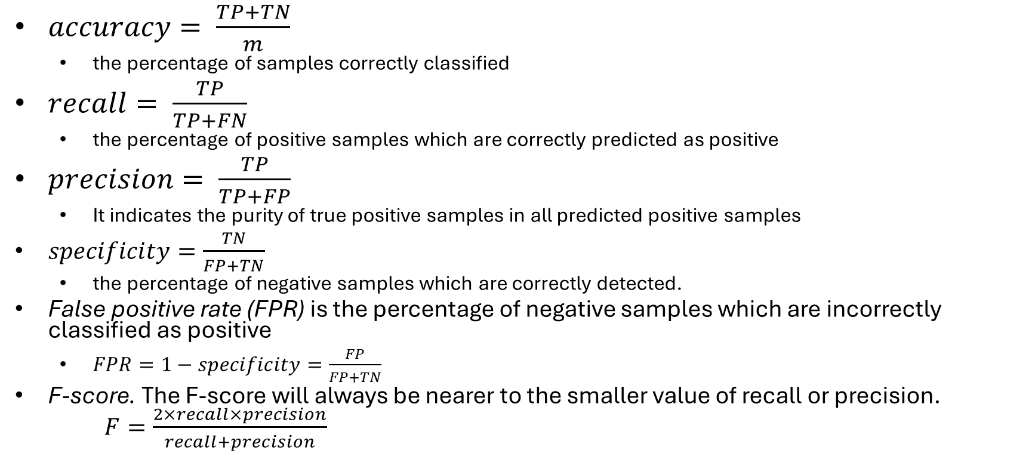
Metrics of classification (2)
actual
predicted
Positive
recall
Positive
  $accuracy= \frac{TP+TN}{m}$
    the percentage of samples correctly classified
  $recall= \frac{TP}{TP+FN}$
    the percentage of positive samples which are correctly predicted as positive
  $precision= \frac{TP}{TP+FP}$
    It indicates the purity of true positive samples in all predicted positive samples
  $specificity=\frac{TN}{FP+TN}$
    the percentage of negative samples which are correctly detected.
  False positive rate (FPR) is the percentage of negative samples which are incorrectly classified as positive
    $FPR=1−specificity=\frac{FP}{FP+TN}$
  F-score. The F-score will always be nearer to the smaller value of recall or precision.
  $F=\frac{2×recall×precision}{recall+precision}$
FPR
negative
negative
specificity
Metrics as probabilities

Slide 15
Confusion matrix for multi-class classification
 |  | Predicted output
 |  | Class 1 | Class 2 | Class 3
Actual class | Class 1 | 8 | 1 | 2
 | Class 2 | 0 | 9 | 1
 | Class 3 | 3 | 1 | 8
Table 3.1 confusion matrix for a 3-class classification task

Slide 16
Metrics of classification (3): example
 |  | Predicted output
 |  | Class 1 | Class 2
Actual class | Class 1 | 95 | 5
 | Class 2 | 20 | 80
TP | 95
FN | 5
TN | 80
FP | 20
Accuracy | 175/200
Recall | 95/100
Precision | 95/115
Specificity | 80/100
False positive rate (FPR) | 20/100
F-score | 95/(0.5*(100+115))
Class 1: positive

Slide 17
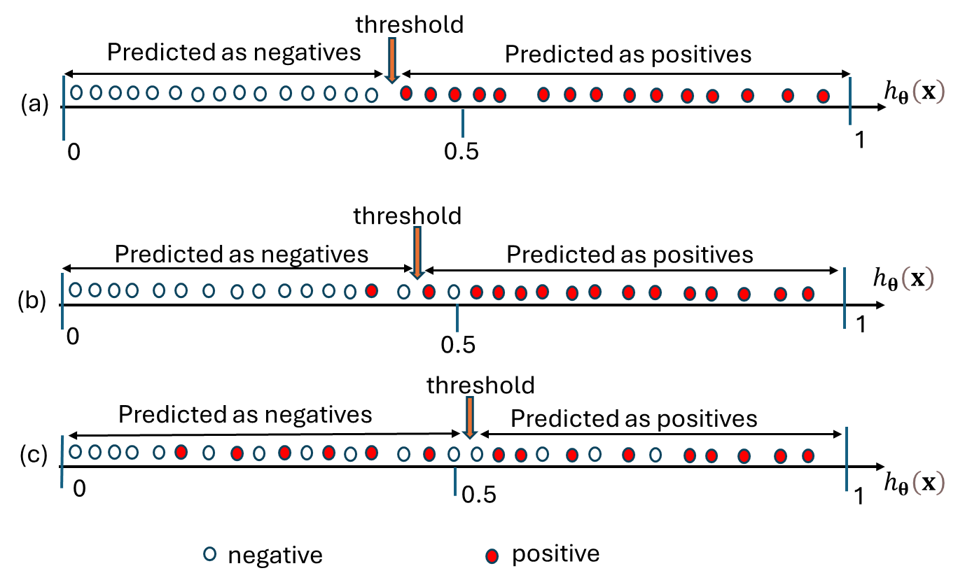
ROC( receiver operating characteristic) curve
Suppose we have three classifiers (a), (b), and (c).
Figure shows their outputs for a dataset with 30 samples.
Which one is the best? Why?

Slide 18
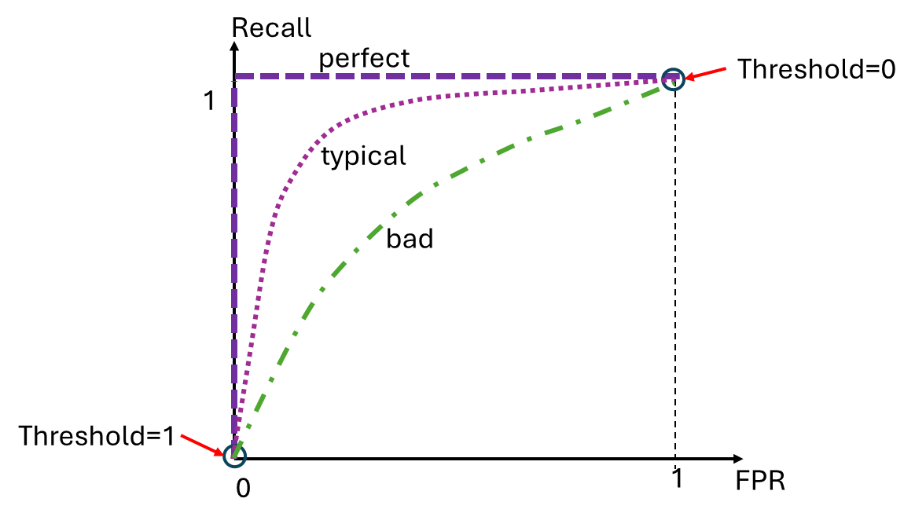
ROC curve
Purpose: visualize the capability of a classifier to separate data samples.
How to plot a ROC curve for a given classifier:
  for each threshold (from 0 to 1), classify the dataset samples, and calculate FPR and recall.
  By scanning threshold from 0 to 1, we can plot recall as a function of FPR.
The larger the area under the ROC curve, the better the classifier.

Slide 19
Implementation: a logistic regression
Task: predict whether a student will get a grade A, depending on his/her two exam scores.
Data sets
# grades_train.txt
# grades_test.txt

Slide 20
Python code
# import packages
# load train dataset
# load test dataset

Slide 21
# define the logistic regression model
# compute the loss
# compute gradient
# iteration for gradient descent

Slide 22
# train the model
# print result and plot loss

Slide 23
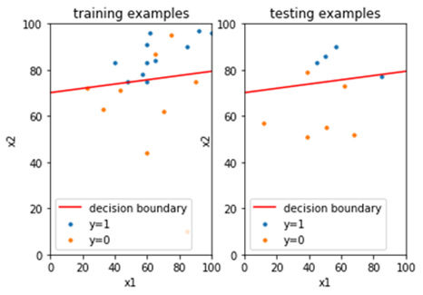
Results

Slide 24
Performance

Slide 25
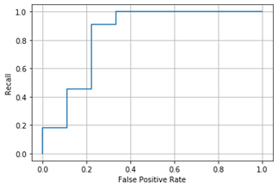
ROC curve

Slide 26
Summary
Logistic regression is a linear regression plus a non-linear activation function.
Logistic regression performs a binary classification task.
The output of logistic regression is interpreted as the probability of the input sample belonging to a certain class.
To train a logistic regression, the gradient can be calculated by chain rule, and then used in gradient descent algorithm.
The result of classification on a dataset can be summarized by a confusion matrix.
There are a few metrics to measure the performance of a classification model: accuracy, recall, precision, specificity, FPR, F-score, ROC curve.

