Slide 1
Chapter 2 Linear Regression

Slide 2
Outline
The basic concepts in linear regression: feature, label, model, loss function.
Analytic solution (i.e. normal equation) for linear regression.
Gradient descent algorithm to linear regression.
Underfitting and overfitting.
Implement a linear regression from scratch by Python (read the Python code).

Slide 3
What is Regression?
Definition: Modeling the relationship between one or more independent variables (features) and a continuous dependent variable (target).
Examples: predicting house prices, and fitting a polynomial curve.
Linear regression: We assume the target can be predicted as a linear combination of input variables

Slide 4
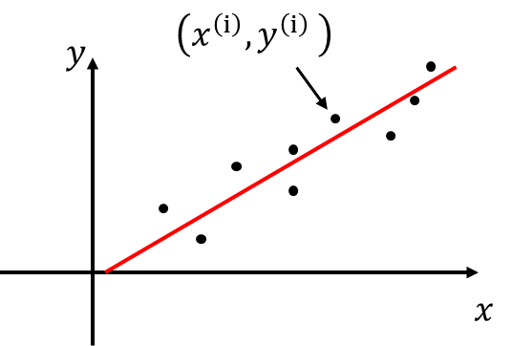
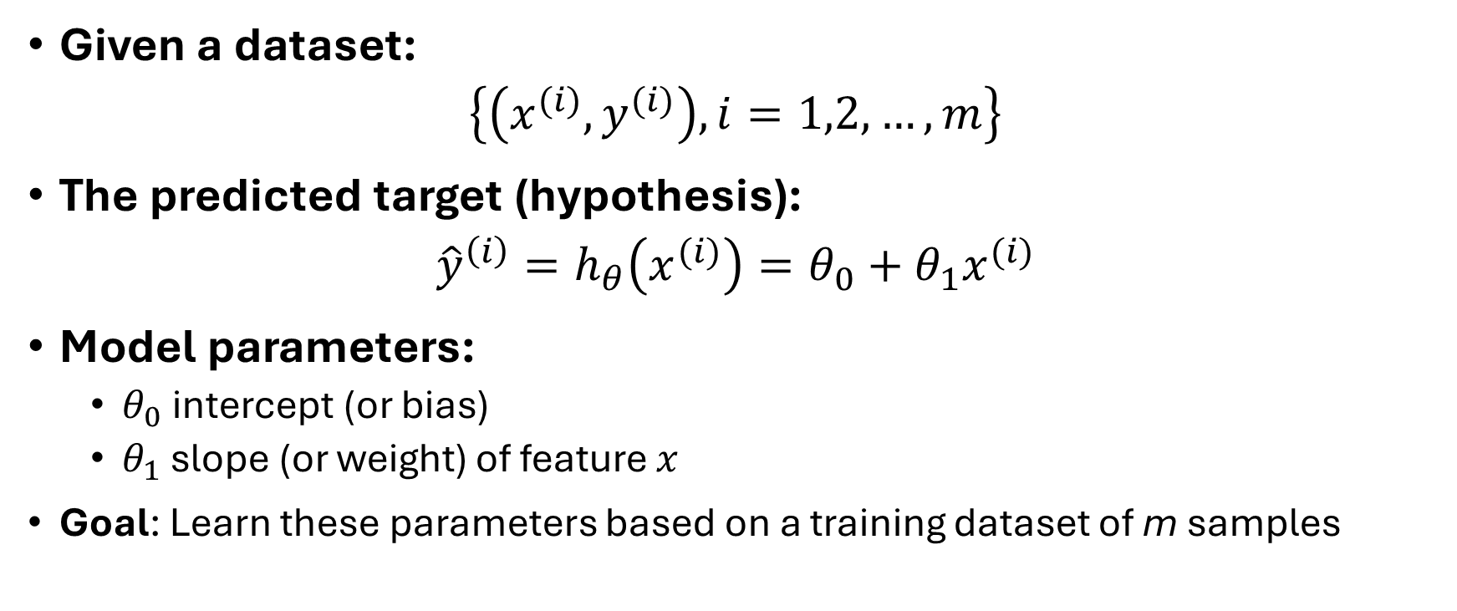
Linear Regression with a Single Feature
feature, target
Given a dataset:
$$\left\{\left(x^{(i)}, y^{(i)}\right), i=1,2,…, m\right\}$$
The predicted target (hypothesis):
$${\hat{y}}^{\left(i\right)}=h_{θ}\left(x^{(i)}\right)=θ_{0}+θ_{1}x^{(i)}$$
Model parameters:
  $θ_{0}$ intercept (or bias)
  $θ_{1}$ slope (or weight) of feature $x$
  Goal: Learn these parameters based on a training dataset of m samples

Slide 5
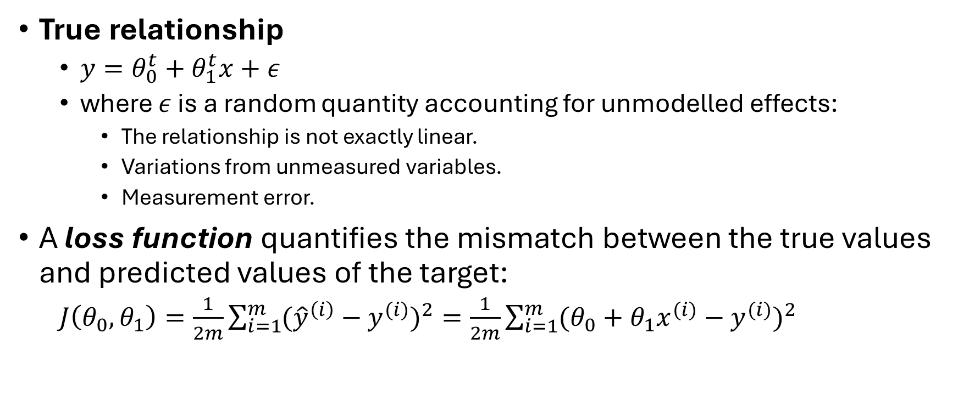
Loss Function
True relationship
  $y=θ_{0}^{t}+θ_{1}^{t}x+ε$
  where $ε$ is a random quantity accounting for unmodelled effects:
    The relationship is not exactly linear.
    Variations from unmeasured variables.
    Measurement error.
A loss function quantifies the mismatch between the true values and predicted values of the target:
  $J\left(θ_{0},θ_{1}\right)=\frac{1}{2m}\sum_{i=1}^{m}{{({\hat{y}}^{\left(i\right)}−y^{(i)})}^{2}}=\frac{1}{2m}\sum_{i=1}^{m}{{(θ_{0}+θ_{1}x^{(i)}−y^{(i)})}^{2}}$

Slide 6
Remarks on Loss Function
Loss function is a function of parameters, given a dataset.
Mean squared error (MSE) function is a commonly used loss function for regression.
The scale of 1/2 is included specifically for the convenience of calculating derivatives.
As we will see later, a different type of loss function will be used for classification.
Solution to loss function: find the optimal value of parameters that minimizes the loss function.

Slide 7
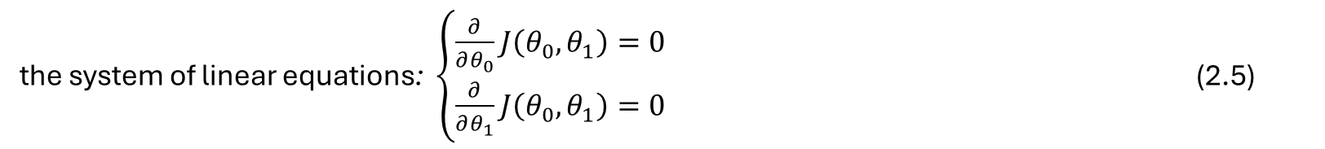


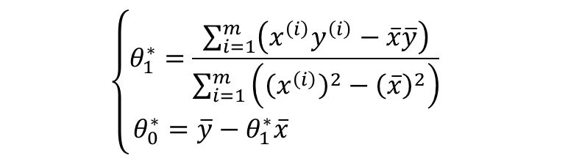
The Analytic Solution: Normal Equation
To minimize the loss function, set its partial derivatives equal to zero.
Solution:
  where $\overline{x}=\frac{1}{m}\sum_{i=1}^{m}{x^{(i)}}$, $\overline{y}=\frac{1}{m}\sum_{i=1}^{m}{y^{(i)}}$ are the sample means
the system of linear equations: $\left\{\begin{matrix}\frac{∂}{∂θ_{0}}J\left(θ_{0},θ_{1}\right)=0 \\ \frac{∂}{∂θ_{1}}J\left(θ_{0},θ_{1}\right)=0\end{matrix}\right.$ (2.5)
$$\left\{\begin{matrix}θ_{1}^{∗}=\frac{\sum_{i=1}^{m}{\left(x^{\left(i\right)}y^{\left(i\right)}−\overline{x}\overline{y}\right)}}{\sum_{i=1}^{m}{\left({\left(x^{\left(i\right)}\right)}^{2}−{\left(\overline{x}\right)}^{2}\right)}} \\ θ_{0}^{∗}=\overline{y}−θ_{1}^{∗}\overline{x} \end{matrix}\right.$$
$$\left\{\begin{matrix}θ_{1}^{∗}=\frac{\sum_{i=1}^{m}{\left(x^{\left(i\right)}−\overline{x}\right)\left(y^{\left(i\right)}−\overline{y}\right)}}{\sum_{i=1}^{m}{{\left(x^{\left(i\right)}−\overline{x}\right)}^{2}}} \\ θ_{0}^{∗}=\overline{y}−θ_{1}^{∗}\overline{x} \end{matrix}\right.$$

Slide 8
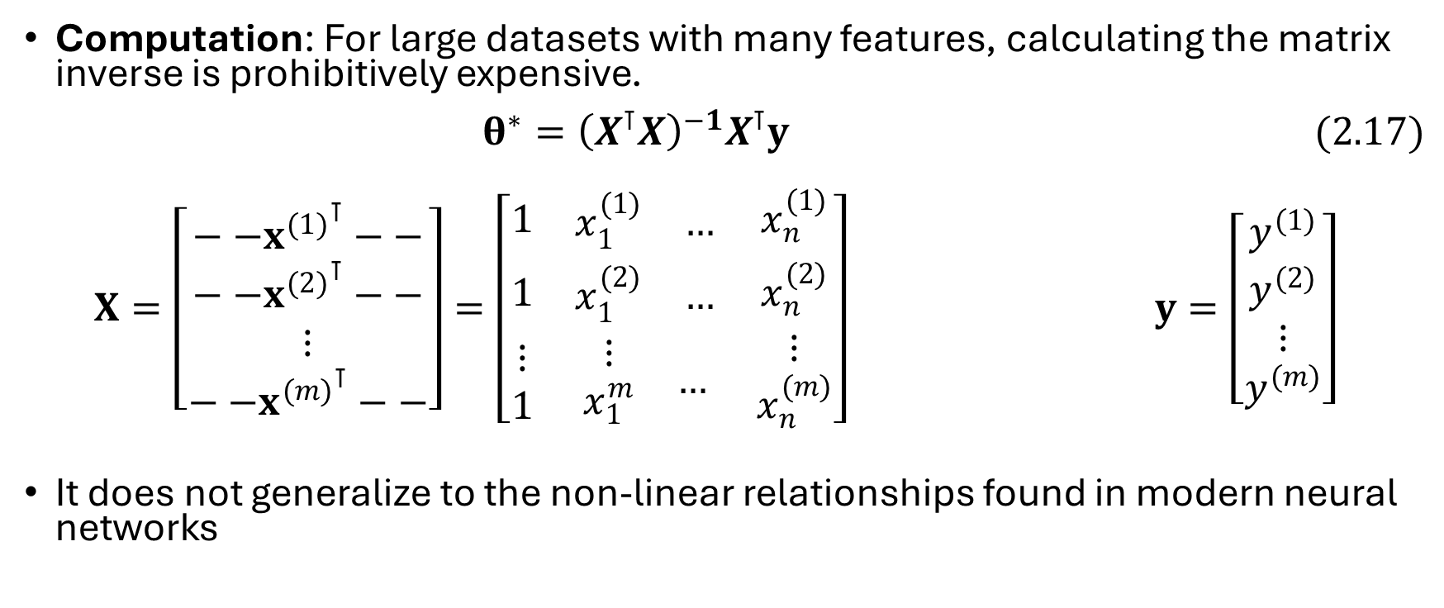
Limits of the Normal Equation
Computation: For large datasets with many features, calculating the matrix inverse is prohibitively expensive.
$θ^{∗}={\left(X^{⊺}X\right)}^{−1}X^{⊺}y (2.17)$
$X=\left[\begin{matrix}{{−−x}^{(1)}}^{⊺}−− \\ \begin{matrix}{{−−x}^{(2)}}^{⊺}−− \\ ⋮\end{matrix} \\ {{−−x}^{(m)}}^{⊺}−−\end{matrix}\right]=\left[\begin{matrix}1 & \begin{matrix}x_{1}^{(1)} & …\end{matrix} & x_{n}^{(1)} \\ 1 & \begin{matrix}x_{1}^{(2)} & …\end{matrix} & x_{n}^{(2)} \\ \begin{matrix}⋮ \\ 1\end{matrix} & \begin{matrix}\begin{matrix}⋮ \\ x_{1}^{m}\end{matrix} & …\end{matrix} & \begin{matrix}⋮ \\ x_{n}^{(m)}\end{matrix}\end{matrix}\right]$ $y=\left[\begin{matrix}y^{(1)} \\ \begin{matrix}y^{(2)} \\ ⋮\end{matrix} \\ y^{(m)}\end{matrix}\right]$
It does not generalize to the non-linear relationships found in modern neural networks

Slide 9
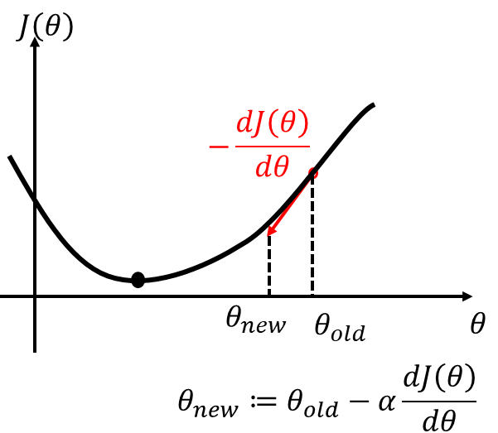
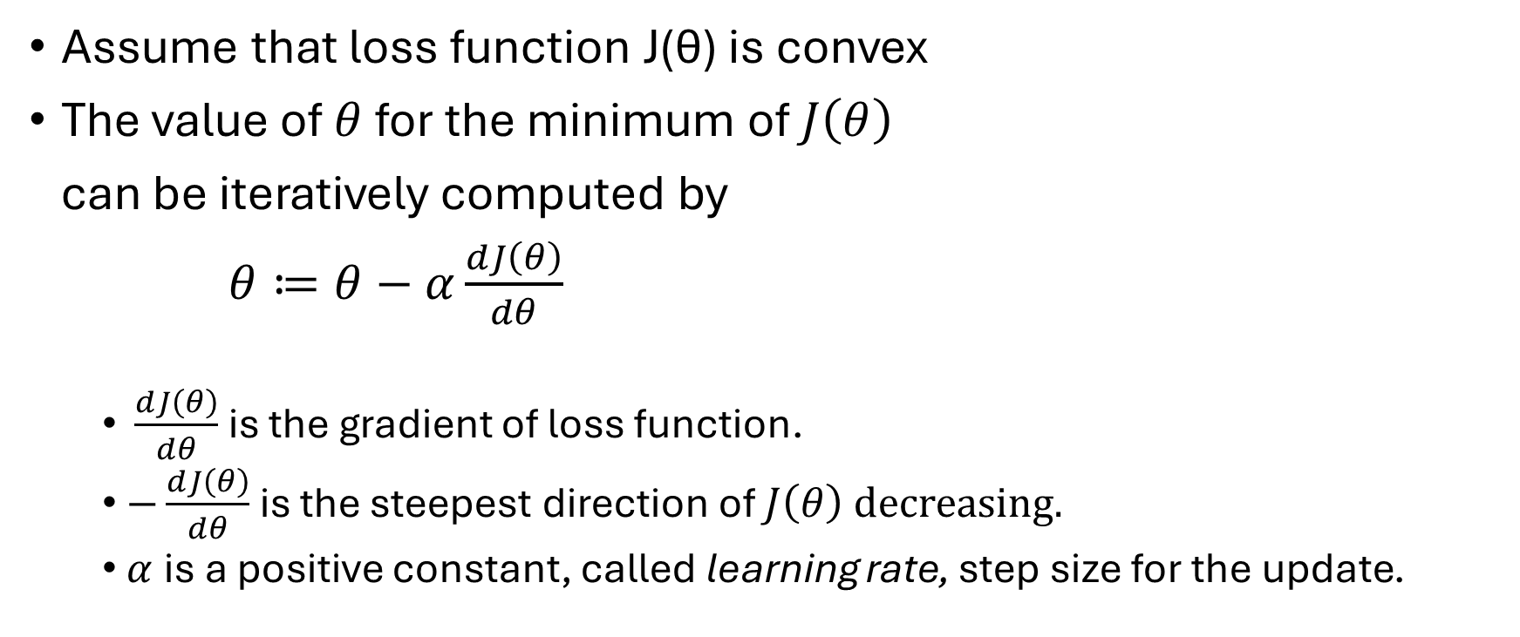
Iterative Optimization: Gradient Descent
Assume that loss function J(θ) is convex
The value of $θ$ for the minimum of $J\left(θ\right)$
can be iteratively computed by
$θ≔θ−α\frac{dJ\left(θ\right)}{dθ}$
  $\frac{dJ\left(θ\right)}{dθ}$ is the gradient of loss function.
  $−\frac{dJ\left(θ\right)}{dθ}$ is the steepest direction of $J\left(θ\right)$ decreasing.
  $α$ is a positive constant, called learning rate, step size for the update.

Slide 10
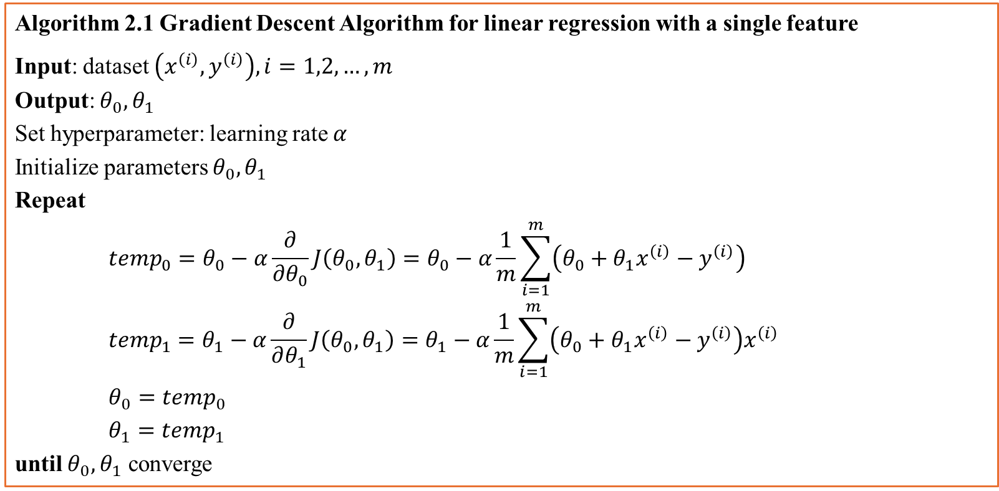
Gradient Descent Algorithm
Algorithm 2.1 Gradient Descent Algorithm for linear regression with a single feature
Input: dataset $\left(x^{\left(i\right)},y^{\left(i\right)}\right), i=1,2,…,m$
Output: $θ_{0}, θ_{1}$
Set hyperparameter: learning rate $α$
Initialize parameters $θ_{0}, θ_{1}$
Repeat
$${{temp}_{0}=θ}_{0}−α\frac{∂}{∂θ_{0}}J\left(θ_{0},θ_{1}\right)=θ_{0}−α\frac{1}{m}\sum_{i=1}^{m}{\left(θ_{0}+θ_{1}x^{\left(i\right)}−y^{\left(i\right)}\right)}$$
$${temp}_{1}=θ_{1}−α\frac{∂}{∂θ_{1}}J\left(θ_{0},θ_{1}\right)=θ_{1}−α\frac{1}{m}\sum_{i=1}^{m}{\left(θ_{0}+θ_{1}x^{\left(i\right)}−y^{\left(i\right)}\right)x^{\left(i\right)}}$$
$θ_{0}={temp}_{0}$
$$θ_{1}={temp}_{1}$$
until $θ_{0}, θ_{1}$ converge

Slide 11
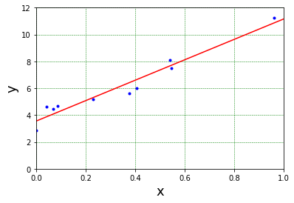
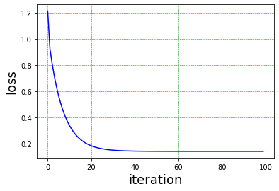
Example
samples
solution

Slide 12

Linear Regression with Multiple Features
Relationship with n input features:
$$y=θ_{0}+θ_{1}x_{1}+θ_{2}x_{2}+⋯+θ_{n}x_{n}+ε$$
Prediction model (hypothesis):
$$\hat{y}=h_{θ}\left(x\right)=θ^{T}x$$
$$θ=\left[\begin{matrix}\begin{matrix}θ_{0} \\ θ_{1}\end{matrix} \\ ⋮ \\ θ_{n}\end{matrix}\right]∈ℝ^{\left(n+1\right)×1}, x=\left[\begin{matrix}\begin{matrix}1 \\ x_{1}\end{matrix} \\ ⋮ \\ x_{n}\end{matrix}\right]∈ℝ^{(n+1)×1}$$

Slide 13

Loss function
Input features as an mx(n+1) matrix, labels as a column vector.
$X=\left[\begin{matrix}{{−−x}^{(1)}}^{⊺}−− \\ \begin{matrix}{{−−x}^{(2)}}^{⊺}−− \\ ⋮\end{matrix} \\ {{−−x}^{(m)}}^{⊺}−−\end{matrix}\right]=\left[\begin{matrix}1 & \begin{matrix}x_{1}^{(1)} & …\end{matrix} & x_{n}^{(1)} \\ 1 & \begin{matrix}x_{1}^{(2)} & …\end{matrix} & x_{n}^{(2)} \\ \begin{matrix}⋮ \\ 1\end{matrix} & \begin{matrix}\begin{matrix}⋮ \\ x_{1}^{m}\end{matrix} & …\end{matrix} & \begin{matrix}⋮ \\ x_{n}^{(m)}\end{matrix}\end{matrix}\right]$, $y=\left[\begin{matrix}y^{(1)} \\ \begin{matrix}y^{(2)} \\ ⋮\end{matrix} \\ y^{(m)}\end{matrix}\right]$
Predictions
$$\hat{y}=X∙ θ$$
Errors
$$E=\left[\begin{matrix}e^{(1)} \\ \begin{matrix}e^{(2)} \\ ⋮\end{matrix} \\ e^{(m)}\end{matrix}\right]=X∙ θ−y$$
Loss function
$$J\left(θ\right)=\frac{1}{2m}\sum_{i=1}^{m}{{\left(e^{\left(i\right)}\right)}^{2}}{=\frac{1}{2m}E^{⊺}E=\frac{1}{2m}\left(X∙θ−y\right)}^{⊺}\left(X∙θ−y\right)$$

Slide 14

Gradient of Loss Function
Partial derivative:
$$\frac{∂J\left(θ\right)}{∂θ_{j}}=\frac{1}{m}\sum_{i=1}^{m}{\left(h_{θ}\left(x^{\left(i\right)}\right)−y^{\left(i\right)}\right)x_{j}^{\left(i\right)}}=\frac{1}{m}{\left(X_{column_{j}}\right)}^{⊺}\left(X∙θ−y\right)$$
$$j=0,1,…,n,{ x}_{0}^{\left(i\right)}=1$$
Gradient
$$grad=\left[\begin{matrix}\frac{∂J(θ)}{∂θ_{0}} \\ \begin{matrix}\frac{∂J(θ)}{∂θ_{1}} \\ ⋮\end{matrix} \\ \frac{∂J(θ)}{∂θ_{n}}\end{matrix}\right]=\frac{1}{m}X^{⊺}∙\left(X∙θ−y\right)$$
Optimization by normal equation
$$grad=\frac{1}{m}X^{⊺}∙\left(X∙θ^{∗}−y\right)=0$$
$$θ^{∗}={\left(X^{⊺}X\right)}^{−1}X^{⊺}y$$

Slide 15
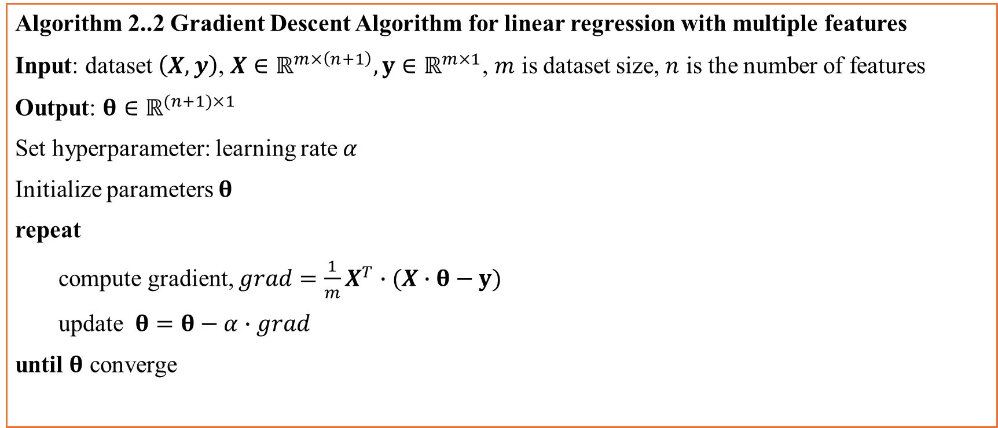
Gradient Descent Algorithm
Algorithm 2..2 Gradient Descent Algorithm for linear regression with multiple features
Input: dataset $\left(X,y\right)$, $X∈ℝ^{m×\left(n+1\right)},y∈ℝ^{m×1}$, $m$ is dataset size, $n$ is the number of features
Output: $θ∈ℝ^{(n+1)×1}$
Set hyperparameter: learning rate $α$
Initialize parameters $θ$
repeat
compute gradient, $grad=\frac{1}{m}X^{T}∙(X∙θ−y)$
update $θ=θ−α∙grad$
until $θ$ converge

Slide 16
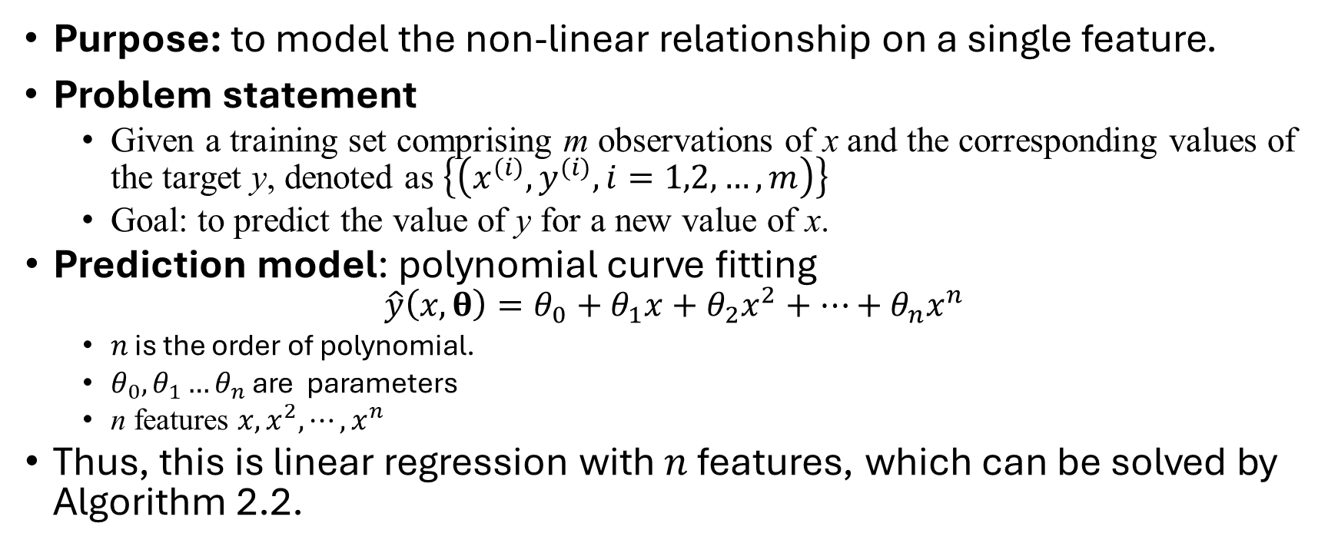
Polynomial Curve Fitting
Purpose: to model the non-linear relationship on a single feature.
Problem statement
  Given a training set comprising m observations of x and the corresponding values of the target y, denoted as $\left\{\left(x^{(i)}, y^{(i)}, i=1,2,…, m\right)\right\}$
  Goal: to predict the value of y for a new value of x.
  Prediction model: polynomial curve fitting
  $$\hat{y}\left(x,θ\right)=θ_{0}+θ_{1}x+θ_{2}x^{2}+⋯+θ_{n}x^{n}$$
    $n$ is the order of polynomial.
    $θ_{0}, θ_{1}…θ_{n}$ are parameters
    n features $x,x^{2},⋯,x^{n}$
    Thus, this is linear regression with $n$ features, which can be solved by Algorithm 2.2.

Slide 17
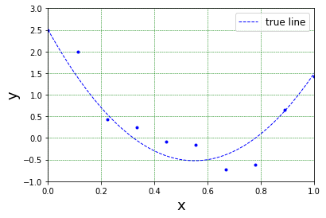
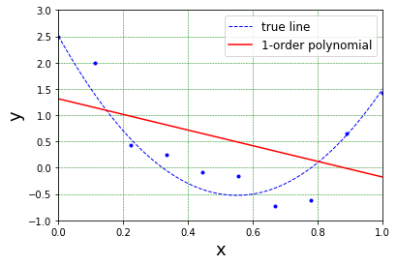
Polynomial Curve Fitting
10 samples generated by the true line plus Gaussian noise
$$y=10{\left(x−0.5\right)}^{2}−x+0.5×𝒩\left(0,1\right)$$

Slide 18
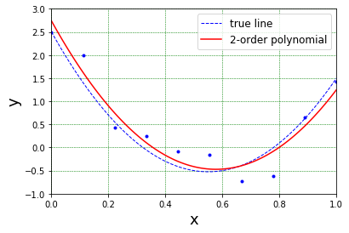
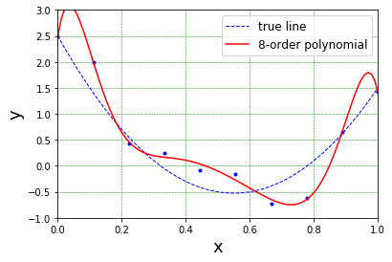
Polynomial Curve Fitting

Slide 19
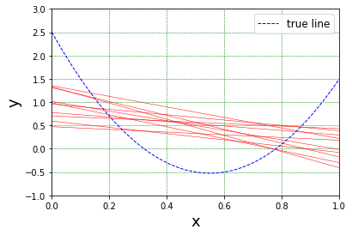
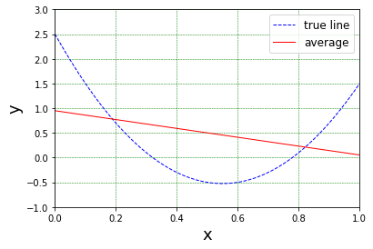
Underfitting: high bias
Each red curve (linear model) is the result from a different set of samples
Model is too simple to represent the characteristics of data.
There is a big bias between the true line and the average

Slide 20
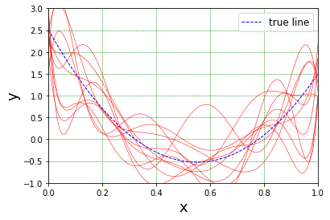
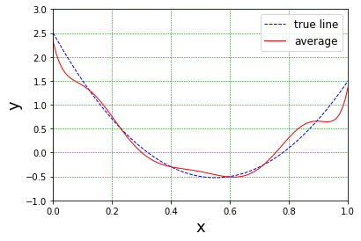
Overfitting: high variance
Each red curve (8-order polynomial) is the result from a different set of samples
There is a big variance between the results
Model is too complicated; it is over-sensitive to the noise component in the sample.
There is a small bias between the true line and the average

Slide 21
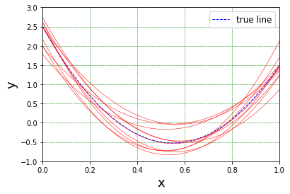
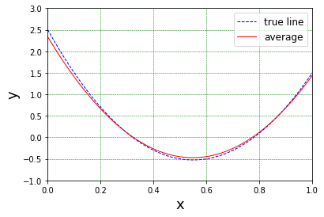
Good Fitting
Each red curve (2-order polynomial) is the result from a different set of samples
There is a variance between the results, due to the variation of datasets.
Model is a good match.
There is a small bias between the true line and the average

Slide 22
How to fix underfitting or overfitting
To fix underfitting:
  Increase the complexity of the model
To fix overfitting
  Reduce the complexity of the model
    e.g. the order of polynomial
  Increase the number of training data samples

Slide 23
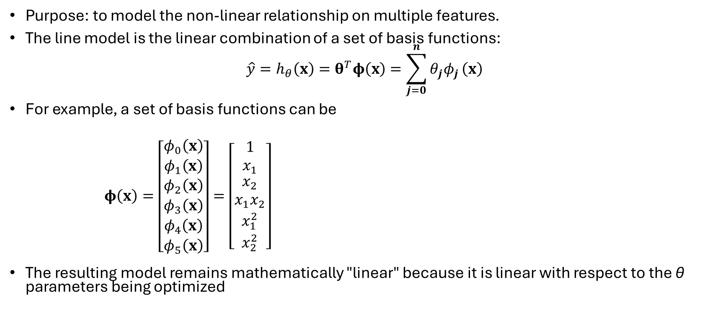
Linear Model with Basis Functions
Purpose: to model the non-linear relationship on multiple features.
The line model is the linear combination of a set of basis functions:
$$\hat{y}=h_{θ}\left(x\right)=θ^{T}φ\left(x\right)=\sum_{j=0}^{n}{θ_{j}φ_{j}}\left(x\right)$$
For example, a set of basis functions can be
$φ\left(x\right)=\left[\begin{matrix}\begin{matrix}φ_{0}\left(x\right) \\ φ_{1}\left(x\right) \\ φ_{2}\left(x\right)\end{matrix} \\ \begin{matrix}φ_{3}\left(x\right) \\ φ_{4}\left(x\right) \\ φ_{5}\left(x\right)\end{matrix}\end{matrix}\right]=\left[\begin{matrix}1 \\ x_{1} \\ \begin{matrix}x_{2} \\ x_{1}x_{2} \\ \begin{matrix}x_{1}^{2} \\ x_{2}^{2}\end{matrix}\end{matrix}\end{matrix}\right]$
The resulting model remains mathematically "linear" because it is linear with respect to the θ parameters being optimized

Slide 24

Linear Model with Basis Functions
Loss function
$$J\left(θ\right)=\frac{1}{2m}\sum_{i=1}^{m}{{\left(e^{\left(i\right)}\right)}^{2}}{=\frac{1}{2m}E^{⊺}E=\frac{1}{2m}\left(Φ∙θ−y\right)}^{⊺}\left(Φ∙θ−y\right)$$
where, the training set is represented by
$$Φ=\left[\begin{matrix}φ_{0}\left(x^{(1)}\right) & \begin{matrix}φ_{1}\left(x^{(1)}\right) & \begin{matrix}φ_{2}\left(x^{(1)}\right) & φ_{3}\left(x^{(1)}\right)\end{matrix}…\end{matrix} & φ_{n}\left(x^{(1)}\right) \\ φ_{0}\left(x^{(2)}\right) & \begin{matrix}φ_{1}\left(x^{(2)}\right) & \begin{matrix}φ_{2}\left(x^{(2)}\right) & φ_{3}\left(x^{(2)}\right)\end{matrix}…\end{matrix} & φ_{n}\left(x^{(2)}\right) \\ \begin{matrix}⋮ \\ φ_{0}\left(x^{(m)}\right)\end{matrix} & \begin{matrix}\begin{matrix}⋮ \\ φ_{1}\left(x^{(m)}\right)\end{matrix} & \begin{matrix}\begin{matrix}⋮ \\ φ_{2}\left(x^{(m)}\right)\end{matrix} & \begin{matrix}⋮ \\ φ_{3}\left(x^{(m)}\right)\end{matrix}\end{matrix}…\end{matrix} & \begin{matrix}⋮ \\ φ_{n}\left(x^{(m)}\right)\end{matrix}\end{matrix}\right]$$
Gradient
$grad=\frac{∂J(θ)}{∂θ}=\left[\begin{matrix}\frac{∂J(θ)}{∂θ_{0}} \\ \begin{matrix}\frac{∂J(θ)}{∂θ_{1}} \\ ⋮\end{matrix} \\ \frac{∂J(θ)}{∂θ_{n}}\end{matrix}\right]=\frac{1}{m}Φ^{⊺}∙\left(Φ∙θ−y\right)$
basis function index
sample index

Slide 25
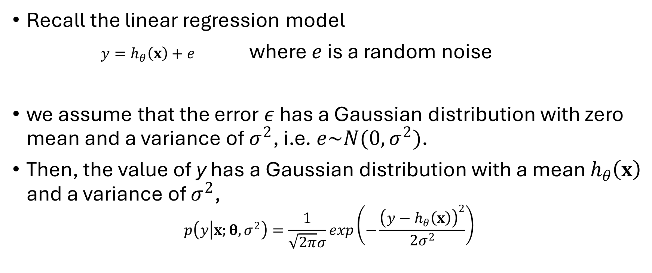
Equivalence of least mean square error and maximum likelihood estimate: a theoretical view
Recall the linear regression model
$y=h_{θ}\left(x\right)+e$ where $e$ is a random noise
we assume that the error $ε$ has a Gaussian distribution with zero mean and a variance of $σ^{2}$, i.e.$e\sim N(0,σ^{2})$.
Then, the value of y has a Gaussian distribution with a mean $h_{θ}\left(x\right)$ and a variance of $σ^{2}$,
$$p\left(y | x;θ,σ^{2}\right)=\frac{1}{\sqrt{2π}σ}exp\left(−\frac{{\left(y−h_{θ}\left(x\right)\right)}^{2}}{2σ^{2}}\right)$$

Slide 26
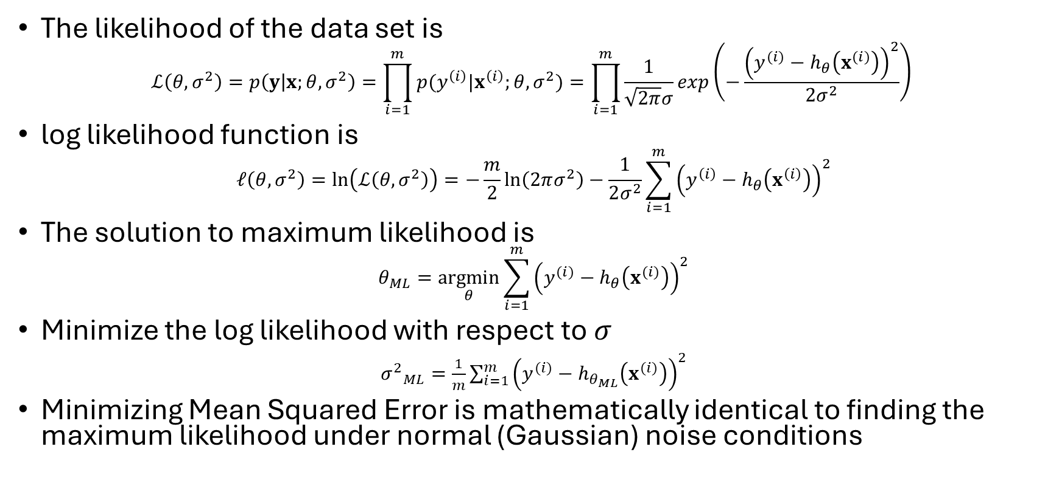
Equivalence of least mean square error and maximum likelihood estimate: a theoretical view
The likelihood of the data set is
$$ℒ\left(θ,σ^{2}\right)=p\left(y | x;θ,σ^{2}\right)=\prod_{i=1}^{m}{p(y^{\left(i\right)}|x^{\left(i\right)};θ,}σ^{2})=\prod_{i=1}^{m}{\frac{1}{\sqrt{2π}σ}exp\left(−\frac{{\left(y^{(i)}−h_{θ}\left(x^{(i)}\right)\right)}^{2}}{2σ^{2}}\right) }$$
log likelihood function is
$$𝓁\left(θ,σ^{2}\right)=\ln\left(ℒ\left(θ,σ^{2}\right)\right)=−\frac{m}{2}\ln\left(2πσ^{2}\right)−\frac{1}{2σ^{2}}\sum_{i=1}^{m}{{\left(y^{\left(i\right)}−h_{θ}\left(x^{\left(i\right)}\right)\right)}^{2}}$$
The solution to maximum likelihood is
$$θ_{ML}=\underset{θ}{argmin}{\sum_{i=1}^{m}{{\left(y^{(i)}−h_{θ}\left(x^{(i)}\right)\right)}^{2}}}$$
Minimize the log likelihood with respect to $σ$
${σ^{2}}_{ML}=\frac{1}{m}\sum_{i=1}^{m}{{\left(y^{(i)}−h_{θ_{ML}}\left(x^{(i)}\right)\right)}^{2}}$
Minimizing Mean Squared Error is mathematically identical to finding the maximum likelihood under normal (Gaussian) noise conditions

Slide 27





Practical issues
Feature scaling
  Min-max scaler
  $z_{i}=\frac{x_{i}−\min_{j}{\{x_{i}^{\left(j\right)}\}}}{\max_{j}{\{x_{i}^{\left(j\right)}\}}−\min_{j}{\{x_{i}^{\left(j\right)}\}}}$
  Standard scaler
  $z_{i}=\frac{x_{i}−μ_{i}}{σ_{i}}$
Choice of learning rate
  Too small: slowly converge
  Too large: overshooting
Contour plot
$$θ_{2}$$
$$θ_{2}$$
Convergence path
$$θ_{1}$$
$$θ_{1}$$
Unbalanced feature scale
Balanced feature scale

Slide 28
Example: predicting house prices
Dataset: Housing.csv from kaggle.com
Linear regression model: 12 input features
# load dataset

Slide 29
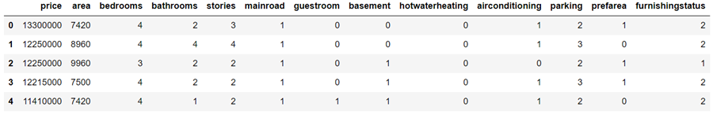
Data pre-processing (1/2)

Slide 30
Data pre-processing (2/2)
# split dataset
# data-frame to numpy
# scale input features

Slide 31
Gradient descent algorithm

Slide 32
Results

Slide 33
Summary
Linear regression models the linear relationship between the target and input features.
Given a training set, the loss function is defined the mean squared errors between the ground truth and the predictions.
The optimal values of model parameters are obtained by minimizing the loss function through:
  theoretically, normal equation by solving a linear system.
  practically, gradient descent algorithm.
A set of basis functions can be used to extend the input features, so that the model can handle a non-linear relationship.
Underfitting or overfitting may occur, depending on the complexity of the model and the size of training set.
Practical issues: feature scaling and learning rate.

