Slide 1
Chapter 15 Transformer

Slide 2
Outline
Revisit attention mechanism in RNN encoder-decoder architecture
Definition of attention mechanism in general
Transformer architecture and mathematical equations
BERT: pre-train and fine-tune
GPT: pre-train and fine-tune
Build a transformer from scratch in Python

Slide 3
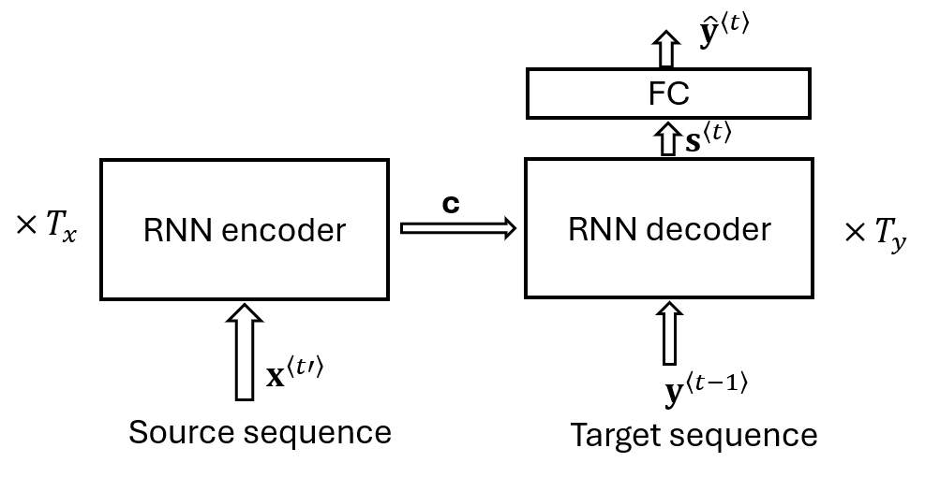


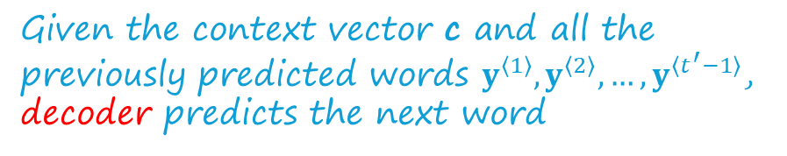

Revisit encoder-decoder RNN
# encoder: generate hidden state
at each time step
Given the context vector c and all the previously predicted words $y^{〈1〉},y^{〈2〉},…,y^{〈t^{′}−1〉}$, decoder predicts the next word
$$h^{〈t〉}=f\left(x^{〈t〉},h^{〈t−1〉}\right) , t=1,2,…, T_{x}$$
# encoder: generate context vector
based on all hidden states
$$s^{〈t′〉}=g\left(y^{〈t′−1〉},s^{〈t′−1〉},c\right) t′=1,2,…$$
$$c=q\left(\left\{h^{〈1〉},h^{〈2〉},…,h^{〈T_{x}〉}\right\}\right)$$
$${\hat{y}}^{〈t′〉}=g_{y}\left(s^{〈t′〉}\right)$$

Slide 4
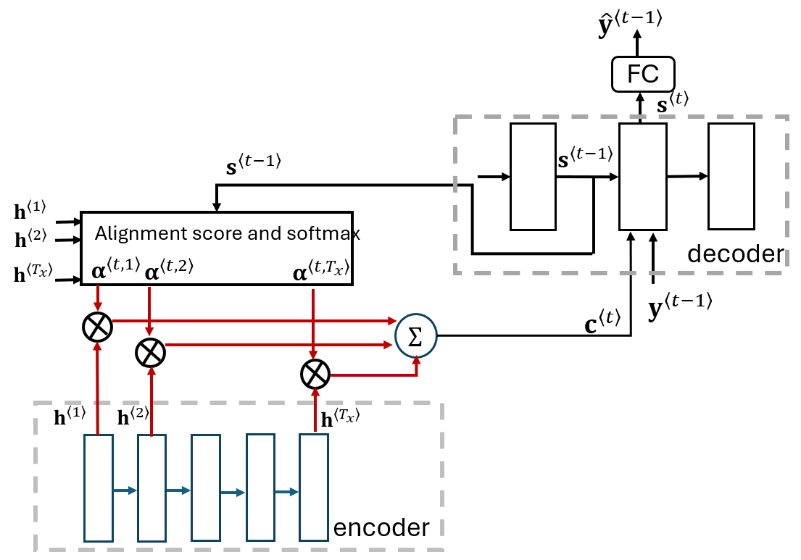
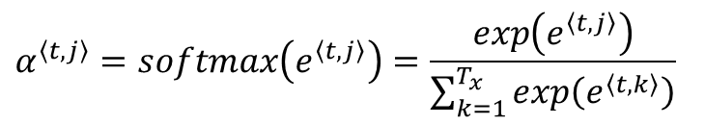

Encoder-decoder with attention mechanism
# query
# key
# value
$$e^{〈t,j〉}=a\left(s^{〈t−1〉},h^{〈j〉}\right)={v_{a}}^{⊺} tanh\left(W_{a}s^{〈t−1〉}+U_{a}h^{〈j〉}\right)$$
$$α^{〈t,j〉}=softmax\left(e^{〈t,j〉}\right)=\frac{exp\left(e^{〈t,j〉}\right)}{\sum_{k=1}^{T_{x}}{exp\left(e^{〈t,k〉}\right)}}$$
$$c^{〈t〉}=\sum_{j=1}^{T_{x}}{α^{〈t,j〉}∙}h^{〈j〉}$$

Slide 5











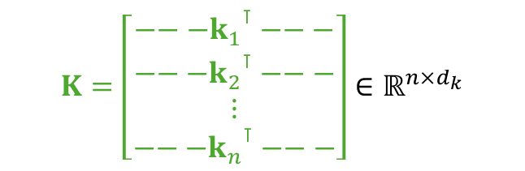


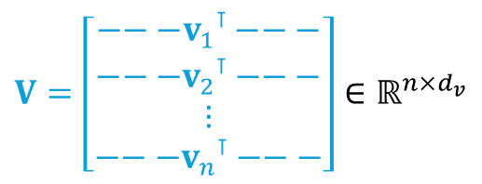



Attention mechanism in general
Given a query vector, n key vectors, n value vectors
Attention is the linear combination of n value vectors, and the weights are determined by correlation between the query and keys.
keys
scores
weights
values
Score function
$$a\left(q,k_{1}\right)$$
$$α\left(q,k_{1}\right)$$
$$k_{1}$$
x
$$v_{1}$$
$$a\left(q,k_{2}\right)$$
$$α\left(q,k_{2}\right)$$
$$k_{2}$$
Score function
x
$$v_{2}$$
softmax
Score function
$$a\left(q,k_{n}\right)$$
$$α\left(q,k_{n}\right)$$
$$k_{n}$$
x
$$v_{n}$$
$$q$$
+
attention
query
$$q∈ℝ^{d_{q}}$$
$$K=\left[\begin{matrix}{{−−−k}_{1}}^{⊺}−−− \\ \begin{matrix}{{−−−k}_{2}}^{⊺}−−− \\ ⋮\end{matrix} \\ −−−{k_{n}}^{⊺}−−−\end{matrix}\right]∈ℝ^{n×d_{k}}$$
$$V=\left[\begin{matrix}{−−−v_{1}}^{⊺}−−− \\ \begin{matrix}{{−−−v}_{2}}^{⊺}−−− \\ ⋮\end{matrix} \\ −−−{v_{n}}^{⊺}−−−\end{matrix}\right]∈ℝ^{n×d_{v}}$$
$$k_{i}∈ℝ^{d_{k}}$$
$$v_{i}∈ℝ^{d_{v}}$$

Slide 6


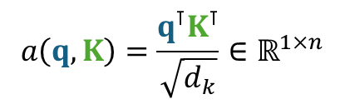
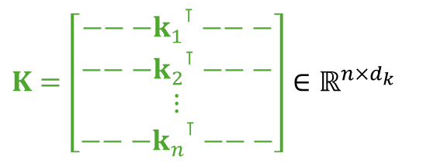


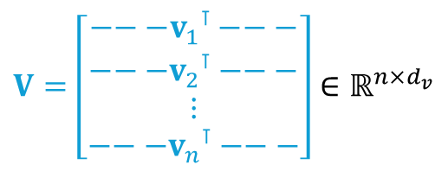


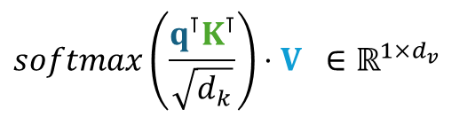





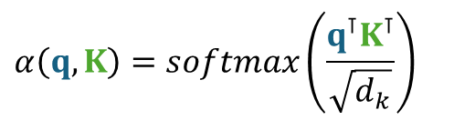



Scaled dot-product attention mechanism
keys
scores
weights
values
$$q∈ℝ^{d_{q}}$$
Score function
$$a\left(q,k_{1}\right)$$
$$α\left(q,k_{1}\right)$$
$$k_{1}$$
x
$$v_{1}$$
$$K=\left[\begin{matrix}{{−−−k}_{1}}^{⊺}−−− \\ \begin{matrix}{{−−−k}_{2}}^{⊺}−−− \\ ⋮\end{matrix} \\ −−−{k_{n}}^{⊺}−−−\end{matrix}\right]∈ℝ^{n×d_{k}}$$
$$a\left(q,k_{2}\right)$$
$$α\left(q,k_{2}\right)$$
$$k_{2}$$
Score function
x
$$v_{2}$$
softmax
$$V=\left[\begin{matrix}{−−−v_{1}}^{⊺}−−− \\ \begin{matrix}{{−−−v}_{2}}^{⊺}−−− \\ ⋮\end{matrix} \\ −−−{v_{n}}^{⊺}−−−\end{matrix}\right]∈ℝ^{n×d_{v}}$$
Score function
$$a\left(q,k_{n}\right)$$
$$α\left(q,k_{n}\right)$$
$$k_{n}$$
x
$$v_{n}$$
$$q$$
+
attention
$$softmax\left(\frac{q^{⊺}K^{⊺}}{\sqrt{d_{k}}}\right)⋅V ∈ℝ^{1×d_{v}}$$
query
# scaled dot-product
$$a\left(q,K\right)=\frac{q^{⊺}K^{⊺}}{\sqrt{d_{k}}}∈ℝ^{1×n}$$
$$α\left(q, K\right)=softmax\left(\frac{q^{⊺}K^{⊺}}{\sqrt{d_{k}}}\right)$$

Slide 7
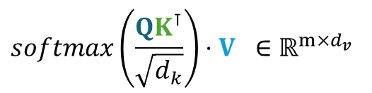




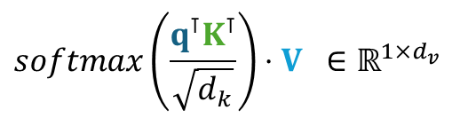


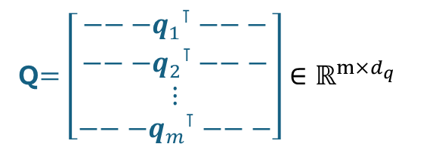
Attention for m queries
$$q∈ℝ^{d_{q}}$$
Q$=\left[\begin{matrix}{{−−−q}_{1}}^{⊺}−−− \\ \begin{matrix}{{−−−q}_{2}}^{⊺}−−− \\ ⋮\end{matrix} \\ −−−{q_{m}}^{⊺}−−−\end{matrix}\right]∈ℝ^{m×d_{q}}$
$$K=\left[\begin{matrix}{{−−−k}_{1}}^{⊺}−−− \\ \begin{matrix}{{−−−k}_{2}}^{⊺}−−− \\ ⋮\end{matrix} \\ −−−{k_{n}}^{⊺}−−−\end{matrix}\right]∈ℝ^{n×d_{k}}$$
$$K=\left[\begin{matrix}{{−−−k}_{1}}^{⊺}−−− \\ \begin{matrix}{{−−−k}_{2}}^{⊺}−−− \\ ⋮\end{matrix} \\ −−−{k_{n}}^{⊺}−−−\end{matrix}\right]∈ℝ^{n×d_{k}}$$
$$q^{⊺}→Q$$
$$V=\left[\begin{matrix}{−−−v_{1}}^{⊺}−−− \\ \begin{matrix}{{−−−v}_{2}}^{⊺}−−− \\ ⋮\end{matrix} \\ −−−{v_{n}}^{⊺}−−−\end{matrix}\right]∈ℝ^{n×d_{v}}$$
$$V=\left[\begin{matrix}{−−−v_{1}}^{⊺}−−− \\ \begin{matrix}{{−−−v}_{2}}^{⊺}−−− \\ ⋮\end{matrix} \\ −−−{v_{n}}^{⊺}−−−\end{matrix}\right]∈ℝ^{n×d_{v}}$$
$$softmax\left(\frac{q^{⊺}K^{⊺}}{\sqrt{d_{k}}}\right)⋅V ∈ℝ^{1×d_{v}}$$
$$softmax\left(\frac{QK^{⊺}}{\sqrt{d_{k}}}\right)⋅V ∈ℝ^{m×d_{v}}$$
Attention for a single query vector

Slide 8

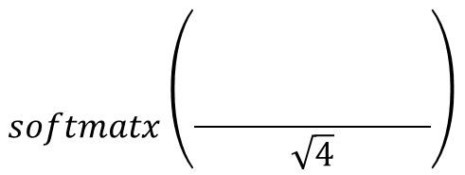



Illustration of attention equation
$$K^{⊺}$$
Q
$$softmatx\left(\frac{\begin{matrix} & & \begin{matrix} & \end{matrix} \\ & & \begin{matrix} & \end{matrix} \\ & & \begin{matrix} & \end{matrix}\end{matrix}}{\sqrt{4}}\right)$$
Atten$\left(Q,K,V\right)$
V
m=2, n=3
$d_{q}=d_{k}=4$
$$d_{v}=5$$

Slide 9
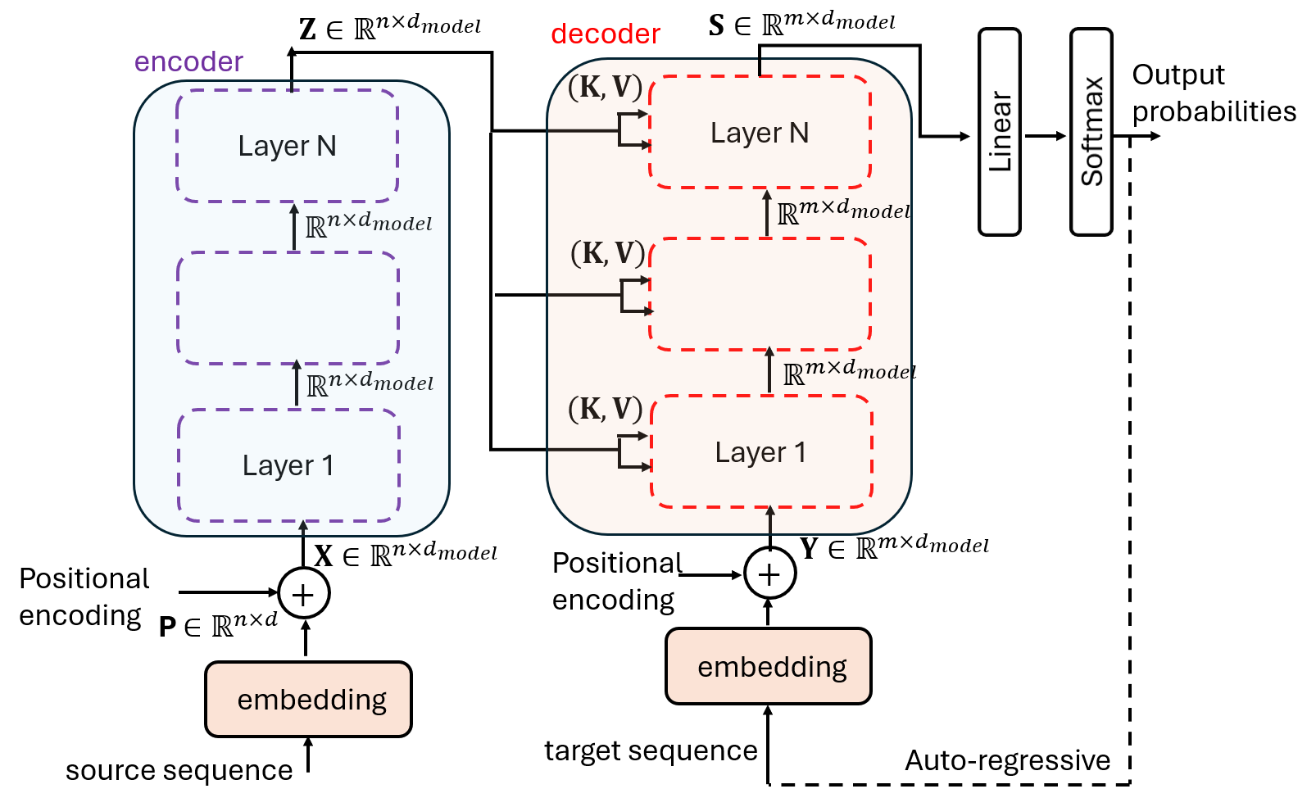
Transformer architecture
Vaswani, A., Shazeer, N., Parmar, N., Uszkoreit J., Jones L., Gomez, A. N., Kaiser, L., Polosukhin, I. (2017). Attention Is All You Need. arXiv:1706.03762v5 [cs.CL.] https://arxiv.org/pdf/1706.03762.pdf .
Input: source sequence embeddings
Output: target sequence embeddings
Encoder: N stacked layers (e.g. N=6)
Decoder: N stacked layers.

Slide 10
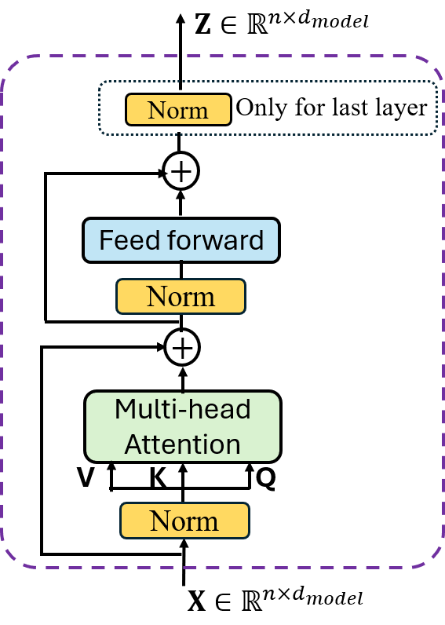
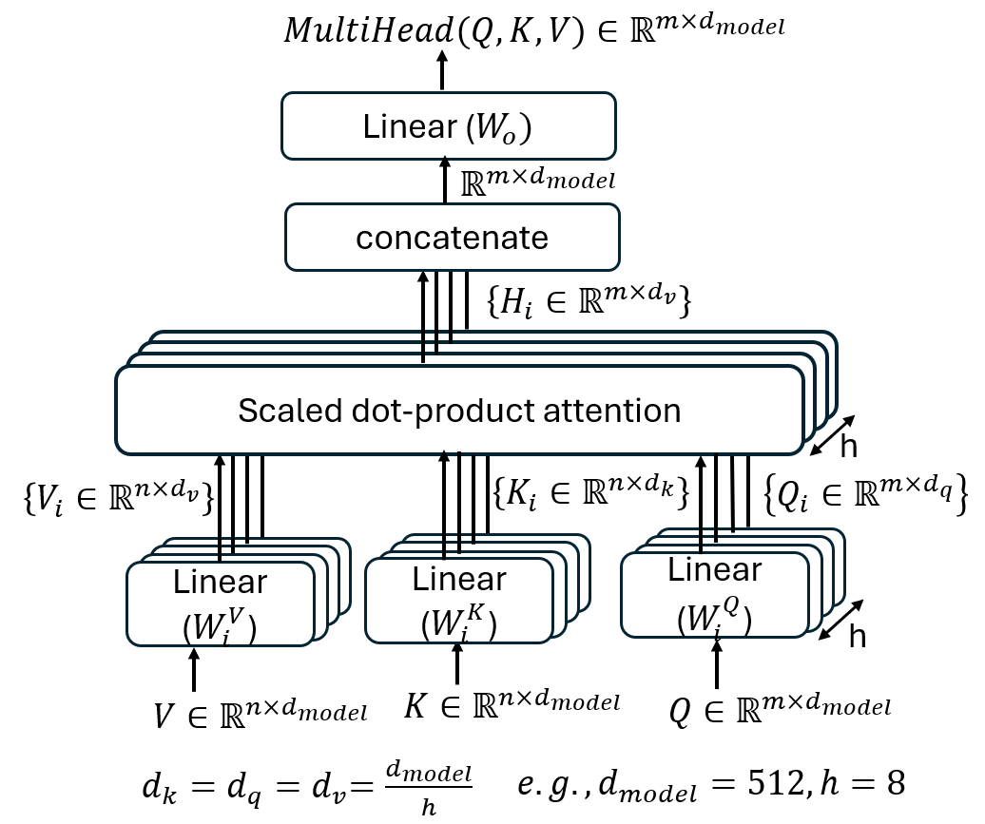
Each stacked layer in encoder

Slide 11
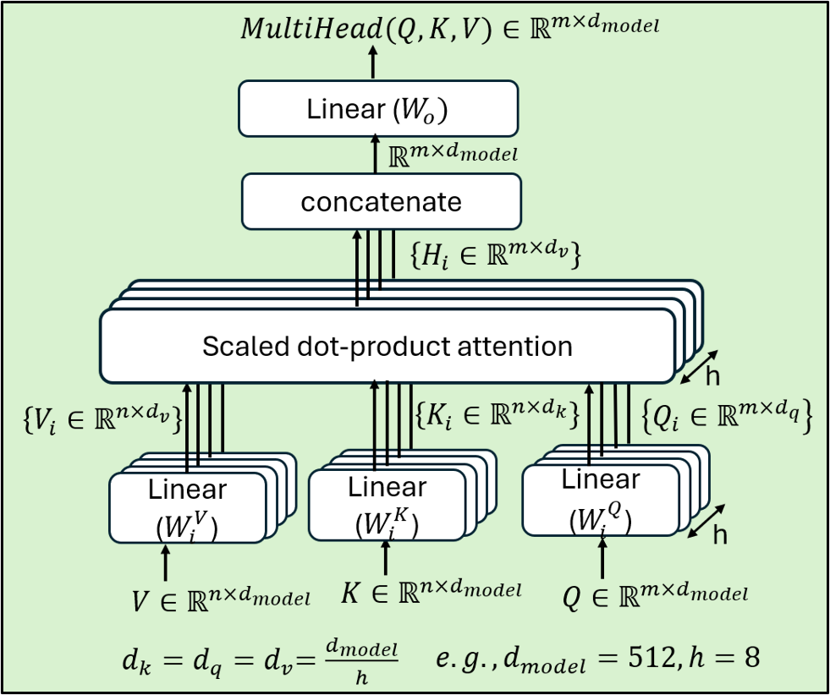
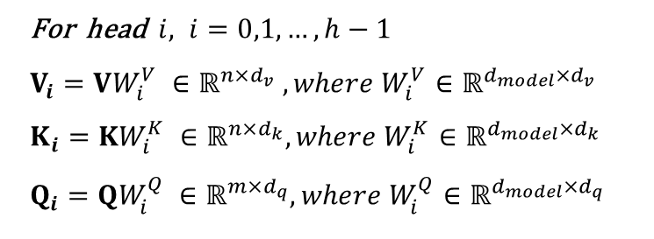
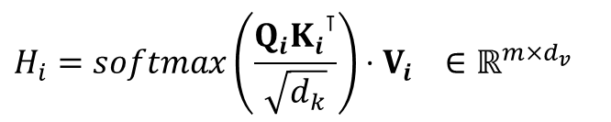
Multi-head attention in one stacked layer
Linear transform
For head $i, i=0,1,…,h−1$
$$V_{i}=VW_{i}^{V} ∈ℝ^{n×d_{v}} , where W_{i}^{V}∈ℝ^{d_{model}×d_{v}}$$
$$K_{i}=KW_{i}^{K} ∈ℝ^{n×d_{k}}, where W_{i}^{K}∈ℝ^{d_{model}×d_{k}}$$
$$Q_{i}=QW_{i}^{Q} ∈ℝ^{m×d_{q}}, where W_{i}^{Q}∈ℝ^{d_{model}×d_{q}}$$
Multi-head attentions
$$H_{i}=softmax\left(\frac{Q_{i}{K_{i}}^{⊺}}{\sqrt{d_{k}}}\right)⋅V_{i} ∈ℝ^{m×d_{v}}$$
Concatenation and linear transform
$$MultiHead\left(Q,K,V\right)=Concat\left(H_{0}, {H_{1}, …,H}_{h−1}\right)W_{o}$$
Discuss: Compare multi-head with single-head:
Computation complexity;
Benefits.

Slide 12
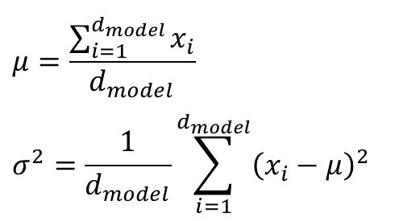


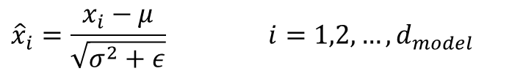
Layer normalization
Layer normalization is applied for sequential models, while batch normalization is for computer vision.
Layer normalization: to normalize each sample across features
Batch normalization: to normalize each feature across samples
Input
Normalizing
$$x=\left[x_{1},x_{2}, …,x_{d_{model}}\right]∈ℝ^{1×d_{model}}$$
$${\hat{x}}_{i}=\frac{x_{i}−μ}{\sqrt{σ^{2}+ε}} i=1,2,…,d_{model}$$
$$μ=\frac{\sum_{i=1}^{d_{model}}{x_{i}}}{d_{model}}$$
$$σ^{2}=\frac{1}{d_{model}}\sum_{i=1}^{d_{model}}{{\left(x_{i}−μ\right)}^{2}}$$
Scaling and shifting
$$y_{i}=γ_{i}∙{\hat{x}}_{i}+β_{i} i=1,2,…,d_{model}$$
Learnable parameters

Slide 13


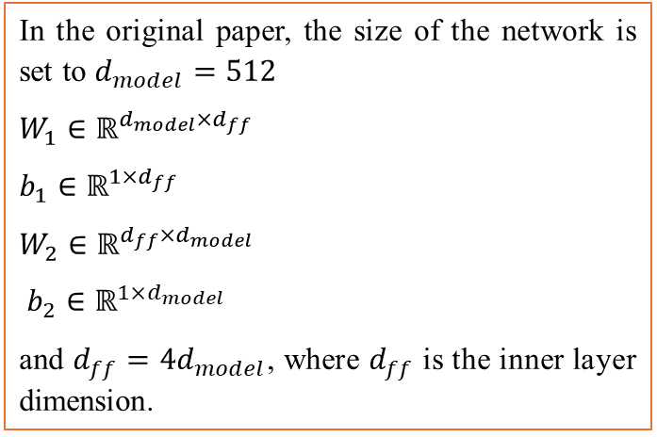


Feed forward in each stacked layer of encoder
Position-wise fully connected network.
The network is shared across n positions.
In the original paper, the size of the network is set to $d_{model}=512$
$$W_{1}∈ℝ^{d_{model}×d_{ff}}$$
$${b_{1}∈ℝ}^{1×d_{ff}}$$
$$W_{2}∈ℝ^{d_{ff}×d_{model}}$$
${b_{2}∈ℝ}^{1×d_{model}}$
and $d_{ff}=4d_{model}$, where $d_{ff}$ is the inner layer dimension.
$$FFN\left(x\right)=\left(ReLU\left(xW_{1}+b_{1}\right)\right)W_{2}+b_{2}$$
$$\left[\begin{matrix}\begin{matrix}∗ & ∗ & ∗ \\ ∗ & ∗ & ∗ \\ ∗ & ∗ & ∗\end{matrix} & \begin{matrix}∗ & ∗ & ∗ \\ ∗ & ∗ & ∗ \\ ∗ & ∗ & ∗\end{matrix} & \begin{matrix}∗ & ∗ & ∗ \\ ∗ & ∗ & ∗ \\ ∗ & ∗ & ∗\end{matrix} \\ \begin{matrix}∗ & ∗ & ∗ \\ ∗ & ∗ & ∗ \\ ∗ & ∗ & ∗\end{matrix} & \begin{matrix}∗ & ∗ & ∗ \\ ∗ & ∗ & ∗ \\ ∗ & ∗ & ∗\end{matrix} & \begin{matrix}∗ & ∗ & ∗ \\ ∗ & ∗ & ∗ \\ ∗ & ∗ & ∗\end{matrix} \\ \begin{matrix}∗ & ∗ & ∗ \\ ∗ & ∗ & ∗ \\ ∗ & ∗ & ∗\end{matrix} & \begin{matrix}∗ & ∗ & ∗ \\ ∗ & ∗ & ∗ \\ ∗ & ∗ & ∗\end{matrix} & \begin{matrix}∗ & ∗ & ∗ \\ ∗ & ∗ & ∗ \\ ∗ & ∗ & ∗\end{matrix}\end{matrix}\right]$$
$$x∈ℝ^{1×d_{model}}$$
$$X∈ℝ^{n×d_{model}}$$

Slide 14

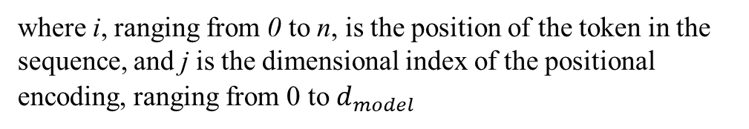
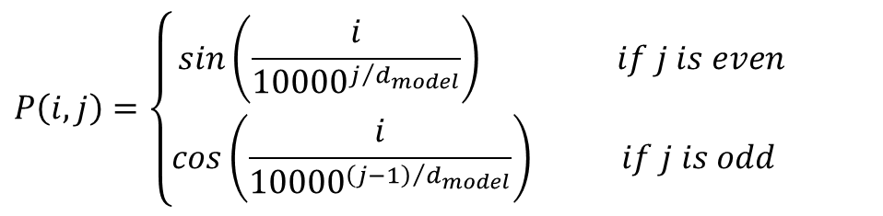
Output of the encoder
Input to the encoder is the embeddings of a sequence, a matrix $X∈ℝ^{n×d_{model}}$ (positional encoding included).
Positional encoding
The output of each stacked layer serves as the input for the next stacked layer.
The output of the last stacked layer can be interpreted as: $Z∈ℝ^{n×d_{model}}$ is an improved representation (embeddings) of the source sequence considering the relationships among the tokens.
$$P\left(i,j\right)=\left\{\begin{matrix}sin\left(\frac{i}{{10000}^{j/{d_{model}}}}\right) if j is even \\ cos\left(\frac{i}{{10000}^{{\left(j−1\right)}/{d_{model}}}}\right) if j is odd \end{matrix}\right.$$
where i, ranging from 0 to n, is the position of the token in the sequence, and j is the dimensional index of the positional encoding, ranging from 0 to $d_{model}$

Slide 15
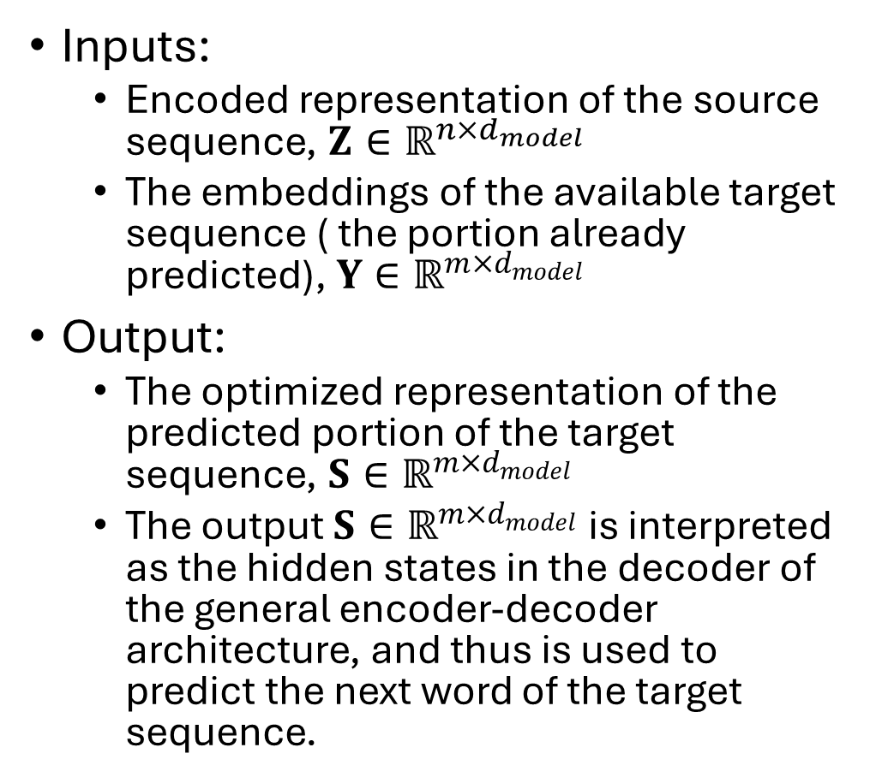
Decoder: input and output
Position-wisely:
do one row at a time
Inputs:
  Encoded representation of the source sequence, $Z∈ℝ^{n×d_{model}}$
  The embeddings of the available target sequence ( the portion already predicted), ${Y∈ℝ}^{m×d_{model}}$
Output:
  The optimized representation of the predicted portion of the target sequence, $S∈ℝ^{m×d_{model}}$
  The output $S∈ℝ^{m×d_{model}}$ is interpreted as the hidden states in the decoder of the general encoder-decoder architecture, and thus is used to predict the next word of the target sequence.

Slide 16
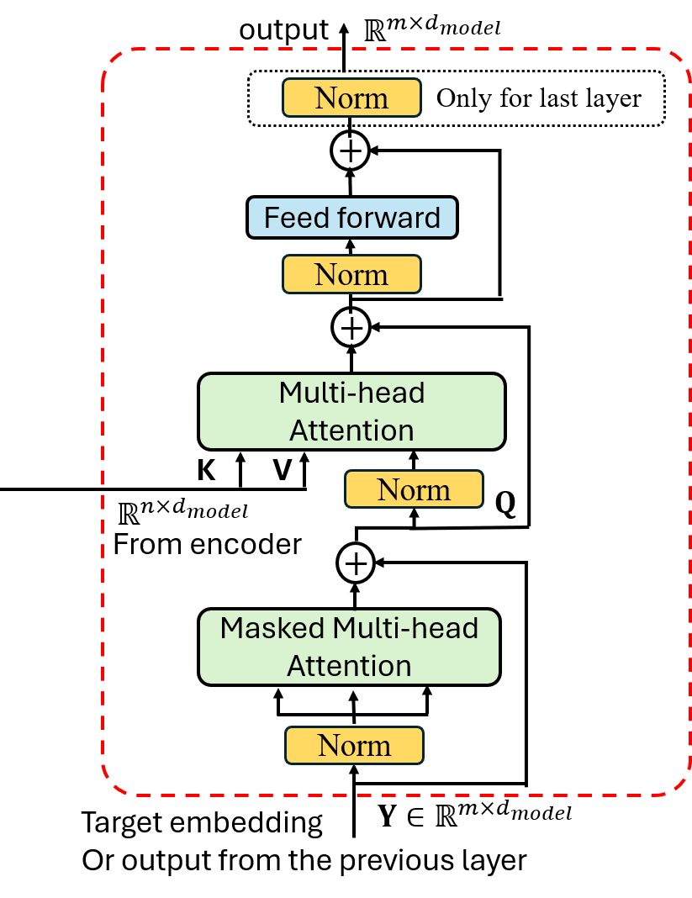
Decoder: architecture

Slide 17
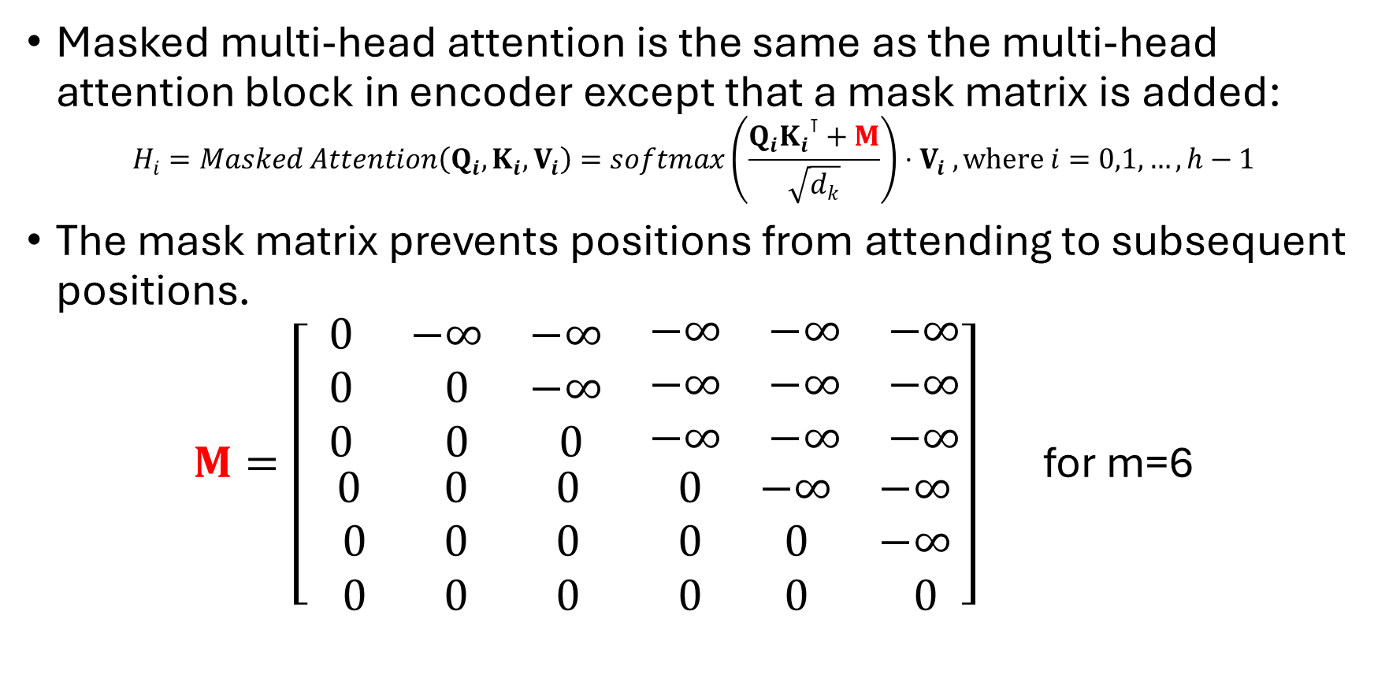
Decoder: masked multi-head attention
Masked multi-head attention is the same as the multi-head attention block in encoder except that a mask matrix is added:
$$H_{i}=Masked Attention\left(Q_{i},K_{i},V_{i}\right)=softmax\left(\frac{Q_{i}{K_{i}}^{⊺}+M}{\sqrt{d_{k}}}\right)⋅V_{i} , where i=0,1,…, h−1$$
The mask matrix prevents positions from attending to subsequent positions.
$M=\left[ \begin{matrix}\begin{matrix} 0 & −∞ & −∞ \\ 0 & 0 & −∞ \\ 0 & 0 & 0 \end{matrix} & \begin{matrix}−∞ & −∞ & −∞ \\ −∞ & −∞ & −∞ \\ −∞ & −∞ & −∞\end{matrix} \\ \begin{matrix}0 & 0 & 0 \\ 0 & 0 & 0 \\ 0 & 0 & 0 \end{matrix} & \begin{matrix}0 & −∞ & −∞ \\ 0 & 0 & −∞ \\ 0 & 0 & 0 \end{matrix}\end{matrix}\right]$ for m=6

Slide 18
Decoder: multi-head attention and feed forward network
The multi-head attention block handles the cross-attention between the target sequence (Q) and the source sequence (V,K).
Its implementation is identical to the one in encoder, but with different learnable parameters.
The feed forward networks are also the same as the ones in encoder, but with different learnable parameters.

Slide 19

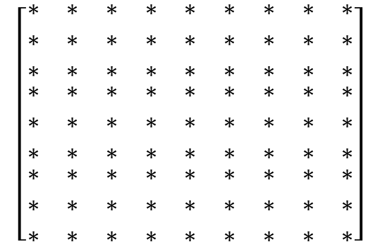
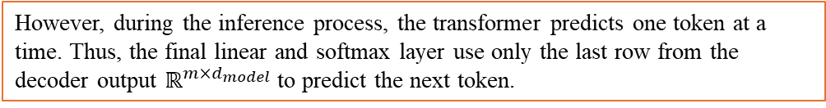

Final linear and softmax layer after decoder
$$d_{model}$$
0
$$\left[\begin{matrix}\begin{matrix}∗ & ∗ & ∗ \\ ∗ & ∗ & ∗ \\ ∗ & ∗ & ∗\end{matrix} & \begin{matrix}∗ & ∗ & ∗ \\ ∗ & ∗ & ∗ \\ ∗ & ∗ & ∗\end{matrix} & \begin{matrix}∗ & ∗ & ∗ \\ ∗ & ∗ & ∗ \\ ∗ & ∗ & ∗\end{matrix} \\ \begin{matrix}∗ & ∗ & ∗ \\ ∗ & ∗ & ∗ \\ ∗ & ∗ & ∗\end{matrix} & \begin{matrix}∗ & ∗ & ∗ \\ ∗ & ∗ & ∗ \\ ∗ & ∗ & ∗\end{matrix} & \begin{matrix}∗ & ∗ & ∗ \\ ∗ & ∗ & ∗ \\ ∗ & ∗ & ∗\end{matrix} \\ \begin{matrix}∗ & ∗ & ∗ \\ ∗ & ∗ & ∗ \\ ∗ & ∗ & ∗\end{matrix} & \begin{matrix}∗ & ∗ & ∗ \\ ∗ & ∗ & ∗ \\ ∗ & ∗ & ∗\end{matrix} & \begin{matrix}∗ & ∗ & ∗ \\ ∗ & ∗ & ∗ \\ ∗ & ∗ & ∗\end{matrix}\end{matrix}\right]$$
m
Linear
softmax
Probabilities
to predict position i+1
i
m-1
$$S∈ℝ^{m×d_{model}}$$
During the training process, since the whole target sequence, i.e., the ground truth, is available to the input of the decoder, the final linear and softmax layer position-wisely uses all m rows from the decoder output to predict the next tokens for all m positions (i.e., do one row at a time), and further computes the loss function based on the m positions instead of a single token.
Decoder
However, during the inference process, the transformer predicts one token at a time. Thus, the final linear and softmax layer use only the last row from the decoder output $ℝ^{m×d_{model}}$ to predict the next token.

Slide 20




Overall picture of transformer
Hidden states
encoder
decoder
$$S∈ℝ^{m×d_{model}}$$
$$Z∈ℝ^{n×d_{model}}$$
prediction
++m
$$X∈ℝ^{n×d_{model}}$$
$$Y∈ℝ^{m×d_{model}}$$
Word embeddings of
a source sequence
Word embeddings of
a part of target sequence

Slide 21
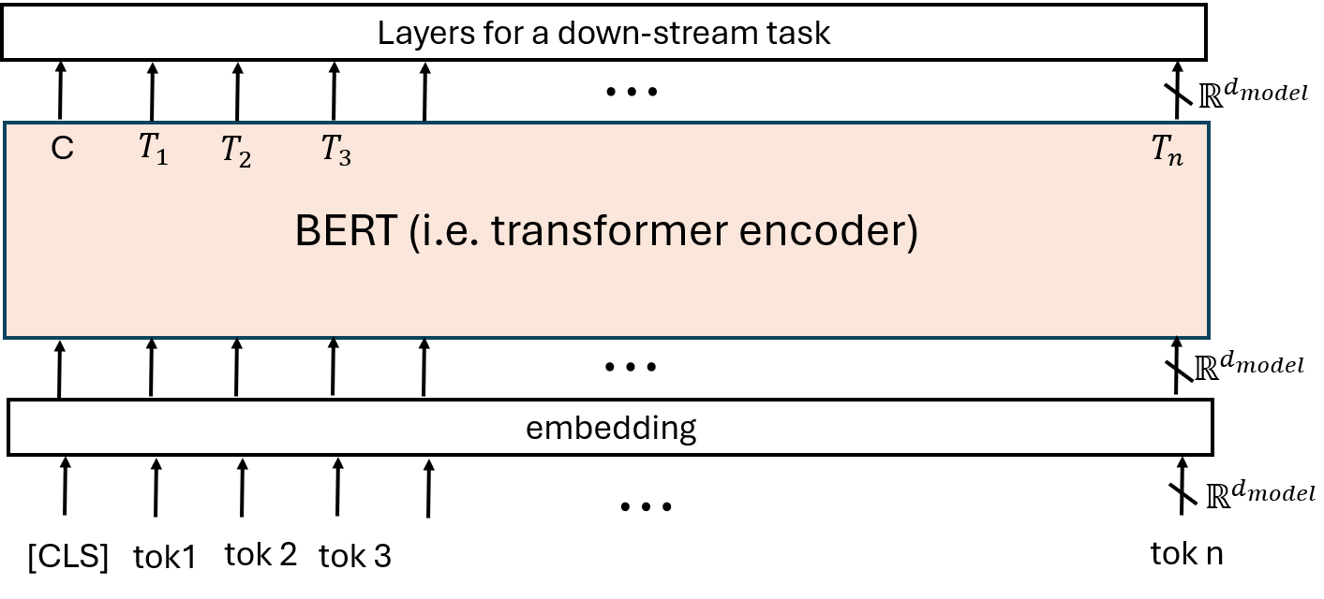

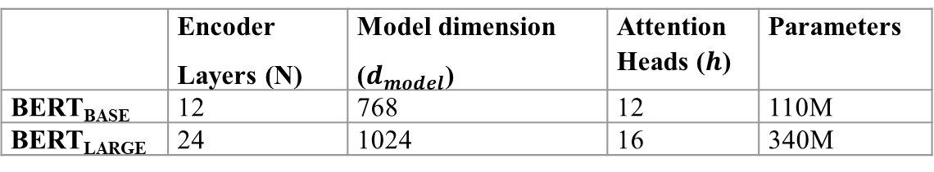
BERT
Devlin, J., Chang, M. W., Lee, K., and Toutanova, K. (2018). BERT: Pre-training of Deep Bidirectional Transformers for Language Understanding. arXiv:1810.04805v2
BERT (Bidirectional Encoder Representation from Transformer) is an architecture that is built upon the transformer encoder for generating contextual wording embeddings.
Output: $\left\{C, T_{i}∈ℝ^{d_{model}}, i=1,2,…, n\right\}$
Input: a sequence embeddings
 | Encoder Layers (N) | Model dimension ($d_{model}$) | Attention Heads ($h$) | Parameters
BERT_{BASE} | 12 | 768 | 12 | 110M
BERT_{LARGE} | 24 | 1024 | 16 | 340M

Slide 22
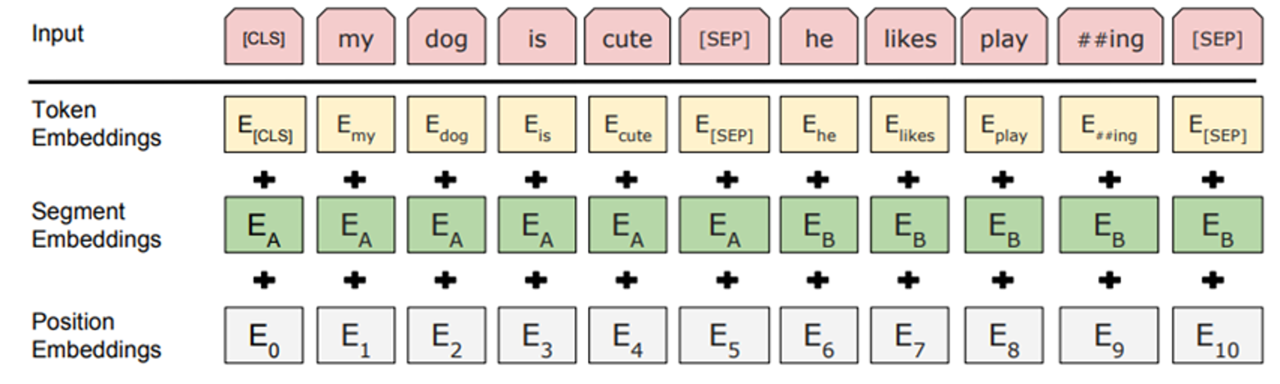
BERT input embeddings
Input: a single sentence or a pair of sentences, starting with classification token [CLS], separated by token [SEP].
For each token, its input embedding consists of three parts: token embedding, segment embedding, position embedding.
(print from Devlin et al. 2018)

Slide 23
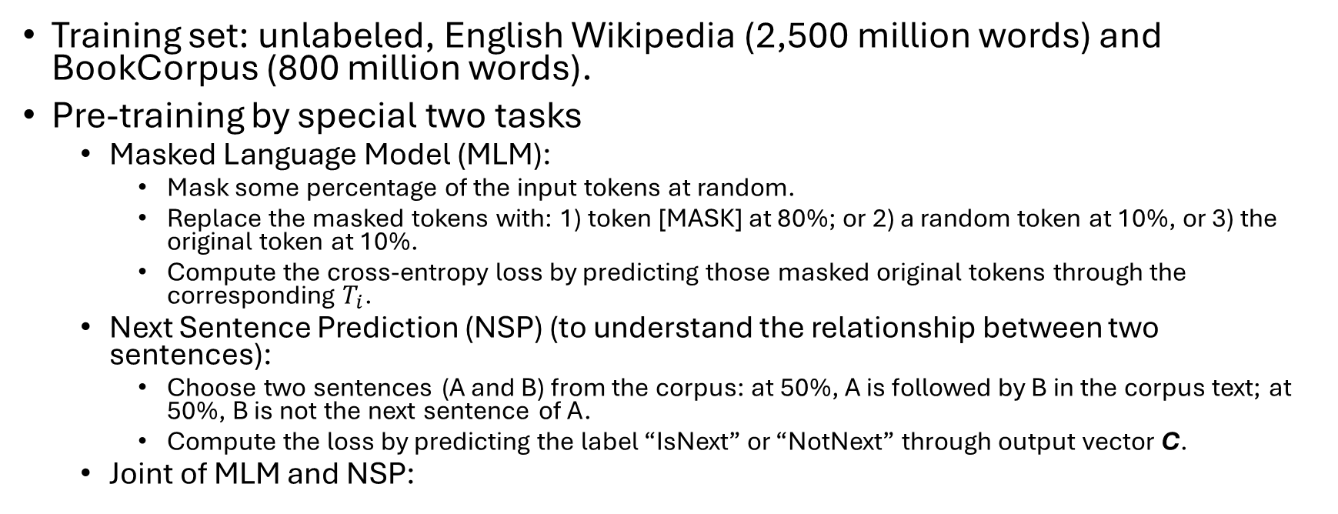
BERT pre-training
Training set: unlabeled, English Wikipedia (2,500 million words) and BookCorpus (800 million words).
Pre-training by special two tasks
  Masked Language Model (MLM):
    Mask some percentage of the input tokens at random.
    Replace the masked tokens with: 1) token [MASK] at 80%; or 2) a random token at 10%, or 3) the original token at 10%.
    Compute the cross-entropy loss by predicting those masked original tokens through the corresponding $T_{i}$.
  Next Sentence Prediction (NSP) (to understand the relationship between two sentences):
    Choose two sentences (A and B) from the corpus: at 50%, A is followed by B in the corpus text; at 50%, B is not the next sentence of A.
    Compute the loss by predicting the label “IsNext” or “NotNext” through output vector C.
  Joint of MLM and NSP:
Input sequence: [CLS] the man went to [MASK] store [SEP] he bought a gallon [MASK] milk [SEP]
Label: IsNext
Input sequence: [CLS] the man went to [MASK] store [SEP] penguin [MASK] are flight ##less birds [SEP]
Label: NotNext

Slide 24
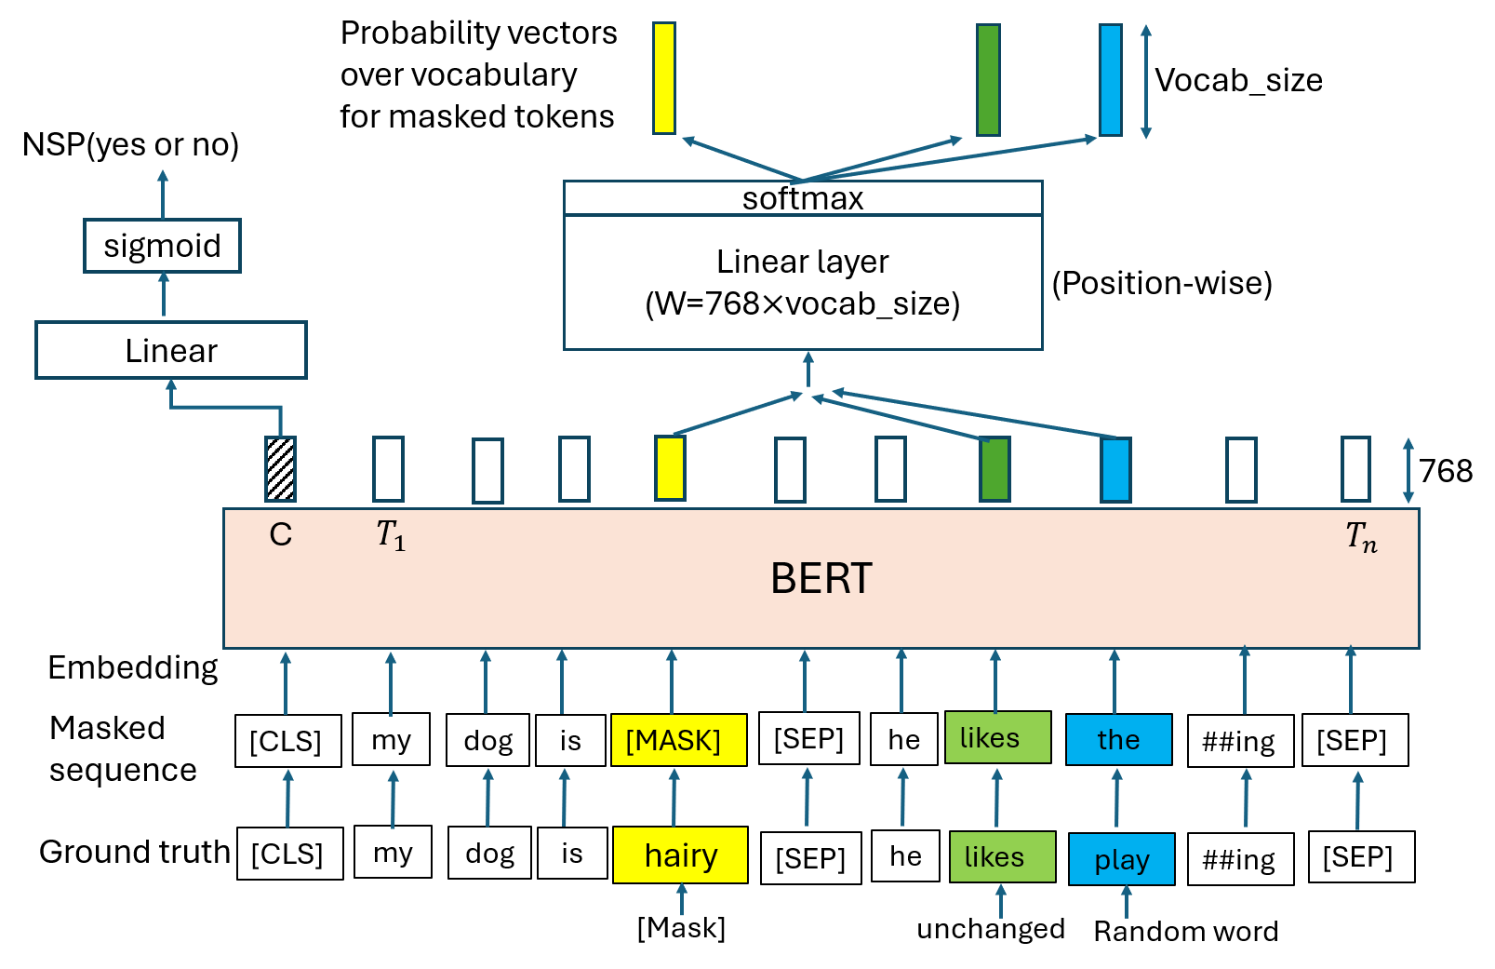
BERT pre-training diagram
Steps:
Generate masked sequence
Predict
Loss

Slide 25
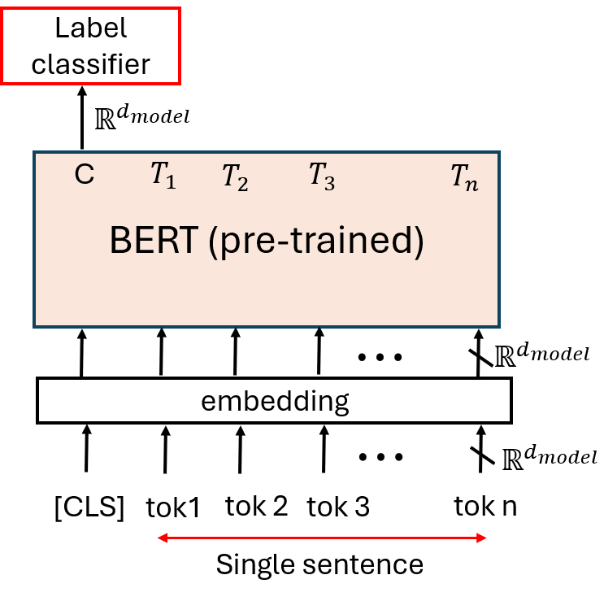
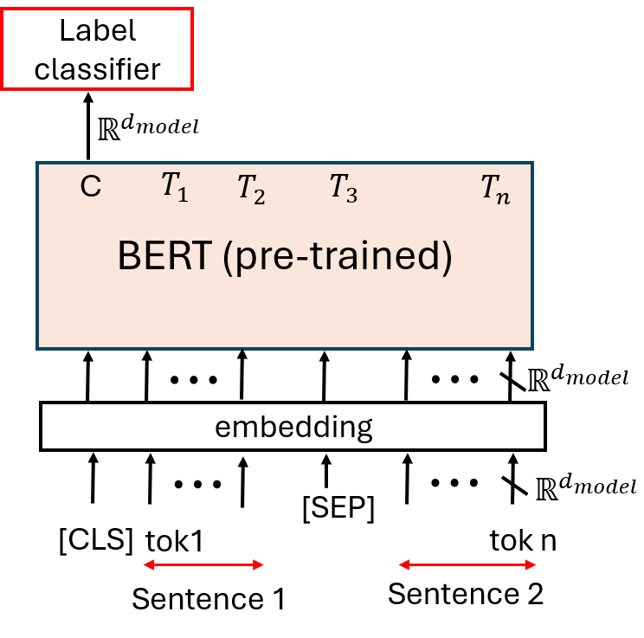
BERT fine-tuning by application tasks (1)
Single sentence classification
Sentence pair classification

Slide 26
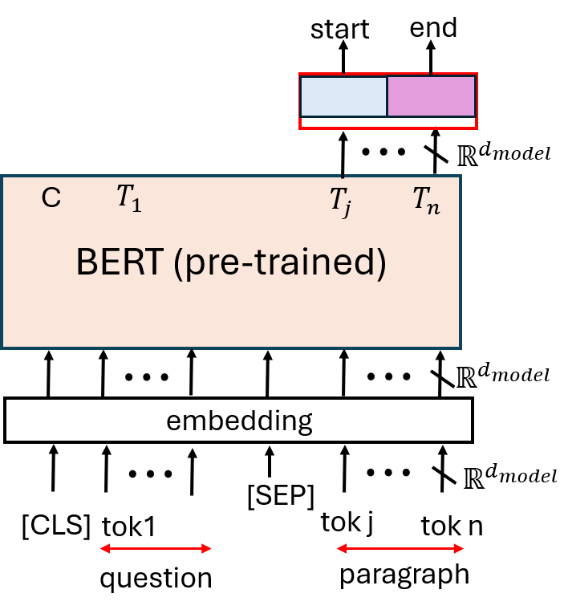
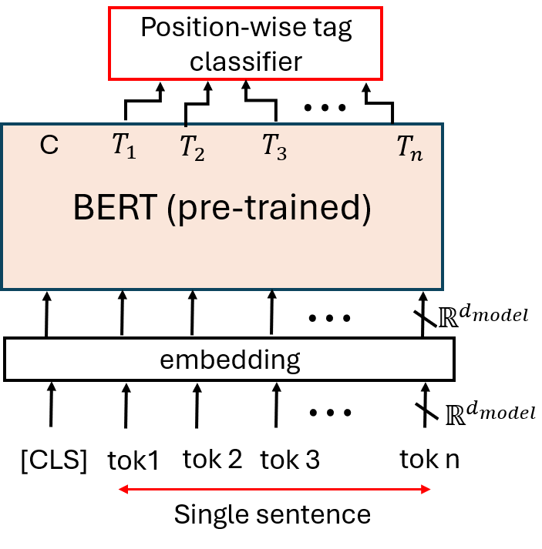
BERT fine-tuning by application tasks (2)
Single sentence tagging
Question answering task
See next slide

Slide 27
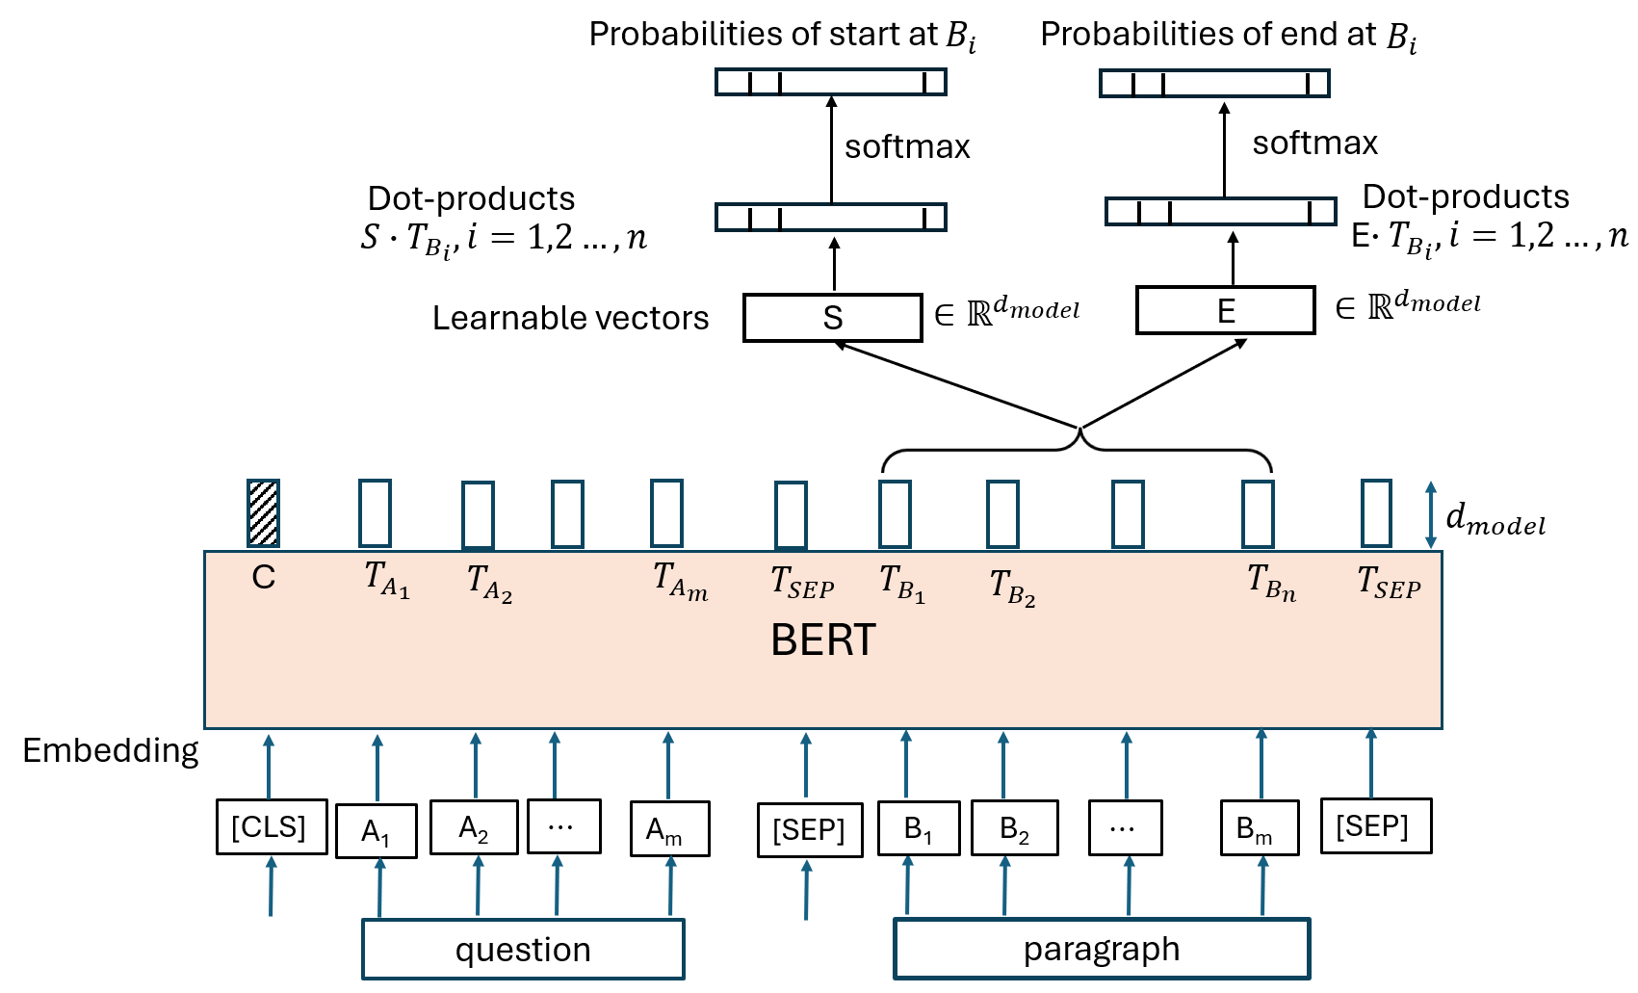
BERT fine-tune by question answering task

Slide 28
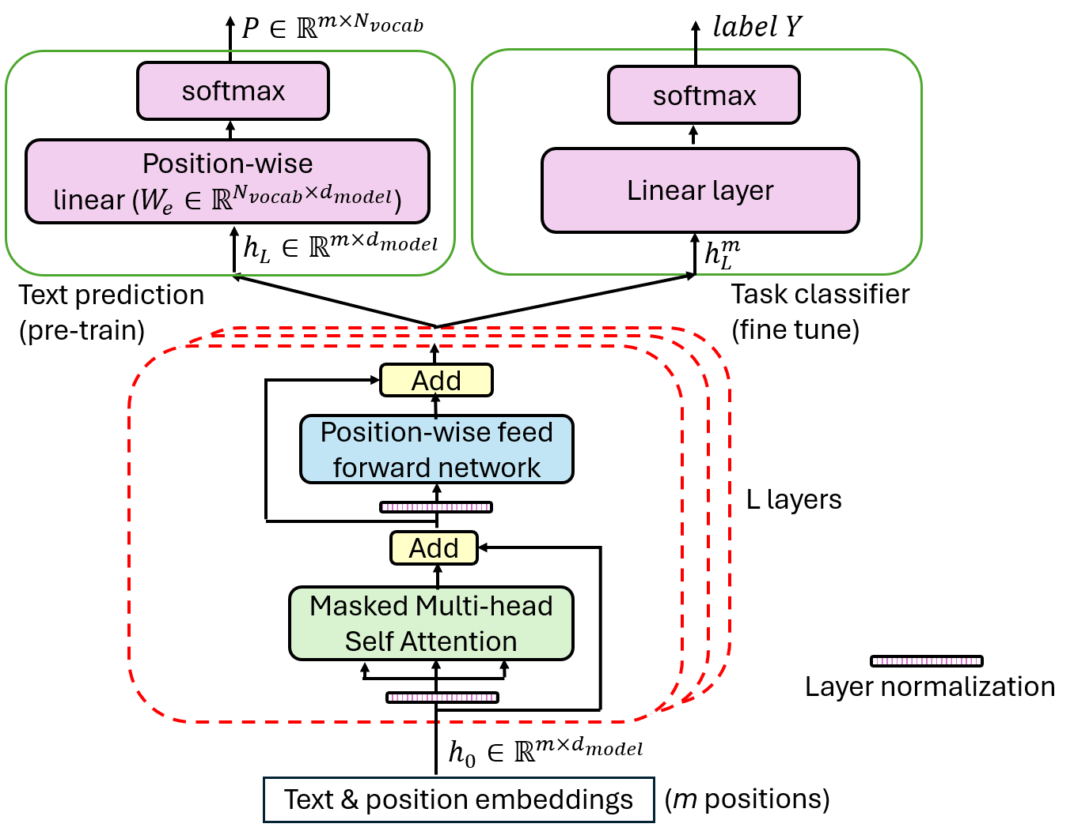
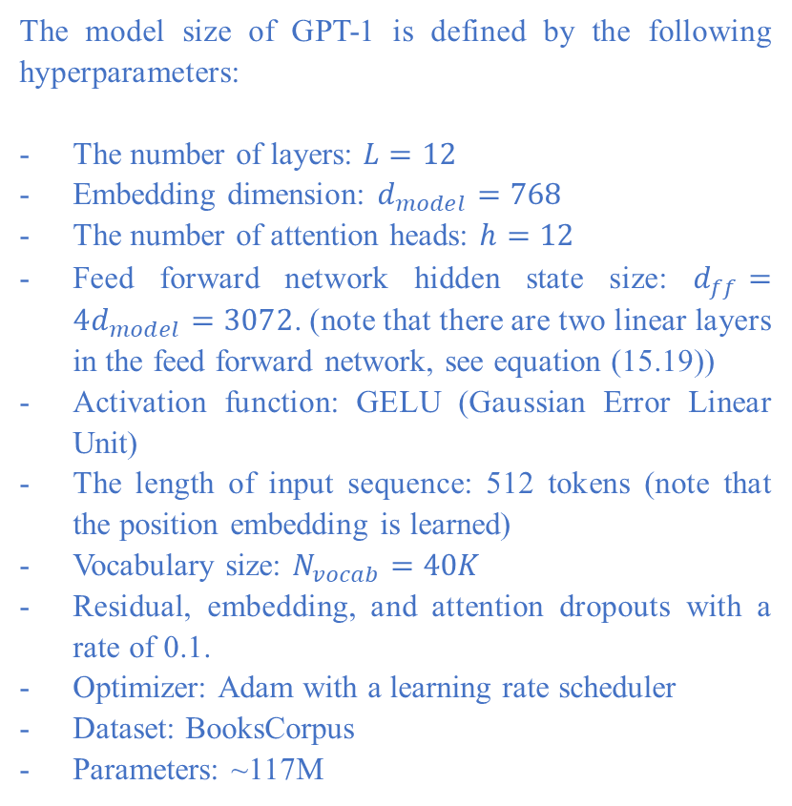
Generative Pre-trained Transformer (GPT)
The model size of GPT-1 is defined by the following hyperparameters:
The number of layers: $L=12$
Embedding dimension: $d_{model}=768$
The number of attention heads: $h=12$
Feed forward network hidden state size: $d_{ff}=4d_{model}=3072$. (note that there are two linear layers in the feed forward network, see equation (15.19))
Activation function: GELU (Gaussian Error Linear Unit)
The length of input sequence: 512 tokens (note that the position embedding is learned)
Vocabulary size: $N_{vocab}=40K$
Residual, embedding, and attention dropouts with a rate of 0.1.
Optimizer: Adam with a learning rate scheduler
Dataset: BooksCorpus
Parameters: ~117M
Radford, A., Narasimhan, K., Salimans, and T., Sutskever, I. (2018). Improving Language Understanding by Generative Pre-Training.
https://mbrenndoerfer.com/writing/gpt-1-generative-pretraining-language-understanding

Slide 29
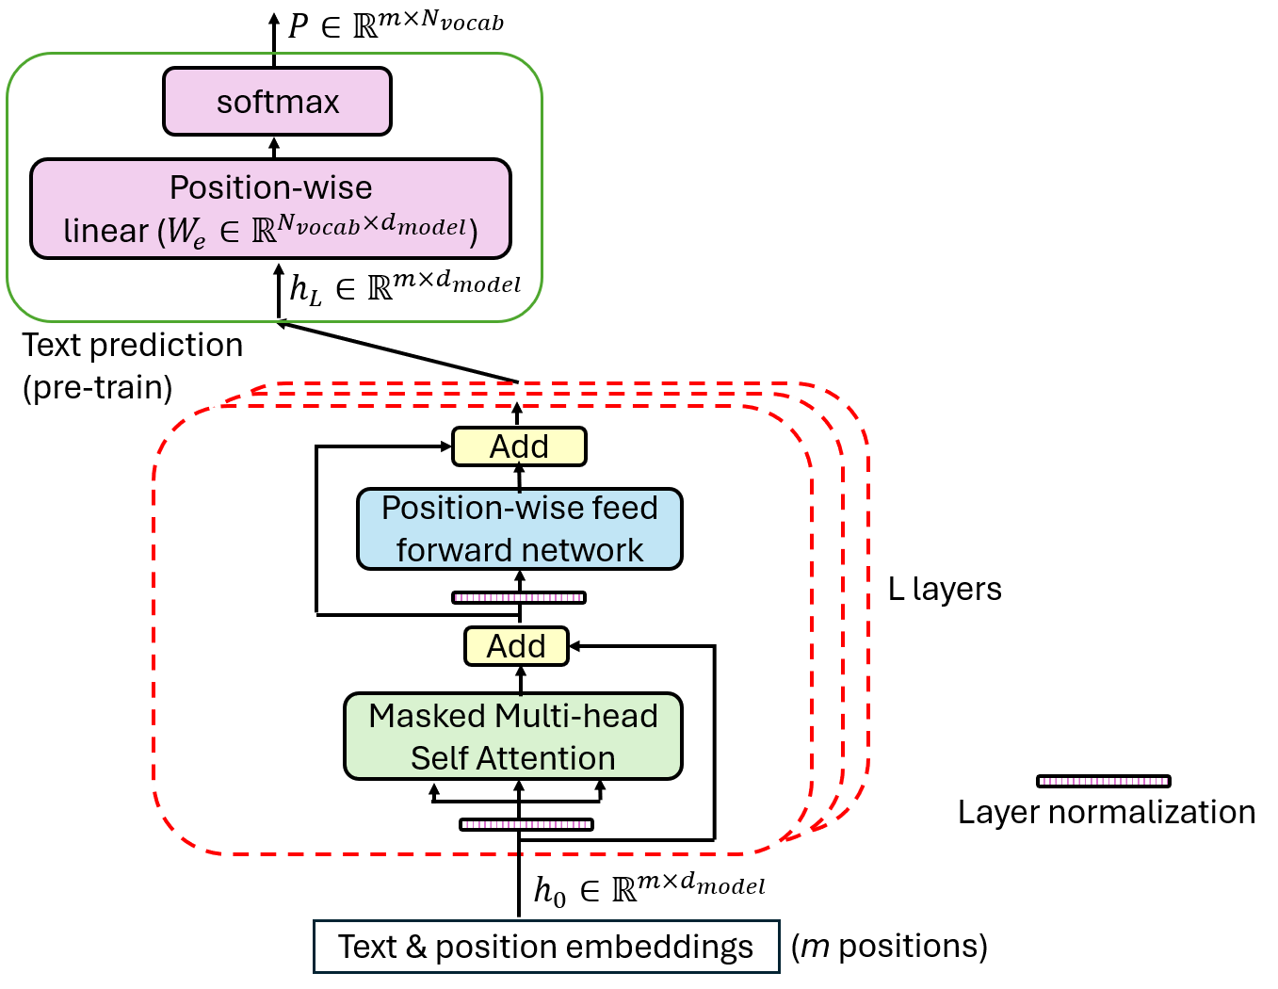








GPT1: pre-train (idea)
target
cat
sat
on
the
mat
[EOS]
Cross-entropy loss
$$P\left(.|t<1\right)$$
$$P\left(.|t<2\right)$$
$$P\left(.|t<3\right)$$
$$P\left(.|t<4\right)$$
$$P\left(.|t<5\right)$$
$$P\left(.|t<6\right)$$
40000
40000
40000
40000
40000
40000
Linear + softmax prediction
$$h_{L}:(6, 768)$$
L=12 layers
input
the
cat
sat
on
the
mat
$$L=12$$
$$m=6$$
$$d_{model}=768$$
$$N_{vocab}=40000$$

Slide 30





GPT1: pre-train (math)
Training samples: sequences
input ($h_{0}): ABCDEF(G…)$
Ground truth ($P): BCDEFG$
Position-wise
$$h_{0}=UW_{e}+W_{p}$$
$U∈ℝ^{m×N_{vocab}}$ is the one-hot-vector matrix of the input sequence,
and each row in U is the one-hot vector of a token,
$W_{e}∈ℝ^{N_{vocab}×d_{model}}$ is the token embedding matrix whose row
represents the embedding vector of a vocabulary token,
$W_{p}∈ℝ^{m×d_{model}}$ is the learned position embedding matrix instead of
the fixed sinusoidal position embeddings.
$$h_{l}=Layer \left(h_{l−1}\right)∈ℝ^{{m×d}_{model}}, l=1, 2, …,L$$
m probability distributions for m positions:
$$P=softmax\left(h_{L}W_{e}^{T}\right) ∈ℝ^{{m×N}_{vocab}}$$
Position-wise
Maximize the likelihood:
$$L_{1}\left(𝒰\right)=\sum_{i}{\ln{P\left(u_{i}|u_{i−k} , …u_{i−1},\right)}}$$

Slide 31




GPT1: fine-tuning
Dataset: each sample is a sequence $\left\{x^{1}, …,x^{m}\right\}$ with label y
$$P\left(y|x^{1} , …x^{m},\right)=softmax\left(h_{L}^{m}W_{y}\right)$$
Likelihood
$$L_{2}\left(𝒞\right)=\sum_{\left(x,y\right)}{\ln{P\left(y|x^{1} , …x^{m},\right)}}$$
Maximize likelihood
$L_{3}\left(𝒞\right)=L_{2}\left(𝒞\right)+λ∙L_{1}\left(𝒞\right) ,$ $λ=0.5$
Softmax layer after each linear

Slide 32

Build transformer from scratch in Python
Hyper-parameter | Description | Example value
d_model | the dimension of token embedding, the dimension of intermediate results | 512
d_ff | the size of hidden layer in the position-wise feed forward networks | 2048
N | the number of layers in encoder the number of layers in decoder | 6
h | the number of heads in multi-head attention | 8
src_seq_len | the length of the source sequence | 512
tgt_seq_len | the length of the target sequence | 512
src_vocab_size | the number of tokens in the source vocabulary | 40000
tgt_vocab_size | the number of tokens in the target vocabulary | 40000
dropout | dropout rate for regularization at some layer outputs | 0.1

Slide 33
Input token embeddings
import torch
import torch.nn as nn
import math
import numpy as np
import matplotlib.pyplot as plt
class InputEmbeddings(nn.Module):
def __init__(self, d_model, vocab_size):
super(InputEmbeddings, self).__init__()
self.d_model = d_model
self.vocab_size = vocab_size
self.embedding = nn.Embedding(vocab_size, d_model)
def forward(self, x):
return self.embedding(x)*math.sqrt(self.d_model)
# scaled
# test InputEmbeddings
src = torch.randint(0, 10, (2, 10))
my_inputembeddings = InputEmbeddings(512, 40000)
embeddings = my_inputembeddings(src)
print(embeddings.size())
torch.Size([2, 10, 512])
# two sequences, 10 tokens for each

Slide 34
Positional encoding
class PositionalEncoding(nn.Module):
def __init__(self, d_model, max_len, dropout=0.1):
super(PositionalEncoding, self).__init__()
self.dropout = nn.Dropout(dropout)
# Create matrix pe, shape (max_len, d_model).
pe = torch.zeros(max_len, d_model) # shape (max_len,d_model)
position = torch.arange(0, max_len).unsqueeze(1) # shape (max_len, 1)
div_term = torch.exp(torch.arange(0,d_model,2)*(-math.log(10000.0) /
d_model))
# sin for even indices
pe[:, 0::2] = torch.sin(position * div_term)
# cos for odd indices
pe[:, 1::2] = torch.cos(position * div_term)
# add a batch dimension: (1, max_len, d_model)
pe = pe.unsqueeze(0)
# register pe as a buffer
self.register_buffer('pe', pe)
def forward(self, x):
x = x + (self.pe[:, :x.shape[1], :]).requires_grad_(False)
# (batch, seq_len, d_model)
# pe is fixed, and not learned.
return self.dropout(x)
# test PositionalEncoding
my_positionalencoding = PositionalEncoding(512,512)
positionalencoding = my_positionalencoding(embeddings)
print(positionalencoding.size())
torch.Size([2, 10, 512])

Slide 35
Layer normalization and feedforward net
class LayerNormalization(nn.Module):
def __init__(self, features=512, eps=10**-6):
super().__init__()
self.eps = eps
self.alpha = nn.Parameter(torch.ones(features))
# learnable parameters
self.bias = nn.Parameter(torch.zeros(features))
# learnable parameters
def forward(self,x):
# x shape (batch, seq_len, d_model)
mean = x.mean(dim=-1, keepdim = True)
# normalize on the last dimension, shape (batch, seq_len, 1)
std = x.std(dim=-1, keepdim = True)
return self.alpha*(x-mean)/(std+self.eps)+self.bias
# of parameters: ?
# test LayerNormalization()
x=5*torch.randn(2,10,512)+10
features = x.shape[2]
my_layernorm = LayerNormalization(features)
y = my_layernorm(x)
print('my layernorm', y)
print(y.size())
torch.Size([2, 10, 512])
class FeedForwardBlock(nn.Module):
def __init__(self, d_model, d_ff, dropout = 0.1):
super().__init__()
self.linear1 = nn.Linear(d_model, d_ff)
# bias is true at default, W1, b1
self.linear2 = nn.Linear(d_ff, d_model) # W2, b2
self.dropout = nn.Dropout(dropout)
def forward(self, x):
# (batch,seq_len,d_model)-->(batch,seq_len,d_ff)
# -->(batch,seq_len,d_model)
return self.linear2(self.dropout(torch.relu(self.linear1(x))))
# test FeedForwardBlock()
my_ffn = FeedForwardBlock(512,2048)
x = torch.randn(2, 10, 512)
y = my_ffn(x)
print(y.size())
torch.Size([2, 10, 512])
# of parameters: ?

Slide 36

Multi-head attention (1/3)
class MultiHeadAttentionBlock(nn.Module):
def __init__(self, d_model, h, dropout = 0.1):
super().__init__()
self.d_model = d_model
self.h = h
assert d_model % h == 0, "d_model is not divisible by h"
self.d_k = d_model // h
self.d_v = d_model // h
self.w_q = nn.Linear(d_model, d_model) # Wq
self.w_k = nn.Linear(d_model, d_model) # Wk
self.w_v = nn.Linear(d_model, d_model) # Wv
self.w_o = nn.Linear(d_model, d_model) # Wo
self.dropout = nn.Dropout(dropout)

Slide 37
Multi-head attention (2/3)
@staticmethod
def attention(query, key, value, mask, dropout:nn.Dropout):
d_k = query.shape[-1]
attention_scores = (query @ key.transpose(-2,-1))/math.sqrt(d_k)
# @ matrix multiplication on the last two dimensions
if mask is not None:
attention_scores.masked_fill_(mask == 0, -1e9)
attention_scores = attention_scores.softmax(dim = -1)
# --> (batch, h, seq_len, seq_len)
if dropout is not None:
attention_scores = dropout(attention_scores)
# return (batch, h, seq_len, d_v), (batch, h, seq_len, seq_len)
return (attention_scores @ value), attention_scores

Slide 38
Multi-head attention (3/3)
def forward(self, q, k, v, mask):
# linear projection:
# (batch,seq_len,d_model)-->(batch,seq_len,d_model)
query = self.w_q(q)
key = self.w_k(k)
value = self.w_v(v)
# split to h heads
# (batch,seq_len,d_model) --> (batch,seq_len,h,d_k)
# --> (batch, h, seq_len, d_k)
query = query.view(query.shape[0], query.shape[1], self.h, self.d_k)
.transpose(1,2)
key = key.view(key.shape[0], key.shape[1], self.h, self.d_k)
.transpose(1,2)
value = value.view(value.shape[0], value.shape[1], self.h, self.d_v)
.transpose(1,2)
x, self.attention_scores = MultiHeadAttentionBlock.attention
(query, key, value, mask, self.dropout)
# x: (batch, h, seq_len, d_k)
x = x.transpose(1,2).contiguous().view(x.shape[0],-1,self.h*self.d_k)
# (batch, h, seq_len,d_k) --> (batch, seq_len, h, d_k)
# -->(batch, seq,len,d_model)
return self.w_o(x)
# of parameters: ?
# test MultiHeadAttention
my_MultiHeadAttentionBlock = MultiHeadAttentionBlock(d_model=512, h=8)
z1 = my_MultiHeadAttentionBlock(x,x,x, mask=None)
print(z1.size())
torch.Size([2, 10, 512])

Slide 39
Residual connection
class ResidualConnection(nn.Module):
def __init__(self,features, dropout=0.1):
super().__init__()
self.dropout = nn.Dropout(dropout)
self.norm = LayerNormalization(features, dropout)
def forward(self, x, sublayer):
return x + self.dropout(sublayer(self.norm(x)))
# apply norm before sublayer.
# This is different from the original paper.
# test residual
my_Residual0 = ResidualConnection(512, 0.1)
my_Residual1 = ResidualConnection(512, 0.1)
z2 = my_Residual0(x,lambda y: my_MultiHeadAttentionBlock(y,y,y, mask = None))
z3 = my_Residual1 (z1, FeedForwardBlock(512, 2048))
print(z2.size())
print(z3.size())
torch.Size([2, 10, 512])
torch.Size([2, 10, 512])

Slide 40
One layer in encoder
class EncoderBlock(nn.Module):
def __init__(self, size, self_attention_block: MultiHeadAttentionBlock,
feed_forward_block: FeedForwardBlock, dropout):
super().__init__()
self.self_attention_block = self_attention_block
self.feed_forward_block = feed_forward_block
self.residual_connections = nn.ModuleList
([ResidualConnection(size, dropout) for _ in range(2)])
self.size = size
def forward(self, x, src_mask):
x = self.residual_connections[0](x,
lambda x: self.self_attention_block(x,x,x,src_mask))
# why lambda x:? because, in self_attention_block there are
# three input q,k,v, instead of one x
# we need to assign x to all of them (q,k,v)
x = self.residual_connections[1](x, self.feed_forward_block)
return x
# of parameters: ?
# test EncoderBlock
attention_block = MultiHeadAttentionBlock(d_model=512, h=8)
feed_forward = FeedForwardBlock(512, 2048)
size = x.shape[2]
my_encoderblock = EncoderBlock(size,attention_block,feed_forward,dropout=0.1)
z4=my_encoderblock(x, src_mask = None)
print('(batch, seq_len, d_model):', z4.size())
(batch, seq_len, d_model): torch.Size([2, 10, 512])

Slide 41
Encoder
class Encoder(nn.Module):
def __init__(self, d_model, layers: nn.ModuleList):
super(Encoder, self).__init__()
self.layers = layers
self.norm = LayerNormalization(d_model)
def forward(self, x, mask):
for layer in self.layers:
x = layer(x,mask)
return self.norm(x)
# test Encoder
N=6
d_model=512
h=8
d_ff=2048
dropout=0.1
# generate encoder_layers using nn.ModuleList([...for...in range(N)])
encoder_layers = nn.ModuleList([ EncoderBlock(d_model,MultiHeadAttentionBlock(d_model, h), FeedForwardBlock(d_model, d_ff), dropout) for _ in range(N)])
my_Encoder = Encoder(d_model, encoder_layers)
encoder_output=my_Encoder(x, mask = None)
print('Encoder output shape:', encoder_output.size())
Encoder output shape: torch.Size([2, 10, 512])
# of parameters: ?

Slide 42
One layer in decoder
class DecoderBlock(nn.Module):
def __init__(self, size, self_attention_block: MultiHeadAttentionBlock,
cross_attention_block:MultiHeadAttentionBlock,
feed_forward_block: FeedForwardBlock, dropout=0.1):
super(DecoderBlock, self).__init__()
self.size = size
self.self_attention_block = self_attention_block
self.cross_attention_block = cross_attention_block
self.feed_forward_block = feed_forward_block
self.residual_connections = nn.ModuleList
([ResidualConnection(size, dropout) for _ in range(3)])
def forward(self, x, encoder_output, src_mask, tgt_mask):
x = self.residual_connections[0](x,
lambda x: self.self_attention_block(x,x,x,tgt_mask))
x = self.residual_connections[1](x,
lambda x: self.cross_attention_block(x,encoder_output,
encoder_output,src_mask))
x = self.residual_connections[2](x, self.feed_forward_block)
return x
# test DecoderBlock()
x2=torch.randn(2, 5, 512)
size =x2.shape[2]
self_attention_block = MultiHeadAttentionBlock(d_model=512, h=8)
cross_attention_block = MultiHeadAttentionBlock(d_model=512,h=8)
feed_forward_block = FeedForwardBlock(512, 2048)
my_decoderblock = DecoderBlock(size, self_attention_block, cross_attention_block,feed_forward_block)
decoderblock_output = my_decoderblock(x2, encoder_output, src_mask = None, tgt_mask = None)
print('DecoderBlock output size:', decoderblock_output.size())
DecoderBlock output size: torch.Size([2, 5, 512])
# of parameters: ?

Slide 43
Decoder
class Decoder(nn.Module):
def __init__(self, d_model, layers: nn.ModuleList):
super(Decoder, self).__init__()
self.layers = layers
self.norm = LayerNormalization(d_model)
def forward(self, x, encoder_output, src_mask, tgt_mask):
for layer in self.layers:
x = layer(x, encoder_output, src_mask, tgt_mask)
return self.norm(x)
# test Decoder()
decoder_layers = nn.ModuleList([ DecoderBlock(d_model, \
MultiHeadAttentionBlock(d_model, h),\
MultiHeadAttentionBlock(d_model, h), \
FeedForwardBlock(d_model, d_ff), dropout) \
for _ in range(N)])
my_decoder = Decoder(d_model, decoder_layers)
decoder_output = my_decoder(x2, encoder_output, \
src_mask = None, tgt_mask = None)
print('decoder output size:', decoder_output.size())
decoder output size: torch.Size([2, 5, 512])
# of parameters: ?

Slide 44
Position-wise prediction
class ProjectionLayer(nn.Module):
def __init__(self, d_model, vocab_size):
super().__init__()
self.linear =nn.Linear(d_model, vocab_size)
def forward(self, x):
#(batch, seq_len, d_model) --> (batch, seq_len, vocab_size)
return torch.log_softmax(self.linear(x), dim = -1)
# test ProjectLayer()
x = torch.randn(2,5,512)
projection = ProjectionLayer(512, 40000)
log_prob = projection(x)
print('log_prob size:', log_prob.size())
log_prob size: torch.Size([2, 5, 40000])
# of parameters: ?

Slide 45
Put it all together
class Transformer(nn.Module):
def __init__(self, encoder: Encoder, decoder: Decoder,
src_embed: InputEmbeddings, tgt_embed: InputEmbeddings,
src_pos: PositionalEncoding, tgt_pos: PositionalEncoding,
projection_layer: ProjectionLayer):
super().__init__()
self.encoder = encoder
self.decoder = decoder
self.src_embed = src_embed
self.tgt_embed = tgt_embed
self.src_pos = src_pos
self.tgt_pos = tgt_pos
self.projection_layer = projection_layer
def encode(self, src, src_mask):
src = self.src_embed(src)
src = self.src_pos(src)
return self.encoder(src, src_mask)
def decode(self, encoder_output, src_mask, tgt, tgt_mask):
tgt = self.tgt_embed(tgt)
tgt = self.tgt_pos(tgt)
return self.decoder(tgt, encoder_output, src_mask, tgt_mask)
def project(self, x):
return self.projection_layer(x)
def forward(self, src, tgt, src_mask, tgt_mask):
#Take in and process masked src and target sequences.
return self.project(self.decode(self.encode(src, src_mask),\
src_mask, tgt, tgt_mask))

Slide 46
Make a specific transformer (1/2)
# the goal is to construct a transformer, given the hyper parameters
# steps:
# 1) embedding layers: src_embed, tgt_embed, src_pos, tgt_pos
# 2) encoder_blocks --> encoder
# 3) decoder_blocks --> decoder
# 4) projection_layer
# 5) call Transformer()
def make_model(src_vocab_size, tgt_vocab_size, src_seq_len, tgt_seq_len, \
d_model=512, N=6, h=8, d_ff=2048, dropout=0.1):
# create embedding layers
src_embed = InputEmbeddings(d_model, src_vocab_size)
tgt_embed = InputEmbeddings(d_model, tgt_vocab_size)
# create positional encoding layers
src_pos = PositionalEncoding(d_model, src_seq_len, dropout)
tgt_pos = PositionalEncoding(d_model, tgt_seq_len, dropout)
# create encoder
encoder_layers = nn.ModuleList([ EncoderBlock(d_model, \
MultiHeadAttentionBlock(d_model, h,dropout),\
FeedForwardBlock(d_model, d_ff,dropout), dropout) \
for _ in range(N)])
encoder = Encoder(d_model, encoder_layers)

Slide 47
Make a specific transformer (2/2)
# create decoder
decoder_layers = nn.ModuleList([ DecoderBlock(d_model, \
MultiHeadAttentionBlock(d_model, h, dropout), \
MultiHeadAttentionBlock(d_model, h, dropout), \
FeedForwardBlock(d_model, d_ff, dropout), dropout) \
for _ in range(N)])
decoder = Decoder(d_model, decoder_layers)
# create projection layer
projection_layer = ProjectionLayer(d_model, tgt_vocab_size)
# finally, create the transformer
model = Transformer(encoder, decoder, src_embed, tgt_embed, \
src_pos, tgt_pos, projection_layer)
# initialize the parameters
for p in model.parameters():
if p.dim()>1:
nn.init.xavier_uniform_(p)
return model
# test model
model = make_model(src_vocab_size=40000, tgt_vocab_size=40000, src_seq_len=512, tgt_seq_len=512, d_model=512, N=6, h=8, d_ff=2048, dropout=0.1)

Slide 48
Test the model
# this function can be used to calculate the number of parameters for any module.
def count_parameters(model):
return sum(p.numel() for p in model.parameters() if p.requires_grad)
src = torch.randint(0, 10, (2, 10))
tgt = torch.randint(0, 10, (2, 8))
outputs=model(src,tgt, src_mask=None, tgt_mask=None)
print('outputs size:', outputs.size())
outputs size: torch.Size([2, 8, 40000])
print(count_parameters(model))
105620544

Slide 49
Manually calculate the number of parameters
# compute the number of learnable parameters
vocab_size=40000
d_model = 512
d_ff = 2048
N = 6
estimate_embed = vocab_size*d_model
print('source embedding parameters:', estimate_embed)
print('target embedding parameters:', estimate_embed)
estimate_encoder = (4*(d_model*(d_model+1))+(d_model+1)*d_ff+(d_ff+1)*d_model+4*d_model)*N+ 2*d_model
print('encoder parameters:', estimate_encoder)
estimate_decoder = (4*(d_model*(d_model+1))+4*(d_model*(d_model+1))+(d_model+1)*d_ff+(d_ff+1)*d_model+6*d_model)*N+2*d_model
print('decoder parameters:', estimate_decoder)
estimate_project = (d_model+1)*vocab_size
print('projection parameters:', estimate_project)
total_parameters = 2*estimate_embed+estimate_encoder+estimate_decoder+estimate_project
print('total parameters:', total_parameters)
source embedding parameters: 20480000
target embedding parameters: 20480000
encoder parameters: 18915328
decoder parameters: 25225216
projection parameters: 20520000
total parameters: 105620544

Slide 50
Summary
The transformer is a transduction model with an encoder-decoder structure.
The encoder maps an input sequence of tokens into a sequence of learned representations, considering the context of each token in the sequence.
The decoder then generates an output sequence of tokens one token at a time, based on the output of the encoder and the generated portion of the output sequence.
Two important innovations in the Transformer:
  The attention mechanism allows the model to draw the global dependencies between input and output sequences.
  The attention mechanism module is highly parallelable without relying on sequence-aligned RNN structures, enabling faster training and better scalability on modern hardware such as GPUs and TPUs.
GPT (generative pre-trained transformer) uses a decoder-only architecture with a left-to-right (causal) language modeling objective, which is well-suited to text generation and can be scaled to long sequences.
The successors (e.g. GPT 5.5, Gemini, Claude, Llama) of GPT-1 dominate AI applications in large language model.

