Slide 1
Chapter 14 Recurrent Neural Networks

Slide 2
Outline
Basic RNN architecture and its unfolded diagram
Backpropagation through time in RNN
Gradient vanishing and exploding
GRU (Gated Recurrent Unit) for RNN
LSTM (Long Short-Term Memory) for RNN
Deep RNN
Bidirectional RNN
Language modeling
Encoder-decoder RNN with attention mechanism: sequence-to-sequence learning
BLEU: metric of machine translation
Example of RRN implementation via PyTorch

Slide 3
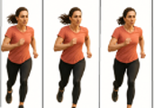
Sequential models
Sequence X
Sequential model
Sequence Y
Application | Input X | Output Y
Speech recognition | Audio clip: | Text: In the beginning God created the heavens and the earth
Music generation | Empty set, a few notes of the piece of music, or a single integer | Music notes:
Sentiment analysis | Text: there is nothing to like in this movie | Reviews:
DNA sequence analysis | AGCCCTGTGAAAGGCTAGC | Protein patten match
Machine translation | Voulez-vous chanter avec moi? | Translation: Do you want to sing with me?
Video activity recognition |  | Comments: running
Name entity recognition | Yesterday, Harry Potter met Hermione Granger. | Highlight the person’s names: Yesterday, Harry Potter met Hermione Granger.

Slide 4
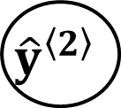
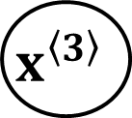

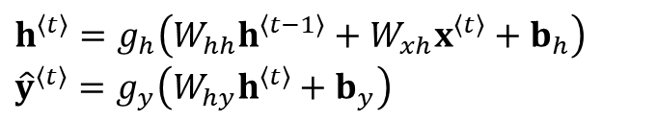




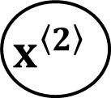
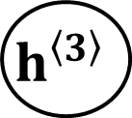


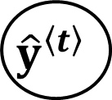
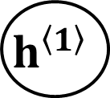




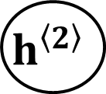


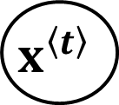





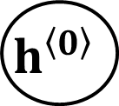
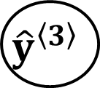



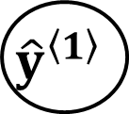




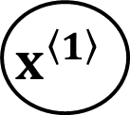
Basic RNN: architecture
$${\hat{y}}^{\left\langle t\right\rangle }$$
$$g_{y}\left(\right)$$
$${\hat{y}}^{\left\langle 1\right\rangle }$$
$${\hat{y}}^{\left\langle 2\right\rangle }$$
$${\hat{y}}^{\left\langle 3\right\rangle }$$
$$g_{h}\left(\right)$$
$$g_{y}\left(\right)$$
$$g_{y}\left(\right)$$
$$g_{y}\left(\right)$$
$$g_{y}\left(\right)$$
$$W_{hy}, b_{y}$$
$$W_{hy}, b_{y}$$
$$W_{hy}, b_{y}$$
$$W_{hy}, b_{y}$$
$$h^{\left\langle t\right\rangle }$$
$$h^{\left\langle 0\right\rangle }$$
$$h^{\left\langle 1\right\rangle }$$
$$h^{\left\langle 2\right\rangle }$$
$$h^{\left\langle 3\right\rangle }$$
Unit delay
$$g_{h}\left(\right)$$
$$g_{h}\left(\right)$$
$$g_{h}\left(\right)$$
$$g_{h}\left(\right)$$
$$W_{hh}$$
$$W_{hh}$$
$$W_{hh}$$
$$W_{xh}, b_{h}$$
$$W_{xh}, b_{h}$$
$$W_{xh}, b_{h}$$
$$W_{xh}, b_{h}$$
$$W_{hh}$$
$$x^{\left\langle 2\right\rangle }$$
$$x^{\left\langle t\right\rangle }$$
$$x^{\left\langle 1\right\rangle }$$
$$x^{\left\langle 3\right\rangle }$$
Input: $x^{〈t〉}∈ℝ^{n_{x}}, t=1,2,…T_{x}$
Unfolded RNN diagram
Output: ${\hat{y}}^{〈t〉}∈ℝ^{n_{y}}, t=1,2,…T_{y}$
What are learnable parameters?
Shapes of all signals and parameters?
$h^{〈t〉}=g_{h}\left(W_{hh}h^{〈t−1〉}+W_{xh}x^{〈t〉}+b_{h}\right)$
$${\hat{y}}^{〈t〉}=g_{y}\left(W_{hy}h^{〈t〉}+b_{y}\right)$$

Slide 5
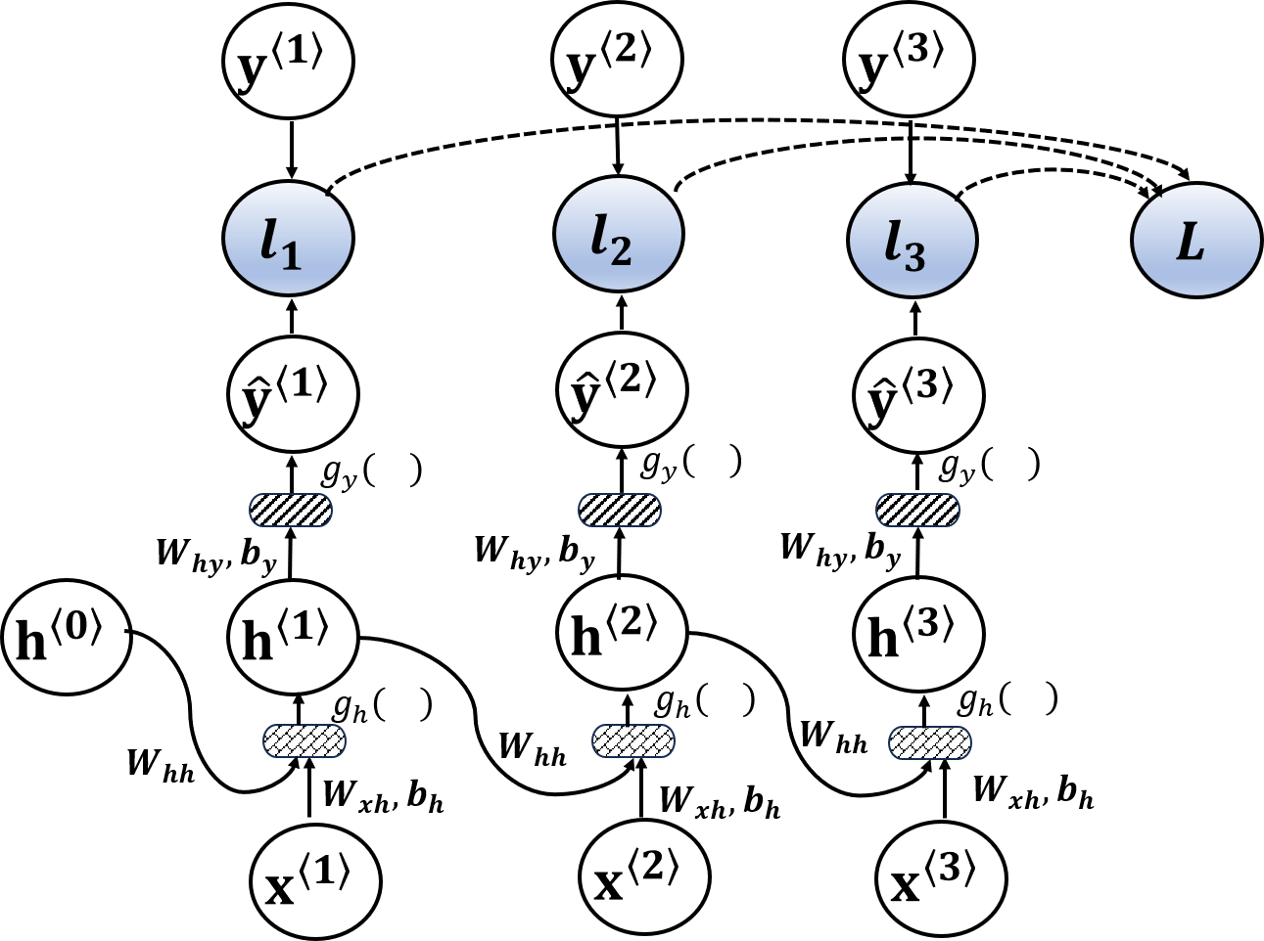


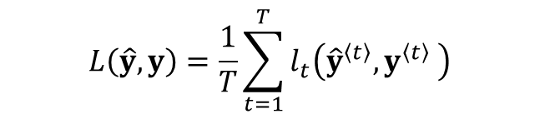
RNN: backpropagation through time (BPTT) (1)
Loss function for one sample ( assuming $T_{x}=T_{y}=T$)
$$L\left(\hat{y},y\right)=\frac{1}{T}\sum_{t=1}^{T}{l_{t}\left({\hat{y}}^{〈t〉},y^{〈t〉} \right)}$$
Binary classification
$$l_{t}\left({\hat{y}}^{〈t〉},y^{〈t〉}\right)=−y^{〈t〉}\ln{{\hat{y}}^{〈t〉}}−\left(1−y^{〈t〉}\right)\ln\left(1−{\hat{y}}^{〈t〉}\right)$$
Multi-classification
$$l_{t}\left({\hat{y}}^{〈t〉},y^{〈t〉}\right)=−{\left(y^{〈t〉}\right)}^{⊺}\ln{{\hat{y}}^{〈t〉}}$$

Slide 6
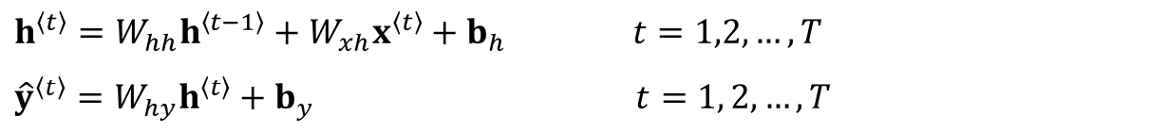

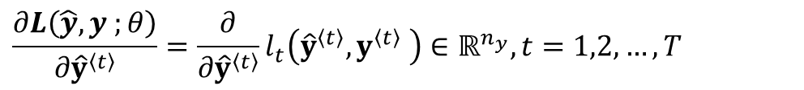
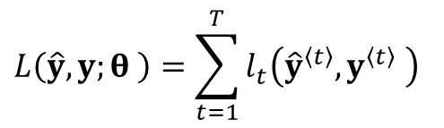
RNN: backpropagation through time (BPTT) (2)
For simplicity, assume every activation is a unit function.
Forward propagation, $h^{〈0〉}=0,$
Derivatives of L with respect to the outputs ${\hat{y}}^{〈t〉}$
$$h^{〈t〉}=W_{hh}h^{〈t−1〉}+W_{xh}x^{〈t〉}+b_{h} t=1,2,…, T$$
${\hat{y}}^{〈t〉}=W_{hy}h^{〈t〉}+b_{y}$ $t=1, 2, …,T$
$$L\left(\hat{y},y;θ \right)=\sum_{t=1}^{T}{l_{t}\left({\hat{y}}^{〈t〉},y^{〈t〉} \right)}$$
# it is ok to drop $\frac{1}{T}$, $θ$ is the set of parameters
$$\frac{∂L\left(\hat{y},y ;θ\right)}{∂{\hat{y}}^{〈t〉}}=\frac{∂}{∂{\hat{y}}^{〈t〉}}l_{t}\left({\hat{y}}^{〈t〉},y^{〈t〉} \right)∈ℝ^{n_{y}}, t=1,2,…, T$$
# depending on loss function

Slide 7

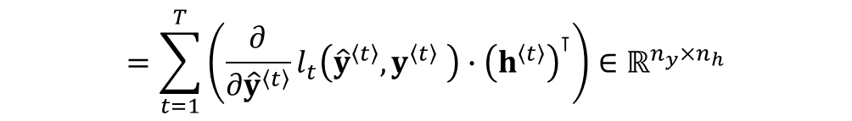
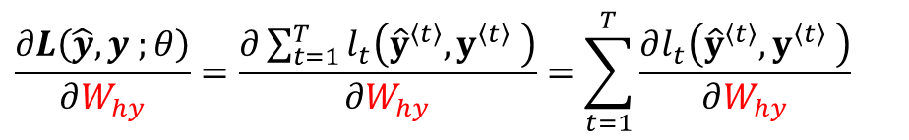
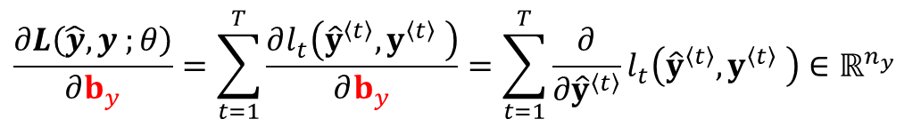
RNN: backpropagation through time (BPTT) (3)
Derivatives of L with respect to parameters (W_{hy} , b_{y})
$$\frac{∂L\left(\hat{y},y ;θ\right)}{∂W_{hy}}=\frac{∂\sum_{t=1}^{T}{l_{t}\left({\hat{y}}^{〈t〉},y^{〈t〉} \right)}}{∂W_{hy}}=\sum_{t=1}^{T}{\frac{∂l_{t}\left({\hat{y}}^{〈t〉},y^{〈t〉} \right)}{∂W_{hy}}}$$
$$=\sum_{t=1}^{T}{\left(\frac{∂}{∂{\hat{y}}^{〈t〉}}l_{t}\left({\hat{y}}^{〈t〉},y^{〈t〉} \right){∙\left(h^{〈t〉}\right)}^{⊺}\right)∈ℝ^{n_{y}×n_{h}}}$$
$$\frac{∂L\left(\hat{y},y ;θ\right)}{∂b_{y}}=\sum_{t=1}^{T}{\frac{∂l_{t}\left({\hat{y}}^{〈t〉},y^{〈t〉} \right)}{∂b_{y}}}=\sum_{t=1}^{T}{\frac{∂}{∂{\hat{y}}^{〈t〉}}l_{t}\left({\hat{y}}^{〈t〉},y^{〈t〉} \right)}∈ℝ^{n_{y}}$$

Slide 8



RNN: backpropagation through time (BPTT) (4)
Derivatives of L with respect to parameters (W_{xh} , W_{hh} , b_{h})
  To compute $\frac{∂L}{∂W_{xh}}$, $\frac{∂L}{∂W_{hh}}$, and $\frac{∂L}{∂b_{h}}$, it is essential to note that these parameters (W_{hh},W_{xh}, and b_{h}) impacts the loss L via the hidden states $h^{〈t〉}$ at all time-steps,
  $h^{〈t〉}$ depends on $h^{〈t−1〉}$
$$\frac{∂L}{∂W_{xh}}=\sum_{t=1}^{T}{\left(\frac{∂L}{∂h^{〈t〉}}{\left(x^{〈t〉}\right)}^{⊺}\right)}∈ℝ^{n_{h}×n_{x}}$$
$$\frac{∂L}{∂W_{hh}}=\sum_{t=1}^{T}{\left(\frac{∂L}{∂h^{〈t〉}}{\left(h^{〈t−1〉}\right)}^{⊺}\right)}∈ℝ^{n_{h}×n_{h}}$$
$$\frac{∂L}{∂b_{h}}=\sum_{t=1}^{T}{\frac{∂L}{∂h^{〈t〉}}}∈ℝ^{n_{h}}$$

Slide 9
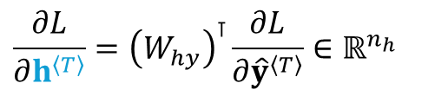

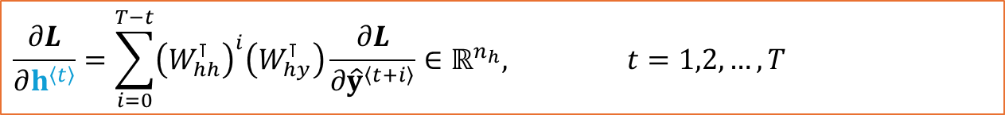
RNN: backpropagation through time (BPTT) (5)
# compute $\frac{∂L}{∂h^{〈t〉}}$
$$\frac{∂L}{∂h^{〈T〉}}={\left(W_{hy}\right)}^{⊺}\frac{∂L}{∂{\hat{y}}^{〈T〉}}∈ℝ^{n_{h}}$$
$$\frac{∂L}{∂h^{〈t〉}}={\left(W_{hh}\right)}^{⊺}\frac{∂L}{∂h^{〈t+1〉}}+{\left(W_{hy}\right)}^{⊺}\frac{∂L}{∂{\hat{y}}^{〈t〉}} ∈ℝ^{n_{h}}, t=T−1, T−2, …, 2, 1$$
$$\frac{∂L}{∂h^{〈t〉}}=\sum_{i=0}^{T−t}{{\left(W_{hh}^{⊺}\right)}^{i}\left(W_{hy}^{⊺}\right)\frac{∂L}{∂{\hat{y}}^{〈t+i〉}}}∈ℝ^{n_{h}}, t=1,2, …, T$$

Slide 10

RNN: backpropagation through time (BPTT) (6)
$$\frac{∂L}{∂W_{xh}}=\sum_{t=1}^{T}{\left[\sum_{i=0}^{T−t}{{\left(W_{hh}^{⊺}\right)}^{i}\left(W_{hy}^{⊺}\right)\frac{∂L}{∂{\hat{y}}^{〈t+i〉}}}\right]{\left(x^{〈t〉}\right)}^{⊺}} (14.16a)$$
$$\frac{∂L}{∂W_{hh}}=\sum_{t=1}^{T}{\left[\sum_{i=0}^{T−t}{{\left(W_{hh}^{⊺}\right)}^{i}\left(W_{hy}^{⊺}\right)\frac{∂L}{∂{\hat{y}}^{〈t+i〉}}}\right]{\left(h^{〈t−1〉}\right)}^{⊺}} (14.16b)$$
$$\frac{∂L}{∂b_{h}}=\sum_{t=1}^{T}{\sum_{i=0}^{T−t}{{\left(W_{hh}^{⊺}\right)}^{i}\left(W_{hy}^{⊺}\right)\frac{∂L}{∂{\hat{y}}^{〈t+i〉}}}} (14.16c)$$
# gradient vanishing or exploding

Slide 11
Long Short-Term Memory (LSTM)
Basic RNNs suffer from the gradient vanishing or exploding issue.
Truncated BPTT sacrifices the ability to learn long-range dependencies in a sequence.
Long Short-Term Memory (LSTM) replaces the hidden layer of the vanilla RNNs: various gates are added in the LSTM unit to control gradients.
  LSTM unit was initially proposed by Hochreiter et al., 1997
  gated recurrent unit (GRU) (Cho et al., 2014): simplified LSTM
  Other variants of LSTM (see Section 14.3.3)

Slide 12
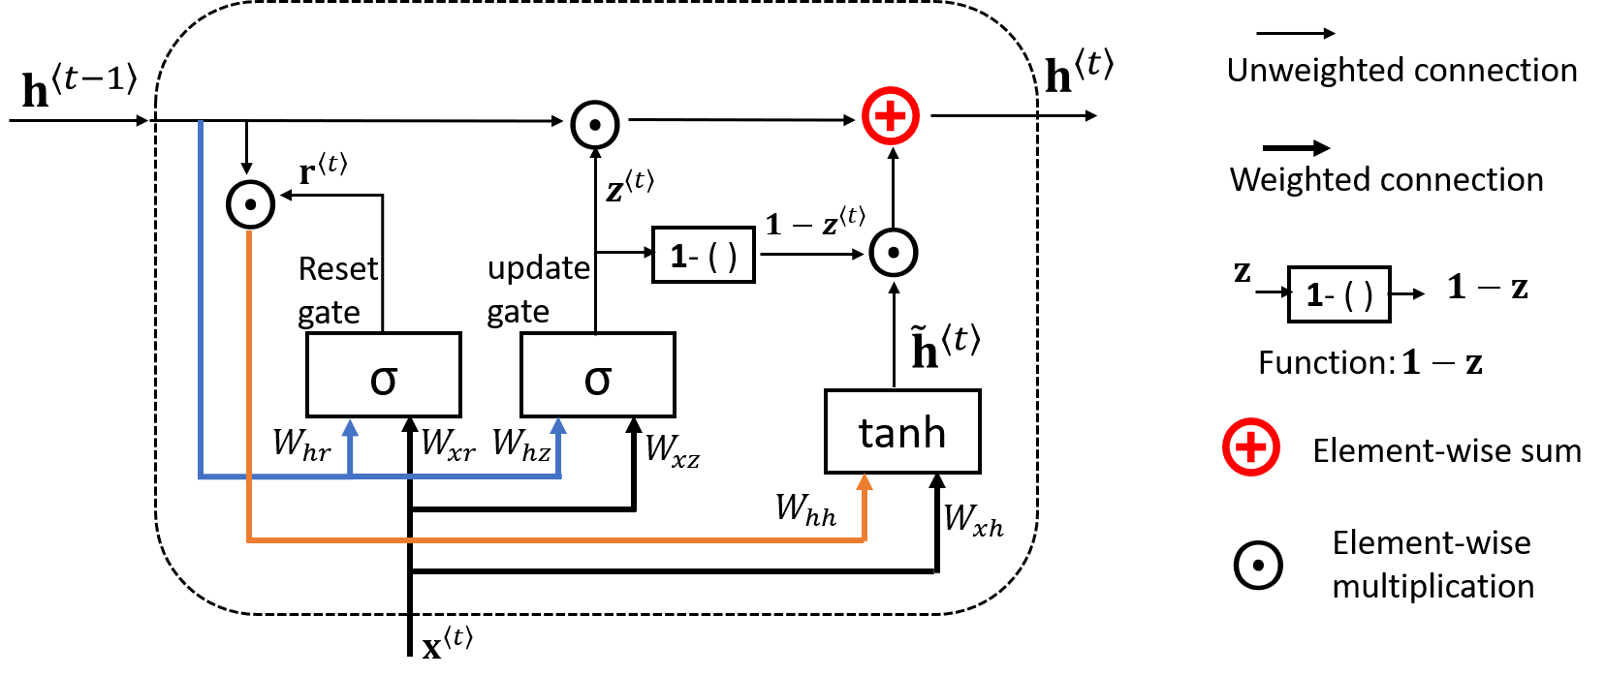
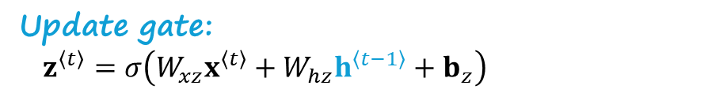
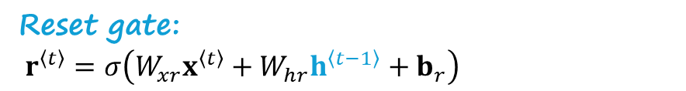
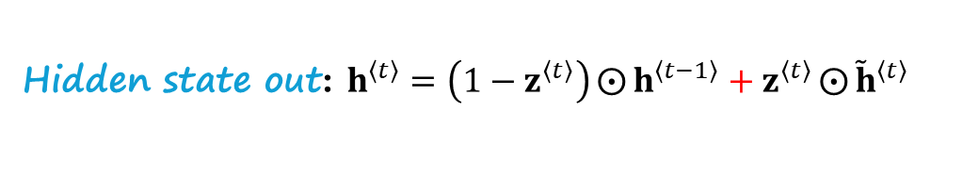
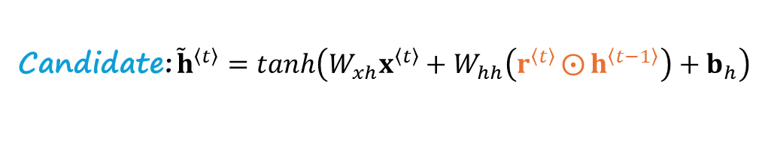
Gated recurrent unit (GRU)
Reset gate:
$r^{〈t〉}=σ\left(W_{xr}x^{〈t〉}+W_{hr}h^{〈t−1〉}+b_{r}\right)$
Update gate:
$z^{〈t〉}=σ\left(W_{xz}x^{〈t〉}+W_{hz}h^{〈t−1〉}+b_{z}\right)$
Candidate: ${\tilde{h}}^{〈t〉}=tanh\left(W_{xh}x^{〈t〉}+W_{hh}\left(r^{〈t〉}⨀{h^{〈t−1〉}}\right)+b_{h}\right)$
Hidden state out: $h^{〈t〉}=\left(1−z^{〈t〉}\right)⨀{h^{〈t−1〉}}+z^{〈t〉}⨀{{\tilde{h}}^{〈t〉}}$

Slide 13
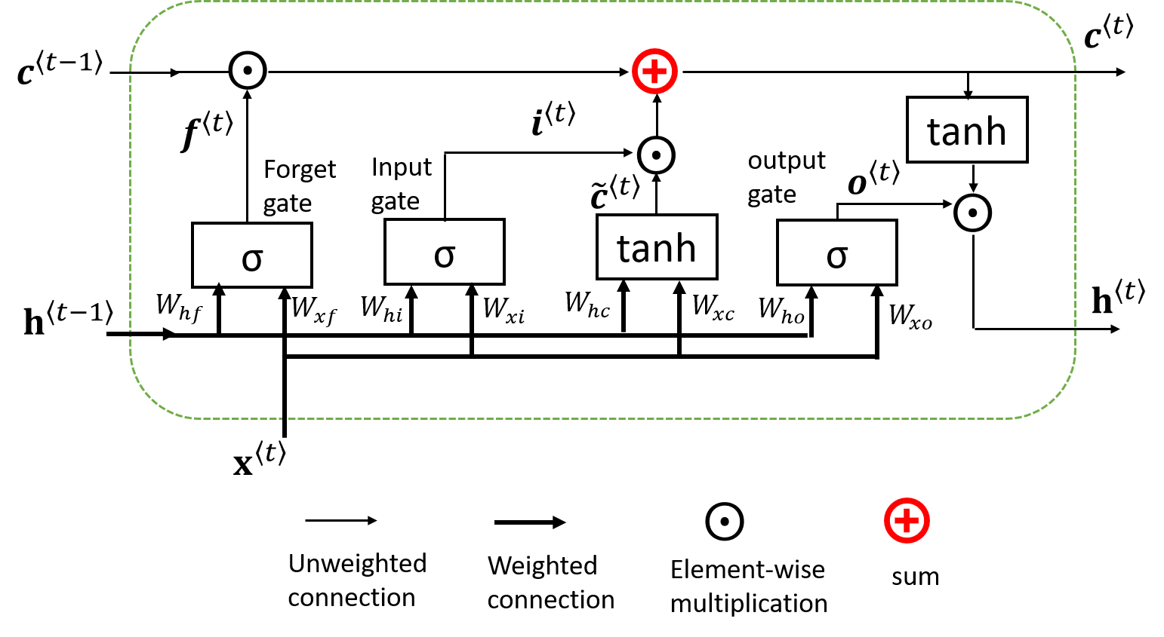

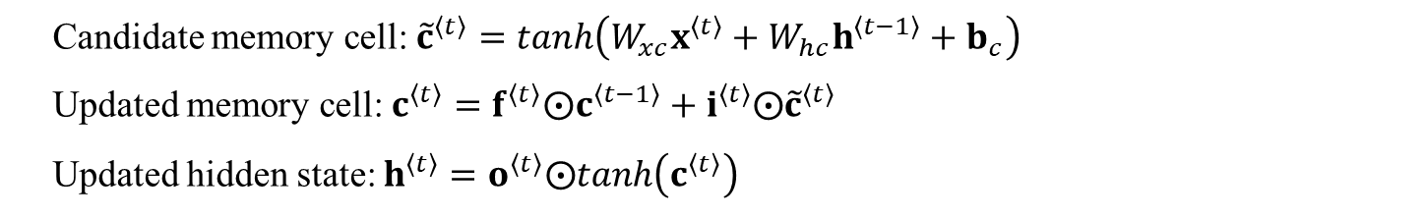
Long short-term memory unit
LSTM: maintains the content of a memory cell
Three gates (forget gate, input gate and output gate):
$$f^{〈t〉}=σ\left(W_{xf}x^{〈t〉}+W_{hf}h^{〈t−1〉}+b_{f}\right)$$
$$i^{〈t〉}=σ\left(W_{xi}x^{〈t〉}+W_{hi}h^{〈t−1〉}+b_{i}\right)$$
$$o^{〈t〉}=σ\left(W_{xo}x^{〈t〉}+W_{ho}h^{〈t−1〉}+b_{o}\right)$$
Candidate memory cell: ${\tilde{c}}^{〈t〉}=tanh\left(W_{xc}x^{〈t〉}+W_{hc}h^{〈t−1〉}+b_{c}\right)$
Updated memory cell: $c^{〈t〉}=f^{〈t〉}⨀c^{〈t−1〉}+i^{〈t〉}⨀{\tilde{c}}^{〈t〉}$
Updated hidden state: $h^{〈t〉}=o^{〈t〉}⨀tanh\left(c^{〈t〉}\right)$

Slide 14
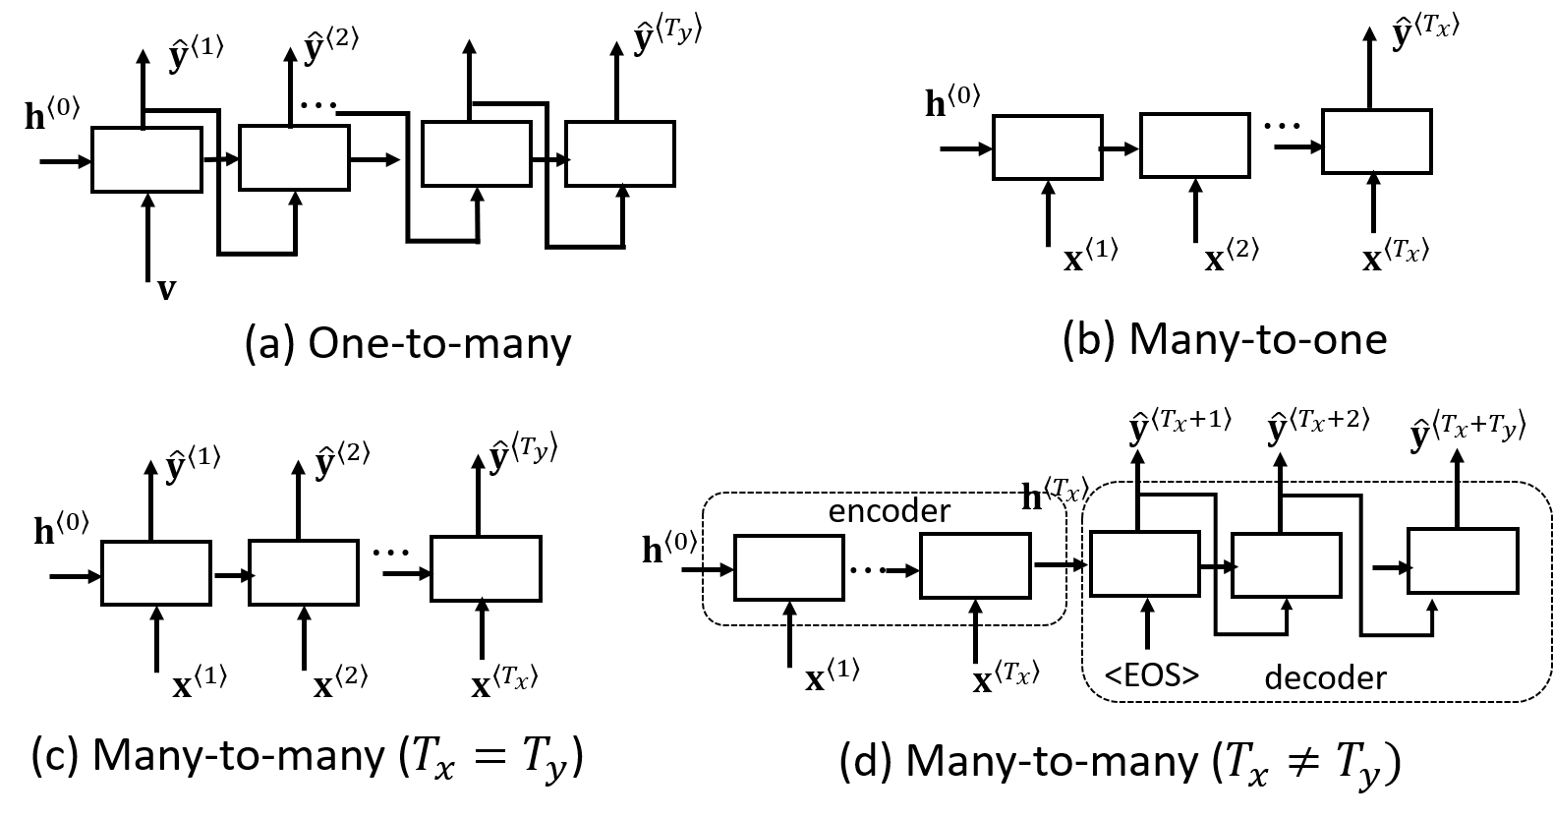

Task-specific RNN architectures
$$x^{<2>}$$
# sequence generator
# sequence classifier
# speech tagging
# question/answer, translation
Equations for each case?

Slide 15
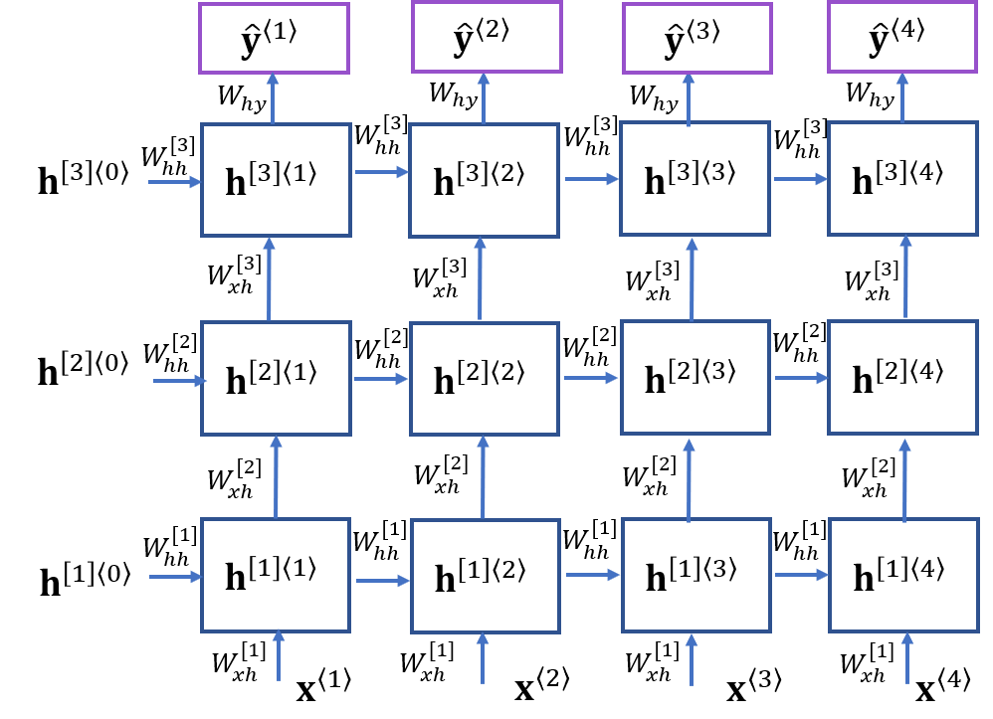
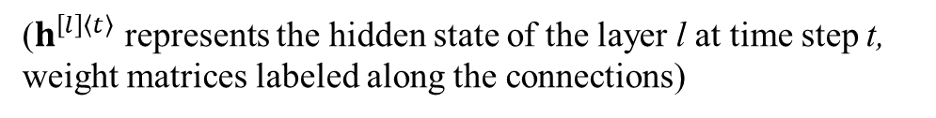

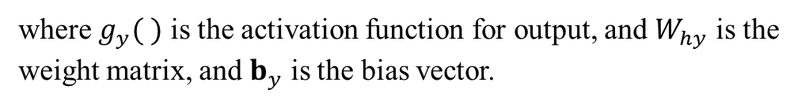

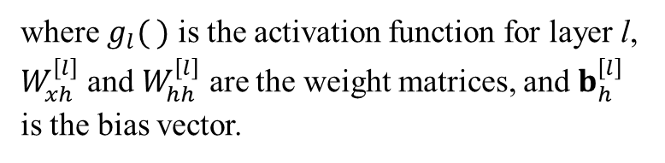
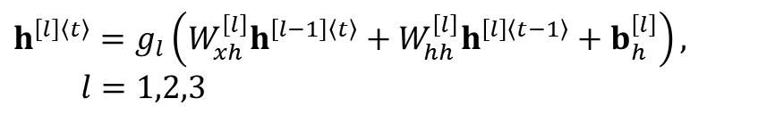
Deep RNN
($h^{\left[l\right]〈t〉}$ represents the hidden state of the layer l at time step t, weight matrices labeled along the connections)
Deep RNN: multiple layers to generate the hidden state.
# hidden states
$$h^{\left[0\right]〈t〉}=x^{〈t〉}$$
$$h^{\left[l\right]〈t〉}=g_{l}\left(W_{xh}^{\left[l\right]}h^{\left[l−1\right]〈t〉}+W_{hh}^{\left[l\right]}h^{\left[l\right]〈t−1〉}+b_{h}^{\left[l\right]}\right),$$
$$l=1,2,3$$
where $g_{l}( )$ is the activation function for layer l, $W_{xh}^{\left[l\right]}$ and $W_{hh}^{\left[l\right]}$ are the weight matrices, and $b_{h}^{\left[l\right]}$ is the bias vector.
# outputs
$${\hat{y}}^{〈t〉}=g_{y}\left(W_{hy}h^{\left[3\right]〈t〉}+b_{y}\right)$$
where $g_{y}( )$ is the activation function for output, and $W_{hy}$ is the weight matrix, and $b_{y}$ is the bias vector.
Unfolded deep RNN

Slide 16
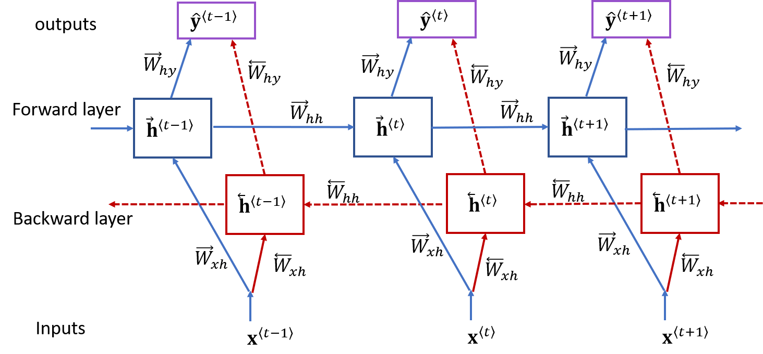
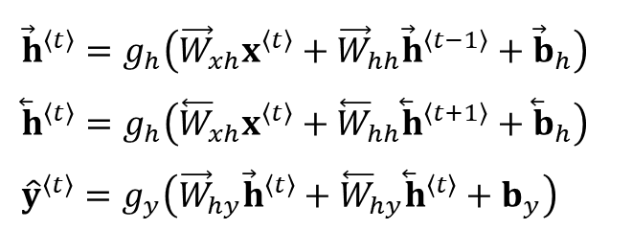
Bidirectional RNN
Consider both the original sequence and its reversed version.
Generate two hidden states for two direction, respectively.
Combine two hidden states to generate output.
${\vec{h}}^{〈t〉}=g_{h}\left({\vec{W}}_{xh}x^{〈t〉}+{\vec{W}}_{hh}{\vec{h}}^{〈t−1〉}+{\vec{b}}_{h}\right)$
${\overset{⃖}{h}}^{〈t〉}=g_{h}\left({\overset{⃖}{W}}_{xh}x^{〈t〉}+{\overset{⃖}{W}}_{hh}{\overset{⃖}{h}}^{〈t+1〉}+{\overset{⃖}{b}}_{h}\right)$
${\hat{y}}^{〈t〉}=g_{y}\left({\vec{W}}_{hy}{\vec{h}}^{〈t〉}+{\overset{⃖}{W}}_{hy}{\overset{⃖}{h}}^{〈t〉}+b_{y}\right)$
I am ____when I hear the bad news.
I feel ____when I hear the good news.

Slide 17
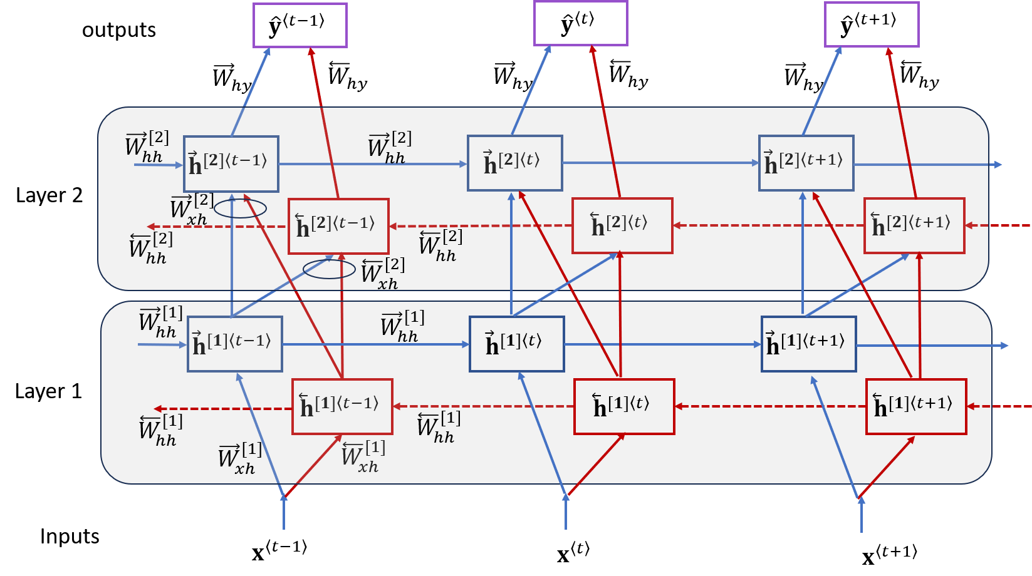
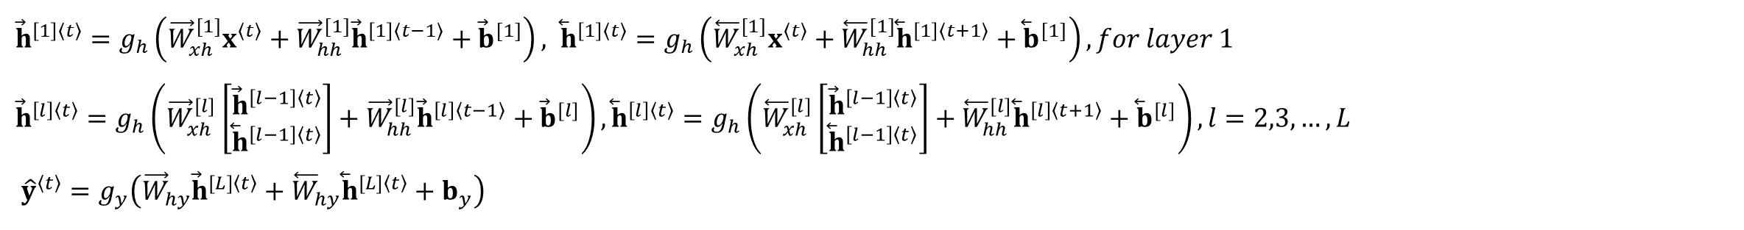
Deep bidirectional RNN
A combination of deep RNN and bidirectional RNN.
${\vec{h}}^{\left[1\right]〈t〉}=g_{h}\left({\vec{W}}_{xh}^{[1]}x^{〈t〉}+{\vec{W}}_{hh}^{[1]}{\vec{h}}^{\left[1\right]〈t−1〉}+{\vec{b}}^{[1]}\right), {\overset{⃖}{h}}^{\left[1\right]〈t〉}=g_{h}\left({\overset{⃖}{W}}_{xh}^{[1]}x^{〈t〉}+{\overset{⃖}{W}}_{hh}^{[1]}{\overset{⃖}{h}}^{\left[1\right]〈t+1〉}+{\overset{⃖}{b}}^{[1]}\right), for layer 1$
$${\vec{h}}^{\left[l\right]〈t〉}=g_{h}\left({\vec{W}}_{xh}^{[l]}\left[\begin{matrix}{\vec{h}}^{\left[l−1\right]〈t〉} \\ {\overset{⃖}{h}}^{\left[l−1\right]〈t〉}\end{matrix}\right]+{\vec{W}}_{hh}^{[l]}{\vec{h}}^{\left[l\right]〈t−1〉}+{\vec{b}}^{[l]}\right), {\overset{⃖}{h}}^{\left[l\right]〈t〉}=g_{h}\left({\overset{⃖}{W}}_{xh}^{[l]}\left[\begin{matrix}{\vec{h}}^{\left[l−1\right]〈t〉} \\ {\overset{⃖}{h}}^{\left[l−1\right]〈t〉}\end{matrix}\right]+{\overset{⃖}{W}}_{hh}^{[l]}{\overset{⃖}{h}}^{\left[l\right]〈t+1〉}+{\overset{⃖}{b}}^{[l]}\right), l=2,3,…,L$$
$${\hat{y}}^{〈t〉}=g_{y}\left({\vec{W}}_{hy}{\vec{h}}^{[L]〈t〉}+{\overset{⃖}{W}}_{hy}{\overset{⃖}{h}}^{[L]〈t〉}+b_{y}\right)$$

Slide 18
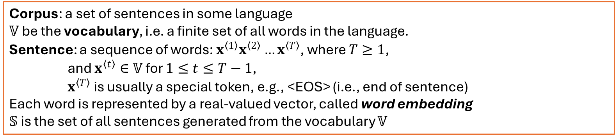
Sequence-to-sequence learning
Sequence-to-sequence learning: map one sequence to another sequence, for example, machine translation, and question answering.
Language modeling
# terminology
Corpus: a set of sentences in some language
$𝕍$ be the vocabulary, i.e. a finite set of all words in the language.
Sentence: a sequence of words: $x^{〈1〉}x^{〈2〉}…x^{〈T〉}$, where $T≥1$,
and $x^{〈t〉}∈𝕍$ for $1≤t≤T−1$,
$x^{〈T〉}$ is usually a special token, e.g., <EOS> (i.e., end of sentence)
Each word is represented by a real-valued vector, called word embedding
$𝕊$ is the set of all sentences generated from the vocabulary $𝕍$
Learning a language model is to find a probability distribution $p(x^{〈1〉}, x^{〈2〉},…{,x}^{〈T〉})$ to fit a given training set (i.e., a corpus).

Slide 19
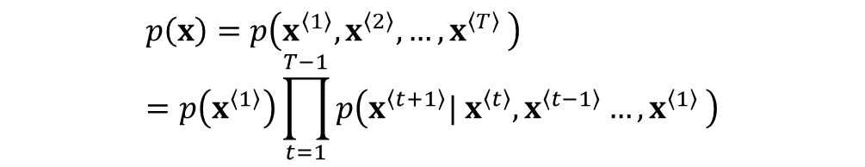
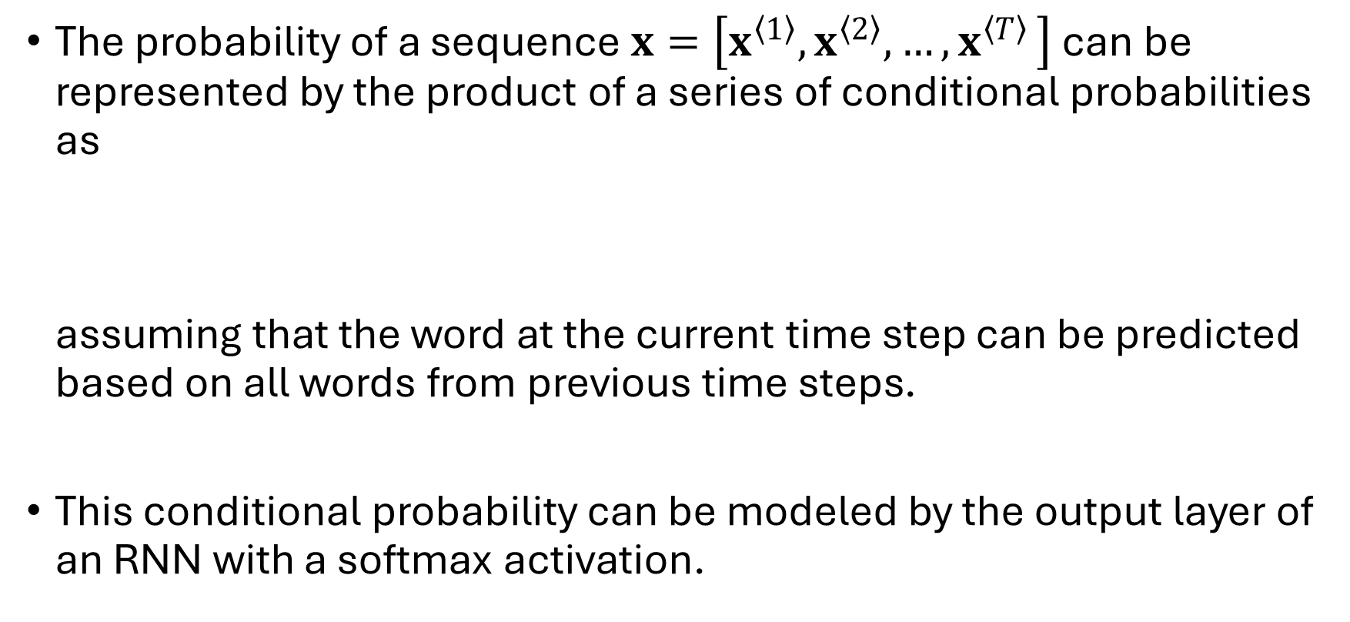

Language modeling (1): concept
The probability of a sequence $x=\left[x^{〈1〉}, x^{〈2〉},…{,x}^{〈T〉}\right]$ can be represented by the product of a series of conditional probabilities as
assuming that the word at the current time step can be predicted based on all words from previous time steps.
This conditional probability can be modeled by the output layer of an RNN with a softmax activation.
$$p\left(x\right)=p\left(x^{〈1〉}, x^{〈2〉},…{,x}^{〈T〉}\right)=p\left(x^{〈1〉}\right)\prod_{t=1}^{T−1}{p\left(x^{〈t+1〉}{{| x}^{〈t〉},x}^{〈t−1〉}…{,x}^{〈1〉}\right)}$$
$$p\left(x^{〈t+1〉}{{| x}^{〈t〉},x}^{〈t−1〉}…{,x}^{〈1〉}\right)$$

Slide 20



Language modeling (2): one-hot encoding
For example, conceptually (not practically), assuming $x^{〈t〉}$ is one-hot encoded (1-of-K encoding), the j-th element in the softmax output vector represents the probability of $x^{〈t〉}$ being the j-th word in the vocabulary, given the previous words (hidden state), i.e.,
$$\left[\begin{matrix}z_{1} \\ z_{2} \\ \begin{matrix}⋮ \\ z_{\left|𝕍\right|}\end{matrix}\end{matrix}\right]=z=W_{hy}h^{〈t〉}$$
$$p\left({x_{j}}^{〈t+1〉}=1|x^{〈t〉}, x^{〈t−1〉}…{,x}^{〈1〉}\right)=\frac{exp\left(z_{j}\right)}{\sum_{i=1}^{\left|𝕍\right|}{exp\left(z_{i}\right)}}$$

Slide 21






Encoder-decoder RNN: sequence-to-sequence
Encoder
  Input: original sequence
  Output: a context vector
Decoder
  Input: context vector
  Output: a relevant sequence in an auto-regressive way
$$h^{〈t〉}=f\left(x^{〈t〉}, h^{〈t−1〉}\right)$$
$${C=h}^{〈T_{x}〉}$$
$$\left[\begin{matrix}z_{1} \\ z_{2} \\ \begin{matrix}⋮ \\ z_{\left|𝕍\right|}\end{matrix}\end{matrix}\right]=z=W_{sy}s^{〈t〉}$$
$$s^{〈t〉}=g\left(y^{〈t−1〉}, s^{〈t−1〉}, C\right) t=1,2,…,s^{〈0〉}=C$$
$${y^{〈t〉}=\hat{y}}^{〈t〉}$$
$$p\left({{\hat{y}}_{j}}^{〈t〉}|y^{〈t−1〉} , , y^{〈t−2〉}…{,y}^{〈0〉},C\right)=\frac{exp\left(z_{j}\right)}{\sum_{i=1}^{\left|𝕍\right|}{exp\left(z_{i}\right)}}$$

Slide 22

Beam search: strategy to generate a sequence
Goal is to maximize the joint probability for a generated sequence
Greedy search: we simply take the word with the maximum probability at each time step as the input word for the next time step. However, sometimes the sequence generated by greedy search may not have a maximum joint probability.
Beam search achieves a tradeoff between the greedy search and the exhaustive search. At each time step t, we choose the top W best predictions for the input at the next time step. W is the width of the beam. At the next time step, the decoder runs W times on the W best predictions from the previous time step, respectively.
$$p\left(y^{〈T_{y}〉}, y^{〈T_{y}−1〉},…{,y}^{〈0〉}\left|C\right.\right)=p\left(y^{〈0〉}\left|C\right.\right)∙p\left(y^{〈1〉}|y^{〈0〉}C,\right)⋯p\left(y^{〈T_{y}〉}{\left|y\right.}^{〈T_{y}〉}, y^{〈t−2〉},…{,y}^{〈0〉},C\right)$$

Slide 23

Example for beam search
# vocabulary:
A, B, C, D, <eos>
# joint probabilities
# joint probabilities
beam width: 2
What is the result
if greedy search is used?
# result

Slide 24

Attention mechanism in encoder-decoder
Bottleneck in encoder-decoder: a single fixed length context vector.
For each input word in decoder, attention mechanism generates a context vector.

Slide 25



Bahdanau mechanism
# scores (t: time step in decoder, j: time step in encoder)
$$e_{tj}=a\left(s^{〈t−1〉},h^{〈j〉}\right)={v_{a}}^{⊺} tanh\left(W_{a}s^{〈t−1〉}+U_{a}h^{〈j〉}\right)$$
# softmax
$$α_{tj}=\frac{exp\left(e_{tj}\right)}{\sum_{k=1}^{T_{x}}{exp\left(e_{tk}\right)}}$$
# attention vector:
linear combination of encoder hidden states
$$c^{〈t〉}=\sum_{j=1}^{T_{x}}{α_{tj}h^{〈j〉}}$$

Slide 26

BLEU: translation metric
BLEU: Bilingual Evaluation Understudy
$0≤BLEU≤1$
  0: the worst model
  1: the perfect model
Terms:
  Source sentence: to be translated
  Candidate: translated by machine
  Reference: translated by human
Ref: Papineni, K., Roukos, S., Ward, T., and Zhu, W.J. (2002), BLEU: a Method for Automatic Evaluation of Machine Translation, Proceedings of the 40th Annual Meeting of the Association for Computational Linguistics (ACL), Philadelphica, July 2002, pp. 311-318.
Translation
model
Candidate
Source
sentence
References
Human professional
translation
# examples
Candidate 1: I was late because of the traffic.
Candidate 2: I was the late because the traffic was there.
Candidate 3: I I I I I was late.
Reference 1: I was late because there was traffic.
Reference 2: I was late due to the traffic.

Slide 27

BLEU: clipped n-gram precision
n-gram: a set of n consecutive words in a sentence.
Precision: percentage of true positives among the total predicted positives, i.e., purity.
For a given n, clipped n-gram precision:$p_{n}$
  list all n-grams in the candidate sentence, and count the number of n-grams, denoted by $N_{n−grams}$
  Identify the n-grams that can be found in any reference sentence.
  Count the identified n-grams, while clipping the count of duplicated n-grams with its maximal occurrence in a single reference sentence, denoted by $N_{clip}$
  $p_{n}=\frac{N_{clip}}{N_{n−grams}}$
“the apple is green”
1-grams (or uni-grams): (the), (apple), (is), (green)
2-grams: (the apple), (apple is), (is green)
3-grams: (the apple is), (apple is green)
4-grams: (the apple is green)

Slide 28



Examples: clipped unigram precision
Example 1.
Candidate: the the the the the the the.
Reference 1: The cat is on the mat.
Reference 2: There is a cat on the mat.
Example 2.
Candidate 1
It is a guide to action which ensures that the military always obeys the commands of the party.
Candidate 2
It is to insure the troops forever hearing the activity guidebook that party direct.
Unigrams: $N_{uni−grams}=7$
Maximal count of “the” is 2 in reference 1
Thus, $N_{clip}=\min\left(7,2\right)=2$
$$p_{1}=2/7$$
Reference 1: It is a guide to action that ensures that the military will forever heed Party commands.
Reference 2: It is the guiding principle which guarantees the military forces always being under the command of the Party. Reference 3: It is the practical guide for the army always to heed the directions of the party.
Candidate 1:
Candidate 2:
Unigrams: $N_{uni−grams}=18$
only “obeys” does not match any reference
Thus, $N_{clip}=17$
$$p_{1}=17/18$$
Unigrams: $N_{uni−grams}=14$
6 unigrams are not found in any reference
Thus, $N_{clip}=8$
$$p_{1}=8/14$$

Slide 29



Examples: clipped bigram precision
Example 1.
Candidate: the the the the the the the.
Reference 1: The cat is on the mat.
Reference 2: There is a cat on the mat.
Example 2.
Candidate 1
It is a guide to action which ensures that the military always obeys the commands of the party.
Candidate 2
It is to insure the troops forever hearing the activity guidebook that party direct.
bigrams: $N_{bi−grams}=6$
Maximal count of “the the” is 0 in
any reference
Thus, $N_{clip}=\min\left(6,0\right)=0$
$$p_{2}=0/6$$
Reference 1: It is a guide to action that ensures that the military will forever heed Party commands.
Reference 2: It is the guiding principle which guarantees the military forces always being under the command of the Party. Reference 3: It is the practical guide for the army always to heed the directions of the party.
Candidate 1:
Candidate 2:
bigrams: $N_{bi−grams}=17$
7 bigrams do not match any reference
Thus, $N_{clip}=10$
$$p_{2}=10/17$$
bigrams: $N_{bi−grams}=13$
Only one bigram “It is” is found in reference
Thus, $N_{clip}=1$
$$p_{2}=1/13$$

Slide 30
Example for computing clipped n-gram precision
All Clipped 1-grams:
Numbers: “2”, and “1”
are clipped numbers
2: two “was” in reference 1
1: only one “the” in reference 2
Total number of 1-grams in the candidate
(2 for “was”, 2 for “the”)
Among all 1-grams of the candidate,
those also show up in references with clipping by a reference

Slide 31

Clipped n-gram precision on a set of sentences
First, compute the n-gram matches sentence by sentence in the test corpus.
Next, we add the clipped n-gram counts for all the candidate sentences
divide by the number of candidate n-grams in the test corpus
$$p_{n}=\frac{\sum_{C∈\left\{candidates\right\}}{\sum_{n_gram∈C}{{Count}_{clip}\left(n_gram\right)}}}{\sum_{C^{′}∈\left\{candidates\right\}}{\sum_{{n_gram}^{′}∈C^{′}}{Count\left(n_gram′\right)}}}$$

Slide 32

Combined of clipped n-gram precisions over n
A candidate matching the same words (1-grams) as in the references tends to satisfy adequacy. (a language beginner with a large vocabulary in mind, but little grammar skill).
The longer n-gram matches account for fluency. (a person with a fluence language skill: words and grammar)
To combine the precisions of various n-gram sizes n into one quantity, the overall precision is defined as the average logarithm with uniform weights,
$p=\sum_{n=1}^{N}{w_{n}log\left(p_{n}\right)}, for example,$N=4, $w_{n}=\frac{1}{N}$

Slide 33

Sentence brevity penalty
A candidate sentence should be neither too long nor too short, compared to its references.
Penalty for “too long” by precision:
  The clipped n-gram precision penalizes words (or n-grams) in the candidate that do not appear in any of the references.
  The clipped precision is penalized if a word (or n-gram) occurs more frequently in a candidate than its maximum reference count.
The clipped n-gram precision fails to penalize too short and absurd candidates which miss many important words (or n-grams).
  To penalize the poor short translations, we introduce a multiplicative brevity penalty factor, denoted as BP,
$$BP=\left\{\begin{aligned}1 c>r \\ e^{\left(1−\frac{r}{c}\right)} c≤r\end{aligned}\right.$$
where r is the sum of the best match lengths for all candidate sentences in the test set. For each candidate sentence, the best match length is the length of one of its references whose length is closest to the candidate sentence. c is the total length of the candidate sentences in the test set.

Slide 34

BLEU definition
The metric BLEU is defined as the product of brevity penalty factor and the geometric mean of the clipped n-gram precisions on the test set,
$$BLEU=BP∙exp\left(p\right)=BP∙exp\left(\sum_{n=1}^{N}{w_{n}\ln\left(p_{n}\right)}\right)=BP∙\prod_{n=1}^{N}{p_{n}^{w_{n}}}$$
Equivalently, BLEU can be expressed in the log domain,
$$\log{BLEU}=\min\left(1−\frac{r}{c},0\right)+\sum_{n=1}^{N}{w_{n}\ln\left(p_{n}\right)}$$
A major weakness of BLEU is that it does not consider the meaning of words and the importance of words.
Interchangeable synonymous words are pessimistically considered mismatched.
The functions of BLEU score are available in Python from packages
  nltk.translate.bleu_score
  torchtext.data.metrics.bleu_score

Slide 35

Implementation of RNN in Python
Task: to classify an MNIST image with a shape of (28, 28). One row of the image is the input to RNN at a time step, and thus the sequence length is 28. The last hidden state is used to classify the image.
Architecture: shown below.

Slide 36
RNN Python: download datasets
import torch
import torch.nn as nn
import torchvision.transforms as transforms
import torchvision.datasets as dsets
from matplotlib import pyplot as plt
import torchvision
# download datasets
transform=transforms.Compose([transforms.ToTensor(),transforms.Normalize((0.5,), (0.5,))])
train_dataset = dsets.MNIST(root='./data',
train=True,
transform=transform,
download=True)
test_dataset = dsets.MNIST(root='./data',
train=False,
transform=transform)

Slide 37
RNN Python: DataLoader
# create data loaders
batch_size = 128
train_loader = torch.utils.data.DataLoader(dataset=train_dataset,
batch_size=batch_size,
shuffle=True)
test_loader = torch.utils.data.DataLoader(dataset=test_dataset,
batch_size=batch_size,
shuffle=False)
# get a batch of data samples
samples_batch, labels = next(iter(train_loader))
print(samples_batch.size()) #torch.Size([128, 1, 28, 28])
torch.Size([128, 1, 28, 28])

Slide 38
RNN Python: RNN model hyperparameters
# hyper-parameters
input_size = samples_batch.size()[3] # the number of columns: 28
seq_length = samples_batch.size()[2] # the number of rows: 28
batch_size = samples_batch.size()[0] # the number of images: 128
hidden_size = 120 # output size of the hidden state
num_layers = 1 # number of layers for the hidden state
num_classes = 10 # number of output classes
device = torch.device("cuda:0" if torch.cuda.is_available() else "cpu")

Slide 39
RNN Python: RNN model
class RNNModel(nn.Module):
def __init__(self, input_size, hidden_size, num_layers, num_classes):
super(RNNModel, self).__init__()
# Hidden state dimension
self.hidden_size = hidden_size
# Number of hidden layers
self.num_layers = num_layers
self.rnn = nn.RNN(input_size, hidden_size, num_layers,
batch_first=True, nonlinearity='relu')
# Output layer for classification
self.fc = nn.Linear(hidden_size, num_classes)
def forward(self, x):
out, hn= self.rnn(x)
# -- x: (batch_size, seq_length, input_size)
# -- out (batch_size, seq_length, hidden_size)
# for all hidden_states at different time steps
# -- hn (1, batch_size, hidden_size):
# containing the final hidden state for each element in the batch
# only need the last time step hidden states!
hn = torch.squeeze(hn)
# (1, batch_size, hidden_size) reshape to: (batch_size, hidden_size)
out = self.fc(hn)
# out.size() --> batch_size, 10
return out
If we want to implement LSTM for the RNNModel, just replace nn.RNN() with nn.LSTM().

Slide 40
Model instantiation
model = RNNModel(input_size, hidden_size, num_layers, num_classes).to(device)
criterion = nn.CrossEntropyLoss()
learning_rate=0.01
optimizer = torch.optim.SGD(model.parameters(), lr=learning_rate)
num_epochs = 40
iter = 0
loss_list = []
accuracy_list = []

Slide 41
Training
for epoch in range(num_epochs):
for i, (images, labels) in enumerate(train_loader):
model.train()
# fit input tensor shape with gradient required:
# (batch, seq_dim, x_dim)
images = images.view(-1, seq_length,
input_size).requires_grad_().to(device)
labels = labels.to(device)
# Clear gradients w.r.t. parameters
optimizer.zero_grad()
# Forward pass to get output/logits
# outputs.size(): (batch, 10)
outputs = model(images)
# Calculate Loss: softmax and cross entropy loss
loss = criterion(outputs, labels)
# backward
loss.backward()
# Updating parameters
optimizer.step()
iter += 1

Slide 42
Testing
if iter % 100 == 0:
model.eval()
correct = 0
total = 0
# iterate batch by batch over test set
for images, labels in test_loader:
# Load images
images = images.view(-1, seq_length, input_size).to(device)
labels = labels.to(device)
# Forward pass
outputs = model(images)
# Get predictions from the maximum value
_, predicted = torch.max(outputs.data, 1)
# Total number of labels
total += labels.size(0)
# Total correct predictions
correct += (predicted == labels).sum()
accuracy = 100 * correct / total
# Print and save losss and accuracy
print('Iteration: {}. Loss: {}. Accuracy: {}'.format(iter,
loss.item(), accuracy))
loss_list.append(loss.item())
accuracy_list.append(accuracy)

Slide 43

Results
# Output during the training process
Iteration: 100. Loss: 2.290172815322876. Accuracy: 11.399999618530273
Iteration: 200. Loss: 2.2888529300689697. Accuracy: 11.799999237060547
Iteration: 300. Loss: 2.2904212474823. Accuracy: 15.00999927520752
…
Iteration: 18600. Loss: 0.06424959003925323. Accuracy: 97.20999908447266
Iteration: 18700. Loss: 0.1438976675271988. Accuracy: 97.47999572753906
# Python code in textbook.

Slide 44
Summary
This chapter addressed:
  the basic concepts of vanilla RNN architecture and the gradient exploding/vanishing issues due to backpropagation through time
  LSTM and GRU RNN architectures dealing with the gradient exploding/vanishing issues
  variants of RNNs such as deep RNN, bidirectional RNN, and deep bidirectional RNN for improved performance
  a typical application of RNNs: sequence-to-sequence learning, in which an encoder-decoder RNN architecture with attention mechanism is introduced
  BLEU, a metric for evaluating translation machines

