Slide 1
Chapter 10 Introduction to Probabilistic Generative Models
Gaussian mixture models (GMMs) and Variational auto-encoders (VAEs)

Slide 2
Outline
Difference between discriminative model and generative model
Probabilistic graphical models
Gaussian mixture models (GMMs)
  Latent variable
  Incomplete dataset vs complete dataset
  Learn a GMM and sample a GMM
  EM algorithm for GMMs
EM algorithm for general latent models
Variational auto-encoder (VAE)
  Principle: lower bound ELBO
  Practical architecture
  Training
Implementation of VAE on MNIST using Python

Slide 3
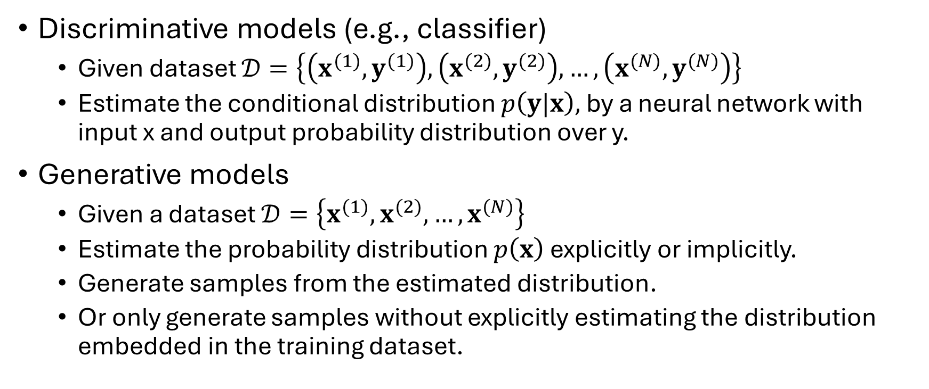
Discriminative model vs. generative model
Discriminative models (e.g., classifier)
  Given dataset $𝒟=\left\{\left(x^{(1)},y^{(1)}\right),\left(x^{(2)},y^{(2)}\right),…,\left(x^{(N)},y^{(N)}\right)\right\}$
  Estimate the conditional distribution $p\left(y|x\right),$by a neural network with input x and output probability distribution over y.
Generative models
  Given a dataset $𝒟=\left\{x^{(1)},x^{(2)},…,x^{(N)}\right\}$
  Estimate the probability distribution $p\left(x\right)$ explicitly or implicitly.
  Generate samples from the estimated distribution.
  Or only generate samples without explicitly estimating the distribution embedded in the training dataset.

Slide 4






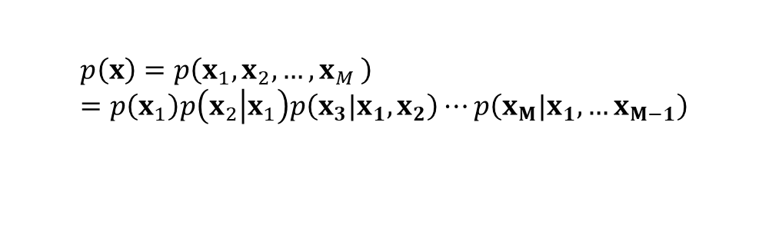


Graphical models
Graph
  Each node associates with one random variable
  Arc from a parent node to a child node
  Each node represents the probability distribution of the random variable conditioned on their parents.
  A node without any parent is called root node.
  The model is the product of all conditional probability distributions.
parent
x
$$p\left(x\right)$$
child
z
$$p\left(z|x,y\right)$$
parent
y
$$p\left(y\right)$$
$$p\left(x\right)=p\left(x_{1},x_{2}, {…,x}_{M}\right)=p\left(x_{1}\right)p\left(x_{2}\left|x_{1}\right.\right)p\left(x_{3}|x_{1},x_{2}\right)⋯p\left(x_{M}|x_{1},…x_{M−1}\right)$$
$${ x}_{1}$$
$${ x}_{2}$$
$${ x}_{3}$$
$${ x}_{M−1}$$
$${ x}_{M}$$
Fully connected graphical model

Slide 5
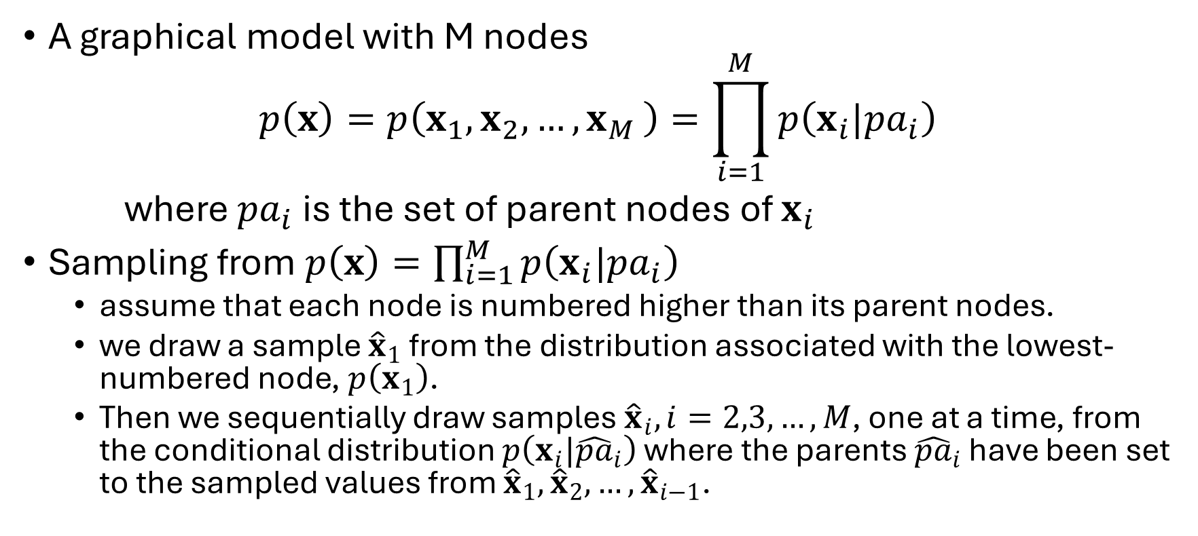
Sample from a graphical model
A graphical model with M nodes
$$p\left(x\right)=p\left(x_{1},x_{2}, {…,x}_{M}\right)=\prod_{i=1}^{M}{p\left(x_{i}|{pa}_{i}\right)}$$
where ${pa}_{i}$ is the set of parent nodes of $x_{i}$
Sampling from $p\left(x\right)=\prod_{i=1}^{M}{p\left(x_{i}|{pa}_{i}\right)}$
  assume that each node is numbered higher than its parent nodes.
  we draw a sample ${\hat{x}}_{1}$ from the distribution associated with the lowest-numbered node, $p\left(x_{1}\right)$.
  Then we sequentially draw samples ${\hat{x}}_{i}, i=2,3,…,M$, one at a time, from the conditional distribution $p\left(x_{i}|{\hat{pa}}_{i}\right)$ where the parents ${\hat{pa}}_{i}$ have been set to the sampled values from ${\hat{x}}_{1}, {\hat{x}}_{2},…,{\hat{x}}_{i−1}$.

Slide 6



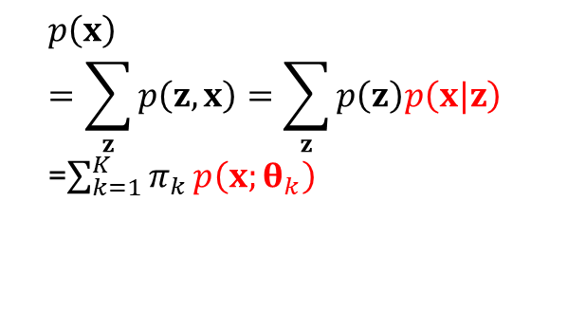
Gaussian mixture models (GMMs)
Gaussian mixture model with K Gaussian components
  $p\left(x\right)=\sum_{k=1}^{K}{π_{k}}p\left(x;θ_{k}\right)$, where $p\left(x|θ_{k}\right)=ℕ\left(x;μ_{k},Σ_{k}\right)$, $x∈ℝ^{D}$
  $ℕ\left(x;μ_{k},Σ_{k}\right)$ is a Gaussian density function with mean $μ_{k}$, and covariance $Σ_{k}$
  $θ_{k}$ are the model parameters
  $π_{k}$ specifies a discrete probability distribution $p\left(z=k\right)=π_{k}$
$$p\left(z,x\right)=p\left(z\right)p\left(x|z\right)$$
z
x
discrete
Gaussian
$$p\left(x\right)=\sum_{z}{p\left(z,x\right)=\sum_{z}{p\left(z\right)p\left(x|z\right)}}$$
=$\sum_{k=1}^{K}{π_{k}}p\left(x;θ_{k}\right)$
$$p\left(x|z=k\right)$$

Slide 7
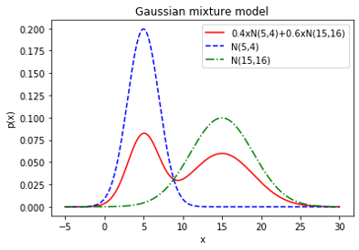



GMM example: D=1, K=2
$π_{1}=0.4, π_{2}=0.6$, $μ_{1}=5, μ_{2}=15, Σ_{1}=4, Σ_{2}=16$,
Statistical average of two Gaussian densities
$$p\left(x\right)=0.4\frac{1}{\sqrt{2π}2}e^{−\frac{{\left(x−5\right)}^{2}}{2×4}}+0.6\frac{1}{\sqrt{2π}4}e^{−\frac{{\left(x−15\right)}^{2}}{2×16}}$$
Stronger expression capacity than a single Gaussian distribution

Slide 8
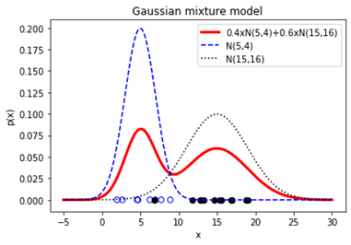
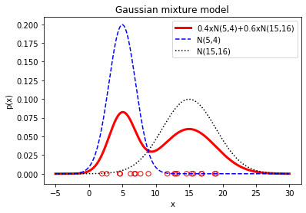


Draw a dataset from GMM
To draw a sample from the Gaussian mixture model, we can first generate a sample $z^{(i)}$ from the distribution $p\left(z\right)$, and then draw a sample $x^{(i)}$ from the conditional distribution $p\left(x|z\right)$ given $z=z^{(i)}$.
Complete dataset (with z labels): $\left\{\left(x^{(n)},z^{(n)}\right), n=1,2,…,N\right\}$
Incomplete dataset:$\left\{x^{(n)}, n=1,2,…,N\right\}$
Given
generate

Slide 9
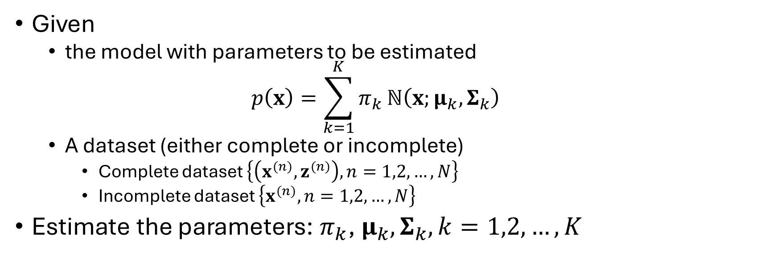
Estimate density from a dataset
Given
  the model with parameters to be estimated
  $$p\left(x\right)=\sum_{k=1}^{K}{π_{k}}ℕ\left(x;μ_{k},Σ_{k}\right)$$
  A dataset (either complete or incomplete)
    Complete dataset $\left\{\left(x^{(n)},z^{(n)}\right), n=1,2,…,N\right\}$
    Incomplete dataset $\left\{x^{(n)}, n=1,2,…,N\right\}$
Estimate the parameters: $π_{k}$, $μ_{k},Σ_{k}, k=1,2,…, K$

Slide 10
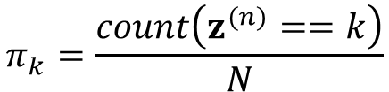

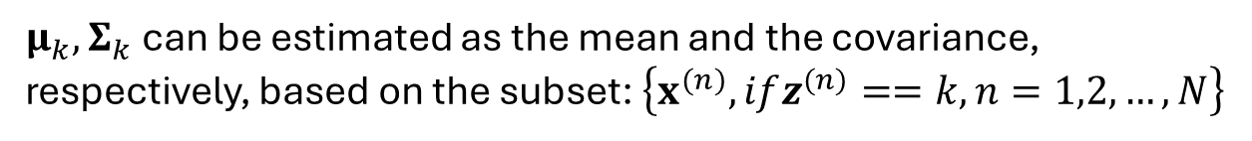
Estimate density from a complete dataset
Complete dataset: $\left\{\left(x^{(n)},z^{(n)}\right), n=1,2,…,N\right\}$
This is equivalent to estimating K separate Gaussian distributions
$$π_{k}=\frac{count\left(z^{(n)}==k\right)}{N}$$
$μ_{k},Σ_{k}$ can be estimated as the mean and the covariance, respectively, based on the subset: $\left\{x^{(n)}, ifz^{(n)}==k, n=1,2,…,N\right\}$

Slide 11
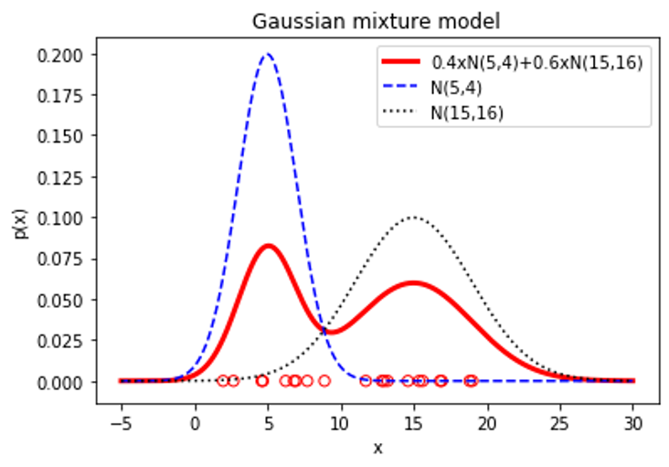
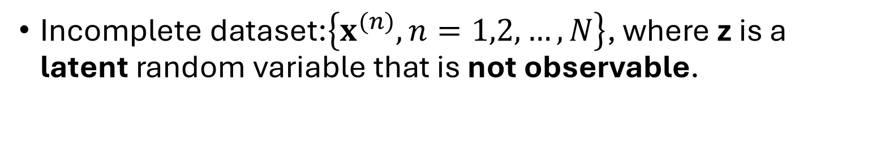
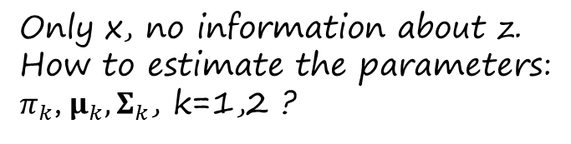
Estimate density from an incomplete dataset
Incomplete dataset:$\left\{x^{(n)}, n=1,2,…,N\right\}$, where z is a latent random variable that is not observable.
Only x, no information about z.
How to estimate the parameters:
$π_{k}$, $μ_{k},Σ_{k}$, k=1,2 ?

Slide 12
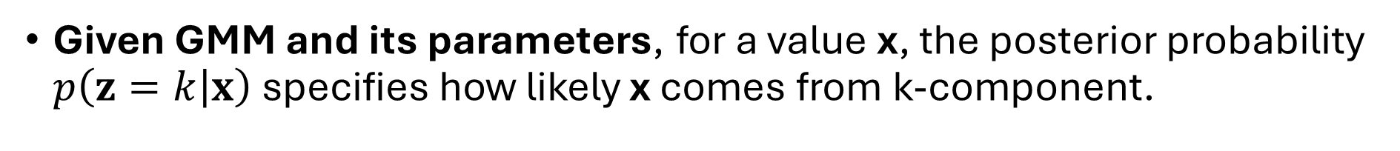
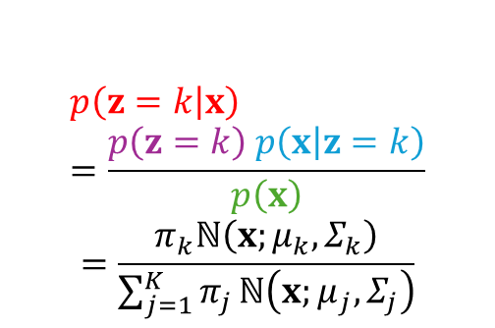
Posterior probability of z
Given GMM and its parameters, for a value x, the posterior probability $p\left(z=k\left|x\right.\right)$ specifies how likely x comes from k-component.
Posterior
Prior
likelihood
$$p\left(z=k\left|x\right.\right)=\frac{p\left(z=k\right) p\left(x\left|z=k\right.\right)}{p\left(x\right)}$$
$$=\frac{π_{k}ℕ\left(x;μ_{k},Σ_{k}\right)}{\sum_{j=1}^{K}{π_{j}}ℕ\left(x;μ_{j},Σ_{j}\right)}$$
marginal

Slide 13
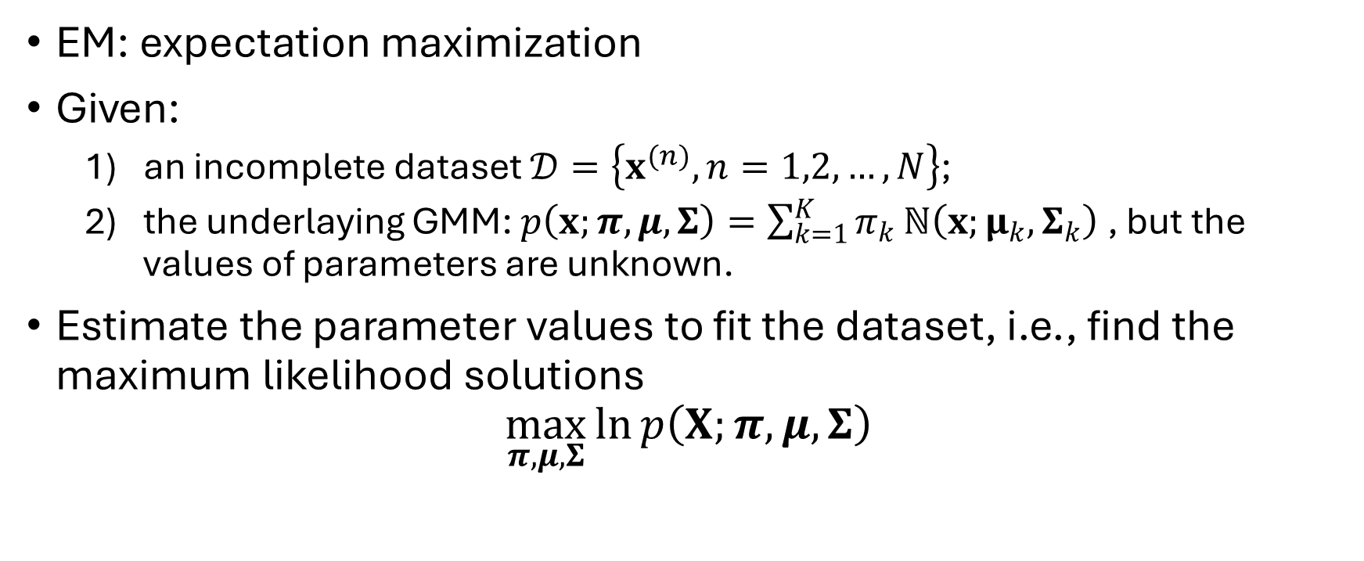
EM algorithm for GMMs: problem statement
EM: expectation maximization
Given:
  an incomplete dataset $𝒟=\left\{x^{(n)}, n=1,2,…,N\right\}$;
  the underlaying GMM: $p\left(x;π,μ,Σ\right)=\sum_{k=1}^{K}{π_{k}}ℕ\left(x;μ_{k},Σ_{k}\right)$, but the values of parameters are unknown.
Estimate the parameter values to fit the dataset, i.e., find the maximum likelihood solutions
$$\max_{π,μ,Σ}{\ln{p\left(X;π,μ,Σ\right)}}$$
Sample index

Slide 14
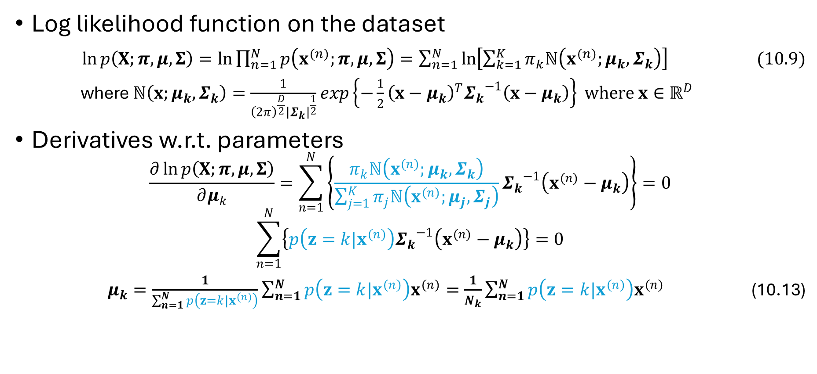
Derive EM algorithm for GMM
Log likelihood function on the dataset
$\ln{p\left(X;π,μ,Σ\right)=\ln{\prod_{n=1}^{N}{p\left(x^{(n)};π,μ,Σ\right)}}=\sum_{n=1}^{N}{\ln\left[\sum_{k=1}^{K}{π_{k}ℕ\left(x^{(n)};μ_{k},Σ_{k}\right)}\right] (10.9)}}$
where $ℕ\left(x;μ_{k},Σ_{k}\right)=\frac{1}{{\left(2π\right)}^{\frac{D}{2}}{\left|Σ_{k}\right|}^{\frac{1}{2}}}exp\left\{−\frac{1}{2}{\left(x−μ_{k}\right)}^{T}{Σ_{k}}^{−1}\left(x−μ_{k}\right)\right\} where x∈ℝ^{D}$
Derivatives w.r.t. parameters
$$\frac{∂\ln{p\left(X;π,μ,Σ\right)}}{∂μ_{k}}=\sum_{n=1}^{N}{\left\{\frac{π_{k}ℕ\left(x^{(n)};μ_{k},Σ_{k}\right)}{\sum_{j=1}^{K}{π_{j}ℕ\left(x^{(n)};μ_{j},Σ_{j}\right)}}{Σ_{k}}^{−1}\left(x^{(n)}−μ_{k}\right)\right\}}=0$$
$$\sum_{n=1}^{N}{\left\{p\left(z=k|x^{(n)}\right){Σ_{k}}^{−1}\left(x^{(n)}−μ_{k}\right)\right\}}=0$$
$μ_{k}=\frac{1}{\sum_{n=1}^{N}{p\left(z=k|x^{(n)}\right)}}\sum_{n=1}^{N}{p\left(z=k|x^{(n)}\right)x^{(n)}}=\frac{1}{N_{k}}\sum_{n=1}^{N}{p\left(z=k|x^{(n)}\right)x^{(n)}}$ (10.13)
$N_{k}$ can be interpreted as the effective number of data points in the dataset belonging to the k-th Gaussian component.

Slide 15
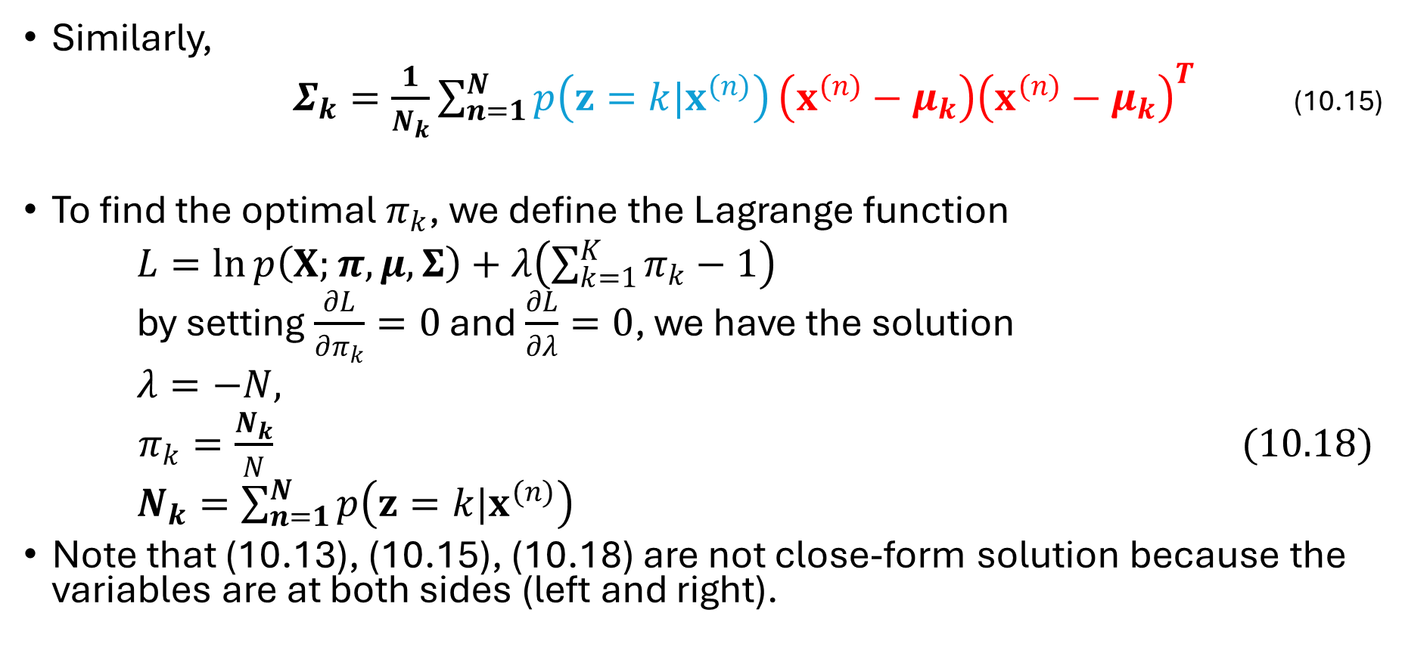
Derive EM algorithm for GMM
percentage
covariance
Similarly,
$Σ_{k}=\frac{1}{N_{k}}\sum_{n=1}^{N}{p\left(z=k|x^{(n)}\right)}\left(x^{(n)}−μ_{k}\right){\left(x^{(n)}−μ_{k}\right)}^{T}$ (10.15)
To find the optimal $π_{k}$, we define the Lagrange function
$L=\ln{p\left(X;π,μ,Σ\right)}+λ\left(\sum_{k=1}^{K}{π_{k}}−1\right)$
by setting $\frac{∂L}{∂π_{k}}=0$ and $\frac{∂L}{∂λ}=0$, we have the solution
$λ=−N,$
$π_{k}=\frac{N_{k}}{N} (10.18)$
$N_{k}=\sum_{n=1}^{N}{p\left(z=k|x^{(n)}\right)}$
Note that (10.13), (10.15), (10.18) are not close-form solution because the variables are at both sides (left and right).

Slide 16
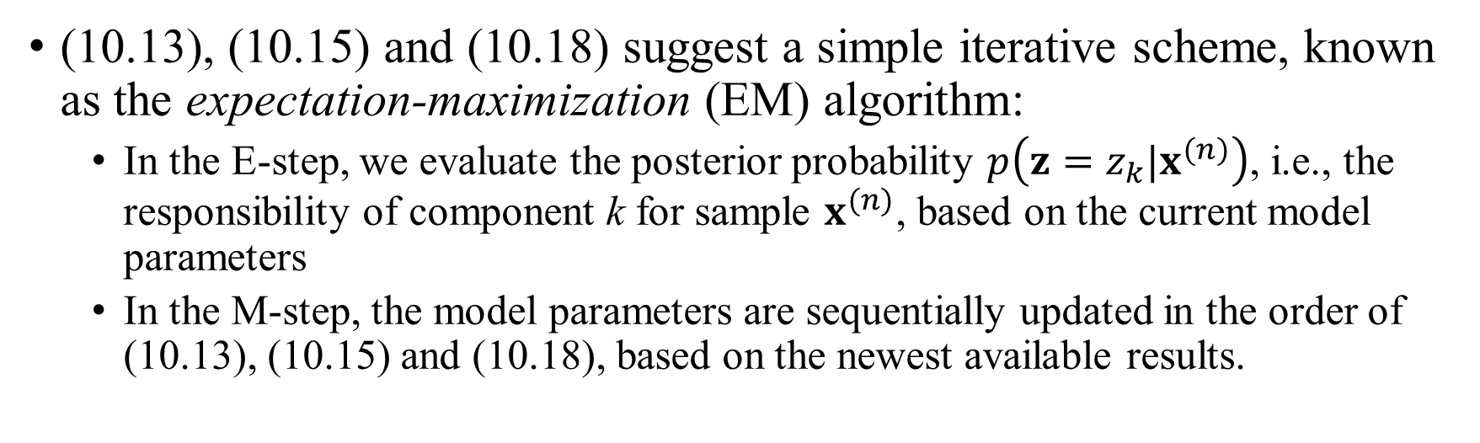
Dynamic programing: iterative scheme
(10.13), (10.15) and (10.18) suggest a simple iterative scheme, known as the expectation-maximization (EM) algorithm:
  In the E-step, we evaluate the posterior probability $p\left(z=z_{k}|x^{(n)}\right)$, i.e., the responsibility of component k for sample $x^{(n)}$, based on the current model parameters
  In the M-step, the model parameters are sequentially updated in the order of (10.13), (10.15) and (10.18), based on the newest available results.

Slide 17
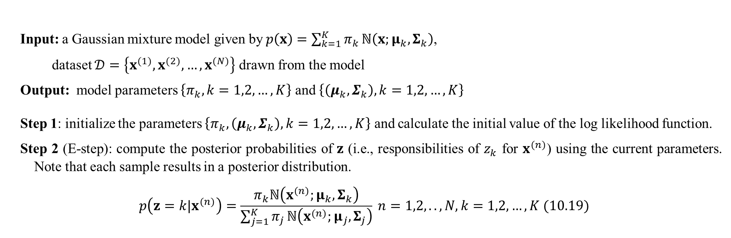
EM algorithm for GMMs (1/2)
Input: a Gaussian mixture model given by$p\left(x\right)=\sum_{k=1}^{K}{π_{k}}ℕ\left(x;μ_{k},Σ_{k}\right)$,
dataset $𝒟=\left\{x^{(1)},x^{(2)},…,x^{(N)}\right\}$ drawn from the model
Output: model parameters $\left\{π_{k}, k=1,2,…,K\right\}$ and $\left\{\left(μ_{k},Σ_{k}\right), k=1,2,…,K\right\}$
Step 1: initialize the parameters $\left\{π_{k},\left(μ_{k},Σ_{k}\right), k=1,2,…,K\right\}$ and calculate the initial value of the log likelihood function.
Step 2 (E-step): compute the posterior probabilities of $z$ (i.e., responsibilities of $z_{k}$ for $x^{(n)}$) using the current parameters. Note that each sample results in a posterior distribution.
$$p\left(z=k|x^{(n)}\right)=\frac{π_{k}ℕ\left(x^{(n)};μ_{k},Σ_{k}\right)}{\sum_{j=1}^{K}{π_{j}}ℕ\left(x^{(n)};μ_{j},Σ_{j}\right)} n=1,2,..,N, k=1,2,…,K (10.19)$$

Slide 18
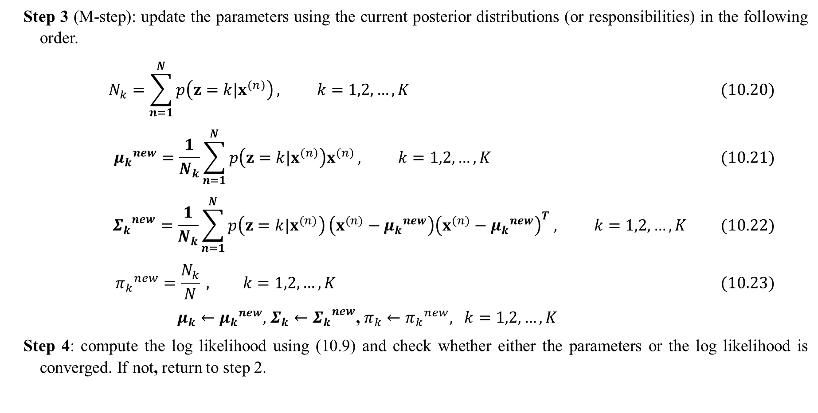
EM algorithm for GMMs (2/2)
Step 3 (M-step): update the parameters using the current posterior distributions (or responsibilities) in the following order.
$$N_{k}=\sum_{n=1}^{N}{p\left(z=k|x^{(n)}\right)}, k=1,2,…,K (10.20)$$
$${μ_{k}}^{new}=\frac{1}{N_{k}}\sum_{n=1}^{N}{p\left(z=k|x^{(n)}\right)x^{(n)}}, k=1,2,…,K (10.21)$$
$${Σ_{k}}^{new}=\frac{1}{N_{k}}\sum_{n=1}^{N}{p\left(z=k|x^{(n)}\right)}\left(x^{(n)}−{μ_{k}}^{new}\right){\left(x^{(n)}−{μ_{k}}^{new}\right)}^{T} , k=1,2,…,K (10.22)$$
$${π_{k}}^{new}=\frac{N_{k}}{N} , k=1,2,…,K (10.23)$$
$μ_{k}{{←μ}_{k}}^{new},$ ${{Σ_{k}←Σ}_{k}}^{new}$, ${{π_{k}←π}_{k}}^{new}, k=1,2,…,K$
Step 4: compute the log likelihood using (10.9) and check whether either the parameters or the log likelihood is converged. If not, return to step 2.

Slide 19
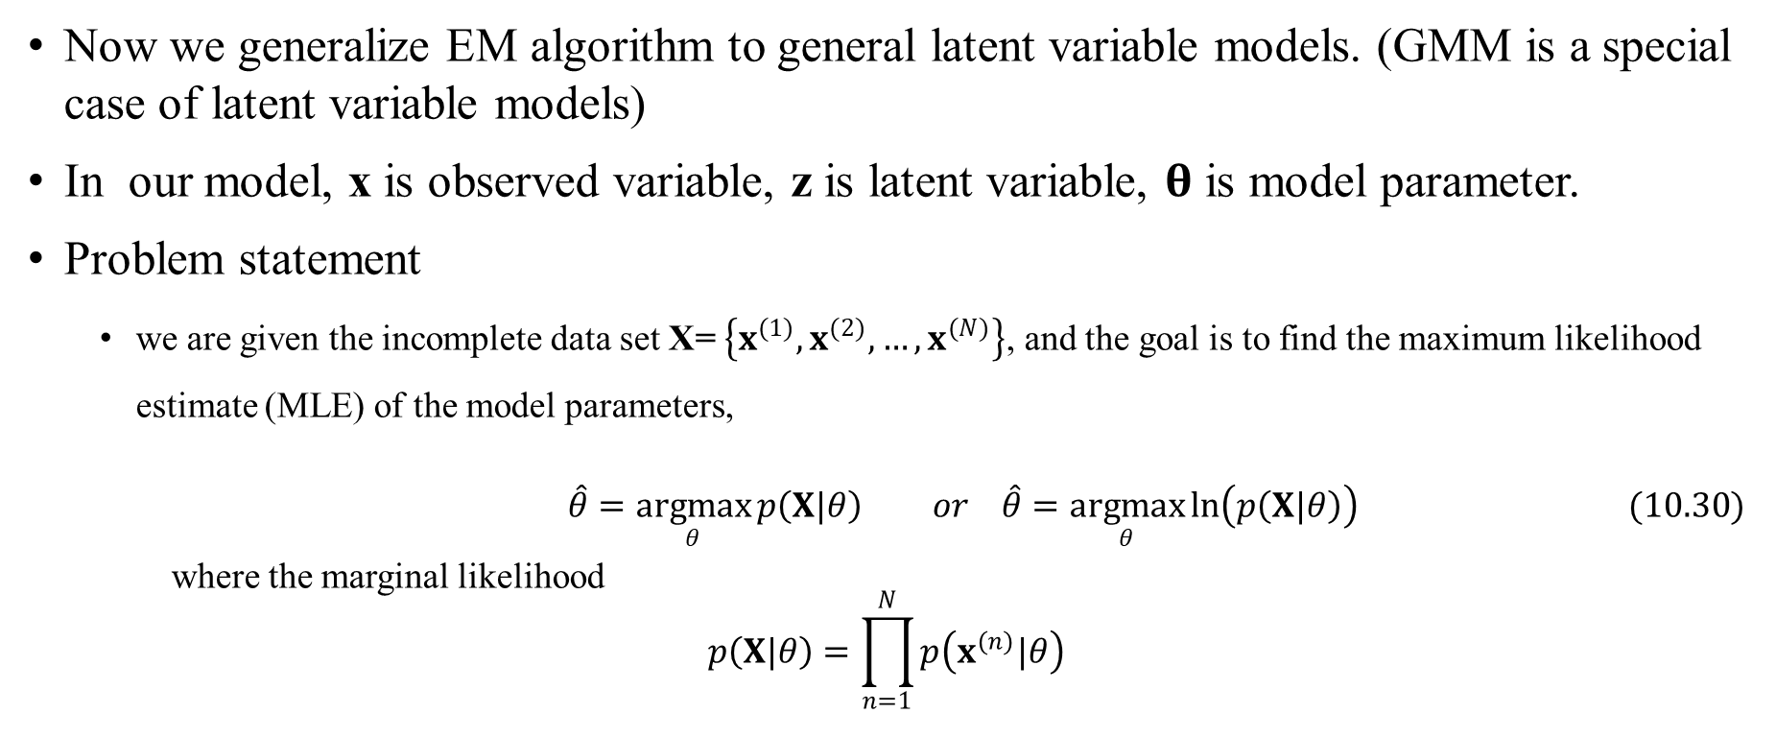
EM algorithm for latent variable models in general
Now we generalize EM algorithm to general latent variable models. (GMM is a special case of latent variable models)
In our model, x is observed variable, z is latent variable, $θ$ is model parameter.
Problem statement
  we are given the incomplete data set X= $\left\{x^{(1)},x^{(2)},…,x^{(N)}\right\}$, and the goal is to find the maximum likelihood estimate (MLE) of the model parameters,
$$\hat{θ}=\underset{θ}{argmax}{p\left(X|θ\right)} or \hat{θ}=\underset{θ}{argmax}{\ln\left(p\left(X|θ\right)\right)} (10.30)$$
where the marginal likelihood
$$p\left(X|θ\right)=\prod_{n=1}^{N}{p\left(x^{(n)}|θ\right)}$$
Assume that we know the probability models with unknow parameters: $p\left(z\right)$, $p\left(x|z\right)$

Slide 20

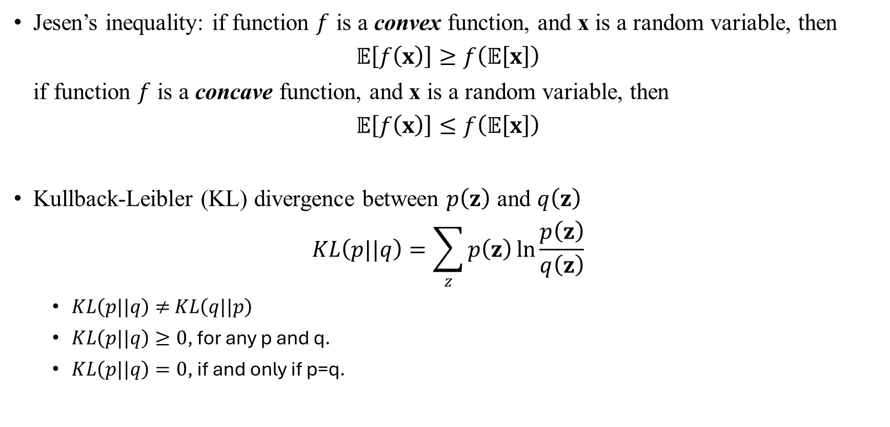

Two concepts: Jesen’s inequality, KL divergence
Jesen’s inequality: if function $f$ is a convex function, and x is a random variable, then
$$𝔼\left[f\left(x\right)\right]≥f\left(𝔼\left[x\right]\right)$$
if function $f$ is a concave function, and x is a random variable, then
$$𝔼\left[f\left(x\right)\right]≤f\left(𝔼\left[x\right]\right)$$
Kullback-Leibler (KL) divergence between $p\left(z\right)$ and $q\left(z\right)$
$$KL\left(p||q\right)=\sum_{z}{p\left(z\right)}\ln{\frac{p\left(z\right)}{q\left(z\right)}}$$
  $KL\left(p||q\right)≠$ $KL\left(q||p\right)$
  $KL\left(p||q\right)≥0$, for any p and q.
  $KL\left(p||q\right)=0$, if and only if p=q.
$$f\left(x\right)$$
$$x$$
concave

Slide 21
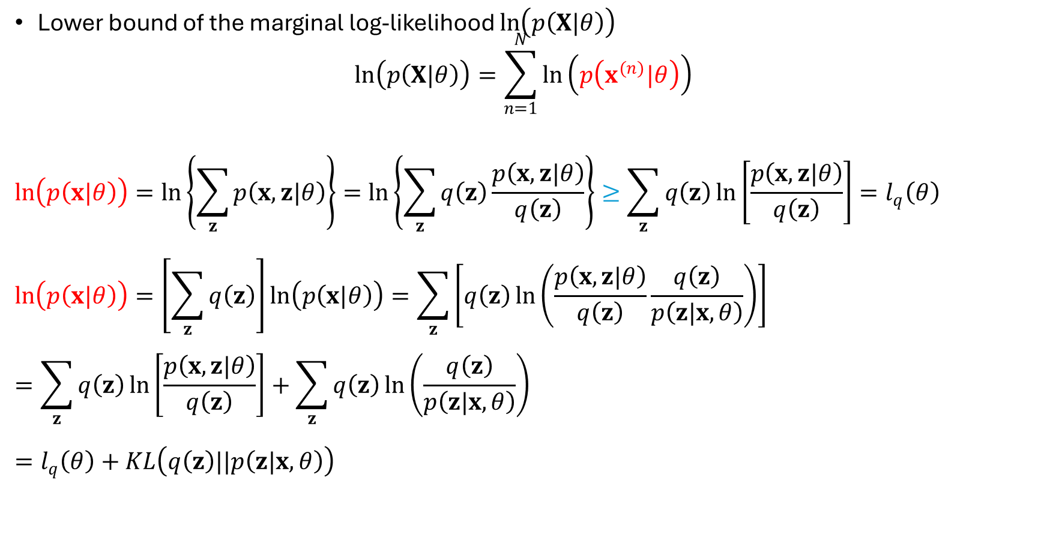
Evidence Lower Bound (ELBO)
Lower bound of the marginal log-likelihood $\ln\left(p\left(X|θ\right)\right)$
$$\ln\left(p\left(X|θ\right)\right)=\sum_{n=1}^{N}{\ln\left(p\left(x^{(n)}|θ\right)\right)}$$
$$\ln\left(p\left(x|θ\right)\right)=\ln\left\{\sum_{z}{p\left(x,z|θ\right)}\right\}=\ln\left\{\sum_{z}{q\left(z\right)\frac{p\left(x,z|θ\right)}{q\left(z\right)}}\right\}≥\sum_{z}{q\left(z\right)\ln\left[\frac{p\left(x,z|θ\right)}{q\left(z\right)}\right]}=l_{q}\left(θ\right)$$
$$\ln\left(p\left(x|θ\right)\right)=\left[\sum_{z}{q\left(z\right)}\right]\ln\left(p\left(x|θ\right)\right)=\sum_{z}{\left[q\left(z\right)\ln\left(\frac{p\left(x,z|θ\right)}{q\left(z\right)}\frac{q\left(z\right)}{p\left(z|x,θ\right)}\right)\right]}=\sum_{z}{q\left(z\right)\ln\left[\frac{p\left(x,z|θ\right)}{q\left(z\right)}\right]}+\sum_{z}{q\left(z\right)}\ln\left(\frac{q\left(z\right)}{p\left(z|x,θ\right)}\right)$$
$$=l_{q}\left(θ\right)+KL\left(q\left(z\right)||p\left(z|x,θ\right)\right)$$
Jesen’s inequality

Slide 22
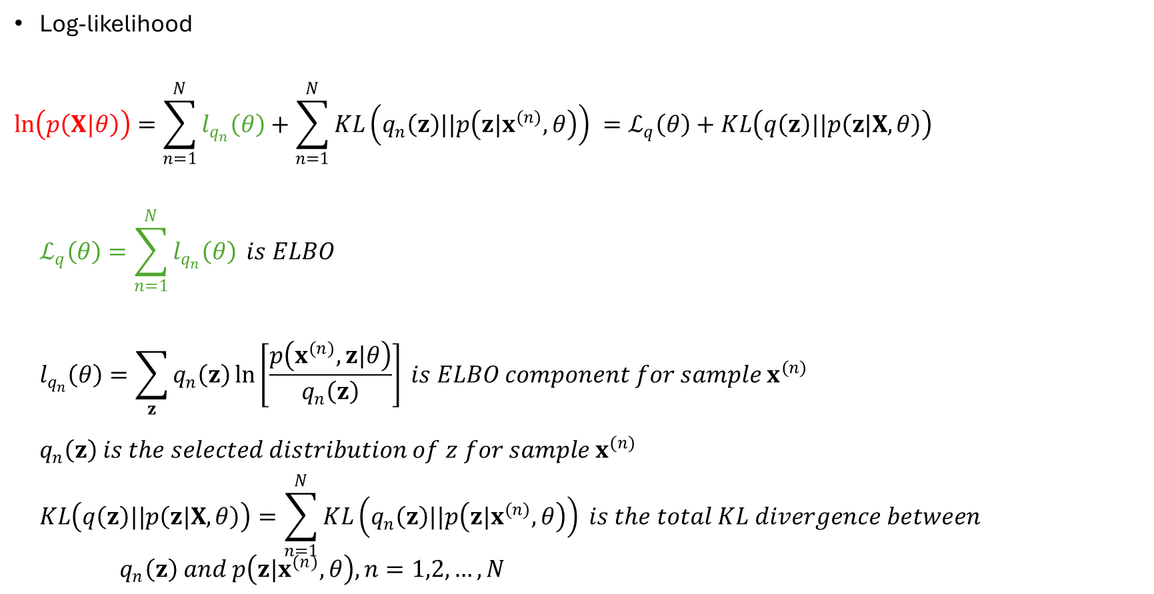
Evidence Lower Bound (ELBO)
Log-likelihood
$$\ln\left(p\left(X|θ\right)\right)=\sum_{n=1}^{N}{l_{q_{n}}\left(θ\right)}+\sum_{n=1}^{N}{KL\left(q_{n}\left(z\right)||p\left(z|x^{(n)},θ\right)\right)} =ℒ_{q}\left(θ\right)+KL\left(q\left(z\right)||p\left(z|X,θ\right)\right)$$
$$ℒ_{q}\left(θ\right)=\sum_{n=1}^{N}{l_{q_{n}}\left(θ\right)} is ELBO$$
$$l_{q_{n}}\left(θ\right)=\sum_{z}{q_{n}\left(z\right)\ln\left[\frac{p\left(x^{(n)},z|θ\right)}{q_{n}\left(z\right)}\right]} is ELBO component for sample x^{(n)}$$
$$q_{n}\left(z\right) is the selected distribution of z for sample x^{(n)}$$
$$KL\left(q\left(z\right)||p\left(z|X,θ\right)\right)=\sum_{n=1}^{N}{KL\left(q_{n}\left(z\right)||p\left(z|x^{(n)},θ\right)\right)} is the total KL divergence between$$
$${ q}_{n}\left(z\right) and p\left(z|x^{(n)},θ\right), n=1,2,…,N$$

Slide 23
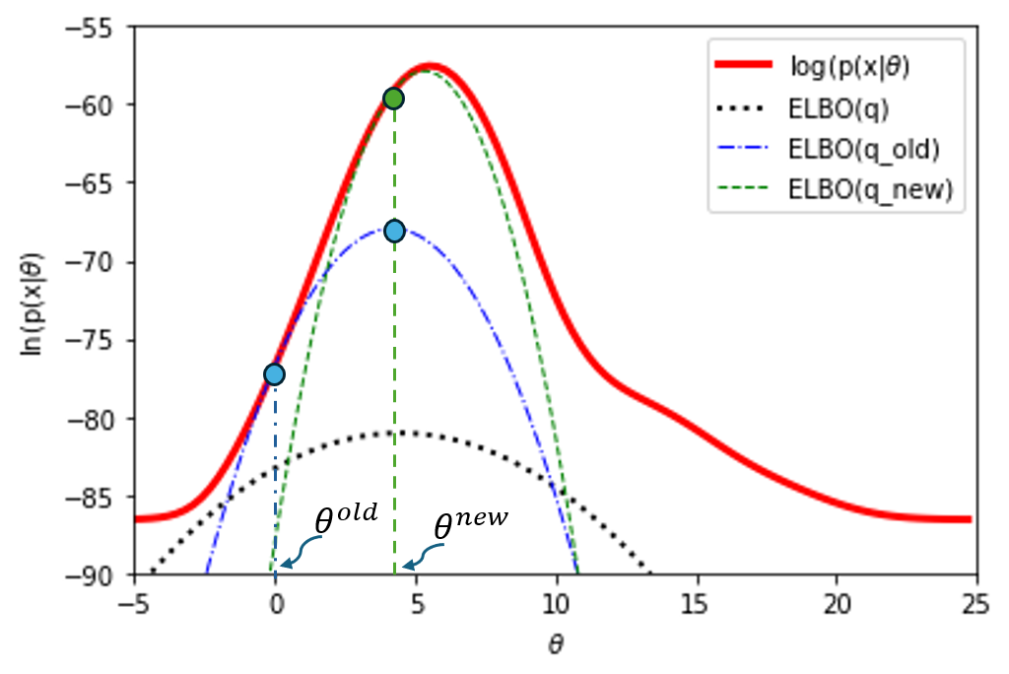
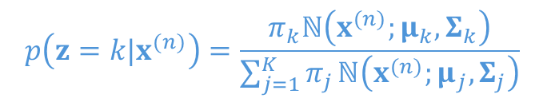




Visual example for ELBO
Model (assume GMM with only one parameter): $p\left(x|θ\right)=0.4\frac{1}{\sqrt{2π}2}e^{−\frac{{\left(x−θ\right)}^{2}}{2×4}}+0.6\frac{1}{\sqrt{2π}4}e^{−\frac{{\left(x−15\right)}^{2}}{2×16}}$
(1)
$$q_{n}^{old}\left(z\right)=p\left(z{|x}^{(n)},θ^{old}\right)$$
$$p\left(z=k|x^{(n)}\right)=\frac{π_{k}ℕ\left(x^{(n)};μ_{k},Σ_{k}\right)}{\sum_{j=1}^{K}{π_{j}}ℕ\left(x^{(n)};μ_{j},Σ_{j}\right)}$$
(5)
$$ℒ_{q^{old}}\left(θ\right)$$
(3)
$$ℒ_{q^{old}}\left(θ\right)$$
(4)
Dataset: 20 samples
(1)
(2)
$$ℒ_{q}\left(θ\right)$$
an arbitrarily particular set of distributions $\left\{q_{n}\left(z\right), z∈\left\{1,2\right\}, n=1,2,…,N\right\}$.

Slide 24
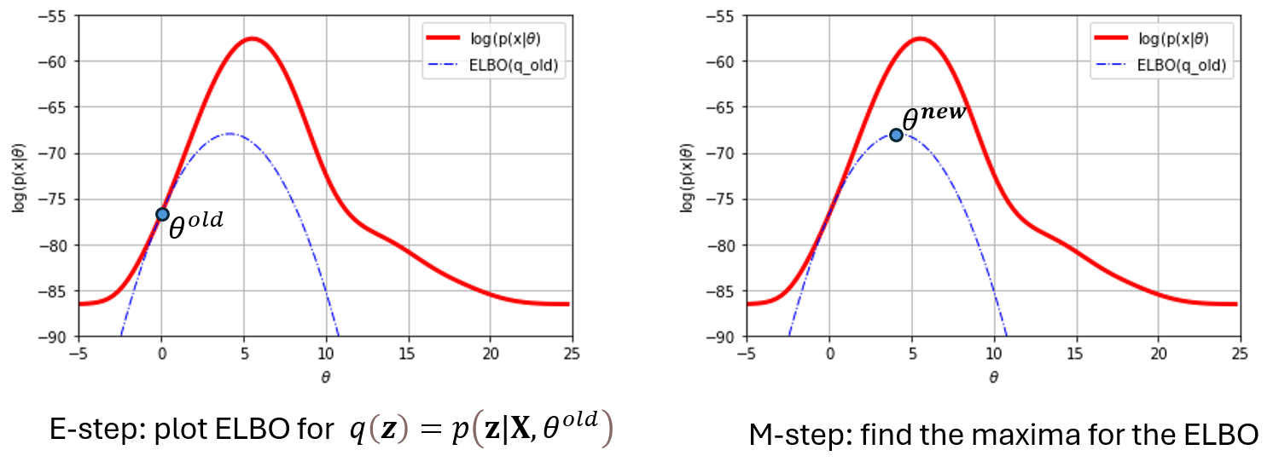
EM algorithm: E-step and M-step

Slide 25




















$$\ln{p\left(X|θ^{new}\right)}$$
$$KL\left(q||p\right)$$
$$\ln{p\left(X|θ^{old}\right)}$$
E-step
$$KL\left(q||p\right)$$
M-step:
$$\max_{θ}{ℒ_{q}\left(θ\right)}$$
$$ℒ_{q}\left(θ^{new}\right)$$
E-step:
$$\max_{q}{ℒ_{q}\left(θ^{old}\right)}$$
$$ℒ_{q}\left(θ^{old}\right)$$
$$ℒ_{q}\left(θ^{old}\right)$$
$$q=p\left(z|X,θ^{old}\right)$$
$$q=p\left(z|X,θ^{old}\right)$$
$$q=p\left(z|X,θ^{new}\right)$$
$$q=q\left(z\right) any initially$$
$$p=p\left(z|X,θ^{old}\right)$$
$$p=p\left(z|X,θ^{new}\right)$$
$$p=p\left(z|X,θ^{new}\right)$$
$KL\left(q||p\right)$=0
$KL\left(q||p\right)>$0
$KL\left(q||p\right)$=0
$$p=p\left(z|X,θ^{old}\right)$$
Not included in the book

Slide 26
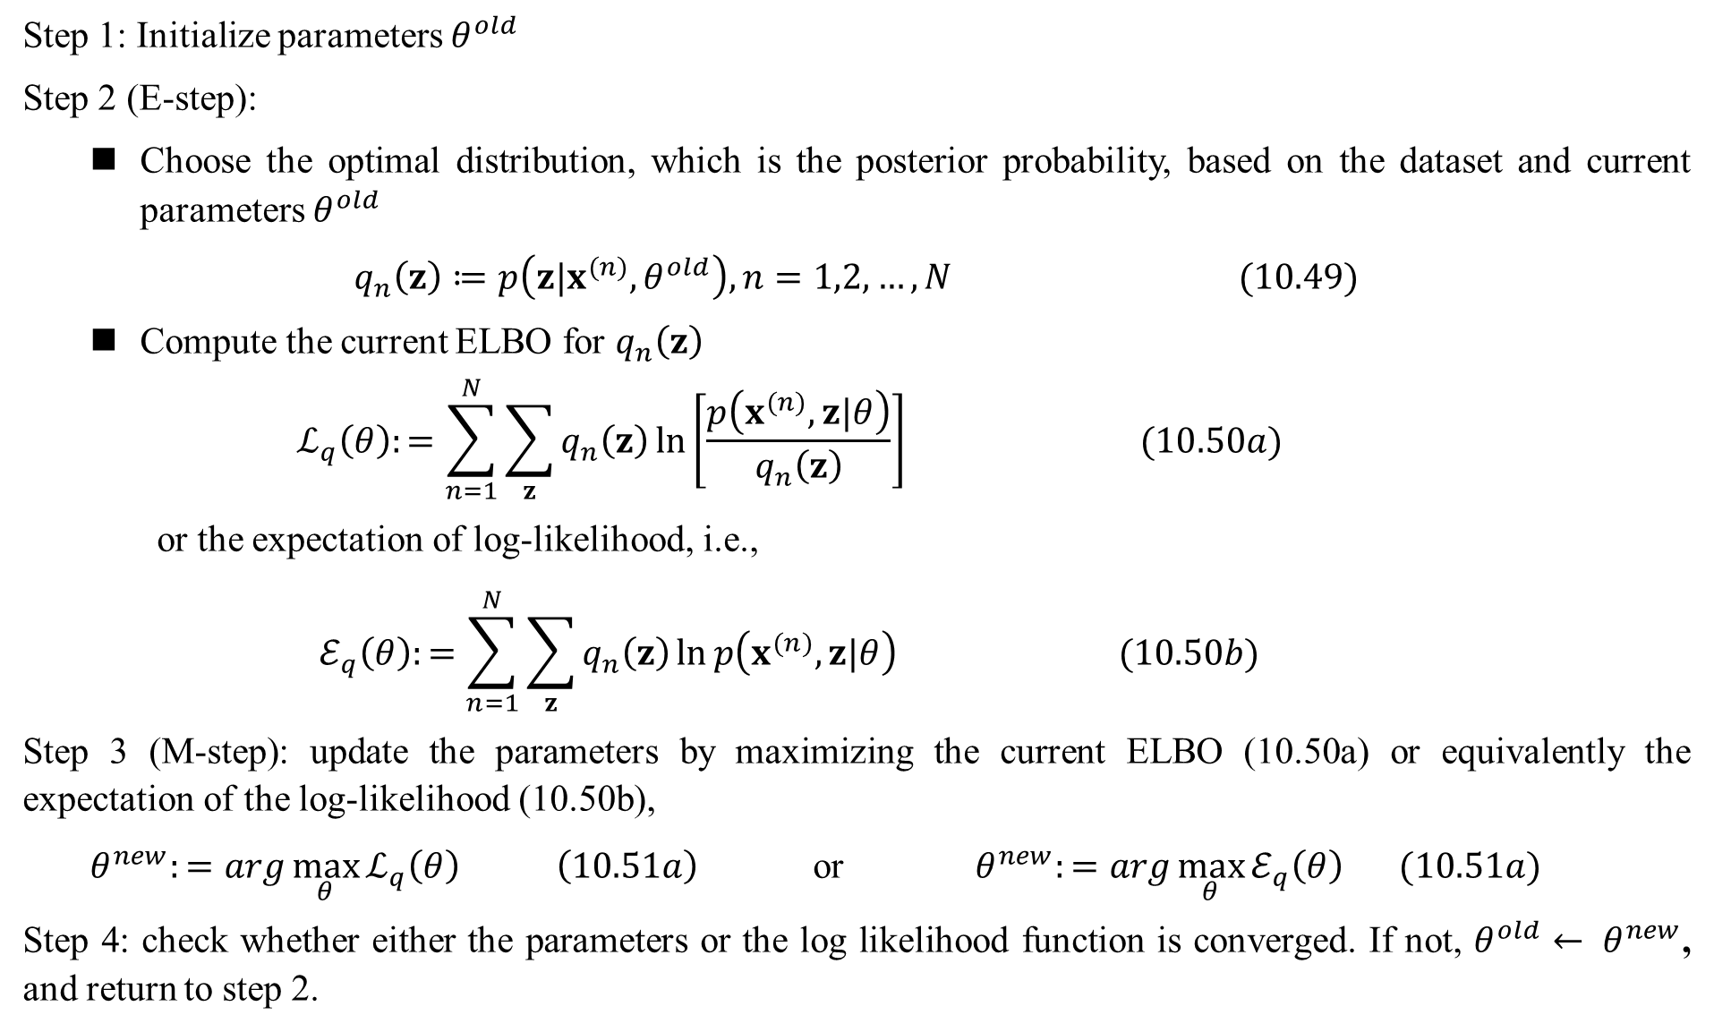
Step 1: Initialize parameters $θ^{old}$
Step 2 (E-step):
Choose the optimal distribution, which is the posterior probability, based on the dataset and current parameters $θ^{old}$
$$q_{n}\left(z\right)≔p\left(z|x^{(n)},θ^{old}\right), n=1,2,…, N (10.49)$$
Compute the current ELBO for $q_{n}\left(z\right)$
$$ℒ_{q}\left(θ\right):=\sum_{n=1}^{N}{\sum_{z}{q_{n}\left(z\right)\ln\left[\frac{p\left(x^{(n)},z|θ\right)}{q_{n}\left(z\right)}\right] (10.50a)}}$$
or the expectation of log-likelihood, i.e.,
$$ℰ_{q}\left(θ\right):=\sum_{n=1}^{N}{\sum_{z}{q_{n}\left(z\right)\ln{p\left(x^{(n)},z|θ\right) (10.50b)}}}$$
Step 3 (M-step): update the parameters by maximizing the current ELBO (10.50a) or equivalently the expectation of the log-likelihood (10.50b),
$θ^{new}:=arg\max_{θ}{ℒ_{q}\left(θ\right)} \left(10.51a\right)$or $θ^{new}:=arg\max_{θ}{ℰ_{q}\left(θ\right)} (10.51a)$
Step 4: check whether either the parameters or the log likelihood function is converged. If not, $θ^{old}← θ^{new}$, and return to step 2.
EM algorithm

Slide 27
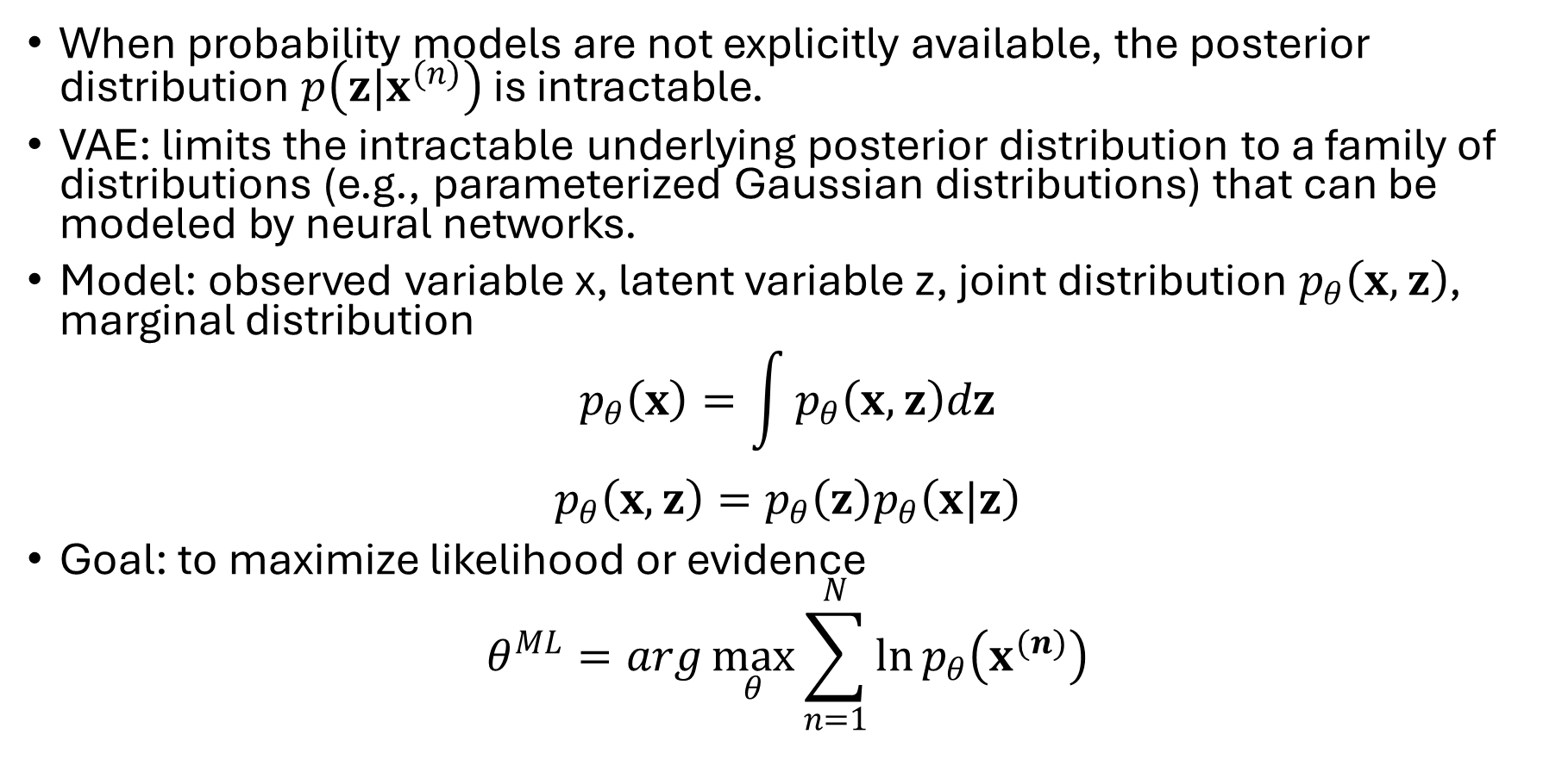
Variational Auto-Encoder (VAE)
When probability models are not explicitly available, the posterior distribution $p\left(z|x^{(n)}\right)$ is intractable.
VAE: limits the intractable underlying posterior distribution to a family of distributions (e.g., parameterized Gaussian distributions) that can be modeled by neural networks.
Model: observed variable x, latent variable z, joint distribution $p_{θ}\left(x,z\right)$, marginal distribution
$$p_{θ}\left(x\right)=\int{p_{θ}\left(x,z\right)dz}$$
$$p_{θ}\left(x,z\right)=p_{θ}\left(z\right)p_{θ}\left(x|z\right)$$
Goal: to maximize likelihood or evidence
$$θ^{ML}=arg\max_{θ}{\sum_{n=1}^{N}{\ln{p_{θ}\left(x^{(n)}\right)}}}$$

Slide 28

VAE ELBO
# independent of z
$$\ln{p_{θ}\left(x\right)}=𝔼_{q\left(z\right)}\left[\ln{p_{θ}\left(x\right)}\right]$$
$$=𝔼_{q\left(z\right)}\left[\ln{\frac{p_{θ}\left(x,z\right)}{q\left(z\right)}}\right]+𝔼_{q\left(z\right)}\left[\ln{\frac{q\left(z\right)}{p_{θ}\left(z|x\right)}}\right]$$
$$=ℒ_{q}\left(θ;x\right)+KL\left(q\left(z\right)||p_{θ}\left(z|x\right)\right)$$
The best choice of q(z) is $p_{θ}\left(z|x\right)$, which can be approximated or modeled by $q_{φ}\left(z|x\right)$

Slide 29
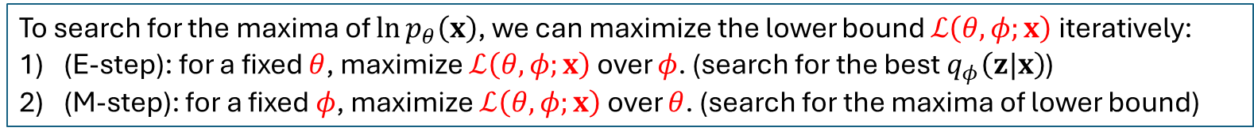
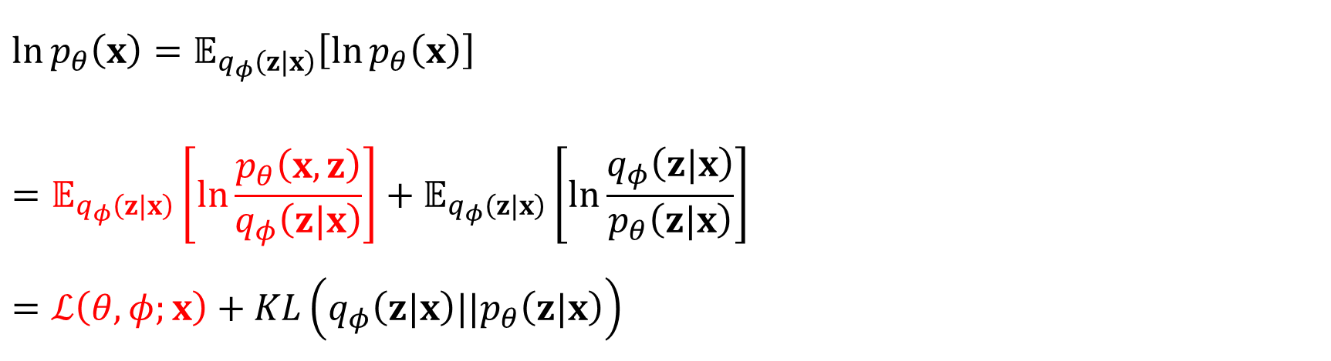
VAE variational lower bound
$$\ln{p_{θ}\left(x\right)}=𝔼_{q_{φ}\left(z|x\right)}\left[\ln{p_{θ}\left(x\right)}\right]$$
$$=𝔼_{q_{φ}\left(z|x\right)}\left[\ln{\frac{p_{θ}\left(x,z\right)}{q_{φ}\left(z|x\right)}}\right]+𝔼_{q_{φ}\left(z|x\right)}\left[\ln{\frac{q_{φ}\left(z|x\right)}{p_{θ}\left(z|x\right)}}\right]$$
$$=ℒ\left(θ,φ;x\right)+KL\left(q_{φ}\left(z|x\right)||p_{θ}\left(z|x\right)\right)$$
$$ℒ\left(θ,φ;x\right)=𝔼_{q_{φ}\left(z\left|x\right.\right)}\left[\ln{\frac{p_{θ}\left(x,z\right)}{q_{φ}\left(z\left|x\right.\right)}}\right]=𝔼_{q_{φ}\left(z\left|x\right.\right)}\left[\ln{p_{θ}\left(x,z\right)}−\ln{q_{φ}\left(z\left|x\right.\right)}\right]$$
Inspired by EM algorithm
To search for the maxima of $\ln{p_{θ}\left(x\right)}$, we can maximize the lower bound $ℒ\left(θ,φ;x\right)$ iteratively:
(E-step): for a fixed $θ$, maximize $ℒ\left(θ,φ;x\right)$ over $φ$. (search for the best $q_{φ}\left(z|x\right)$)
(M-step): for a fixed $φ$, maximize $ℒ\left(θ,φ;x\right)$ over $θ$. (search for the maxima of lower bound)
But we can jointly optimize the lower bound using stochastic gradient ascent.

Slide 30
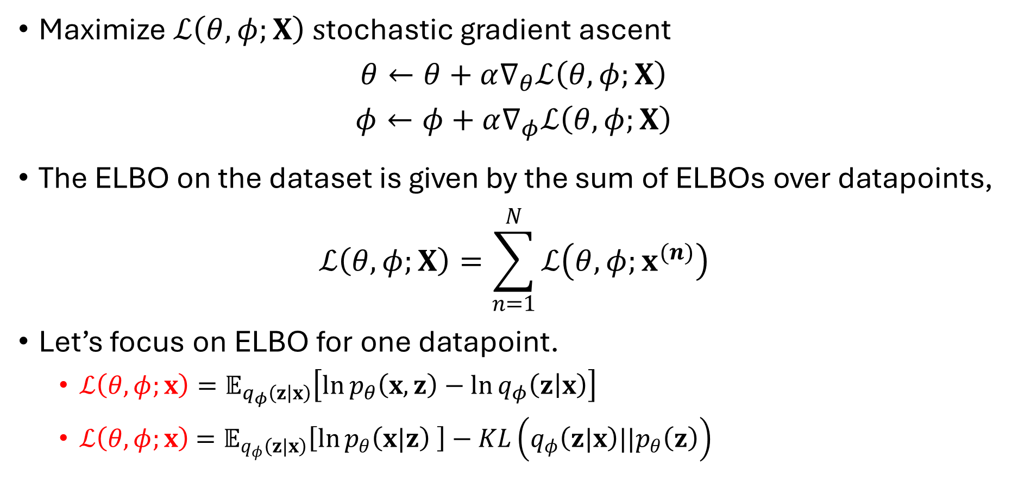
Optimize the variational lower bound
Maximize $ℒ\left(θ,φ;X\right) s$tochastic gradient ascent
$$θ←θ+α∇_{θ}ℒ\left(θ,φ;X\right)$$
$$φ←φ+α∇_{φ}ℒ\left(θ,φ;X\right)$$
The ELBO on the dataset is given by the sum of ELBOs over datapoints,
$$ℒ\left(θ,φ;X\right)=\sum_{n=1}^{N}{ℒ\left(θ,φ;x^{(n)}\right)}$$
Let’s focus on ELBO for one datapoint.
  $ℒ\left(θ,φ;x\right)=𝔼_{q_{φ}\left(z\left|x\right.\right)}\left[\ln{p_{θ}\left(x,z\right)}−\ln{q_{φ}\left(z\left|x\right.\right)}\right]$
  $ℒ\left(θ,φ;x\right)$ $=𝔼_{q_{φ}\left(z|x\right)}\left[\ln{p_{θ}\left(x|z\right)} \right]−KL\left(q_{φ}\left(z|x\right)||p_{θ}\left(z\right)\right)$

Slide 31
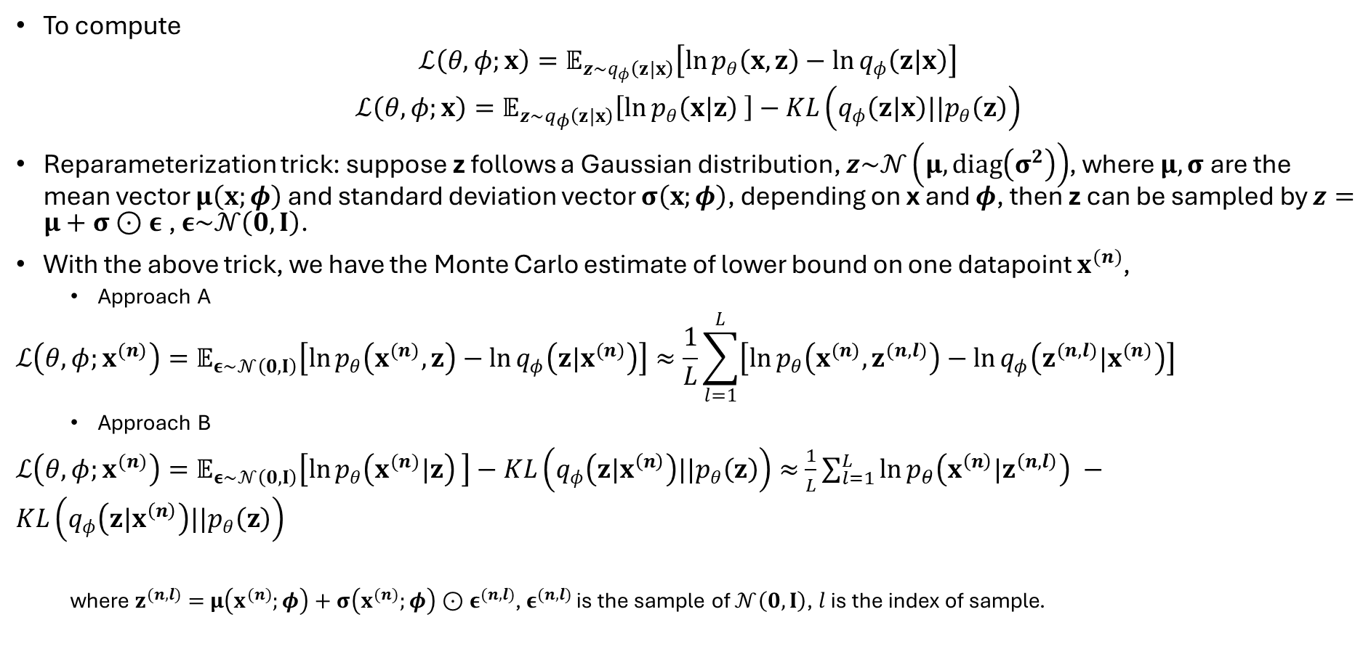
ELBO MC estimator for a single datapoint
To compute
$$ℒ\left(θ,φ;x\right)=𝔼_{{z\sim q}_{φ}\left(z|x\right)}\left[\ln{p_{θ}\left(x,z\right)}−\ln{q_{φ}\left(z|x\right)}\right]$$
$$ℒ\left(θ,φ;x\right)=𝔼_{{z\sim q}_{φ}\left(z|x\right)}\left[\ln{p_{θ}\left(x|z\right)} \right]−KL\left(q_{φ}\left(z|x\right)||p_{θ}\left(z\right)\right)$$
Reparameterization trick: suppose z follows a Gaussian distribution, $z\sim 𝒩\left(μ,diag\left(σ^{2}\right)\right)$, where $μ,σ$ are the mean vector $μ\left(x;φ\right)$ and standard deviation vector $σ\left(x;φ\right)$, depending on x and $φ$, then z can be sampled by $z=μ+σ⊙ε$, $ε\sim 𝒩\left(0,I\right)$.
With the above trick, we have the Monte Carlo estimate of lower bound on one datapoint $x^{(n)}$,
  Approach A
$$ℒ\left(θ,φ;x^{(n)}\right)=𝔼_{ε\sim 𝒩\left(0,I\right)}\left[\ln{p_{θ}\left(x^{(n)},z\right)}−\ln{q_{φ}\left(z|x^{(n)}\right)}\right]≈\frac{1}{L}\sum_{l=1}^{L}{\left[\ln{p_{θ}\left(x^{(n)},z^{(n,l)}\right)}−\ln{q_{φ}\left(z^{(n,l)}|x^{(n)}\right)}\right]}$$
  Approach B
  $ℒ\left(θ,φ;x^{(n)}\right)=𝔼_{ε\sim 𝒩\left(0,I\right)}\left[\ln{p_{θ}\left(x^{(n)}|z\right)} \right]−KL\left(q_{φ}\left(z|x^{\left(n\right)}\right)||p_{θ}\left(z\right)\right)≈$ $\frac{1}{L}\sum_{l=1}^{L}{\ln{p_{θ}\left(x^{\left(n\right)}|z^{\left(n,l\right)}\right)}} −KL\left(q_{φ}\left(z|x^{\left(n\right)}\right)||p_{θ}\left(z\right)\right)$
  where $z^{(n,l)}=$ $μ\left(x^{(n)};φ\right)+σ\left(x^{(n)};φ\right)⊙ε^{(n,l)}$, $ε^{(n,l)}$ is the sample of $𝒩\left(0,I\right)$, $l$ is the index of sample.
# Monte Carlo estimate

Slide 32
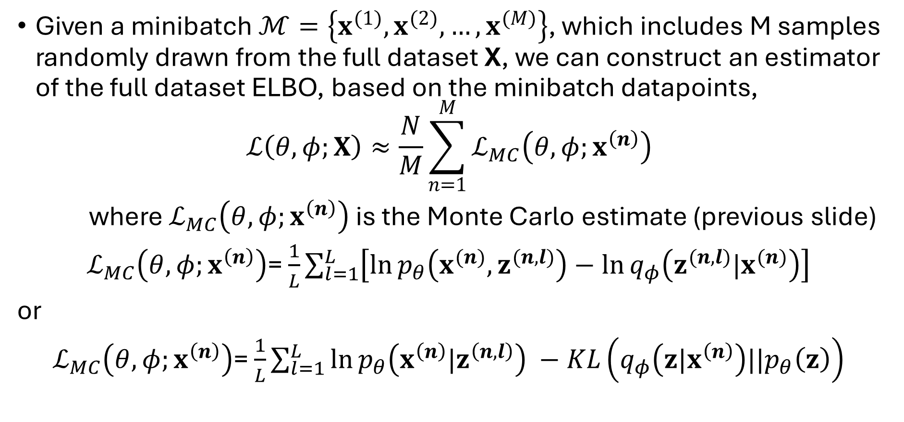
ELBO MC estimator for a dataset
Given a minibatch $ℳ=\left\{x^{(1)},x^{(2)},…,x^{(M)}\right\}$, which includes M samples randomly drawn from the full dataset X, we can construct an estimator of the full dataset ELBO, based on the minibatch datapoints,
$$ℒ\left(θ,φ;X\right)≈\frac{N}{M}\sum_{n=1}^{M}{ℒ_{MC}\left(θ,φ;x^{\left(n\right)}\right)}$$
where $ℒ_{MC}\left(θ,φ;x^{\left(n\right)}\right)$ is the Monte Carlo estimate (previous slide)
$ℒ_{MC}\left(θ,φ;x^{\left(n\right)}\right)$= $\frac{1}{L}\sum_{l=1}^{L}{\left[\ln{p_{θ}\left(x^{(n)},z^{(n,l)}\right)}−\ln{q_{φ}\left(z^{(n,l)}|x^{(n)}\right)}\right]}$
or
$ℒ_{MC}\left(θ,φ;x^{\left(n\right)}\right)$= $\frac{1}{L}\sum_{l=1}^{L}{\ln{p_{θ}\left(x^{\left(n\right)}|z^{\left(n,l\right)}\right)}} −KL\left(q_{φ}\left(z|x^{\left(n\right)}\right)||p_{θ}\left(z\right)\right)$

Slide 33
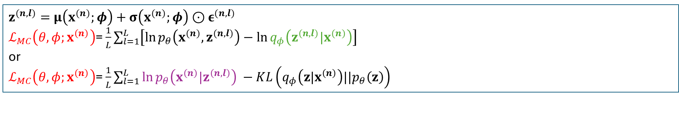
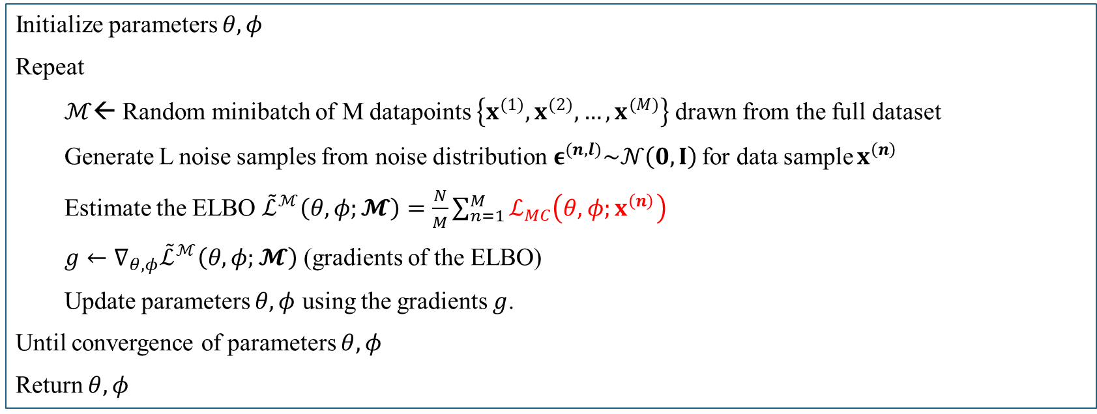
VAE algorithm
Initialize parameters $θ,φ$
Repeat
$ℳ$← Random minibatch of M datapoints $\left\{x^{(1)},x^{(2)},…,x^{(M)}\right\}$drawn from the full dataset
Generate L noise samples from noise distribution${ ε}^{(n,l)}\sim 𝒩\left(0,I\right)$ for data sample $x^{\left(n\right)}$
Estimate the ELBO ${\tilde{ℒ}}^{ℳ}\left(θ,φ;𝓜\right)=\frac{N}{M}\sum_{n=1}^{M}{ℒ_{MC}\left(θ,φ;x^{\left(n\right)}\right)}$
$g←∇_{θ,φ}{\tilde{ℒ}}^{ℳ}\left(θ,φ;𝓜\right)$ (gradients of the ELBO)
Update parameters $θ,φ$ using the gradients $g$.
Until convergence of parameters $θ,φ$
Return $θ,φ$
$z^{(n,l)}=$ $μ\left(x^{(n)};φ\right)+σ\left(x^{(n)};φ\right)⊙ε^{(n,l)}$
$ℒ_{MC}\left(θ,φ;x^{\left(n\right)}\right)$= $\frac{1}{L}\sum_{l=1}^{L}{\left[\ln{p_{θ}\left(x^{(n)},z^{(n,l)}\right)}−\ln{q_{φ}\left(z^{(n,l)}|x^{(n)}\right)}\right]}$
or
$ℒ_{MC}\left(θ,φ;x^{\left(n\right)}\right)$= $\frac{1}{L}\sum_{l=1}^{L}{\ln{p_{θ}\left(x^{\left(n\right)}|z^{\left(n,l\right)}\right)}} −KL\left(q_{φ}\left(z|x^{\left(n\right)}\right)||p_{θ}\left(z\right)\right)$
encoder
decoder

Slide 34
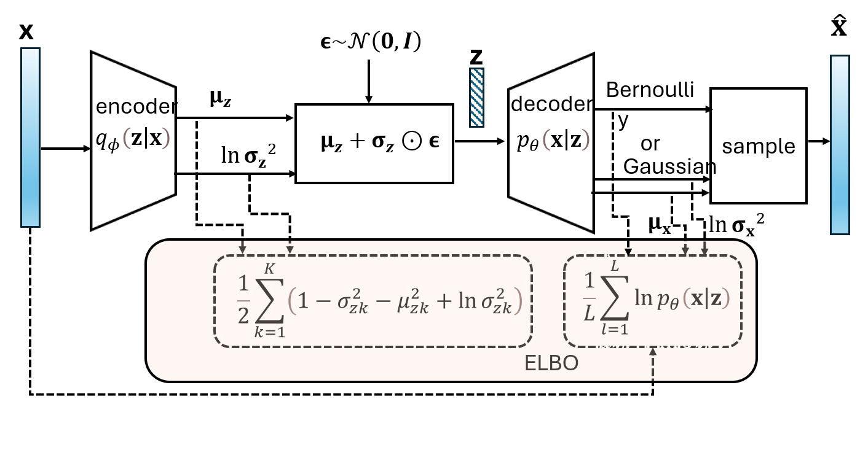
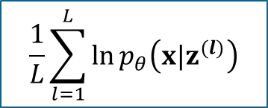
Architecture of VAE
$$\frac{1}{L}\sum_{l=1}^{L}{\ln{p_{θ}\left(x|z^{(l)}\right)}}$$

Slide 35
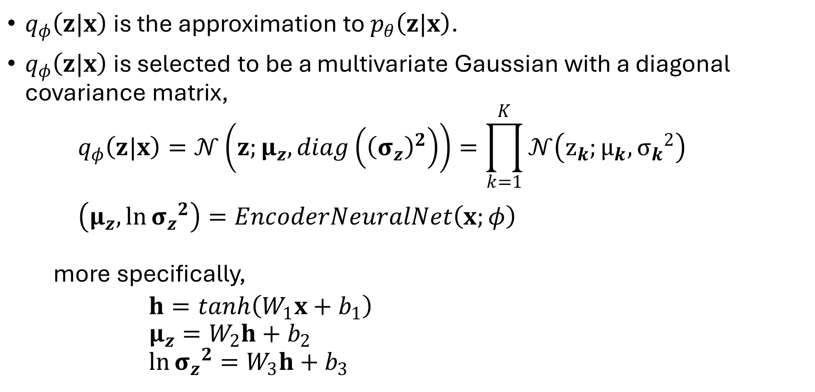
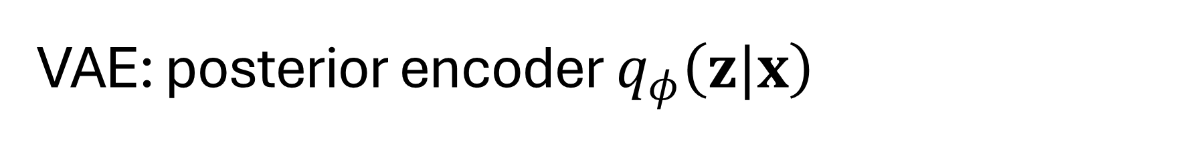
VAE: posterior encoder $q_{φ}\left(z|x\right)$
$q_{φ}\left(z|x\right)$ is the approximation to $p_{θ}\left(z|x\right)$.
$q_{φ}\left(z|x\right)$ is selected to be a multivariate Gaussian with a diagonal covariance matrix,
$$q_{φ}\left(z|x\right)=𝒩\left(z;μ_{z},diag\left({\left(σ_{z}\right)}^{2}\right)\right)=\prod_{k=1}^{K}{𝒩\left(z_{k};μ_{k},{σ_{k}}^{2}\right)}$$
$$\left(μ_{z},\ln{{σ_{z}}^{2}}\right)=EncoderNeuralNet\left(x;φ\right)$$
more specifically,
$$h=tanh\left(W_{1}x+b_{1}\right)$$
$$μ_{z}=W_{2}h+b_{2}$$
$$\ln{{σ_{z}}^{2}}=W_{3}h+b_{3}$$

Slide 36
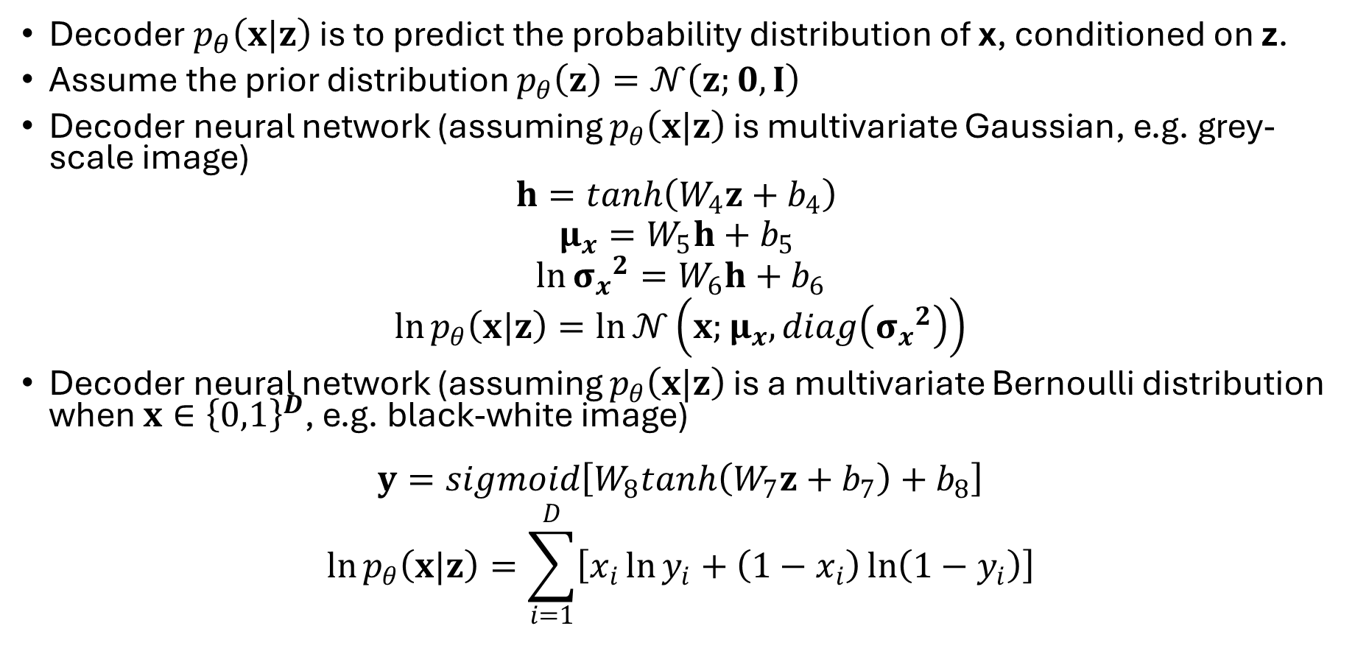

VAE: decoder $p_{θ}\left(x|z\right)$
Decoder $p_{θ}\left(x|z\right)$ is to predict the probability distribution of x, conditioned on z.
Assume the prior distribution $p_{θ}\left(z\right)=𝒩\left(z;0,I\right)$
Decoder neural network (assuming $p_{θ}\left(x|z\right)$ is multivariate Gaussian, e.g. grey-scale image)
$$h=tanh\left(W_{4}z+b_{4}\right)$$
$$μ_{x}=W_{5}h+b_{5}$$
$$\ln{{σ_{x}}^{2}}=W_{6}h+b_{6}$$
$$\ln{p_{θ}\left(x|z\right)}=\ln{𝒩\left(x;μ_{x},diag\left({σ_{x}}^{2}\right)\right)}$$
Decoder neural network (assuming $p_{θ}\left(x|z\right)$ is a multivariate Bernoulli distribution when $x∈{\left\{0,1\right\}}^{D}$, e.g. black-white image)
$$y=sigmoid\left[W_{8}tanh\left(W_{7}z+b_{7}\right)+b_{8}\right]$$
$$\ln{p_{θ}\left(x|z\right)}=\sum_{i=1}^{D}{\left[x_{i}\ln{y_{i}}+\left(1−x_{i}\right)\ln\left(1−y_{i}\right)\right]}$$
Negative cross-entropy loss

Slide 37
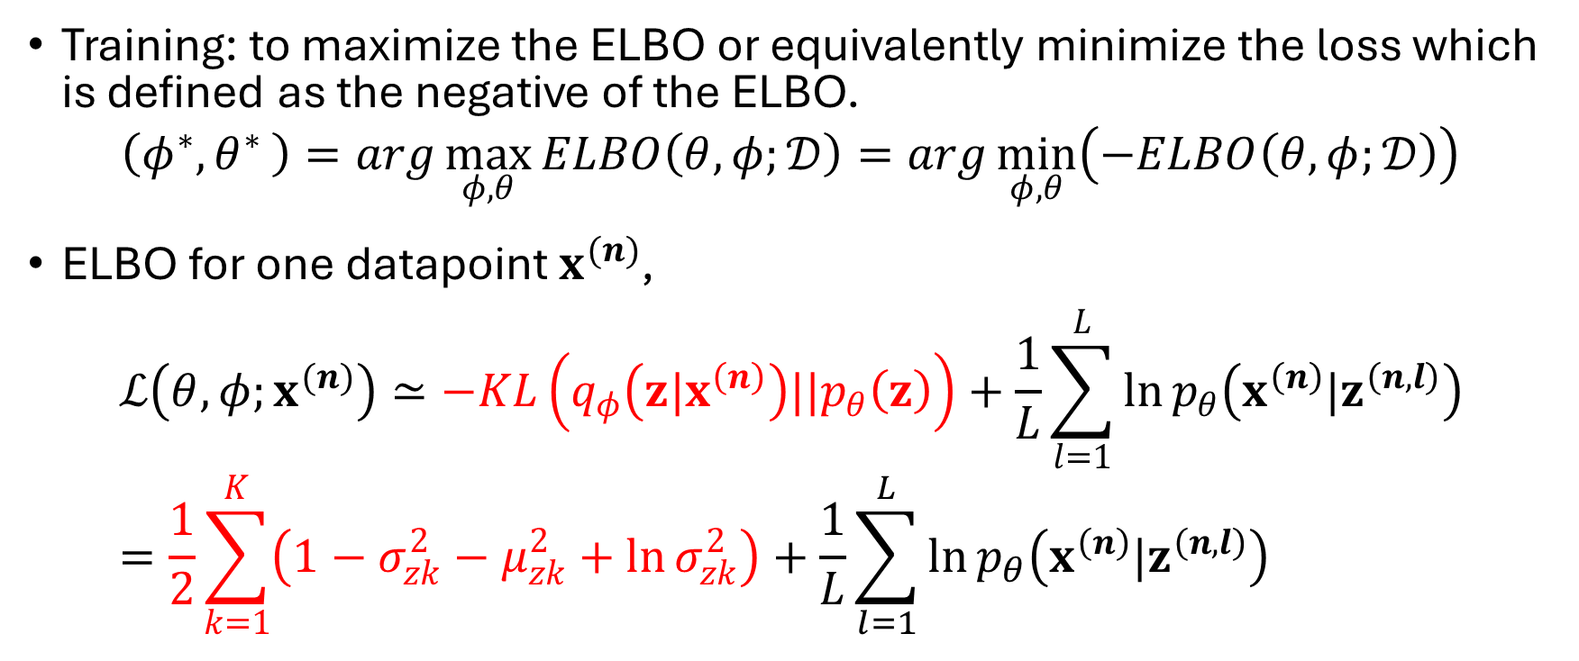
VAE training: loss function
Training: to maximize the ELBO or equivalently minimize the loss which is defined as the negative of the ELBO.
$$\left(φ^{∗}{,θ}^{∗}\right)=arg\max_{φ,θ}{ELBO\left(θ,φ;𝒟\right)}=arg\min_{φ,θ}\left(−ELBO\left(θ,φ;𝒟\right)\right)$$
ELBO for one datapoint $x^{(n)}$,
$$ℒ\left(θ,φ;x^{(n)}\right)≃−KL\left(q_{φ}\left(z|x^{\left(n\right)}\right)||p_{θ}\left(z\right)\right)+\frac{1}{L}\sum_{l=1}^{L}{\ln{p_{θ}\left(x^{\left(n\right)}|z^{\left(n,l\right)}\right)}}=\frac{1}{2}\sum_{k=1}^{K}{\left(1−σ_{zk}^{2}−μ_{zk}^{2}+\ln{σ_{zk}^{2}}\right)}+\frac{1}{L}\sum_{l=1}^{L}{\ln{p_{θ}\left(x^{\left(n\right)}|z^{\left(n,l\right)}\right)}}$$

Slide 38
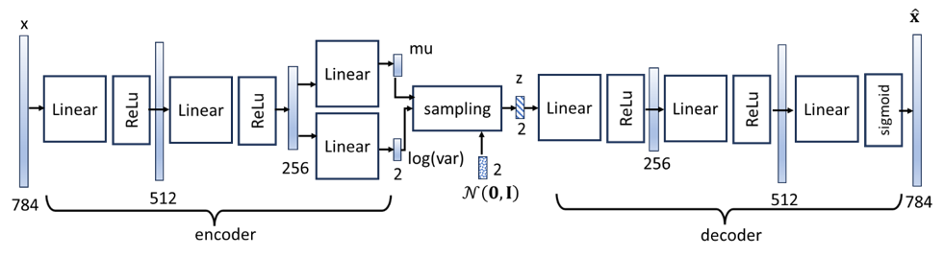
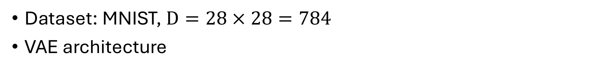
VAE implementation using PyTorch
Dataset: MNIST, $D=28×28=784$
VAE architecture

Slide 39
Prepare data
# Package imports
import numpy as np
import matplotlib.pyplot as plt
import torch
import torch.nn as nn
import torch.nn.functional as F
import torch.optim as optim
from torchvision import datasets, transforms
from torch.autograd import Variable
from torchvision.utils import save_image
# import packages
# normalized from [0,255] to [0, 1]
# prepare data
# MNIST Dataset
train_dataset = datasets.MNIST(root='../torch_tutorial/data', train=True, transform=transforms.ToTensor(), download=True)
test_dataset = datasets.MNIST(root='../torch_tutorial/data/', train=False, transform=transforms.ToTensor(), download=True)
bs=128
# Data Loader
train_loader = torch.utils.data.DataLoader(dataset=train_dataset, batch_size=bs, shuffle=True)
test_loader = torch.utils.data.DataLoader(dataset=test_dataset, batch_size=bs, shuffle=False)

Slide 40
Build VAE module
class VAE(nn.Module):
def __init__(self, x_dim, h_dim1, h_dim2, z_dim):
super(VAE, self).__init__()
# encoder
self.encoder = nn.Sequential(
nn.Linear(x_dim, h_dim1),
nn.LeakyReLU(0.2),
nn.Linear(h_dim1, h_dim2),
nn.LeakyReLU(0.2)
)
# latent mean and variance
self.mean_layer = nn.Linear(h_dim2, z_dim)
self.logvar_layer = nn.Linear(h_dim2, z_dim)
# decoder
self.decoder = nn.Sequential(
nn.Linear(z_dim, h_dim2),
nn.LeakyReLU(0.2),
nn.Linear(h_dim2, h_dim1),
nn.LeakyReLU(0.2),
nn.Linear(h_dim1, x_dim),
nn.Sigmoid()
)
def encode(self, x):
x = self.encoder(x)
mu, log_var = self.mean_layer(x), self.logvar_layer(x)
return mu, log_var
# sample z from q(z/x) by reparameterization trick
def reparameterization(self, mu, log_var):
std = torch.exp(0.5*log_var)
eps = torch.randn_like(std)
z = eps.mul(std).add_(mu)
return z
def decode(self, x):
return self.decoder(x)
def forward(self, x):
mu, log_var = self.encode(x.view(-1, 784))
z = self.reparameterization(mu, log_var)
y = self.decode(z)
return y, mu, log_var

Slide 41
Architecture size, optimizer, loss function
h_dim1 = 512
h_dim2 = 256
z_dim = 2
vae = VAE(x_dim=784, h_dim1=h_dim1, h_dim2=h_dim2, z_dim=z_dim)
if torch.cuda.is_available():
vae.cuda()
# instantiate VAE
optimizer = optim.Adam(vae.parameters(), lr=0.001)
# loss_function returns reconstruction error + KL divergence losses
def loss_function(recon_x, x, mu, log_var):
BCE = F.binary_cross_entropy(recon_x, x.view(-1, 784), reduction='sum')
KLD = 0.5 * torch.sum(1 + log_var - mu.pow(2) - log_var.exp())
return BCE - KLD
# optimizer, loss

Slide 42
Train and loss test
def train(epoch):
vae.train()
train_loss = 0
for batch_idx, (data, _) in enumerate(train_loader):
optimizer.zero_grad()
recon_batch, mu, log_var = vae(data)
loss = loss_function(recon_batch, data, mu, log_var)
loss.backward()
#train_loss += loss.item()
optimizer.step()
if batch_idx % 100 == 0:
print('Epoch {} , Batch {} \tLoss: {:.6f}'.format(
epoch, (batch_idx), loss.item() / len(data)))
for epoch in range(1, 10):
train(epoch)
test()
def test():
vae.eval()
test_loss= 0
with torch.no_grad():
for data, _ in test_loader:
#data = data.cuda()
recon, mu, log_var = vae(data)
# sum up batch loss
test_loss += loss_function(recon, data, mu, log_var).item()
test_loss /= len(test_loader.dataset)
print('=> Test set average loss per batch: {:.4f}'.format(test_loss))

Slide 43


Generate random samples
with torch.no_grad():
z = torch.randn(64, z_dim)
sample = vae.decode(z)
# generate 64 samples
save_image(1-sample.view(64, 1, 28, 28), './samples/sample_weidong_z2' +
'.png')
samples in the Z space
(Python code in Textbook)
sample_weidong_z2.png

Slide 44

Latent variable z
samples in the Z space
(Python code in Textbook)
Test dataset distribution in z-space
Open question: what happens if we change the dimension of z?

Slide 45



Conditional VAE
Python code
(see textbook)
$$ELBO\left(θ,φ;x\right)=𝔼_{q_{φ}\left(z|x\right)}\left[\ln{p_{θ}\left(x|z\right)} \right]−KL\left(q_{φ}\left(z|x\right)||p_{θ}\left(z\right)\right)$$
$ELBO\left(θ,φ;x,c\right)=\ln{p_{θ}\left(x|c\right)}−KL\left(q_{φ}\left(z|x,c\right)||p_{θ}\left(z|c\right)\right)$
$$=𝔼_{q_{φ}\left(z|x,c\right)}\left[\ln{p_{θ}\left(x|z,c\right)} \right]−KL\left(q_{φ}\left(z|x,c\right)||p_{θ}\left(z|c\right)\right)$$
assumed to be a standard Gaussian distribution
c: a 10-element one-hot code for each label

Slide 46

Summary
First, we briefly introduced the basics of generative models, including graphical models, latent variables, Bayes’ inference, evidence lower bound, etc., which form a foundation for advanced generative models such as variational auto-encoders (VAEs) and diffusion models.
The Gaussian mixture model is a good introductory example of generative models for us to present these basics.
Given a Gaussian mixture model, the EM algorithm was derived to learn the probability distribution of a dataset.
The goal of the EM algorithm is to maximize the evidence lower bound (ELBO) iteratively by selecting a currently optimal (or a better) inference distribution $q\left(z\right)$ and searching currently optimal (or better) parameter values $θ$.
To deal with the intractability of $q\left(z\right)$ , we use neural networks to approximate the inference $q\left(z\right)$. This leads to the framework of variational auto-encoder.
Finally, the detailed implementation of VAE on MNIST dataset is described.

