Slide 1
Chapter 1 Introduction to Deep Learning

Slide 2
Outline
Definition of AI, machine learning and deep learning.
Three types of machine learning: supervised, unsupervised, and reinforcement.
Data samples and data sets.
Historical evolution of deep learning.
Resources and tools for learning deep learning.

Slide 3
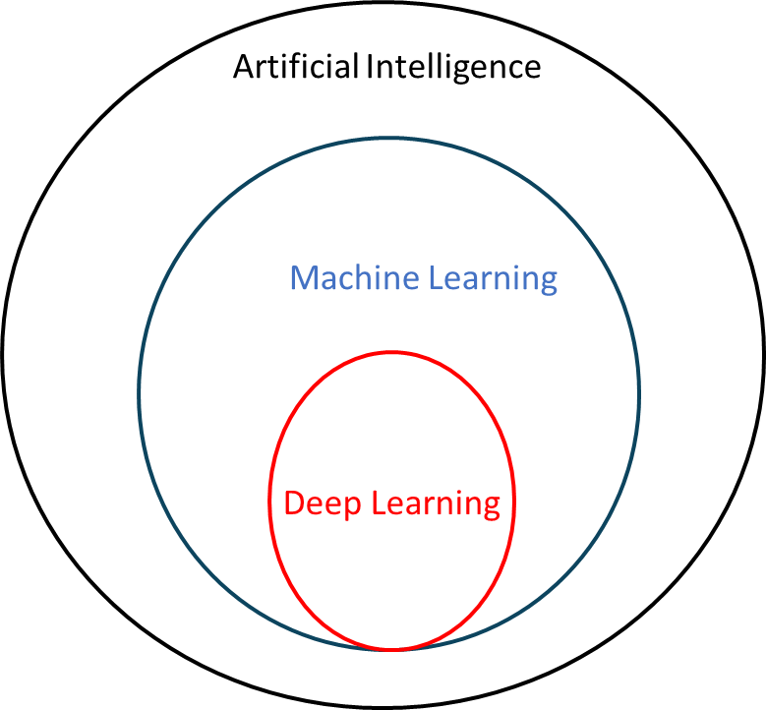
Defining the Hierarchy
Artificial Intelligence (AI): Technologies mimicking the intelligence or behavioral patterns of humans or living entities.
Machine Learning (ML): Programs that learn from data without explicit rules.
Deep Learning (DL): A subset of ML inspired by the neural networks in the human brain

Slide 4
What is Machine Learning?
Tom Mitchell’s Definition: A program learns from experience (E) with respect to a task (T) and performance (P) if its performance on T, measured by P, improves with E.
Example: Email Spam Filter
--Task (T): Classify emails as "spam" or "not spam."
--Experience (E): Learning from previously identified samples.
--Performance (P): The percentage of emails correctly predicted.

Slide 5
Key Characteristics of ML Systems
Learning from Data: Viewing existing data as past experiences
Adapting: The machine modifies itself based on its outputs to improve future results.
Generalizing: Applying learned knowledge to understand new, unseen data situations.

Slide 6
Types of Machine Learning
Supervised Learning: Training a model using a labeled dataset
Unsupervised Learning: Learning structural patterns or clustering from unlabeled data
Reinforcement Learning (RL): An agent learns to interact with an environment to maximize cumulative rewards through trial-and-error

Slide 7
Supervised Learning
Learning Process: A model is trained using a labeled dataset containing features (properties) and labels (desired outputs)
Training: Searching for optimal parameter values so model outputs are "close" to the ground truth labels
Inference: The process where a trained model produces sensible outputs for new, unseen data samples
update
prediction
training
Model
Loss
Training set
Labels
from training set
done
inference
New data
prediction
Trained model

Slide 8




















Regression vs. Classification
Regression: The labels are continuously valued. The model maps inputs to a continuous function (e.g., predicting house prices based on area).
Classification: The labels are discrete. The model predicts which category a sample belongs to (e.g., identifying if a tumor is malignant or benign)
age
Price (k$)
$$⨁$$
$$⨁$$
$$⨁$$
$$⨁$$
$$⨀$$
$$⨁$$
$$⨀$$
$$⨁$$
$$⨀$$
$$⨁$$
$$⨁$$
Price for A
$$⨀$$
$$⨁$$
$$⨀$$
$$⨁$$
$$⨁$$
$$⨀$$
$$⨁$$
$$⨀$$
$$⨀$$
A
area (sqft)
Tumor size

Slide 9
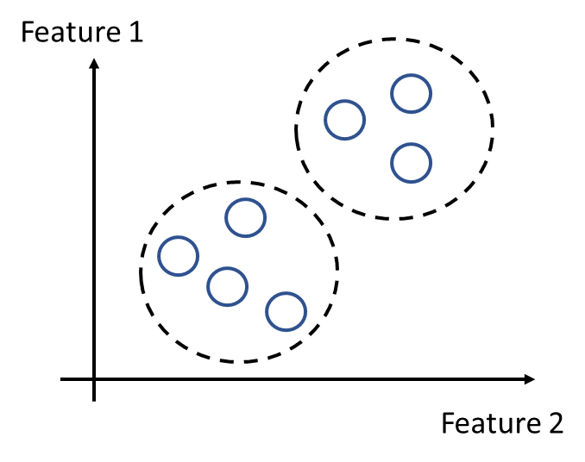
Unsupervised Learning
Definition: Algorithms that learn the structural patterns of data without using labels.
Example: (Clustering) Grouping samples based on similarities or proximity (e.g., grouping 1,000,000 genes).
Applications:
  Market segmentation.
  Social network analysis.
  Dimensionality reduction to remove redundancy
  among features

Slide 10
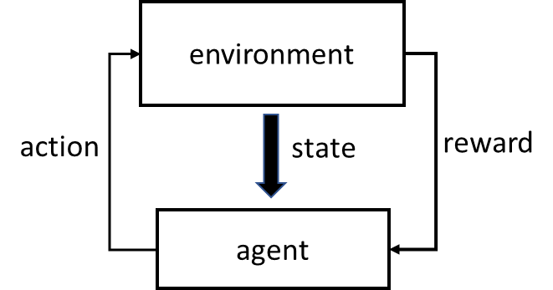
Reinforcement Learning (RL)
The Agent-Environment Interaction: An agent interacts with an environment by taking actions.
Reward System: The environment provides a reward or penalty based on the action, and the state changes.
Objective: Find the best policy (strategy) to maximize cumulative rewards over time through trial-and-error.

Slide 11
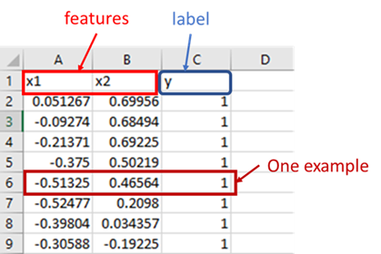
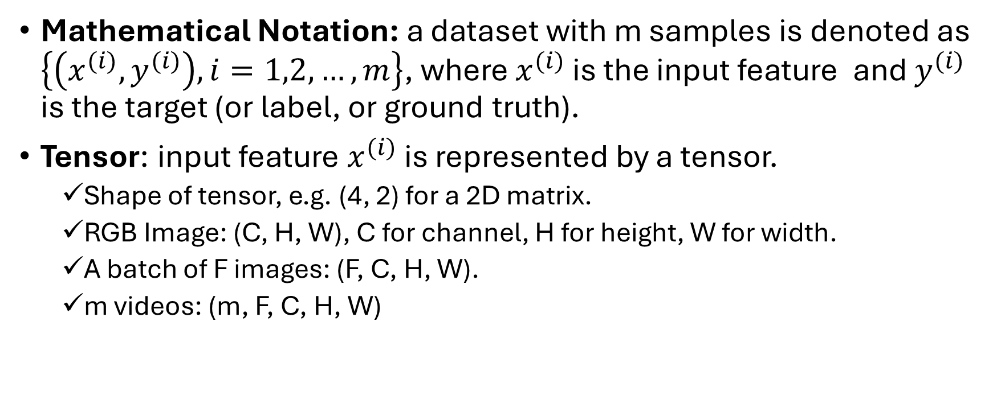
Data Representation
Mathematical Notation: a dataset with m samples is denoted as $\left\{\left(x^{(i)}, y^{(i)}\right), i=1,2,…,m\right\}$, where $x^{(i)}$ is the input feature and $y^{(i)}$ is the target (or label, or ground truth).
Tensor: input feature $x^{(i)}$ is represented by a tensor.
  Shape of tensor, e.g. (4, 2) for a 2D matrix.
  RGB Image: (C, H, W), C for channel, H for height, W for width.
  A batch of F images: (F, C, H, W).
  m videos: (m, F, C, H, W)

Slide 12
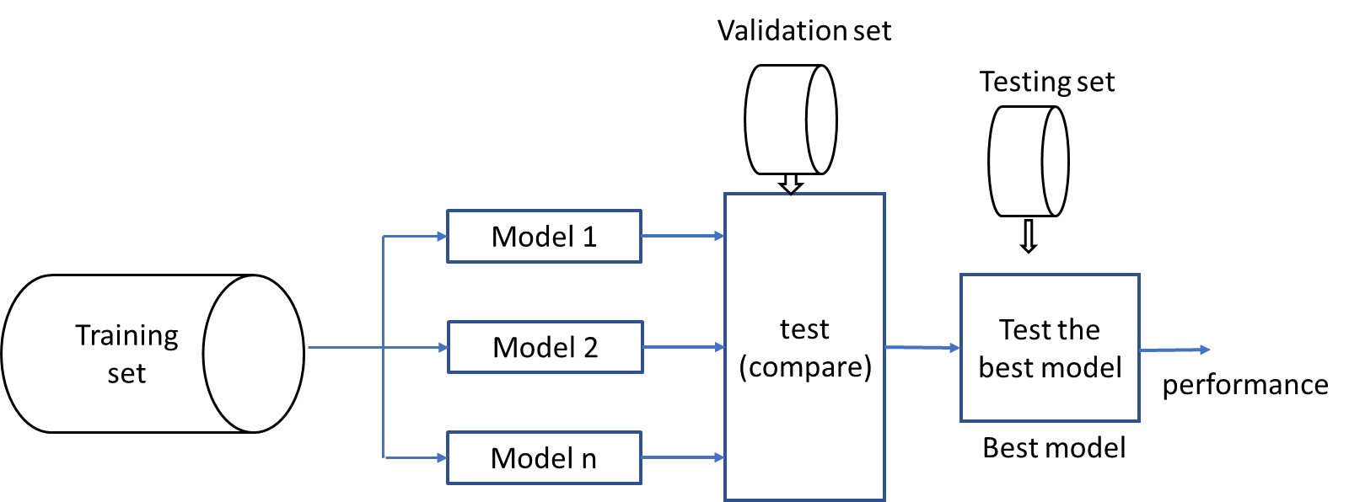
Dataset Partitioning
Training Set: Used to train models
Validation Set: Used to test and select the "best" model among various candidates.
Testing Set: Used to estimate final performance of the selected model.
Typical Ratios: 60% Training, 20% Validation, and 20% Testing
For large datasets (e.g., >1,000,000 samples), the split may be 98% Training, 1% Validation, and 1% Testing
Randomness: Datasets must be shuffled to ensure statistical consistency
Stratified Sampling: Maintaining the same categorical ratios in each split, which is critical for imbalanced classes (e.g., rare diseases)

Slide 13
Historical Evolution
The Perceptron (1950s)
  It consists of a single layer of artificial neurons used for binary classification, where a neuron fires only if the sum of its weighted inputs exceeds a specific threshold.
Multilayer Networks & Backpropagation (1980s-1990s)
  Backpropagation: use the calculus chain rule to calculate gradients and update weights
  Train multilayer neural networks by backpropagation.
Modern Resurgence (2010s-Present)
  Massive training datasets: images, videos, social media
  Computation power: graphic processing units(GPUs)
  Development of advanced algorithms and architectures: CNNs, YOLO, transformer, diffusion model, etc.

Slide 14
Deep Learning Ecosystem
Python
Developing deep learning models typically involves using specialized frameworks that provide the necessary libraries and interfaces to build architectures without starting from scratch.
Popular Frameworks: TensorFlow (flexible and extensible) and PyTorch (known for simplicity and dynamic computational graphs) are the most widely used.
Cloud Computing: Google Colab is a free online service that allows you to execute Python code in a browser and provides access to powerful GPU resources, which are essential for training large models

Slide 15
Resources
Online Courses: Coursera, edX, and Udemy
Foundational textbooks:
  -- Deep Learning by Goodfellow et al. (2016)
  -- Dive into Deep Learning by Zhang et al. (2022)
  -- Deep Learning: Foundations and Concepts by Bishop and Bishop (2024)
  -- Reinforcement Learning: An Introduction by Sutton and Barto (2018)
  Datasets
    -- UC Irvine Machine Learning Repository
    -- Kaggle
  Github: sharing Python code for machine learning projects.
  Research papers: NeurIPS, ICML, ICLR, arXiv, etc.

