Slide 1
Brief Announcement:
Reachability in Deletion-only Chemical Reaction Networks
The 4th Symposium on Algorithmic Foundations of Dynamic Networks (SAND)
June 9-11, 2025 | Liverpool, UK
Bin Fu, Timothy Gomez , Ryan Knobel, Austin Luchsinger, Aiden Massie,
Marco Rodriguez, Adrian Salinas, Robert Schweller, Tim Wylie
a
e
a
d
c
a
a
d
d
c
d
c
b
b
b

Slide 2

Reactants
Products
Reaction
Chemical Reaction Networks

Slide 3
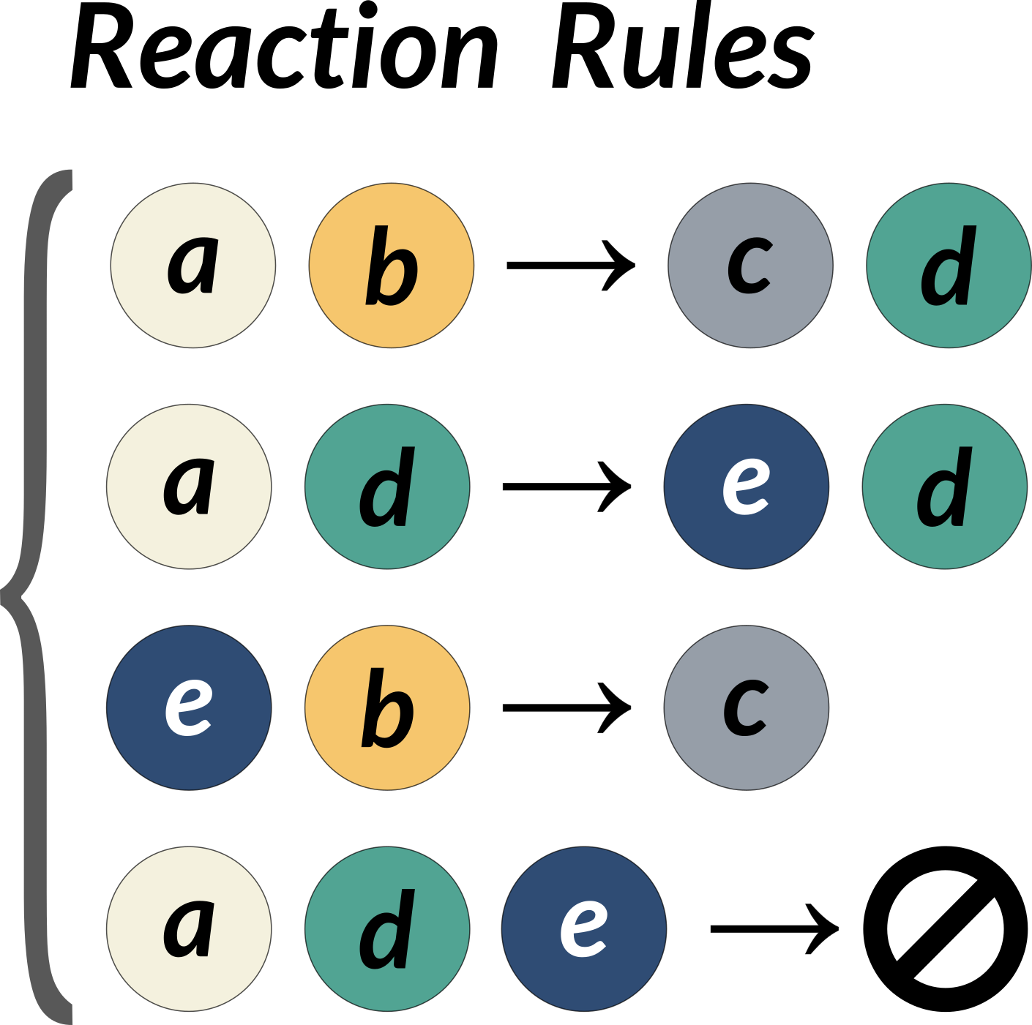
d
a
e
a
d
c
a
c
d
c
b
b
CRNs

Slide 4
d
a
e
a
d
c
a
c
d
c
b
b
CRNs

Slide 5
d
a
e
c
d
c
a
c
d
c
d
b
CRNs

Slide 6
d
a
e
c
d
c
a
c
d
c
d
b
CRNs

Slide 7
d
a
e
c
d
c
c
c
d
c
d
d
CRNs

Slide 8
d
a
e
c
d
c
c
c
d
c
d
d
CRNs

Slide 9
d
c
c
c
c
d
c
d
d
CRNs

Slide 10
CRN:
Configuration I:
Configuration D:
e
d
d
a
a
c
d
c
c
c
a
c
d
c
d
c
c
d
b
d
b
D is Reachable from I
CRNs

Slide 11
CRN:
Configuration I:
Configuration D:
e
d
d
a
c
a
d
c
a
c
c
c
c
d
d
c
c
d
b
d
b
D is Reachable from I
Reachability Problem:
Input:
1) Reaction Rules (a CRN)
2) An initial configuration I
3) a destination configuration D
Output: Is D reachable from I with these reactions?
CRNs

Slide 12
CRN:
Configuration I:
Configuration D:
e
d
d
a
c
a
d
c
a
c
c
c
c
d
d
c
c
d
b
d
b
D is Reachable from I
Reachability Problem:
Input:
1) Reaction Rules (a CRN)
2) An initial configuration I
3) a destination configuration D
Output: Is D reachable from I with these reactions?
Reachability is Ackerman-Complete
[Wojciech Czerwiński and Łukasz Orlikowski, FOCS’21]
[Jérôme Leroux, FOCS’21]
CRNs

Slide 13
CRN:
Configuration I:
Configuration D:
e
d
d
a
c
a
d
c
a
c
c
c
c
d
d
c
c
d
b
d
b
D is Reachable from I
General CRNs reactions can ADD and DELETE
  => Reachability is Ackermann-complete [FOCS 2021]

Slide 14
CRN:
Configuration I:
Configuration D:
e
d
d
a
c
a
d
c
a
c
c
c
c
d
d
c
c
d
b
d
b
D is Reachable from I
General CRNs reactions can ADD and DELETE
  => Reachability is Ackermann-complete [FOCS 2021]
What if a system could only ADD OR DELETE (but not both)?
    Reachability is in NP

Slide 15
CRN:
Configuration I:
Configuration D:
e
d
d
a
c
a
d
c
a
c
c
c
c
d
d
c
c
d
b
d
b
D is Reachable from I
General CRNs reactions can ADD and DELETE
  => Reachability is Ackermann-complete [FOCS 2021]
What if a system could only ADD OR DELETE (but not both)?
    Reachability is in NP
    Our Focus:
    We characterize Reachability in Deletion-Only systems
    Based on rule size.

Slide 16
Deletion-Only Reactions (Void Rules)
Rule Size:
(2,0)
a
b
Ø
(3,0)
a
b
c
Ø

Slide 17
Deletion-Only Reactions (Void Rules)
Rule Size:
(2,0)
a
b
Ø
(3,0)
a
b
c
Ø
(2,1)
a
b
b
(3,1)
a
b
c
c
Catalytic Reactions
(3,2)
a
b
c
b
c

Slide 18
Deletion-Only CRNs
(2,0) rules
(3,0) rules
Versus:
a
+
b
Ø
a
+
b
+
c
Ø
?
?
1
2
3
4
5
6
Number of Reactants

Slide 19
(2,0) Algorithm
Target
Configuration:
Reactions:
=> Ø
=> Ø
=> Ø
Initial Configuration:
e
b
e
a
b
a
e
b
c
a
a
b
c
d
e
d
a
d
b
b
b
d

Slide 20
(2,0) Algorithm
Target
Configuration:
Difference
Configuration:
Reactions:
=> Ø
=> Ø
=> Ø
Initial Configuration:
e
b
e
b
a
b
a
e
-
=
a
e
b
c
a
a
b
c
d
b
c
e
d
a
d
b
b
a
d
b
d
b
Algorithm:
Compute the “Difference” configuration

Slide 21
(2,0) Algorithm
Target
Configuration:
Difference
Configuration:
Reactions:
=> Ø
=> Ø
=> Ø
Initial Configuration:
e
b
e
b
a
b
a
e
-
=
a
e
b
c
a
a
b
c
d
b
c
e
d
a
d
b
b
a
d
b
d
b
Algorithm:
Compute the “Difference” configuration
Create the Reaction Graph
Reaction Graph:
b
a
e
b
c
a
d
b

Slide 22
(2,0) Algorithm
Target
Configuration:
Difference
Configuration:
Reactions:
=> Ø
=> Ø
=> Ø
Initial Configuration:
e
b
e
b
a
b
a
e
-
=
a
e
b
c
a
a
b
c
d
b
c
e
d
a
d
b
b
a
d
b
d
b
Algorithm:
Compute the “Difference” configuration
Create the Reaction Graph
Run a Perfect Matching Algorithm
Reaction Graph:
b
a
e
b
c
a
d
b

Slide 23
(2,0) Algorithm
Target
Configuration:
Difference
Configuration:
Reactions:
=> Ø
=> Ø
=> Ø
Initial Configuration:
e
b
e
b
a
b
a
e
-
=
a
e
b
c
a
a
b
c
d
b
c
e
d
a
d
b
b
a
d
b
d
b
Algorithm:
Compute the “Difference” configuration
Create the Reaction Graph
Run a Perfect Matching Algorithm
Reaction Graph:
1
e
2
3
1
a
b
c
1
d

Slide 24
(2,0) Algorithm
Target
Configuration:
Difference
Configuration:
Reactions:
=> Ø
=> Ø
=> Ø
Initial Configuration:
e
b
e
b
a
b
a
e
-
=
a
e
b
c
a
a
b
c
d
b
c
e
d
a
d
b
b
a
d
b
d
b
Algorithm:
Compute the “Difference” configuration
Create the Reaction Graph
Run a Perfect Matching Algorithm
Reaction Graph:
8245
e
5132
913
214
a
b
c
d
413

Slide 25
(2,0) Algorithm
Target
Configuration:
Difference
Configuration:
Reactions:
=> Ø
=> Ø
=> Ø
Initial Configuration:
e
b
e
b
a
b
a
e
-
=
a
e
b
c
a
a
b
c
d
b
c
e
d
a
d
b
b
a
d
b
d
b
Algorithm:
Compute the “Difference” configuration
Create the Reaction Graph
Run a Perfect Matching Algorithm b-Matching Algorithm [Cunningham, Marsh, 1979]
Reaction Graph:
8245
e
5132
913
214
a
b
c
d
413

Slide 26
Deletion-Only CRNs
(2,0) rules
(3,0) rules
Versus:
a
+
b
Ø
a
+
b
+
c
Ø
P
B-Matching
?
1
2
3
4
5
6
Number of Reactants

Slide 27
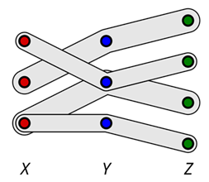
(3,0) Reachability: NP completeness
Reduction from 3D Matching
3D Matching Problem:
Does there exist a subset of non-overlapping triplets that cover the tripartite graph?
(3,0) Reachability Instance:
Initial Configuration:
Target Configuration:
(empty)
Reactions:
x1
y1
z1
x1 + y2 + z2 -> Ø
x2
y2
z2
x2 + y1 + z1 -> Ø
x3
y3
z3
x3 + y2 + z3 -> Ø
z4
x3 + y3 + z4 -> Ø

Slide 28
Deletion-Only CRNs
(2,0) rules
(3,0) rules
Versus:
a
+
b
Ø
a
+
b
+
c
Ø
P
B-Matching
NPC
3D-Match
1
2
3
4
5
6
Number of Reactants

Slide 29
Deletion-Only CRNs
(2,1) rules
(3,1) rules
(3,2) rules
(etc.)
a
+
b
a
a
+
b
+
c
a
a
+
b
+
c
b
+
c
P
B-Matching
NPC
3D-Match
1
2
3
4
5
6
Number of Reactants

Slide 30
Deletion-Only CRNs
(2,1) rules
(3,1) rules
(3,2) rules
(etc.)
a
+
b
a
a
+
b
+
c
a
a
+
b
+
c
b
+
c
3
Non-Void
Rules
2
Number of Products
1
P
B-Matching
NPC
3D-Match
1
2
3
4
5
6
Number of Reactants

Slide 31
Deletion-Only CRNs
(3,1) rules
a
+
b
+
c
a
3
Non-Void
Rules
2
Number of Products
(3,1)
1
?
P
B-Matching
NPC
3D-Match
1
2
3
4
5
6
Number of Reactants

Slide 32
Deletion-Only CRNs: (3,1) NP-complete
Hamiltonian Path
from s to t?
a
b
s
t
c
d

Slide 33
Deletion-Only CRNs: (3,1) NP-complete
Initial Configuration:
For each vertex:
c
Hamiltonian Path
from s to t?
c
c
c
c
a
b
c
s
t
Target Configuration:
c
d
Eliminate all of these species
except for a single “t”

Slide 34
Deletion-Only CRNs: (3,1) NP-complete
Initial Configuration:
Reactions:
For each vertex:
c
1) Non-deterministically guess
A traversal for each vertex:
A+B+C -> A
A+B+C -> B
A+B+C -> C
Hamiltonian Path
from s to t?
c
c
c
c
a
b
c
2) Check if the guessed traversal constitutes a Hamiltonian Path:
s
t
Target Configuration:
c
d
Eliminate all of these species
except for a single “t”
b
c
+
c
c
+

Slide 35
Deletion-Only CRNs: (3,1) NP-complete
Initial Configuration:
Reactions:
For each vertex:
c
1) Non-deterministically guess
A traversal for each vertex:
A+B+C -> A
A+B+C -> B
A+B+C -> C
Hamiltonian Path
from s to t?
c
c
c
c
a
b
c
2) Check if the guessed traversal constitutes a Hamiltonian Path:
s
t
Target Configuration:
c
d
Eliminate all of these species
except for a single “t”
b
c
+
c
c
+
a
b
s
t
c
d

Slide 36
Deletion-Only CRNs: (3,1) NP-complete
Initial Configuration:
Reactions:
For each vertex:
c
1) Non-deterministically guess
A traversal for each vertex:
A+B+C -> A
A+B+C -> B
A+B+C -> C
Hamiltonian Path
from s to t?
c
c
c
c
a
b
c
2) Check if the guessed traversal constitutes a Hamiltonian Path:
s
t
Target Configuration:
c
d
Eliminate all of these species
except for a single “t”
b
c
+
c
c
+
a
b
s
t
c
d

Slide 37
Deletion-Only CRNs: (3,1) NP-complete
Initial Configuration:
Reactions:
For each vertex:
c
1) Non-deterministically guess
A traversal for each vertex:
A+B+C -> A
A+B+C -> B
A+B+C -> C
Hamiltonian Path
from s to t?
c
c
c
c
a
b
c
2) Check if the guessed traversal constitutes a Hamiltonian Path:
s
t
Target Configuration:
c
d
Eliminate all of these species
except for a single “t”
b
c
+
c
c
+
a
b
t
c
d

Slide 38
Deletion-Only CRNs: (3,1) NP-complete
Initial Configuration:
Reactions:
For each vertex:
c
1) Non-deterministically guess
A traversal for each vertex:
A+B+C -> A
A+B+C -> B
A+B+C -> C
Hamiltonian Path
from s to t?
c
c
c
c
a
b
c
2) Check if the guessed traversal constitutes a Hamiltonian Path:
s
t
Target Configuration:
c
d
Eliminate all of these species
except for a single “t”
b
c
+
c
c
+
a
b
t
c
d

Slide 39
Deletion-Only CRNs: (3,1) NP-complete
Initial Configuration:
Reactions:
For each vertex:
c
1) Non-deterministically guess
A traversal for each vertex:
A+B+C -> A
A+B+C -> B
A+B+C -> C
Hamiltonian Path
from s to t?
c
c
c
c
a
b
c
2) Check if the guessed traversal constitutes a Hamiltonian Path:
s
t
Target Configuration:
c
d
Eliminate all of these species
except for a single “t”
b
c
+
c
c
+
b
t
c
d

Slide 40
Deletion-Only CRNs: (3,1) NP-complete
Initial Configuration:
Reactions:
For each vertex:
c
1) Non-deterministically guess
A traversal for each vertex:
A+B+C -> A
A+B+C -> B
A+B+C -> C
Hamiltonian Path
from s to t?
c
c
c
c
a
b
c
2) Check if the guessed traversal constitutes a Hamiltonian Path:
s
t
Target Configuration:
c
d
Eliminate all of these species
except for a single “t”
b
c
+
c
c
+
b
t
c
d

Slide 41
Deletion-Only CRNs: (3,1) NP-complete
Initial Configuration:
Reactions:
For each vertex:
c
1) Non-deterministically guess
A traversal for each vertex:
A+B+C -> A
A+B+C -> B
A+B+C -> C
Hamiltonian Path
from s to t?
c
c
c
c
a
b
c
2) Check if the guessed traversal constitutes a Hamiltonian Path:
s
t
Target Configuration:
c
d
Eliminate all of these species
except for a single “t”
b
c
+
c
c
+
t
c
d

Slide 42
Deletion-Only CRNs: (3,1) NP-complete
Initial Configuration:
Reactions:
For each vertex:
c
1) Non-deterministically guess
A traversal for each vertex:
A+B+C -> A
A+B+C -> B
A+B+C -> C
Hamiltonian Path
from s to t?
c
c
c
c
a
b
c
2) Check if the guessed traversal constitutes a Hamiltonian Path:
s
t
Target Configuration:
c
d
Eliminate all of these species
except for a single “t”
b
c
+
c
c
+
t
c
d

Slide 43
Deletion-Only CRNs: (3,1) NP-complete
Initial Configuration:
Reactions:
For each vertex:
c
1) Non-deterministically guess
A traversal for each vertex:
A+B+C -> A
A+B+C -> B
A+B+C -> C
Hamiltonian Path
from s to t?
c
c
c
c
a
b
c
2) Check if the guessed traversal constitutes a Hamiltonian Path:
s
t
Target Configuration:
c
d
Eliminate all of these species
except for a single “t”
b
c
+
c
c
+
t
d

Slide 44
Deletion-Only CRNs: (3,1) NP-complete
Initial Configuration:
Reactions:
For each vertex:
c
1) Non-deterministically guess
A traversal for each vertex:
A+B+C -> A
A+B+C -> B
A+B+C -> C
Hamiltonian Path
from s to t?
c
c
c
c
a
b
c
2) Check if the guessed traversal constitutes a Hamiltonian Path:
s
t
Target Configuration:
c
d
Eliminate all of these species
except for a single “t”
b
c
+
c
c
+
t
d

Slide 45

Deletion-Only CRNs: (3,1) NP-complete
Initial Configuration:
Reactions:
For each vertex:
c
1) Non-deterministically guess
A traversal for each vertex:
A+B+C -> A
A+B+C -> B
A+B+C -> C
Hamiltonian Path
from s to t?
c
c
c
c
a
b
c
2) Check if the guessed traversal constitutes a Hamiltonian Path:
s
t
Target Configuration:
c
d
Eliminate all of these species
except for a single “t”
b
c
+
c
c
+
t

Slide 46

Deletion-Only CRNs: (3,1) NP-complete
Initial Configuration:
Reactions:
For each vertex:
c
1) Non-deterministically guess
A traversal for each vertex:
A+B+C -> A
A+B+C -> B
A+B+C -> C
Hamiltonian Path
from s to t?
c
c
c
c
a
b
c
2) Check if the guessed traversal constitutes a Hamiltonian Path:
s
t
Target Configuration:
c
d
Eliminate all of these species
except for a single “t”
b
c
+
c
c
+
No “double visits”
No branching
a
b
a
b
a
b
s
t
s
t
s
t
c
d
c
d
c
d
Only one
Fails to delete d
c

Slide 47
Deletion-Only CRNs
(3,1) rules
a
+
b
+
c
a
3
Non-Void
Rules
2
Number of Products
(3,1)
1
NPC
Ham-Path
P
B-Matching
NPC
3D-Match
1
2
3
4
5
6
Number of Reactants

Slide 48
Deletion-Only CRNs
3
Non-Void
Rules
2
(k,k-2)
Number of Products
1
(3,1)
NPC
Ham-Path
P
B-Matching
NPC
3D-Match
1
2
3
4
5
6
Number of Reactants

Slide 49
Deletion-Only CRNs
NPC
Ham-Path
3
Non-Void
Rules
2
(k,k-2)
Number of Products
1
P
B-Matching
NPC
3D-Match
1
2
3
4
5
6
Number of Reactants

Slide 50
Deletion-Only CRNs
NPC
Ham-Path
3
Non-Void
Rules
2
(k,k-1)?
(k,k-2)
Number of Products
1
P
B-Matching
NPC
3D-Match
1
2
3
4
5
6
Number of Reactants

Slide 51



Reaction Graph
For rule $A+B→A$ add edge between $A$ and $B$. Mark species with a target value $>0$
$$A$$
$$B$$

Slide 52

(2,1) Rules
A species is a root if one of the following is true
  The species starts with the correct number of copies
$$A$$

Slide 53


(2,1) Rules
A species is a root if one of the following is true
  The species starts with the correct number of copies
  The species can be deleted by some marked species.
  The species has a self loop.
$$B$$
$$A$$

Slide 54

(2,1) Rules
A species is a root if one of the following is true
  The species starts with the correct number of copies
  The species can be deleted by some marked species.
  The species has a self loop.
$$A$$

Slide 55
(2,1) Rules
Checking if a species is a root can be done in log space
For each species we must find another one that
  Is reachable in the Reaction Graph
  Is a root species
  This takes 2 pointers
Reachability in a directed graph can be solved in non-deterministic log space.

Slide 56
Deletion-Only CRNs
P
Dynamic Programming
NPC
Ham-Path
3
Non-Void
Rules
2
(k,k-1)
(k,k-2)
Number of Products
(2,1)
1
NL
P
B-Matching
NPC
3D-Match
1
2
3
4
5
6
Number of Reactants

Slide 57
2-Step CRNs
2-Step CRN systems include a multiset of “step-2” species to be added after the system is terminal:
2-step CRN:
Step-2 species:
a
e
a

Slide 58
2-Step CRNs
2-Step CRN systems include a multiset of “step-2” species to be added after the system is terminal:
2-step CRN:
Step-2 species:
a
e
a
Configuration I:
Terminal
Configuration:
e
a
c
c
d
e
b
d
d
a
b

Slide 59

2-Step CRNs
2-Step CRN systems include a multiset of “step-2” species to be added after the system is terminal:
2-step CRN:
Step-2 species:
a
e
a
Add Step-2 species:
Configuration I:
Terminal
Configuration:
a
e
c
e
a
a
c
d
e
b
d
d
a
b

Slide 60
2-Step CRNs
2-Step CRN systems include a multiset of “step-2” species to be added after the system is terminal:
2-step CRN:
Step-2 species:
a
e
a
Add Step-2 species:
Configuration I:
Terminal
Configuration:
a
e
c
e
a
a
c
d
c
c
e
b
d
d
a
b

Slide 61
2-Step Deletion-Only CRNs
NPC
3-SAT
NPC
Ham-Path
3
Non-Void
Rules
2
Number of Products
NPC
3-SAT
1
NPC
3-Color
NPC
3D-Match
P
1
2
3
4
5
6
Number of Reactants

Slide 62
Deletion-Only 2-Step CRNs: (2,0) NP-complete
3-Color Input:
Initial Configuration:
Reactions:
For each vertex v:
For each vertex v:
For each edge (i,j):
For all vertices V:
b
d
Ø
i
+
j
Ø
Ø
v
+
v
x
+
v
a
f
v
v
v
+
v
Ø
i
+
j
Ø
x
+
v
Ø
c
e
v
v
v
v
+
v
Ø
i
+
j
Ø
x
+
v
Ø
Target Configuration:
2nd Step Additions: |V| copies of
x
Eliminate all of these species
a
a
a
a
a

Slide 63
Deletion-Only 2-Step CRNs: (2,0) NP-complete
3-Color Input:
Initial Configuration:
Reactions:
For each vertex v:
For each vertex v:
For each edge (i,j):
For all vertices V:
b
d
Ø
i
+
j
Ø
Ø
v
+
v
x
+
v
a
f
v
v
v
+
v
Ø
i
+
j
Ø
x
+
v
Ø
c
e
v
v
v
v
+
v
Ø
i
+
j
Ø
x
+
v
Ø
Target Configuration:
2nd Step Additions: |V| copies of
x
Eliminate all of these species
a
a
a
a
a

Slide 64
Deletion-Only 2-Step CRNs: (2,0) NP-complete
3-Color Input:
Initial Configuration:
Reactions:
For each vertex v:
For each vertex v:
For each edge (i,j):
For all vertices V:
b
d
Ø
i
+
j
Ø
Ø
v
+
v
x
+
v
a
f
v
v
v
+
v
Ø
i
+
j
Ø
x
+
v
Ø
c
e
v
v
v
v
+
v
Ø
i
+
j
Ø
x
+
v
Ø
Target Configuration:
2nd Step Additions: |V| copies of
x
Eliminate all of these species
a

Slide 65
Deletion-Only 2-Step CRNs: (2,0) NP-complete
3-Color Input:
Initial Configuration:
Reactions:
For each vertex v:
For each vertex v:
For each edge (i,j):
For all vertices V:
b
d
Ø
i
+
j
Ø
Ø
v
+
v
x
+
v
a
f
v
v
v
+
v
Ø
i
+
j
Ø
x
+
v
Ø
c
e
v
v
v
v
+
v
Ø
i
+
j
Ø
x
+
v
Ø
Target Configuration:
2nd Step Additions: |V| copies of
x
Eliminate all of these species
b
d
a
f
c
e

Slide 66
Deletion-Only 2-Step CRNs: (2,0) NP-complete
3-Color Input:
Initial Configuration:
Reactions:
For each vertex v:
For each vertex v:
For each edge (i,j):
For all vertices V:
b
d
Ø
i
+
j
Ø
Ø
v
+
v
x
+
v
a
f
v
v
v
+
v
Ø
i
+
j
Ø
x
+
v
Ø
c
e
v
v
v
v
+
v
Ø
i
+
j
Ø
x
+
v
Ø
Target Configuration:
2nd Step Additions: |V| copies of
x
Eliminate all of these species
b
d
a
f
c
e

Slide 67
Deletion-Only 2-Step CRNs: (2,0) NP-complete
3-Color Input:
Initial Configuration:
Reactions:
For each vertex v:
For each vertex v:
For each edge (i,j):
For all vertices V:
b
d
Ø
i
+
j
Ø
Ø
v
+
v
x
+
v
a
f
v
v
v
+
v
Ø
i
+
j
Ø
x
+
v
Ø
c
e
v
v
v
v
+
v
Ø
i
+
j
Ø
x
+
v
Ø
Target Configuration:
2nd Step Additions: |V| copies of
x
Eliminate all of these species
b
a
f
e

Slide 68
Deletion-Only 2-Step CRNs: (2,0) NP-complete
3-Color Input:
Initial Configuration:
Reactions:
For each vertex v:
For each vertex v:
For each edge (i,j):
For all vertices V:
b
d
Ø
i
+
j
Ø
Ø
v
+
v
x
+
v
a
f
v
v
v
+
v
Ø
i
+
j
Ø
x
+
v
Ø
c
e
v
v
v
v
+
v
Ø
i
+
j
Ø
x
+
v
Ø
Target Configuration:
2nd Step Additions: |V| copies of
x
Eliminate all of these species
x
x
x
x
b
x
x
a
f
e

Slide 69
Deletion-Only 2-Step CRNs: (2,0) NP-complete
3-Color Input:
Initial Configuration:
Reactions:
For each vertex v:
For each vertex v:
For each edge (i,j):
For all vertices V:
b
d
Ø
i
+
j
Ø
Ø
v
+
v
x
+
v
a
f
v
v
v
+
v
Ø
i
+
j
Ø
x
+
v
Ø
c
e
v
v
v
v
+
v
Ø
i
+
j
Ø
x
+
v
Ø
Target Configuration:
2nd Step Additions: |V| copies of
x
Eliminate all of these species
x
x

Slide 70
2-Step Deletion-Only CRNs
NPC
3-SAT
NPC
Ham-Path
3
Non-Void
Rules
2
(k,k-1)
(k,k-2)
Number of Products
NPC
3-SAT
1
NPC
3-Color
NPC
3D-Match
P
1
2
3
4
5
6
Number of Reactants

Slide 71
Thank you.
Questions?
Deletion-Only CRNs
P Dynamic Programming
NPC
Ham-Path
2-Step Deletion Only CRNs
NPC
Ham-Path
NPC
3-SAT
3
3
Non-Void
Rules
(k,k-1)
Non-Void
Rules
(k,k-1)
2
(k,k-2)
2
Number of Products
(k,k-2)
Number of Products
(2,1)
NPC
3-SAT
1
1
NL
P
B-Matching
NPC
3D-Match
NPC
3-Color
NPC
3D-Match
P
1
2
3
4
5
6
1
2
3
4
5
6
Number of Reactants
Number of Reactants
Brief Announcement: Reachability in Deletion-only Chemical Reaction Networks
Bin Fu, Timothy Gomez , Ryan Knobel, Austin Luchsinger, Aiden Massie, Marco Rodriguez, Adrian Salinas, Robert Schweller, Tim Wylie
Full Version: (to appear) The 31st International Conference on DNA Computing and Molecular Programming (DNA31)

Slide 72
Deletion-Only CRNs: Mixed Rules
(4,0)
NPC
NPC
NPC
NPC
(3,0)
NPC
NPC
NPC
NPC
(2,0)
P
B-Matching
?
?
?
(2,1)
(3,2)
…
(k,k-1)

Slide 73
Deletion-Only CRNs
NPC
Ham-Path
2-Step Deletion Only CRNs
NPC
Ham-Path
P Dynamic Programming
NPC
3-SAT
3
3
2
Non-Void
Rules
Number of Products
Non-Void
Rules
2
Number of Products
NPC
3-SAT
1
1
NL
P
B-Matching
NPC
3D-Match
NPC
3-Color
NPC
3D-Match
P
1
2
3
4
5
6
1
2
3
4
5
6
Number of Reactants
Number of Reactants
Deletion-Only CRNs:
Mixed Rules
(4,0)
(3,0)
NPC
(2,0)
P
B-Matching
?
?
?
(2,1)
(3,2)
…
(k,k-1)

