Slide 1
Virtual Computer Introduction and Background Information
Dr. John P. Abraham
UTRGV

Slide 2
Major microprocessor components
PC- Program Counter
MBR- Memory Buffer Register
MAR- Memory Address Register
ALU- Arithmetic Logic Unit
IR- Instruction Register
General Purpose Registers.

Slide 3
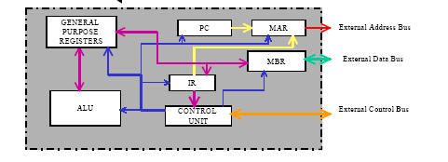

Slide 4
operation
When a program begins execution, the program counter (PC, a register inside the CPU) has the address of the next instruction to fetch.
this address is placed there initially by the operating system and updated automatically by the CPU.
There are three additional registers, the instruction register (IR), memory address register (MAR) and the memory buffer register (MBR) that work together to fetch the instruction.

Slide 5
Operation (2)
The address from the PC is moved to the MAR.
  The reason for this is that the address bus is connected to the MAR and all addresses issued must go through this register.
Then the address contained in the MAR is placed on the address bus and the READ line is asserted on the control bus.

Slide 6
Operation(3)
The memory whose address is found on the address bus places its contents on the data bus.
The only register that is connected to the data bus is the MBR, and all data should go in an out through this register.
Thus the data on the data bus is copied into the MBR. The instruction is now copied on to the IR to free up the MBR to handle another transfer.

Slide 7
Operation(4)
The contents of the PC will be now incremented by one instruction.
The instruction is then decoded and executed.
In practice, more than one instruction is read during an instruction cycle. Additional instructions are kept in temporary storage registers such as the Instruction Buffer Register (IBR).

Slide 8
Main Memory System
  When small memory was available we used overlays.
    Talk about overlays
  Virtual Memory
    Main memory and secondary memory are considered to contiguous
    The OS maintains special tables that keep track of where each part of the program reside in main memory and in external storage

Slide 9
Memory hierarchy of multilevel storage system
  Registers
  internal cache (in CPU-SRAM)
  external cache (outside CPU-SRAM or DRAM)
  Main Memory
  Secondary Memory

Slide 10
Program relocation and Memory Protection
  Crucial features needed for multiprogramming:
    program relocation
    memory protection
    privileged modes of operation
    timer interrupts

Slide 11
Cache Memory
  When CPU access a piece of information from memory , there is a high possibility that this data or adjacent data will be accessed again.
  during a memory read, it also reads adjacent memory locations and places the data in the cache
  cache entries include address tags where the data came from.
  So each cache consists of data and data tag.

Slide 12
Cache contd.
  When CPU finds what it is looking for in the cache it is called a hit
  when it does not find the data it is called a miss.
  Most cache memory has a 90% hit rate
  when a write is done, cache is updated, and if memory is updated immediately it is called write-through cache.
  If memory update is delayed it is called write-back cache. The cache may wait until entire block needs to be written.
  A dirty cell is the main memory that has not been updated yet, but the cache has.

Slide 13
Cache structure and organization
  cache has two sub-systems. Tag and memory subsystem.
  Memory and cache are divided into refill lines.
  Refill lines are unit of data transfer. (several words, up to 64 bytes)
  Cache has to map main memory to its own, techniques
    associative
    direct mapped
    set associate
    sector-mapped

Slide 14
Background
Next few slides will give you some background information
You may have had this in other courses
So it will be brief

Slide 15
Virtual Memory
  Logical address space is larger than physical address space.
  For example if computer is designed with 32 bit address bus it can have 4GB of memory; 64 bit can have more than 16 exabytes of addressable memory.
  Practically most computers have far less physical memory.
  virtual memory makes it appear that the physical memory is as much as the logical memory
  Programmer, therefore, do not have to use overlays.

Slide 16
Virtual memory
CPU uses MMU (memory management unit) to locate Page in RAM
MMU provides mapping to Physical memory
Table with DirtyBit, Resident Bit, and Physical Page number is used to determine if page available in Virtual memory pages.
Virtual memory should have more than 90% hit rate.

Slide 17
Virtual memory
  When a memory is needed the effective address is calculated.
  The effective address is sent to a memory map (which is part of the virtual memory hardware)
  The memory map checks to if the effective address is active, if it is
    This memory map translate the effective address to the physical address.
  If it is not, the memory map interrupts the CPU to load it.

Slide 18
Paging
  Hardware technique for managing physical memory.
  Only what is currently needed is loaded into memory.
  In a paging system, the virtual memory hardware divides logical address into two parts.
    A virtual page number and word offset
    the high order bits are the page number
    the low order bits are the offset

Slide 19
Paging
  The application program uses logical addresses.
  The OS convert the logical to physical address during execution.
  The last page may not be enough to fill a frame. So still some fragmentation will exist.

Slide 20
Virtual memory
  A program may have many subroutines, some may never be used.
  Some subroutines may only be executed once then not needed afterwards.
  While a program is executing a loop, those programs outside the loop is not needed for a while.
  Many array elements will never be filled.
  All these are reasons why only needed portions be loaded into memory.

Slide 21
Virtual memory
  The set of active pages is called the working set.
  As the program progresses, new pages enter working set and old ones leave.
  Demand paging: when needed portion is not in memory the OS simply loads it.
  When needed page is not in memory it is called page fault.
  When lots of page faults occur, it is called page thrashing.

Slide 22
Virtual memory
  If the allocated memory is full, but still needs to load a new page, the operating system replaces a new page with one that is no longer needed.
  Before OS can release a page and replace with a new one, it must decide the contents were changed. If it was changed the changes must be written to disk drive.
  To keep track if it was changed, the OS keeps a dirty bit. The page is loaded into memory the dirty bit is set to zero. If the STORE instruction was issued, then the dirty bit is set to one.

Slide 23
Cache memory vs. virtual memory
  Both share several features.
  Both systems use hardware that maps one set of address to another.
  Both hold data for the CPU.
  Both operate on demand basis, replacing older data with newer data as the CPU requests it.

Slide 24
Differences
  They are different in their purpose
  Cache to speed up
  Virtual to run large programs on smaller machines
  Cache misses occur more frequently
  refill lines of cache are much smaller than pages.

Slide 25
Single machine, single OS
Each OS is bound to the underlying hardware
Each application program is bound to the OS
If the hardware fails in order to restore the backup, same hardware and OS are needed.

Slide 26
Single machine, single OS
CPU use of a stand alone server or computer is only about 10%
90% of the time it is idle. Implied waste of money is 90% of investment plus manpower needed to keep up the hardware and software.

Slide 27
Virtual Machine
Each virtual machine is treated as a process and a file
So virtual memory table can be modified to include a VM number and virtual page number.
Each virtual machine can now have a virtual page 0.
CPU gives a time slice to each virtual machine
Virtual machines take away dependence on the hardware. Virtual drivers are generic drivers that can be used by any operating system or version

Slide 28
Virtual Machine
Creates pools
  CPU pool
  Memory Pool
  Storage Pool
  Interconnection Pool
Hypervisor manages allocation of these pools to Virtual Machines

Slide 29
Virtual machine lifecycle
Create, Suspend, Resume, Save, migrate, and destroy
Each VM can have an OS and a VM Monitor (hypervisor).
Virtual Infrastructure Managers (VIM) are used to manage, deploy and monitor Virtual Machines.

Slide 30
Two approaches to virtualization
"hosted" (paravirtualization) and "bare-metal“ (full virtualization).
Hosted virtualization software runs as an application or "guest" on top of a general-purpose operating system.
Bare-metal virtualization interfaces directly with computer hardware, without the need for a host operating system. Even BIOS is virtualized (emulated).

Slide 31
Virtual Machine Software functions
Partitioning – Multiple VM on a single hardware pool
Isolation - Each VM is isolated from others
Encapsulation – VM encapsulates hardware, OS and application
Hardware independence – RUN VM on any machine without modification

Slide 32
VM software
Vmware
VirtualBox
Microsoft HyperV
Citrix XenServer
Others

Slide 33
Core Mechanism behind a VM software
None of the high level languages can use the hardware directly.
HL programs need to be compiled. Compiler creates Machine executable Code
High level languages such as Python, JAVA, and Ruby have their own Virtual Machines
For VMs, create bytecodes. Bytecodes can be compiled (runtime) to machine codes.

Slide 34
How to create a VM software
CPUs work by fetching, decoding and executing.

Slide 35
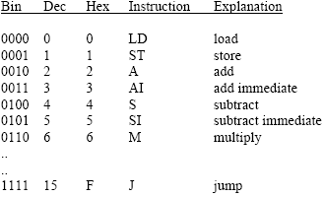
Instruction set of an imaginary computer

Slide 36
Operations of a Microprocessor
This hypothetical computer has only one user addressable register, which is the accumulator (AC).
When a load (LD) is executed, the contents of the location as indicated by the operand is brought into the AC
The reverse happens in a store (ST).

Slide 37
Operations of a Microprocessor(2)
When an add (A) is executed, the value contained in the memory location as indicated by the operand is added to the contents of the AC, and the result is placed back in the AC.
The add immediate (AI) differs from the add (A) in that the operand is what is added, not the content of the memory pointed by the operand.

Slide 38
Program Example
B = B + A
C = B + 2
The variable A is kept in memory location 200h
Variable B in 201h
Variable C in 202h.
The values in each are 5, 3 and 0 respectively.

Slide 39
Program Example (2)
There are three registers that need watching, the Accumulator (AC), Program Counter (PC), and the Instruction Register (IR).
The PC contains 100h, which means that the next instruction should be fetched from memory location 100 hexadecimal.

Slide 40
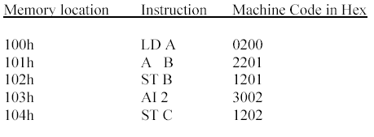
Program Example (3) – The code

Slide 41
Program Example (4)
The control unit fetches the instruction contained in the address indicated by the PC, which is 100h.
The instruction 0200 is brought into the IR.
The IR now contains 0200. The instruction is decoded and separated in opcode of 0 and operand of 200. This is based on the assumption that 4 bits (one hexadecimal digit) are used for the opcode and 12 bits (three hexadecimal digits) are used for the operand.

Slide 42
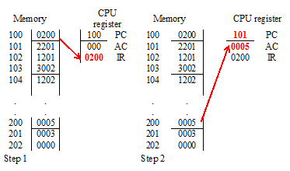

Slide 43
Program Example (5)
Once the instruction is fetched the PC is automatically incremented, and now contains 101h.
The opcode 0 indicates a load, and the operand is fetched from memory location 200h and loaded into the accumulator (AC).
Now the accumulator contains 5.

Slide 44
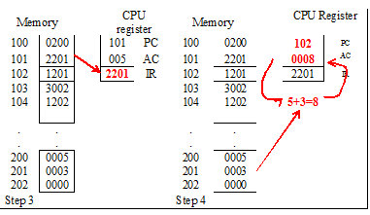

Slide 45
Program Example (6)
The instruction from 101h is fetched and placed in the IR.
The PC is incremented to 102h.
The content of IR is decoded and based on the opcode of 2, the operand located in address 201h is added to the AC.
The AC now has a value of 8.

Slide 46
Program Example (7)
The next instruction whose address is contained in the PC is fetched and placed in the IR giving it a value of 1201.
The PC is incremented to 103h.
The contents of IR (1201) is decoded and based on the opcode of 1, the contents of the AC is saved in the address indicated by the operand, which is 201h.
Address 201 (variable B) now has a value of 8.

Slide 47
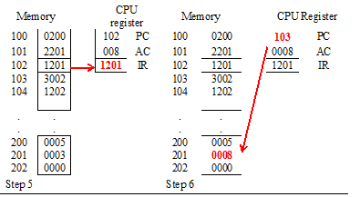

Slide 48
Program Example (8)
The instruction contained in 103h (PC content) is fetched next and placed in the IR giving it a value of 3002.
The PC is incremented to 104h The contents of IR is decoded, and based on the opcode of 3 it is an add immediate.
No data fetching is necessary and the 2 is added to the AC.
The new value of the accumulator is now 10.

Slide 49
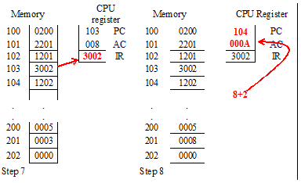

Slide 50
Program Example (9)
The last instruction is now fetched and placed in IR.
The PC is incremented to 105h.
The PC now contains 1202, and it is decoded to give the opcode of 1 and operand of 202.
Since hex 1 is a store, the value of AC (the value is 10) is stored in memory location 202h.
It was already mentioned that 202h is the memory location assigned to C.

Slide 51
More information on actual building of VM
University of San Francisco, Terence Parr
  https://www.youtube.com/watch?v=OjaAToVkoTw
  https://www.youtube.com/watch?v=DelO8tZFMrc

Slide 52
Installing virtualBox
Download and install virtualBox
Extensions can be download as VMDK file
  For example Kali Linux can be downloaded as a VMDK file
Allocating memory space and hardware space: be careful to leave enough memory for the host computer
You should allow cut and paste between host and VM
Should have shared file (read only) that is mounted on boot by VM
Most network assignments work in bridged mode of the network rather than NAT. May not work at UTRGV WIFI
Special attention must be paid to assign IP addresses (covered shortly)

Slide 53
Network setting on VirtualBox
Network Address Translation (NAT)
Bridged networking
Internal networking
Host-only networking
NAT with Port-forwarding

Slide 54
NAT
Virtual box will create a separate IP pool for virtual machines
All traffic in out will be done using a NAT table
Users can’t see the host machine from a virtual machine
Initially when you setup a virtual machine use NAT and make sure that you can connect to the Internet using NAT.
Once you can connect to Internet, it is time to change from NAT to Bridged

Slide 55
Bridged
Bridged will automatically assign you IP address through DHCP within your host-machine IP range
You can also assign a static IP within your host-machine IP range
In Bridged mode the host-machine and virtual machines act as independent machines for the purpose of a LAN
Most of our assignments require a LAN setup

Slide 56
Other virtualBox Network settings
You can network within the virtual machines and even with the host using other network settings, but would not have control over the IPs.
For our labs, you are going to be the network administrator and need to have control over the IP.
https://www.youtube.com/watch?v=cDF4X7RmV4Q

Slide 57
What is Cloud Computing
a model for enabling convenient, on-demand network access to a shared pool of configurable computing resources (e.g., networks, servers, storage, applications, and services) that can be rapidly provisioned and released with minimal management effort or service provider interaction.
Cloud Computing makes computer infrastructure and services available "on-need" basis.

Slide 58
Pros and Cons
Users do not pay for hardware infrastructure or software. Less hardware means less noise and electricity
Pay for usage as you would for electricity usage. Lower IT cost.
You need much wider bandwidth. Latency concern.
If Internet service goes down at either end
If the provider goes down
Security of data – gov. regulations
Hardware dependent software may not run

Slide 59
Components of Cloud computing
Client computers – mobile, thin/thick computers
Provider site
  Server farm (distributed servers)
  Storage farm (distributed storage)
  Data farm (distributed datacenter)

Slide 60
Cloud Computing Characteristics
This cloud model promotes availability and is composed of five essential characteristics
  On-Demand Self-Service: User can essentially set up a server on the cloud. Availability of large computing infrastructure on need basis
  Resource Pooling: Users of the cloud can provision computing resources based on their needs, and then destroy those resources, giving them back to the shared pool once their needs are met. Additionally, users can share resources amongst themselves. For example, if an institution has developed a new piece of software and would like to share it with other institutions, they can create a template for that system in the cloud and allow other institutions to use that template as they see fit.

Slide 61
Cloud Computer Characteristics
3. Rapid Elasticity: If a system requires more computing resources, an IT department can easily scale the technology to meet those demands
4. Broad Network Access: The whole computer and programs available from anywhere (like google docs).
5. Measured Service: both cloud providers and IT departments to monitor usage. “pay-per-use" billing model

Slide 62
Hadoop
Hadoop is a fault-tolerant distributed system for data storage which is highly scalable.
The scalability is the result of a Self-Healing High Bandwidth Clustered Storage, known by the acronym of HDFS (Hadoop Distributed File System) and a specific fault-tolerant Distributed Processing, known as MapReduce.

Slide 63
Use of Hadoop
Traditionally data moves to the computation node. In Hadoop, data is processed where the data resides . The types of data Hadoop helps to manipulate are those unstoppable streams created by human and machines:
  Computer logs
  Satellite telemetry (espionage or science)
  GPS outputs
  Temperature and environmental sensors
  Industrial sensors
  Video from security cameras
  Outputs from medical devises
  Seismic and Geo-physical sensors

