Slide 1
Host and virtual machine IP
Dr. Abraham, Professor
UTRGV
Please note that the networks may not work on campus. It should work work at home.

Slide 2
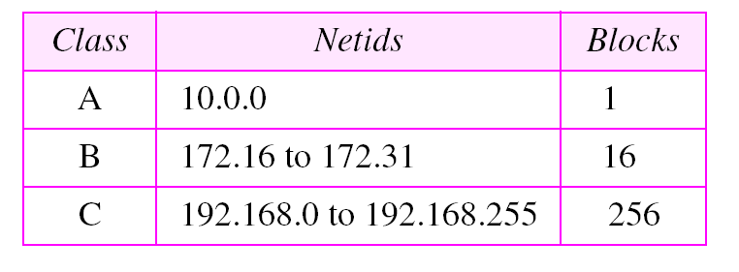
PRIVATE IP RANGES

Slide 3
HOST IP
CHECK YOUR HOST IP USING IPCONFIG
WRITE DOWN THE IP, DEFAULT GATEWAY, AND DNS
THE HOST IP CAN BE DYNAMIC OR STATIC. IF YOU SET IT STATIC, WHEN YOU MOVE YOUR COMPUTER AROUND IT WILL NOT WORK.

Slide 4
NAT AND BRIDGED
Make sure you read up on it
All our network assignments should work on bridged mode if you follow these instructions

Slide 5
Virtual machine IP
You need to set up static IP
Use all the numbers exactly as the host IP, except change the last octet of the IP address to something between 230 to 250

Slide 6
Ping both directions
Ping from host to virtual machine
Ping from virtual machine to host
If does not ping, solve the problems
Once pinging, share folders
Connect to the shared folder like this \\192.168.1.28\sharedfolder

