Slide 1
Internet Applications and Network Programming
Dr. Abraham
Professor
UTPA

Slide 2
Basics of socket programming
Server program
Client Program

Slide 3
Server Program
Create a socket with the socket() system call
Bind the socket to an address using the bind() system call. For a server socket on the Internet, an address consists of a port number on the host machine. Each application should use a unique port.
Listen for connections with the listen() system call
Accept a connection with the accept() system call. This call typically blocks until a client connects with the server.
Send and receive data

Slide 4
Client Program
Create a socket with the socket() system call
Connect the socket to the address of the server using the connect() system call
Send and receive data. There are a number of ways to do this, but the simplest is to use the read() and write() system calls.

Slide 5
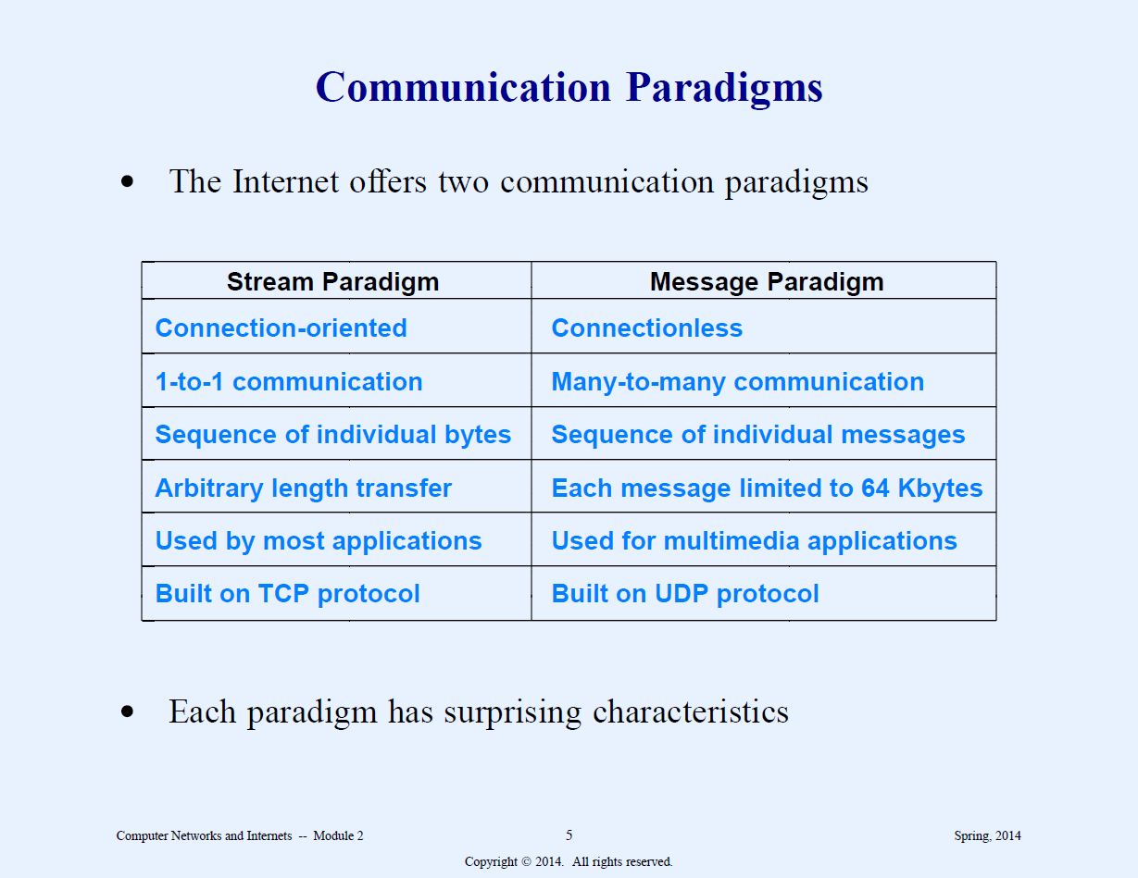
Communication Paradigms

Slide 6
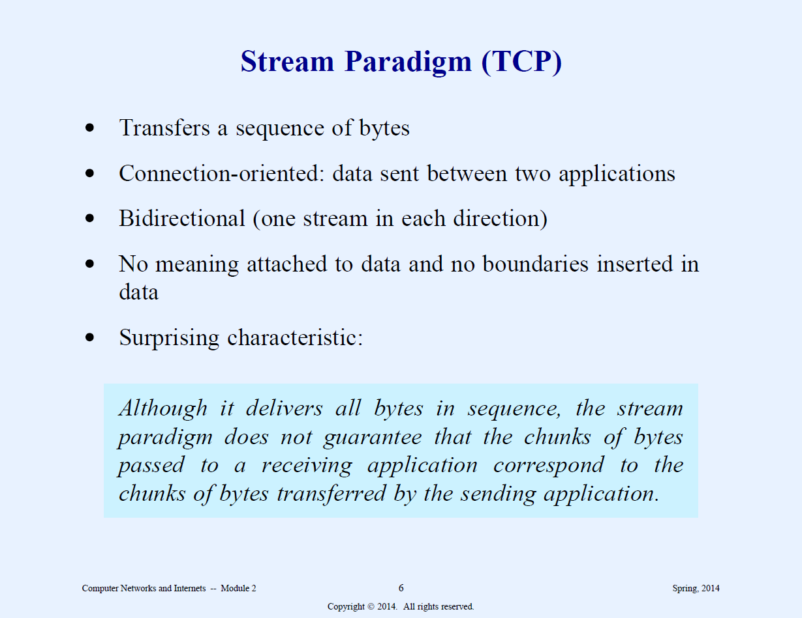
Stream

Slide 7
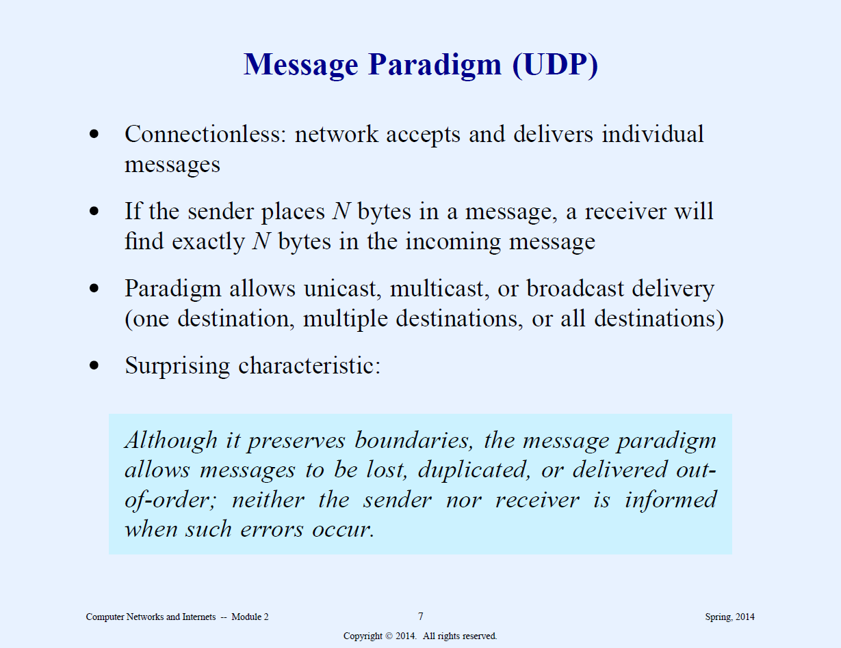

Slide 8
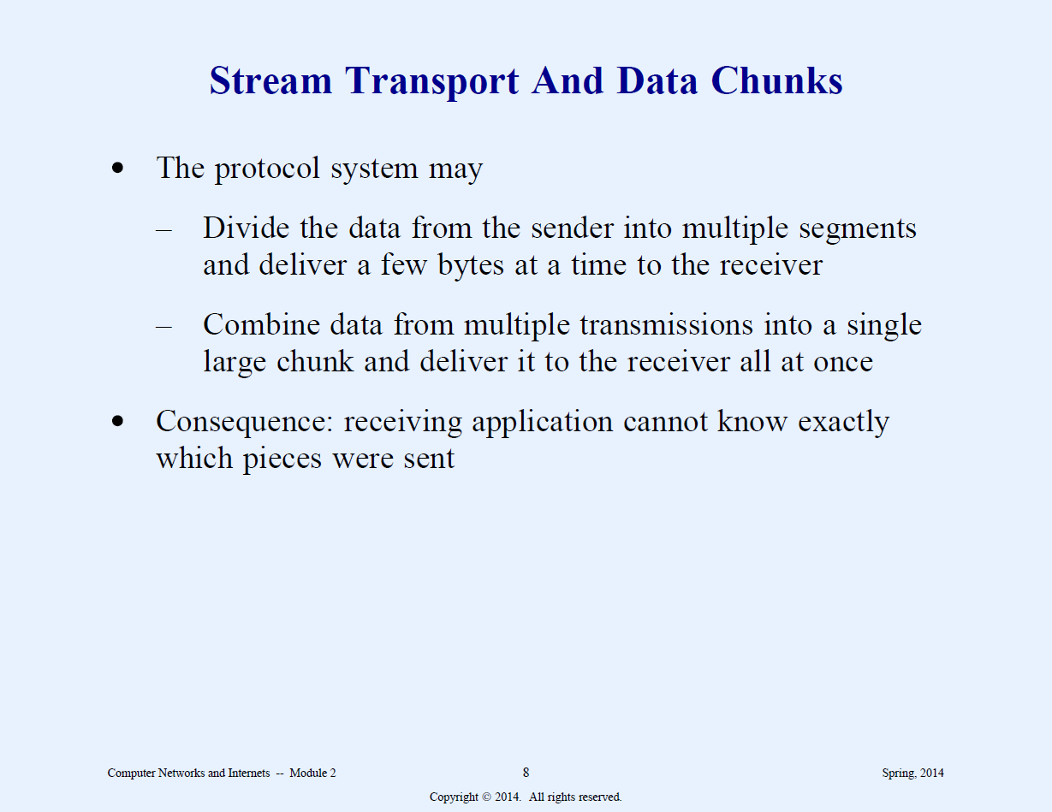

Slide 9
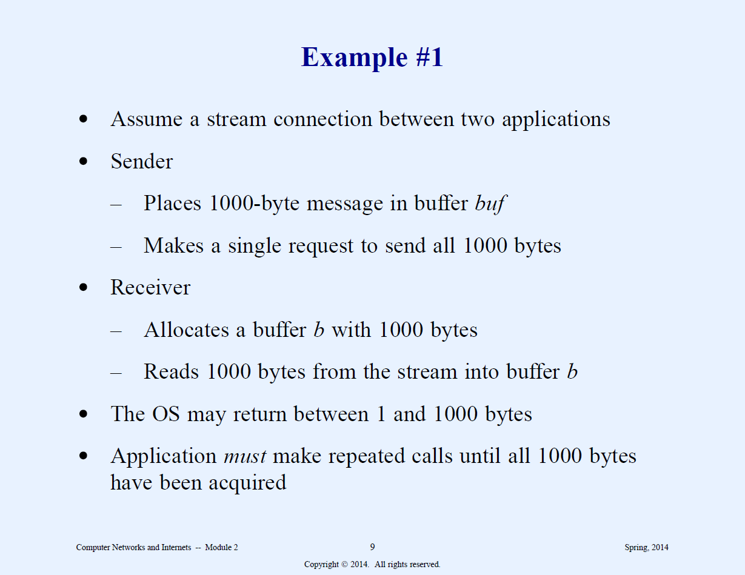

Slide 10
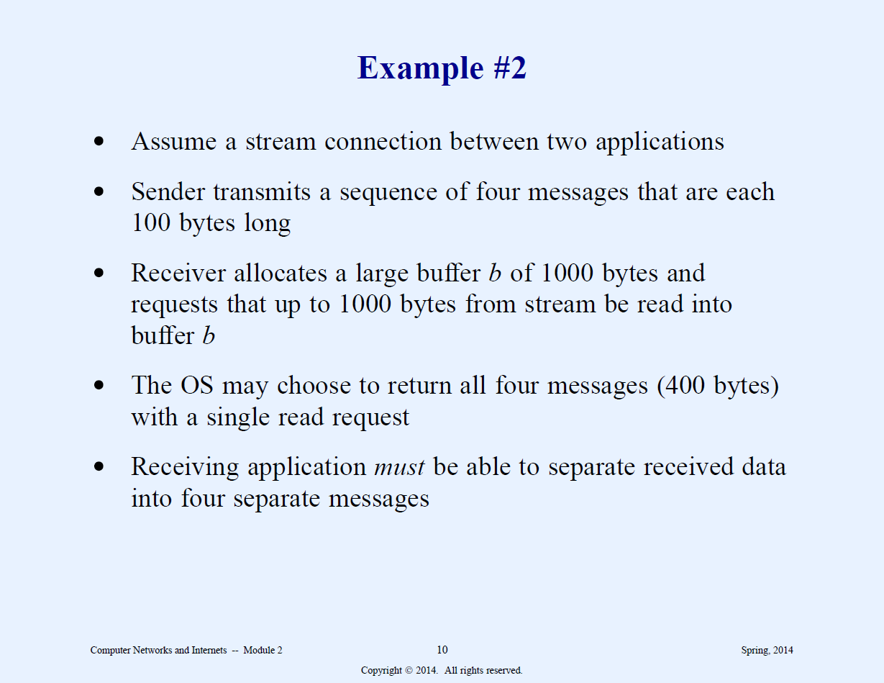

Slide 11
Connection of Oriented Communication (TCP)
Stream service
First connection must be established
Data may be send in either direction
Finish communication
Applications request connection terminated.

Slide 12
Client-server model of interaction
The server application starts first and waits for client to connect
Client starts next and initiates connection

Slide 13
Server application
Starts first
Does not need to know which client will contact it (so need to know client IP)
Waits passively
Communicates with a client by sending and receiving data
When one client finished, waits for another.

Slide 14
Client application
Starts second
Must know the IP of the intended server.
Initiates contact with the server when communication is needed.
Sends and receives data between server and the client
May terminate after interacting with the server or contact another server

Slide 15
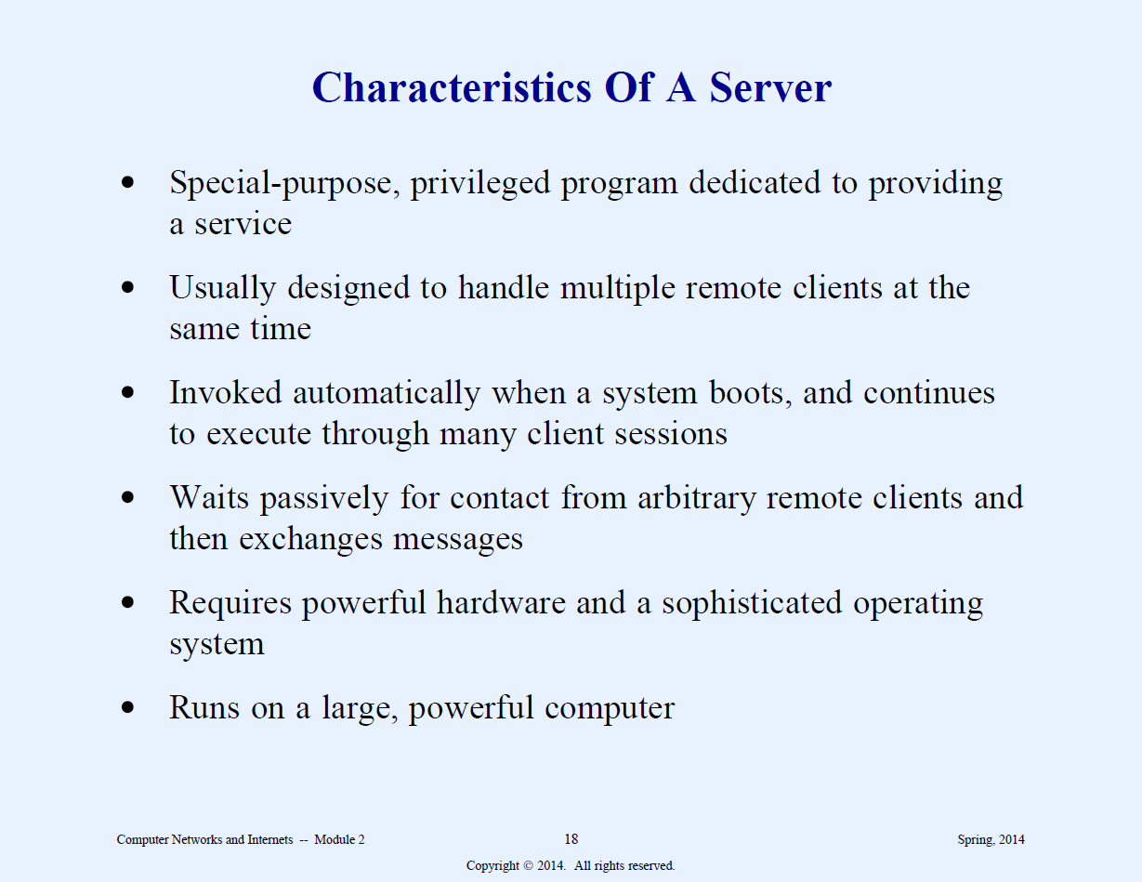

Slide 16
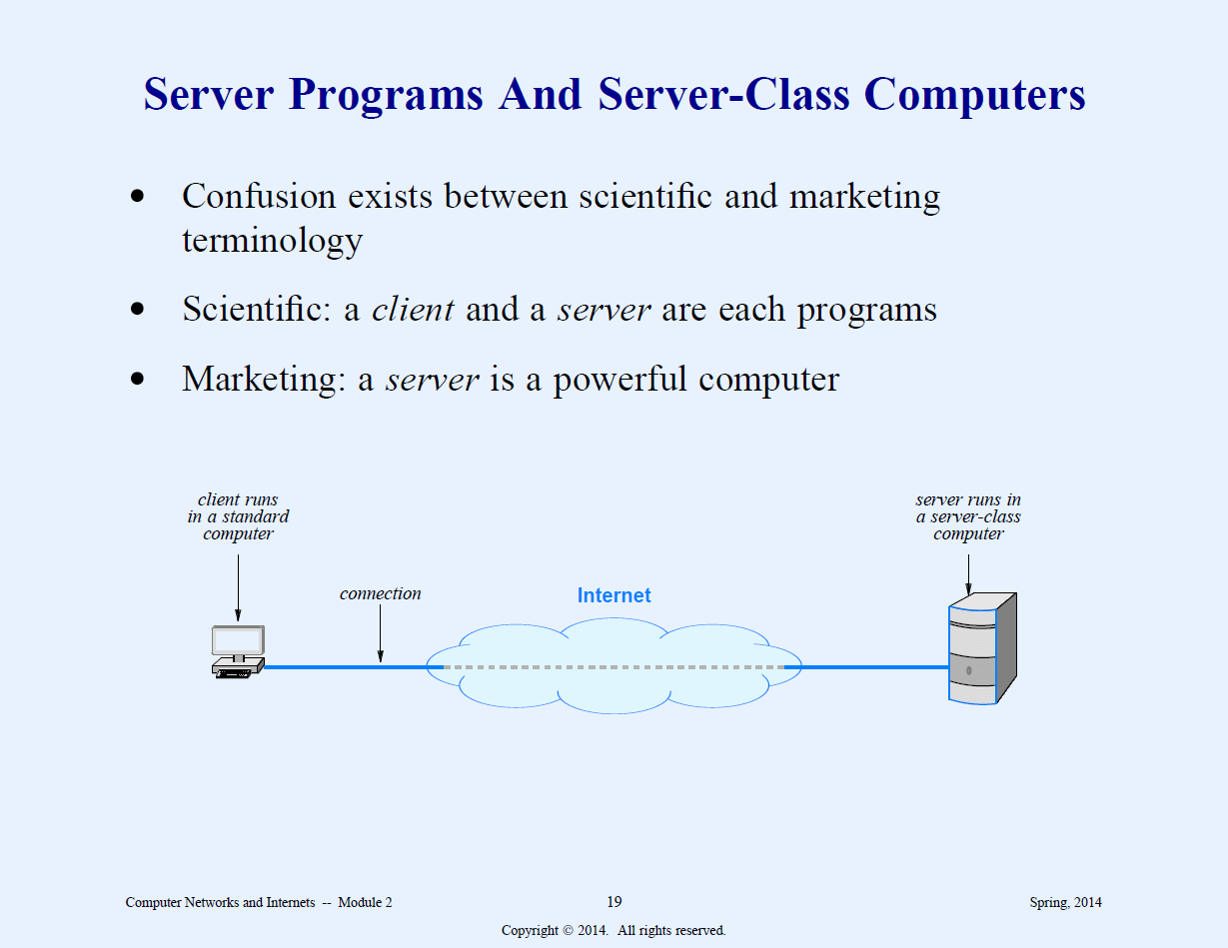

Slide 17
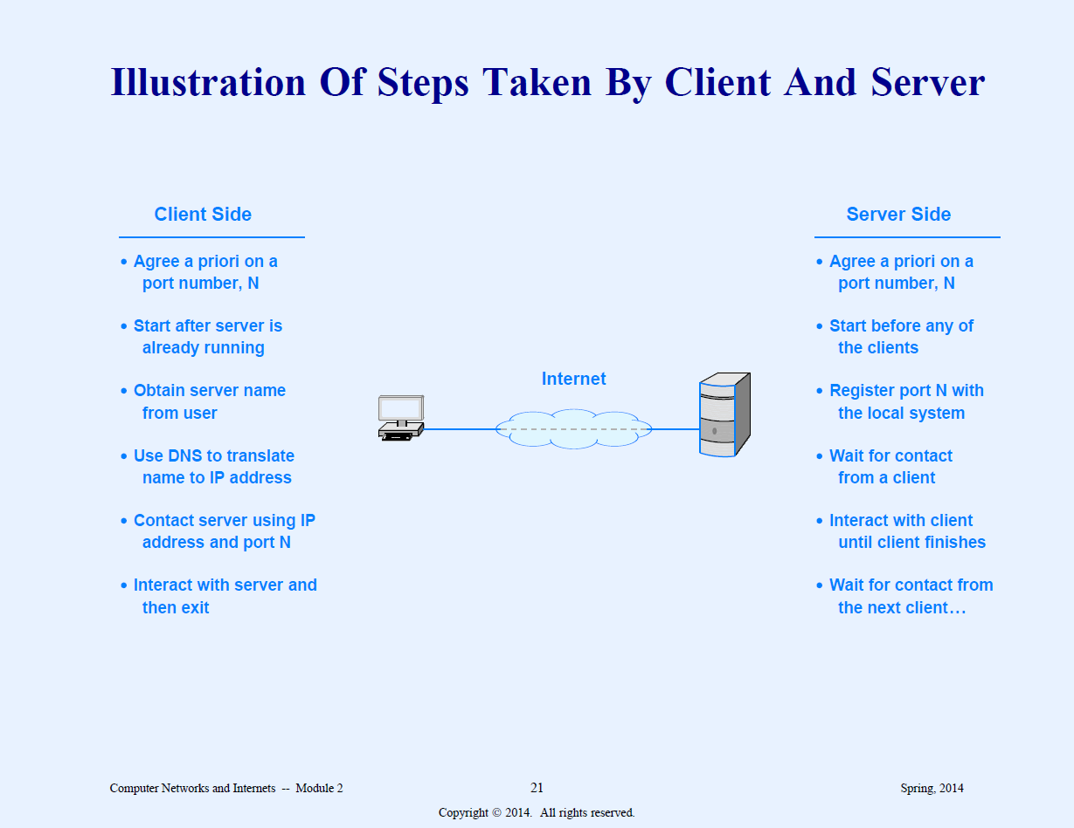

Slide 18
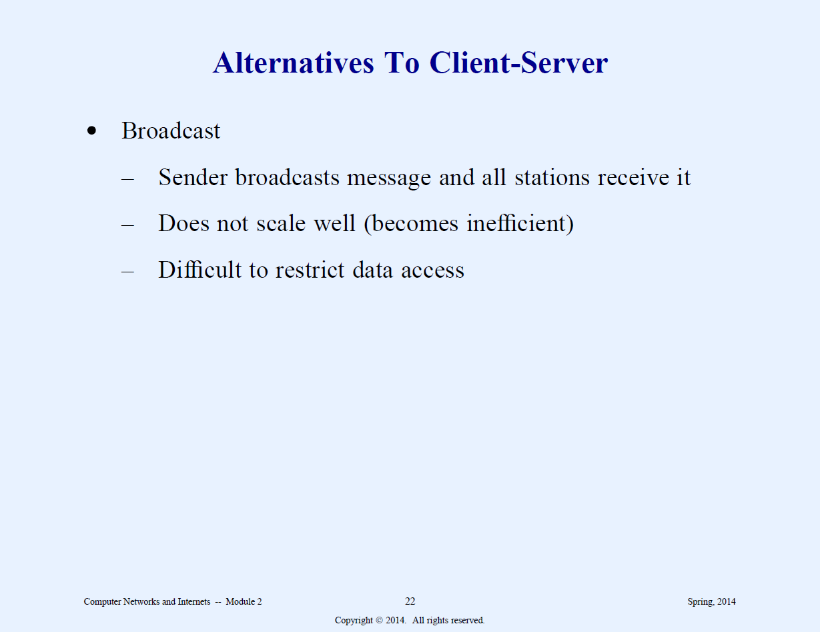

Slide 19
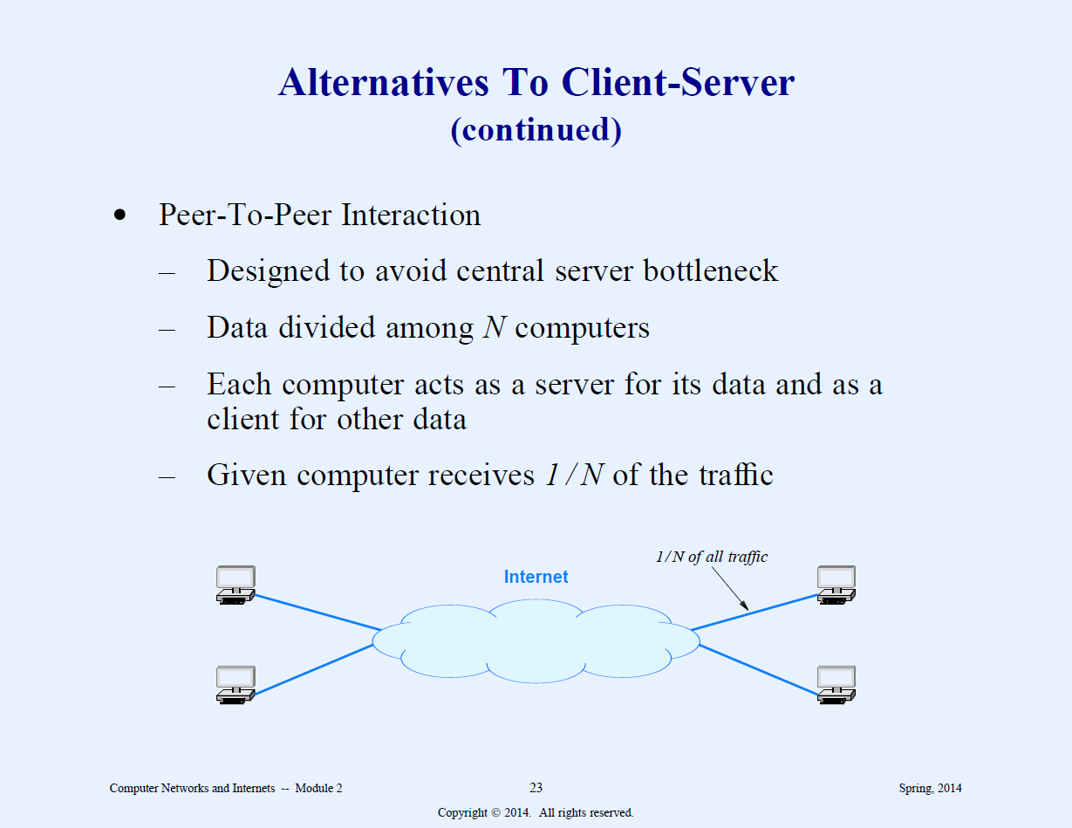

Slide 20
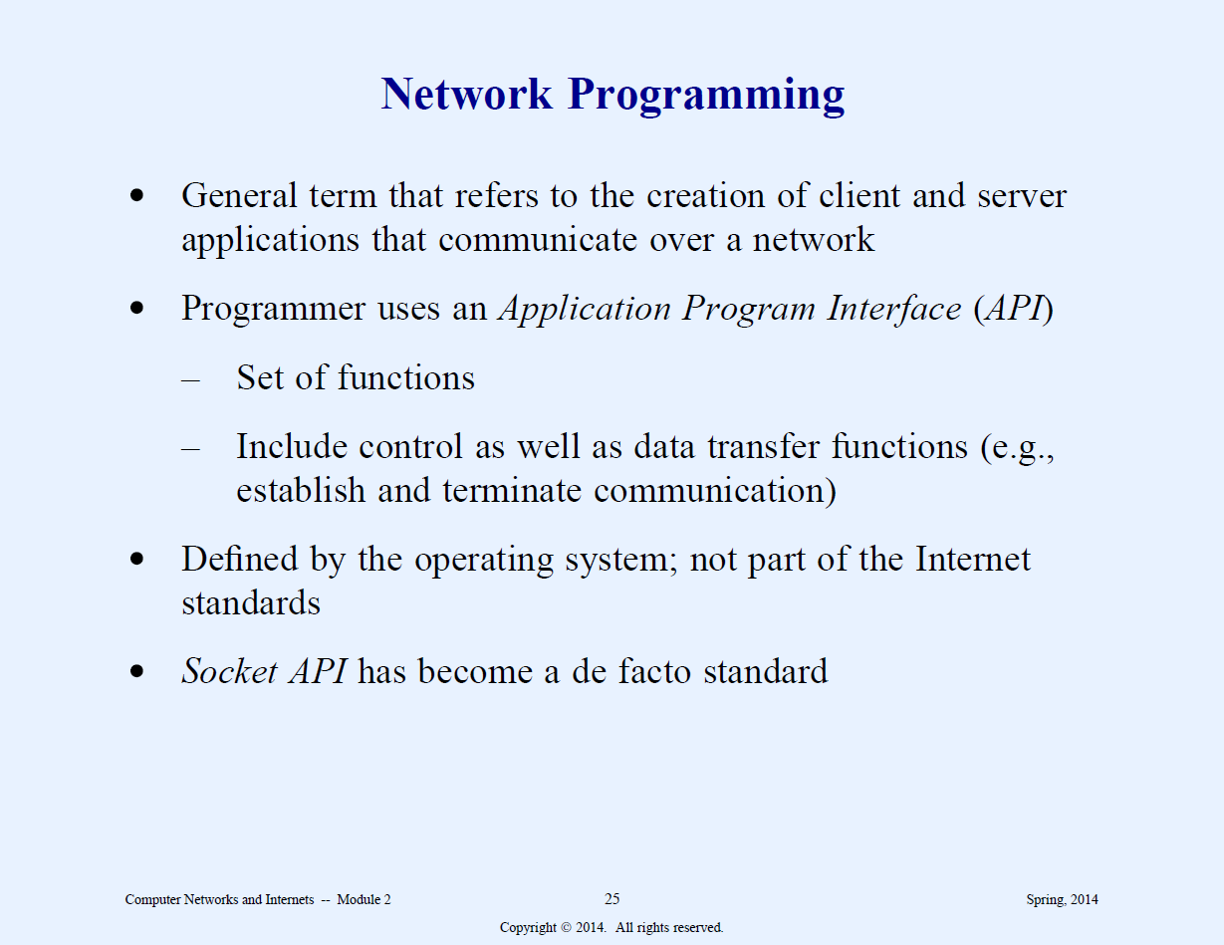

Slide 21
Server Identification
Identify Computer
  IP address, or use DNS to obtain IP
Identify Process
  16 bit protocol port number.
  Well known or ephemeral

Slide 22
SOME WELL KNOWN PORTS
SERVICE | PORT
HTTP | 80
POP3 | 110
SMTP | 25
TELNET | 23
FTP | 21,20
FINGER | 79
LOCAL LOOPS | 0

Slide 23
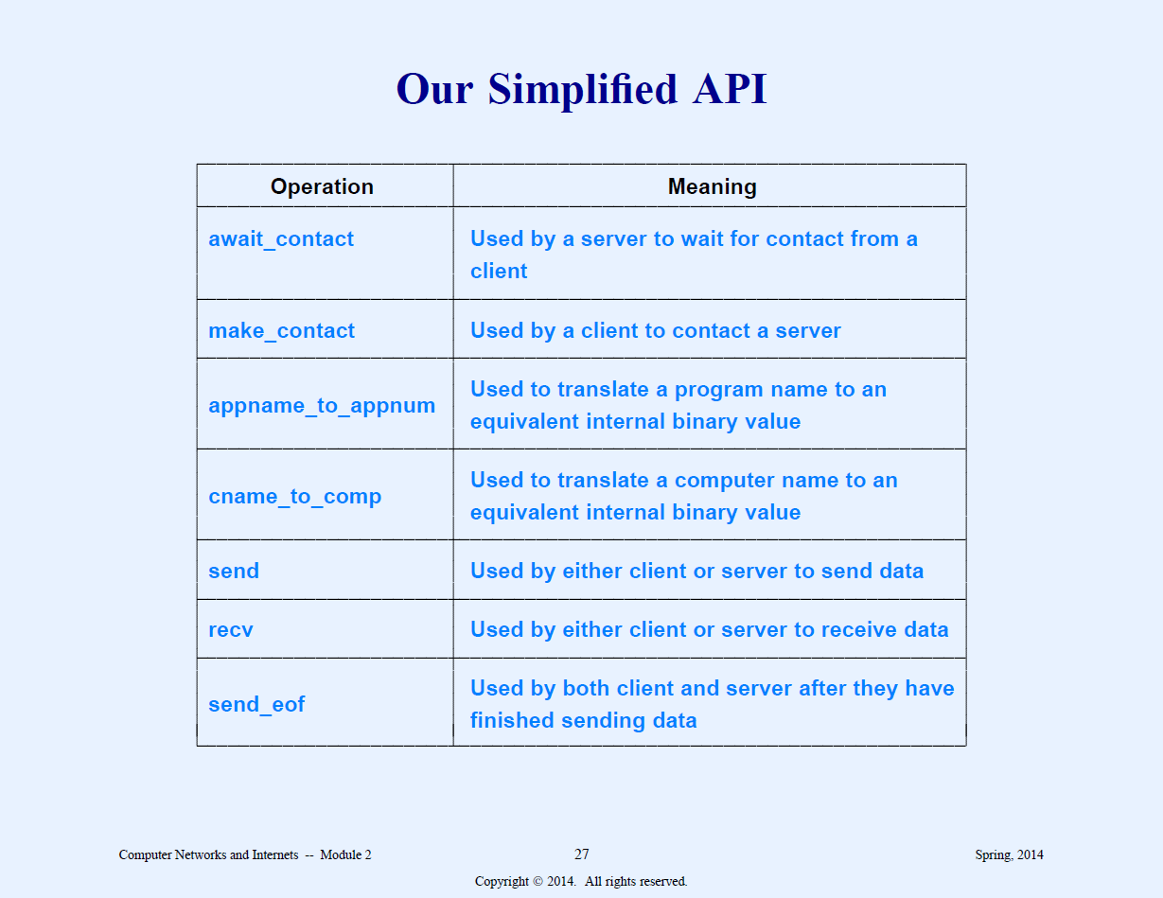

Slide 24
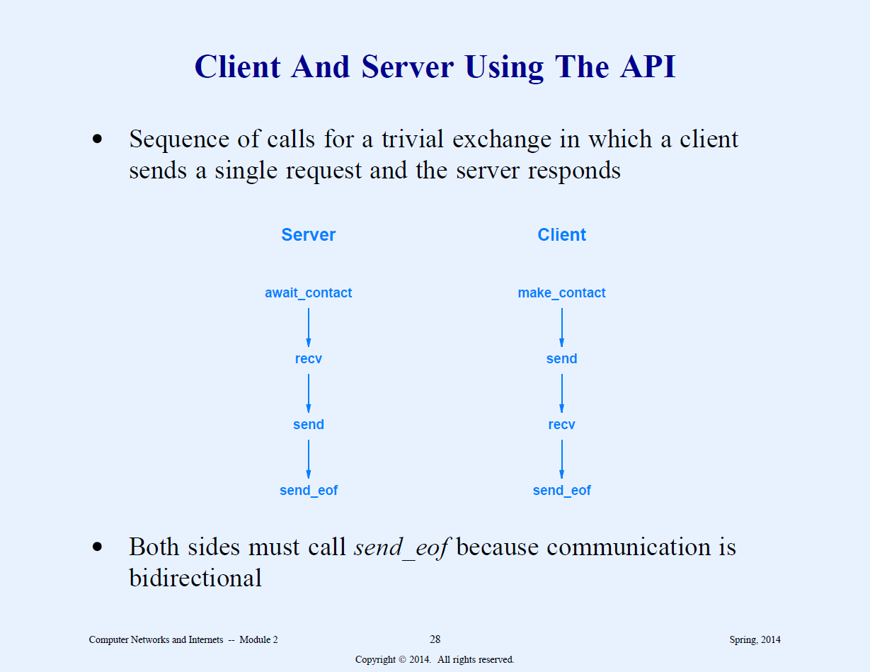

Slide 25
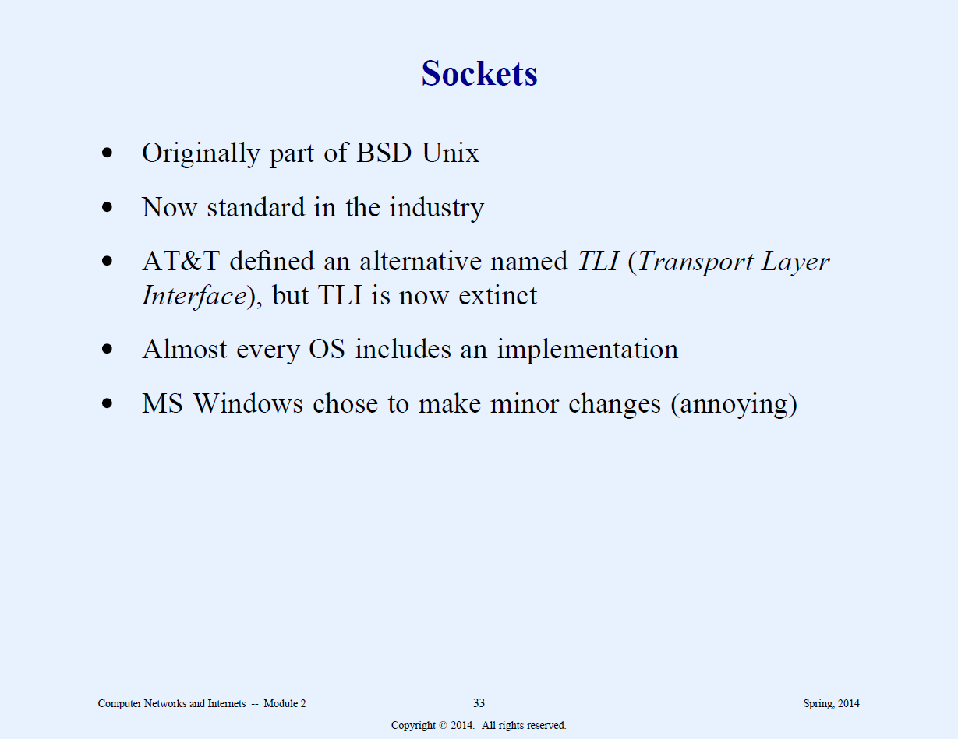

Slide 26
SOCKET
APPLICATION PROGRAMMER’S INTERFACE (API) TO THE NETWORK (TRANSPORT LAYER)
The socket API is integrated with I/O
When an application creates a socket to use for Internet communication, the OS returns a small integer descriptor that identifies the socket
The application then passes the descriptor as an argument when it calls functions to perform an operation on the socket

Slide 27
TCP or UDP
THE TRANSPORT PROTOCOL CAN USE EITHER TCP OR UDP
PROGRAMMER NEEDS TO SPECIFY WHICH IS BEING USED

Slide 28
More on Socket
Sockets are endpoints of bidirectional communication channel between processes.
SOCK-STREAM is used for connection oriented protocols and SOCK-DGRAM for connectionless protocols
Socket_family (SF) is either IP version 4 or IP version 6

Slide 29
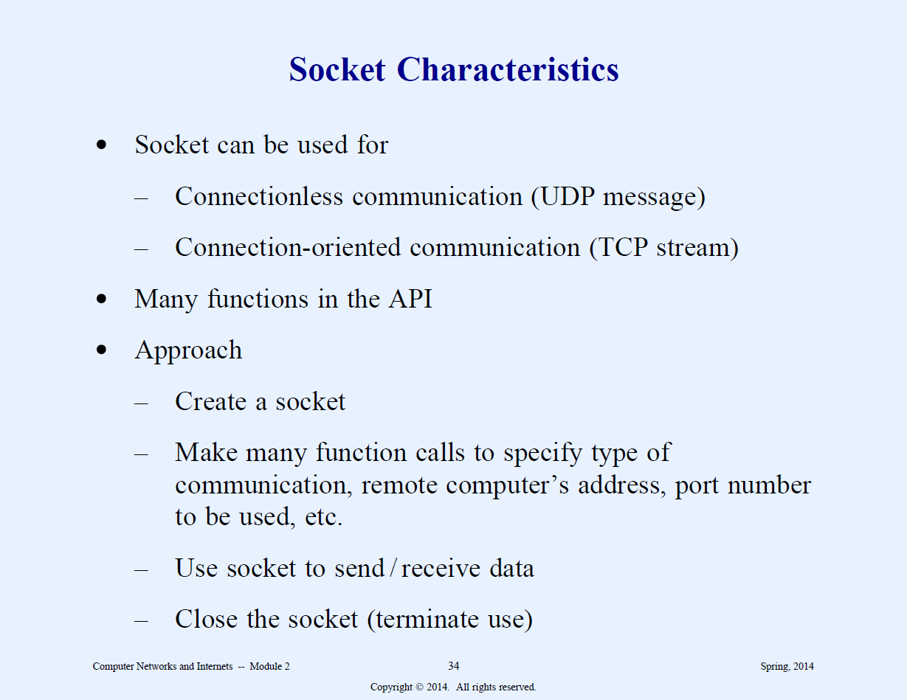

Slide 30
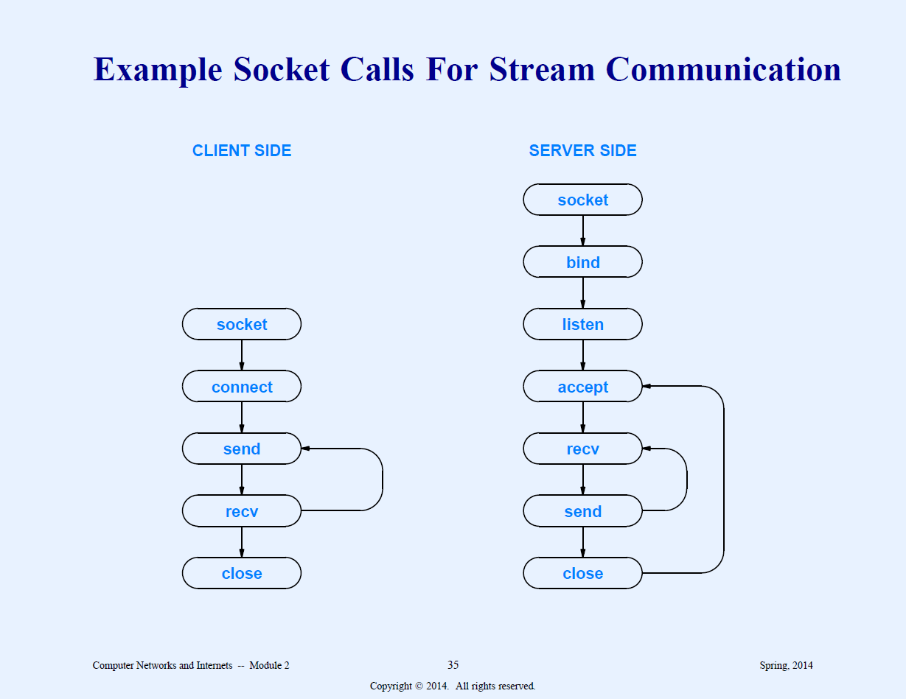

Slide 31
Methods
Server.bind() binds IP and portnumber to socket.
Server.listen() setup TCP listner
Server.accept() accepts incoming connection
client.connect() initiates a TCP server connection
Sc.recv() receives TCP message
Sc.send() transmits TCP messate
Socket.gethostname() returns hostname
Sendto and recvfrom are UDP methods

Slide 32
C# (.NET)
The .NET framework provides two namespaces, System.Net and System.Net.Sockets for socket programming.
The communication can be either connection oriented or connectionless. They can also be either stream oriented or data-gram based.
The most widely used protocol TCP is used for stream-based communication and UDP is used for data-grams based applications.
.

Slide 33
Discovering IP address
System.Net contains the Dns class.
Dns class can be used to query information about various things including the IP addresses
Dns.GetHostByName can be used to return DNS host name of the local machine.
Here is an example of this program. You will have to write this program yourself, so I am only showing the executable program.

Slide 34
Sample program in c# to resolve address given a host name
using System;
using System.Net;
using System.Net.Sockets;
class SocketAddress
{
public static void Main()
{
IPHostEntry IPHost = Dns.Resolve("www.utpa.edu");
Console.WriteLine(IPHost.HostName);
string []aliases = IPHost.Aliases;
IPAddress[] addr = IPHost.AddressList;
for(int i= 0; i < addr.Length ; i++)
{
Console.WriteLine(addr[i]);
}
Console.ReadKey();
}
}

Slide 35
Explanation
IPHostEntry IPHost = Dns.Resolve("www.utpa.edu");
The Resolve method queries a DNS server for the IP address associated with a host name or IP address.
IPHost.Aliases gives any aliases associated with that host name. This can be stored in an array.
IPHost.AddressList will provide addresses associated with the hostname. They can be stored in an array.

Slide 36
Another Program
using System;
using System.Net;
using System.Net.Sockets;
class MyClient
{
public static void Main()
{
IPHostEntry IPHost = Dns.Resolve("www.ebay.com");
Console.WriteLine(IPHost.HostName);
string[] aliases = IPHost.Aliases;
Console.WriteLine(aliases.Length);
IPAddress[] addr = IPHost.AddressList;
Console.WriteLine(addr.Length);
for (int i = 0; i < addr.Length; i++)
{
Console.WriteLine(addr[i]);
}
Console.ReadKey();
}
}

Slide 37
Sample program (in VB)
Private Sub Form_Load()
' Set the LocalPort property to an integer. ‘ Then invoke the Listen method.
tcpServer.LocalPort = 1001
tcpServer.Listen frmClient.Show ' Show the client form.
End Sub Private Sub
tcpServer_ConnectionRequest _ (ByVal requestID As Long)
' Check if the control's State is closed. If not, ' close the connection before accepting the new ' connection.
If tcpServer.State <> sckClosed Then _ tcpServer.Close ' Accept the request with the requestID '
parameter. tcpServer.Accept requestID End Sub Private Sub txtSendData_Change()
' The TextBox control named txtSendData ' contains the data to be sent. Whenever the user ' types into the textbox, the string is sent ' using the SendData method.
tcpServer.SendData txtSendData.Text
End Sub
Private Sub tcpServer_DataArrival _ (ByVal bytesTotal As Long)
' Declare a variable for the incoming data. ' Invoke the GetData method and set the Text
' property of a TextBox named txtOutput to ' the data.
Dim strData As String tcpServer.GetData strData txtOutput.Text = strData
End Sub

Slide 38
Python program to contact Yahoo.com
import socket
TCP_PORT = 80
BUFFER_SIZE = 1024
client = socket.socket(socket.AF_INET, socket.SOCK_STREAM)
TCP_IP = socket.gethostbyname("WWW.yahoo.com")
print (TCP_IP)
client.connect((TCP_IP, TCP_PORT))
client.sendall(b"GET / HTTP/1.1\r\nHost: yahoo.com\r\n\r\n")
data = client.recv(BUFFER_SIZE)
client.close()
print ("RECEIVED FROM YAHOO:", data)

Slide 39
Output from Python program above
C:\Users\nef512\PycharmProjects\test\venv\Scripts\python.exe C:/Users/nef512/PycharmProjects/test/venv/client.py
98.137.246.7
RECEIVED FROM YAHOO: b'HTTP/1.1 301 Moved Permanently\r\nDate: Wed, 06 Feb 2019 23:08:18 GMT\r\nConnection: keep-alive\r\nVia: http/1.1 media-router-fp1008.prod.media.gq1.yahoo.com (ApacheTrafficServer [c s f ])\r\nServer: ATS\r\nCache-Control: no-store, no-cache\r\nContent-Type: text/html\r\nContent-Language: en\r\nX-Frame-Options: SAMEORIGIN\r\nLocation: https://yahoo.com/\r\nContent-Length: 8\r\n\r\nredirect'
Process finished with exit code 0
    .

