Slide 1
Advanced Computer Networking Course 6345 2022
Dr. John P. Abraham, Professor
UTRGV

Slide 2
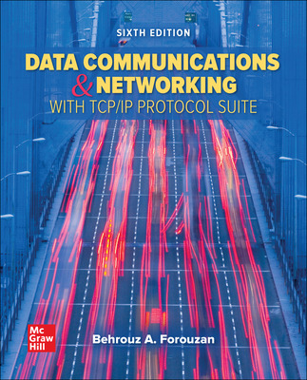
Textbook
Required Textbook: Forouzan, Behrouz, Data Communications & Networking with TCP/IP protocol Suite, 6th Edition, McGraw Hill 2022.
ISBN10: 0078022096, ISBN13: 9780078022098

Slide 3
What is covered in the course
Lecture Portion
Network Applications & Network programming
Data communications (low level details)
Packet switching and network technologies
Internetworking with TCP/IP
Other concepts such as interoperability standards, protocol suites and layering models
Practical portion
Virtual Machine networking
Some additional latest topics

Slide 4
Socket programming
All underlying network applications such as email, ftp, web, etc. use underlying technologies and programs
The goal of this course is not to teach you programming. Students should write three socket programs in a language of their choice

Slide 5
Data Communication
Technologies used to send data across communication lines
Modulation
Digital to analog
Light
Multiplexing
Encryption

Slide 6
Website used
All assignments and study questions will be posted at
http://faculty.utpa.edu/jabraham/schcurrent.htm
Also check the Blackboard

Slide 7
Multiple choice questions
I will post multiple choice questions for each chapter. Please check your answers with the key I will post.
Many of the exam questions will be taken from these quizzes. If you do not do them, more than likely you fail the exams.

Slide 8
Attendance
Attendance and class participation is required to pass the course. If you must miss an exam, make prior arrangements. No make-up exams will be given unless you contact me in advance!
Late homework will be levied heavy penalties. Penalty:
Fall: One day late 10%, 1 week late 20%, 2 weeks late 50%. Not accepted afterwards.
Summer: 1 day late 10%, 2 days late 20%, 1 week late 50%, not accepted after 1 week.

Slide 9
Grading
Midterm and Final Exams 60%
Practical portion (labs), programming 35%
Attendance 5%

Slide 10
Practical portion (lab)
Virtual Machine
Share files - SAMBA
Peer to Peer
Ethical Hacking
Socket Programming
RDP
Domain
Netadmin (Tools)
Join the domain
Create Security groups
Grant local Admin rights
Packet analyzer Cisco Academy
WSUS
Backup
IIS
Current topics

