Slide 1

Chapter 09
Transport Layer
Data Communications and Networking, With TCP/IP protocol suite
Sixth Edition
Behrouz A. Forouzan
© 2022 McGraw Hill, LLC. All rights reserved. Authorized only for instructor use in the classroom.
No reproduction or further distribution permitted without the prior written consent of McGraw Hill, LLC.

Slide 2
Chapter 9: Outline
9.1 Transport-Layer Services
9.2 Transport-Layer Protocols
9.2 User-Datagram Protocol (UDP)
9.3 Transmission Control Protocol (TCP)
9.4 Stream Control Transmission Protocol (SCTP)

Slide 3
9-1 TRANSPORT LAYER SERVICES
The transport layer is located between the application layer and the network layer. It provides a process-to-process communication between two application layers, one at the local host and the other at the remote host. Communication is provided using a logical connection. Figure 9.1 shows the idea behind this logical connection.

Slide 4
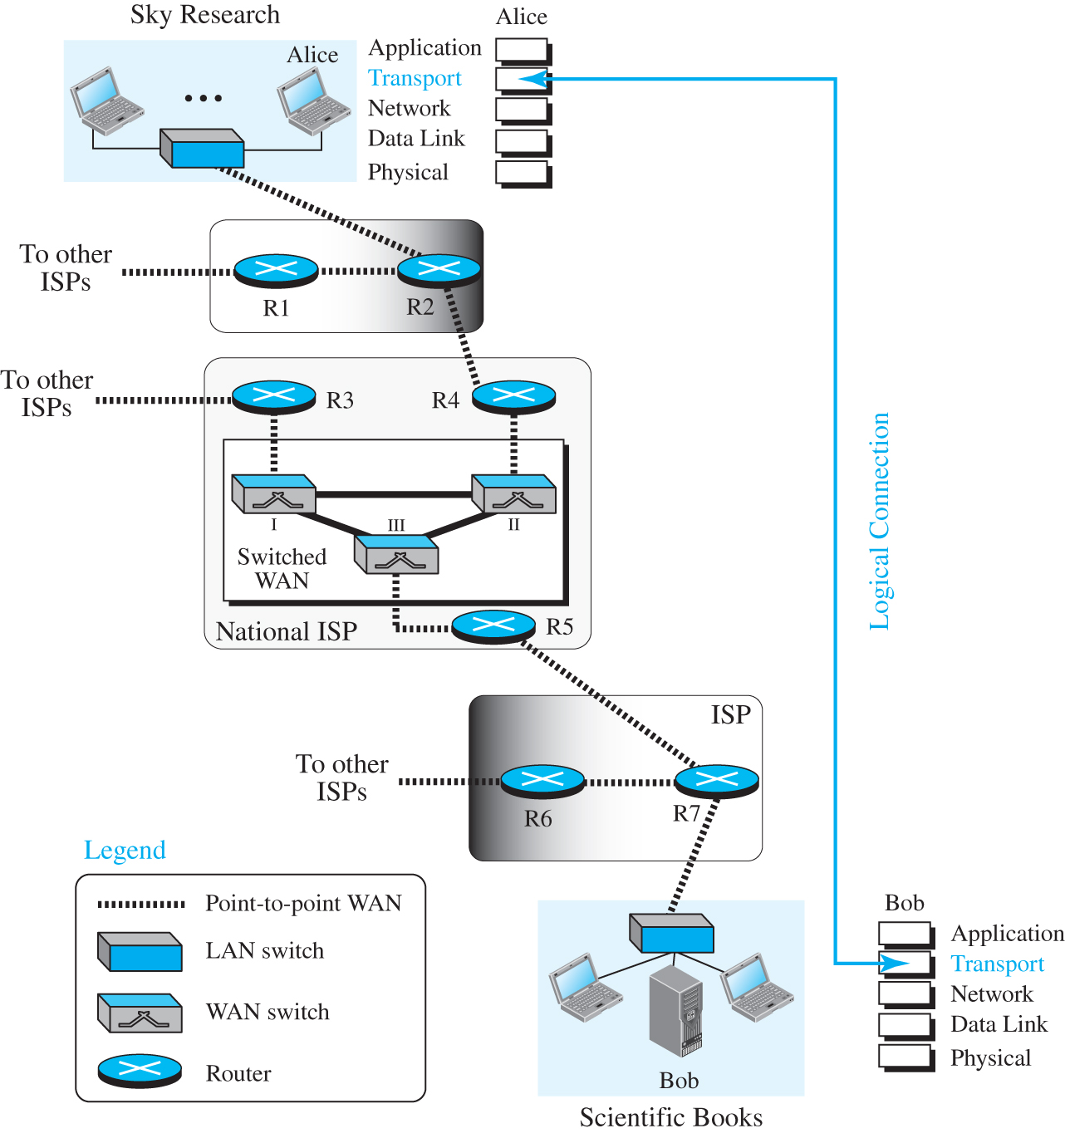
Figure 9.1 Logical connection at the transport layer
Access the text alternative for slide images.

Slide 5
9.1.1 Process-to-Process Communication
The first duty of a transport-layer protocol is to provide process-to-process communication. A process is an application-layer entity (running program) that uses the services of the transport layer. Before we discuss how process-to-process communication can be accomplished, we need to understand the difference between host-to-host communication and process-to-process communication.

Slide 6
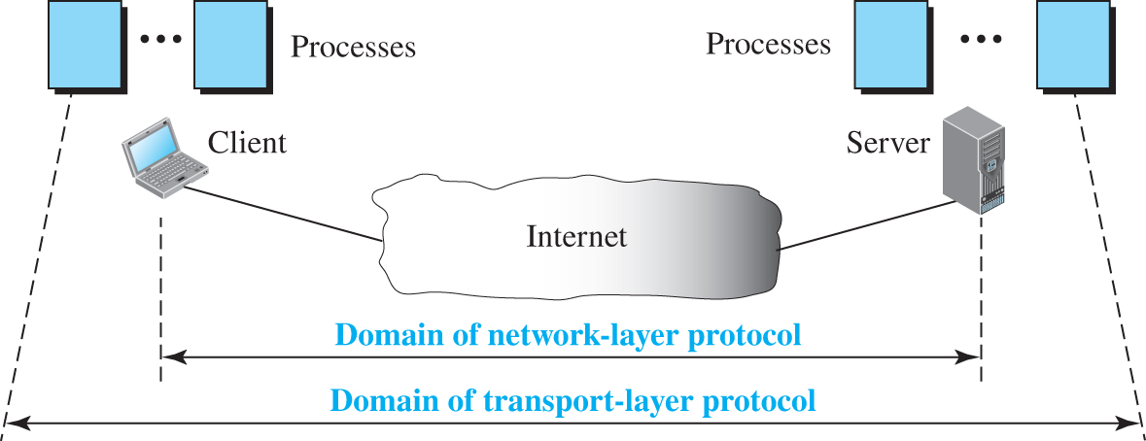
Figure 9.2 Network layer versus transport layer
Access the text alternative for slide images.

Slide 7
9.1.2 Addressing: Port Numbers
Although there are a few ways to achieve process-to-process communication, the most common is through the client-server paradigm. A process on the local host, called a client, needs services from a process usually on the remote host, called a server.
However, operating systems today support both multiuser and multiprogramming environments. A remote computer can run several programs at the same time, just as several local computers can run one or more client programs at the same time.

Slide 8
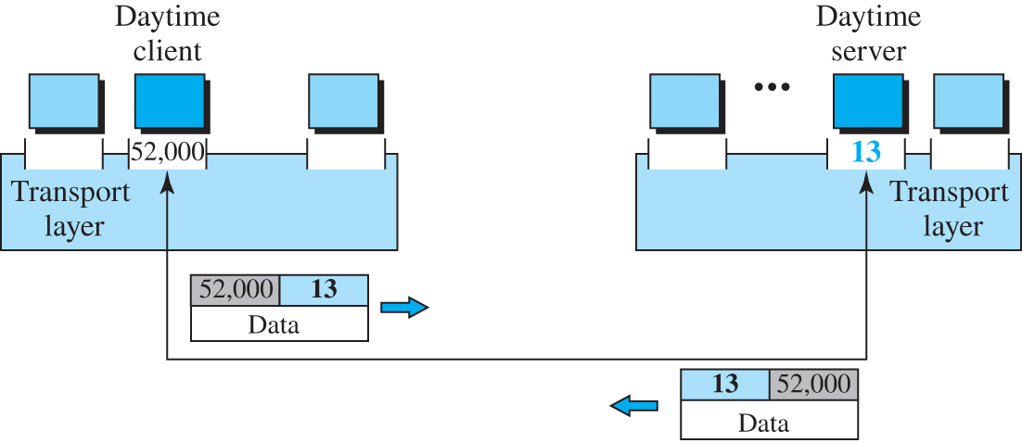
Figure 9.3 Port numbers
Access the text alternative for slide images.

Slide 9
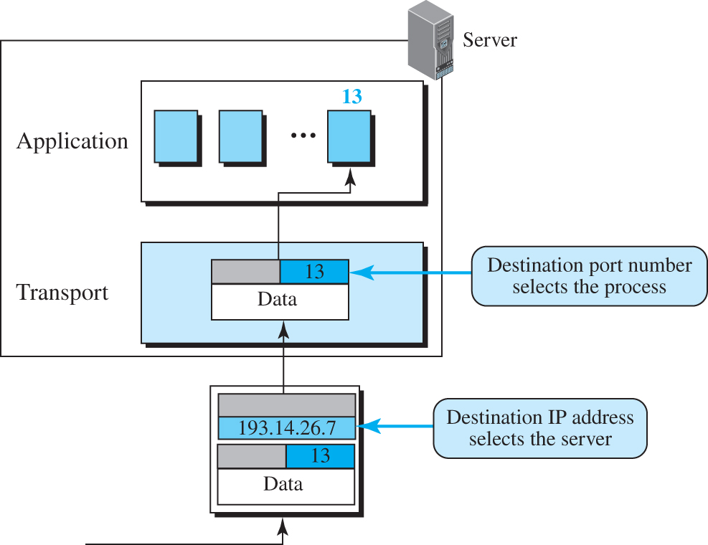
Figure 9.4 IP addresses versus port numbers
Access the text alternative for slide images.

Slide 10
ICANN Ranges
ICANN (Internet Corporation for Assigned Names and Numbers) has divided the port numbers into three ranges: well-known, registered, and dynamic (or private).

Slide 11
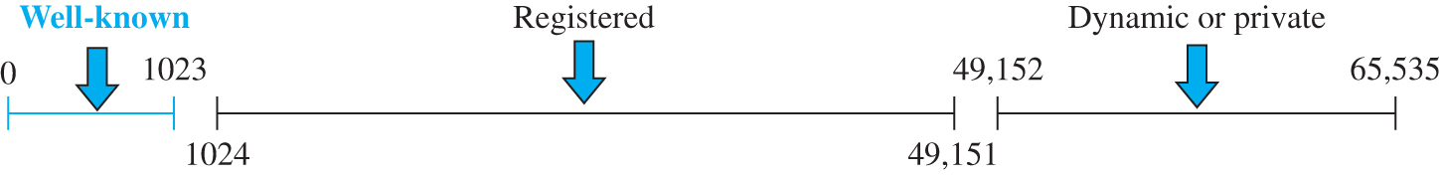
Figure 9.5 ICANN ranges
Access the text alternative for slide images.

Slide 12
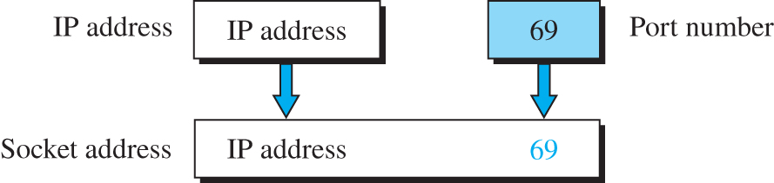
Figure 9.6 Socket address

Slide 13
9.1.3 Encapsulation and Decapsulation
To send a message from one process to another, the transport-layer protocol encapsulates and decapsulates messages. Encapsulation happens at the sender site. When a process has a message to send, it passes the message to the transport layer along with a pair of socket addresses and some other pieces of information, which depend on the transport-layer protocol. The transport layer receives the data and adds the transport-layer header.

Slide 14
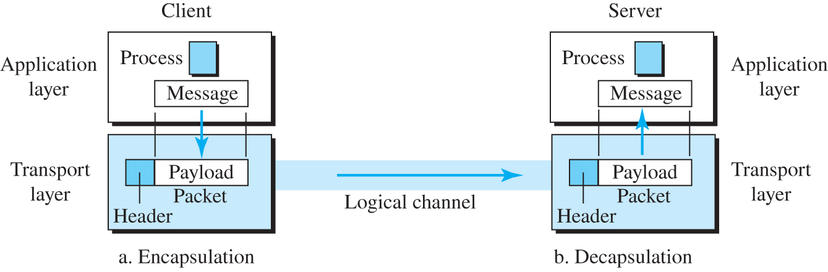
Figure 9.7 Encapsulation and decapsulation
Access the text alternative for slide images.

Slide 15
9.1.4 Multiplexing and Demultiplexing
Whenever an entity accepts items from more than one source, this is referred to as multiplexing (many to one); whenever an entity delivers items to more than one source, this is referred to as demultiplexing (one to many). The transport layer at the source performs multiplexing; the transport layer at the destination performs demultiplexing.

Slide 16
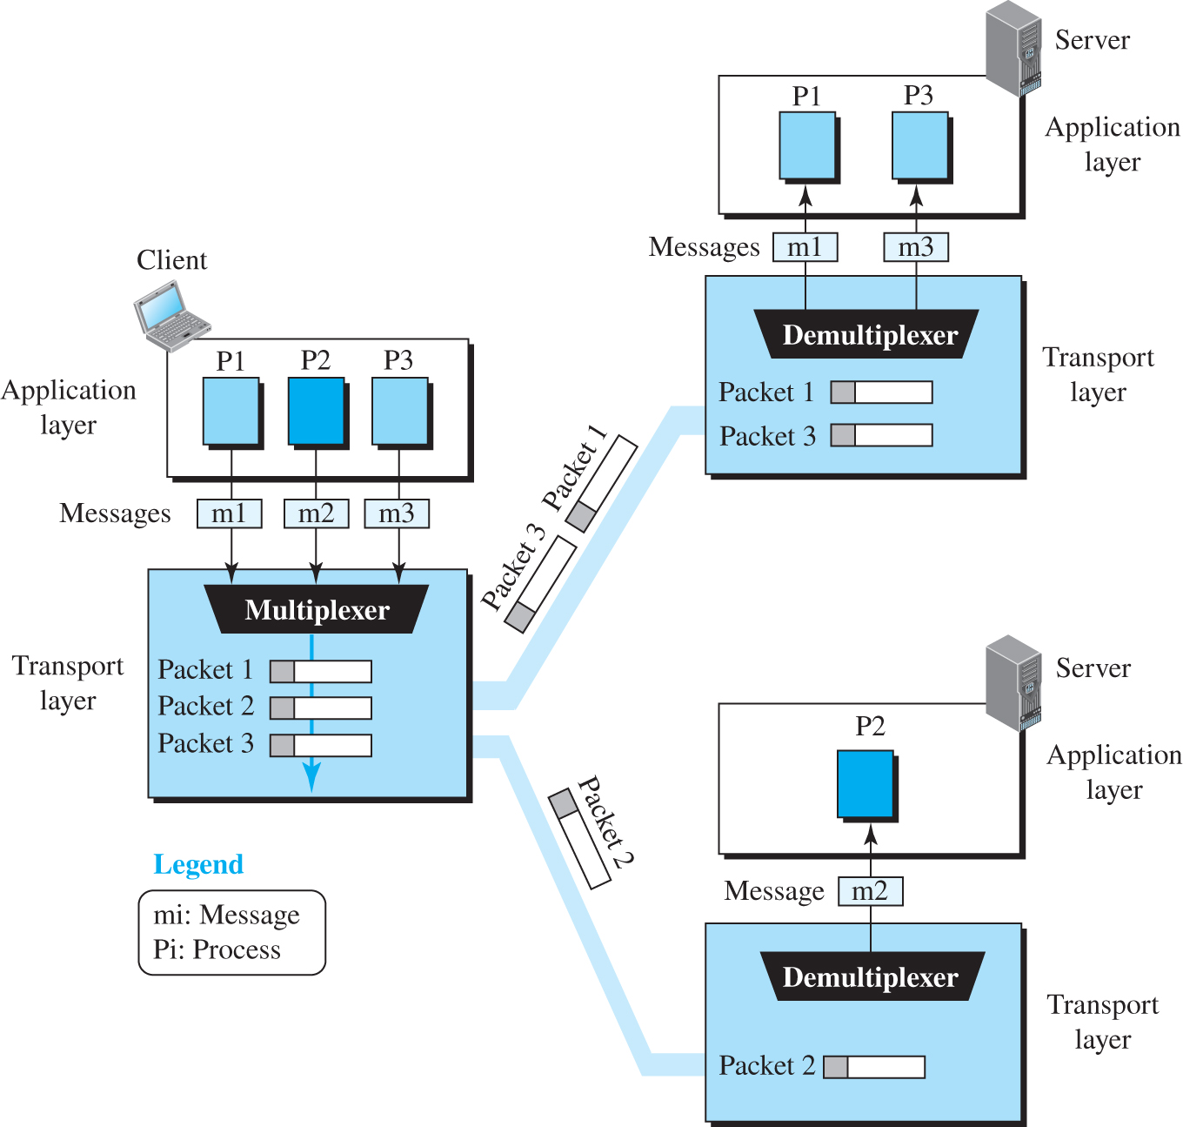
Figure 9.8 Multiplexing and demultiplexing
Access the text alternative for slide images.

Slide 17
9.1.5 Flow Control
Whenever an entity produces items and another entity consumes them, there should be a balance between production and consumption rates. If the items are produced faster than they can be consumed, the consumer can be overwhelmed and may need to discard some items. If the items are produced more slowly than they can be consumed, the consumer must wait, and the system becomes less efficient. Flow control is related to the first issue. We need to prevent losing the data items at the consumer site.

Slide 18
Pushing and Pooling
Delivery of items from a producer to a consumer can occur in one of two ways: pushing or pulling. If the sender delivers items whenever they are produced without a prior request from the consumer, the delivery is referred to as pushing. If the producer delivers the items after the consumer has requested them, the delivery is referred to as pulling these two types of delivery.

Slide 19
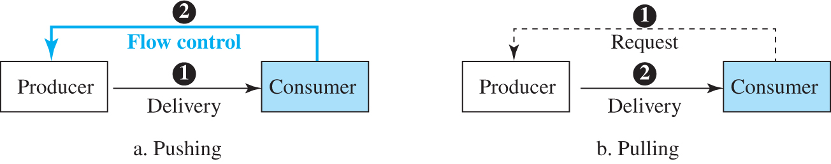
Figure 9.9 Pushing or pulling
Access the text alternative for slide images.

Slide 20
Handling Error Control
In communication at the transport layer, we are dealing with four entities: sender process, sender transport layer, receiver transport layer, and receiver process. The sending process at the application layer is only a producer. It produces message chunks and pushes them to the transport layer. The sending transport layer has a double role: it is both a consumer and a producer. It consumes the messages pushed by the producer. It encapsulates the messages in packets and pushes them to the receiving transport layer. The receiving transport layer also has a double role, it is the consumer for the packets received from the sender and the producer that decapsulates the messages and delivers them to the application layer.

Slide 21
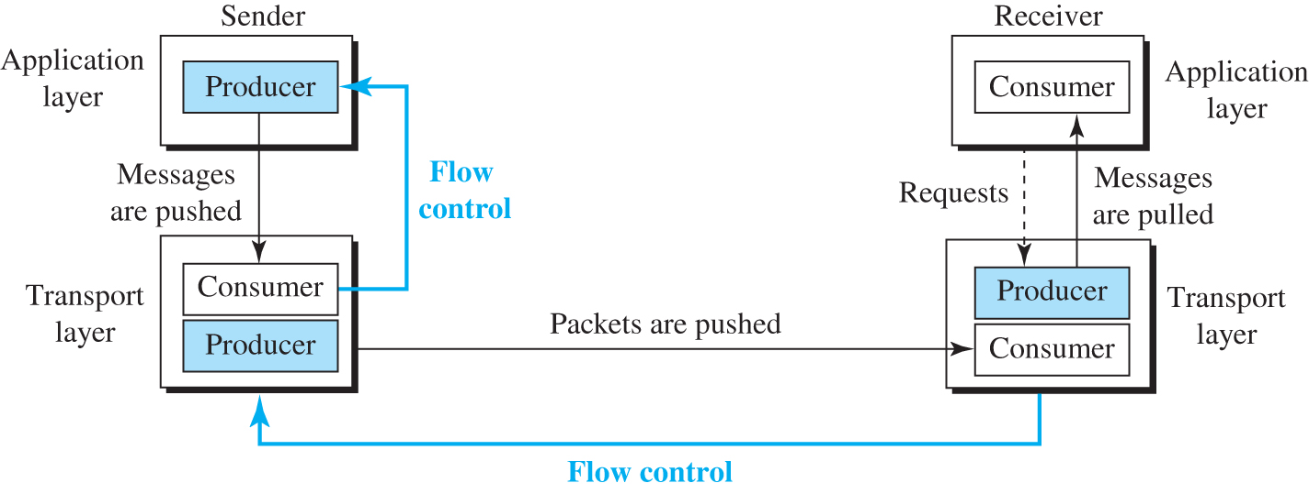
Figure 9.10 Flow control at the transport layer
Access the text alternative for slide images.

Slide 22
Example 9.1
The above discussion requires that the consumers communicate with the producers on two occasions: when the buffer is full and when there are vacancies. If the two parties use a buffer with only one slot, the communication can be easier. Assume that each transport layer uses one single memory location to hold a packet. When this single slot in the sending transport layer is empty, the sending transport layer sends a note to the application layer to send its next chunk; when this single slot in the receiving transport layer is empty, it sends an acknowledgment to the sending transport layer to send its next packet. As we will see later, however, this type of flow control, using a single-slot buffer at the sender and the receiver, is inefficient.

Slide 23
9.1.6 Error Control
In the Internet, since the underlying network layer (IP) is unreliable, we need to make the transport layer reliable if the application requires reliability. Reliability can be achieved to add error control services to the transport layer. Error control at the transport layer is responsible for:
Detecting and discarding corrupted packets.
Keeping track of lost and discarded packets and resending them.
Recognizing duplicate packets and discarding them.
Buffering out-of-order packets until the missing packets arrive.

Slide 24
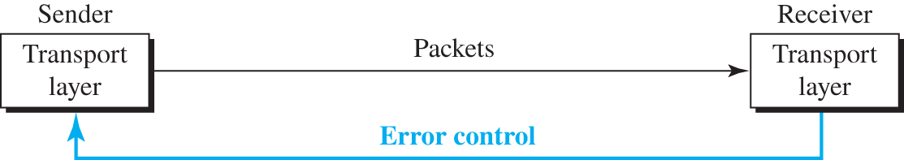
Figure 9.11 Error control at the transport layer
Access the text alternative for slide images.

Slide 25
9.1.7 Combination of Flow and Error Control
We have discussed that flow control requires the use of two buffers, one at the sender site and the other at the receiver site. We have also discussed that error control requires the use of sequence and acknowledgment numbers by both sides. These two requirements can be combined if we use two numbered buffers, one at the sender, one at the receiver.

Slide 26
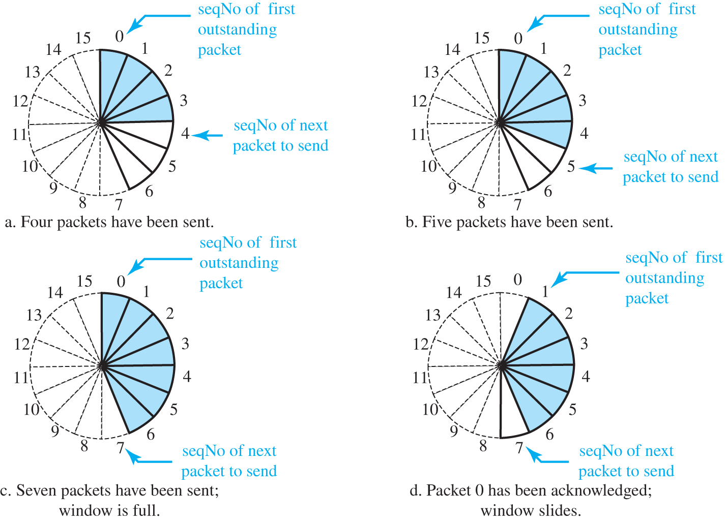
Figure 9.12 Sliding window in circular format
Access the text alternative for slide images.

Slide 27
9.1.8 Congestion Control
An important issue in a packet-switched network, such as the Internet, is congestion. Congestion in a network may occur if the load on the network—the number of packets sent to the network—is greater than the capacity of the network—the number of packets a network can handle. Congestion control refers to the mechanisms and techniques that control the congestion and keep the load below the capacity.

Slide 28
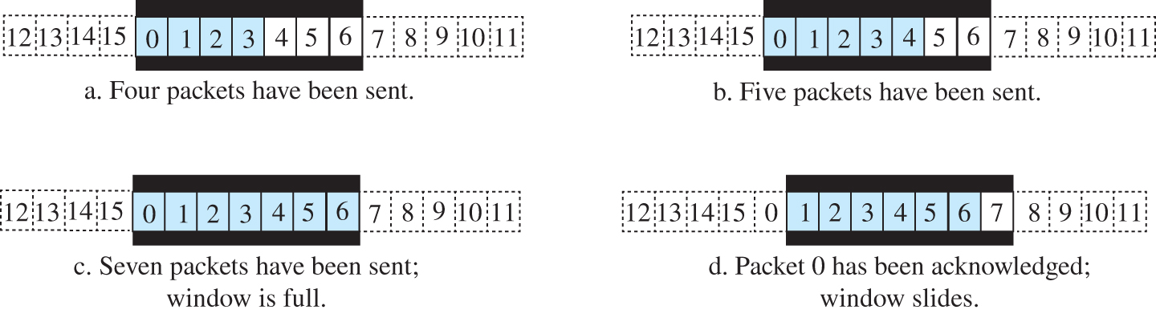
Figure 9.13 Sliding window in linear format
Access the text alternative for slide images.

Slide 29
9.1.9 Connectionless and Connection-Oriented Protocol
A transport-layer protocol, like a network-layer protocol, can provide two types of services: connectionless and connection-oriented. The nature of these services at the transport layer, however, is different from the ones at the network layer. At the network layer, a connectionless service may mean different paths for different datagrams belonging to the same message. Connectionless service at the transport layer means independency between packets; connection-oriented means dependency. Let us elaborate on these two services.

Slide 30
Connectionless Service
In a connectionless service, the source process needs to divide its message into chunks of data of the size acceptable by the transport layer and deliver them to the transport layer one by one. The transport layer treats each chunk as a single unit without any relation between the chunks. When a chunk arrives from the application layer, the transport layer encapsulates it in a packet and sends it. (Figure 9.14).

Slide 31
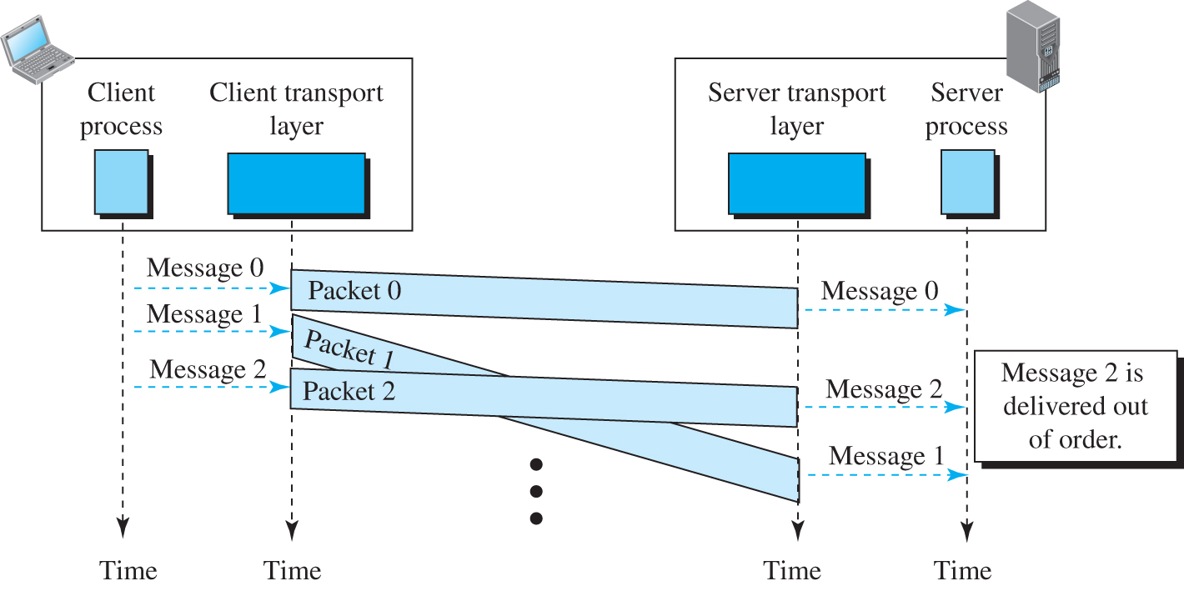
Figure 9.14 Connectionless service
Access the text alternative for slide images.

Slide 32
Connection-Oriented Service 1
In a connection-oriented service, the client and the server first need to establish a logical connection between themselves. The data exchange can only happen after the connection establishment. After data exchange, the connection needs to be torn down (Figure 9.15).

Slide 33
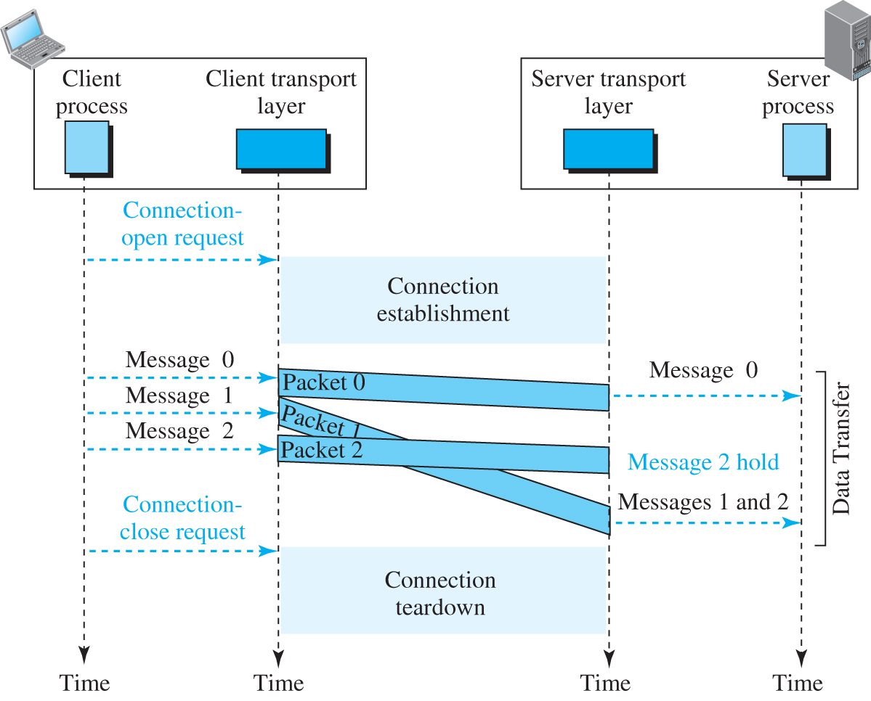
Figure 9.15 Connection-oriented service
Access the text alternative for slide images.

Slide 34
Finite State Machine
The behavior of a transport-layer protocol, both when it provides a connectionless and when it provides a connection-oriented protocol, can be better shown as a finite state machine (FSM). Figure 9.16 shows a representation of a transport layer using an FSM. Using this tool, each transport layer (sender or receiver) is taught as a machine with a finite number of states. The machine is always in one of the states until an event occurs.

Slide 35
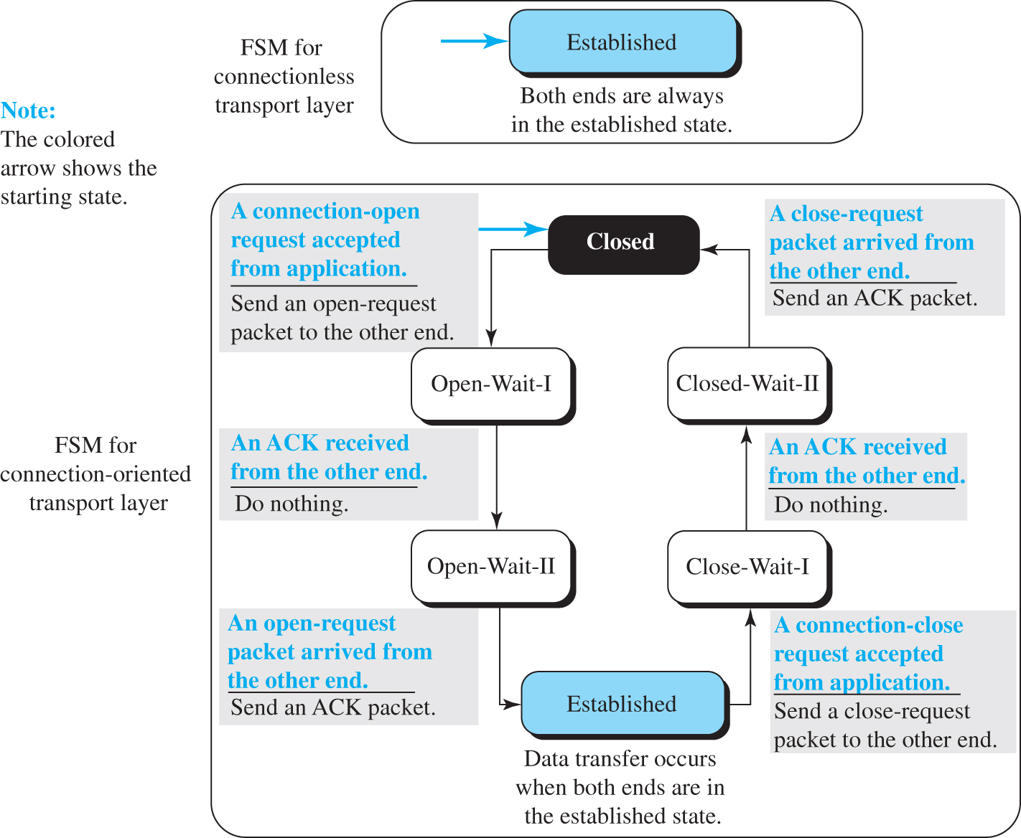
Figure 9.16 Connectionless and connection-oriented service represented as FSMs
Access the text alternative for slide images.

Slide 36
9-2 TRANSPORT-LAYER PROTOCOLS
After discussing the general principle behind the transport layer in the previous section, we concentrate on the transport protocols in the Internet in this section. shows the position of these three protocols in the TCP/IP protocol suite: UDP, TCP, and SCTP.

Slide 37
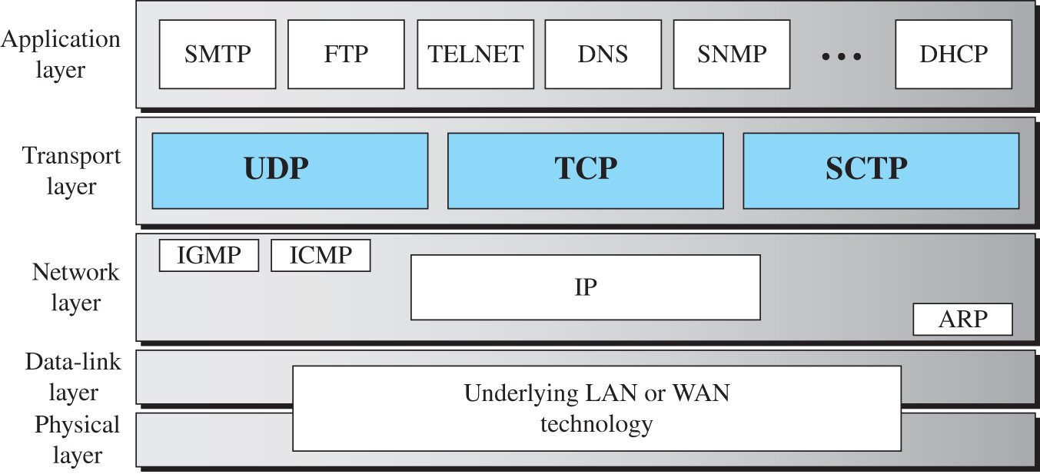
Figure 9.17 Position of transport-layer protocols in the TCP/IP protocol suite
Access the text alternative for slide images.

Slide 38
9.2.1 Services
Each protocol provides a different type of service and should be used appropriately.

Slide 39
UDP
UDP is an unreliable connectionless transport-layer protocol used for its simplicity and efficiency in applications where error control can be provided by the application-layer process.

Slide 40
TCP
TCP is a reliable connection-oriented protocol that can be used in any application where reliability is important.

Slide 41
SCTP
SCTP is a new transport-layer protocol that combines the features of UDP and TCP.

Slide 42
9.2.2 Port Numbers
A transport-layer protocol usually has several responsibilities. One is to create a process-to-process communication; these protocols use port numbers to accomplish this. Port numbers provide end-to-end addresses at the transport layer and allow multiplexing and de-multiplexing at this layer, just as IP addresses do at the network layer. Table 9.1 gives some common port numbers for all three protocols we discuss in this chapter.

Slide 43
Table 9.1 Some well-known ports used with UDP and TCP
Port | Protocol | UDP | TCP | SCTP | Description
7 | Echo | √ | √ | √ | Echoes back a received datagram
9 | Discard | √ | √ | √ | Discards any datagram that is received
11 | Users | √ | √ | √ | Active users
13 | Daytime | √ | √ | √ | Returns the date and the time
17 | Quote | √ | √ | √ | Returns a quote of the day
19 | Chargen | √ | √ | √ | Returns a string of characters
20 | FTP-data |  | √ | √ | File Transfer Protocol
21 | FTP-21 |  | √ | √ | File Transfer Protocol
23 | TELNET |  | √ | √ | Terminal Network
25 | SMTP |  | √ | √ | Simple Mail Transfer Protocol
53 | DNS | √ | √ | √ | Domain Name System
67 | DHCP | √ | √ | √ | Dynamic Host Configuration Protocol
69 | TFTP | √ | √ | √ | Trivial File Transfer Protocol
80 | HTTP |  | √ | √ | Hypertext Transfer Protocol
111 | RPC | √ | √ | √ | Remote Procedure Call
123 | NTP | √ | √ | √ | Network Time Protocol
161 | SNMP-server | √ |  |  | Simple Network Management Protocol
162 | SNMP-client | √ |  |  | Simple Network Management Protocol

Slide 44
9-3 USER DADAGRAM PROTOCOL (UDP)
The User Datagram Protocol (UDP) is a connectionless, unreliable transport protocol. If UDP is so powerless, why would a process want to use it? With the disadvantages come some advantages. UDP is a very simple protocol using a minimum of overhead.

Slide 45
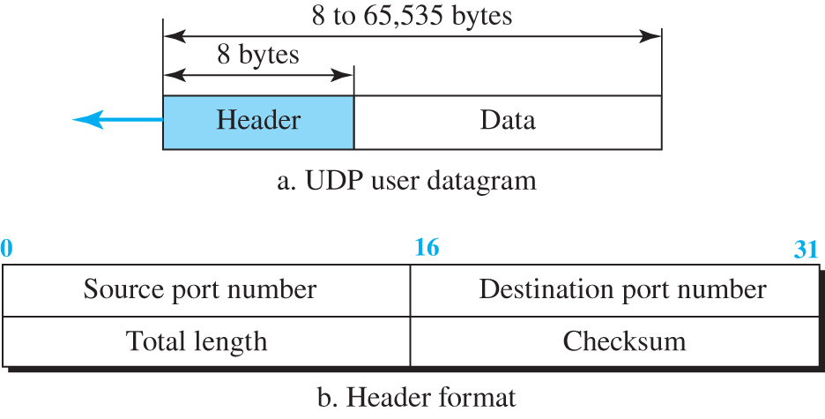
Figure 9.18 User datagram packet format
Access the text alternative for slide images.

Slide 46
Example 9.2 (1)
The following is the contents of a UDP header in hexadecimal format.
CB84000D001C001C
What is the source port number?
What is the destination port number?
What is the total length of the user datagram?
What is the length of the data?
Is the packet directed from a client to a server or vice versa?
What is the client process?

Slide 47
Example 9.2 (2)
Solution
The source port number is the first four hexadecimal digits (CB84)₁₆ or 52100
The destination port number is the second four hexadecimal digits (000D)₁₆ or 13.
The third four hexadecimal digits (001C)₁₆ define the length of the whole UDP packet as 28 bytes.
The length of the data is the length of the whole packet minus the length of the header, or 28 − 8 = 20 bytes.
Since the destination port number is 13 (well-known port), the packet is from the client to the server.
The client process is the Daytime.

Slide 48
9.3.1 UDP Services
Earlier we discussed the general services provided by a transport-layer protocol. In this section, we discuss what portions of those general services are provided by UDP.

Slide 49
Process-to-Process Communication 1
UDP provides process-to-process communication using socket addresses, a combination of IP addresses and port numbers.

Slide 50
Connectionless Services
As mentioned previously, UDP provides a connectionless service. This means that each user datagram sent by UDP is an independent datagram. There is no relationship between the different user datagrams even if they are coming from the same source process and going to the same destination program. The user datagrams are not numbered.

Slide 51
Flow Control
UDP is a very simple protocol. There is no flow control, and hence no window mechanism. The receiver may overflow with incoming messages. The lack of flow control means that the process using UDP should provide for this service, if needed.

Slide 52
Error Control
There is no error control mechanism in UDP except for the checksum. This means that the sender does not know if a message has been lost or duplicated. When the receiver detects an error through the checksum, the user datagram is silently discarded. The lack of error control means that the process using UDP should provide for this service, if needed.

Slide 53
Checksum 1
UDP checksum calculation includes three sections: a pseudo-header, the UDP header, and the data coming from the application layer. The pseudo-header is the part of the header of the IP packet in which the user datagram is to be encapsulated with some fields filled with 0s.

Slide 54
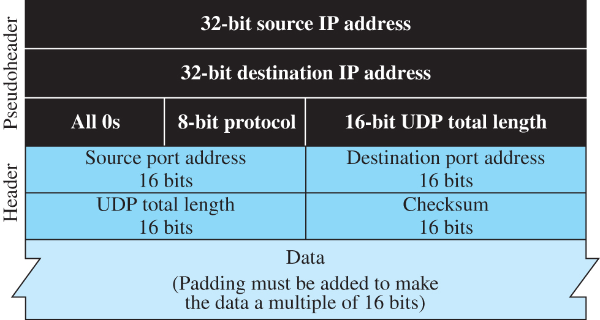
Figure 9.19 Pseudoheader for checksum calculation
Access the text alternative for slide images.

Slide 55
Example 9.3
What value is sent for the checksum in one of the following hypothetical situations?
The sender decides not to include the checks
The sender decides to include the checksum, but the value of the sum is all 1s.
The sender decides to include the checksum, but the value of the sum is all 0s.

Slide 56
Example 9.3 Solution
The value sent for the checksum field is all 0s to show that the checksum is not -calculated.
When the sender complements the sum, the result is all 0s; the sender complements the result again before sending. The value sent for the checksum is all 1s. The second -complement operation is needed to avoid confusion with the case in part a.
This situation never happens because it implies that the value of every term included in the calculation of the sum is all 0s, which is impossible; some fields in the pseudo-header have nonzero values.

Slide 57
Congestion Control 1
Since UDP is a connectionless protocol, it does not provide congestion control. UDP assumes that the packets sent are small and sporadic and cannot create congestion in the network. This assumption may or may not be true today, when UDP is used for interactive real-time transfer of audio and video.

Slide 58
Encapsulation and Decapsulation
To send a message from one process to another, the UDP protocol encapsulates and decapsulates messages.

Slide 59
Queuing
We have talked about ports without discussing the actual implementation of them. In UDP, queues are associated with ports.
At the client site, when a process starts, it requests a port number from the operating system. Some implementations create both an incoming and an outgoing queue associated with each process. Other implementations create only an incoming queue associated with each process.

Slide 60
Multiplexing and Demultiplexing 1
In a host running a TCP/IP protocol suite, there is only one UDP but possibly several processes that may want to use the services of UDP. To handle this situation, UDP multiplexes and demultiplexes.

Slide 61
Comparison
We can compare UDP with the connectionless simple protocol we discussed earlier. The only difference is that UDP provides an optional checksum to detect corrupted packets at the receiver site. If the checksum is added to the packet, the receiving UDP can check the packet and discard the packet if it is corrupted. No feedback, however, is sent to the sender.

Slide 62
9.3.2 UDP Applications
Although UDP meets almost none of the criteria we mentioned earlier for a reliable transport-layer protocol, UDP is preferable for some applications. The reason is that some services may have some side effects that are either unacceptable or not preferable. An application designer sometimes needs to compromise to get the optimum. For example, in our daily life, we all know that a one-day delivery of a package by a carrier is more expensive than a three-day delivery. Although high speed and low cost are both desirable features in delivery of a parcel, they are in conflict with each other.

Slide 63
UDP Features
We briefly discuss some features of UDP and their advantages and disadvantages.

Slide 64
Example 9.4
A client-server application such as DNS uses the services of UDP because a client needs to send a short request to a server and to receive a quick response from it. The request and response can each fit in one user datagram. Since only one message is exchanged in each direction, the connectionless feature is not an issue; the client or server does not worry that messages are delivered out of order.

Slide 65
Example 9.5
A client-server application such as SMTP, which is used in electronic mail, cannot use the services of UDP because a user can send a long e-mail message, which may include multimedia (images, audio, or video). If the application uses UDP and the message does not fit in one single user datagram, the message must be split by the application into different user datagrams. Here the connectionless service may create problems. The user datagrams may arrive and be delivered to the receiver application out of order. The receiver application may not be able to reorder the pieces. This means the connectionless service has a disadvantage for an application program that sends long messages.

Slide 66
Example 9.6
Assume we are downloading a very large text file from the Internet. We definitely need to use a transport layer that provides reliable service. We don’t want part of the file to be missing or corrupted when we open the file. The delay created between the deliveries of the parts is not an overriding concern for us; we wait until the whole file is composed before looking at it. In this case, UDP is not a suitable transport layer.

Slide 67
Example 9.7
Assume we are using a real-time interactive application, such as Skype. Audio and video are divided into frames and sent one after another. If the transport layer is supposed to resend a corrupted or lost frame, the synchronizing of the whole transmission may be lost. The viewer suddenly sees a blank screen and needs to wait until the second transmission arrives. This is not tolerable. However, if each small part of the screen is sent using one single user datagram, the receiving UDP can easily ignore the corrupted or lost packet and deliver the rest to the application program. That part of the screen is blank for a very short period of time, which most viewers do not even notice.

Slide 68
Typical Applications
UDP is suitable for a process that requires simple request-response communication with little concern for flow and error control.
UDP is suitable for a process with internal flow- and error-control mechanisms.
UDP is a suitable transport protocol for multicasting.
UDP is used for management processes such as SNMP.
UDP is used for some route updating protocols such as Routing Information Protocol (RIP).
UDP is normally used for interactive real-time applications that cannot tolerate uneven delay between sections of a received message.

Slide 69
9-4 TRANSMISSION CONTROL PROTOCOL
Transmission Control Protocol (TCP) is a connection-oriented, reliable protocol. TCP explicitly defines connection establishment, data transfer, and connection teardown phases to provide a connection-oriented service. TCP uses a combination of GBN and SR protocols to provide reliability.

Slide 70
9.4.1 TCP Services
Before discussing TCP in detail, let us explain the services offered by TCP to the processes at the application layer.

Slide 71
Process-to-Process Communication 2
Before discussing TCP in detail, let us explain the services offered by TCP to the processes at the application layer.

Slide 72
Stream Delivery Service
TCP allows the sending process to deliver data as a stream of bytes and allows the receiving process to obtain data as a stream of bytes. TCP creates an environment in which the two processes seem to be connected by an imaginary “tube” that carries their bytes across the Internet. This imaginary environment is depicted in Figure 9.20. The sending process produces (writes to) the stream and the receiving process consumes (reads from) it.

Slide 73
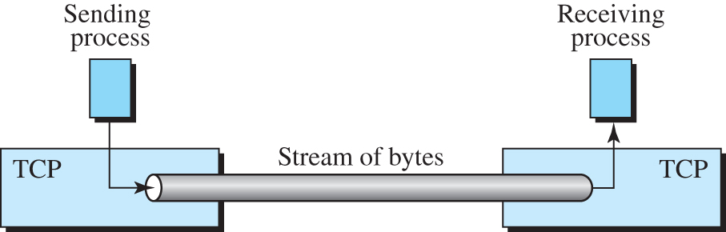
Figure 9.20 Stream delivery

Slide 74
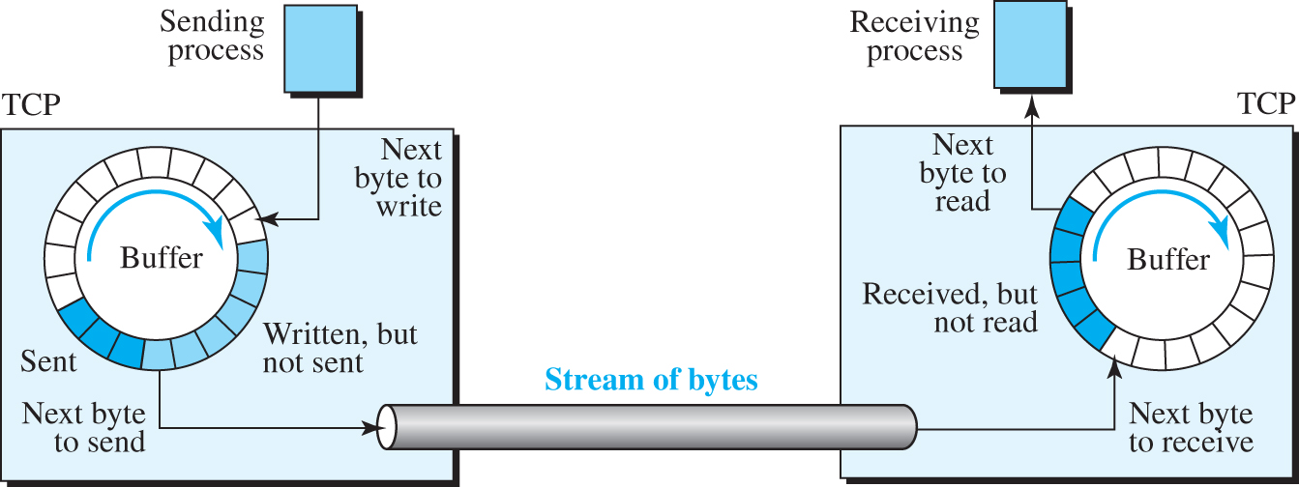
Figure 9.21 Sending and receiving buffers
Access the text alternative for slide images.

Slide 75
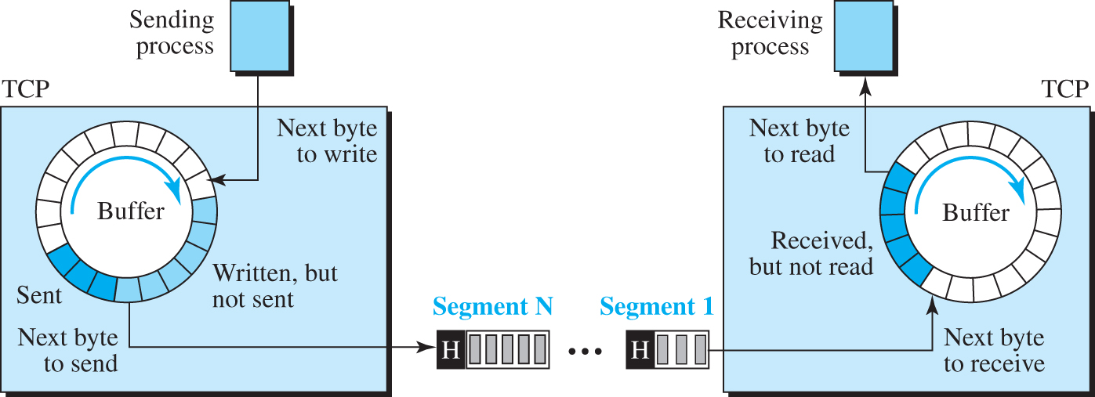
Figure 9.22 TCP segments
Access the text alternative for slide images.

Slide 76
Full-Duplex Communication 1
TCP offers full-duplex service, where data can flow in both directions at the same time. Each TCP endpoint then has its own sending and receiving buffer, and segments move in both directions.

Slide 77
Multiplexing and Demultiplexing 2
Like UDP, TCP performs multiplexing at the sender and demultiplexing at the receiver. However, since TCP is a connection-oriented protocol, a connection needs to be established for each pair of processes.

Slide 78
Connection-Oriented Service 2
TCP, unlike UDP, is a connection-oriented protocol. When a process at site A wants to send to and receive data from another process at site B, the following three phases occur:
The two TCP’s establish a logical connection.
Data are exchanged in both directions.
The connection is terminated.

Slide 79
Reliable Service 1
TCP is a reliable transport protocol. It uses an acknowledgment mechanism to check the safe and sound arrival of data. We will discuss this feature further in the section on error control.

Slide 80
9.4.2 TCP Features
To provide the services mentioned in the previous section, TCP has several features that are briefly summarized in this section and discussed later in detail.

Slide 81
Numbering System
Although the TCP software keeps track of the segments being transmitted or received, there is no field for a segment number value in the segment header. Instead, there are two fields, called the sequence number and the acknowledgment number. These two fields refer to a byte number and not a segment number.

Slide 82
Example 9.8
Suppose a TCP connection is transferring a file of 5,000 bytes. The first byte is numbered 10,001. What are the sequence numbers for each segment if data are sent in five segments, each carrying 1,000 bytes?
Solution
The following shows the sequence number for each segment:
Segment 1 | → | Sequence number: | 10,001 | Range: | 10,001 | to | 11,000
Segment 2 | → | Sequence number: | 11,001 | Range: | 11,001 | to | 12,000
Segment 3 | → | Sequence number: | 12,001 | Range: | 12,001 | to | 13,000
Segment 4 | → | Sequence number: | 13,001 | Range: | 13,001 | to | 14,000
Segment 5 | → | Sequence number: | 14,001 | Range: | 14,001 | to | 15,000

Slide 83
9.4.3 Segment
Before discussing TCP in more detail, let us discuss the TCP packets themselves. A packet in TCP is called a segment.

Slide 84
Format
The format of a segment is shown in Figure 9.23. The segment consists of a header of 20 to 60 bytes, followed by data from the application program. The header is 20 bytes if there are no options and up to 60 bytes if it contains options. We will discuss some of the header fields in this section. The meaning and purpose of these will become clearer as we proceed through the section.

Slide 85
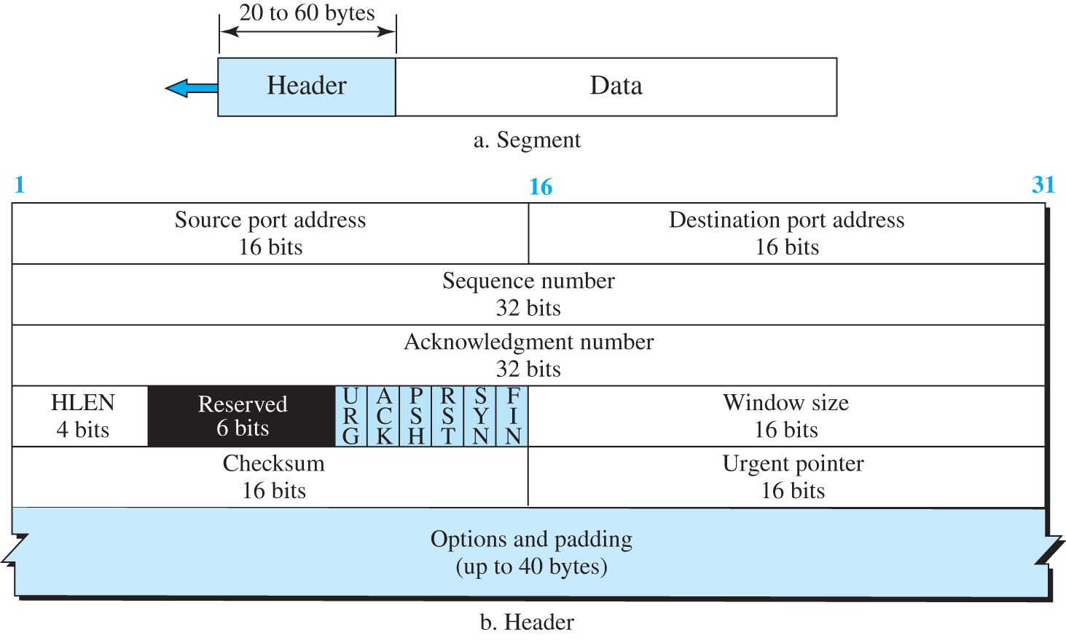
Figure 9.23 TCP segment format
Access the text alternative for slide images.

Slide 86
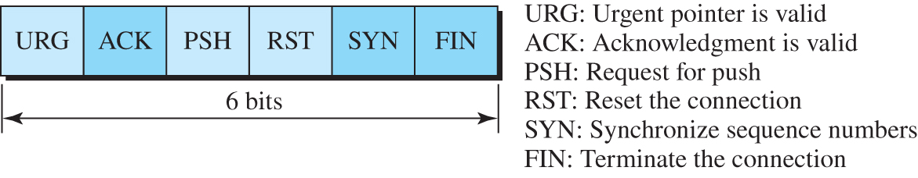
Figure 9.24 Control field
Access the text alternative for slide images.

Slide 87
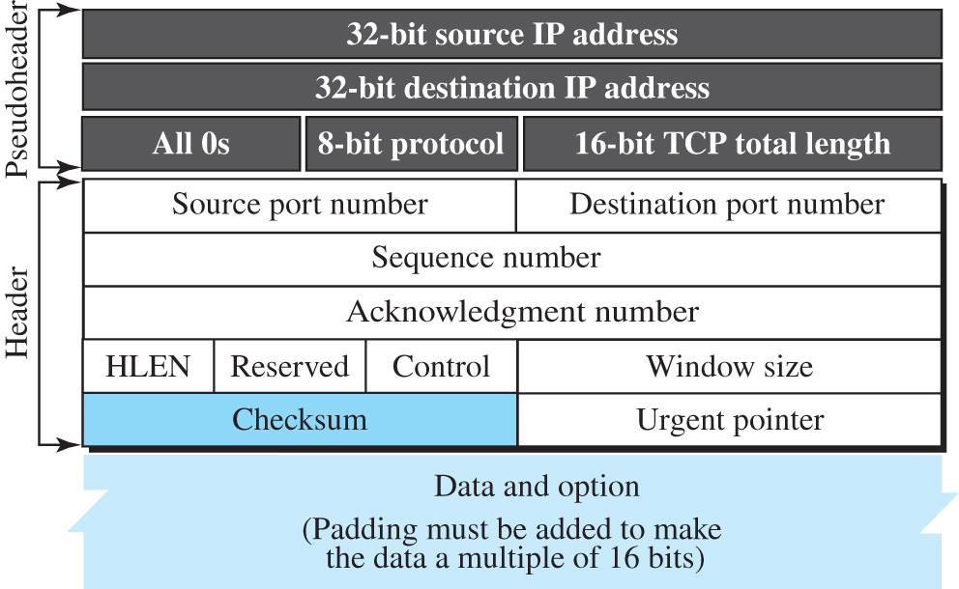
Figure 9.25 Pseudoheader added to the TCP datagram
Access the text alternative for slide images.

Slide 88
Encapsulation
A TCP segment encapsulates the data received from the application layer. The TCP segment is encapsulated in an IP datagram, which in turn is encapsulated in a frame at the data-link layer.

Slide 89
9.4.4 A TCP Connection
TCP is connection-oriented. All of the segments belonging to a message are then sent over this logical path. Using a single logical pathway for the entire message facilitates the acknowledgment process as well as retransmission of damaged or lost frames. You may wonder how TCP, which uses the services of IP, a connectionless protocol, can be connection-oriented. The point is that a TCP connection is logical, not physical. TCP operates at a higher level. TCP uses the services of IP to deliver individual segments to the receiver, but it controls the connection itself.

Slide 90
Connection Establishment
TCP transmits data in full-duplex mode. When two TCPs in two machines are connected, they are able to send segments to each other simultaneously. This implies that each party must initialize communication and get approval from the other party before any data are transferred.

Slide 91
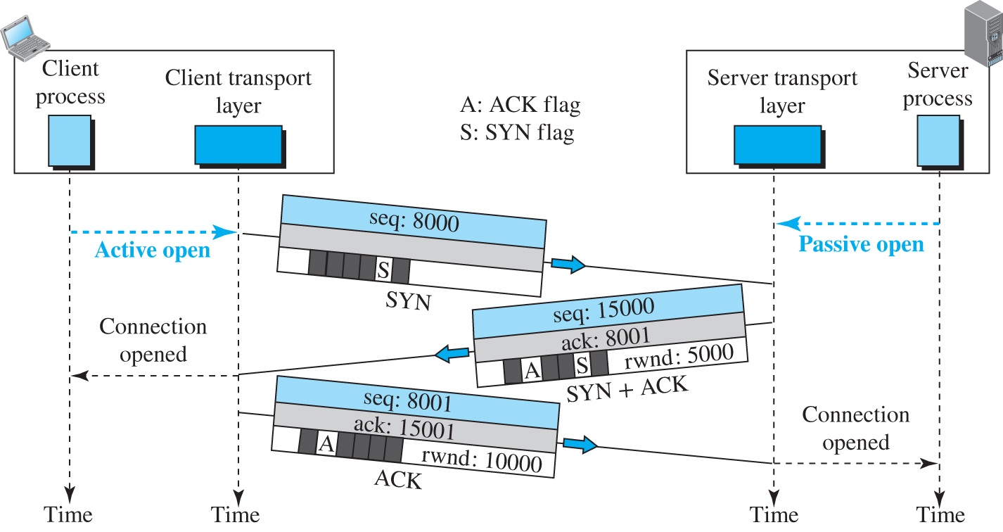
Figure 9.26 Connection establishment using three-way handshaking
Access the text alternative for slide images.

Slide 92
Data Transfer 1
After connection is established, bidirectional data transfer can take place. The client and server can send data and acknowledgments in both directions. We will study the rules of acknowledgment later in the chapter; for the moment, it is enough to know that data traveling in the same direction as an acknowledgment are carried on the same segment. The acknowledgment is piggybacked with the data. Figure 9.27 shows an example.

Slide 93
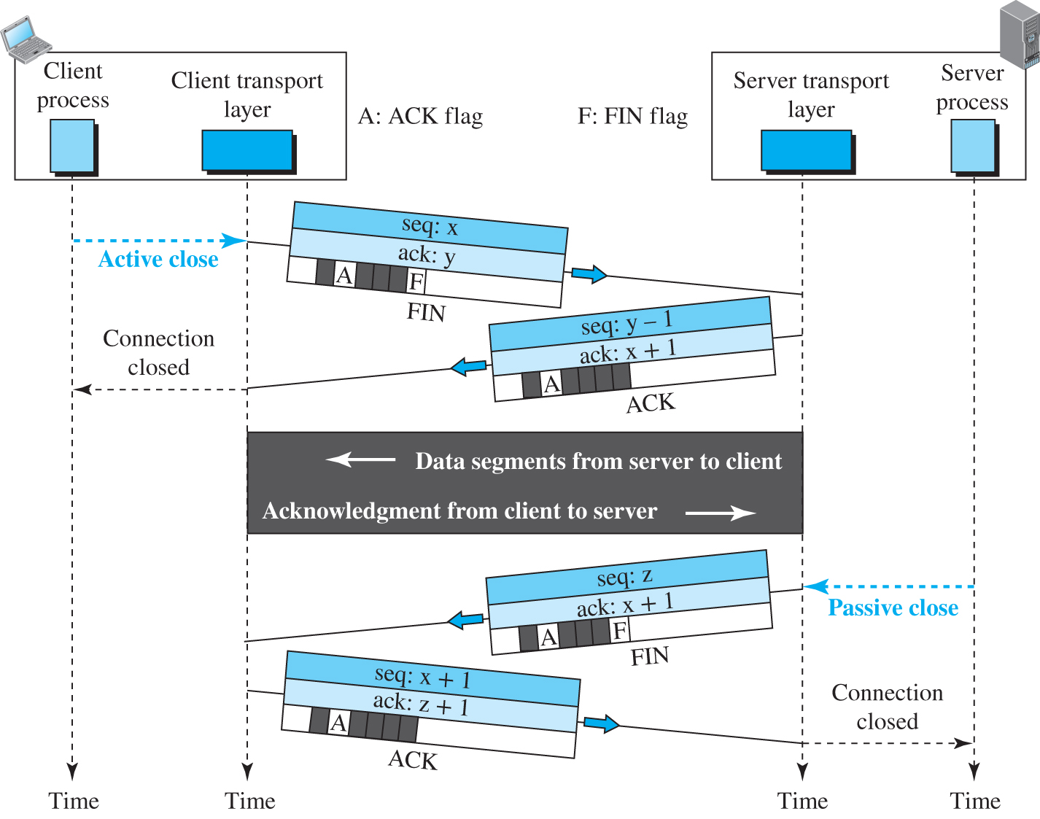
Figure 9.27 Data transfer
Access the text alternative for slide images.

Slide 94
Connection Termination
Either of the two parties involved in exchanging data (client or server) can close the connection, although it is usually initiated by the client. Most implementations today allow two options for connection termination: three-way handshaking and four-way handshaking with a half-close option.

Slide 95
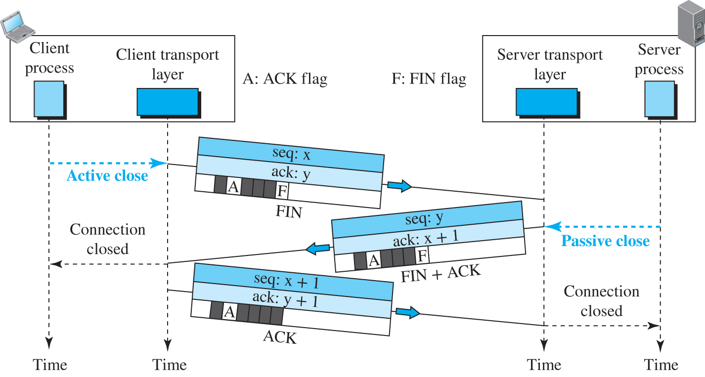
Figure 9.28 Connection termination using three-way handshaking
Access the text alternative for slide images.

Slide 96

Figure 9.29 Half-close
Access the text alternative for slide images.

Slide 97
Connection Reset
TCP at one end may deny a connection request, may abort an existing connection, or may terminate an idle connection. All of these are done with the RST (reset) flag.

Slide 98
9.4.5 State Transition Diagram
To keep track of all the different events happening during connection establishment, connection termination, and data transfer, TCP is specified as the finite state machine (FSM) as shown in Figure 9.30.

Slide 99
Scenarios
To understand the TCP state machines and the transition diagrams, we go through one scenario in this section.

Slide 100
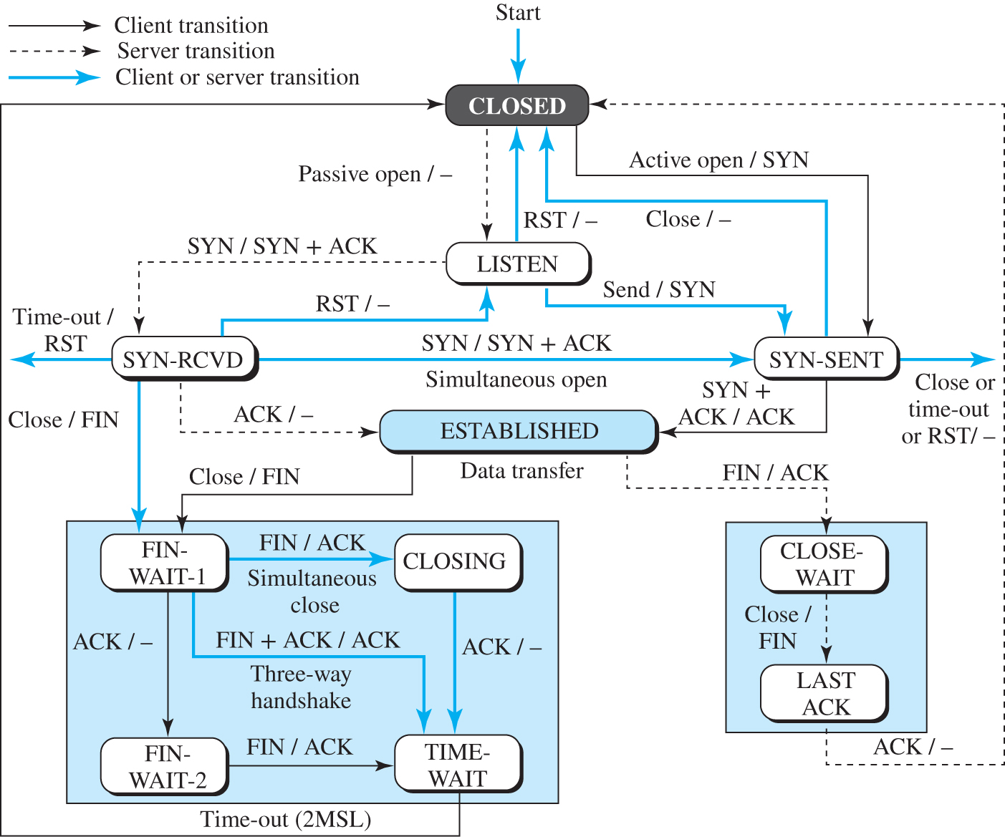
Figure 9.30 State transition diagram
Access the text alternative for slide images.

Slide 101
Table 9.2 States for TCP
State | Description
CLOSED | No connection exists
LISTEN | Passive open received; waiting for SYN
SYN-SENT | SYN sent; waiting for ACK
SYN-RCVD | SYN + ACK sent; waiting for ACK
ESTABLISHED | Connection established; data transfer in progress
FIN-WAIT-1 | First FIN sent; waiting for ACK
FIN-WAIT-2 | ACK to first FIN received; waiting for second FIN
CLOSE-WAIT | First FIN received, ACK sent; waiting for application to close
TIME-WAIT | Second FIN received, ACK sent; waiting for 2MSL time-out
LAST-ACK | Second FIN sent; waiting for ACK
CLOSING | Both sides decided to close simultaneously

Slide 102
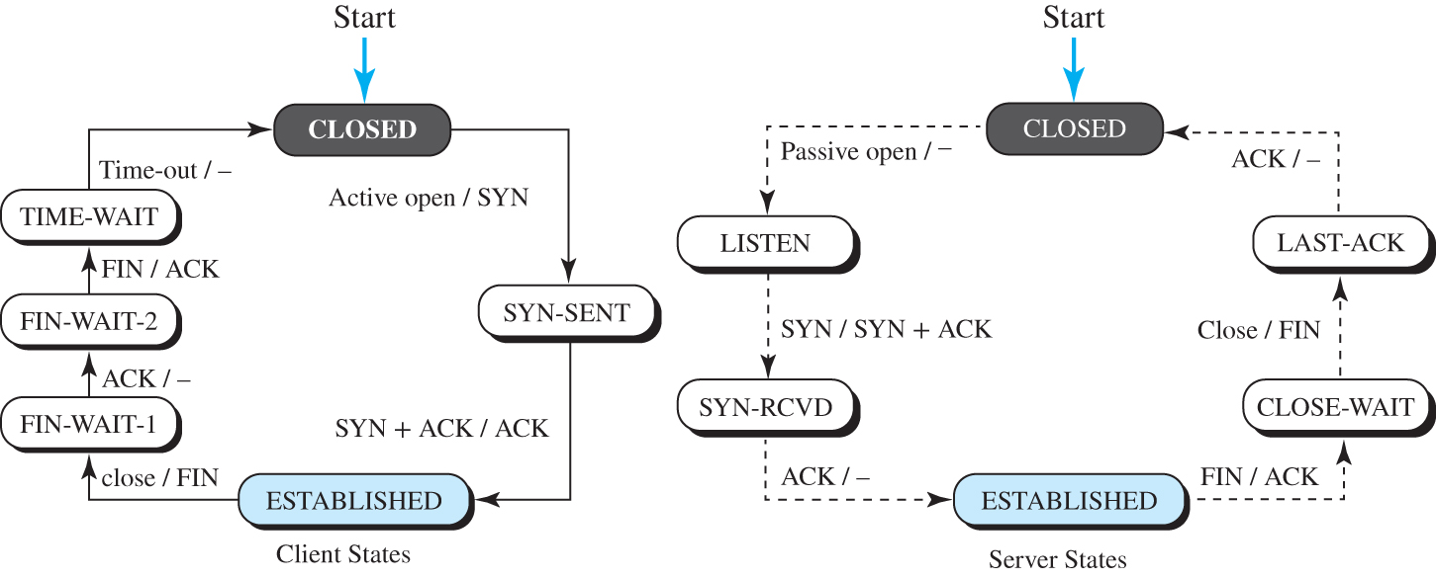
Figure 9.31 Transition diagram with half-close connection termination
Access the text alternative for slide images.

Slide 103
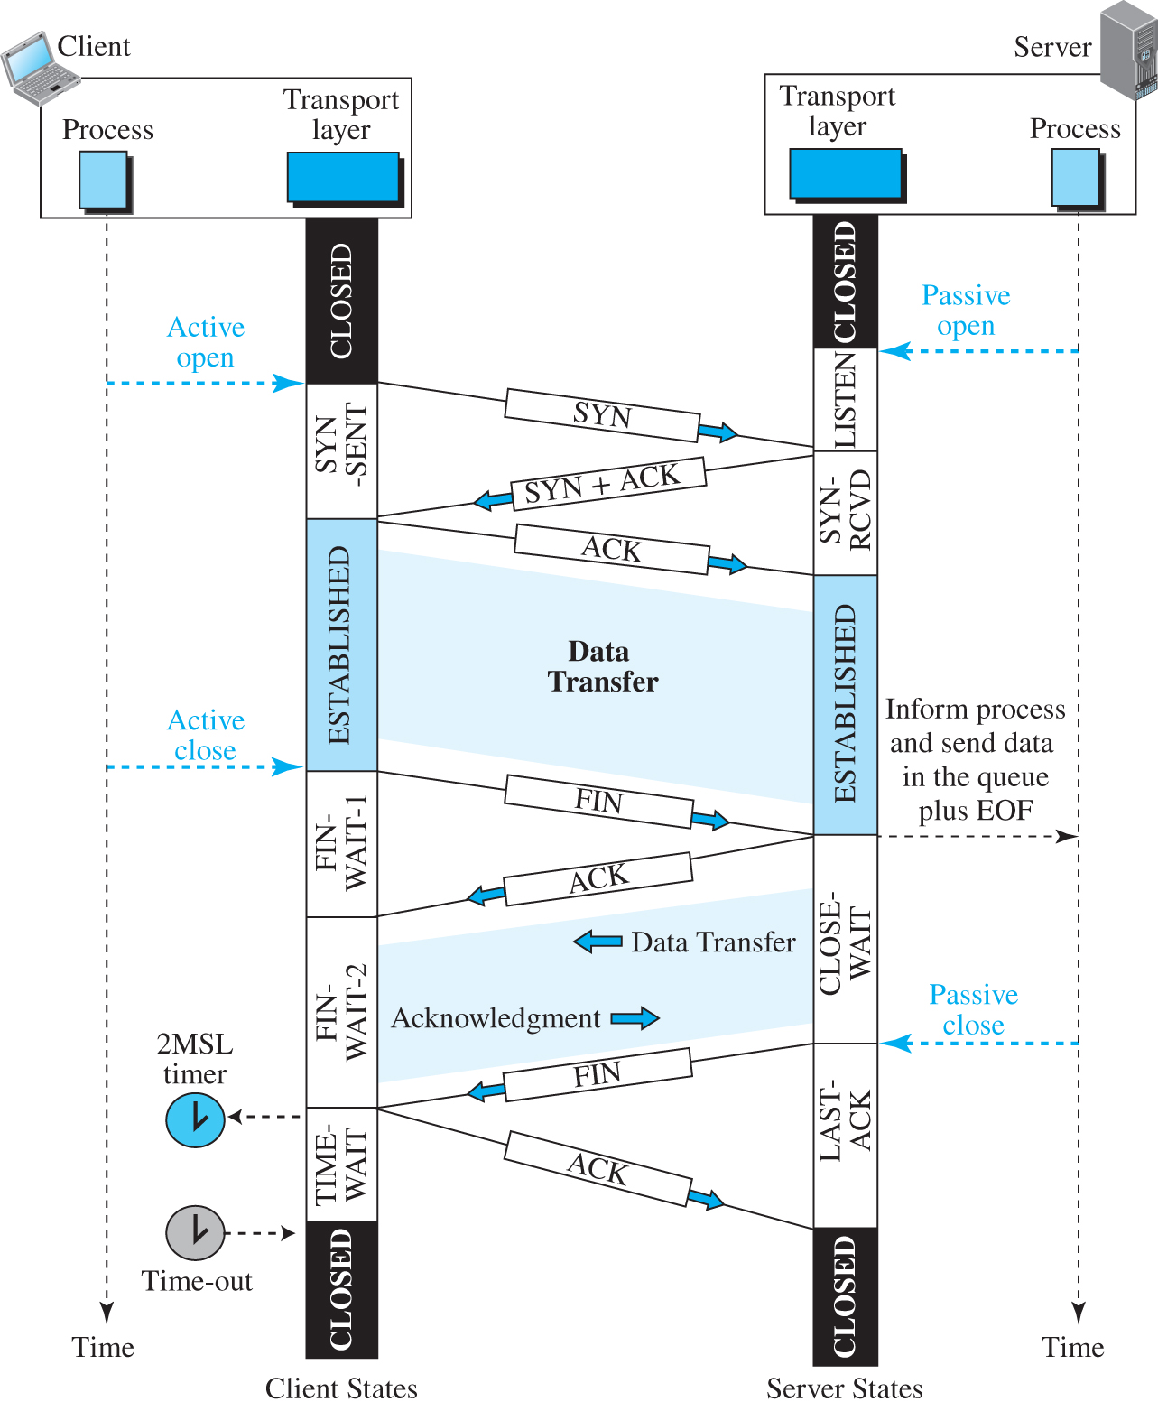
Figure 9.32 Time-line diagram for a common scenario
Access the text alternative for slide images.

Slide 104
9.4.6 Windows in TCP
Before discussing data transfer in TCP and the issues such as flow, error, and congestion control, we describe the windows used in TCP. TCP uses two windows (send window and receive window) for each direction of data transfer, which means four windows for a bidirectional communication. To make the discussion simple, we make an unrealistic assumption that communication is only unidirectional. The bidirectional communication can be inferred using two unidirectional communications with piggybacking.

Slide 105
Send Window
Figure 9.33 shows an example of a send window. The window size is 100 bytes but later we see that the send window size is dictated by the receiver (flow control) and the congestion in the underlying network (congestion control). The figure shows how a send window opens, closes, or shrinks.

Slide 106
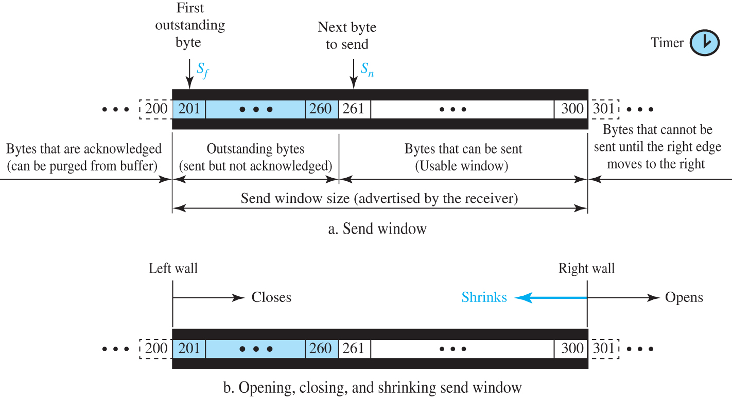
Figure 9.33 Send window in TCP
Access the text alternative for slide images.

Slide 107
Receive Window
Figure 9.34 shows an example of a receive window. The window size is 100 bytes. The figure also shows how the receive window opens and closes; in practice, the window should never shrink.

Slide 108
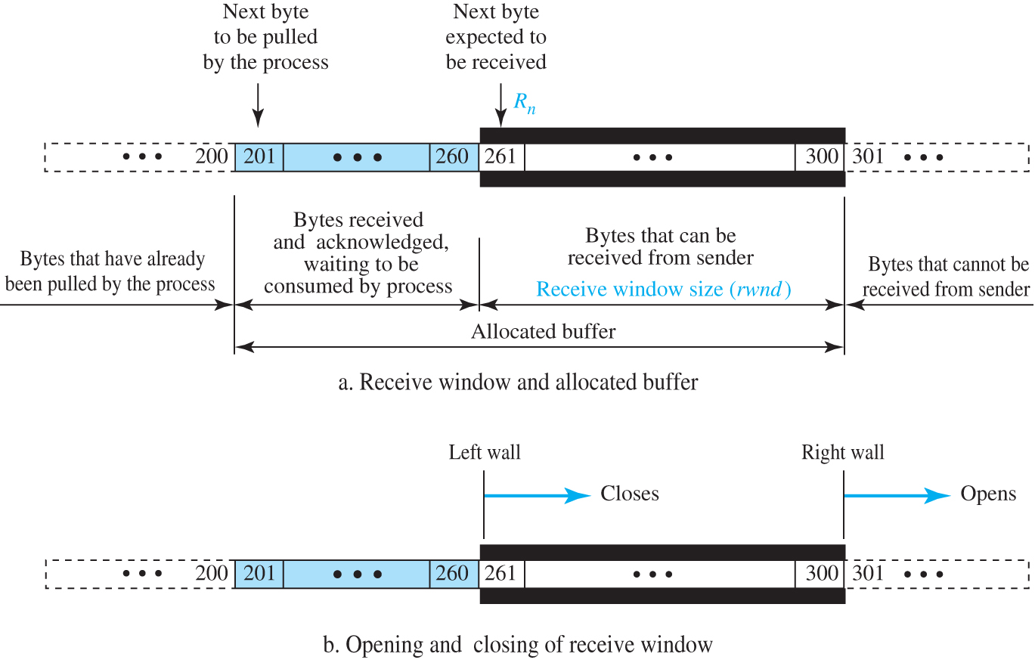
Figure 9.34 Receive window in TCP
Access the text alternative for slide images.

Slide 109
9.4.7 Flow Control
As discussed before, flow control balances the rate a producer creates data with the rate a consumer can use the data. TCP separates flow control from error control. In this section we discuss flow control, ignoring error control. We assume that the logical channel between the sending and receiving TCP is error-free.

Slide 110
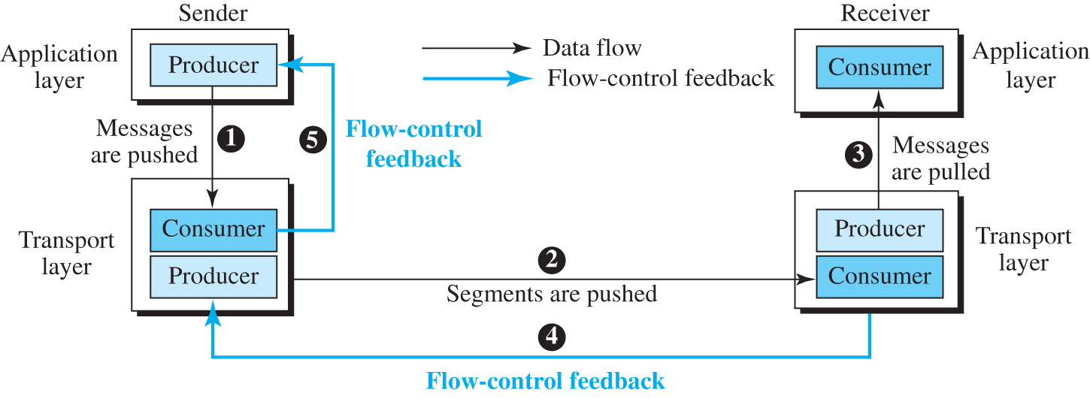
Figure 9.35 Data flow and flow control feedbacks in TCP
Access the text alternative for slide images.

Slide 111
Opening and Closing Windows
To achieve flow control, TCP forces the sender and the receiver to adjust their window sizes, although the size of the buffer for both parties is fixed when the connection is established. The receive window closes (moves its left wall to the right) when more bytes arrive from the sender; it opens (moves its right wall to the right) when more bytes are pulled by the process. We assume that it does not shrink (the right wall does not move to the left).

Slide 112
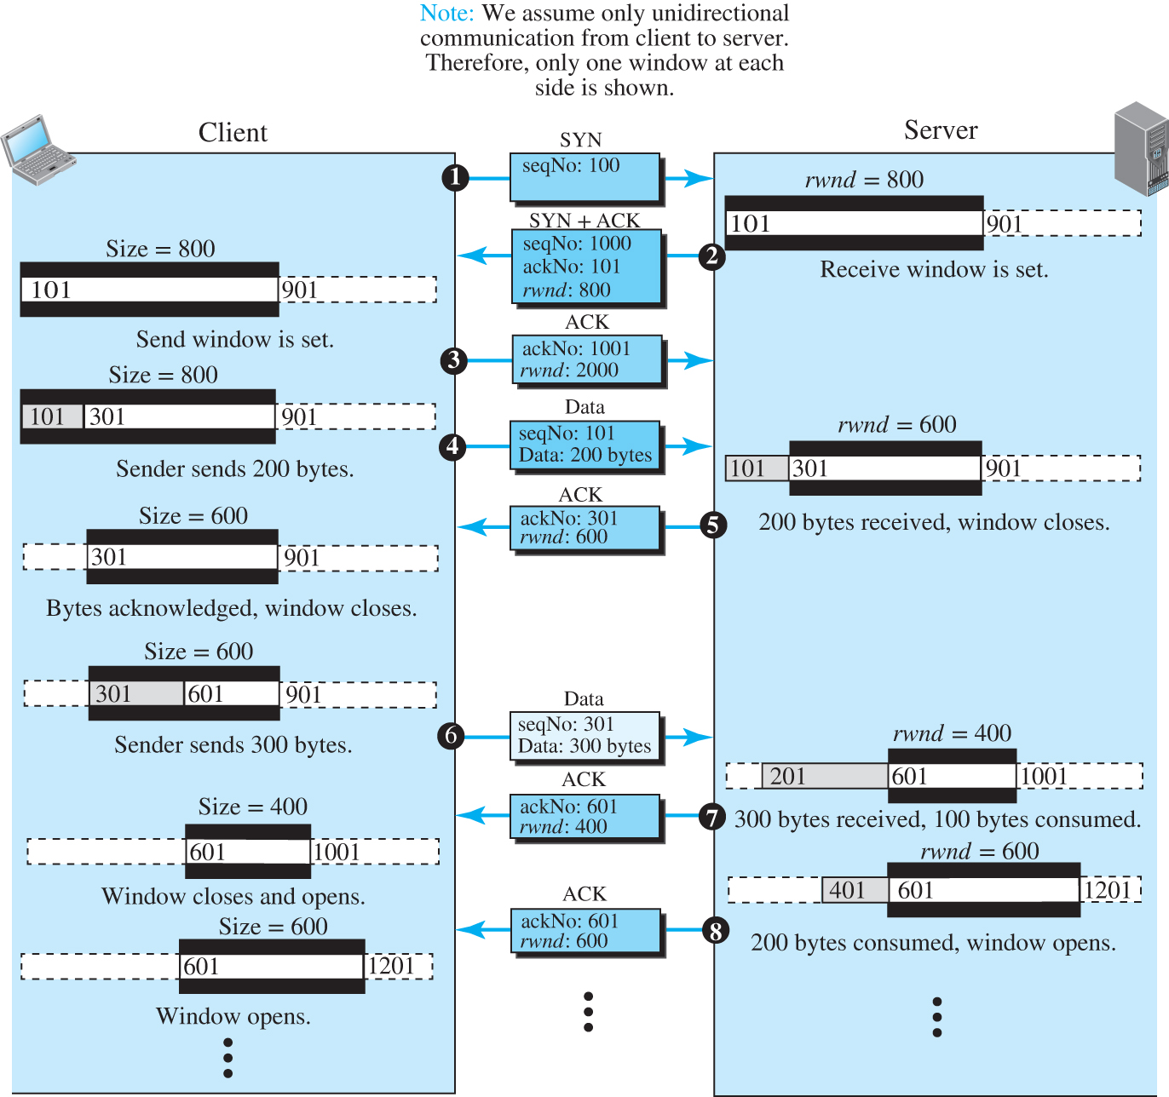
Figure 9.36 An example of flow control
Access the text alternative for slide images.

Slide 113
Shrinking of Windows
As we said before, the receive window cannot shrink. The send window, on the other hand, can shrink if the receiver defines a value for rwnd that results in shrinking the window. However, some implementations do not allow shrinking of the send window. The limitation does not allow the right wall of the send window to move to the left. In other words, the receiver needs to keep the following relationship between the last and new acknowledgment and the last and new rwnd values to prevent shrinking of the send window.
new ackNo + new rwnd >= last ackNo + last rwnd

Slide 114
Example 9.9
Figure 9.37 shows the reason for this mandate.
Part a of the figure shows the values of the last acknowledgment and rwnd. Part b shows the situation in which the sender has sent bytes 206 to 214. Bytes 206 to 209 are acknowledged and purged. The new advertisement, however, defines the new value of rwnd as 4, in which
210 + 4 < 206 + 12.

Slide 115
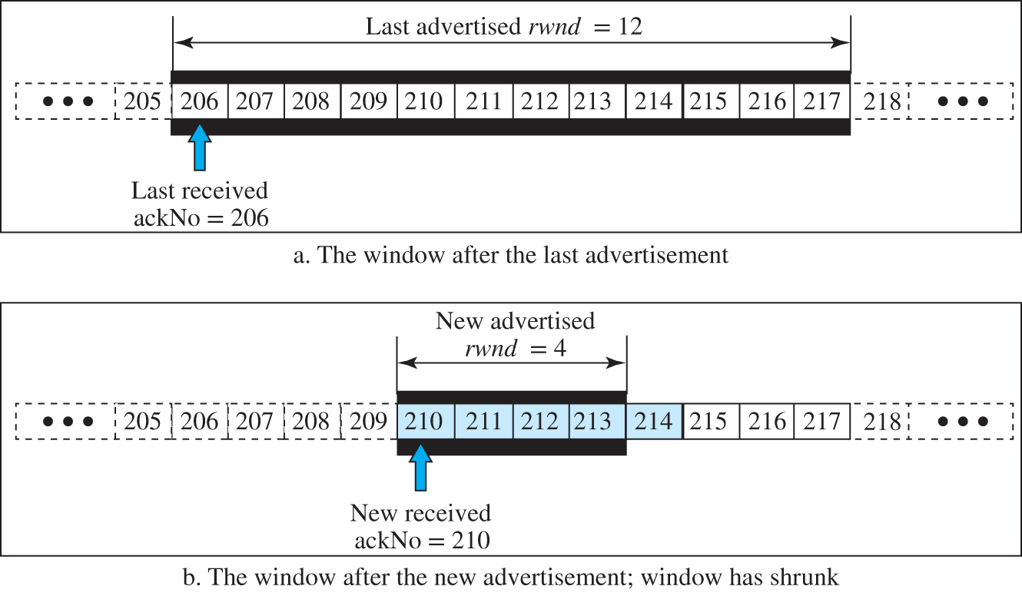
Figure 9.37 Example 9.9
Access the text alternative for slide images.

Slide 116
Silly Window Syndrome
A serious problem can arise in the sliding window operation when either the sending application program creates data slowly or the receiving application program consumes data slowly, or both. Any of these situations results in the sending of data in very small segments, which reduces the efficiency of the operation. This problem is called the silly window syndrome. For each site, we first describe how the problem is created and then give a proposed solution.

Slide 117
9.4.8 Error Control
TCP is a reliable transport-layer protocol. This means that an application program that delivers a stream of data to TCP relies on TCP to deliver the entire stream to the application program on the other end in order, without error, and without any part lost or duplicated.

Slide 118
Checksum 2
Each segment includes a checksum field, which is used to check for a corrupted segment. If a segment is corrupted, as detected by an invalid checksum, the segment is discarded by the destination TCP and is considered as lost. TCP uses a 16-bit checksum that is mandatory in every segment.

Slide 119
Acknowledgment
TCP uses acknowledgments to confirm the receipt of data segments. Control segments that carry no data, but consume a sequence number, are also acknowledged. ACK segments are never acknowledged.

Slide 120
Retransmission
The heart of the error control mechanism is the retransmission of segments. When a segment is sent, it is stored in a queue until it is acknowledged. When the retransmission timer expires or when the sender receives three duplicate ACKs for the first segment in the queue, that segment is retransmitted.

Slide 121
Out-of-Order Segments
TCP implementations today do not discard out-of-order segments. They store them temporarily and flag them as out-of-order segments until the missing segments arrive. Note, however, that out-of-order segments are never delivered to the process. TCP guarantees that data are delivered to the process in order.

Slide 122
FSMs for Data Transfer in TCP
Data transfer in TCP is close to the Selective-Repeat protocol with a slight similarity to GBN. Since TCP accepts out-of-order segments, TCP can be thought of as behaving more like the SR protocol, but since the original acknowledgments are cumulative, it looks like GBN. However, if the TCP implementation uses SACKs, then TCP is closest to SR.

Slide 123
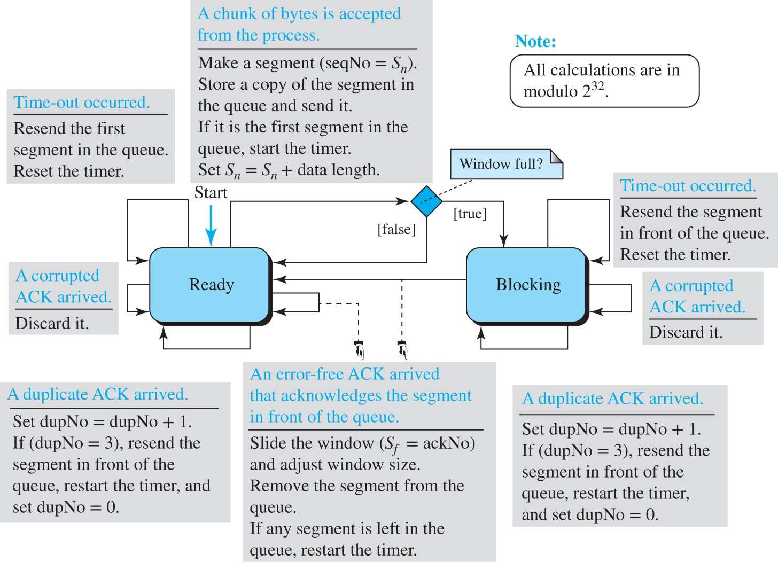
Figure 9.38 Simplified FSM for the TCP sender side
Access the text alternative for slide images.

Slide 124
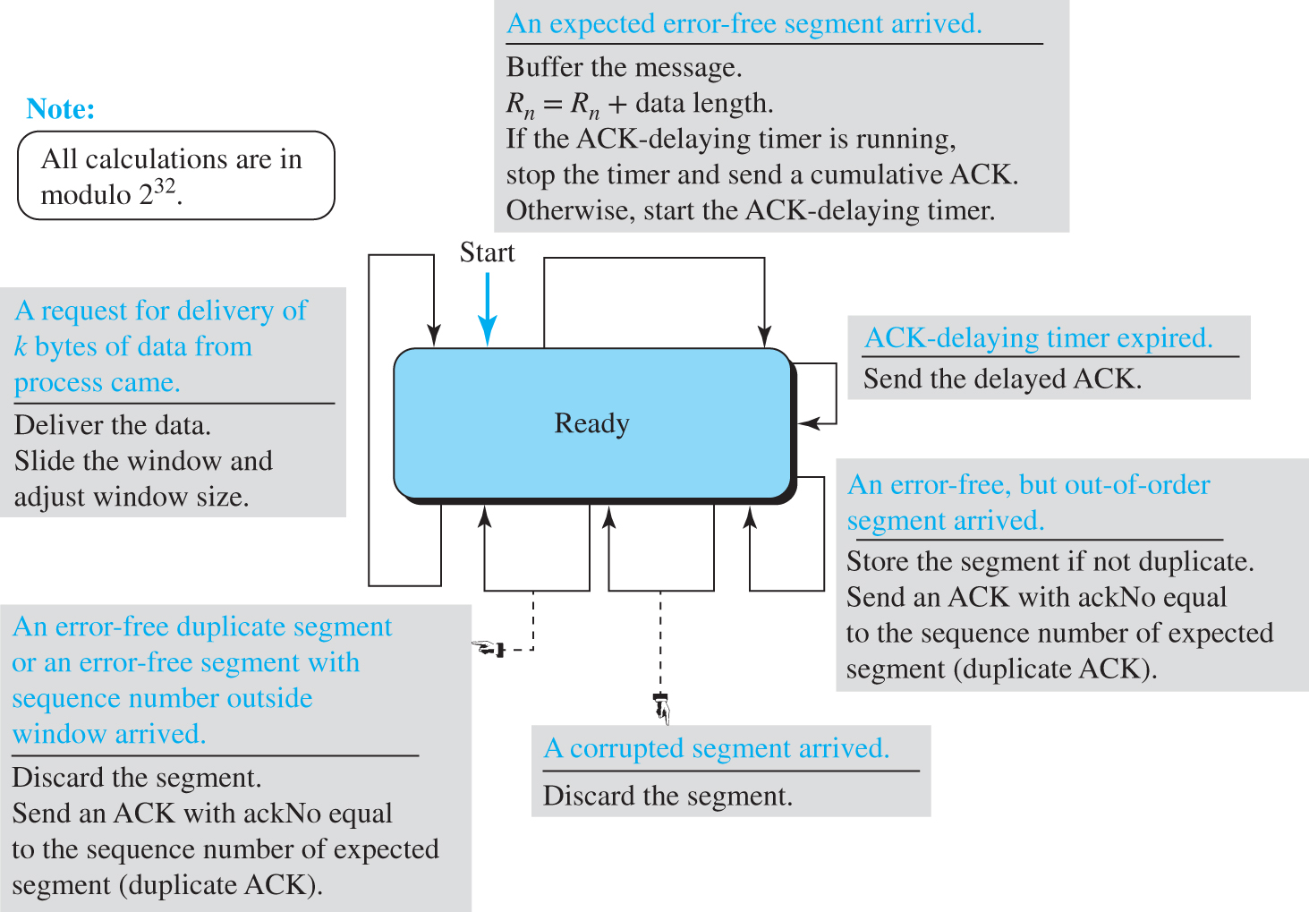
Figure 9.39 Simplified FSM for the TCP receiver side
Access the text alternative for slide images.

Slide 125
Some Scenarios
In this section we give some examples of scenarios that occur during the operation of TCP, considering only error control issues. In these scenarios, we show a segment by a rectangle. If the segment carries data, we show the range of byte numbers and the value of the acknowledgment field. If it carries only an acknowledgment, we show only the acknowledgment number in a smaller box.

Slide 126
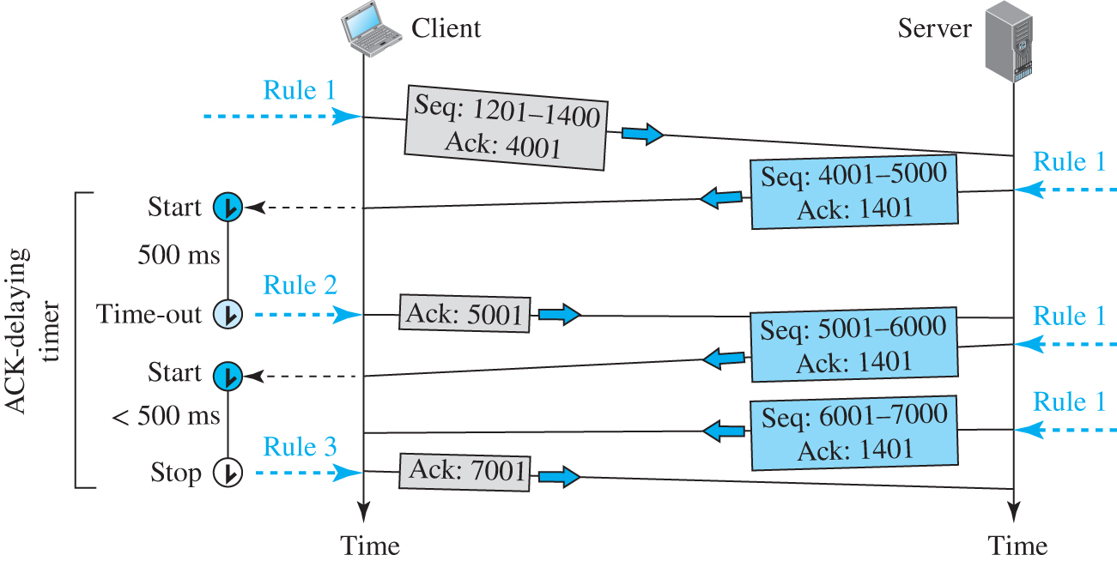
Figure 9.40 Normal operation
Access the text alternative for slide images.

Slide 127
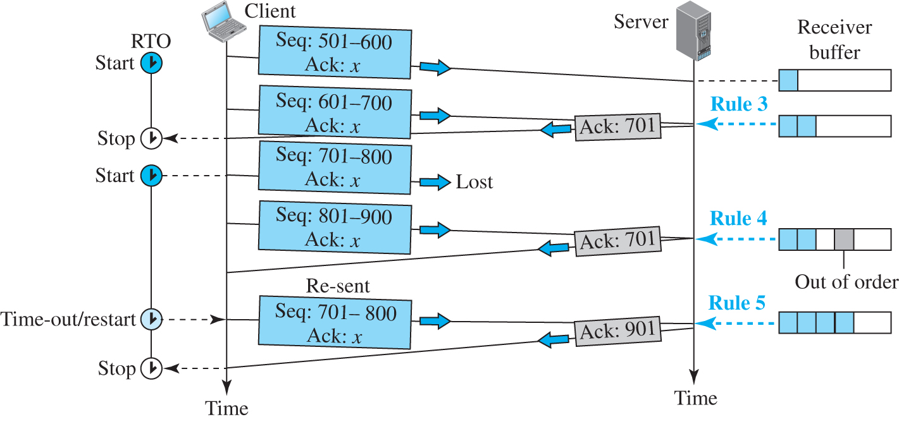
Figure 9.41 Lost segment
Access the text alternative for slide images.

Slide 128
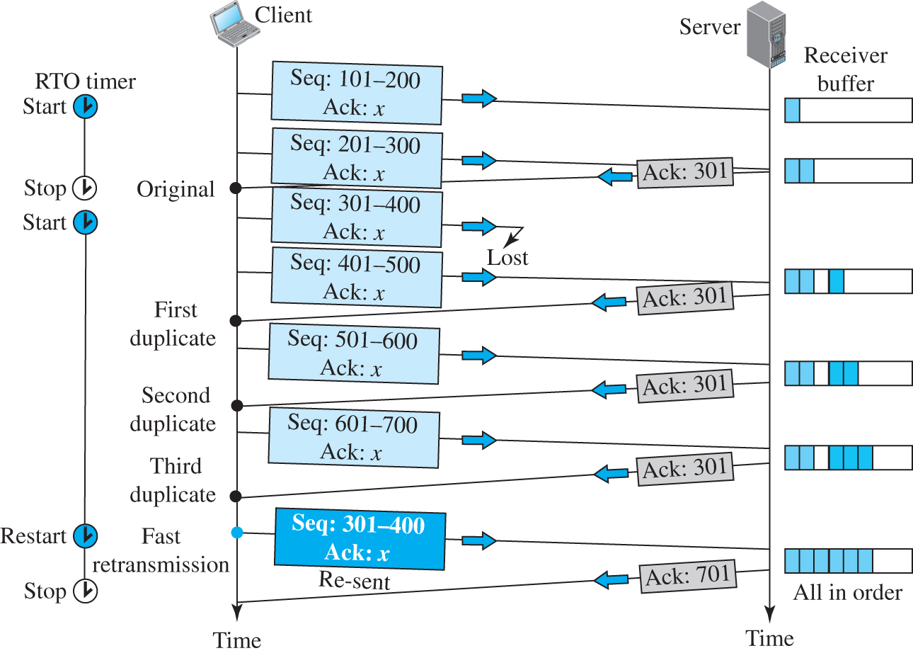
Figure 9.42 Fast retransmission
Access the text alternative for slide images.

Slide 129
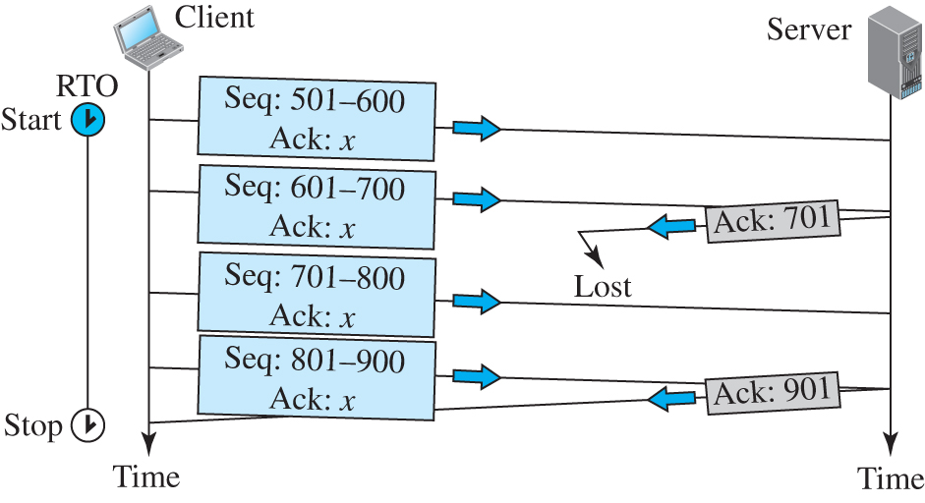
Figure 9.43 Lost acknowledgment
Access the text alternative for slide images.

Slide 130
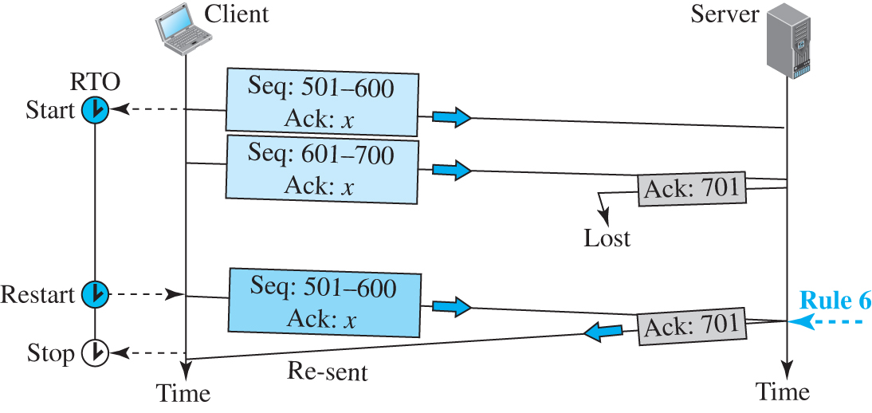
Figure 9.44 Lost acknowledgment corrected by resending a segment
Access the text alternative for slide images.

Slide 131
9.4.9 TCP Congestion Control
TCP uses different policies to handle the congestion in the network. We describe these policies in this section.

Slide 132
Congestion Window
When we discussed flow control in TCP, we mentioned that the size of the send window is controlled by the receiver using the value of rwnd, which is advertised in each segment traveling in the opposite direction. The use of this strategy guarantees that the receive window is never overflowed with the received bytes (no end congestion). This, however, does not mean that the intermediate buffers, buffers in the routers, do not become congested. A router may receive data from more than one sender.

Slide 133
Congestion Detection
Before discussing how the value of cwnd should be set and changed, we need to describe how a TCP sender can detect the possible existence of congestion in the network. The TCP sender uses the occurrence of two events as signs of congestion in the network: time-out and receiving three duplicate ACKs.
The first is the time-out. If a TCP sender does not receive an ACK for a segment or a group of segments before the time-out occurs, it assumes that the corresponding segment or segments are lost and the loss is due to congestion.

Slide 134
Congestion Policies
TCP’s general policy for handling congestion is based on three algorithms: slow start, congestion avoidance, and fast recovery.

Slide 135
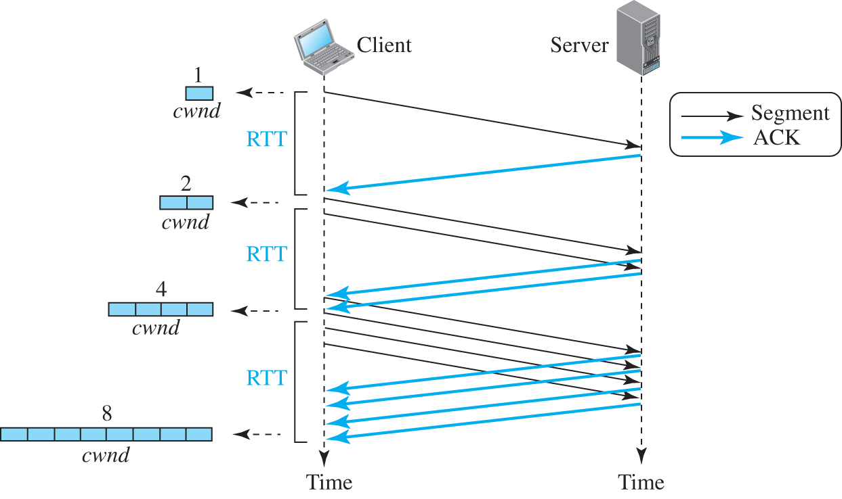
Figure 9.45 Slow start, exponential increase
Access the text alternative for slide images.

Slide 136
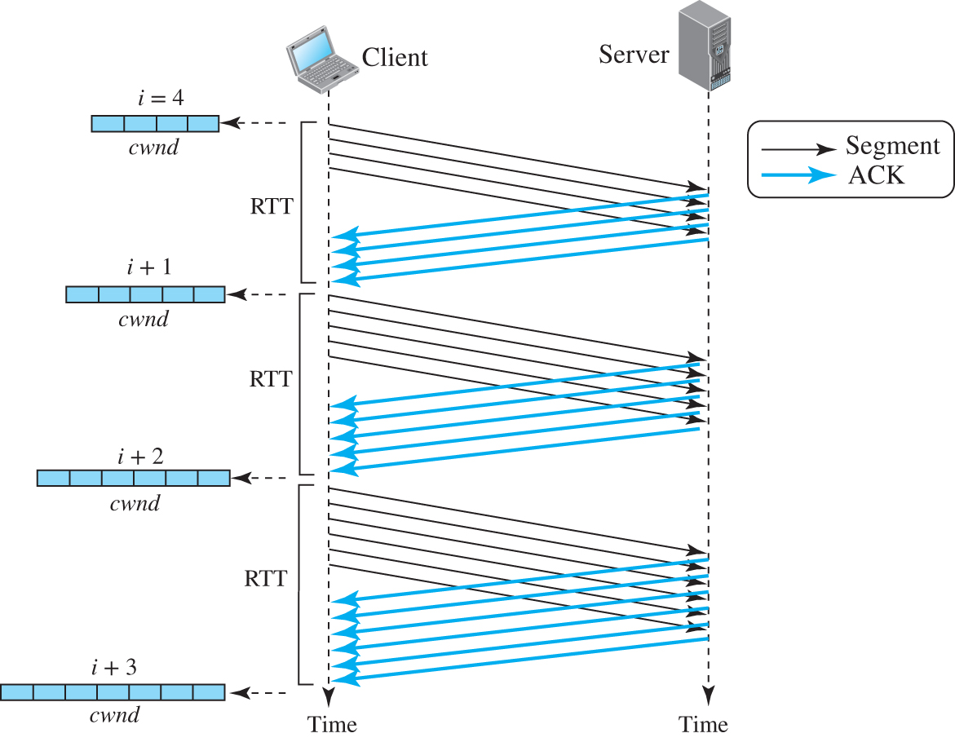
Figure 9.46 Congestion avoidance, additive increase
Access the text alternative for slide images.

Slide 137
Policy Transition
We discussed three congestion policies in TCP. Now the question is when each of these policies are used and when TCP moves from one policy to another. To answer these questions, we need to refer to three versions of TCP: Taho TCP, Reno TCP, and New Reno TCP.

Slide 138
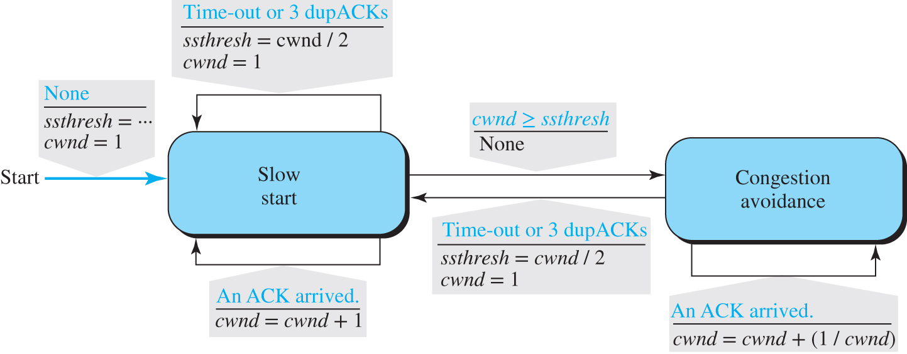
Figure 9.47 FSM for Taho TCP
Access the text alternative for slide images.

Slide 139
Example 9.10 (1)
Figure 9.48 shows an example of congestion control in a Taho TCP. TCP starts data transfer and sets the ssthresh variable to an ambitious value of 16 MSS. TCP begins at the slow-start (SS) state with the cwnd = 1. The congestion window grows exponentially, but a time-out occurs after the third RTT (before reaching the threshold). TCP assumes that there is congestion in the network. It immediately sets the new ssthresh = 4 MSS (half of the current cwnd, which is 8) and begins a new slow start (SA) state with cwnd = 1 MSS. The congestion grows exponentially until it reaches the newly set threshold. TCP now moves to the congestion avoidance (CA) state and the congestion window grows additively until it reaches cwnd = 12 MSS.

Slide 140
Example 9.10 (2)
At this moment, three duplicate ACKs arrive, another indication of the congestion in the network. TCP again halves the value of ssthresh to 6 MSS and begins a new slow-start (SS) state. The exponential growth of the cwnd continues. After RTT 15, the size of cwnd is 4 MSS. After sending four segments and receiving only two ACKs, the size of the window reaches the ssthresh (6) and the TCP moves to the congestion avoidance state. The data transfer now continues in the congestion avoidance (CA) state until the connection is terminated after RTT 20.

Slide 141
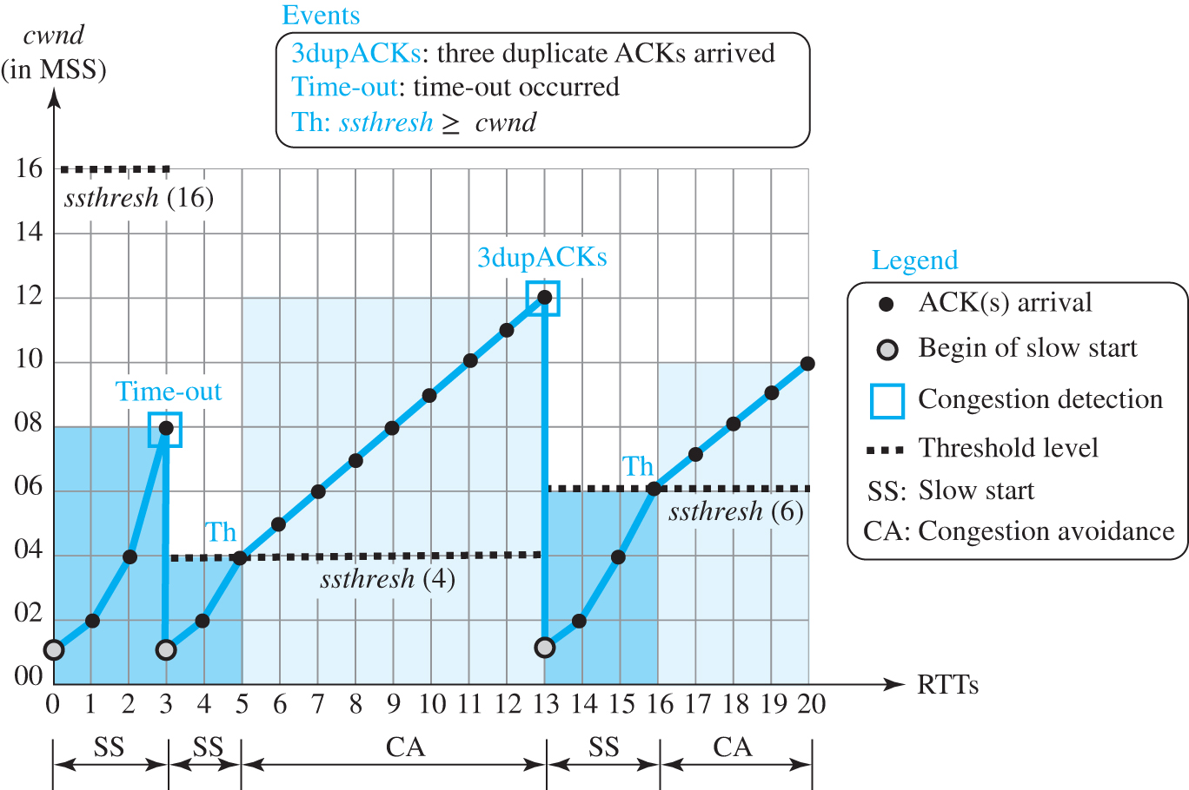
Figure 9.48 Example of Taho TCP
Access the text alternative for slide images.

Slide 142
Additive Increase, Multiplicative Decrease
Out of the three versions of TCP, the Reno version is most common today. It has been observed that, in this version, most of the time the congestion is detected and taken care of by observing the three duplicate ACKs. Even if there are some time-out events, TCP recovers from them by aggressive exponential growth.

Slide 143
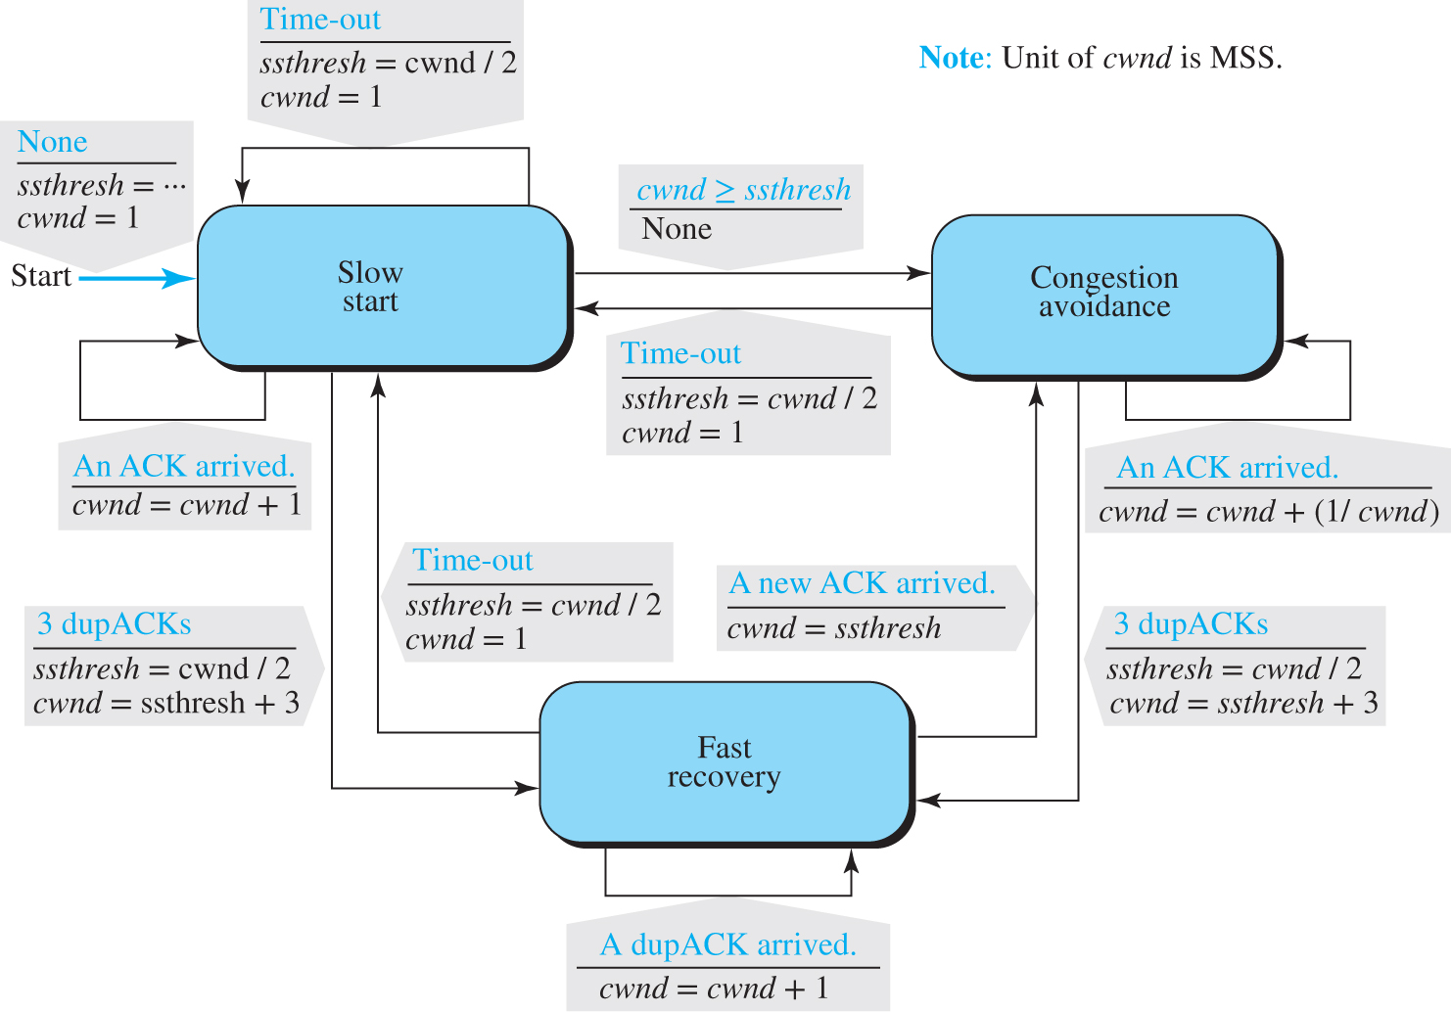
Figure 9.49 FSM for Reno TCP
Access the text alternative for slide images.

Slide 144
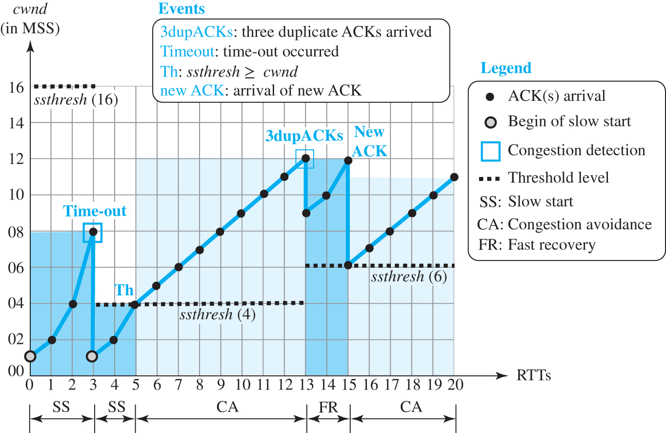
Figure 9.50 Example of a Reno TCP
Access the text alternative for slide images.

Slide 145
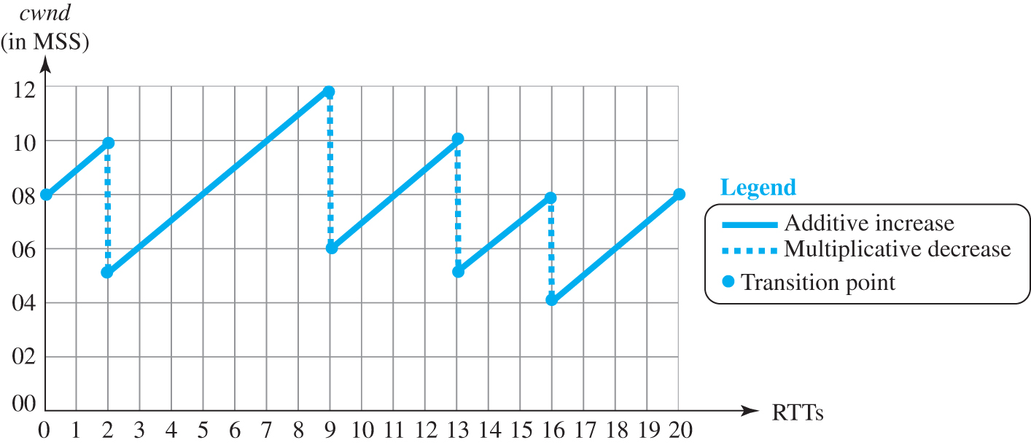
Figure 9.51 Additive increase, multiplicative decrease (AIMD)
Access the text alternative for slide images.

Slide 146
TCP Throughput
The throughput for TCP, which is based on the congestion window behavior, can be easily found if the cwnd is a constant (flat line) function of RTT. The throughput with this unrealistic assumption is throughput = cwnd / RTT.
Throughput = (0.75) Wmax / RTT

Slide 147
Example 9.12
If MSS = 10 KB (kilobytes) and RTT = 100 ms in Figure 9.51, we can calculate the throughput as shown below.
Wmax = (10 + 12 + 10 + 8 + 8) / 5 = 9.6 MSS
Throughput = (0.75 Wmax / RTT) = 0.75 * 960 kbps / 100 ms = 7.2 Mbps

Slide 148
9.4.10 TCP Timers
To perform their operations smoothly, most TCP implementations use at least four timers: retransmission, persistence, keepalive, and TIME-WAIT

Slide 149
Retransmission Timer
To retransmit lost segments, TCP employs one retransmission timer (for the whole connection period) that handles the retransmission time-out (RTO), the waiting time for an acknowledgment of a segment.

Slide 150
Example 9.13
Let us give a hypothetical example. Figure 9.52 shows part of a connection. The figure shows the connection establishment and part of the data transfer phases.

Slide 151

Figure 9.52 Example 9.13
Access the text alternative for slide images.

Slide 152
Example 9.14
Figure 9.53 is a continuation of the previous example. There is retransmission and Karn’s algorithm is applied. The first segment in the figure is sent, but lost. The RTO timer expires after 4.74 seconds. The segment is re-transmitted and the timer is set to 9.48, twice the previous value of RTO. This time an ACK is received before the time-out. We wait until we send a new segment and receive the ACK for it before recalculating the RTO (Karn’s algorithm).

Slide 153

Figure 9.53 Example 9.14
Access the text alternative for slide images.

Slide 154
Keepalive Timer
A keepalive timer is used in some implementations to prevent a long idle connection between two TCP’s. Suppose that a client opens a TCP connection to a server, transfers some data, and becomes silent. Perhaps the client has crashed. In this case, the connection remains open forever.

Slide 155
TIME-WAIT Timer
The TIME-WAIT (2MSL) timer is used during connection termination. The maximum segment life time (MSL) is the amount of time any segment can exist in a network before being discarded. The implementation needs to choose a value for MSL. Common values are 30 seconds, 1 minute, or even 2 minutes. The 2MSL timer is used when TCP performs an active close and sends the final ACK. The connection must stay for 2 MSL amount of time to allow TCP resend the final ACK in case the ACK is lost. This requires that the RTO timer at the other end times out and new FIN and ACK segments are resent.

Slide 156
9.4.11 Options
The TCP header can have up to 40 bytes of optional information. Options convey additional information to the destination or align other options. These options are included on the book website for further reference.

Slide 157
9-5 STREAM CONTROL TRANSMISSION PROTOCOL
Stream Control Transmission Protocol (SCTP) is a new transport-layer protocol designed to combine some features of UDP and TCP in an effort to create a protocol for multimedia communication.

Slide 158
9.5.1 SCTP Services
Before discussing the operation of SCTP, let us explain the services offered by SCTP to the application-layer processes.

Slide 159
Process-to-Process Communication 3
SCTP, like UDP or TCP, provides process-to-process communication.

Slide 160
Multiple Streams
We learned that TCP is a stream-oriented protocol. Each connection between a TCP client and a TCP server involves one single stream. The problem with this approach is that a loss at any point in the stream blocks the delivery of the rest of the data. This can be acceptable when we are transferring text; it is not when we are sending real-time data such as audio or video. SCTP allows multistream service in each connection, which is called association in SCTP terminology. If one of the streams is blocked, the other streams can still deliver their data. Figure 9.54 shows the idea of multiple-stream delivery.

Slide 161

Figure 9.54 Multiple-stream concept
Access the text alternative for slide images.

Slide 162
Multihoming
A TCP connection involves one source and one destination IP address. This means that even if the sender or receiver is a multihomed host (connected to more than one physical address with multiple IP addresses), only one of these IP addresses per end can be used during the connection. An SCTP association, on the other hand, supports multihoming service. The sending and receiving host can define multiple IP addresses in each end for an association. In this fault-tolerant approach, when one path fails, another interface can be used for data delivery without interruption. This fault-tolerant feature is very helpful when we are sending and receiving a real-time payload such as Internet telephony.

Slide 163

Figure 9.55 Multihoming concept
Access the text alternative for slide images.

Slide 164
Full-Duplex Communication 2
Like TCP, SCTP offers full-duplex service, where data can flow in both directions at the same time. Each SCTP then has a sending and receiving buffer and packets are sent in both directions.

Slide 165
Connection-Oriented Service
Like TCP, SCTP is a connection-oriented protocol. However, in SCTP, a connection is called an association.

Slide 166
Reliable Service 2
SCTP, like TCP, is a reliable transport protocol. It uses an acknowledgment mechanism to check the safe and sound arrival of data. We will discuss this feature further in the section on error control.

Slide 167
9.5.2 SCTP Features
The following shows the general features of SCTP.

Slide 168
Transmission Sequence Number (TSN)
The unit of data in SCTP is a data chunk, which may or may not have a one-to-one relationship with the message coming from the process because of fragmentation (discussed later). Data transfer in SCTP is controlled by numbering the data chunks. SCTP uses a transmission sequence number (TSN) to number the data chunks. In other words, the TSN in SCTP plays the analogous role as the sequence number in TCP. TSN’s are 32 bits long and randomly initialized between 0 and 232 - 1. Each data chunk must carry the corresponding TSN in its header.

Slide 169
Stream Identifier (SI)
In SCTP, there may be several streams in each association. Each stream in SCTP needs to be identified using a stream identifier (SI). Each data chunk must carry the SI in its header so that when it arrives at the destination, it can be properly placed in its stream. The SI is a 16-bit number starting from 0.

Slide 170
Stream Sequence Number (SSN)
When a data chunk arrives at the destination SCTP, it is delivered to the appropriate stream and in the proper order. This means that, in addition to an SI, SCTP defines each data chunk in each stream with a stream sequence number (SSN).

Slide 171
Packets
In TCP, a segment carries data and control information. Data are carried as a collection of bytes; control information is defined by six control flags in the header. The design of SCTP is totally different: data are carried as data chunks, control information as control chunks. Several control chunks and data chunks can be packed together in a packet. A packet in SCTP plays the same role as a segment in TCP.

Slide 172

Figure 9.56 Comparison between a TCP segment and an SCTP packet
Access the text alternative for slide images.

Slide 173

Figure 9.57 Packets, data chunks, and streams
Access the text alternative for slide images.

Slide 174
Acknowledgment Number
SCTP acknowledgment numbers are chunk-oriented. They refer to the TSN. In SCTP, the control information is carried by control chunks, which do not need a TSN. These control chunks are acknowledged by another control chunk of the appropriate type (some need no acknowledgment). For example, an INIT control chunk is acknowledged by an INIT-ACK chunk. There is no need for a sequence number or an acknowledgment number.

Slide 175
9.5.3 Packet Format
An SCTP packet has a mandatory general header and a set of blocks called chunks. There are two types of chunks: control chunks and data chunks. A control chunk controls and maintains the association; a data chunk carries user data. In a packet, the control chunks come before the data chunks. Figure 9.58 shows the general format of an SCTP packet.

Slide 176

Figure 9.58 SCTP packet format
Access the text alternative for slide images.

Slide 177
General Header
The general header (packet header) defines the end points of each association to which the packet belongs, guarantees that the packet belongs to a particular association, and preserves the integrity of the contents of the packet including the header itself. The format of the general header is shown in Figure 9.59.

Slide 178

Figure 9.59 General header
Access the text alternative for slide images.

Slide 179
Chunks
Control information or user data are carried in chunks. Chunks have a common layout, as shown in Figure 9.60. The first three fields are common to all chunks; the information field depends on the type of chunk. The type field can define up to 256 types of chunks. Only a few have been defined so far; the rest are reserved for future use.

Slide 180

Figure 9.60 Common layout of a chunk
Access the text alternative for slide images.

Slide 181
Table 9.3 Chunks
Type | Chunk | Description
0 | DATA | User data
1 | INIT | Sets up an association
2 | INIT ACK | Acknowledges INIT chunk
3 | SACK | Selective acknowledgment
4 | HEARTBEAT | Probes the peer for liveliness
5 | HEARTBEAT ACK | Acknowledges HEARTBEAT chunk
6 | ABORT | Aborts an association
7 | SHUTDOWN | Terminates an association
8 | SHUTDOWN ACK | Acknowledges SHUTDOWN chunk
9 | ERROR | Reports errors without shutting down
10 | COOKIE ECHO | Third packet in association establishment
11 | COOKIE ACK | Acknowledges COOKIE ECHO chunk
14 | SHUTDOWN COMPLETE | Third packet in association termination
192 | FORWARD TSN | For adjusting cumulating TSN

Slide 182
9.5.4 An SCTP Association
SCTP, like TCP, is a connection-oriented protocol. However, a connection in SCTP is called an association to emphasize multihoming.

Slide 183
Association Establishment
Association establishment in SCTP requires a four-way handshake. In this procedure, a process, normally a client, wants to establish an association with another process, normally a server, using SCTP as the transport-layer protocol. Similar to TCP, the SCTP server needs to be prepared to receive any association (passive open). Association establishment, however, is initiated by the client (active open). SCTP association establishment is shown in Figure 9.61.

Slide 184

Figure 9.61 Four-way handshaking
Access the text alternative for slide images.

Slide 185
Data Transfer 2
The whole purpose of an association is to transfer data between two ends. After the association is established, bidirectional data transfer can take place. The client and the server can both send data. Like TCP, SCTP supports piggybacking.
There is a major difference, however, between data transfer in TCP and SCTP. TCP receives messages from a process as a stream of bytes without recognizing any boundary between them. The only ordering system imposed by TCP is the byte numbers.

Slide 186
Association Termination
In SCTP, like TCP, either of the two parties involved in exchanging data (client or server) can close the connection. However, unlike TCP, SCTP does not allow a “half-closed” association. If one end closes the association, the other end must stop sending new data. If any data are left over in the queue of the recipient of the termination request, they are sent and the association is closed. Association termination uses three packets, as shown in Figure 9.62. Note that although the figure shows the case in which termination is initiated by the client, it can also be initiated by the server.

Slide 187

Figure 9.62 Association termination
Access the text alternative for slide images.

Slide 188
9.5.5 Flow Control
Flow control in SCTP is similar to that in TCP. In SCTP, we need to handle two units of data, the byte and the chunk. The values of rwnd and cwnd are expressed in bytes; the values of TSN and acknowledgments are expressed in chunks. To show the concept, we make some unrealistic assumptions. We assume that there is never congestion in the network and that the network is error free.

Slide 189
Receiver Site 1
The receiver has one buffer (queue) and three variables. The queue holds the received data chunks that have not yet been read by the process. The first variable holds the last TSN received, cumTSN. The second variable holds the available buffer size, winSize. The third variable holds the last cumulative acknowledgment, lastACK. Figure 9.63 shows the queue and variables at the receiver site.

Slide 190

Figure 9.63 Flow control, receiver site
Access the text alternative for slide images.

Slide 191
Sender Site 1
The sender has one buffer (queue) and three variables: curTSN, rwnd, and inTransit, as shown in Figure 9.64. We assume each chunk is 100 bytes long.

Slide 192

Figure 9.64 Flow control, sender site
Access the text alternative for slide images.

Slide 193
9.5.6 Error Control
SCTP, like TCP, is a reliable transport-layer protocol. It uses a SACK chunk to report the state of the receiver buffer to the sender. Each implementation uses a different set of entities and timers for the receiver and sender sites. We use a very simple design to convey the concept to the reader.

Slide 194
Receiver Site 2
In our design, the receiver stores all chunks that have arrived in its queue including the out-of-order ones. However, it leaves spaces for any missing chunks. It discards duplicate messages, but keeps track of them for reports to the sender. Figure 9.65 shows a typical design for the receiver site and the state of the receiving queue at a particular point in time.

Slide 195

Figure 9.65 Error control, receiver site
Access the text alternative for slide images.

Slide 196
Sender Site 2
At the sender site, our design demands two buffers (queues): a sending queue and a retransmission queue. We also use three variables: rwnd, inTransit, and curTSN, as described in the previous section. Figure 9.66 shows a typical design.

Slide 197

Figure 9.66 Error control, sender site
Access the text alternative for slide images.

Slide 198

Figure 9.67 New state at the sender site after receiving a SACK chunk
Access the text alternative for slide images.

Slide 199
Sending Data Chunks
An end can send a data packet whenever there are data chunks in the sending queue with a TSN greater than or equal to curTSN or if there are data chunks in the retransmission queue. The retransmission queue has priority. However, the total size of the data chunk or chunks included in the packet must not exceed the (rwnd - inTransit) value and the total size of the frame must not exceed the MTU size, as we discussed in previous sections.

Slide 200
Generating SACK Chunks
Another issue in error control is the generation of SACK chunks. The rules for generating SCTP SACK chunks are similar to the rules used for acknowledgment with the TCP ACK flag.

Slide 201
Congestion Control 2
SCTP, like TCP, is a transport-layer protocol with packets subject to congestion in the network. The SCTP designers have used the same strategies for congestion control as those used in TCP.

Slide 202
End of Main Content
© 2022 McGraw Hill, LLC. All rights reserved. Authorized only for instructor use in the classroom.
No reproduction or further distribution permitted without the prior written consent of McGraw Hill, LLC.

Slide 203
Accessibility Content: Text Alternatives for Images

Slide 204
Figure 9.1 Logical connection at the transport layer - Text Alternative
Return to parent-slide containing images.
A point-to-point W A N represents a laptop that connects to a L A N switch connects to Alice with physical, data-link, network, transport, and application. The L A N switch connects to router R 2 by point-to-point W A N. The R 2 connects to router R 1 to other I S P S through point-to-point W A N. Three switched W A N switches are arranged in a triangle shape and labeled as I, II and III. R 2 connects to router connects to R 4 connects to W A N switch II b point-to-point W A N, where II connects to I and III through switched W A N. W A N switch I connects to router R 3 connects To other I S P S through point-to-point W A N. The W A N switch III connects to router R 5 by point-to-point W A N represents National I S P. The router R 5 connects to router R 7 connects to L A N switch connects to two laptops and a mainframe represents Bob scientific books. R 7 connects to router R 6 connects To other I S P s, by point-point W A N. The Alice connects to Bob with physical, data-link, network, transport and application through logical connection.
Return to parent-slide containing images.

Slide 205
Figure 9.2 Network layer versus transport layer - Text Alternative
Return to parent-slide containing images.
Laptop labeled as client and server are connected to internet represents the domain of network-layer protocol. Processes from the client and processes from the server represent the domain of transport-layer protocol.
Return to parent-slide containing images.

Slide 206
Figure 9.3 Port numbers - Text Alternative
Return to parent-slide containing images.
A transport layer represents daytime client with a layer with label 52000 and a transport layer represents daytime server with a layer label 13. Reversible communication of client and server represents 52000 13 data right arrow and 52000 13 left arrow.
Return to parent-slide containing images.

Slide 207
Figure 9.4 IP addresses versus port numbers - Text Alternative
Return to parent-slide containing images.
A server has an application layer of three layers and a layer labeled with 13, and a transport layer with data and 13 represents the destination port number selects the process, where the transport layer connects to 13 of the application layer. A box has 1 9 3.1 4.26.7 represents destination I p address selects the server, and data 13.
Return to parent-slide containing images.

Slide 208
Figure 9.5 ICANN ranges - Text Alternative
Return to parent-slide containing images.
The well-known lies in between 0 to 1023. The registered lies in between 1024 to 49,151, The dynamic or private lies in between 49,152 to 65,535.
Return to parent-slide containing images.

Slide 209
Figure 9.7 Encapsulation and decapsulation - Text Alternative
Return to parent-slide containing images.
The client has an application layer including process and message, and a transport layer including payload packet and header. The message from the application layer shows payload packet in transport layer represents encapsulation. The encapsulation moves to a server through a logical channel. The server includes a transport layer with a payload packet and header and an application layer with process and message. The payload moves to the message in the application layer represent decapsulation.
Return to parent-slide containing images.

Slide 210
Figure 9.8 Multiplexing and demultiplexing - Text Alternative
Return to parent-slide containing images.
The client has an application layer with P 1, P 2, P 3 that transmits messages m 1, m 2, and m 3 to the multiplexer in transport layer shows packet 1, packet 2, and packet 3. Packet 3 and packet 1 move to a demultiplexer in the transport layer of a server on top, where packet 1 and packet 3 provide messages m 1 and m 3 to P 1 and P 3 in the application layer of the server. Packet 2 moves to the demultiplexer of the transport layer of the server in the bottom, where packet 2 provides message m 2 to P 2.
Return to parent-slide containing images.

Slide 211
Figure 9.9 Pushing or pulling - Text Alternative
Return to parent-slide containing images.
Pushing represents a process of the producer to consumer labeled as 1 and delivery, and consumer to producer labeled as 2 and flow control. Pulling represents the process of the consumer to producer labeled as 1 and request and producer to consumer labeled as 2 and delivery.
Return to parent-slide containing images.

Slide 212
Figure 9.10 Flow control at the transport layer - Text Alternative
Return to parent-slide containing images.
The sender has a transport layer with the consumer and producer and an application layer with the producer. The process of consumer from the transport layer to the producer of application layer represents flow control and from the producer of the application layer to the consumer of transport layer represents messages are pushed. The receiver has a transport layer with producer and consumer and an application layer with the consumer. The process of producer of the transport layer to the consumer of application layer represents messages are pulled and from the consumer of the application layer to the producer of transport layer represents requests. The process of transmission from the transport layer of the sender to the consumer of the transport layer of receiver represents packets are pushed. The process of transmission from the consumer of the transport layer to the transport layer of the sender represents flow control.
Return to parent-slide containing images.

Slide 213
Figure 9.11 Error control at the transport layer - Text Alternative
Return to parent-slide containing images.
A sender with transport layer transmits packets to transport layer of receiver. The process from the transport layer of the receiver to the transport layer of the sender represents error control.
Return to parent-slide containing images.

Slide 214
Figure 9.12 Sliding window in circular format - Text Alternative
Return to parent-slide containing images.
The first circular diagram has labels from 0 to 15, where 0 represents seq No of a first outstanding packet, 4 seq No of the next packet to send and the diagram represents four packets that have been sent. The second circular diagram has labels from 0 to 15, where 0 represents seq No of the first outstanding packet and 5 represents seq No of the next packet to send, which represents five packets that have been sent. The third circular diagram has labels from 0 to 15, where 0 represents seq No of the first outstanding packet and 7 represents seq NO of the next packet to send represents seven packets that have been sent, the window is full. The fourth diagram has labels from 0 to 15, where 1 represents seq No of the first outstanding packet and 7 represents seq No of next packet to send represents packet 0 has been acknowledged, window slides.
Return to parent-slide containing images.

Slide 215
Figure 9.13 Sliding window in linear format - Text Alternative
Return to parent-slide containing images.
The first diagram represents continuous bars with labels 12 13 14 15 0 1 2 3 4 5 6 7 8 9 10 11 from left to right, where 0 1 2 3 are highlighted represents four packets that have been sent. The second diagram represents continuous bars with labels 12 13 14 15 0 1 2 3 4 5 6 7 8 9 10 11 from left to right, where 0 1 2 3 4 are highlighted represents five packets that have been sent. The third diagram represents continuous bars with labels 12 13 14 15 0 1 2 3 4 5 6 7 8 9 10 11 from left to right, where 0 1 2 3 4 5 6 are highlighted represents seven packets have been sent, the window is full. The fourth diagram represents continuous bars with labels 12 13 14 15 0 1 2 3 4 5 6 7 8 9 10 11 from left to right, where 1 2 3 4 5 6 are highlighted represents packet 0 has been acknowledged, window slides.
Return to parent-slide containing images.

Slide 216
Figure 9.14 Connectionless service - Text Alternative
Return to parent-slide containing images.
A laptop with client process and client transport layer. A server has a server transport layer and server process. The client process transmits message 0, message 1, and message 2 to the client transport layer as time increases. The client transport layer transmits message 0 as packet 0, message 1 as packet 1, and message 2 as packet 2 as time increases to the server transport layer of server as time increases and to the server process, where the message 2 is delivered out of order.
Return to parent-slide containing images.

Slide 217
Figure 9.15 Connection-oriented service - Text Alternative
Return to parent-slide containing images.
A laptop with client process and client transport layer. A server has a server transport layer and server process. The client process sends a connection open request to the client transport layer, then connection establishment in between the client transport layer and server transport layer. The client process transmits message 0, message 1, and message 2 to the client transport layer as time increases. The client transport layer transmits message 0 as packet 0, message 1 as packet 1, and message 2 as packet 2 as time increases to the server transport layer of the server as time increases. The server transport layer transmits message 0 to the server process, message to 2 holds, and messages 1 and 2 to server process represents data transfer. The client process sends connection close requests and connection teardown in between the client transport layer and server transport layer.
Return to parent-slide containing images.

Slide 218
Figure 9.16 Connectionless and connection-oriented service represented as FSMs - Text Alternative
Return to parent-slide containing images.
F S M for connectionless transport layer represents with color arrow established both ends are always in the established state. The F S M for connection-oriented transport layer represents A connection open request accepted from the application. Send an open-request packet to the other end with a color arrow to closed. The closed moves to Open-Wait-I, an A C K received from the other end. Do nothing. Open-Wait-I moves to Open-wait-II. An open-request packet arrived from the other end. Send an A C K packet. The open wait-II moves to established where data transfers occur when both ends are in the established state. Then moves to close-wait-I represent a connection-close request accepted from the application, send a close-request packet to the other end. The close-wait I moves to closed-wait-II represents an A C K received from the other end, do nothing. The closed-Wait-II moves to closed represent a close-request packet arrived from the other end, send an A C K packet. Note: The colored arrow shows the starting state.
Return to parent-slide containing images.

Slide 219
Figure 9.17 Position of transport-layer protocols in the TCP/IP protocol suite - Text Alternative
Return to parent-slide containing images.
The physical layer and data-link layer represent underlying L A N or W A N technology. The network layer includes I G M P, I C M P, I P, and A R P. The transport layer represents U D P, T C P and S C T P. The application layer includes S M T P, F T P, T E L N E T, D N S, S N M P, and D H C P.
Return to parent-slide containing images.

Slide 220
Figure 9.18 User datagram packet format - Text Alternative
Return to parent-slide containing images.
The U D P user datagram represents header with 8 bytes and data, where header and data represent 8 to 65,535 bytes. The header format represents the source port number and the total length from 0 to 16 and destination port number and checksum from 16 to 31.
Return to parent-slide containing images.

Slide 221
Figure 9.19 Pseudoheader for checksum calculation - Text Alternative
Return to parent-slide containing images.
The pseudo-header represents a 32-bit source I P address, a 32-bit destination I P address, All 0s, 8-bit protocol and 16-bit U D P total length. The header represents source port address 16 bits destination port address 16 bits, U D P total length 16 bits, and checksum 16 bits. The data (padding must be added to make the data a multiple of 16 bits).
Return to parent-slide containing images.

Slide 222
Figure 9.21 Sending and receiving buffers - Text Alternative
Return to parent-slide containing images.
The sending process has T C P with a circle that represents a buffer with many segments. The circle has a blank segment that represents the next byte to write, dark-colored segments represent sent, light-colored segments represent the next byte to send and written but not sent. The receiving process has T C P with a circle that represents buffer. The next byte to send transmits through a cylinder tube represents a stream of bytes to the buffer circle, the next byte to receive, received, but not read, next to byte to read to receiving process.
Return to parent-slide containing images.

Slide 223
Figure 9.22 TCP segments - Text Alternative
Return to parent-slide containing images.
The sending process has T C P with a circle that represents a buffer with many segments. The circle has a blank segment that represents the next byte to write, dark-colored segments represent sent, light-colored segments represent the next byte to send and written but not sent. The receiving process has T C P with a circle that represents buffer. The next byte to send transmits through a segment N which transmits to segment 1. Segment 1 to the buffer circle, the next byte to receive, received, but not read, next to byte to read to receiving process.
Return to parent-slide containing images.

Slide 224
Figure 9.23 TCP segment format - Text Alternative
Return to parent-slide containing images.
The segment represents header from 20 to 60 bytes and data. The header represents source port address 16 bits from 1 to 16, destination port address 16 bits from 16 to 31, sequence number 32 bits from 1 to 31, acknowledgment number 32 bits from 1 to 31, H L E N 4 bits, reserved 6 bits, U R G, A C K, P S H, P S T, S Y N, and F I N from 1 to 16 and window size 16 bits from 16 to 31, checksum 16 bits from 1 to 16 and urgent pointer 16 bits from 16 to 31 and options and padding (up to 40 bytes).
Return to parent-slide containing images.

Slide 225
Figure 9.24 Control field - Text Alternative
Return to parent-slide containing images.
The illustration shows urgent pointer is valid (U R G), acknowledgment is valid (A C K), request for push (P S H), reset the connection (R S T), synchronize sequence numbers (S Y N), and terminate the connection (F I N) 6 bits.
Return to parent-slide containing images.

Slide 226
Figure 9.25 Pseudoheader added to the TCP datagram - Text Alternative
Return to parent-slide containing images.
The pseudo-header represents a 32-bit source I P address, a 32-bit destination I P address, All 0s, 8-bit protocol, and 16-bit T C P total length. The header represents source port number, destination port number, sequence number, acknowledgment number, H L E N reserved and control, window size, checksum, and urgent pointer. Data and option (padding must be added to make the data a multiple of 16 bits).
Return to parent-slide containing images.

Slide 227
Figure 9.26 Connection establishment using three-way handshaking - Text Alternative
Return to parent-slide containing images.
A laptop represents the client process and client transport layer. A server represents the server transport layer and server process. The client process sends active open to client transport layer passes to server transport layer through S Y N flag seq 8000 provides passive open in between server process to the server transport layer and with seq: 15000, ack:8001 with A C K flag and S Y N flag rwnd:5000 to the client transport layer, where a connection opened in between client transport layer to the client process. An A C K flag with seq: 8001, ack: 15001, rwnd: 10000 transmits from client transport layer to server transport layer, where a connection opened to the server process.
Return to parent-slide containing images.

Slide 228
Figure 9.27 Data transfer - Text Alternative
Return to parent-slide containing images.
A laptop represents the client process and client transport layer. A server represents the server transport layer and server process. The client process sends active close to client transport layer passes to server transport layer through F I N flag with seq: x, ack: y and A C K flag and F I N flag pass to the server transport layer. A C K flag with seq: y minus 1, ack: x plus 1 with A C K flag to client transport layer and connection closed in between the client transport layer and client process. Data segment from server to client and acknowledgment from client to server. The server process sends passive close to server transport layer represents F I N flag with seq: z, ack: x plus 1, and A C K and F I N flags to the client transport layer. The client transport layer sends A C K flag with seq x plus 1, ack: z plus 1 move to server transport layer and connection closed in between server transport layer to the server process.
Return to parent-slide containing images.

Slide 229
Figure 9.28 Connection termination using three-way handshaking - Text Alternative
Return to parent-slide containing images.
A laptop represents the client process and client transport layer. A server represents the server transport layer and server process. The client process sends active close to client transport layer passes to server transport layer through F I N flag with seq: x, ack: y and A C K flag and F I N flag pass to the server transport layer. Passive close in between server process and server transport layer pass to the client transport layer and client process through F I N plus A C K with seq: y, ack: x plus 1 and A C K and F I N to client transport layer and connection closed in between client transport layer and client process. An A C K flag from client transport passes to the server transport layer, where the connection closed in between the server transport layer and server process.
Return to parent-slide containing images.

Slide 230
Figure 9.29 Half-close - Text Alternative
Return to parent-slide containing images.
A laptop represents the client process and client transport layer. A server represents the server transport layer and server process. The client process sends active close to client transport layer passes to server transport layer through F I N flag with seq: x, ack: y and A C K flag and F I N flag pass to the server transport layer. A C K flag with seq: y minus 1, ack: x plus 1 with A C K flag to client transport layer and connection closed in between the client transport layer and client process. Data segment from server to client and acknowledgment from client to server. The server process sends passive close to server transport layer represents F I N flag with seq: z, ack: x plus 1, and A C K and F I N flags to the client transport layer. The client transport layer sends A C K flag with seq x plus 1, ack: z plus 1 move to server transport layer and connection closed in between server transport layer to the server process.
Return to parent-slide containing images.

Slide 231
Figure 9.30 State transition diagram - Text Alternative
Return to parent-slide containing images.
Start from client or server transition to closed passive open server transition to listen to server transition with S Y N / S Y N plus A C K to server transition S Y N – R C V D, client or server transition time-out/R S T, client or server transition R S T to listen or S Y N / S Y N plus A C K to S Y N-S E N T to client or server transition close or time-out or R S T/-. The listen to client or server transition to S Y N – S E N T. The listen to client or server transition to closed. The S Y N – S E N T close /- client or server transition to closed. From closed to client transition with active open / S Y N to S Y N – S E N T. The S Y N – R C V D client or server transition through close/F I N to F I N wait-1. The S Y N-R C V D with A C K /- server transition to established. The established with close/F I N to F I N – W ait 1. The S Y N-S E N T client transition with S Y N plus A C K / A C K to established. The established represents data transfer. Server transition from established through F I N / A C K to close-wait server transition to Last A C K through close/F I N. Server transition from Last A C K to closed through A C K/-. The F I N wait-1 client transition through A C K /- to Fin wait-2 client transition to time wait through F I N/ A C K. The F I N wait-1 client or server transition to F I N / A C K simultaneous close to closing client or server transition to Time wait through A C K /-. Client or server transaction from F I N wait-1 to time wait through F I N plus A C K/A C K. Client transition from time wait time-out (2 M S L) to closed.
Return to parent-slide containing images.

Slide 232
Figure 9.31 Transition diagram with half-close connection termination - Text Alternative
Return to parent-slide containing images.
The client states represent the start to close to S Y N-S E N T through active open/S Y N to established through S Y N plus A C K / A C K. From established to F I N -wait 1 through close/F I N to F I N – wait 2 through A C K /- to time-wait through F I N/ A C K to closed through time out/-. The server states represent start to closed passive open to listen to S Y N – R C V D through S Y N / S Y N plus A C K to S Y N – R C V D to established through A C K /-. From established to close-wait through F I N/A C K to Last A C K through close/F I N to closed through A C K /-.
Return to parent-slide containing images.

Slide 233
Figure 9.32 Time-line diagram for a common scenario - Text Alternative
Return to parent-slide containing images.
The client represents the process and transport layer. The transport layer of the client includes closed, S Y N - S E N T, established, F I N – Wait-1, F I N – wait-2, Time-Wait, and closed. The server represents the transport layer and process. The transport of server includes closed, listen, S Y N-R C V D, established, close-wait, Last-A C K, and closed. Active open from the process of client to closed of the transport layer to listen of the transport layer of server through S Y N. Passive open from process to closed of the transport layer of the server. From listen of the server of the transport layer to established of the transport layer of the client through S Y N plus A C K. From established of the client to established of server represents data transfer. From established of client to established of server through F I N to process of server represents inform the process and send data in the queue plus E O F. From established of the server to F I N wait-1 through A C K. from close wait of server F I N wait 2 represents data transfer. From F I N wait 2 of the client to close wait of server represents acknowledgment. From the process of the server to last A C K passive close to time wait of client through F I N, where 2 M S L timer is shown. From time wait of the client to closed of server through A C K. The closed represents time-out.
Return to parent-slide containing images.

Slide 234
Figure 9.33 Send window in TCP - Text Alternative
Return to parent-slide containing images.
The send window represents Bytes that are acknowledged (can be purged from buffer) till 200, first outstanding byte S subscript f in 201 to 260 represents outstanding bytes (sent but not acknowledged). Next byte to send S subscript n in 261 to 300 represents Bytes that can be send (usable window). From 201 to 300 represents send window size (advertised by the receiver. 301 represents Bytes that cannot be sent until the right edge moves to the right. The timer is shown. The opening, closing, and shrinking send window represents the left wall in between 200 and 201, from 201 to 260, 261 to 300 and the right wall is in between 300 and 301. Shrinks from 300 to less and opens from 301. Closes from 201.
Return to parent-slide containing images.

Slide 235
Figure 9.34 Receive window in TCP - Text Alternative
Return to parent-slide containing images.
The receive window and allocated buffer represent Bytes that have already been pulled by the process till 200. Next byte to be pulled by the process from 201 to 260 represents bytes received and acknowledged, waiting to be consumed by the process. Next byte expected to be received R subscript n from 261 to 300 represents bytes that can be received from sender and receive window size (r w n d), from 301 represents bytes that cannot be received from sender. From 201 to 300 represents allocated buffer. The opening and closing of receive window represent 200, 201 to 260, left wall in 261 and closes, 261 to 300, right wall in 301 and opens from 301.
Return to parent-slide containing images.

Slide 236
Figure 9.35 Data flow and flow control feedbacks in TCP - Text Alternative
Return to parent-slide containing images.
The sender includes the application layer with producer and transport layer with consumer and producer. The receiver includes the application layer with consumer and transport layer with producer and consumer. The data flow from the producer of the application layer of the sender to the consumer of transport layer represents messages are pushed. The data flow from the producer of the transport layer of the sender to the consumer of the transport layer of receiver represents segments are pushed. Data flow from producer of the transport layer of the receiver to consumer of the application layer of receiver represents messages are pulled. Flow control feedback from the consumer of the transport layer of the receiver to the producer of the transport layer of sender represents flow-control feedback. Flow control feedback from the consumer of the transport layer of the sender to the producer of the application layer of sender represents flow control feedback.
Return to parent-slide containing images.

Slide 237
Figure 9.36 An example of flow control - Text Alternative
Return to parent-slide containing images.
A client has 101 901 with size of 800 represents send window is set. 101 301 901 size of 800 represents sender sends 200 bytes. 301 and 901, size of 600 represents bytes acknowledged, window closes. 301, 601 and 901 size of 600 represents sender sends 300 bytes. 601 and 1001 size of 400 represents window closes and opens. 601 and 1201, size of 600 represents window opens. The server has 101 and 901 r w n d of 800 represents receive window is set, 101, 301 and 901, r w n d of 600 represents 200 bytes received, window closes. 201, 601 and 1001 r w n d of 400 represents 300 bytes received, 100 bytes consumed, and 401, 601 and 1201 r w n d of 600 represents 200 bytes consumed, window opens. SeqNO: 100 from client to server represents S Y N. Seq NO: 1000, a c k no: 101, r w n d 800 from server to client represents S Y N plus A C K. a c k no. 1001, r w n d of 2000 from client to server represents A C K. Seq No 101 and data 200 bytes from client to server represents data. A c k NO. 301, r w n d: 600 from server to client represents A C K. SeqNo: 301 and data: 300 bytes from client to server represents data. A c k No: 601 and r w n d: 400 from server to client represents A C K. A c k No. 601 and r w n d 600 from server to client represents A C K. Note: We assume only unidirectional communication from client to server. Therefore, only one window at each side is shown.
Return to parent-slide containing images.

Slide 238
Figure 9.37 Example 9.9 - Text Alternative
Return to parent-slide containing images.
The window after the last advertisement has 205, 206 represents last received a c k no of 206, 207 208 209 210 211 212 213 214 215 216 217 218, where 206 to 217 represents last advertised r w n d of 12. The window after the new advertisement, the window has shrunk has 205 206 207 208 209 210 211 212 213 214 215 216 217 218, where 210 represents new received a c k N of 210 and from 210 to 213 represents new advertised r w n d of 4.
Return to parent-slide containing images.

Slide 239
Figure 9.38 Simplified FSM for the TCP sender side - Text Alternative
Return to parent-slide containing images.
Start shows a chunk of bytes is accepted from the process make a segment (seq NO of S subscript n), store a copy of the segment in the queue and send it, if it is the first segment in the queue, start the timer, set S subscript n is S subscript n plus data length. Start moves to ready. Ready to ready represents time out occurred, resend the first segment in the queue and reset the timer. Ready to ready represents a corrupted A C K arrived, discard it. Ready to ready represents a duplicate A C K arrived, set dupNO is equal to dupNO plus 1, if (dupNo is equal to 3), resend the segment in front of the queue, restart the timer, and set dup No is equal to 0. Ready to ready and blocking to ready represents an error-free A C K arrived that acknowledges the segment in front of the queue, slide the window (S subscript f of a c k No) and adjust window size, remove the segment from the queue, if any segment is left in the queue, restart the timer. Ready to window full false to ready, true to blocking. Blocking to blocking represents time-out occurred, resend the segment in front of the queue, reset the timer. Blocking to blocking represents a corrupted A C K arrived, discard it. Blocking to blocking represents a duplicate A C K arrived, set dupNo of dupNo plus 1, if (dup no is equal to 3), resend the segment in front of the queue, restart the timer, and set dup no is equal to 0. All calculations are in modulo 2 superscript 32.
Return to parent-slide containing images.

Slide 240
Figure 9.39 Simplified FSM for the TCP receiver side - Text Alternative
Return to parent-slide containing images.
Start to ready. Ready to ready represents a request for delivery of k bytes of data from process came, deliver the data, slide the window and adjust window size. Ready to ready represents an error-free duplicate segment or an error-free segment with a sequence number outside window arrived, discard the segment, send an A C K with a c k N o equal to the sequence number of the expected segment (duplicate A C K). Ready to ready, a corrupted segment arrived, discard the segment. Ready to ready, an error-free, but out-of-order segment arrived, store the segment if not duplicate, send an A C K with a c k No equal to the sequence number of the expected segment (duplicate A C K). Ready to ready represents A C K delaying timer expired, send the delayed A C K. Ready to ready represents an expected error-free segment arrived, buffer the message, R subscript n is equal to R subscript plus data length, if the A C K delaying timer is running, stop the timer and send a cumulative A CK, otherwise, start the A C K-delaying timer. Note: all calculations are in modulo 2 superscript 32.
Return to parent-slide containing images.

Slide 241
Figure 9.40 Normal operation - Text Alternative
Return to parent-slide containing images.
Rule 1 from client represents Seq: 1201 to 1400 A c k: 4001 to server. Rule 1 from server represents Seq: 4001 to 5000, A c k: 1401 to the client to start, 500 ms, time-out rule 2 represents A c k: 5001 to rule 1 in server, and rule 1 from server represents Seq: 5001-6000 A c k: 1401 to clients start, less than ms stop rule 3 from client represents A c k: 7001 to server. The start time out and start stop represents A C K-delaying.
Return to parent-slide containing images.

Slide 242
Figure 9.41 Lost segment - Text Alternative
Return to parent-slide containing images.
The client has R T O start timer. Seq: 501-600 A c k: x from client to server to receiver buffer. Rule 3 from server represents A c k: 701 to Seq: 601-700 A c k : x of client to stop timer. Start timer, Seq:701-800 A c k: x from the client is lost. Seq: 801-900 A ck: x to server. Rule 4 from server represents out of order and A c k: 701 to the client. Time-out restart timer from client represents re-sent Seq: 701 to 800 A c k: x to server. Rule 5 represents A c k: 901 to the client stop timer.
Return to parent-slide containing images.

Slide 243
Figure 9.42 Fast retransmission - Text Alternative
Return to parent-slide containing images.
R T O timer shows first start and stop represents original, second start and restart represents fist duplicate, second duplicate, and third duplicate, then restart to stop fast retransmission. Seq: 101 to 200 A c k: x from client to server. Seq: 201 to 300, A c k: x from client to server. A c k: 301 from server to client original. Seq: 301-400 a c k: x from the client is lost. Seq: 401-500 A c k: x from client to server. A c k: 301 from server to client-first duplicate. Seq: 501-600 A c k: x to server. A c k: 301 from server to client second duplicate. Seq: 601 to 700 A c k: x to server. A c k: 301 from server to client third duplicate. Seq: 301 to 400 A c k: x to server. A c k: 701 from server to client re-sent. The receiver buffer in the server shows all in order.
Return to parent-slide containing images.

Slide 244
Figure 9.43 Lost acknowledgment - Text Alternative
Return to parent-slide containing images.
The R T O shows start and stop. Seq: 501 to 600 A c k: x from client to server. S e q: 601 to 700 A c k: x from client to server. A c k: 701 from the server is lost. Seq: 701 to 800 A c k: x from client to server. Seq: 801-900 A c k: x from client to server. Ack: 901 from server to client.
Return to parent-slide containing images.

Slide 245
Figure 9.44 Lost acknowledgment corrected by resending a segment - Text Alternative
Return to parent-slide containing images.
R T O shows start, restart and stop. Seq: 501-600 A c k: x from client to server. Seq: 601-700 A c k: x from client to server. A c k: 701 from the server is lost. Seq: 501-600 A c k: x from the client in the restart to server. Rule 6 A c k: 701 from server to client re-sent stop.
Return to parent-slide containing images.

Slide 246
Figure 9.45 Slow start, exponential increase - Text Alternative
Return to parent-slide containing images.
A segment from client to server and an A C K from server to client represents R T T and 1 c w n d. Two segments from client to server and two A C K from server to client represents R T T and 2 c w n d. Four segments from client to server represents 4 c w n d and four A C K from server to client represents R T T and 8 c w n d.
Return to parent-slide containing images.

Slide 247
Figure 9.46 Congestion avoidance, additive increase - Text Alternative
Return to parent-slide containing images.
Four segments from client to server and 4 A C K from server to client represents i is equal to 4 c w n d. Four segments from client to server represent i plus 1 c w n d and four A C K from server to a client represents i plus 2 c w n d. Five segments from client to server and five A C K from server to client represents i plus 3 c w n d.
Return to parent-slide containing images.

Slide 248
Figure 9.47 FSM for Taho TCP - Text Alternative
Return to parent-slide containing images.
Start to slow start represents none s s t h r e s h is equal to .., c w n d 1. Slow start to slow start represents time-out or 3 dup A C K s s t h r e s h is equal to c w n d / 2, c w n d is equal to 1. Slow start to slow start represents An A C K arrived, c w n d is equal to c w n d plus 1. The slow start to congestion avoidance represents c w n d greater than or equal to s s t h r e s h none. Congestion avoidance to congestion avoidance represents an A C K arrived c w n d is equal to c w n d plus (1 / c w n d). The congestion avoidance to slow start represents time-out or 3 dup A C K s, s s t h r e s h is equal to c w n d/2, c w n d is equal to 1.
Return to parent-slide containing images.

Slide 249
Figure 9.48 Example of Taho TCP - Text Alternative
Return to parent-slide containing images.
The horizontal axis represents R T T s that ranges from 0 to 20 in increments of 1. The vertical axis represents c w n d in M S S that ranges 00 to 16 in increments of 02. The graph represents three duplicate A C K s arrived, time-out occurred and s s t h r e s h greater than equal to c w n d.
Return to parent-slide containing images.

Slide 250
Figure 9.49 FSM for Reno TCP - Text Alternative
Return to parent-slide containing images.
Start represents None s s t h r e s h is equal to . ., c w n d is equal to 1, to slow start. Slow start to slow start represents time out s s t h r e s h is equal to c w n d / 2, c w n d is equal to 1. Slow start to congestion avoidance represents c w n d greater than or equal to s s t h r e s h none. Congestion avoidance to slow start represents time-out s s t h r e s h is equal to c w n d / 2, c w n d is equal to 1. Congestion avoidance to congestion avoidance represents an A C K arrived, c w n d is equal to c w n d plus (1/c w n d). Congestion avoidance to fast recovery represents 3 dup A C K s s s t h r e s h is equal to c w n d/2, c w n d is equal to s s t h r e s h plus 3. Fast recover to congestion avoidance represents A new A C K arrived, c w n d is equal to s s t h r e s h. fast recovery to fast recover represents A dupA C K arrived, c w n d is equal to c w n d plus 1. Fast recovery to slow start represents time-out s s t h r e s h is equal to c w n d /2 and c w n d is equal to 1. Slow start to slow start represents 3 dup A C Ks s s t h r e s h is equal to c w n d/2 and c w n d is equal to s s t h r e s h plus 3. Slow start to slow start represents an A C K arrived and c w n d is equal to c w n d plus 1. Note: unit of c w n d is M S S. ֙
Return to parent-slide containing images.

Slide 251
Figure 9.50 Example of a Reno TCP - Text Alternative
Return to parent-slide containing images.
The horizontal axis represents R T T s that ranges from 0 to 20 in increments of 1. The vertical axis represents c w n d in M S S that ranges from 00 to 16 in increments of 02. The graph shows 3 dup A C Ks: three duplicate A C K s arrived, time out occurred, s s t h r e s h greater than or equal to c w n d, and the arrival of new A C K.
Return to parent-slide containing images.

Slide 252
Figure 9.51 Additive increase, multiplicative decrease (AIMD) - Text Alternative
Return to parent-slide containing images.
The horizontal axis represents R T T s that ranges from 0 to 20 in increments of 1. The vertical axis represents c w n d in M S S that ranges from 00 to 12 in increments of 02. The graph shows the c w n d additive increase from 5 M S S to 12 M S S in R T T s of 2 to 9.
Return to parent-slide containing images.

Slide 253
Figure 9.52 Example 9.13 - Text Alternative
Return to parent-slide containing images.
Seq: 1400 Ack: with R T O is equal to 6.00 represents S Y N from sender to receiver. Seq: 4000 A c k: 1401 represents S Y N plus A C K from receiver to sender represents R T T subscript M is equal to 1.5, R T T s is equal to 1.50, R T T subscript D is equal to 0.75, and R T O is equal to 4.50. Seq: 1400 A c k: 4001 from sender to receiver represents data and A C K. Seq: 1401 Ack: 4001, data: 1401-1500 from sender to receiver represents data and Seq: 1501 Ack: 4001, data: 1501-1600 from sender to receiver, and Seq: 4000 A c k: 1601 from receiver to sender represents A C K represents 2.50s and R T T subscript M is equal to 2.50, R T T s is equal to 1.625, R T T subscript D is equal to 0.78 and R T O is equal to 4.74.
Return to parent-slide containing images.

Slide 254
Figure 9.53 Example 9.14 - Text Alternative
Return to parent-slide containing images.
R T T subscript M is equal to 2.50, R T T s is equal to 1.625, R T T subscript D is equal to 0.78 and R T O is equal to 4,74 values from previous example, start data Seq: 1610, A c k: 4001, data 1601-1700 lost. R T O is equal to 2 multiply 4.74 is equal to 9.48 exponential backoff of R T O time out seq: 1601 A c k: 4001 data: 1601-1700 data resent. R T O is equal to 2 multiple 4.74 is equal to 9.48 no change, Karn’s algorithm Seq: 4000 A c k: 1701 to stop represents A C K, and time out to stop of 9.48. R T T subscript M is equal to 4.00, R T T subscript S is equal to 1.92, start Seq: 1701, A c k: 4001 and data 1701-1800 represents data and Seq: 400 A ck: 1801represetns A C K to stop, where start to stop is 4.00 and R T T subscript M is 4.00, R T T subscript S is 1.92, R T T subscript D is 1.105 and R T O is 6.34, new values based on new R T T subscript M.
Return to parent-slide containing images.

Slide 255
Figure 9.54 Multiple-stream concept - Text Alternative
Return to parent-slide containing images.
The sending process has S C T P which transmits through two cylindrical tubes represent a stream of data chunks to S C T P of receiving process.
Return to parent-slide containing images.

Slide 256
Figure 9.55 Multihoming concept - Text Alternative
Return to parent-slide containing images.
The client transmits to switch represents I P 1 to the router to internet to router to switch represents I P 3 to server. The client transmits to switch represents I P 2 to the router to internet to router to switch represents I P 4 to server.
Return to parent-slide containing images.

Slide 257
Figure 9.56 Comparison between a TCP segment and an SCTP packet - Text Alternative
Return to parent-slide containing images.
The segment in T C P includes data bytes represents data, options, checksum, and urgent pointer, H L, control flags and window size, acknowledgment number, sequence number, source port address, and destination port address represent header and options. The packet in S C T P represents data chunks represents data, control chunks represent control and checksum, verification tag and source port address and destination port address represents header.
Return to parent-slide containing images.

Slide 258
Figure 9.57 Packets, data chunks, and streams - Text Alternative
Return to parent-slide containing images.
The first packet includes a header, control chunks, T S N: 101, SI: 0, S S N: 0, T S N: 102, SI: 0, S S N:1 and T S N: 103, SI: 0, and S S N: 2 transmits represents stream 0 to the second packet. The second packet includes a header, control chunks, T S N: 104, SI: 0, S S N: 3, T S N: 105, SI: 1, S S N: 0 and T S N: 106, SI: 1 and S S N: 1 transmits represents stream 1 to the third packet. The third packet includes a header, control chunks, T S N: 107, SI: 1, S S N: 2, T S N: 108, SI: 2, S S N: 0 and T S N: 109, SI: 2 and S S N: 1 transmits represents stream 2 to the fourth packet. The fourth packet includes a header, control chunks, T S N: 110, SI: 2, S S N: 2 and T S N: 111, SI: 2, S S N:3.
Return to parent-slide containing images.

Slide 259
Figure 9.58 SCTP packet format - Text Alternative
Return to parent-slide containing images.
The S C T P packet format includes general header (12 bytes), chunk 1 (variable length), three vertical dots and chunk N (variable length).
Return to parent-slide containing images.

Slide 260
Figure 9.59 General header - Text Alternative
Return to parent-slide containing images.
The general header includes source port address 16 bits and destination port address 16 bits, verification tag 32 bits, and checksum 32 bits.
Return to parent-slide containing images.

Slide 261
Figure 9.60 Common layout of a chunk - Text Alternative
Return to parent-slide containing images.
Type from 0 to 8, flag from 8 to 16, length from 16 to 31, and chunk information (multiple of 4 bytes) from 0 to 31.
Return to parent-slide containing images.

Slide 262
Figure 9.61 Four-way handshaking - Text Alternative
Return to parent-slide containing images.
Client with active open transmits Init tag: 1200, r w n d: 1000 and Init T S N; 100 represents I N I T and V T: 0 to server. The server transmits Init tag: 5000, r w n d: 2000, and Init T S N: 1700 represents I N I T A C K and V T: 1200 to the client. The client transmits cookie represents C O O K I E E C H O and V T: 5000 to server. The server transmits C O O K I E A C K and V T: 1200 to the client.
Return to parent-slide containing images.

Slide 263
Figure 9.62 Association termination - Text Alternative
Return to parent-slide containing images.
The client with active close transmits cum T S N represents Shutdown V T: x to server. The server with passive close transmits shutdown A C K, V T: y to the client. The client transmits shutdown complete and V T:x to the server.
Return to parent-slide containing images.

Slide 264
Figure 9.63 Flow control, receiver site - Text Alternative
Return to parent-slide containing images.
Received transmits to winsize 26 25 24 23 22 to process and receiving queue 26 cum T S N 1000 winsize and 20 last A C K to 26.
Return to parent-slide containing images.

Slide 265
Figure 9.64 Flow control, sender site - Text Alternative
Return to parent-slide containing images.
From process transmits 42 41 40 39 38 37 36 35 30 29 28 27 26 to send, where 36 35 30 29 28 27 and 26 represents outstanding chunks. Sending queue 37 cur T S N, 2000 r w n d and 700 inTransit transmits to 37.
Return to parent-slide containing images.

Slide 266
Figure 9.65 Error control, receiver site - Text Alternative
Return to parent-slide containing images.
Received transmits to 34 33 32 32 28 27 26 23 22 21 to process represents receiving que. Duplicate 22 31 and three vertical dots. Out of order 26 and 28, 31 and 34 and three vertical dots transmits to 34 33 32 31 and 28 27 26. 23 cum T S N, 1000 winsize and 20 last A C K transmits to 23. The S A C K chunk represents type: 3 flag:0 and length: 32, cumulative T S N:23, advertised receiver window credit: 1000, number of gap A C K blocks:2 and number of duplicates: 2, Gap A C K block number 1 start:3 and Gap A C K block number1 end 5 and gap A C K block number 2 start:8 and Gap A C K block number2 end: 11, where the numbers are relative to cum T S N, duplicate T S N: 22 and duplicate T S N: 31.
Return to parent-slide containing images.

Slide 267
Figure 9.66 Error control, sender site - Text Alternative
Return to parent-slide containing images.
From process transmits 40 39 38 37 36 35 three dots 25 24 23 to send, where 36 35 three dots and 25 24 and 23 represents outstanding chunks. Sending queue 37 cur T S N, 2000 r w n d and 1400 inTransit transmits to 37. Add when timer expires or three S A C K s received transmits 22 21 to send represents retransmission queue.
Return to parent-slide containing images.

Slide 268
Figure 9.67 New state at the sender site after receiving a SACK chunk - Text Alternative
Return to parent-slide containing images.
From process transmits 42 41 40 39 38 37 36 35 30 29 to send, where 36 35 30 and 29 represent outstanding chunks. Sending queue 37 cur T S N, 1000 r w n d and 400 inTransit transmits to 37. Add when timer expires or three S A C K s received transmits 25 24 to send represents retransmission queue.
Return to parent-slide containing images.

