Slide 1
Chapter 08
Network Layer: Routing of Packets
Data Communications and Networking, With TCP/IP protocol suite Sixth Edition
Behrouz A. Forouzan
© 2022 McGraw Hill, LLC. All rights reserved. Authorized only for instructor use in the classroom.
No reproduction or further distribution permitted without the prior written consent of McGraw Hill, LLC.

Slide 2
Chapter 8: Outline
8.1 Introduction
8.2 Routing Algorithms
8.3 Unicast Routing Protocols
8.4 Multicast Routing

Slide 3
8-1 INTRODUCTION
Unicast routing in the Internet, with a large number of routers and a huge number of hosts, can be done only by using hierarchical routing: routing in several steps using different routing algorithms. In this section, we first discuss the general concept of unicast routing in an internet. After the routing concepts and algorithms are understood, we show how we can apply them to the Internet.

Slide 4
8.1.1 General Idea
In unicast routing, a packet is routed, hop by hop, from its source to its destination by the help of forwarding tables. The source host needs no forwarding table because it delivers its packet to the default router in its local network. The destination host needs no forwarding table either because it receives the packet from its default router in its local network. This means that only the routers that glue together the networks in the internet need forwarding tables.

Slide 5
An Internet as a Graph
To find the best route, an internet can be modeled as a graph. A graph in computer science is a set of nodes and edges (lines) that connect the nodes. To model an internet as a graph, we can think of each router as a node and each network between a pair of routers as an edge. An internet is, in fact, modeled as a weighted graph, in which each edge is associated with a cost.

Slide 6
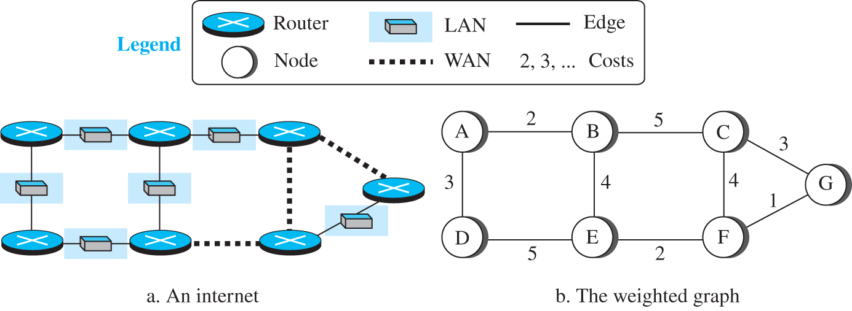
Figure 8.1 An internet and its graphical representation
Access the text alternative for slide images.

Slide 7
8.1.2 Least-Cost Routing
When an internet is modeled as a weighted graph, one of the ways to interpret the best route from the source router to the destination router is to find the least cost between the two. In other words, the source router chooses a route to the destination router in such a way that the total cost for the route is the least cost among all possible routes.

Slide 8
Least Cost Trees
If there are N routers in an internet, there are (N - 1) least-cost paths from each router to any other router. This means we need N * (N - 1) least-cost paths for the whole internet. If we have only 10 routers in an internet, we need 90 least-cost paths. A better way to see all of these paths is to combine them in a least-cost tree. A least-cost tree is a tree with the source router as the root that spans the whole graph (visits all other nodes) and in which the path between the root and any other node is the shortest. Figure 8.2 shows the seven least-cost trees for the internet in Figure 8.1.

Slide 9
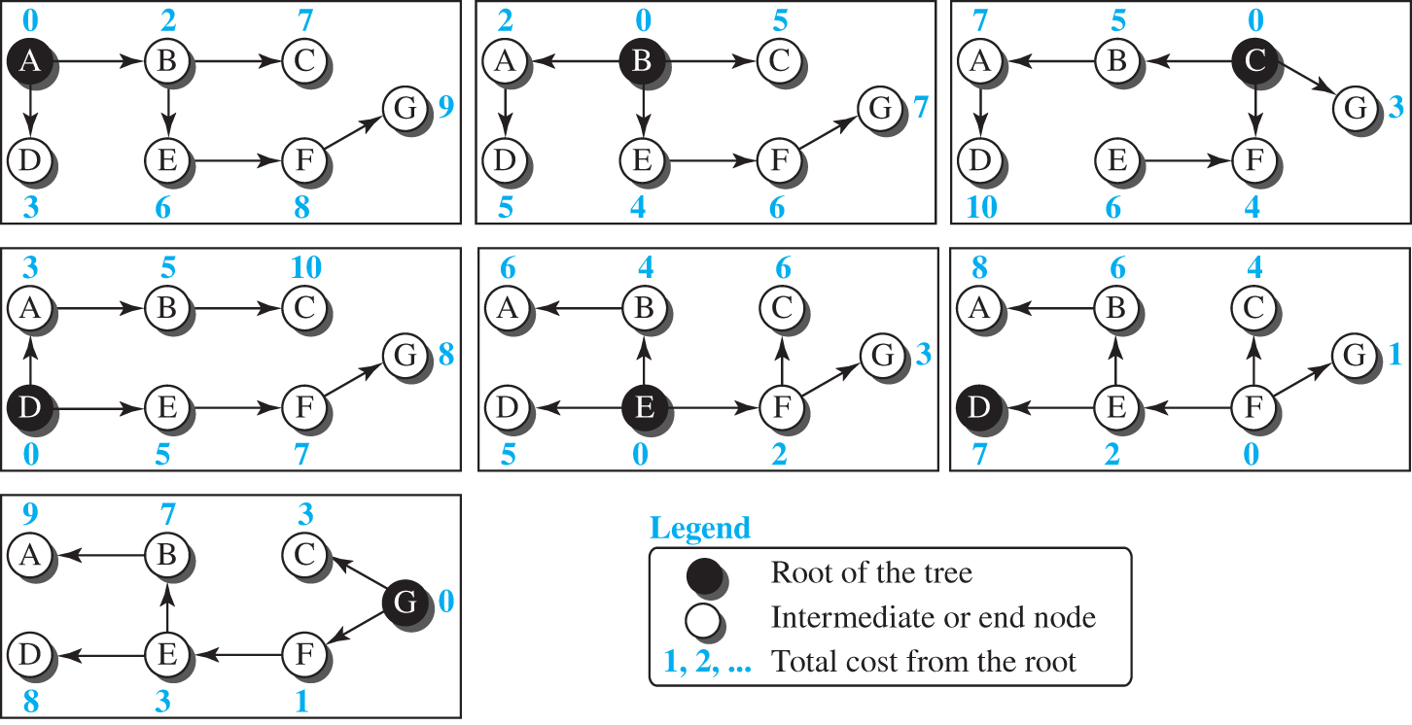
Figure 8.2 Least-cost trees for nodes in the internet of Figure 4.56
Access the text alternative for slide images.

Slide 10
8-2 ROUTING ALGORITHMS
Several routing algorithms have been designed in the past. The differences between these methods are in the way they interpret the least cost and the way they create the least-cost tree for each node. In this section, we discuss the common algorithms; later we show how a routing protocol in the Internet implements one of these algorithms.

Slide 11
8.2.1 Distance-Vector Routing
The distance-vector (DV) routing uses the goal we discussed in the introduction, to find the best route. In distance-vector routing, the first thing each node creates is its own least-cost tree with the rudimentary information it has about its immediate neighbors. The incomplete trees are exchanged between immediate neighbors to make the trees more and more complete and to represent the whole internet. We can say that in distance-vector routing, a router continuously tells all of its neighbors what it knows about the whole internet (although the knowledge can be incomplete).

Slide 12
Bellman-Ford Equation
The heart of distance-vector routing is the famous Bellman-Ford equation. This equation is used to find the least cost (shortest distance) between a source node, x, and a destination node, y, through some intermediary nodes (a, b, c, . . .) when the costs between the source and the intermediary nodes and the least costs between the intermediary nodes and the destination are given.

Slide 13
Figure 8.3 Graphical idea behind Bellman-Ford equation
Access the text alternative for slide images.

Slide 14
Distance Vector
The concept of a distance vector is the rationale for the name distance-vector routing. A least-cost tree is a combination of least-cost paths from the root of the tree to all destinations. These paths are graphically glued together to form the tree. Distance-vector routing unglues these paths and creates a distance vector, a one-dimensional array to represent the tree. Figure 8.4 shows the tree for node A in the internet in Figure 8.1 and the corresponding distance vector.

Slide 15
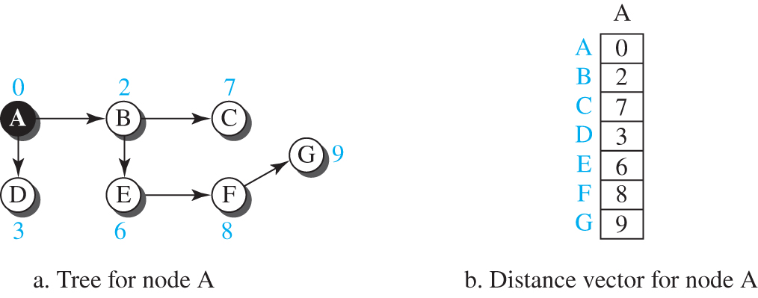
Figure 8.4 The distance vector corresponding to a tree
Access the text alternative for slide images.

Slide 16
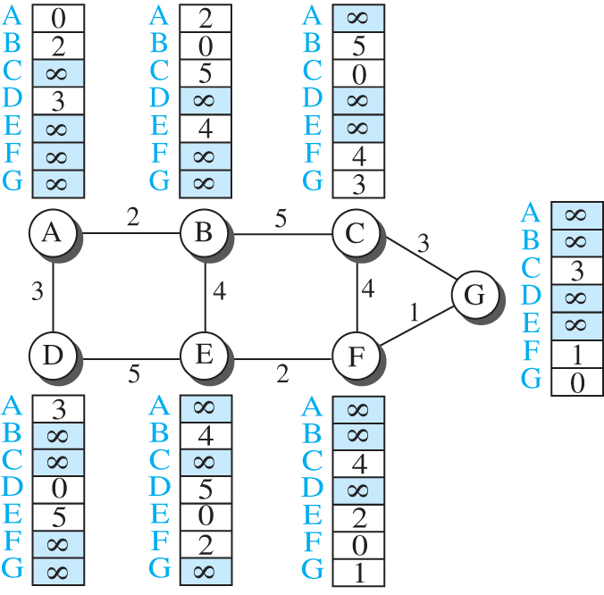
Figure 8.5 The first distance vector for an internet
Access the text alternative for slide images.

Slide 17
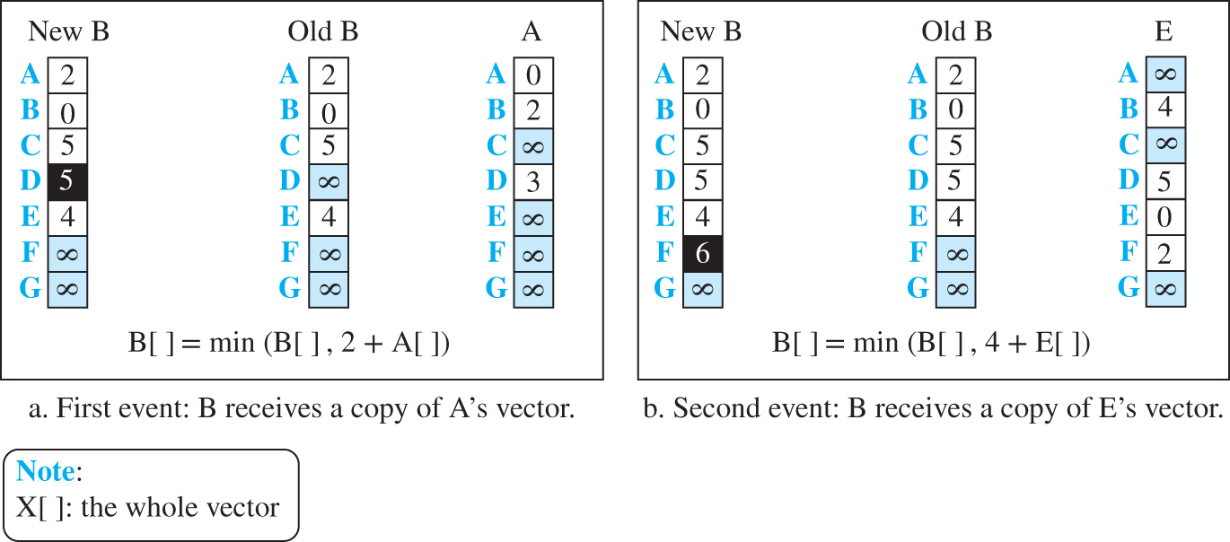
Figure 8.6 Updating distance vectors
Access the text alternative for slide images.

Slide 18
Distance-Vector Routing Algorithm
Now we can give a simplified pseudocode for the distance-vector routing algorithm, as shown in Table 8.1. The algorithm is run by its node independently and asynchronously.

Slide 19
Table 8.1 Distance-vector routing algorithm for a node
1 | Distance_Vector_Routing ( )
2 | {
3 | // Initialize (create initial vectors for the node)
4 | D[myself ] = 0
5 | for (y = 1 to N)
6 | {
7 | if (y is a neighbor)
8 | D[y] = c[myself][y]
9 | Else
10 | D[y] = ∞
11 | }
12 | send vector {D[1], D[2], …, D[N]} to all neighbors
13 | // Update (improve the vector with the vector received from a neighbor)
14 | repeat (forever)
15 | {
16 | wait (for a vector D_{w} from a neighbor w or any change in the link)
17 | for (y = 1 to N)
18 | {
19 | D[y] = min [D[y], (c[myself ][w] + D_{w}[y])] // Bellman-Ford equation
20 | }
21 | if (any change in the vector)
22 | send vector {D[1], D[2], …, D[N]} to all neighbors
23 | }
24 | }

Slide 20
Figure 8.7 Two-node instability
Access the text alternative for slide images.

Slide 21
8.2.2 Link-State Routing
A routing algorithm that directly follows our discussion for creating least-cost trees and forwarding tables is link-state (LS) routing. This method uses the term link-state to define the characteristic of a link (an edge) that represents a network in the internet. In this algorithm the cost associated with an edge defines the state of the link. Links with lower costs are preferred to links with higher costs; if the cost of a link is infinity, it means that the link does not exist or has been broken.

Slide 22
Link-State Database (LSDB)
To create a least-cost tree with this method, each node needs to have a complete map of the network, which means it needs to know the state of each link. The collection of states for all links is called the link-state database (LSDB). There is only one LSDB for the whole internet; each node needs to have a duplicate of it to be able to create the least-cost tree. Figure 8.8 shows an example of an LSDB for the graph in Figure 8.1. The LSDB can be represented as a two-dimensional array (matrix) in which the value of each cell defines the cost of the corresponding link.

Slide 23
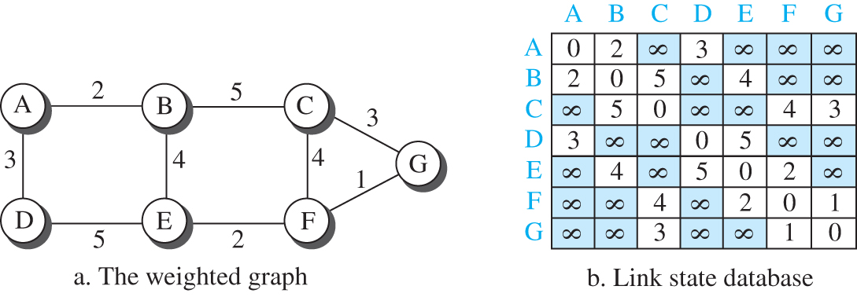
Figure 8.8 Example of a link-state database
Access the text alternative for slide images.

Slide 24
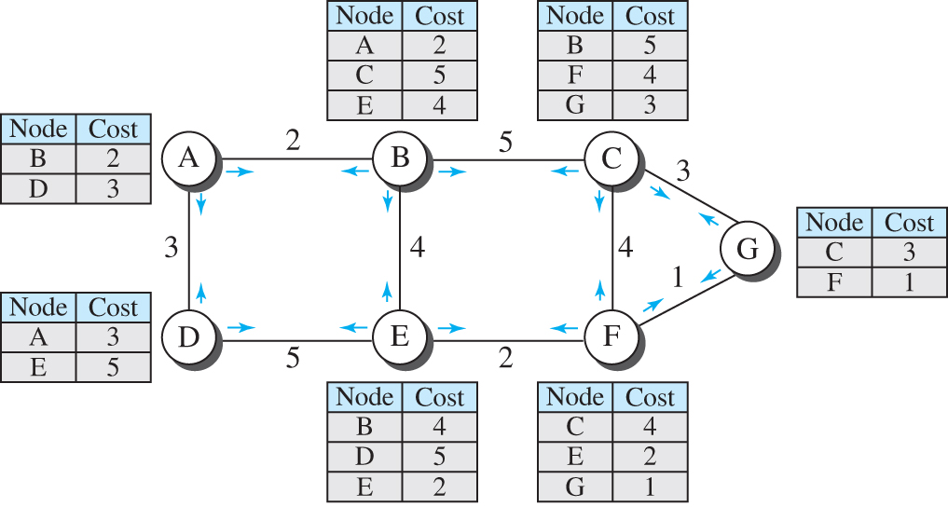
Figure 8.9 LSPs created and sent out by each node to build LSDB
Access the text alternative for slide images.

Slide 25
Formation of Least-Cost Tree
To create a least-cost tree for itself, using the shared LSDB, each node needs to run the famous Dijkstra Algorithm. This iterative algorithm uses the following steps:
The node chooses itself as the root of the tree, creating a tree with a single node, and sets the total cost of each node based on the information in the LSDB.
The node selects one node, among all nodes not in the tree, which is closest to the root, and adds this to the tree.
The node repeats step 2 until all nodes are added to the tree.

Slide 26
Table 8.2 Dijkstra’s algorithm
1 | Distance_Vector_Routing ( )
2 | {
3 | // Initialization
4 | Tree = {root} // Tree is made only of the root
5 | for (y = 1 to N) // N is the number of nodes
6 | {
7 | if (y is the root)
8 | D [y] = 0 // D [y] is shortest distance from root to node y
9 | else if (y is a neighbor)
10 | D [y] = c[root][y] // c [x] [y] is cost between nodes x and y in LSDB
11 | else
12 | D [y] = ∞
13 | }
14 | // Calculation
15 | repeat
16 | {
17 | find a node w, with D [w ] minimum among all nodes not in the Tree
18 | Tree = Tree ∪ {w} // Add w to tree
19 | // Update distances for all neighbor of w
20 | for (every node x, which is neighbor of w and not in the Tree)
21 | {
22 | D[x] = min{D[x], (D[w] + c[w][x])}
23 | }
24 | } until (all nodes included in the Tree)
25 | }

Slide 27
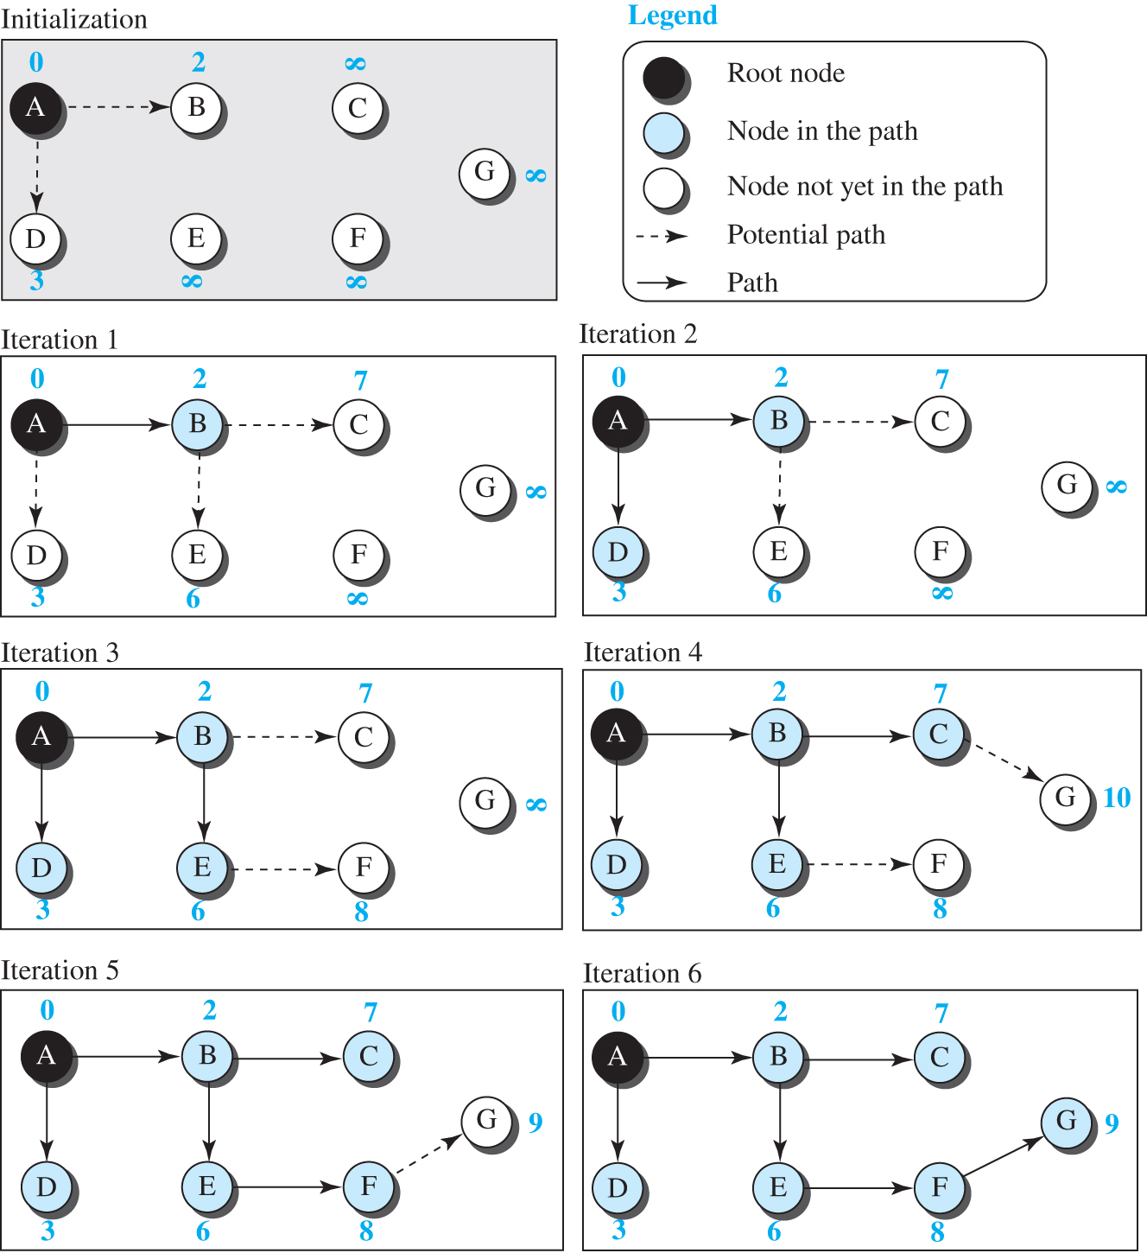
Figure 8.10 Least-cost tree
Access the text alternative for slide images.

Slide 28
8.2.3 Path-Vector Routing
Both link-state and distance-vector routing are based on the least-cost goal. However, there are instances where this goal is not the priority. For example, assume that there are some routers in the internet that a sender wants to prevent its packets from going through. In other words, the least-cost goal, applied by LS or DV routing, does not allow a sender to apply specific policies to the route a packet may take. To respond to these demands, a third routing algorithm, called path-vector (PV) routing has been devised.

Slide 29
Spanning Tree
In path-vector routing, the path from a source to all destinations is also determined by the best spanning tree. The best spanning tree, however, is not the least-cost tree; it is the tree determined by the source when it imposes its own policy. If there is more than one route to a destination, the source can choose the route that meets its policy best. A source may apply several policies at the same time. One of the common policies uses the minimum number of nodes to be visited (something similar to least-cost). Another common policy is to avoid some nodes as the middle node in a route.

Slide 30
Figure 8.11 Spanning trees in path-vector routing
Access the text alternative for slide images.

Slide 31
Creation of Spanning Tree
Path-vector routing, like distance-vector routing, is an asynchronous and distributed routing algorithm. The spanning trees are made, gradually and asynchronously, by each node. When a node is booted, it creates a path vector based on the information it can obtain about its immediate neighbor. A node sends greeting messages to its immediate neighbors to collect these pieces of information. Figure 8.12 shows all of these path vectors for our internet in Figure 8.11.

Slide 32
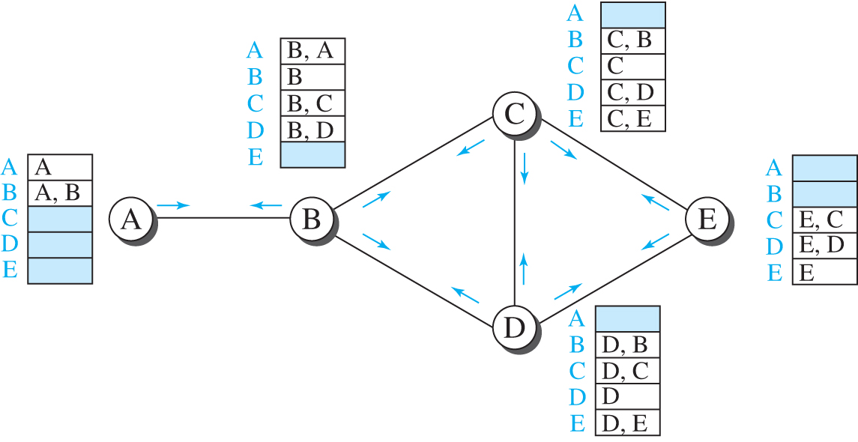
Figure 8.12 Path vectors made at booting time
Access the text alternative for slide images.

Slide 33
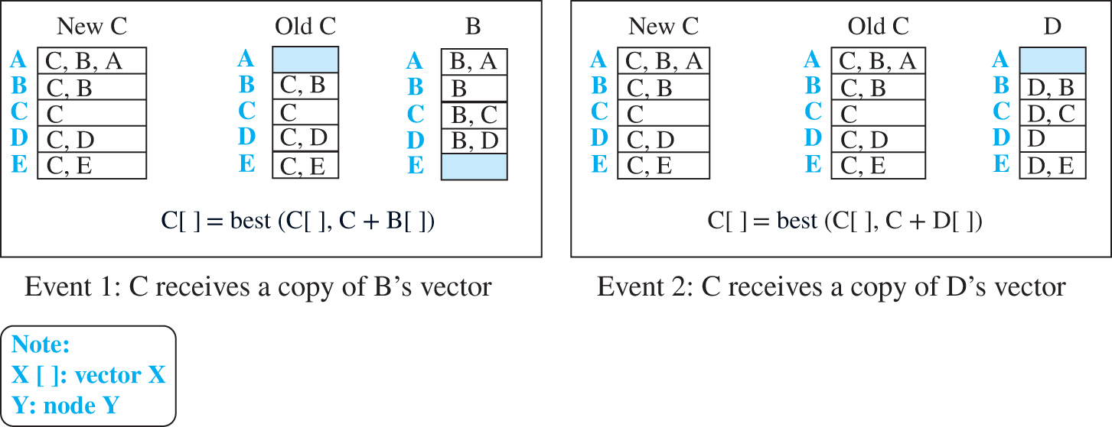
Figure 8.13 Updating path vectors
Access the text alternative for slide images.

Slide 34
Table 8.3 Path-vector algorithm for a node
1 | Table 8.3 Path-vector algorithm for a node
2 | {
3 | // Initialization
4 | for (y = 1 to N)
5 | {
6 | if ( y is myself)
7 | Path[ y] = myself
8 | else if (y is a neighbor)
9 | Path[ y] = myself + neighbor node
10 | else
11 | Path[ y] = empty
12 | }
13 | Send vector {Path[1], Path[2], …, Path[ y]} to all neighbors
14 | // Update
15 | repeat (forever)
16 | {
17 | wait (for a vector Path_{w} from a neighbor w)
18 | for ( y = 1 to N)
19 | {
20 | if (Path_{w} includes myself)
21 | discard the path // Avoid any loop
22 | else
23 | Path[ y] = best {Path[ y], (myself + Path_{w}[ y])}
24 | }
25 | If (there is a change in the vector)
26 | Send vector {Path[1], Path[2], …, Path[ y]} to all neighbors
27 | }
28 | } // End of Path Vector

Slide 35
8-3 UNICAST ROUTING PROTOCOLS
After an introduction, we discuss three common protocols used in the Internet: Routing Information Protocol (RIP), based on the distance-vector algorithm; Open Shortest Path First (OSPF), based on the link-state algorithm; and Border Gateway Protocol (BGP), based on the path-vector algorithm.

Slide 36
8.3.1 Internet Structure
Before discussing unicast routing protocols, we need to understand the structure of today’s Internet. The Internet has changed from a tree-like structure, with a single backbone, to a multi-backbone structure run by different private corporations today. Although it is difficult to give a general view of the Internet today, we can say that the Internet has a structure similar to what is shown in Figure 8.14.

Slide 37
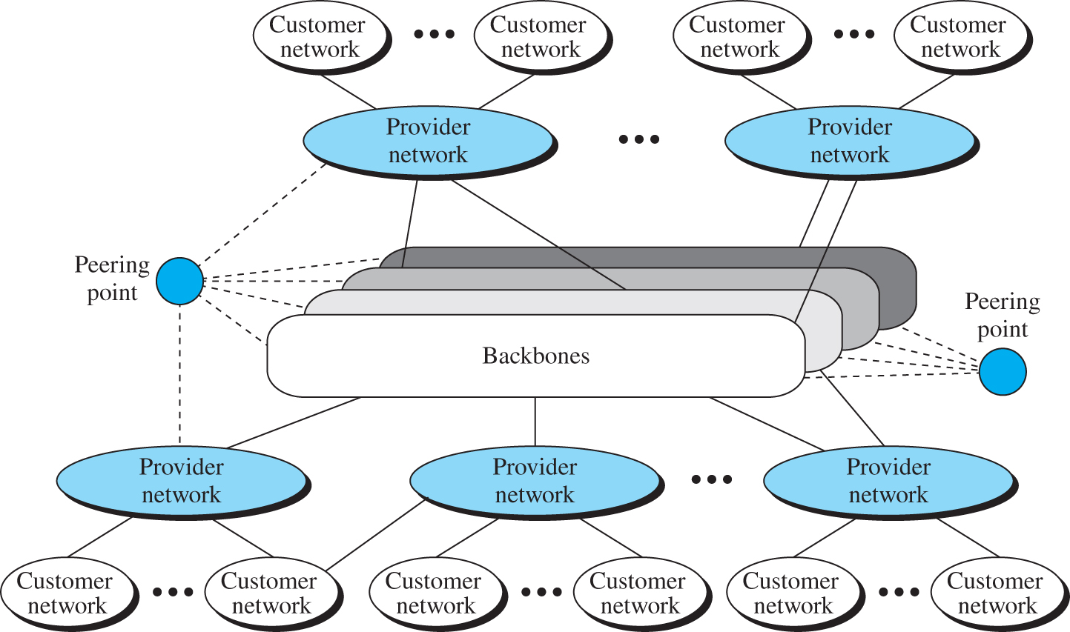
Figure 8.14 Internet structure
Access the text alternative for slide images.

Slide 38
Hierarchical Routing
The Internet today is made of a huge number of networks and routers that connect them. It is obvious that routing in the Internet cannot be done using one single protocol for two reasons: a scalability problem and an administrative issue. Scalability problem means that the size of the forwarding tables becomes huge, searching for a destination in a forwarding table becomes time-consuming, and updating creates a huge amount of traffic. The administrative issue is related to the Internet structure described in Figure 8.14. As the figure shows, each ISP is run by an administrative authority.

Slide 39
Autonomous System
As we said before, each ISP is an autonomous system when it comes to managing networks and routers under its control. Although we may have small, medium-size, and large ASs, each AS is given an autonomous number (ASN) by the ICANN. We have stub ASs, multihomed ASs, and transient ASs.

Slide 40
8.3.2 Routing Information Protocol
The Routing Information Protocol (RIP) is one of the most widely used intradomain routing protocols based on the distance-vector routing algorithm we described earlier. RIP was started as part of the Xerox Network System (XNS), but it was the Berkeley Software Distribution (BSD) version of UNIX that helped make the use of RIP widespread.

Slide 41
Hop Count
A router in this protocol basically implements the distance-vector routing algorithm shown in Table 8.1. However, the algorithm has been modified as described below. First, since a router in an AS needs to know how to forward a packet to different networks (subnets) in an AS, RIP routers advertise the cost of reaching different networks instead of reaching other nodes in a theoretical graph. In other words, the cost is defined between a router and the network in which the destination host is located.

Slide 42
Figure 8.15 Hop counts in RIP
Access the text alternative for slide images.

Slide 43
Forwarding Table 1
Although the distance-vector algorithm we discussed in the previous section is concerned with exchanging distance vectors between neighboring nodes, the routers in an autonomous system need to keep forwarding tables to forward packets to their destination networks.
Figure 8.16 shows the three forwarding tables for the routers in Figure 8.15. Note that the first and the third columns together convey the same information as does a distance vector, but the cost shows the number of hops to the destination networks.

Slide 44
Figure 8.16 Forwarding tables
Access the text alternative for slide images.

Slide 45
RIP Implementation 1
RIP is implemented as a process that uses the service of UDP on the well-known port number 520. In BSD, RIP is a daemon process (a process running at the background), named routed (abbreviation for route daemon and pronounced route-dee). This means that although RIP is a routing protocol to help IP to route its datagrams through the AS, the RIP messages are encapsulated inside UDP user datagrams, which in turn are encapsulated inside IP datagrams. In other words, RIP runs at the application layer, but creates forwarding tables for IP at the network later.

Slide 46
Figure 8.17 RIP message format
Access the text alternative for slide images.

Slide 47
Example 8.1
Figure 8.18 shows a more realistic example of the operation of RIP in an autonomous system. First, the figure shows all forwarding tables after all routers have been booted. Then we show changes in some tables when some update messages have been exchanged. Finally, we show the stabilized forwarding tables when there is no more change.

Slide 48
Figure 8.18 Example of an autonomous system using RIP (Part I)
Access the text alternative for slide images.

Slide 49
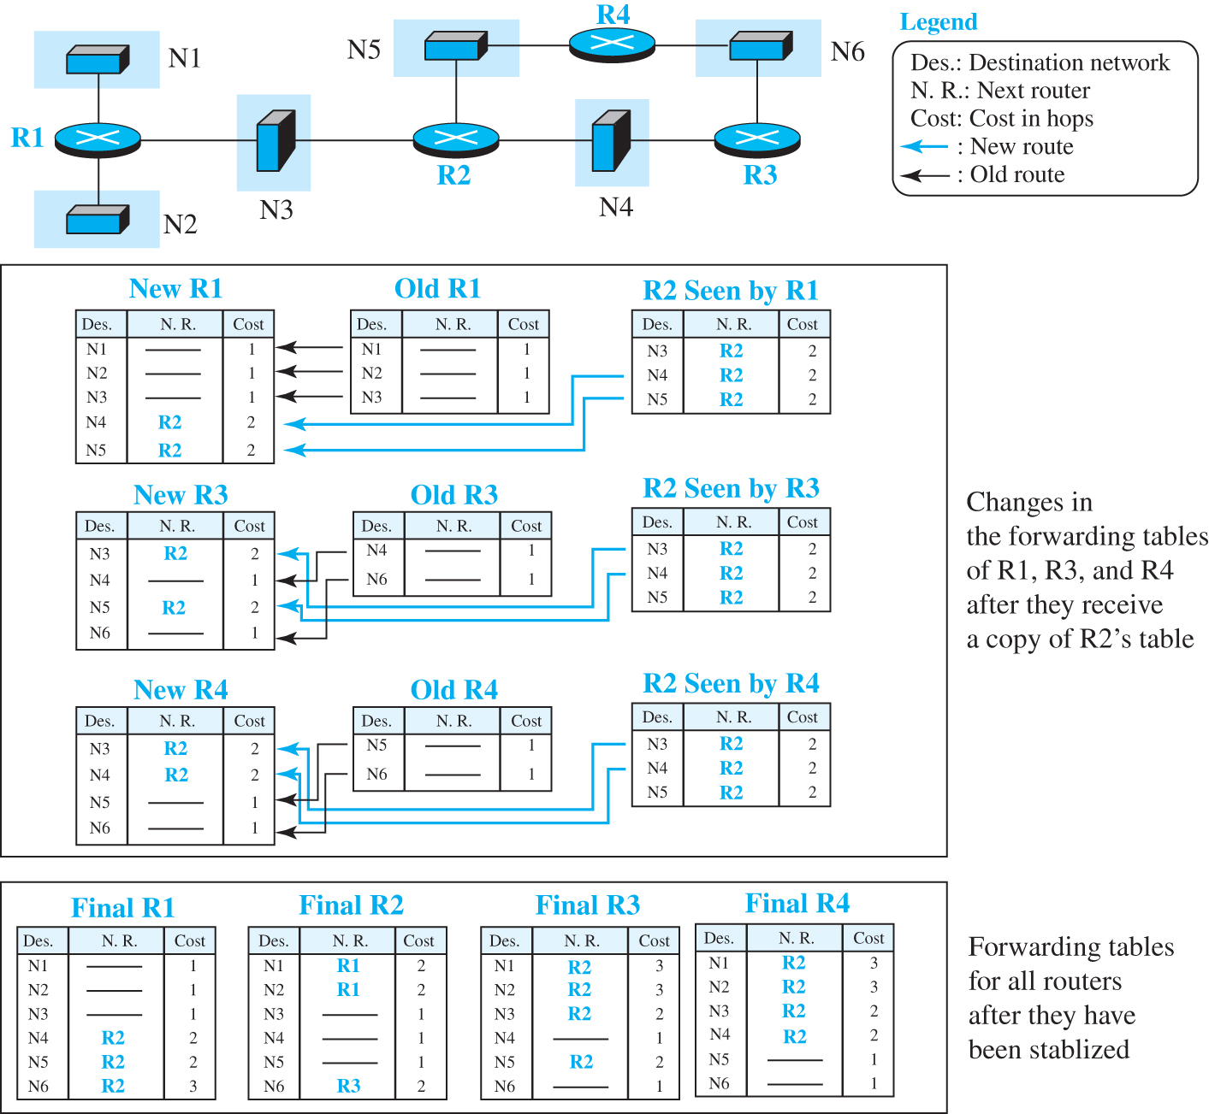
Figure 8.18 Example of an autonomous system using RIP (Part II)

Slide 50
RIP Implementation 2
Before ending this section, let us mention the performance of RIP:
Update Messages
Convergence of Forwarding Tables
Robustness

Slide 51
8.3.3 Open Shortest Path First
Open Shortest Path First (OSPF) is also an intradomain routing protocol like RIP, but it is based on the link-state routing protocol we described earlier in the chapter. OSPF is an open protocol, which means that the specification is a public document.

Slide 52
Metric
In OSPF, like RIP, the cost of reaching a destination from the host is calculated from the source router to the destination network. However, each link (network) can be assigned a weight based on the throughput, round-trip time, reliability, and so on.

Slide 53
Figure 8.19 Metric in OSPF
Access the text alternative for slide images.

Slide 54
Forwarding Table 2
Each OSPF router can create a forwarding table after finding the shortest-path tree between itself and the destination using Dijkstra’s algorithm, described earlier in the chapter. Figure 8.20 shows the forwarding tables for the simple AS in Figure 8.19.

Slide 55
Figure 8.20 Forwarding tables in OSPF
Access the text alternative for slide images.

Slide 56
Areas
Each OSPF router can create a forwarding table after finding the shortest-path tree between itself and the destination using Dijkstra’s algorithm, described earlier in the chapter. Figure 8.20 shows the forwarding tables for the simple AS in Figure 8.19.

Slide 57
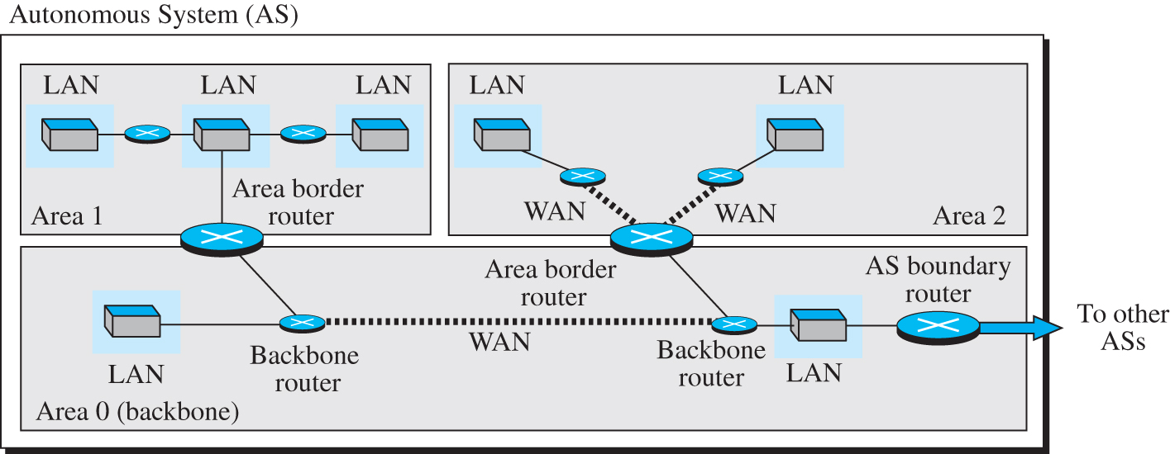
Figure 8.21 Areas in an autonomous system
Access the text alternative for slide images.

Slide 58
Link-State Advertisement
OSPF is based on the link-state routing algorithm, which requires that a router advertise the state of each link to all neighbors for the formation of the LSDB. When we discussed the link-state algorithm, we used the graph theory and assumed that each router is a node and each network between two routers is an edge. The situation is different in the real world, in which we need to advertise the existence of different entities as nodes, the different types of links that connect each node to its neighbors, and the different types of cost associated with each link.

Slide 59
Figure 8.22 Five different LSPs (Part I)
Access the text alternative for slide images.

Slide 60
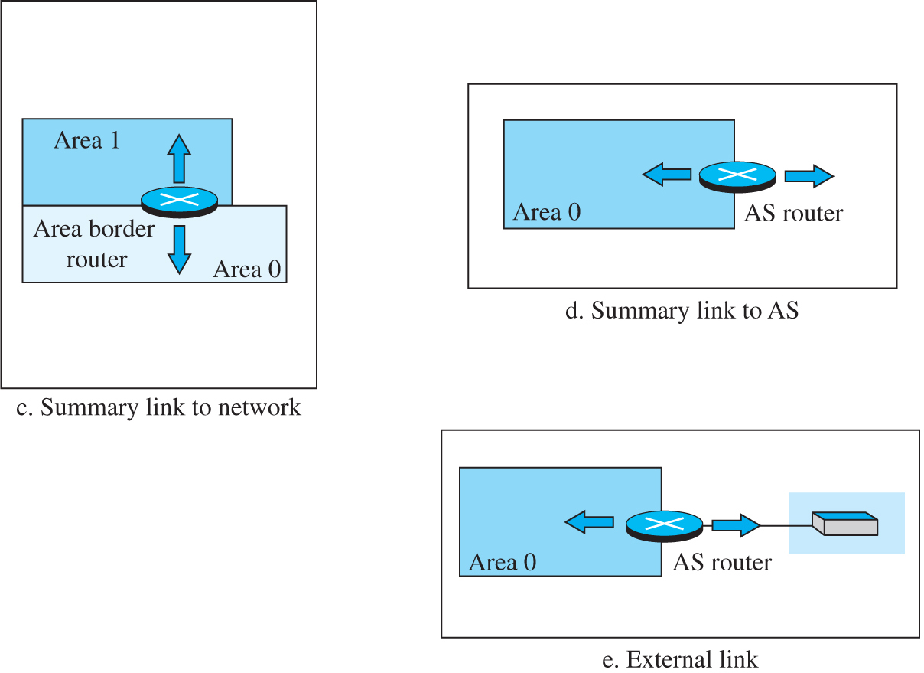
Figure 8.22 Five different LSPs (Part II)

Slide 61
OSPF Implementation
OSPF is implemented as a program in the network layer that uses the service of the IP for propagation. An IP datagram that carries a message from OSPF sets the value of the protocol field to 89. This means that although OSPF is a routing protocol to help IP to route its datagrams inside an AS, the OSPF messages are encapsulated inside datagrams. OSPF has gone through two versions: version 1 and version 2. Most implementations use version 2.

Slide 62
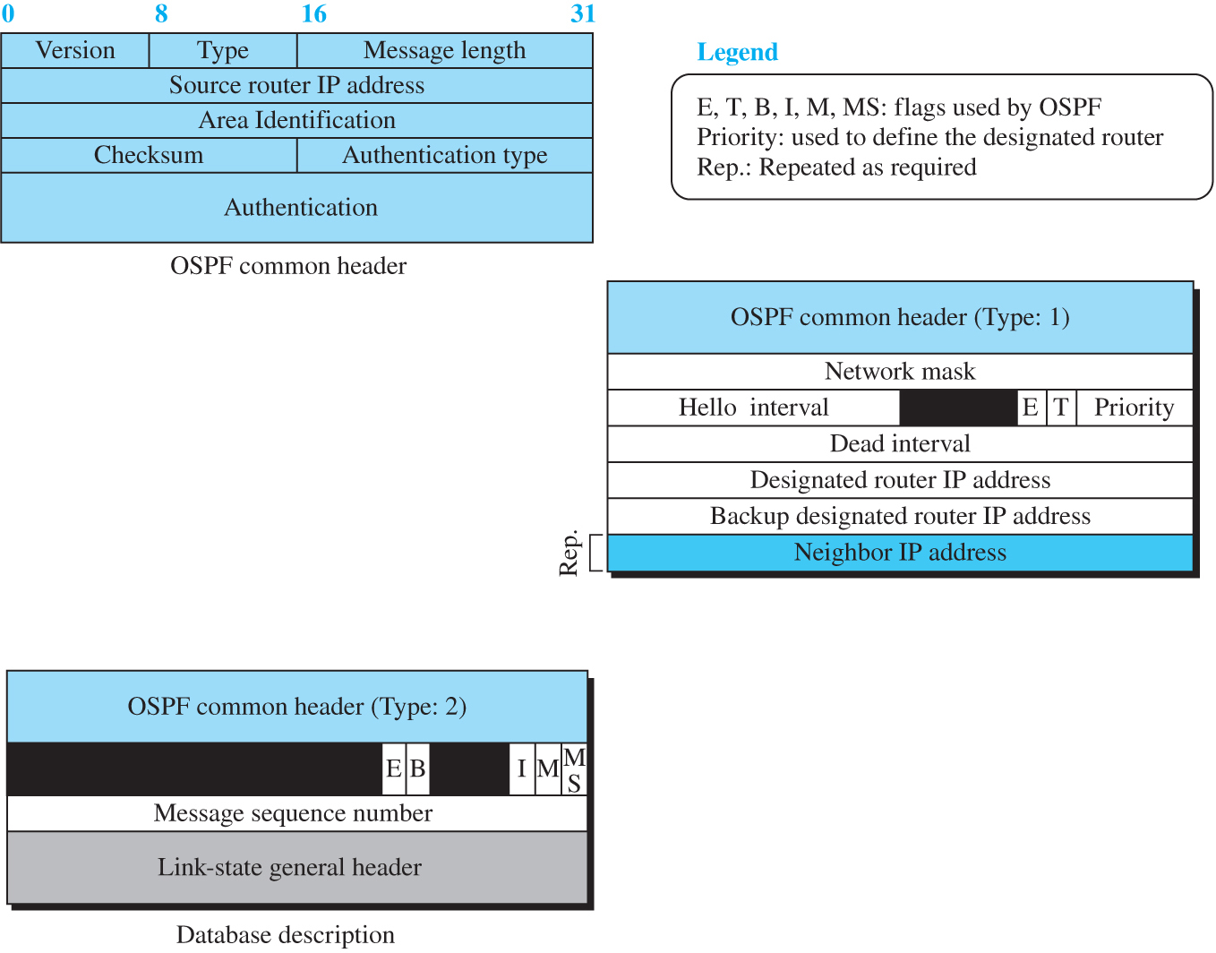
Figure 8.23 OSPF message formats (Part I)
Attention
Access the text alternative for slide images.

Slide 63
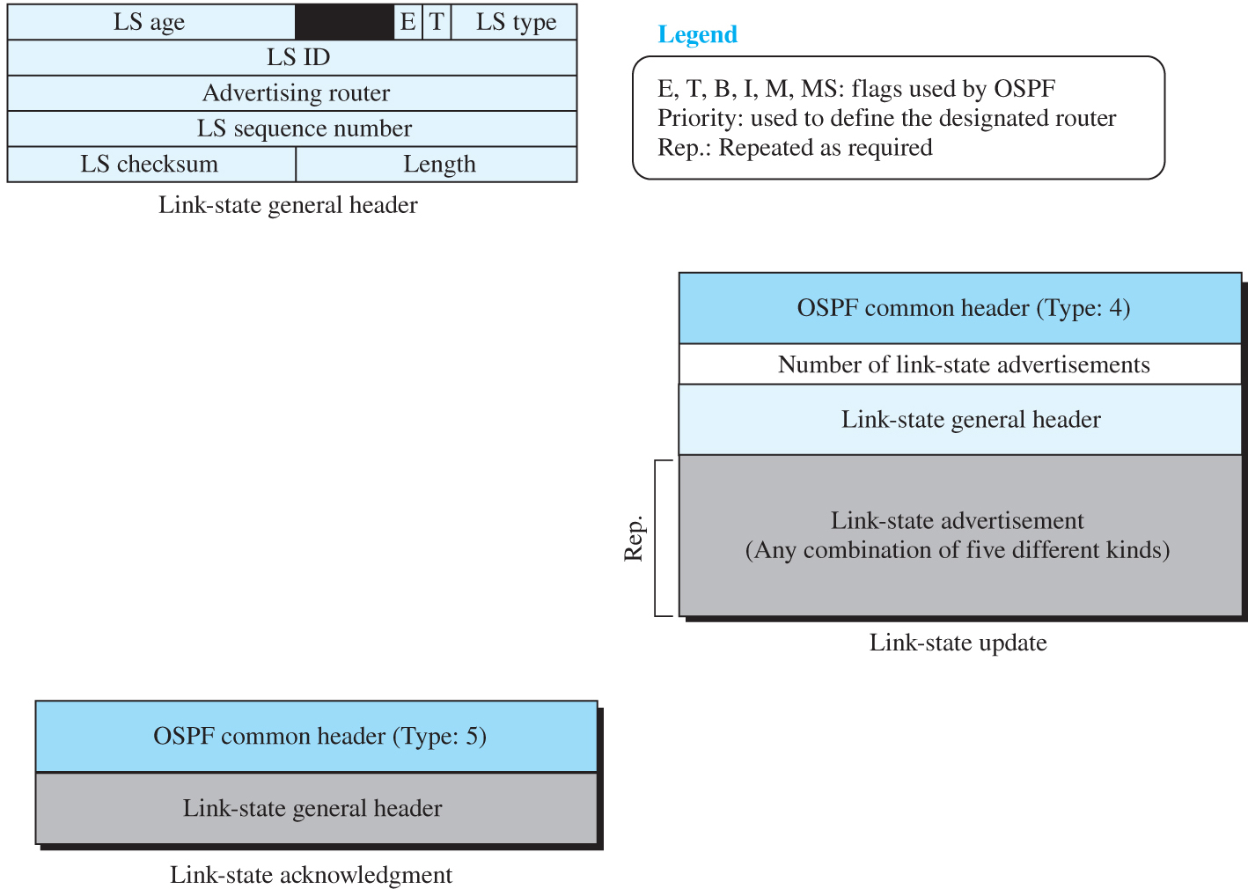
Figure 8.23 OSPF message formats (Part II)
Attention
Access the text alternative for slide images.

Slide 64
Performance 1
Update Messages
The link-state messages in OSPF have a somewhat complex format. They also are flooded to the whole area. If the area is large, these messages may create heavy traffic and use a lot of bandwidth.
Convergence of Forwarding Tables
When the flooding of LSPs is completed, each router can create its own shortest-path tree and forwarding table; convergence is fairly quick. However, each router needs to run the Dijkstra’s algorithm, which may take some time.
Robustness
The OSPF protocol is more robust than RIP because, after receiving the completed LSDB, each router is independent and does not depend on other.

Slide 65
8.3.4 Border Gateway Protocol
The Border Gateway Protocol version 4 (BGP4) is the only interdomain routing protocol used in the Internet today. BGP4 is based on the path-vector algorithm we described before, but it is tailored to provide information about the reachability of networks in the Internet.

Slide 66
Introduction
BGP, and in particular BGP4, is a complex protocol. In this section, we introduce the basics of BGP and its relationship with intradomain routing protocols (RIP or OSPF). Figure 8.24 shows an example of an internet with four autonomous systems. AS2, AS3, and AS4 are stub autonomous systems; AS1 is a transient one. In our example, data exchange between AS2, AS3, and AS4 should pass through AS1.

Slide 67
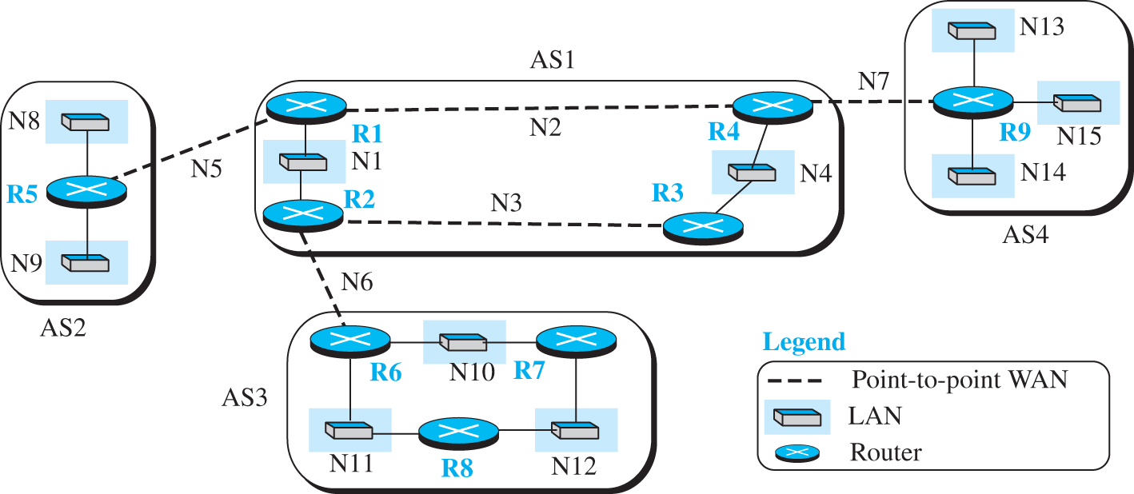
Figure 8.24 A sample internet with four ASs
Access the text alternative for slide images.

Slide 68
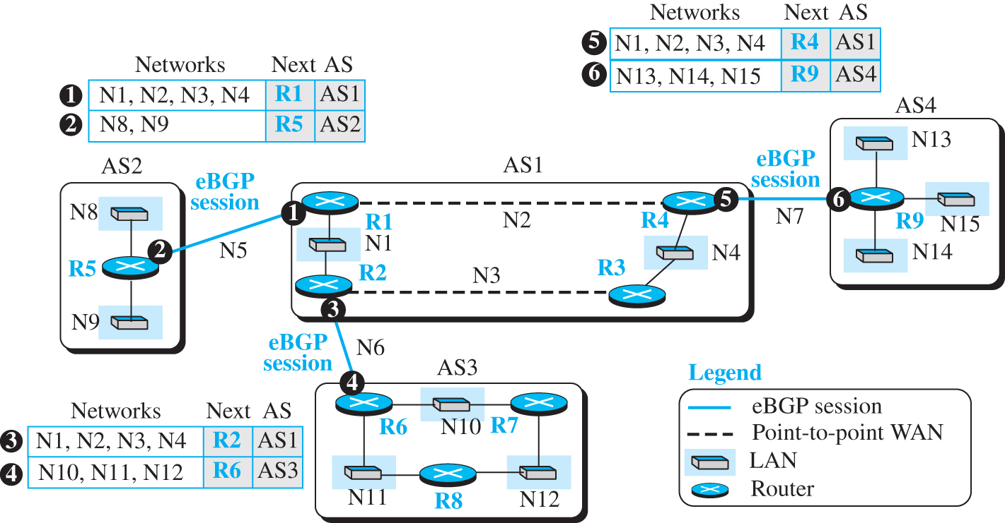
Figure 8.25 eBGP operation
Access the text alternative for slide images.

Slide 69
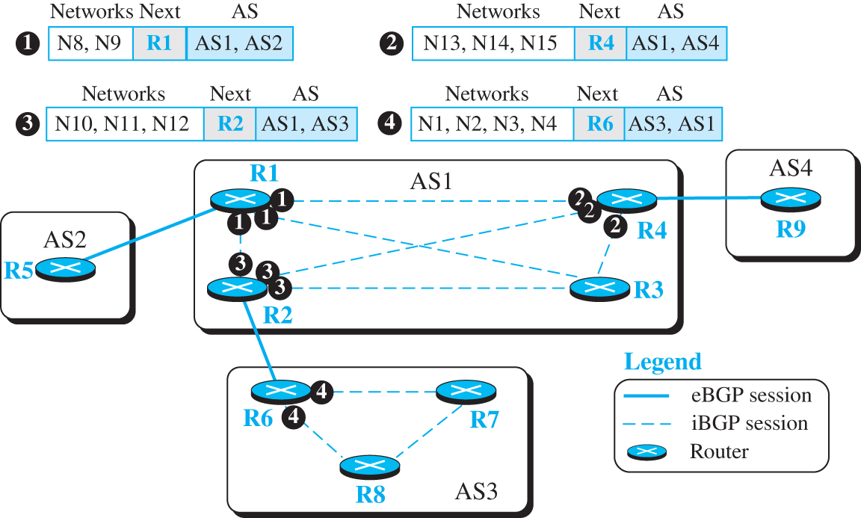
Figure 8.26 Combination of eBGP and iBGP sessions in our internet
Access the text alternative for slide images.

Slide 70
Figure 8.27 Finalized BGP path tables (Part I)
Access the text alternative for slide images.

Slide 71
Figure 8.27 Finalized BGP path tables (Part II)

Slide 72
Figure 8.27 Finalized BGP path tables (Part III)

Slide 73
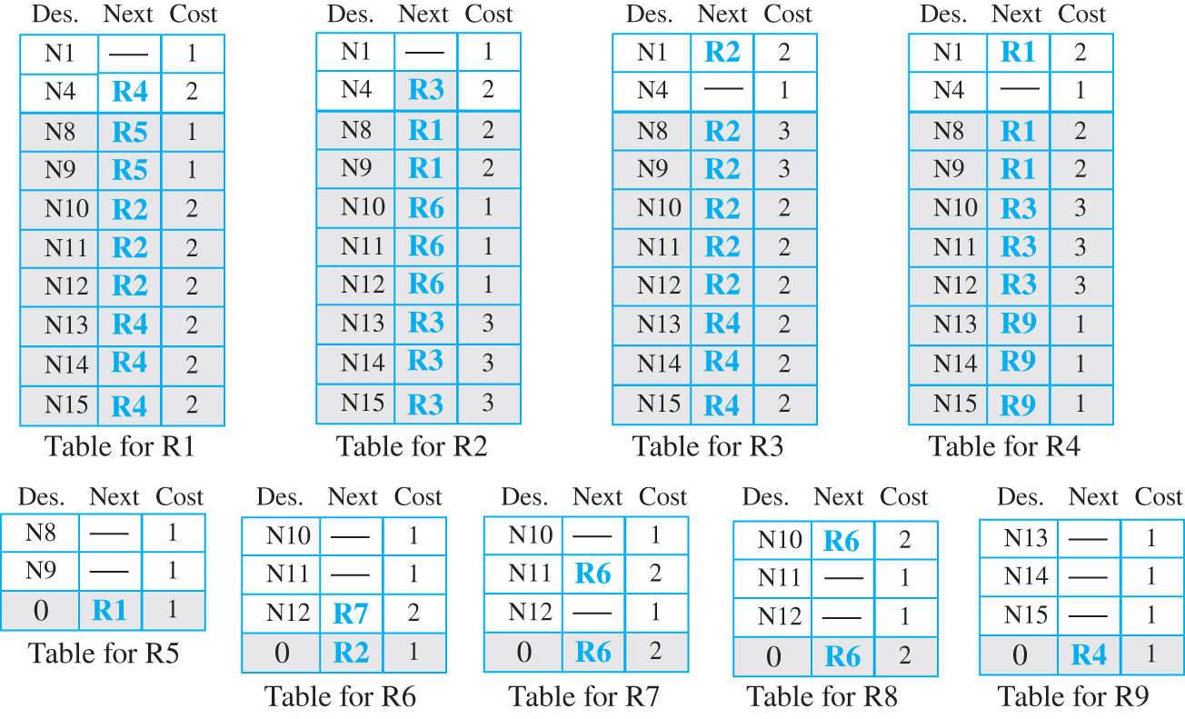
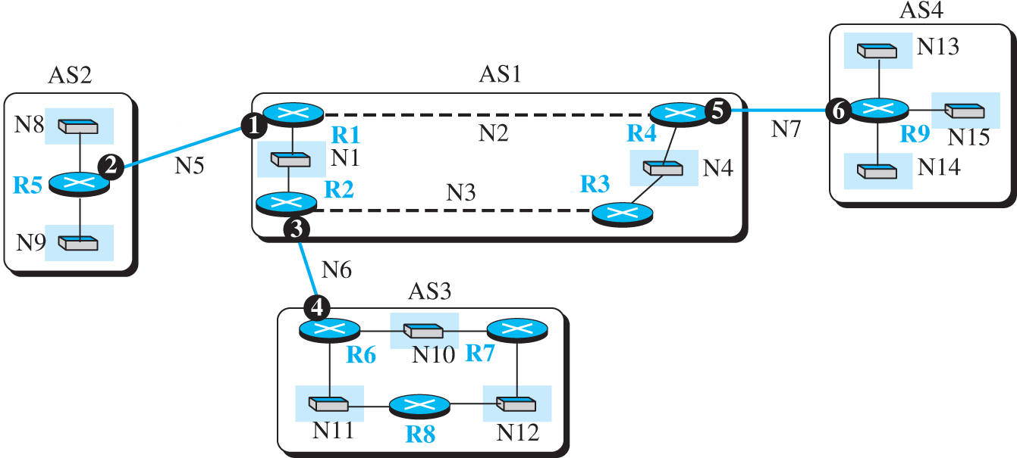
Figure 8.28 Forwarding tables after injection from BGP (Part I)
Access the text alternative for slide images.

Slide 74
Figure 8.28 Forwarding tables after injection from BGP (Part II)
Access the text alternative for slide images.

Slide 75
Path Attributes
In both intradomain routing protocols (RIP or OSPF), a destination is normally associated with two pieces of information: next hop and cost. The first one shows the address of the next router to deliver the packet; the second defines the cost to the final destination. Interdomain routing is more involved and naturally needs more information about how to reach the final destination. In BGP these pieces are called path attributes.

Slide 76
Figure 8.29 Format of path attribute
Access the text alternative for slide images.

Slide 77
Route Selection
So far in this section, we have been silent about how a route is selected by a BGP router mostly because our simple example has one route to a destination. In the case where multiple routes are received to a destination, BGP needs to select one among them. The route selection process in BGP is not as easy as the ones in the intradomain routing protocol that is based on the shortest-path tree. A route in BGP has some attributes attached to it and it may come from an eBGP session or an iBGP session. Figure 8.30 shows the flow diagram as used by common implementations

Slide 78
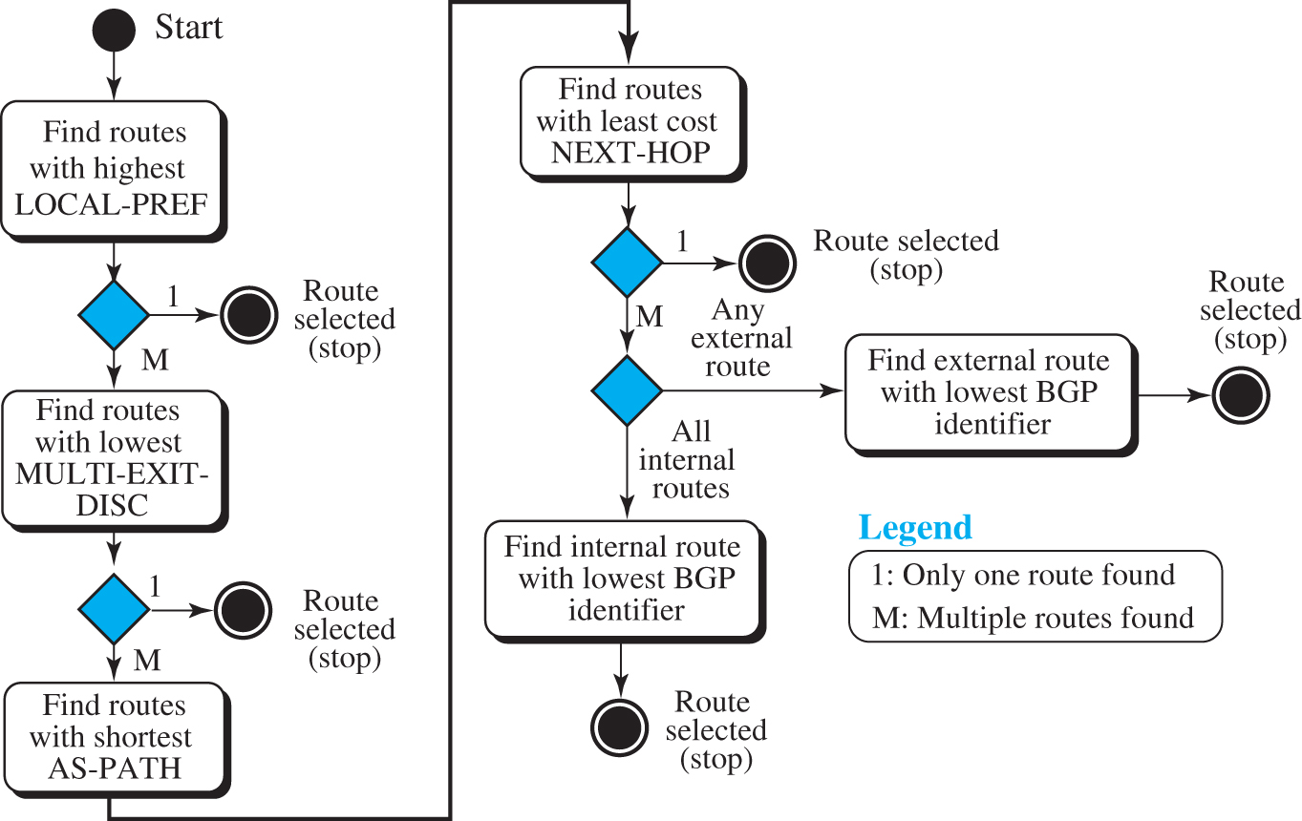
Figure 20.30 Flow diagram for route selection
Access the text alternative for slide images.

Slide 79
Messages
BGP uses four types of messages for communication between the BGP speakers across the ASs and inside an AS: open, update, keepalive, and notification (see Figure 8.31). All BGP packets share the same common header.

Slide 80
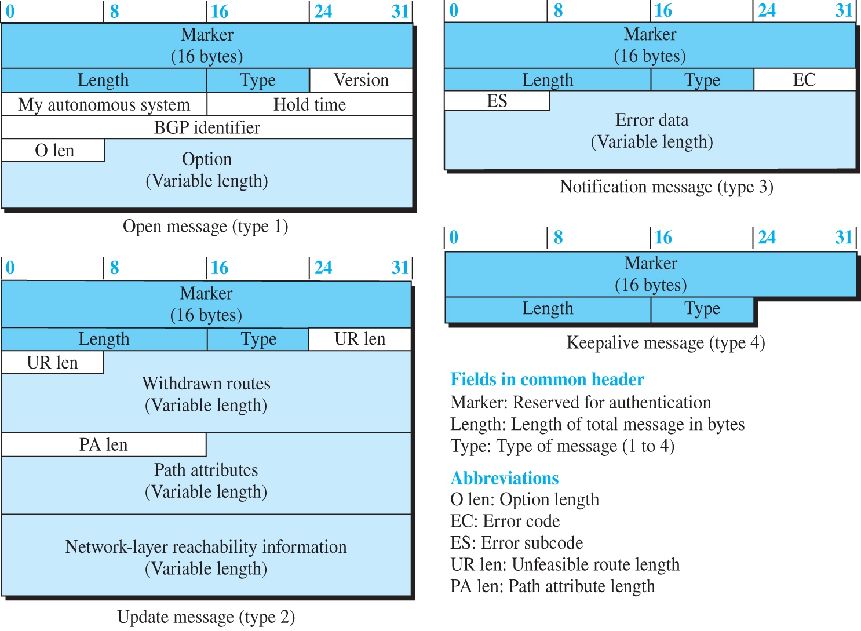
Figure 8.31 BGP messages
Access the text alternative for slide images.

Slide 81
Performance 2
BGP performance can be compared with RIP. BGP speakers exchange a lot of messages to create forwarding tables, but BGP is free from loops and count-to-infinity. The same weakness we mention for RIP about propagation of failure and corruptness also exists in BGP.

Slide 82
8-4 MULTICAST ROUTING
Communication in the Internet today is not only unicasting; multicasting communication is growing fast. In this section, we first discuss the general ideas behind unicasting, multicasting, and broadcasting. We then talk about some basic issues in multicast routing. Finally, we discuss multicasting routing protocols in the Internet.

Slide 83
8.4.1 Unicasting
In unicasting, there is one source and one destination network. The relationship between the source and the destination network is one to one. Each router in the path of the datagram tries to forward the packet to one and only one of its interfaces.

Slide 84
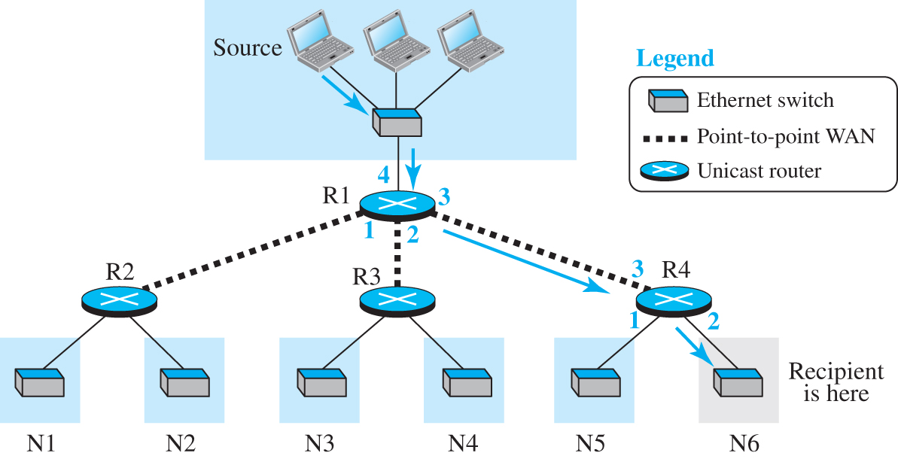
Figure 8.32 Unicasting
Access the text alternative for slide images.

Slide 85
8.4.2 Multicasting
In multicasting, there is one source and a group of destinations. The relationship is one to many. In this type of communication, the source address is a unicast address, but the destination address is a group address, a group of one or more destination networks in which there is at least one member of the group that is interested in receiving the multicast datagram. The group address defines the members of the group.

Slide 86
Multicast Applications
Multicasting has many applications today, such as access to distributed databases, information dissemination, teleconferencing, and distance learning.

Slide 87
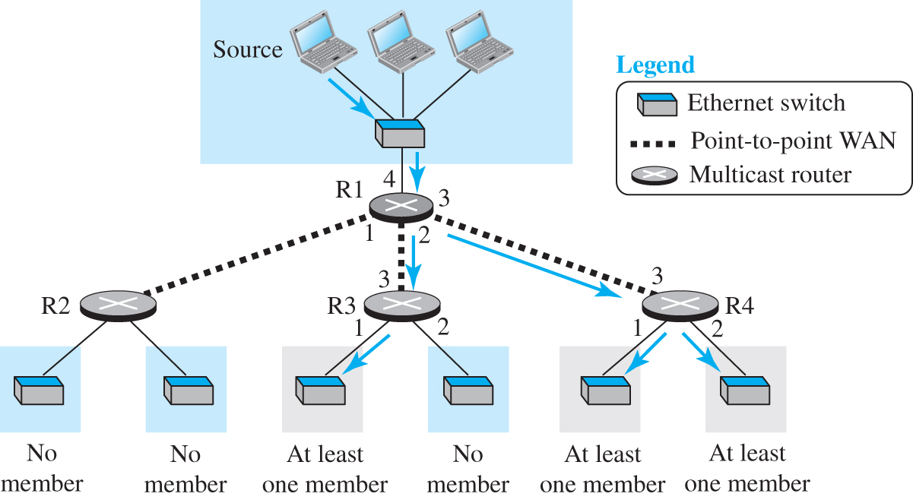
Figure 8.33 Multicasting
Access the text alternative for slide images.

Slide 88
Multicast Addresses
We discuss multicast addresses for IPv4 and IPv6 in Chapter 7.

Slide 89
8.4.3 Multicast Distance Vector
The Distance Vector Multicast Routing Protocol (DVMRP) is the extension of the Routing Information Protocol (RIP) which is used in unicast routing.
It uses the source-based tree approach to multicasting.
It is worth mentioning that each router in this protocol that receives a multicast packet to be forwarded implicitly creates a source-based multicast tree in
three steps:

Slide 90
Reverse Cast Forwarding (RPF)
The first algorithm, reverse path forwarding (RPF), forces the router to forward a multicast packet from one specific interface: the one which has come through the shortest path from the source to the router. How can a router know which interface is in this path if the router does not have a shortest-path tree rooted at the source? The router uses the first property of the shortest-path tree we discussed in unicast routing, which says that the shortest path from A to B is also the shortest path from B to A.

Slide 91
Reverse Path Broadcasting (RPB)
The RPF algorithm helps a router to forward only one copy received from a source and drop the rest. However, when we think about broadcasting in the second step, we need to remember that destinations are all the networks (LANs) in the internet. To be efficient, we need to prevent each network from receiving more than one copy of the packet. When a router that is not the parent of the attached network receives a multicast packet, it simply drops the packet. There are several ways that the parent of the network related to a network can be selected; one way is to select the router that has the shortest path to the source.

Slide 92
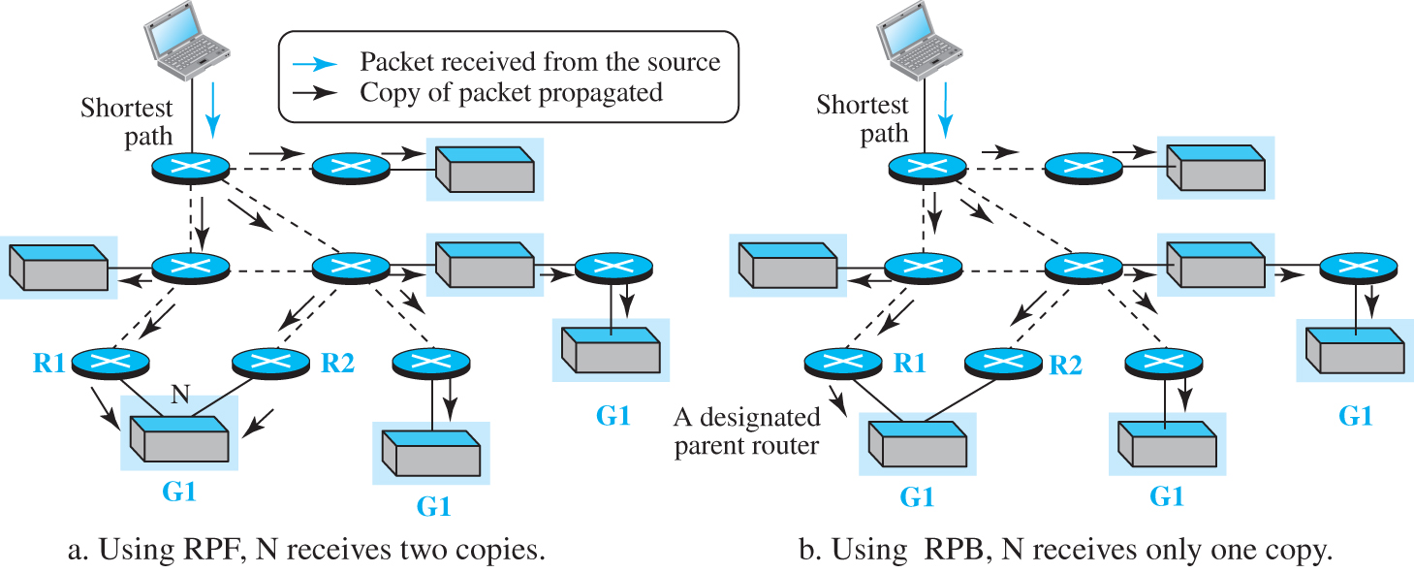
Figure 8.34 Multicasting versus multiple unicasting
Access the text alternative for slide images.

Slide 93
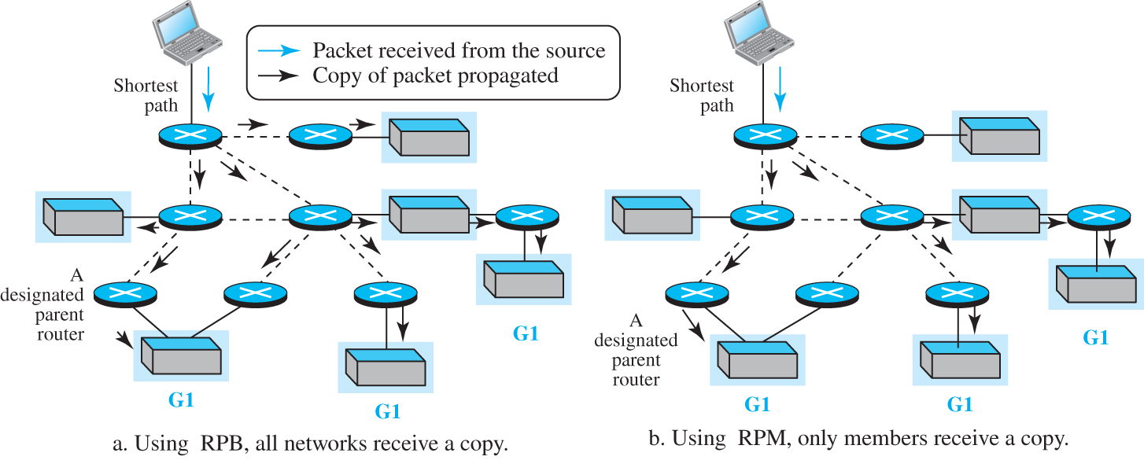
Figure 8.35 RPF versus RPB
Access the text alternative for slide images.

Slide 94
Reverse Cast Multicasting (RPM)
RPB does not multicast the packet, it broadcasts it. This is not efficient. To increase efficiency, the multicast packet must reach only those networks that have active members for that particular group. This is called reverse path multicasting (RPM). To change the broadcast shortest-path tree to a multicast shortest-path tree, each router needs to prune (make inactive) the interfaces that do not reach a network with active members corresponding to a particular source-group combination.

Slide 95
8.4.4 Multicast Link State (MOSPF)
Multicast Open Shortest Path First (MOSPF) is the extension of the Open Shortest Path First (OSPF) protocol, which is used in unicast routing. It also uses the source-based tree approach to multicasting. If the internet is running a unicast link-state routing algorithm, the idea can be extended to provide a multicast link-state routing algorithm. To extend unicasting to multicasting, each router needs to have another database, as with the case of unicast distance-vector routing, to show which interface has an active member in a particular group.

Slide 96
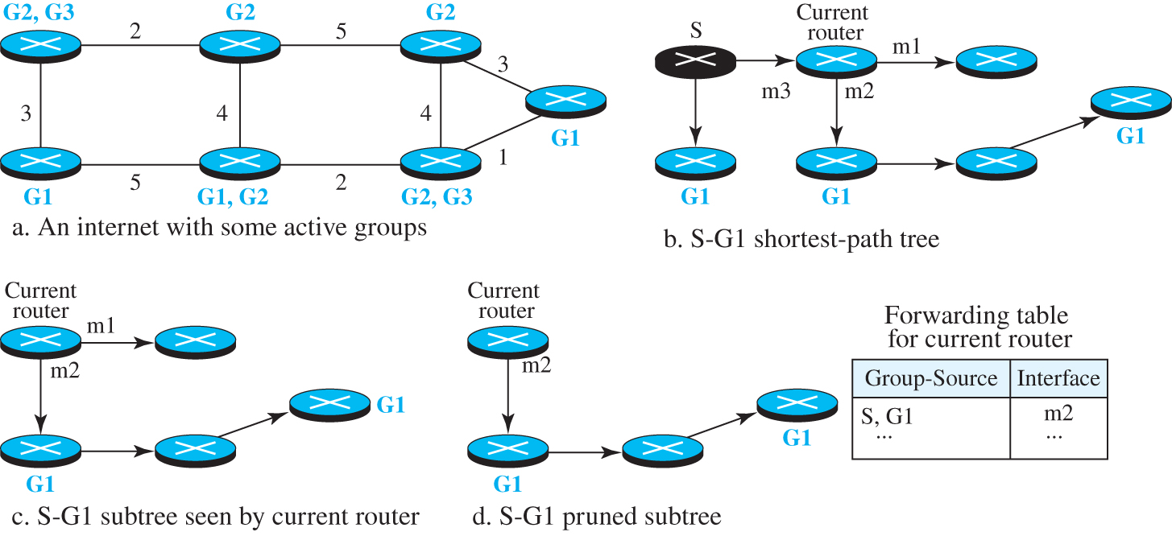
Figure 8.36 Example of tree formation in MOSPF
Access the text alternative for slide images.

Slide 97
8.4.5 Protocol Independent Multicast
Protocol Independent Multicast (PIM) is the name given to a common protocol that needs a unicast routing protocol for its operation, but the unicast protocol can be either a distance-vector protocol or a link-state protocol. In other words, PIM needs to use the forwarding table of a unicast routing protocol to find the next router in a path to the destination, but it does not matter how the forwarding table is created. PIM has another interesting feature: it can work in two different modes: dense and sparse.

Slide 98
Protocol Independent Multicast-Dense Mode)
When the number of routers with attached members is large relative to the number of routers in the internet, PIM works in the dense mode and is called PIM-DM. In this mode, the protocol uses a source-based tree approach and is similar to DVMRP, but simpler. PIM-DM uses only two strategies described in DVMRP: RPF and RPM. But unlike DVMRP, forwarding of a packet is not suspended awaiting pruning of the first subtree. Let us explain the two steps used in PIM-DM to clear the matter.

Slide 99
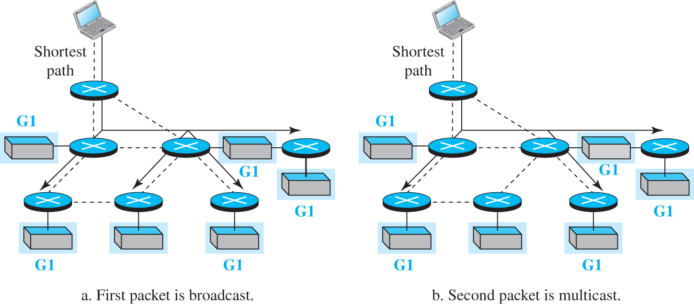
Figure 8.37 Idea behind PIM-DM
Access the text alternative for slide images.

Slide 100
Protocol Independent Multicast-Sparse Mode
When the number of routers with attached members is small relative to the number of routers in the internet, PIM works in the sparse mode and is called PIM-SM. In this environment, the use of a protocol that broadcasts the packets until the tree is pruned is not justified; PIM-SM uses a group-shared tree approach to multicasting. The core router in PIM-SM is called the rendezvous point (RP). Multicast communication is achieved in two steps. Any router that has a multicast packet to send to a group of destinations first encapsulates the multicast packet in a unicast packet (tunneling) and sends it to the RP. The RP then decapsulates the unicast packet and sends the multicast packet to its destination.

Slide 101
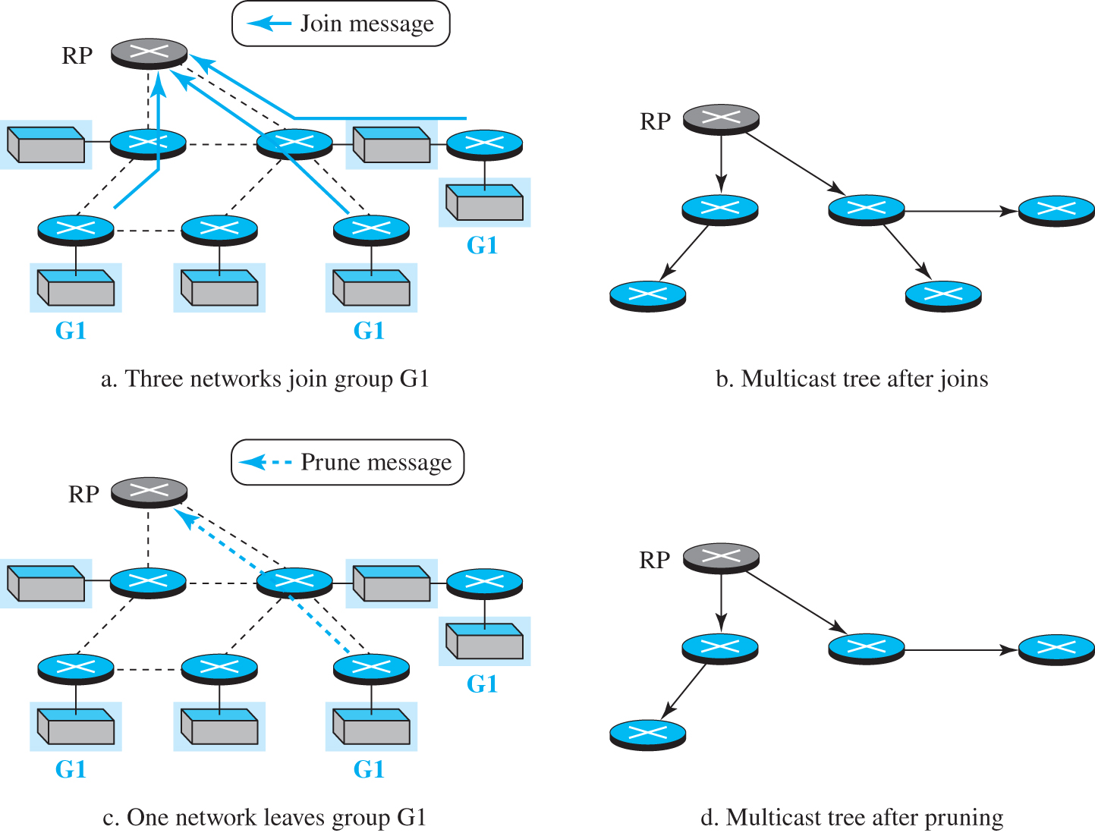
Figure 8.38 Idea behind PIM-SM
Access the text alternative for slide images.

Slide 102
End of Main Content
© 2022 McGraw Hill, LLC. All rights reserved. Authorized only for instructor use in the classroom.
No reproduction or further distribution permitted without the prior written consent of McGraw Hill, LLC.

Slide 103
Accessibility Content: Text Alternatives for Images

Slide 104
Figure 8.1 An internet and its graphical representation - Text Alternative
Return to parent-slide containing images.
The first part shows two rows of three routers with LAN and WAN connections between them. The rightmost routers in both the rows are connected to a common router. The edge connection has LAN where the WAN connection does not. The second part shows A to E arranged in two rows with a connection. C and F are connected to G. The connections between each letters are labeled from 1 to 5. The legend is given above.
Return to parent-slide containing images.

Slide 105
Figure 8.2 Least-cost trees for nodes in the internet of Figure 4.56 - Text Alternative
Return to parent-slide containing images.
Diagram one shows A with 0 is root of the tree. A to B with total cost from the root of 2 to C with total cost from the root of 7. A to D with total cost from the root of 3. B to E with total cost from the root of 6. E to F with total cost from the root of 8. F to G with total cost from the root of 9. Diagram two shows B with 0 is root of the tree. B to A with total cost from the root of 2. A to D with total cost from the root of 5. B to E with total cost from the root of 4. B to C with total cost from the root of 5. E to F with total cost from the root of 6. F to G with total cost from the root of 7. Diagram three shows C with 0 is root of the tree. C to G with total cost from the root of 3. C to F with total cost from the root of 4. C to B with total cost from the root of 5. B to A with total cost from the root of 7. A to D with total cost from the root of 10. E with total cost from the root of 6 to F with total cost from the root of 4. Diagram four shows D with 0 is root of the tree. D to A with total cost from the root of 3. A to B with total cost from the root of 5. B to C with total cost from the root of 10. D to E with total cost from the root of 5. E to F with total cost from the root of 7. F to G with total cost from the root of 8. Diagram five shows E with 0 is root of the tree. E to B with total cost from the root of 4. B to A with total cost from the root of 6. E to D with total cost from the root of 5. E to F with total cost from the root of 2. F to C with total cost from the root of 6. F to G with total cost from the root of 3. Diagram six represents D with 7 is root of the tree. F with 0 to G with total cost from the root of 1. F to C with total cost from the root of 4. F to E with total cost from the root of 2. E to D with total cost from the root of 7. E to B with total cost from the root of 6. B to A with total cost from the root of 8. Diagram seven shows G with 0 is root of the tree. G to F with total cost from the root of 1. G to C with total cost from the root of 3. F to E with total cost from the root of 3. E to B with total cost from the root of 7. B to A with total cost from the root of 9. E to D with total cost from the root of 8.
Return to parent-slide containing images.

Slide 106
Figure 8.3 Graphical idea behind Bellman-Ford equation - Text Alternative
Return to parent-slide containing images.
The first diagram shows x to a representing C x a; a to y represents D a y, x to b represents C x b and b to y represents D b y, x to c represents C x c, c to y represents D c y. The second diagram shows x to z representing C x z, z to y represents D z y, and x to y represents D x y.
Return to parent-slide containing images.

Slide 107
Figure 8.4 The distance vector corresponding to a tree - Text Alternative
Return to parent-slide containing images.
The first part shows A with 0 to B with 2 to C with 7, A to D with 3, B to E with 6, E to F with 8, and F to G with 9. The second part shows a table label labeled as A shows A 0, B 2, C 7, D 3, E 6, F 8, and G 9.
Return to parent-slide containing images.

Slide 108
Figure 8.5 The first distance vector for an internet - Text Alternative
Return to parent-slide containing images.
A to B with 2 to C with 5 to G with 3. A to D with 3 to E with 5 to F with 2. A has A 0, B 2, C 8, D 3, E 8, F 8, and G 8. B has A 2, B 0, C 5, D 8, E 4, F 8, and G 8. C has A 8, B 5, C 0, D 8, E 8, F 4, and G 3. D has A 3, B 8, C 8, D 0, E 5, F 8, and G 8. E has A 8, B 4, C 8, D 5, E 0, F 2, and G 8. F has A 8, B 8, C 8, D 8, E 2, F 0, and G 1. G has A 8, B 8, C 3, D 8, E 8, F 1, and G 0.
Return to parent-slide containing images.

Slide 109
Figure 8.6 Updating distance vectors - Text Alternative
Return to parent-slide containing images.
The first event represents new B with A 2, B 0, C 5, D 5, E 4, F infinitive and G infinitive, old B with A 2, B 0, C 5, D infinitive, E 4, F infinitive, and G infinitive and A with A 0, B 2, C infinitive, D 3, E infinitive, F infinitive and G infinitive, where B open and close square brackets is equal to min (B open and close square brackets, 2 plus A open and close square brackets). The second event represents new B with A 2, B 0, C 5, D 5, E 4, F 6 and G infinitive, old B with A 2, B 0, C 5, D 5, E 4, F infinitive and G infinitive and E with A infinitive, B 4, C infinitive, D 5, E 0, F 2 and G infinitive, where B open and close square brackets is equal to min (B open and close square brackets, 4 plus E open and close square brackets).
Return to parent-slide containing images.

Slide 110
Figure 8.7 Two-node instability - Text Alternative
Return to parent-slide containing images.
The before failure represents L A N labeled as X connects to router A with X 1 A connects to a L A N to router B with X 2 A. The after link failure represents L A N labeled as X Router A with X infinitive A to L A N to router B with X 2 A. After A is updated by B represents L A N labeled as X router A with X 3 A connects to L A N connects to router B with X 2 A. The after B is updated by A represents L A N labeled as X router A with X 3 A connects to L A N connects to router B with X 4 A. The final result represents L A N labeled as A router A with X infinitive connects to L A N connects to router B with X infinitive.
Return to parent-slide containing images.

Slide 111
Figure 8.8 Example of a link-state database - Text Alternative
Return to parent-slide containing images.
The weighted graph represents A to B with 2, B to C with 5, C to G with 3, A to D with 3, D to W with 5, E to F with 2, and F to G with 1. The link state database represents A B C D E F G of A is 0 2 infinitive 3 infinitive. A B C D E F G of B is 2 0 5 infinitive 4 infinitive. A B C D E F G of C is infinitive 5 0 infinitive 4 3. A B C D E F G of D is 3 infinitive 0 5 infinitive. A B C D E F G of E is infinitive 4 infinitive 5 0 2 infinitive. A B C D E F G of F is infinitive 4 infinitive 2 0 1. A B C D E F G of G is infinitive 3 infinitive 1 0.
Return to parent-slide containing images.

Slide 112
Figure 8.9 LSPs created and sent out by each node to build LSDB - Text Alternative
Return to parent-slide containing images.
Node and cost of: A is B 2 and D 3; B is A 2, C 5 and E 4; C is B 5, F 4 and G 3; D is A 3 and E 5; E is B 4, D 5 and E 2; F is C 4, E 2 and G 1; and G is C 3 and F 1. A to B with 2, B T C with 5, C to G with 3, A to D with 3, D to E with 5, E to F with 2 and F to G with 1.
Return to parent-slide containing images.

Slide 113
Figure 8.10 Least-cost tree - Text Alternative
Return to parent-slide containing images.
The initialization represents A with 0 represents the root node. A to B (node not yet in the path) potential path with 2 and A to D (node not yet in the path) potential path with 3. Iteration 1 represents A to B (Node in the path) path with 2, B to C (node not yet in the path) potential path with 7, B to E (node not yet in the path) potential path with 6, and A to D (node not yet in the path) potential path with 3. Iteration 2 represents A to B (Node in the path) path with 2, B to C (node not yet in the path) potential path with 7, B to E (node not yet in the path) potential path with 6, and A to D (Node in the path) path with 3. Iteration 3 represents A to B (Node in the path) path with 2, B to C (node not yet in the path) potential path with 7, A to D (Node in the path) path with 3, B to E (Node in the path) path with 6, and E to F (node not yet in the path) potential path with 8. Iteration 4 represents A to B (Node in the path) path with 2, B to C (Node in the path) path with 7, C to G (node not yet in the path) potential path with 10, A to D (Node in the path) path with 3, B to E (Node in the path) path with 6 and E to F (node not yet in the path) potential path with 8. Iteration 5 represents A to B (Node in the path) path with 2, B to C (Node in the path) path with 7, A to D (Node in the path) path with 3, B to E (Node in the path) path with 6, E to F (Node in the path) path with 8 and F to G (node not yet in the path) potential path with 9. Iteration 6 represents A to B (Node in the path) path with 2, B to C (Node in the path) path with 7, A to D (Node in the path) path with 3, B to E (Node in the path) path with 6, E to F (Node in the path) path with 8 and F to G (Node in the path) path with 9.
Return to parent-slide containing images.

Slide 114
Figure 8.11 Spanning trees in path-vector routing - Text Alternative
Return to parent-slide containing images.
The internet shows A to B to C to E, B to D to E, and C to E. A’s spanning tree shows A to B to C to E and B to D. B’s spanning tree shows B to A, B to C, B to D to E. C’s spanning tree shows C to B to A, C to D and C to E. D’s spanning tree shows D to B to A, D to C and D to E. E’s spanning tree shows E to D, E to C to B to A.
Return to parent-slide containing images.

Slide 115
Figure 8.12 Path vectors made at booting time - Text Alternative
Return to parent-slide containing images.
A has A represents A, and B represents A and B. B has A represents B and A, B represents B, C represents B and C, and D represents B and D. C has B represents C and B, C represents C, D represents C and D, and E represents C and E. E has C represents E and C, D represents E and D and E represents E. D has B represents D and B, C represents D and C, D represents D and E represents D and E. A to B to C to E to D, and C to D.
Return to parent-slide containing images.

Slide 116
Figure 8.13 Updating path vectors - Text Alternative
Return to parent-slide containing images.
Event 1 shows New C with A represents C, B, A, B represents C, B, C represents C, D represents C, D and E represents C, E, old C with B represents C, B, C represents C, D represents C, D and E represents C, E, and B represents A represents B, A, B represents B, C represents B, C and D represents B, D, where C open and close square brackets is equal to (C open and close square brackets, C plus B open and close square brackets). The event 2 shows New C with A represents C, B, A, B represents C, B, C represents C, D represents C, D and E represents C, E, old C with A represents C, B, A, B represents C, B, C represents C, D represents C, D, E represents C, E, and D with B represents D, B, C represents D, C, D represents D and E represents D, E, where C open and close square brackets is equal to best (C open and close square brackets, C plus D open and close square brackets).
Return to parent-slide containing images.

Slide 117
Figure 8.14 Internet structure - Text Alternative
Return to parent-slide containing images.
Backbones share connections with provider networks and peering points. The peering points share connections with the provider network. The provider network shares connections to the customer network. The provider networks have connections between them. The customer networks have connections between them.
Return to parent-slide containing images.

Slide 118
Figure 8.15 Hop counts in RIP - Text Alternative
Return to parent-slide containing images.
N 1 represents a source laptop connects with a switch. N 2 represents two laptops connects to a switch. N 3 represents two laptops connects to a switch. N 4 represents destination laptop connects to a switch. N 1 connects a router R 1 to switch of N 2 to router R 2 to switch of N 3 to router R 3 to switch of N 4. R 3 to N 4 switch represents 1 hop (N 4). R 2 to N 4 switch represents 2 hops (N 3, N 4). R 1 to N 4 switch represents 3 hops (N 2, N 3, N 4).
Return to parent-slide containing images.

Slide 119
Figure 8.16 Forwarding tables - Text Alternative
Return to parent-slide containing images.
The forwarding table for R 1 has destination network, next router, and cost in hops of: N 1, nil and 1; N 2, nil and 1; N 3, R 2 and 2; and N 4, R 2, and 3. The forwarding table for R 2 has destination network, next router, and cost in hops of: N 1, R 1 and 2; N 2, nil and 1; N 3, nil and 1; and N 4, R 3, and 2. The forwarding table for R 3 has destination network, next router, and cost in hops of: N 1, R 2 and 3; N 2, R 2 and 2; N 3, nil and 1; and N 4, nil and 1.
Return to parent-slide containing images.

Slide 120
Figure 8.17 RIP message format - Text Alternative
Return to parent-slide containing images.
The forwarding table for R 1 has destination network, next router, and cost in hops of: N 1, nil and 1; N 2, nil and 1; N 3, R 2 and 2; and N 4, R 2, and 3. The forwarding table for R 2 has destination network, next router, and cost in hops of: N 1, R 1 and 2; N 2, nil and 1; N 3, nil and 1; and N 4, R 3, and 2. The forwarding table for R 3 has destination network, next router, and cost in hops of: N 1, R 2 and 3; N 2, R 2 and 2; N 3, nil and 1; and N 4, nil and 1.
Return to parent-slide containing images.

Slide 121
Figure 8.18 Example of an autonomous system using RIP (Part I) - Text Alternative
Return to parent-slide containing images.
N 1 and N 2 connects to router R 1. R 1 connects to N 3 to router R 2. R 2 connects to N 5 to router R 4 to N 6. R 2 connects to N 4 to router R 3. Forwarding tables after all routers booted of R 1, R 2, R 3, and R 4 are shown. Changes in the forwarding tables of R 1, R 3, and R 4 after they receive a copy of R 2’s table of New R 1, old R 1, R 2 seen by R 1, New R 3, old R 3, R 2 seen by R 3, New R 4, Old R 4 and R 2 seen by R 4 are shown. Forwarding tables for all routers after they have been stabilized of final R 1, final R 2, final R 3, and final R 4 are shown.
Return to parent-slide containing images.

Slide 122
Figure 8.19 Metric in OSPF - Text Alternative
Return to parent-slide containing images.
Cost 4 represents N 1 with a source laptop connected to a switch. Cost 5 represents N 2 with two laptops connects a switch. Cost 3 represents N 3 with two laptops connects to a switch. Cost 4 represents N 4 destination with a laptop connects to a switch. N 1 connects to a router to switch of N 2 to router R 2 to switch of N 3 to router R 3 to switch of N 4. R 3 to N 4 switch represents total cost 4. R 2 to N 4 switch represents total cost 7. R 1 to N 4 switch represents total cost 12.
Return to parent-slide containing images.

Slide 123
Figure 8.20 Forwarding tables in OSPF - Text Alternative
Return to parent-slide containing images.
The forwarding table for R 1 has destination network, next router, and cost: N 1, nil and 4; N 2, nil and 5; N 3, R 2 and 8; and N 4, R 2, and 12. The forwarding table for R 2 has destination network, next router, and cost: N 1, R 1 and 9; N 2, nil and 5; N 3, nil and 3; and N 4, R 3, and 7. The forwarding table for R 3 has destination network, next router, and cost: N 1, R 2 and 12; N 2, R 2 and 8; N 3, nil and 3; and N 4, nil and 4.
Return to parent-slide containing images.

Slide 124
Figure 8.21 Areas in an autonomous system - Text Alternative
Return to parent-slide containing images.
Area 0 has L A N connects to backbone router connects to area border router W A N connects to backbone router connects to area border router and to L A N connects to A S boundary router to other A S s. Area 1 with L A N connects to router to L A N to router to L A N, where the center L A N connects to area border router connected with back bone router. Area 2 has two L A N connects to two routers connects to area border router of backbone router through W A N.
Return to parent-slide containing images.

Slide 125
Figure 8.22 Five different LSPs (Part I) - Text Alternative
Return to parent-slide containing images.
The router link represents a router that connects to a L A N connects to two routers, represents a transient link, the router connects to a L A N represents stub link, and to a router point-to-point link. The network link represents a L A N connected to three different routers, where the network is advertised by a designated router. The summary link to the network represents a router shows up arrow represents area 1 and shows down arrow represents area border router and area 0. The summary link to A S represents an A S router with a left arrow shows area 0 and right arrow. The external link represents an A S router left arrow shows area 0 and the right arrow shows L A N.
Return to parent-slide containing images.

Slide 126
Figure 8.23 OSPF message formats (Part I) - Text Alternative
Return to parent-slide containing images.
The O S P F common header includes version from 0 to 8, type from 8 to 16, message length from 16 to 31, source router I P address from 0 to 31, area identification from 0 to 31, checksum from 0 to 16 and authentication type from 16 to 31 and authentication from 0 to 31. The hello message includes O S P F common header (type:1), network mask, hello interval, E, T and priority, dead interval, designated router I P address, Backup designated router I P address, and neighbor I P address. The database description includes O S P F common header (type: 2), E B 1 M M S, message sequence number and link-state general header. The link-state request incudes O S P F common header
Return to parent-slide containing images.

Slide 127
Figure 8.23 OSPF message formats (Part II) - Text Alternative
Return to parent-slide containing images.
The O S P F common header includes version from 0 to 8, type from 8 to 16, message length from 16 to 31, source router I P address from 0 to 31, area identification from 0 to 31, checksum from 0 to 16 and authentication type from 16 to 31 and authentication from 0 to 31. The hello message includes O S P F common header (type:4), number of link-state advertisements, link-state general header, link state advertisement (any combination of five different kinds). The link-state acknowledgment includes O S P F common header (type: 5) and link-state general header. The E, T, B, I, M, M S are flags used by O S P F. Priority: used to define the designated router Rep: repeated as required.
Return to parent-slide containing images.

Slide 128
Figure 8.24 A sample internet with four ASs - Text Alternative
Return to parent-slide containing images.
A S 1 includes L A N labeled as N 1 connects to router R 1 connects to router R 4 through point-to-point W A N represents N 2, R 4 connects to L A N labeled as N 4 connects to router R 3 connects to router R 2 through point-to-point W A N represents N 3 and N 1 connects to R 2.A S 2 includes router R 5 connects to L A N labeled as N 8 and L A N labeled as N 9. A S 3 includes L A N labeled as N 10 connects to router R 6 and router R 7 connects to LA N labeled as N 12 connects to router R 8 connects to L A N labeled as N 11 connects to router R 6, A S 4 includes L A N labeled as N 13 connects to router R 9, L A N labeled as N 1 5 connects to R 9 and L A N labeled as N 14 connects to R 9. R 1 connects to R 5 through point-to-point W A N represents N 5. R 2 connects to R 6 through point-to-point W A N represents N 6. R 4 connects to R 9 through point-to-point W A N represents N 7.
Return to parent-slide containing images.

Slide 129
Figure 8.25 eBGP operation - Text Alternative
Return to parent-slide containing images.
A S 1 includes L A N labeled as N 1 connects to router R 1 connects to router R 4 through point-to-point W A N represents N 2, R 4 connects to L A N labeled as N 4 connects to router R 3 connects to router R 2 through point-to-point W A N represents N 3 and N 1 connects to R 2. A S 2 includes router R 5 connects to L A N labeled as N 8 and L A N labeled as N 9. A S 3 includes L A N labeled as N 10 connects to router R 6 and router R 7 connects to LA N labeled as N 12 connects to router R 8 connects to L A N labeled as N 11 connects to router R 6, A S 4 includes L A N labeled as N 13 connects to router R 9, L A N labeled as N 1 5 connects to R 9 and L A N labeled as N 14 connects to R 9. R 1 connects to R 5 represents N 5 and e B G P session 1 and 2. R 2 connects to R 6 represents N 6 and e B G P session 3 and 4. R 4 connects to R 9 represents N 7 and e B G P session 5 and 6. The networks, Next and A S of 1 is N 1, N 2, N 3, N 4, R 1 and A S 1 and 2 is N 8, N 9, R 5, and A S 2. The networks, Next and A S of 3 is N 1, N 2, N 3, N 4, R 2, and A S 1 and 4 is N 10, N 11, M 12, R 6, and A S 3. The networks, Next and A S of 5 is N 1, N 2, N 3, N 4, R 4, and A S 1 and 6 is N 13, N 14, N 15, R 9, and A S 4.
Return to parent-slide containing images.

Slide 130
Figure 8.26 Combination of eBGP and iBGP sessions in our internet - Text Alternative
Return to parent-slide containing images.
A S 1 includes router R 1 connects to router R 4 represents 1 and 2 connects to router R 3 represents 2 connects to router R 2 connects to R 1 represents 3. R 1 connects to R 3 represents and R 1 connects to R 2 represents 1. R 4 connects to R 2 represents 2 and R 4 connects to R 3 represents 2. R 2 connects to R 4 represents 3 and R 2 connects to R 3 represents 3. A S 2 represents router R 5. A S 3 represents router R 6 connects to router R 7 represents 4 and R 6 connects to router R 8 represents 4 and R 7 connects to R 8. A S 4 represents router R 9. R 1 connects to R 5, R 4 connects to R 9, R 2 connects to R 6. Networks, next and A S of 1 is N 8, N 9, R 1, A S 1, A S 2, 2 is N 13, N14, N15, R4, A S 1, A S 4, 3 is N 10, N 11, N 12, R 2, A S 1, A S 3 and 4 is N 1, N 2, N 3, N 4, R 6, A S 3, A S 1.
Return to parent-slide containing images.

Slide 131
Figure 8.27 Finalized BGP path tables (Part I) - Text Alternative
Return to parent-slide containing images.
A S 1 includes router R 1 connects to router R 4 represents 1 and 2 connects to router R 3 represents 2 connects to router R 2 connects to R 1 represents 3. R 1 connects to R 3 represents and R 1 connects to R 2 represents 1. R 4 connects to R 2 represents 2 and R 4 connects to R 3 represents 2. R 2 connects to R 4 represents 3 and R 2 connects to R 3 represents 3. A S 2 represents router R 5. A S 3 represents router R 6 connects to router R 7 represents 4 and R 6 connects to router R 8 represents 4 and R 7 connects to R 8. A S 4 represents router R 9. R 1 connects to R 5, R 4 connects to R 9, R 2 connects to R 6. Networks, next and A S of 1 is N 8, N 9, R 1, A S 1, A S 2, 2 is N 13, N14, N15, R4, A S 1, A S 4, 3 is N 10, N 11, N 12, R 2, A S 1, A S 3 and 4 is N 1, N 2, N 3, N 4, R 6, A S 3, A S 1.
Return to parent-slide containing images.

Slide 132
Figure 8.28 Forwarding tables after injection from BGP (Part I) - Text Alternative
Return to parent-slide containing images.
Table for R 1 includes destination, next and cost is: N 1 nil 1; N 4 R 4 2; N 8 R 5 1; N 9 R 5 1; N 10 R 2 2; N 11 R 2 2; N 12 R 2 2; N 13 R 4 2; N 14 R 4 2; and N 15 R 4 2. Table for R 2 includes destination, next and cost is: N 1 nil 1; N 4 R 3 2; N 8 R 1 2; N 9 R 1 2; N 10 R 6 1; N 11 R 6 1; N 12 R 6 1; N 13 R 3 3; N 14 R 3 3; and N 15 R 3 3. Table for R 3 includes destination, next and cost is: N 1 R 2 2; N 4 nil 1; N 8 R 1 2; N 9 R 1 2; N 10 R 3 3; N 11 R 3 3; N 12 R 3 3; N 13 R 9 1; N 14 R 9 1; and N 15 R 9 1. Table for R 4 includes destination, next and cost is: N 1 R 1 2; N 4 nil 1; N 8 R 1 2; N 9 R 1 2; N 10 R 3 3; N 11 R 3 3; N 12 R 3 3; N 13 R 9 1; N 14 R 9 1; and N 15 R 9 1.
A S 1 includes L A N labeled as N 1 connects to router R 1 connects to router R 4 through point-to-point W A N represents N 2, R 4 connects to L A N labeled as N 4 connects to router R 3 connects to router R 2 through point-to-point W A N represents N 3 and N 1 connects to R 2. A S 2 includes router R 5 connects to L A N labeled as N 8 and L A N labeled as N 9. A S 3 includes L A N labeled as N 10 connects to router R 6 and router R 7 connects to LA N labeled as N 12 connects to router R 8 connects to L A N labeled as N 11 connects to router R 6, A S 4 includes L A N labeled as N 13 connects to router R 9, L A N labeled as N 1 5 connects to R 9 and L A N labeled as N 14 connects to R 9. R 1 connects to R 5 represents N 5 and e B G P session 1 and 2. R 2 connects to R 6 represents N 6 and e B G P session 3 and 4. R 4 connects to R 9 represents N 7 and e B G P session 5 and 6.
Return to parent-slide containing images.

Slide 133
Figure 8.28 Forwarding tables after injection from BGP (Part II) - Text Alternative
Return to parent-slide containing images.
Table for R 5 includes destination, next and cost is: N 8 nil 1; N 9 nil 1; and 0 R 1 1. Table for R 6 includes destination, next and cost is: N 10 nil 1; N 11 nil 1; N 12 R 7 1; and 0 R 2 and 1. Table for R 7 includes destination, next and cost is: N 10 nil 1; N 11 R 6 2; N 12 nil 1; and 0 R 6 and 2. Table for R 8 includes destination, next and cost is: N 10 R 6 2; N 11 nil 1; N 12 nil 1; and 0 R 6 and 2. Table for R 9 includes destination, next and cost is: N 13 nil 1; N 14 nil 1; N 15 nil 1; and 0 R 4 and 1.
A S 1 includes L A N labeled as N 1 connects to router R 1 connects to router R 4 through point-to-point W A N represents N 2, R 4 connects to L A N labeled as N 4 connects to router R 3 connects to router R 2 through point-to-point W A N represents N 3 and N 1 connects to R 2. A S 2 includes router R 5 connects to L A N labeled as N 8 and L A N labeled as N 9. A S 3 includes L A N labeled as N 10 connects to router R 6 and router R 7 connects to LA N labeled as N 12 connects to router R 8 connects to L A N labeled as N 11 connects to router R 6, A S 4 includes L A N labeled as N 13 connects to router R 9, L A N labeled as N 1 5 connects to R 9 and L A N labeled as N 14 connects to R 9. R 1 connects to R 5 represents N 5 and e B G P session 1 and 2. R 2 connects to R 6 represents N 6 and e B G P session 3 and 4. R 4 connects to R 9 represents N 7 and e B G P session 5 and 6.
Return to parent-slide containing images.

Slide 134
Figure 8.29 Format of path attribute - Text Alternative
Return to parent-slide containing images.
The first layer includes optional bit (set if the attribute is optional), transitive bit (set if attribute is transitive), partial bit (set if an optional attribute is lost in transit), extended bit (set if attribute length is two bytes), all 0s from 0 to 8, attribute type from 8 to 16, attribute value length from 16 to 24 and attribute value (variable length from 24 to 31.
Return to parent-slide containing images.

Slide 135
Figure 20.30 Flow diagram for route selection - Text Alternative
Return to parent-slide containing images.
Start to find routes with highest local-P R E F to 1 route selected (stop), M find routes with lowest multi-exit Disc to 1 route selected (stop) M find routes with shortest A S -Path find routes with least cost next-HOP to 1 route selected (stop) M, any external route to find external route with lowest B G P identifier to route selected (stop) or to all internal routes to find internal route with lowest B G P identifier to route selected (stop), where 1 represents only one route found and M represents multiple routes found.
Return to parent-slide containing images.

Slide 136
Figure 8.31 BGP messages - Text Alternative
Return to parent-slide containing images.
Start to find routes with highest local-P R E F to 1 route selected (stop), M find routes with lowest multi-exit Disc to 1 route selected (stop) M find routes with shortest A S -Path find routes with least cost next-HOP to 1 route selected (stop) M, any external route to find external route with lowest B G P identifier to route selected (stop) or to all internal routes to find internal route with lowest B G P identifier to route selected (stop), where 1 represents only one route found and M represents multiple routes found.
Return to parent-slide containing images.

Slide 137
Figure 8.32 Unicasting - Text Alternative
Return to parent-slide containing images.
Source connects to the Ethernet switch, connects to two other laptops. The Ethernet switch connects to unicast router R 1 to R 2 through point-to-point W A N, R 1 to R 3 through point-to-point W A N, and R 1 to R 4 through point-to-point W A N. The R 2 connects to two Ethernet switch N1 and N 2. The R 3 connects to two Ethernet switch N 3 and N 4. The R 4 connects to two Ethernet switch N 5 and N 6 (recipient is here).
Return to parent-slide containing images.

Slide 138
Figure 8.33 Multicasting - Text Alternative
Return to parent-slide containing images.
Source laptop connects to an Ethernet switch, connects to two other laptops. The Ethernet switch connects to multicast router R 1. R 1 connects to R 2 through point-to-point W A N. R 1 connects to R 3 through point-to-point W A N. R 1 connects to R 4 through point-to-point W A N. The R 2 connects to two Ethernet switches (no member). The R 3 connects to an Ethernet switch (at least one member) and an Ethernet switch (no member). R 4 connects to an Ethernet switch (at least one member) and an Ethernet switch (at least one member).
Return to parent-slide containing images.

Slide 139
Figure 8.34 Multicasting versus multiple unicasting - Text Alternative
Return to parent-slide containing images.
The first part shows a laptop connects to a router represents shortest path and packet received from the source, then connects to routers and switches represents copy of packet propagated. The second part shows a laptop connects to a router represents shortest path and packet received from the source and connects to many routers and switches represents copy of packet propagated and a designated parent router R 1.
Return to parent-slide containing images.

Slide 140
Figure 8.35 RPF versus RPB - Text Alternative
Return to parent-slide containing images.
The first part shows a laptop connects to a router represents shortest path and packet received from the source, then connects to routers and switches represents copy of packet propagated and a designated parent router. The second part shows a laptop connects to a router represents shortest path and packet received from the source and connects to many routers and switches represents copy of packet propagated and a designated parent router.
Return to parent-slide containing images.

Slide 141
Figure 8.36 Example of tree formation in MOSPF - Text Alternative
Return to parent-slide containing images.
The internet with some active groups represents Routers G 2, G 3 connects to G 2 to G 3 to G 1, G 1 to G 1, G 2 to G 2, G 3 to G 1, G 1 to G 2, G3, and G 1, G 2 to G 2 and G 2, G 3 to G 2. The S-G 1 shortest-path tree represents router S to current router represents m3 to router represents m 1. S to G 1. Current router to G 1 represents m2. G 1 to a router to G 1. The S-G 1 sub tree seen by current router represents current router to a router represents m 1, current router to G 1 represents m 2, to a router to G 1. The S-G1 pruned sub tree represents current router to G 1 represents m 2, to a router to G 1. The forwarding table for current router represents Group-source S, G 1, and interface m 2.
Return to parent-slide containing images.

Slide 142
Figure 8.37 Idea behind PIM-DM - Text Alternative
Return to parent-slide containing images.
The first packet is broadcast represents a laptop connects to a router represents the shortest path, connects to three routers connects with G1 and a router with Ethernet, where one of connects with G1 is connects with a router with G1 and the G 1 connects to router with G 1. The second packet is multicast represents a laptop that connects to a router represents the shortest path and connects to a router that connects to G 1 and two other routers with G 1 and one router with Ethernet. The router with G 1 connects to router with G 1 and G 1 with router with G 1.
Return to parent-slide containing images.

Slide 143
Figure 8.38 Idea behind PIM-SM - Text Alternative
Return to parent-slide containing images.
The three networks join group G 1 represents a router with G1, a router with two routers and one of connects with G1 and an Ethernet router G1 passes join message to R P. The multicast tree after joins represents R P connects with one router to one router, and one router to two routers. The one network leaves group G1 represents R P connects to a router connects with three other routers, where one of connects with a router with G 1 that passes a prune message to R P. The multicast tree after pruning represents R P connects with a router to a router and a router to a router.
Return to parent-slide containing images.

