Slide 1
Chapter 03
Data-Link Layer
Data Communications and Networking, With TCP/IP protocol suite Sixth Edition
Behrouz A. Forouzan
© 2022 McGraw Hill, LLC. All rights reserved. Authorized only for instructor use in the classroom.
No reproduction or further distribution permitted without the prior written consent of McGraw Hill, LLC.

Slide 2
Chapter 3: Outline
3.1 INTRODUCTION
3.2 DATA LINK CONTROL
3.3 MEDIA ACCESS CONTROL
3.4 LINK-LAYER ADDRESSING

Slide 3
3-1 INTRODUCTION
The Internet is a combination of networks glued together by connecting devices (routers or switches). If a packet is to travel from a host to another host, it needs to pass through these networks. Figure 3.1 shows the same scenario we discussed in Chapter 2, but we are now interested in communication at the data-link layer.

Slide 4
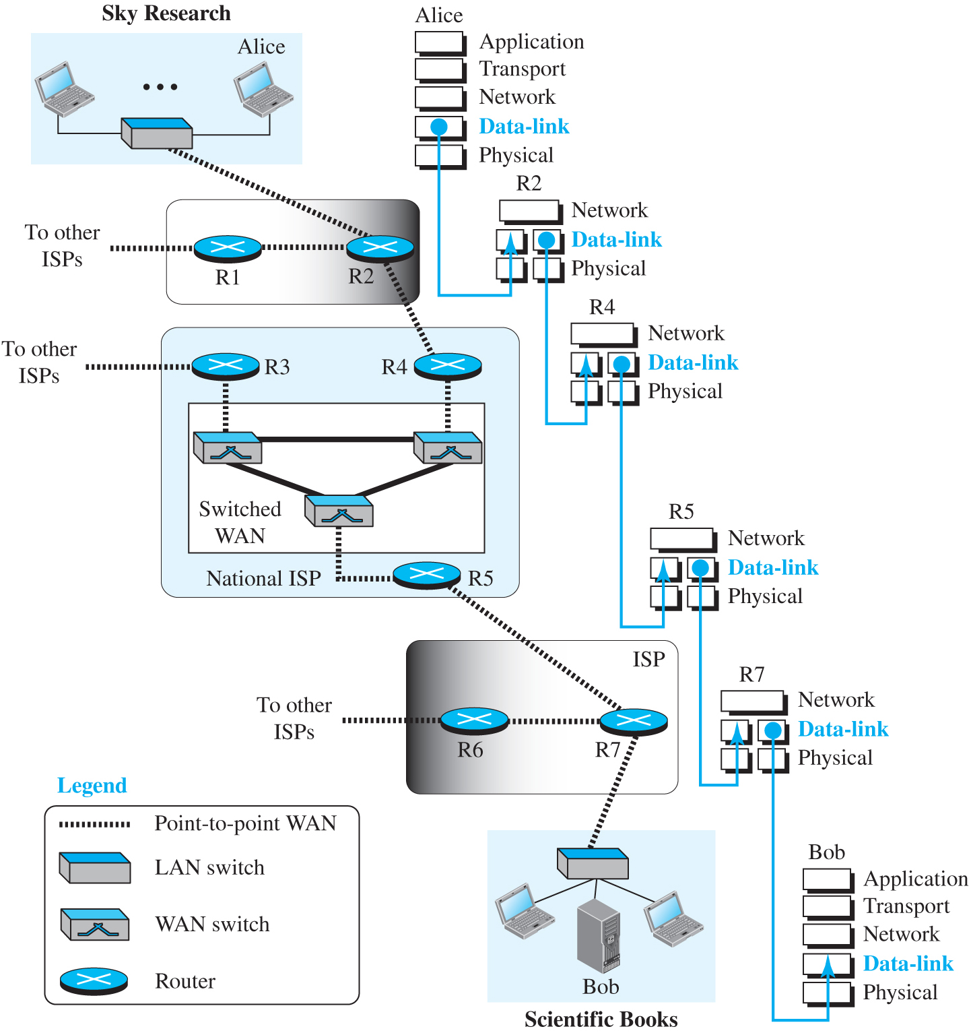
Figure 3.1 Communication at the data-link layer
Access the text alternative for slide images.

Slide 5
3.1.1 Nodes and Links
Communication at the data-link layer is node-to-node. A data unit from one point in the Internet needs to pass through many networks (LANs and WANs) to reach another point. Theses LANs and WANs are connected by routers. It is customary to refer to the two end hosts and the routers as nodes and the networks in between as links. Figure 3.2 is a simple representation of links and nodes when the path of the data unit is only six nodes.

Slide 6
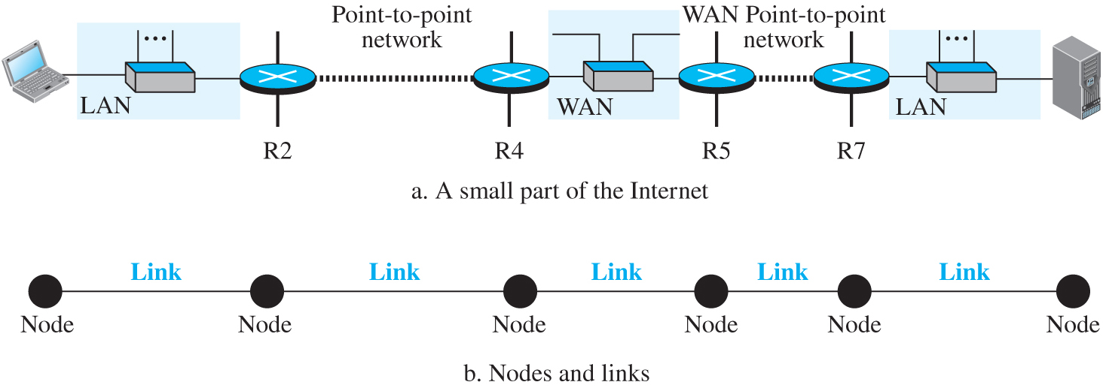
Figure 3.2 Nodes and Links
Access the text alternative for slide images.

Slide 7
3.1.2 Two Types of Links
Although two nodes are physically connected by a transmission medium such as cable or air, we need to remember that the data-link layer controls how the medium is used. We can have a data-link layer that uses the whole capacity of the medium; we can also have a data-link layer that uses only part of the capacity of the link. In other words, we can have a point-to-point link or a broadcast link.

Slide 8
3.1.3 Two Sublayers
To better understand the functionality of and the services provided by the link layer, we can divide the data-link layer into two sublayers: data link control (DLC) and media access control (MAC). This is not unusual because, as we will see in later chapters, LAN protocols actually use the same strategy.

Slide 9
Figure 3.3 Dividing the data-link layer into two sublayers
Access the text alternative for slide images.

Slide 10
3-2 Data Link Control (DLC)
The data link control (DLC) deals with procedures for communication between two adjacent nodes no matter whether the link is dedicated or broadcast. Data link control functions include framing and flow and error control.

Slide 11
3.2.1 Framing
The data-link layer needs to pack bits into frames, so that each frame is distinguishable from another. Our postal system practices a type of framing. The simple act of inserting a letter into an envelope separates one piece of information from another; the envelope serves as the delimiter.

Slide 12
Frame Size
Frames can be fixed or variable size. In the first, there is no need to define the boundary of the frame; in the second, we need to do so.

Slide 13
Character-Oriented Framing
In this type of framing, data to be carried are 8-bit characters (Figure 3.4). In this type of framing, we need to do byte-stuffing to prevent a special character to be interpreted as beginning or end of the message.

Slide 14
Figure 3.4 A frame in a character-oriented protocol
Access the text alternative for slide images.

Slide 15
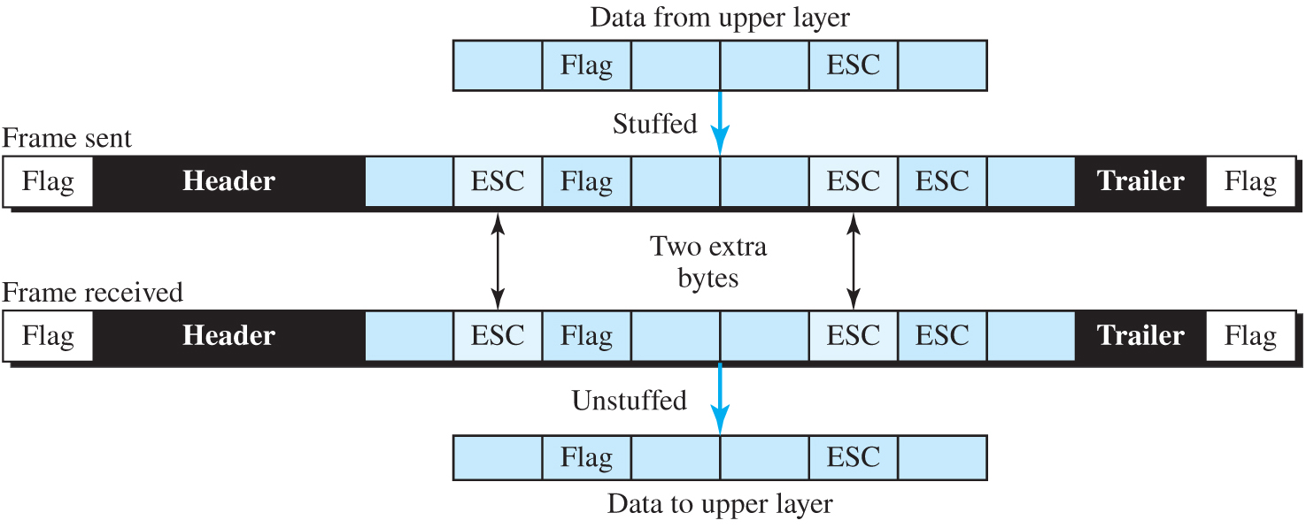
Figure 3.5 Byte stuffing and unstuffing
Access the text alternative for slide images.

Slide 16
Bit-Oriented Framing
In bit-oriented framing data is a sequence of bits. To separate one frame from another, we normally use an 8-bit flag (01111110). To prevent that a byte to be interpreted as a flag, we do bit stuffing (Figure 3.7).

Slide 17
Figure 3.6 A frame in a bit-oriented protocol
Access the text alternative for slide images.

Slide 18
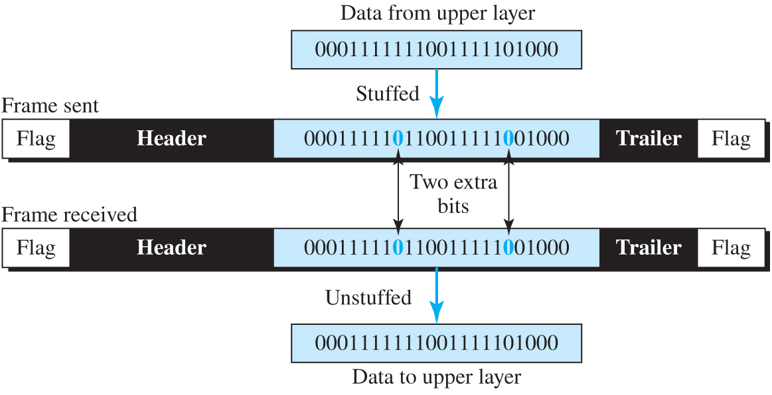
Figure 3.7 Bit stuffing and unstuffing
Access the text alternative for slide images.

Slide 19
3.2.2 Error Control
Error control is both error detection and error correction. It allows the receiver to inform the sender of any frames lost or damage in transition and coordinates the retransmission of frames by the sender.

Slide 20
Types of Error
Whenever bits flow from one point to another, they are subject to unpredictable changes because of interference. This interference can change the shape of the signal. The term single-bit error means that only 1 bit of a given data unit (such as a byte, character, or packet) is changed from 1 to 0 or from 0 to 1. The term burst error means that 2 or more bits in the data unit have changed from 1 to 0 or from 0 to 1. Figure 3.8 shows the effect of a single-bit and a burst error on a data unit.

Slide 21
Figure 3.8 Single-bit and burst error
Access the text alternative for slide images.

Slide 22
Block Coding
In block coding, we divide our message into blocks, each of k bits, called data-words. We add r redundant bits to each block to make the length n = k + r. The resulting n-bit blocks are called codewords. How the extra r bits are chosen or calculated is something we will discuss later.

Slide 23
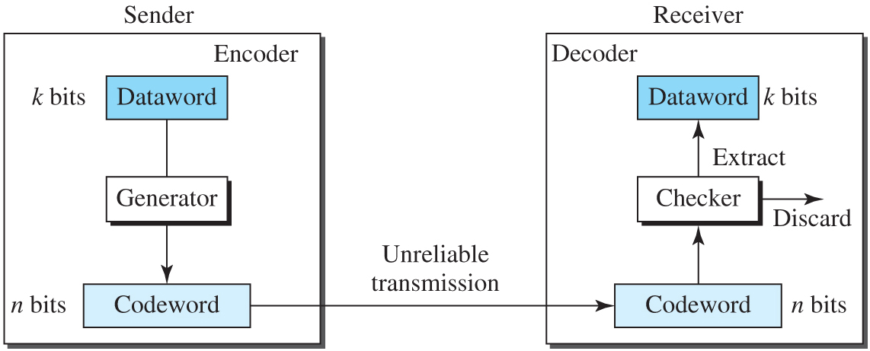
Figure 3.9 Process of error detection in block coding
Access the text alternative for slide images.

Slide 24
Example 3.1 (1)
Let us assume that k = 2 and n = 3. Table 3.1 shows the list of datawords and codewords. Later, we will see how to derive a codeword from a dataword.
Table 3.1 A code for error detection in Example 3.1
Datawords | Codewords | Datawords | Codewords
00 | 000 | 10 | 101
01 | 011 | 11 | 110

Slide 25
Example 3.1 (2)
The receiver receives 011. It is a valid codeword. The receiver extracts the dataword 01 from it.
The codeword is corrupted during transmission, and 111 is received (the leftmost bit is corrupted). This is not a valid codeword and is discarded.
The codeword is corrupted during transmission, and 000 is received (the right two bits are corrupted). This is a valid codeword. The receiver incorrectly extracts the dataword 00. Two corrupted bits have made the error undetectable.

Slide 26
Hamming Distance
One of the central concepts in coding for error control is the idea of the Hamming distance. The Hamming distance between two words (of the same size) is the number of differences between the corresponding bits. The Hamming distance can easily be found if we apply the XOR operation (Å) on the two words and count the number of 1s in the result. Note that the Hamming distance is a value greater than or equal to zero.

Slide 27
Example 3.2
Let us find the Hamming distance between two pairs of words.
The Hamming distance d (000, 011) is 2 because (000 XOR 011) is 011 (two 1s).
The Hamming distance d (10101, 11110) is 3 because (10101 XOR 11110) is 01011 (three 1s).

Slide 28
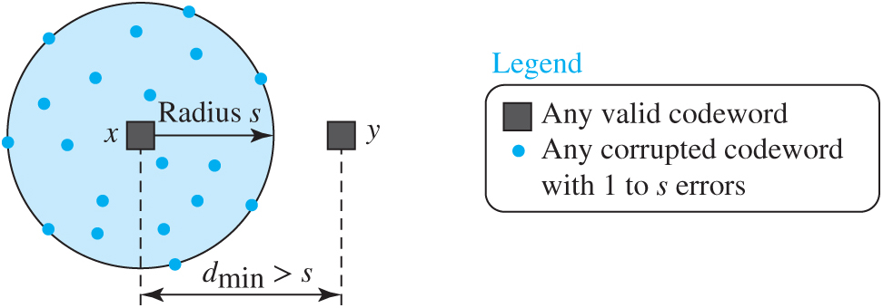
Figure 3.10 Geometric concept explaining d_{min} in error detection
Access the text alternative for slide images.

Slide 29
Example 3.3
The minimum Hamming distance for our first code scheme (Table 3.1) is 2. This code guarantees detection of only a single error. For example, if the third codeword (101) is sent and one error occurs, the received codeword does not match any valid codeword. If two errors occur, however, the received codeword may match a valid codeword and the errors are not detected.

Slide 30
Example 3.4
A code scheme has a Hamming distance dmin = 4. This code guarantees the detection of up to three errors (d = s + 1 or s = 3).

Slide 31
Linear Block Codes 1
Almost all block codes used today belong to subset of a block code called linear block code. For our purposes, a linear block code is a code in which the exclusive OR (addition modulo-2) of two valid codewords creates another valid codeword.
It is simple to find the minimum Hamming distance for a linear block code. The minimum Hamming distance is the number of 1s in the nonzero valid codeword with the smallest number of 1s

Slide 32
Example 3.5
The code in Table 3.1 is a linear block code because the result of XORing any codeword with any other codeword is a valid codeword. For example, the XORing of the second and third codewords creates the fourth one.

Slide 33
Linear Block Codes 2
Perhaps the most familiar error-detecting code is the parity-check code. This code is a linear block code. In this code, a k-bit dataword is changed to an n-bit codeword where n = k + 1. The extra bit, called the parity bit, is selected to make the total number of 1s in the codeword even.

Slide 34
Example 3.6
In our first code (Table 3.1), the numbers of 1s in the nonzero codewords are 2, 2, and 2. So the minimum Hamming distance is dmin = 2.

Slide 35
Table 3.2 Simple parity-check code C(5, 4)
Datawords | Codewords | Datawords | Codewords
0000 | 00000 | 1000 | 10001
0001 | 00011 | 1001 | 10010
0010 | 00101 | 1010 | 10100
0011 | 00110 | 1011 | 10111
0100 | 01001 | 1100 | 11000
0101 | 01010 | 1101 | 11011
0110 | 01100 | 1110 | 11101
0111 | 01111 | 1111 | 11110

Slide 36
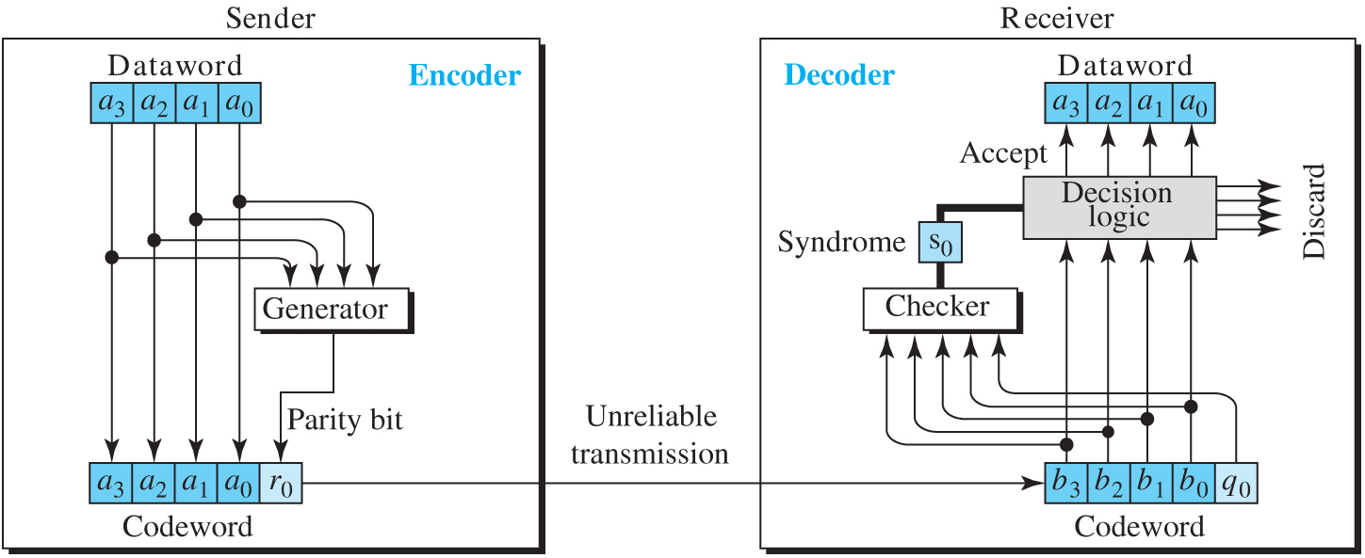
Figure 3.11 Encoder and decoder for simple parity-check code
Access the text alternative for slide images.

Slide 37
Example 3.7 (1)
Let us look at some transmission scenarios. Assume the sender sends the dataword 1011. The codeword created from this dataword is 10111, which is sent to the receiver. We examine five cases:
No error occurs; the received codeword is 10111. The syndrome is 0. The dataword 1011 is created.
One single-bit error changes a₁. The received codeword is 10011. The syndrome is 1. No dataword is created.

Slide 38
Example 3.7 (2)
One single-bit error changes r₀. The received codeword is 10110. The syndrome is 1. No dataword is created. Note that although none of the dataword bits are corrupted, no dataword is created because the code is not sophisticated enough to show the position of the corrupted bit.
An error changes r₀ and a second error changes a₃. The received codeword is 00110. The syndrome is 0. The dataword 0011 is created at the receiver. Note that here the dataword is wrongly created due to the syndrome value. The simple parity-check decoder cannot detect an even number of errors. The errors cancel each other out and give the syndrome a value of 0.

Slide 39
Example 3.7 (3)
Three bits—a₃, a₂, and a₁—are changed by errors. The received codeword is 01011. The syndrome is 1. The dataword is not created. This shows that the simple parity check, guaranteed to detect one single error, can also find any odd number of errors.
A parity-check code can detect an odd number of errors.

Slide 40
Cyclic Codes
Cyclic codes are special linear block codes with one extra property. In a cyclic code, if a codeword is cyclically shifted (rotated), the result is another codeword. For example, if 1011000 is a codeword and we cyclically left-shift, then 0110001 is also a codeword.
We can create cyclic codes to correct errors. However, the theoretical background required is beyond the scope of this book. In this section, we simply discuss a subset of cyclic codes called the cyclic redundancy check (CRC), which is used in networks such as LANs and WANs.

Slide 41
CRC introduced by Hamming
Used in high speed data networks
3 key aspects:
CRC supports Arbitrary length message
Excellent error detection
Fast Hardware implementation, CPU can do CRC computation fast

Slide 42
Theory behind CRC
Given a from of k-bit
Transmitter generates n-bit sequence called FCS (frame check sequence)
The k+n bit is divisible by some predetermined number.
The receiver divides the total by the predetermined number. If no remainder, then the block is fine.

Slide 43
Table 3.3 A CRC code with C(7, 4)
Datawords | Codewords | Datawords | Codewords
0000 | 0000000 | 1000 | 1000101
0001 | 0001011 | 1001 | 1001110
0010 | 0010110 | 1010 | 1010011
0011 | 0011101 | 1011 | 1011000
0100 | 0100111 | 1100 | 1100010
0101 | 0101100 | 1101 | 1101001
0110 | 0110001 | 1110 | 1110100
0111 | 0111010 | 1111 | 1111111

Slide 44
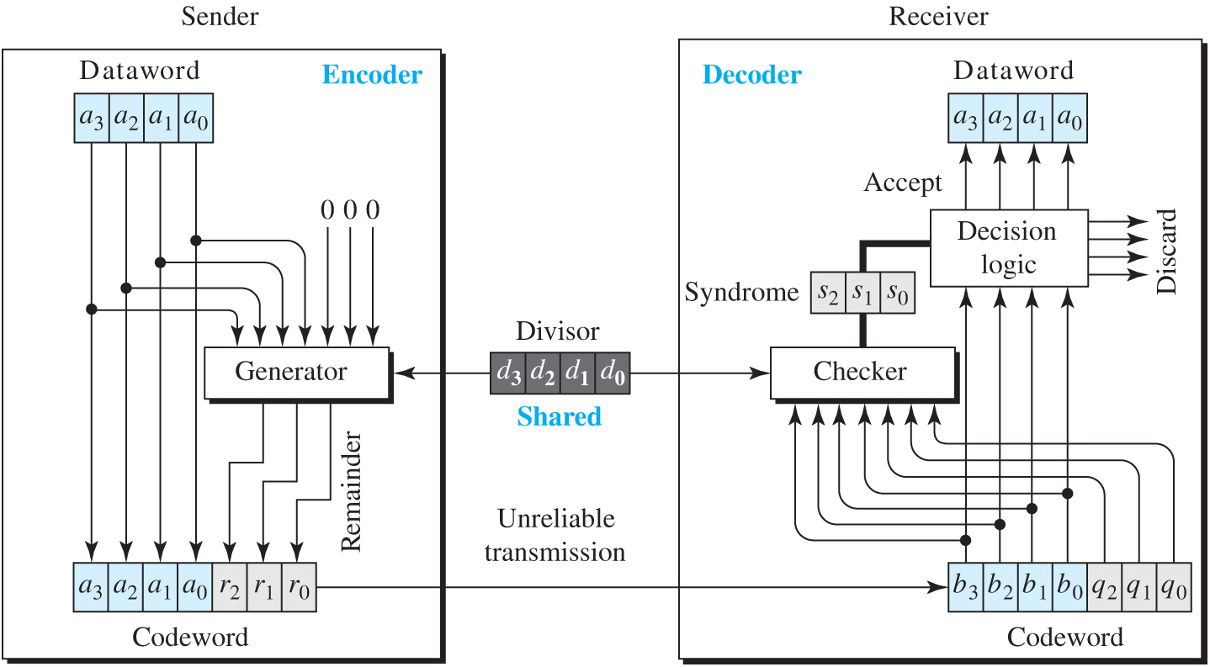
Figure 3.12 CRC encoder and decoder
Access the text alternative for slide images.

Slide 45
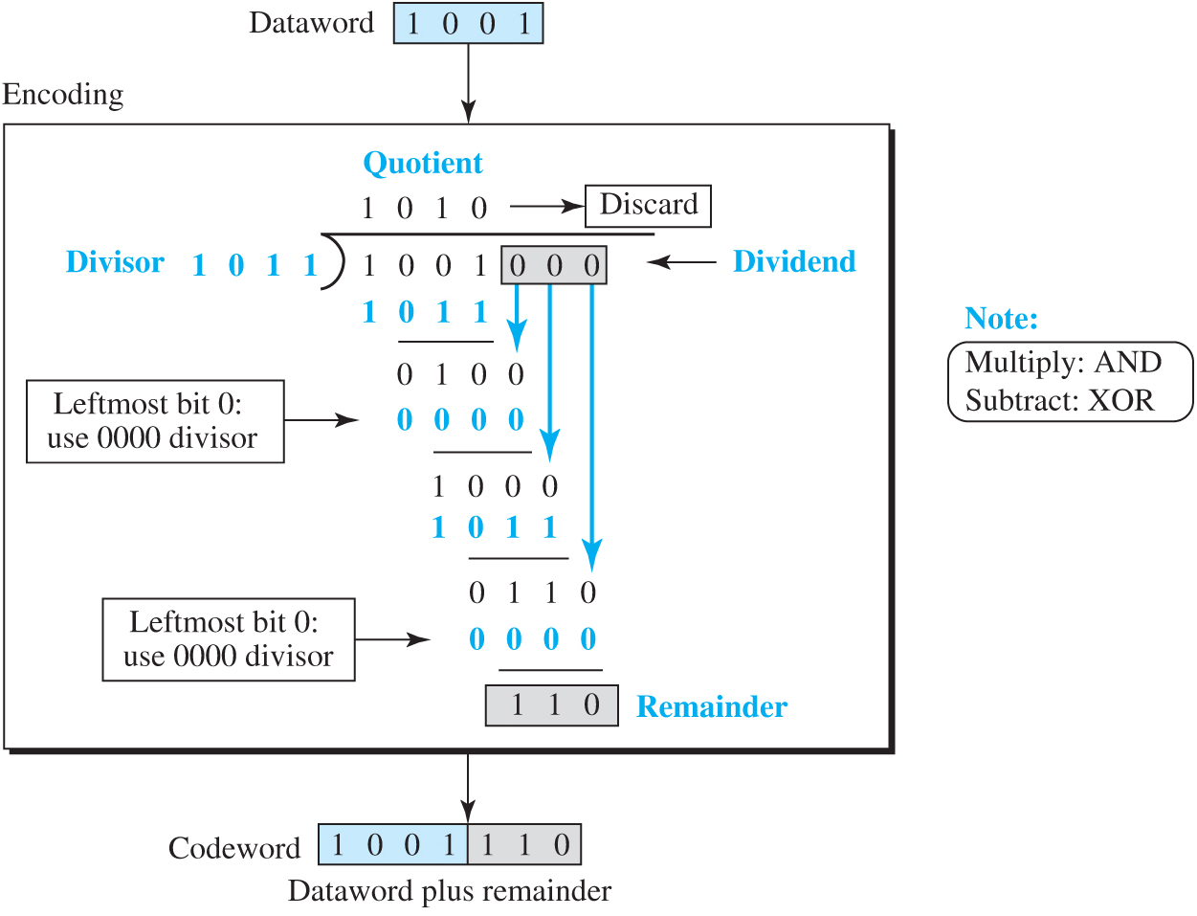
Figure 3.13 Division in CRC encoder
Access the text alternative for slide images.

Slide 46
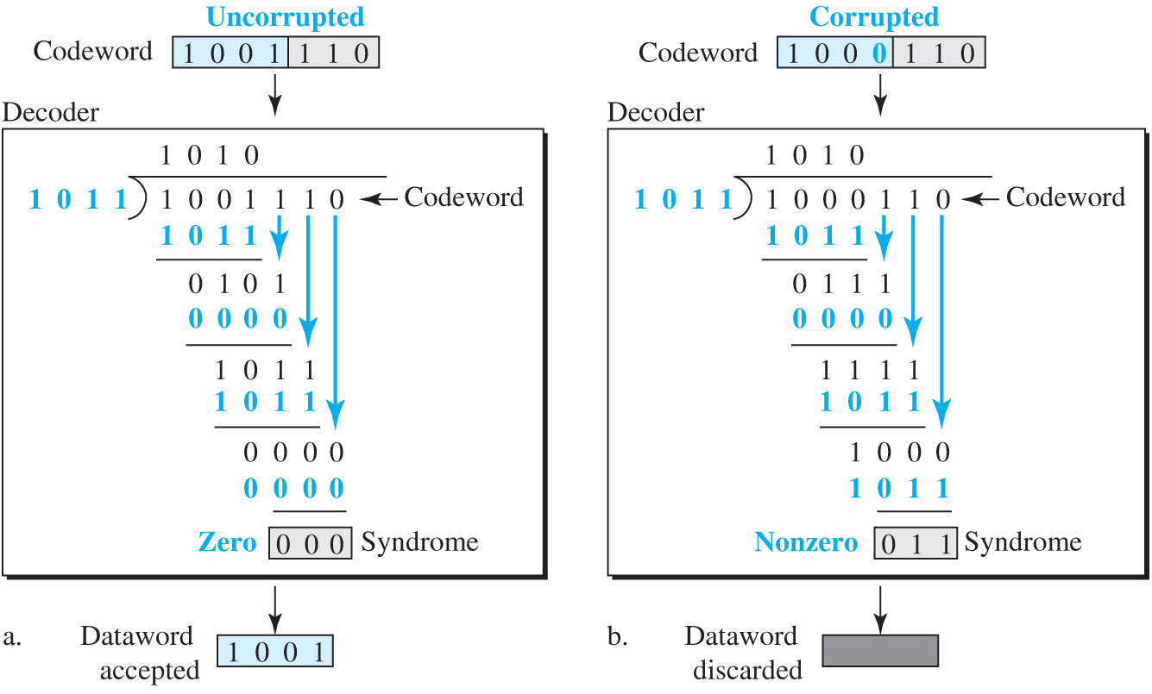
Figure 3.14 Division in the CRC decoder for two cases
Access the text alternative for slide images.

Slide 47
Table 3.4 Standard polynomials
Name | Binary | Application
CRC-8 | 100000111 | ATM header
CRC-10 | 11000110101 | ATM AAL
CRC-16 | 10001000000100001 | HDLC
CRC-32 | 100000100110000010001110110110111 | LANs

Slide 48
Checksum
Checksum is an error-detecting technique that can be applied to a message of any length. In the Internet, the checksum technique is mostly used at the network and transport layer rather than the data-link layer. We discuss it when we discuss the network layer.

Slide 49
3.2.3 Two DLC Protocols
After finishing all issues related to DLC sublayer, we discuss two DCL protocols that actually implement these concepts: HDLC and Point-to-Point.

Slide 50
HDLC
High-level Data Link Control (HDLC) is a bit-oriented protocol for communication over point-to-point and multipoint links. It implements the stop-and-wait protocol we discussed earlier.

Slide 51
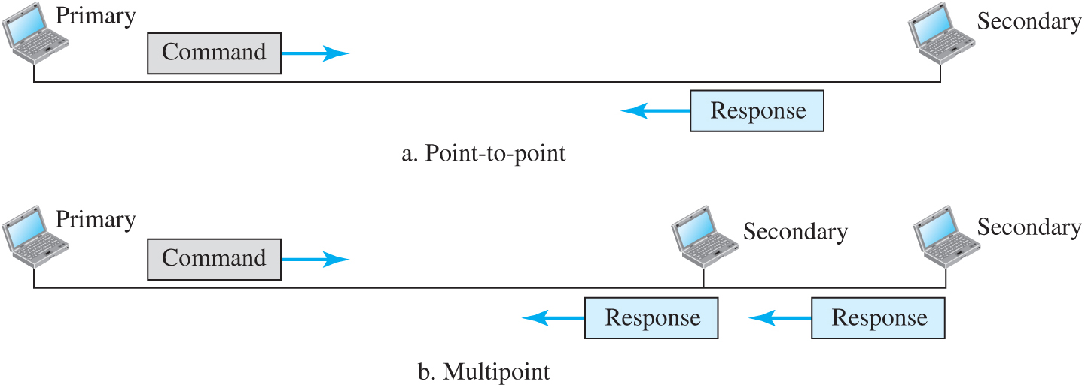
Figure 3.15 Normal response mode
Access the text alternative for slide images.

Slide 52
Figure 3.16 Asynchronous balanced mode
Access the text alternative for slide images.

Slide 53
Figure 3.17 HDLC frames
Access the text alternative for slide images.

Slide 54
Figure 3.18 Control field format for the different frame types
Access the text alternative for slide images.

Slide 55
Point-to-Point Protocol (PPP)
One of the most common protocols for point-to-point access is the point-to-point protocol.

Slide 56
Figure 3.19 PPP frame format
Access the text alternative for slide images.

Slide 57
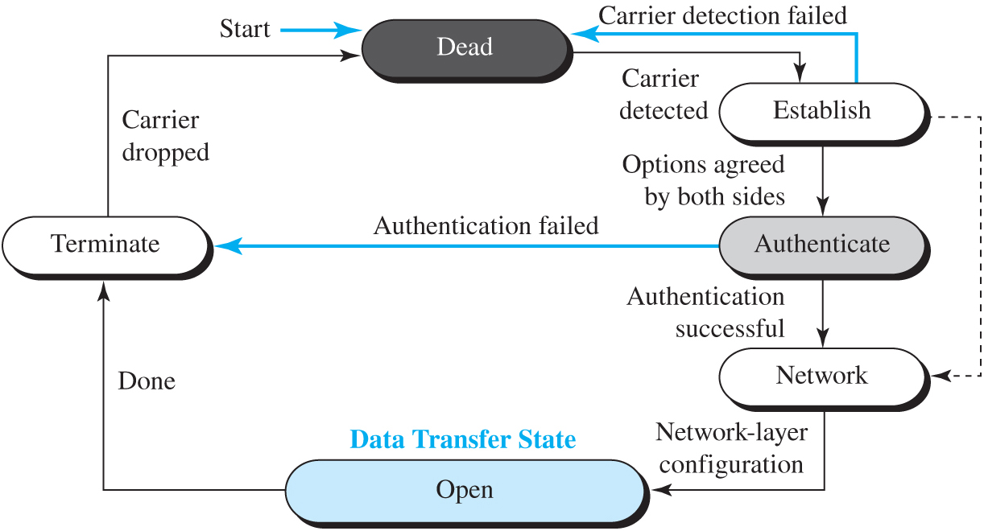
Figure 3.20 Transition phases
Access the text alternative for slide images.

Slide 58
Figure 3.21 Multiplexing in PPP
Access the text alternative for slide images.

Slide 59
3-3 Media Access Protocols
We said that data link control is divided into two groups: data link control and media access control.

Slide 60
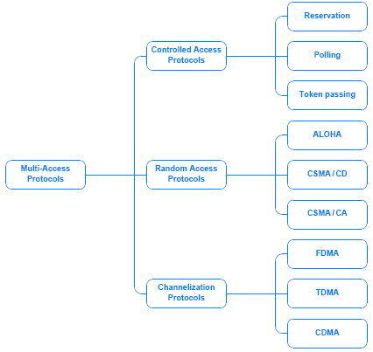

Slide 61
Static and Dynamic Channel Allocation Static is discussed below:
Channelization to refer to a mapping (between communication and a channel in the underlying transmission system).
Traditional way to allow more than one person to use the medium is to use FDM
In Frequency division multiplexing, the total bandwidth is divided among the total number of users, each pair is assigned to a unique frequency. This is known as 1-to-1 static.
FDM works well when there is a small number of users
When users grow a fast busy signal is issued

Slide 62
Channelization Protocols
FDMA
TDMA
Code Division Multi-Access
Already covered these

Slide 63
Controlled Access Protocols – Collision free
Polling: A centralized controller cycles through all stations on the network and gives each an opportunity to transmit a packet, either uses round robin order or priority order
.

Slide 64
Reservation – Collision free
Often used with satellite transmission, employs a two-step process. Each transmission is planned in advanced. In the first step, each potential sender specifies whether they have a packet to send during the next round and the controller transmits a list of stations that will be transmitting. In the second step, stations transmit upon their turn.
Bit-map protocol
A bit map with enough slots for all stations is passed around
Each station wanting to send a frame and if the frame is ready in the queue, inserts a 1 bit into its reserved slot in the bit map.
Once station numbers of all who want to send is known they take turns in order.

Slide 65
Reservation – collision free. Binary count down
Each station is given a binary address
If a station wants to transmit a frame it broadcasts its address one bit at a time starting with the high order bit.
Bits from each station are Ored together the station address starting with the resulting 0 or 1 bit as agreed upon is allowed to go on. If two or more has the same bit then go to the next bit and so on.

Slide 66
Token Passing – collision free
Token bus
Each station knows the address of the station to its left and right
The highest numbered station may send the first frame
Then it passes permission to its immediate neighbor by send a special frame called a token.
The first station passes the token to the highest numbered one.
Token Ring
Physical Ring
Token circulates

Slide 67
Figure 3.22 Multilink PPP
Access the text alternative for slide images.

Slide 68
3.3.1 Random Access
In random access no station is superior to another station and none is assigned the control over another.

Slide 69
ALOHA
ALOHA, the earliest random access method, was developed at the University of Hawaii in early 1970. It was designed for a radio (wireless) LAN, but it can be used on any shared medium. It is obvious that there are potential collisions in this arrangement. The medium is shared between the stations. When a station sends data, another station may attempt to do so at the same time. The data from the two stations collide and become garbled.

Slide 70
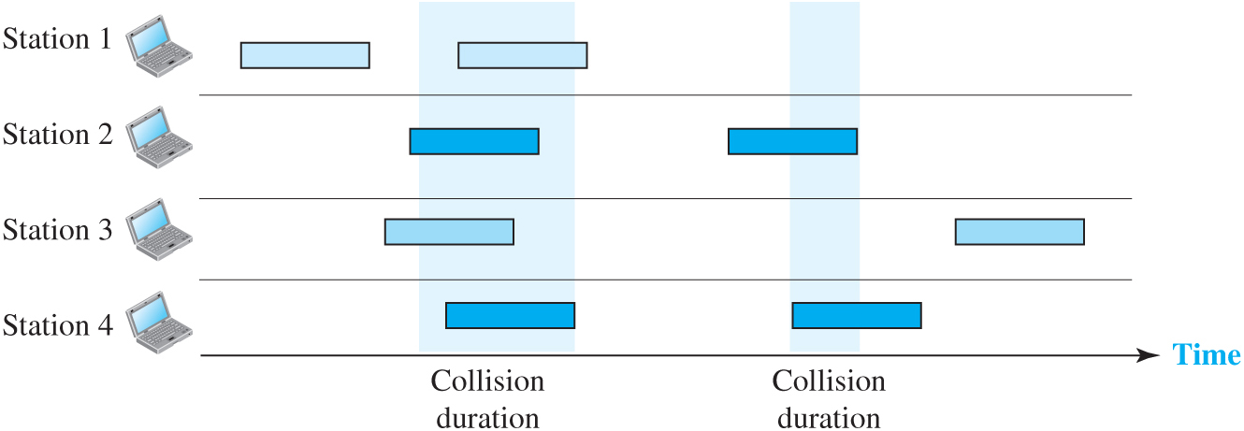
Figure 3.24 Frames in a pure ALOHA network
Access the text alternative for slide images.

Slide 71
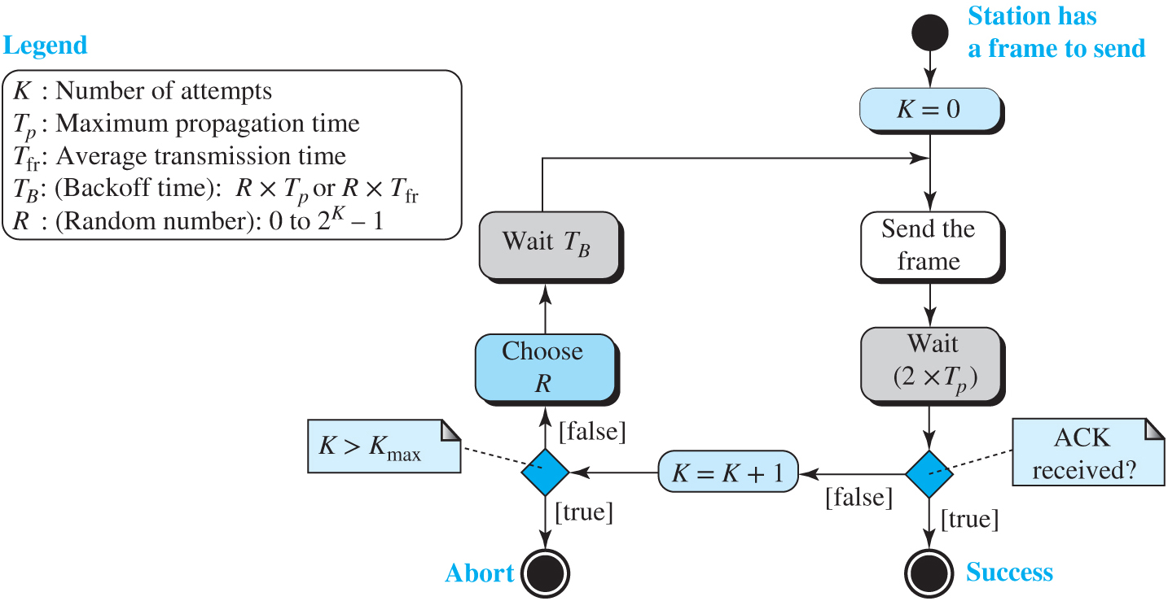
Figure 3.25 Procedure for pure ALOHA protocol
Access the text alternative for slide images.

Slide 72
Example 3.8
The stations on a wireless ALOHA network are a maximum of 600 km apart. If we assume that signals propagate at 3 × 10⁸ m/s, we find T_{p} = (600 × 10³)/(3 × 10⁸) = 2 ms. For K = 2, the range of R is {0, 1, 2, 3}. This means that T_{B} can be 0, 2, 4, or 6 ms, based on the outcome of the random variable R.

Slide 73
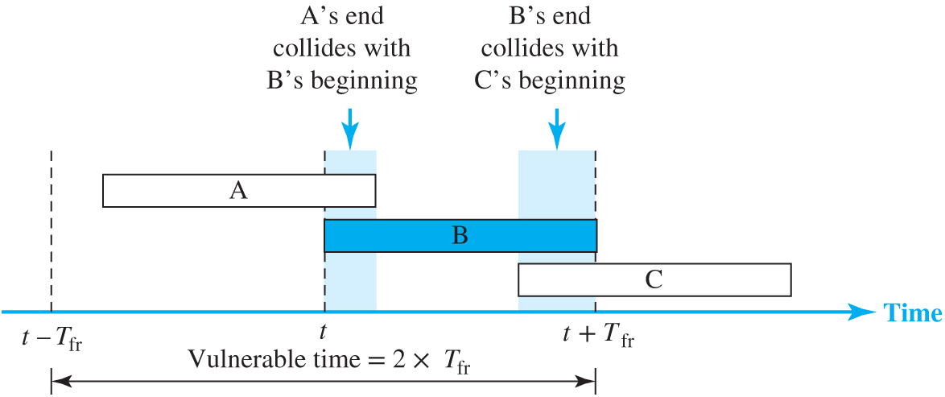
Figure 3.26 Vulnerable time for pure ALOHA protocol
Access the text alternative for slide images.

Slide 74
Example 3.9
A pure ALOHA network transmits 200-bit frames on a shared channel of 200 kbps. What is the requirement to make this frame collision-free?
Solution
Average frame transmission time T_{fr} is 200 bits/200 kbps or 1 ms. The vulnerable time is 2 × 1 ms = 2 ms. This means no station should send later than 1 ms before this station starts transmission and no station should start sending during the period (1 ms) that this station is sending.

Slide 75
Example 3.10 (1)
A pure ALOHA network transmits 200-bit frames on a shared channel of 200 kbps. What is the throughput if the system (all stations together) produces
a. 1000 frames per second?
b. 500 frames per second?
c. 250 frames per second?
Solution
The frame transmission time is 200/200 kbps or 1 ms.
a. If the system creates 1000 frames per second, or 1 frame per millisecond, then G = 1. In this case S = G × e^{−2G} = 0.135 (13.5 percent). This means that the throughput is 1000 × 0.135 = 135 frames. Only 135 frames out of 1000 will probably survive.

Slide 76
Example 3.10 (2)
b. If the system creates 500 frames per second, or 1/2 frames per millisecond, then G = 1/2. In this case S = G × e^{−2G} = 0.184 (18.4 percent). This means that the throughput is 500 × 0.184 = 92 and that only 92 frames out of 500 will probably survive. Note that this is the maximum throughput case, percentage-wise.
c. If the system creates 250 frames per second, or 1/4 frames per millisecond, then G = 1/4. In this case S = G × e^{−2G} = 0.152 (15.2 percent). This means that the throughput is 250 × 0.152 = 38. Only 38 frames out of 250 will probably survive

Slide 77
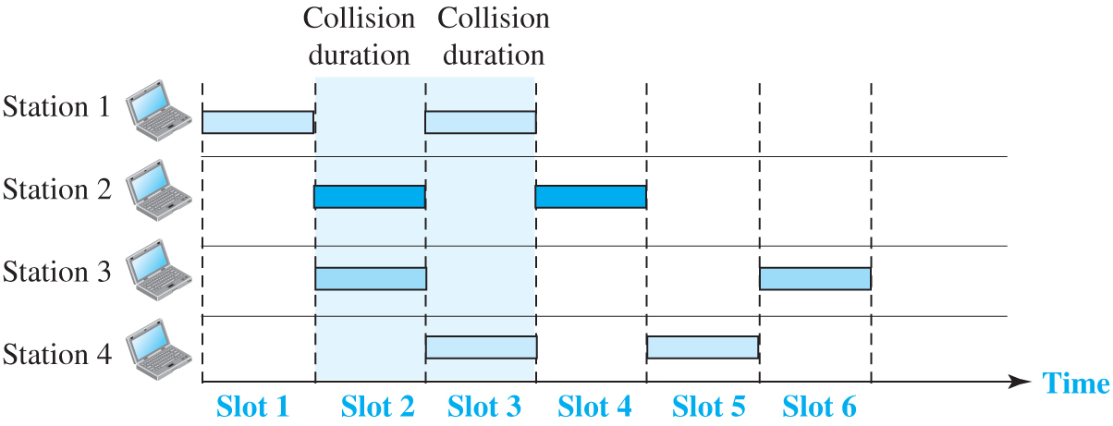
Figure 3.27 Frames in a slotted ALOHA network
Access the text alternative for slide images.

Slide 78
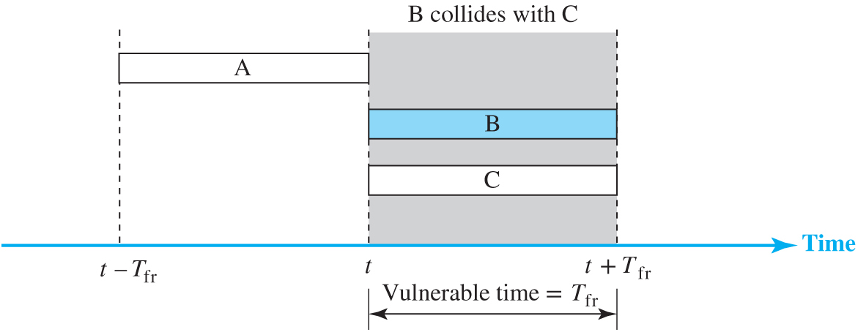
Figure 3.28 Vulnerable time for slotted ALOHA protocol
Access the text alternative for slide images.

Slide 79
Example 3.11 (1)
A slotted ALOHA network transmits 200-bit frames using a shared channel with a 200-kbps bandwidth. Find the throughput if the system (all stations together) produces
a. 1000 frames per second.
b. 500 frames per second.
c. 250 frames per second.
Solution
This situation is similar to the previous exercise except that the network is using slotted ALOHA instead of pure ALOHA. The frame transmission time is 200/200 kbps or 1 ms.

Slide 80
Example 3.11 (2)
In this case G is 1. So S = G × e^{−G} = 0.368 (36.8 percent). This means that the throughput is 1000 × 0.0368 = 368 frames. Only 368 out of 1000 frames will probably survive. Note that this is the maximum throughput case, percentage-wise.
Here G is 1/2. In this case S = G × e^{−G} = 0.303 (30.3 percent). This means that the throughput is 500 × 0.0303 = 151. Only 151 frames out of 500 will probably survive.
Now G is 1/4. In this case S = G × e^{−G} = 0.195 (19.5 percent). This means that the throughput is 250 × 0.195 = 49. Only 49 frames out of 250 will probably survive.

Slide 81
Carrier Sense Multiple Access (CSMA)
To minimize the chance of collision and, therefore, increase the performance, the CSMA method was developed. The chance of collision can be reduced if a station senses the medium before trying to use it. Carrier sense multiple access (CSMA) requires that each station first listen to the medium (or check the state of the medium) before sending. In other words, CSMA is based on the principle “sense before transmit” or “listen before talk.”

Slide 82
Carrier Sense Multiple Access Protocols (CSMA)
Listen for a transmission
If the line is clear then transmit
Implementations:
Persistent, Non Persistent and p-persistent
CSMA with collision detection

Slide 83
Persistent
Listen, if busy wait until line is free
Transmit a frame
If collision occurred, wait for a random amount of time
Transmission time delay between two sending computers will cause the second computer not to hear the transmission.

Slide 84
Non-Persistent
Listen, if busy wait random amount of time and listen again until the line is free
This approach is less greedy than the Persistent one
This prevents two or more wanting to get on the line from doing so at the same time when the channel becomes free.

Slide 85
P-persistent CSMA
Slotted channels.
Listen, if free send at the beginning of the next slot

Slide 86
CSMA with Collision Detection (CSMA-CD)
Abort transmission as soon as collision is detected
Collision is detected by comparing received signal power to sent signal
If collision is detected, stop transmission and wait for random amount of time
CSMA/CD is used widely in LAN IEEE 802.3 is an example.

Slide 87
Binary Exponential Backoff
After a collision occurs, a computer must wait, but how long? In Aloha randomization was used.
In exponential backoff, the computer must wait twice the amount of time than the previous time. This is repeated if collision occur again.

Slide 88
CSMA-CA
For wireless.
May not be able to hear computers outside the range, while the other party can hear. This is known as the hidden station problem.
Ready to send and clear to send are transmitted first before transmitting packet. The clear to send or the ready to send will be heard by all within range.

Slide 89
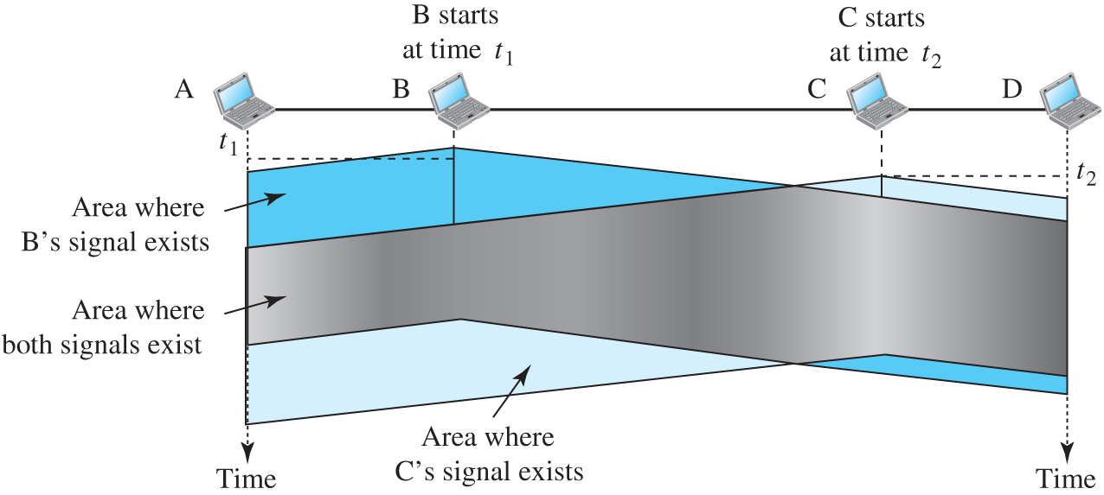
Figure 3.29 Space and time model of a collision in CSMA
Access the text alternative for slide images.

Slide 90
Figure 3.30 Vulnerable time in CSMA
Access the text alternative for slide images.

Slide 91
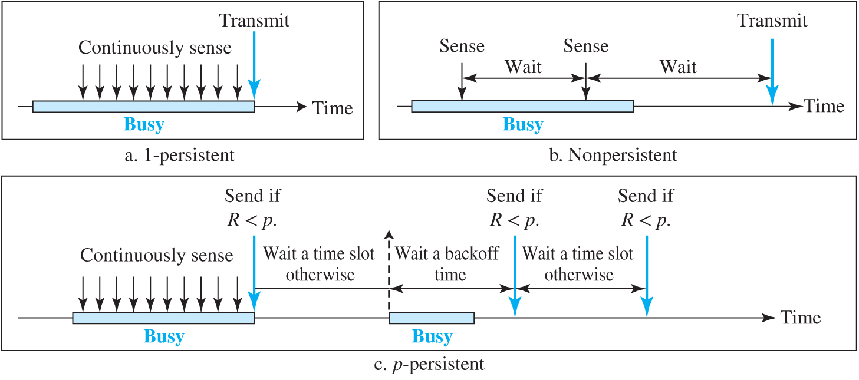
Figure 3.31 Behavior of three persistence methods
Access the text alternative for slide images.

Slide 92
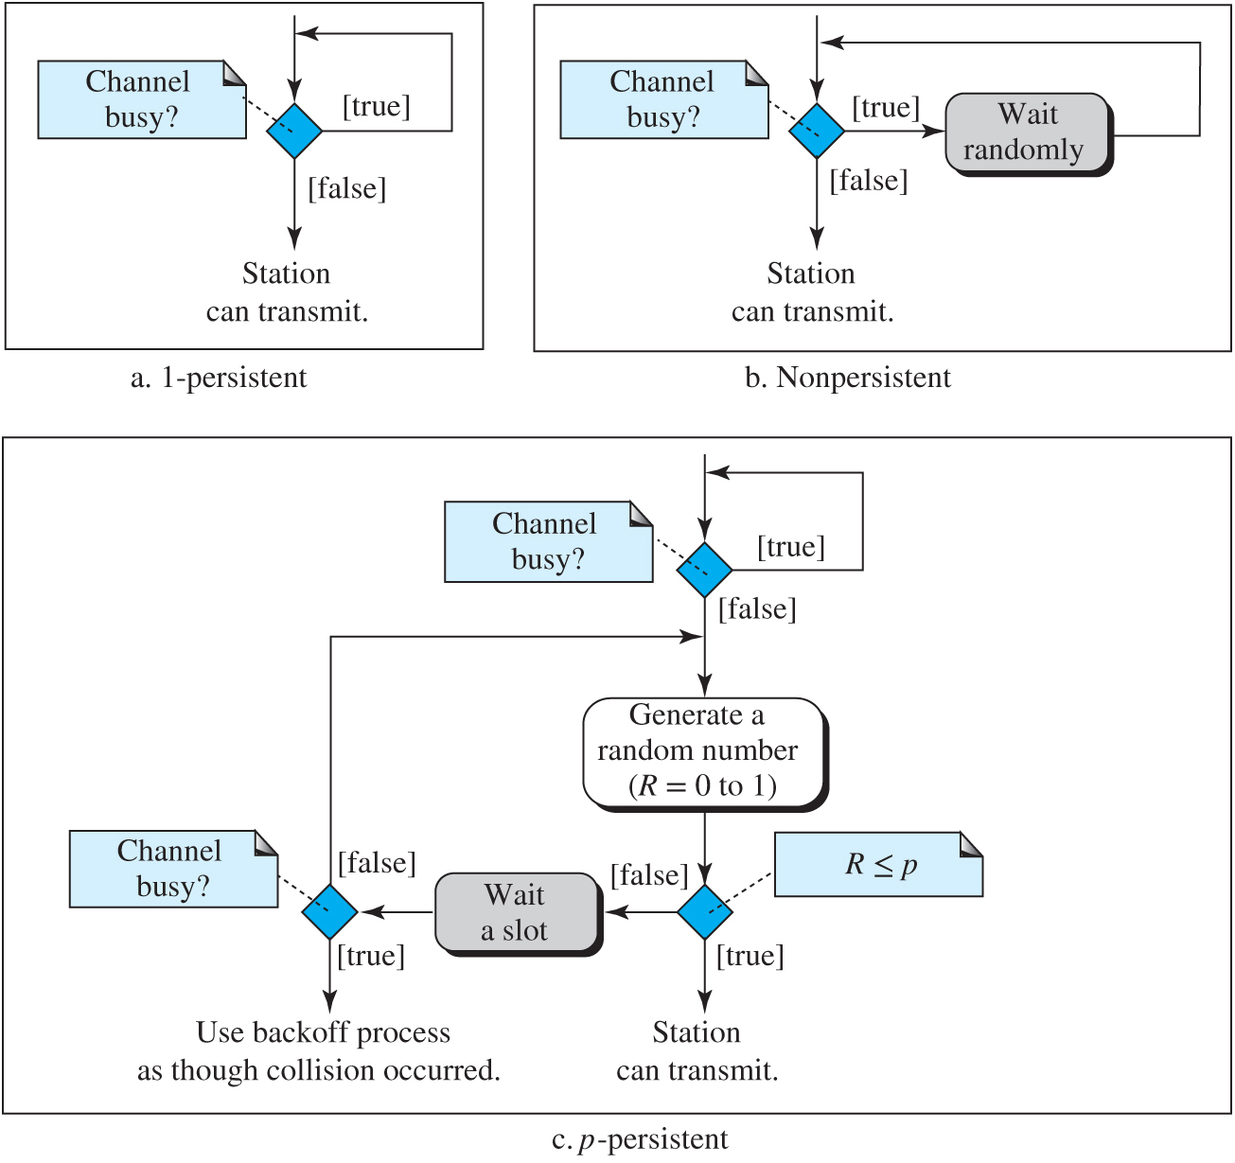
Figure 3.32 Flow diagram for three persistence methods
Access the text alternative for slide images.

Slide 93
Carrier Sense Multiple Access with Collision Detection (CSMA/CD)
The CSMA method does not specify the procedure following a collision. Carrier sense multiple access with collision detection (CSMA/CD) augments the algorithm to handle the collision.
In this method, a station monitors the medium after it sends a frame to see if the transmission was successful. If so, the station is finished. If, however, there is a collision, the frame is sent again.

Slide 94
Figure 3.33 Collision of the first bits in CSMA/CD
Access the text alternative for slide images.

Slide 95
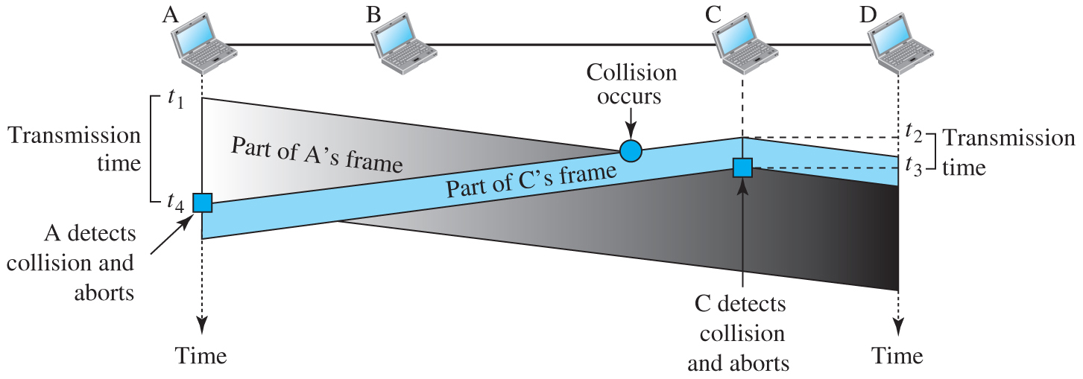
Figure 3.34 Collision and abortion in CSMA/CD
Access the text alternative for slide images.

Slide 96
Example 3.12
A network using CSMA/CD has a bandwidth of 10 Mbps. If the maximum propagation time (including the delays in the devices and ignoring the time needed to send a jamming signal, as we see later) is 25.6 μs, what is the minimum size of the frame?
Solution
The minimum frame transmission time is T_{fr} = 2 × T_{p} = 51.2 μs. This means, in the worst case, a station needs to transmit for a period of 51.2 μs to detect the collision. The minimum size of the frame is 10 Mbps × 51.2 μs = 512 bits or 64 bytes. This is actually the minimum size of the frame for Standard Ethernet, as we will see later in the chapter.

Slide 97
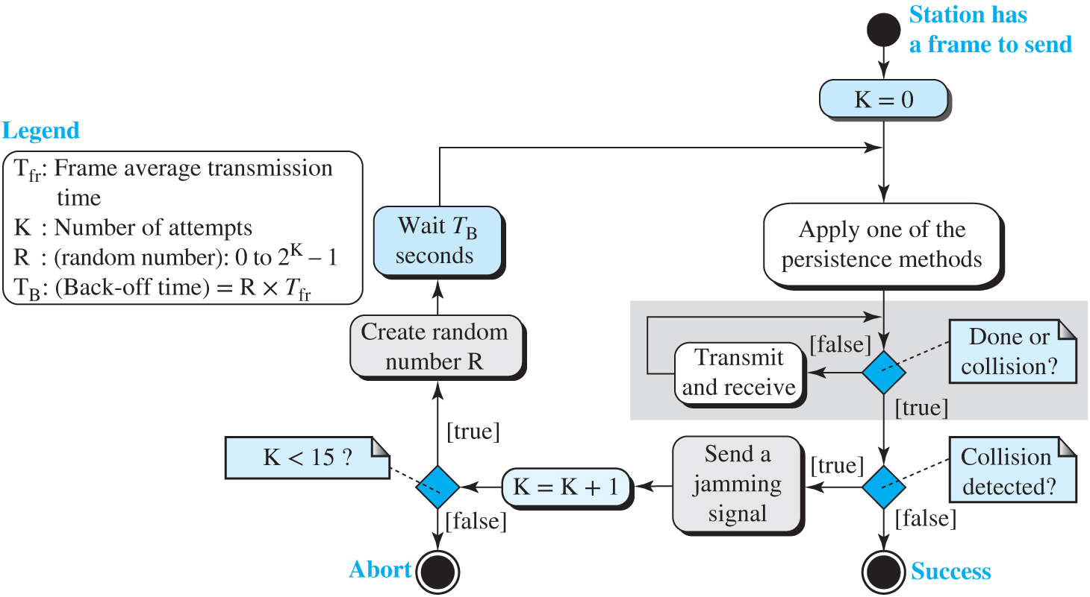
Figure 3.35 Flow diagram for the CSMA/CD
Access the text alternative for slide images.

Slide 98
Figure 3.36 Energy level during transmission, idleness, or collision
Access the text alternative for slide images.

Slide 99
CSMA/CA
Carrier sense multiple access with collision avoidance (CSMA/CA) was invented for wireless networks.

Slide 100
3.3.2 Controlled Access
In controlled access, the stations consult one another to find which station has the right to send. A station cannot send unless it has been authorized by other stations. We discuss three controlled-access methods.

Slide 101
Reservation
In the reservation method, a station needs to make a reservation before sending data. Time is divided into intervals. In each interval, a reservation frame precedes the data frames sent in that interval.

Slide 102
Figure 3.37 Reservation access method
Access the text alternative for slide images.

Slide 103
Polling
Polling works with topologies in which one device is designated as a primary station and the other devices are secondary stations. All data exchanges must be made through the primary device even when the ultimate destination is a secondary device. The primary device controls the link; the secondary devices follow its instructions. It is up to the primary device to determine which device is allowed to use the channel at a given time.

Slide 104
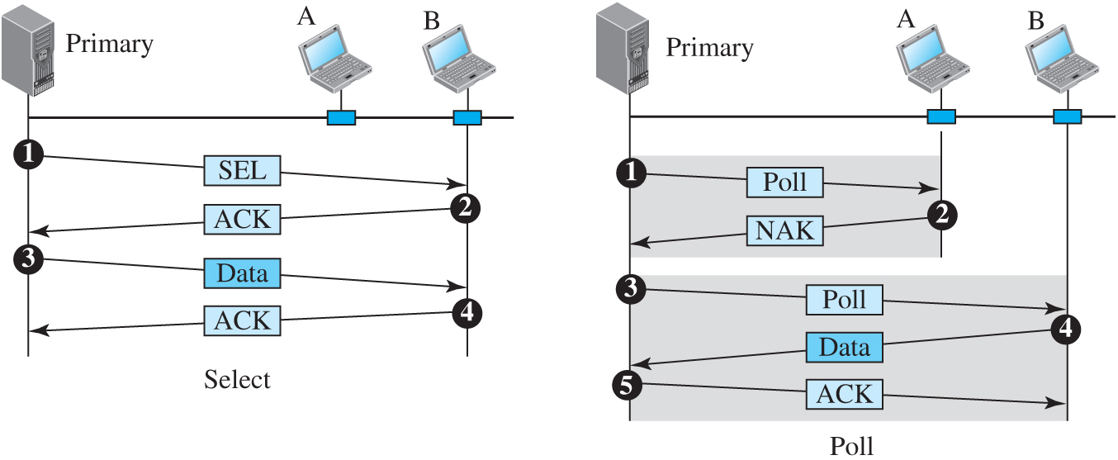
Figure 3.38 Select and poll functions in polling-access method
Access the text alternative for slide images.

Slide 105
Token Passing
In the token-passing method, the stations in a network are organized in a logical ring. In other words, for each station, there is a predecessor and a successor. The predecessor is the station that is logically before the station in the ring; the successor is the station that is after the station in the ring.

Slide 106
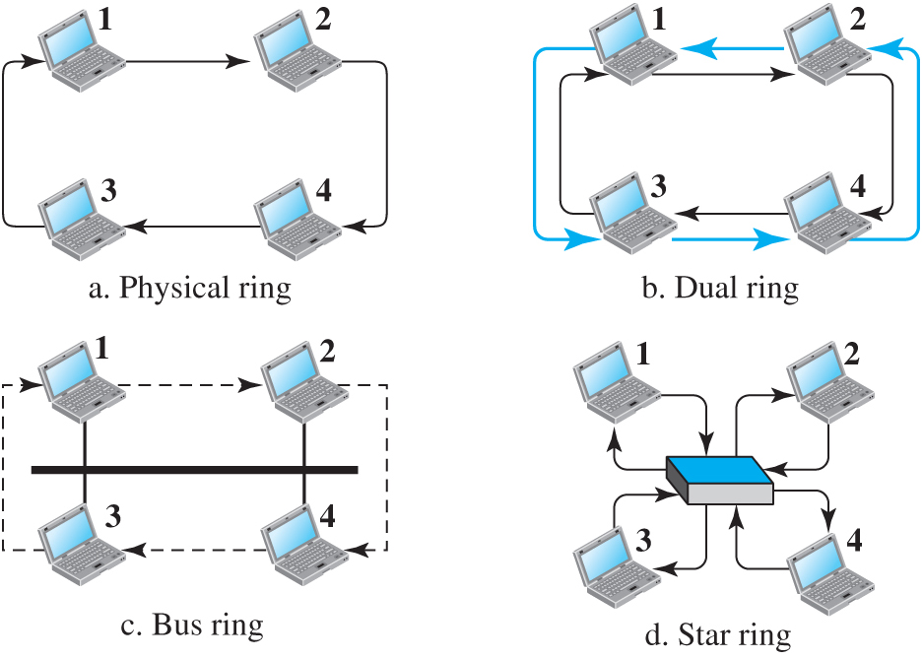
Figure 3.39 Logical ring and physical topology in token-passing access method
Access the text alternative for slide images.

Slide 107
3.3.3 Channelization
Channelization (or channel partition, as it is sometimes called) is a multiple-access method in which the available bandwidth of a link is shared in time, frequency, or through code, among different stations. Since this method is normally used in wireless LAN, we postpone this discussion until Chapter 4.

Slide 108
3-4 LINK-LAYER ADDRESSING
In Chapter 7, we will discuss IP addresses as the identifiers at the network layer. However, in an internetwork such as the Internet we cannot make a datagram reach its destination using only IP addresses. The source and destination IP addresses define the two ends but cannot define which links the packet should pass through.

Slide 109
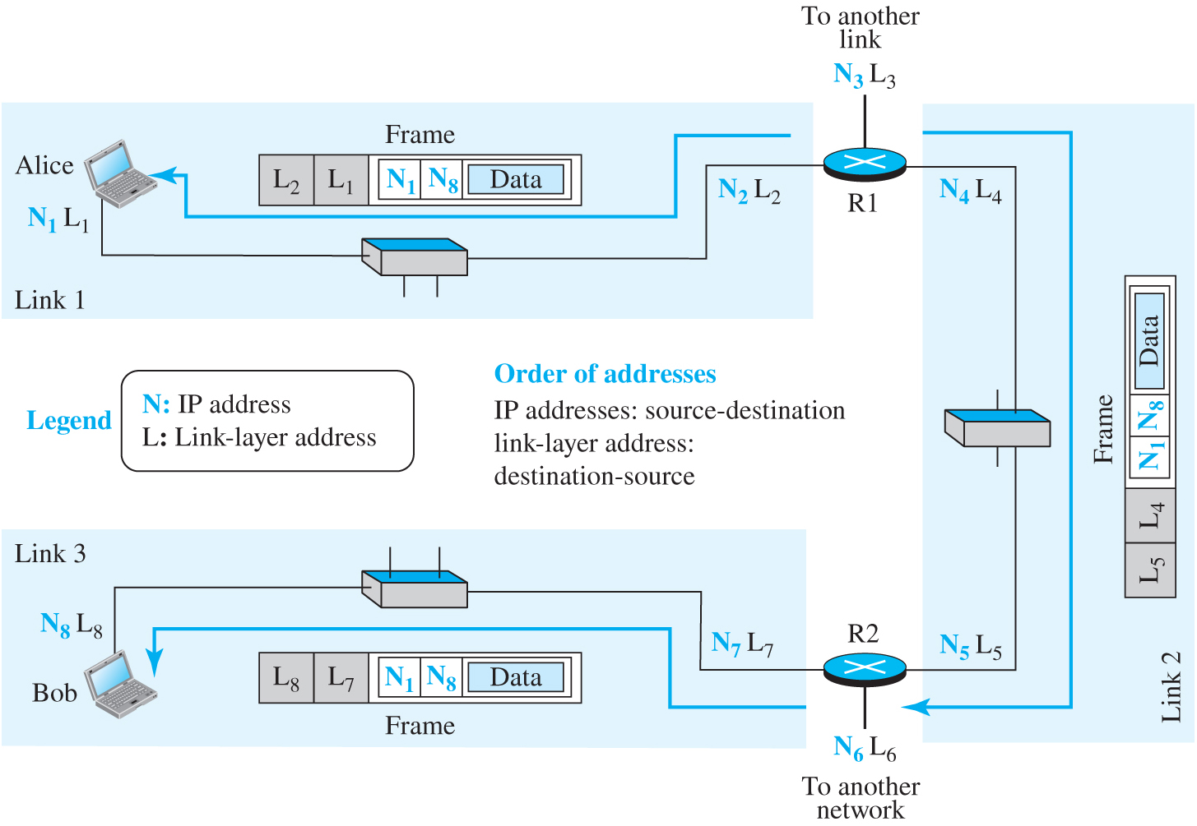
Figure 3.40 IP addresses and link-layer addresses in a small internet
Access the text alternative for slide images.

Slide 110
3.4.1 Three Types of Addresses
Some link-layer protocols define three types of addresses: unicast, multicast, and broadcast.

Slide 111
Unicast Address
Each host or interface is assigned a unicast address.

Slide 112
Example 3.13
As we discuss later in the chapter, the link-layer addresses in the most common LAN, Ethernet, are 48 bits (six bytes) that are presented as 12 hexadecimal digits separated by colons; for example, the following is a link-layer address of a computer.
A2 : 34 : 45 : 11 : 92 : F1

Slide 113
Multicast Address
Some link-layer protocols define multicast addresses. A multicast address means one-to-many communication.

Slide 114
Example 3.14
As we discuss later in the chapter, the link-layer addresses in the most common LAN, Ethernet, are 48 bits (six bytes) that are presented as 12 hexadecimal digits separated by colons; for example, the following is a link-layer address of a computer.
A2 : 34 : 45 : 11 : 92 : F1

Slide 115
Broadcast Address
A broadcast address means one-to-all address.

Slide 116
Example 3.15
A broadcast address is made of 48 bits of 1’s.
FF:FF:FF:FF:FF:FF

Slide 117
3.4.2 Address Resolution Protocol (ARP)
Any time a node has a packet to send to another node, it has the IP address (network-layer address of the next node); it needs the link-layer address of the next node. This is done by a protocol called ARP located in the network layer. We discuss it when we discuss the network layer.

Slide 118
End of Main Content
© 2022 McGraw Hill, LLC. All rights reserved. Authorized only for instructor use in the classroom.
No reproduction or further distribution permitted without the prior written consent of McGraw Hill, LLC.

Slide 119
Accessibility Content: Text Alternatives for Images

Slide 120
Figure 3.1 Communication at the data-link layer - Text Alternative
Return to parent-slide containing images.
The communication between Alice and Bob is depicted using a network topology and a data flow diagram. Two host devices (one belongs to Alice) are connected to a L A N switch. This network represents sky research. The L A N switch connects to a router R 2 by point-to-point W A N. The R 2 connects to a router R 1 which further connects to other I S P s through point-to-point W A N. The R 2 connects to a router R 4 through a by point-to-point W A N, that in turn connects to a W A N switch belonging to a switched W A N network of three W A N devices. The other W A N switch from the switched W A N network connects to a router R 3 through a point-to-point W A N, that further connects to other I S Ps. The third W A N switch from the switched network connects to a router R 5 by point-to-point W A N. This network represents a national I S P. The router R 5 connects to a router R 7 in an I S P network. The router R 7 connects to a L A N switch belonging to a network representing scientific books. The L A N switch connects to two host devices and a mainframe represents Bob. R 7 connects to a router R 6 that further connects to other I S Ps, by point-point W A N. The data flow diagram shows that the data flows from the physical layer of Alice host device to the physical layer of R 2 which has two physical and data-link layers and a network layer. From the other physical layer, the data flows to the physical layer of R4. From the other physical layer of R4, the data flows to the physical layer of R 5. Likewise, the data flows from R 5 to R 7 and reaches the physical layer of the Bob host device.
Return to parent-slide containing images.

Slide 121
Figure 3.2 Nodes and Links - Text Alternative
Return to parent-slide containing images.
A small part of the internet shows a laptop connected to L A N which is connected to a router. The router connects to another router through a point-to-point network. Similarly, two other LANs are connected in the network. The last LAN connects to a server. The second figure shows several nodes connected by links in series.
Return to parent-slide containing images.

Slide 122
Figure 3.3 Dividing the data-link layer into two sublayers - Text Alternative
Return to parent-slide containing images.
The data-link layer of a broadcast link has a data-link layer that includes a data link control sublayer and media access control sublayer. The data-link layer of a point-to-point link represents a data-link layer that includes a data link control sublayer.
Return to parent-slide containing images.

Slide 123
Figure 3.4 A frame in a character-oriented protocol - Text Alternative
Return to parent-slide containing images.
A frame is divided into ten parts. The first part is a flag. The second part is a header. The parts from three to eight represent the variable number of characters and data from the upper layer. The ninth part is a trailer. The tenth part is a flag.
Return to parent-slide containing images.

Slide 124
Figure 3.5 Byte stuffing and unstuffing - Text Alternative
Return to parent-slide containing images.
An illustration shows Data from the upper layer represents a bar with six parts, where the second part is a flag, and the fourth part is an E S C. This upper layer is stuffed to a Frame sent that represents a bar with twelve parts, where the first part is a flag, the second part is a header, the fourth part is an E S C, the fifth part is a flag, eighth and ninth parts are an E S C, eleventh part is a trailer, and twelfth part is the flag. The frame received represents a bar with twelve parts, where the first part is a flag, the second part is a header, the fourth part is an E S C, the fifth part is a flag, eighth and ninth parts are an E S C, eleventh part is a trailer, and twelfth part is the flag. The frame received unstuffs the Data to the upper layer that represents a bar with six parts, where the second part is a flag, and the fourth part is an E S C. The data from the upper layer transmits stuffed to the frame sent. Reversible transmission between frame sent and frame received with two extra bytes. The frame received transmits unstuffed data to the upper layer.
Return to parent-slide containing images.

Slide 125
Figure 3.6 A frame in a bit-oriented protocol - Text Alternative
Return to parent-slide containing images.
A bar with five parts. The first part is a flag with 0 1 1 1 1 1 1 0. The second part is a header. The third part represents variable number of bits and data from upper layer with 0 1 1 1 1 0 1 0 1 1 0 dots 1 1 0 1 1 1 1 0. The fourth part is a trailer. The fifth part is a flag with 0 1 1 1 1 1 1 0.
Return to parent-slide containing images.

Slide 126
Figure 3.7 Bit stuffing and unstuffing - Text Alternative
Return to parent-slide containing images.
An illustration shows Data from the upper layer represents a bar 0 0 0 1 1 1 1 1 1 1 0 0 1 1 1 1 1 0 1 0 0 0. This data is stuffed in a Frame sent that represents a bar with five parts, where the first part is a flag, the second part is a header, the third part is 0 0 0 1 1 1 1 1 0 1 1 0 0 1 1 1 1 1 0 0 1 0 0 0, the fourth part is a trailer and fifth part is a flag. Frame received represents a bar with five parts, where the first part is a flag, the second part is a header, the third part is 0 0 0 1 1 1 1 1 0 1 1 0 0 1 1 1 1 1 0 0 1 0 0 0, the fourth part is a trailer and fifth part is a flag. The data is unstuffed from the received frame and send to upper layer that represents a bar 0 0 0 1 1 1 1 1 1 1 0 0 1 1 1 1 1 0 1 0 0 0. The data from the upper layer transmits stuffed to the frame sent. Between frame sent and frame received has two extra bytes.
Return to parent-slide containing images.

Slide 127
Figure 3.8 Single-bit and burst error - Text Alternative
Return to parent-slide containing images.
The single-bit error has two bars labeled as sent and received. The sent bar is divided into eight parts with 0 0 0 0 0 0 1 0. The received bar is divided into eight bars with 0 0 0 0 1 0 1 0. The sent bar transmits 0 in the fifth part as corrupted bit as 1 to the fifth part of the received bar. The burs error represents two bars labeled as sent and received. The sent bar is divided into 16 parts with 0 1 0 0 1 1 0 1 0 1 0 0 0 0 1 1. The received bar is divided into 16 parts with 0 1 0 1 0 1 0 0 0 1 1 0 0 0 1 1. The sent bar transmits corrupted bits to received, wherefrom fourth part to eleventh part of sent with 0 1 1 0 1 0 1 0 represents length of burst error (8 bits).
Return to parent-slide containing images.

Slide 128
Figure 3.9 Process of error detection in block coding - Text Alternative
Return to parent-slide containing images.
An illustration shows a sender that has an encoder with data word of k bits that is sent to the generator and generates a codeword of n bits. The receiver has a decoder with codeword of n bits that is sent to the checker. It discards and extracts the data word ok k bits. The encoder unreliably transmits the codeword to the receiver.
Return to parent-slide containing images.

Slide 129
Figure 3.10 Geometric concept explaining d_{min} in error detection - Text Alternative
Return to parent-slide containing images.
A circle with many dots on its outline and inner areas. The radius of the circle is defined as s. A square labeled as x at the center of the circle and a square labeled as y out of the circle. The distance between the x and y is labeled as d minute greater than s. The squares represent any valid codeword, and dots represent any corrupted codeword with 1 to s errors.
Return to parent-slide containing images.

Slide 130
Figure 3.11 Encoder and decoder for simple parity-check code - Text Alternative
Return to parent-slide containing images.
The sender has an encoder which represents data word of a 3, a 2, a 1, a 0 that is sent to the generator to generate a codeword of a 3, a 2, a 1, a 0 and r 0, where the r 0 is a parity bit from the generator. The receiver has a decoder which represents codeword with b 3 b 2 b 1 b 0 q 0 to checker to syndrome S 0 to decision logic that represents discard or accept to data word with a 3 a 2 a 1 a 0. The codeword of encoder unreliable transmits to a codeword of the decoder.
Return to parent-slide containing images.

Slide 131
Figure 3.12 CRC encoder and decoder - Text Alternative
Return to parent-slide containing images.
In the illustration, the sender has an encoder that represents data word with a 3 a 2 a 1 a 0 that is sent to a generator that adds 0 0 0 remainder r 2 r 1 r 0 to codeword with a 3 a 2 a 1 a 0 r 2 r 1 r 0. The receiver has a decoder with codeword b 3 b 2 b 1 b 0 q 2 q 1 q 0 to checker to syndrome s 2 s 1 s 0 to decision logic that represents discard or accept to data word with a 3 a 2 a 1 a 0. The codeword of the encoder unreliably transmits to a codeword of the decoder. The generator and checker represent divisor d 3 d 2 d 1 d 0 shared.
Return to parent-slide containing images.

Slide 132
Figure 3.13 Division in CRC encoder - Text Alternative
Return to parent-slide containing images.
The Data word 1 0 0 1 transmits to encoding. The encoding shows divisor 1 0 1 1 of 1 0 0 1 0 0 0 represents dividend. The second line represents 1 0 1 1. The third line represents 0 1 0 0. The fourth line represents 0 0 0 0 that represents leftmost bit 0: use 0 0 0 divisor. The fifth line represents 1 0 0 0. The sixth line represents 1 0 1 1. The seventh line represents 0 1 1 0. The eight line represents 0 0 0 0 that represents leftmost bit 0: use 0 0 0 0 divisor. The ninth line represents 1 1 0 that represents remainder. The quotient is 1 0 1 0 that represents discard. The encoding transmits codeword 1 0 0 1 1 1 0 that is data word plus remainder. Note: multiply: A N D and subtract X O R.
Return to parent-slide containing images.

Slide 133
Figure 3.14 Division in the CRC decoder for two cases - Text Alternative
Return to parent-slide containing images.
The codeword uncorrupted represents transmission of codeword 1 0 0 1 1 1 0 uncorrupted to decoder. The decoder represents divisor 1 0 1 1 of 1 0 0 1 1 1 0 that represents code word. The second line represents 1 0 1 1. The third line represents 0 1 0 1. The fourth line represents 0 0 0 0. The fifth line represents 1 0 1 1. The sixth line represents 1 0 1 1. The seventh line represents 0 0 0 0. The eight line represents 0 0 0 0. The ninth line represents zero 0 0 0 syndrome. The quotient is 1 0 1 0. The decoder transmits dataword accepted 1 0 0 1. The codeword corrupted represents transmission of codeword 1 0 0 0 1 1 0 corrupted to decoder. The decoder represents divisor 1 0 1 1 of 1 0 0 0 1 1 0 that represents code word. The second line represents 1 0 1 1. The third line represents 0 1 1 1. The fourth line represents 0 0 0 0. The fifth line represents 1 1 1 1. The sixth line represents 1 0 1 1. The seventh line represents 1 0 0 0. The eight line represents 1 0 1 01 The ninth line represents non-zero 0 1 1 syndrome. The quotient is 1 0 1 1. The decoder represents dataword discarder.
Return to parent-slide containing images.

Slide 134
Figure 3.15 Normal response mode - Text Alternative
Return to parent-slide containing images.
The point-to-point response mode represents a primary laptop transmits a command to a secondary laptop. The secondary laptop transmits a response to the primary laptop. The multipoint response mode represents the primary laptop transmits a command to two secondary laptops. The two secondary laptops transmit two responses to the primary laptop.
Return to parent-slide containing images.

Slide 135
Figure 3.16 Asynchronous balanced mode - Text Alternative
Return to parent-slide containing images.
In the illustration, the first laptop labeled as combined transmits command/response to the second laptop labeled as combined. The second laptop transmits a command/response to the first laptop.
Return to parent-slide containing images.

Slide 136
Figure 3.17 HDLC frames - Text Alternative
Return to parent-slide containing images.
The I-frame represents a bar with six parts. The first part represents the flag. The second part represents the address. The third part represents control. The fourth part represents user information. The fifth part represents F C S. The sixth part represents the flag. The S-frame represents a bar with five parts. The first part represents the flag. The second part represents the address. The third part represents control. The fourth part represents F C S. The fifth part represents the flag. The U-frame represents a bar with six parts. The first part represents the flag. The second part represents the address. The third part represents control. The fourth part represents management information. The fifth part represents F C S. The sixth part represents the flag.
Return to parent-slide containing images.

Slide 137
Figure 3.18 Control field format for the different frame types - Text Alternative
Return to parent-slide containing images.
The I-frame has a bar divided into eight parts. The first part represents 0, second to fourth represents N (S). The fifth part represents P slash F. The sixth to eighth represents N (R). The S-frame has a bar divided into eight parts. The first part represents 1. The second part represents 0. The third and fourth represents code. The fifth part represents P slash F. The sixth to eighth represents N (R). The U-frame has a bar divided into eight parts. The first part represents 1. The second part represents 1. The third and fourth part represents code. The fifth part represents P slash F. The sixth to eighth represents code.
Return to parent-slide containing images.

Slide 138
Figure 3.19 PPP frame format - Text Alternative
Return to parent-slide containing images.
A bar is divided into seven parts. The first represents 1 byte flag. The second part has 1 byte with (1 1 1 1 1 1 1 1) subscript 2. The third part represents control 1 byte with (0 0 0 0 0 0 1 1) subscript 2. The fourth part represents protocol 1 over 2 bytes. The fifth part represents the payload variable. The sixth part represents F C S 2 slash 4 bytes. The seventh part represents flag 1 byte.
Return to parent-slide containing images.

Slide 139
Figure 3.20 Transition phases - Text Alternative
Return to parent-slide containing images.
The transition phases begins by sending Start to dead which leads to establish on carrier detection. The line from establish to dead represents carrier detection failed. The establish to authenticate represents options agreed by both sides of the establishment directly to the network. The authenticate transmits to terminate if authentication failed or to network if authentication is successful. The network to open represents the data transfer state and network-layer configuration. The open to terminate represents done. The terminate to dead represents carrier dropped.
Return to parent-slide containing images.

Slide 140
Figure 3.21 Multiplexing in PPP - Text Alternative
Return to parent-slide containing images.
The data-link layer has a bar divided into seven parts. The first part represents flat. The second part represents the address. The third part represents control. The fourth part represents protocol. The fifth part represents network control protocol (N C P) with dots, O S I C P and I P CP, authentication protocol (AP) with C H A P and P A P, data to the network layer, and link control protocol (LC P). The sixth part represents F C S. The seventh part represents the flag. The network layer represents data from different networking protocols. The protocol values of LC P is 0 x C 0 2 1, the A P is 0 x C 0 2 3 and 0 x C 2 2 3, the N C P is 0 x 8 0 2 1 and the data is 0 x 0 0 2 1.
Return to parent-slide containing images.

Slide 141
Figure 3.22 Multilink PPP - Text Alternative
Return to parent-slide containing images.
Logical P P P with a bar divided into three parts and divided into four segments. The second part represents the payload. The first represents P P P payload. The second segment represents P P P payload. The first and second represents protocol field: (0 0 3 d) subscript 16. The third segment represents P P P payload to channel 1. The fourth segment represents P P P payload to channel 2.
Return to parent-slide containing images.

Slide 142
Figure 3.24 Frames in a pure ALOHA network - Text Alternative
Return to parent-slide containing images.
An illustration shows four stations. Station 1 represents two bars, where one of which is in collision duration. Station 2 represents two bars in two collision duration. Station 3 two bars. The first one is in the collision duration. Station 4 represents two bars in the collision duration.
Return to parent-slide containing images.

Slide 143
Figure 3.25 Procedure for pure ALOHA protocol - Text Alternative
Return to parent-slide containing images.
A circle represents a station that has a frame to send. The circle transmits k is equal to 0 to send the frame to wait (2 multiply T subscript p) to logic decision represents A C K received? If true then success or false then to K is equal to K plus 1 to a logical decision that represents K greater than K subscript max if true abort or false then choose R to wait for T subscript B to the K is equal to 0. K is a number of attempts. T subscript p is maximum propagation time. T subscript f r is the average transmission time. T subscript B is back-off time: R multiply T subscript p or R multiply T subscript fr and R is (random number): 0 to 2 superscript K minus 1.
Return to parent-slide containing images.

Slide 144
Figure 3.26 Vulnerable time for pure ALOHA protocol - Text Alternative
Return to parent-slide containing images.
A graph with the x-axis representing time t minus T subscript fr, t, and t plus T subscript fr is shown. A bar A lies between t minus T subscript and t. A’s end collides with B’s beginning. Bar B lies between t and t plus T subscript f r. B’s end collides with C’s beginning. A bar C begins at t plus T subscript f r. The t-T subscript fr to t plus T subscript fr represents a vulnerable time of 2 multiply T subscript fr.
Return to parent-slide containing images.

Slide 145
Figure 3.27 Frames in a slotted ALOHA network - Text Alternative
Return to parent-slide containing images.
An illustration shows four stations. Station 1 represents a bar in slot 1 and a bar in slot 3 that represents collision duration. Station 2 represents a bar in slot 2 that represents collision duration and a bar in slot 4. Station 3 represents a bar in slot 2 that represents collision duration and a bar in slot 6. Station 4 represents a bar in slot 3 that represents collision duration and a bar in slot 5.
Return to parent-slide containing images.

Slide 146
Figure 3.28 Vulnerable time for slotted ALOHA protocol - Text Alternative
Return to parent-slide containing images.
A graph depicts the vulnerable time for slotted ALOHA protocol. A bar labeled as A is shown from t minus T subscript f r. Two bars labeled as B and C are shown from t to t plus T subscript fr. B collides with C. The time from t to t plus T subscript fr represents vulnerable time is equal to T subscript f r.
Return to parent-slide containing images.

Slide 147
Figure 3.29 Space and time model of a collision in CSMA - Text Alternative
Return to parent-slide containing images.
A figure shows systems A, B, C, and D arranged in series. B starts at time t 1. C starts at time t 2. A represents t1, and d represents t2. A to B represents area where B’s signal exists. A to D represents area where both signals exist. A to C and C and D area represents where C’s signal exists.
Return to parent-slide containing images.

Slide 148
Figure 3.30 Vulnerable time in CSMA - Text Alternative
Return to parent-slide containing images.
A figure shows systems A, B, C, and D arranged in series. A line T 1 decreases as moving from A to D. B, C, and D are sensed on the line. The graph shows vulnerable time is equal to propagation time. The frame propagation is shown.
Return to parent-slide containing images.

Slide 149
Figure 3.31 Behavior of three persistence methods - Text Alternative
Return to parent-slide containing images.
An illustration depicting l-persistent represents a bar labeled as busy with many down arrows that represents continuously sense and transmit as time increases. The nonpersistent represents a bar labeled as busy and shows two senses on the bar, and the distance between the two senses is wait, and a transmit on a distance from the bar, where the distance between the sense and transmit represents wait. The p-persistent represents a bar labeled as busy with many down arrows that represent continuously sense and end send if R less than p, a bar labeled with busy in the distance from the first bar. The distance between the first bar and second bar represents wait a time slot otherwise. Two down arrow after the second bar in two distances represents send if R less than p and send if R less than p. The distance between the second bar and the first send if R less than p is wait a back-off time. The distance between the first send if R less than p to second send if R less than p is wait a time slot otherwise.
Return to parent-slide containing images.

Slide 150
Figure 3.32 Flow diagram for three persistence methods - Text Alternative
Return to parent-slide containing images.
An illustration depicting l-persistent represents a logic decision represents channel busy? If true return, if false to station can transmit. The nonpersistent represents a logic decision represents channel busy? If true to wait randomly and return, if false to station to transmit. The p-persistent represents a logic decision represents channel busy? If true to use the back-off process as though collision occurred and false to a logic decision that represents channel busy? If true to return, false to generate a random number (R is equal to 0 to 1) to a logic decision represents R less than or equal to p if the true station can transmit or false to wait for a slot and to the first logic decision channel busy?
Return to parent-slide containing images.

Slide 151
Figure 3.33 Collision of the first bits in CSMA/CD - Text Alternative
Return to parent-slide containing images.
Systems A, B, C, and D are arranged in series. A to D at t subscript 1 represents the first bit of A. C to A at t 2 and d to A at t 3 to t 4. t 1 and t 4, t 2 and t 3 are transmission time. t 4 represents A’s collision detection and abortion. The intersection of A to D and D to A represents collision occurs. C in t1 represents C’s collision detection and abortion.
Return to parent-slide containing images.

Slide 152
Figure 3.34 Collision and abortion in CSMA/CD - Text Alternative
Return to parent-slide containing images.
System A, B, C, and D are arranged in series. Transmission of A to D represents t 1, D to A represents t 4. D to C to A represents t 2, t and t 4. t 1 and t 4, t 2 and t3 are transmission time. t 4 represents A detects collision and aborts. The point of intersection of t 1 and t4 and t 2 and t 3 represents collision occurs. The C represents C detects collision and aborts.
Return to parent-slide containing images.

Slide 153
Figure 3.35 Flow diagram for the CSMA/CD - Text Alternative
Return to parent-slide containing images.
A flow diagram shows the process flow from a station that has a frame to send that is K equals 0 to apply one of the persistence methods to a logic decision that represents done or collision? If false to transmit and receive to return, If true to a logical decision that represents collision detected? If false to success, if true, send a jamming signal to K is equal to K plus 1 to a logical decision if false to abort and if true to create random number R to wait for T subscript B seconds and return to K is equal to 0. The T subscript f r is frame average transmission time, K is the number of attempts, R is a random number: 0 to 2 superscript K minus 1, and T subscript B is back-off time is equal to R multiply T subscript fr.
Return to parent-slide containing images.

Slide 154
Figure 3.36 Energy level during transmission, idleness, or collision - Text Alternative
Return to parent-slide containing images.
A graph shows a bar that represents frame transmission, second and third bars represent collision, the gap between second and third bars represents idle. The fourth bar represents frame transmission. The y axis represents energy. The x axis represents time.
Return to parent-slide containing images.

Slide 155
Figure 3.37 Reservation access method - Text Alternative
Return to parent-slide containing images.
A first bar with 0 0 0 0 0 represents reservation frame and labeled as 5 4 3 2 1. A second bar represents data station 1. Third bare represented 0 0 0 0 1 and labeled as 5 4 3 2 1 and 1 from 1 part transmits to data station 1. The fourth bar represents data station 4. The fifth bar represents data station 3. The sixth bar represents data station 1. The seventh bar represents 0 1 1 0 1 with labels 5 4 3 2 1, where 1 in part 4 transmits to data station 4, 1 in part 3 transmits to data station 3, and 1 in part 1 transmits to data station 1.
Return to parent-slide containing images.

Slide 156
Figure 3.38 Select and poll functions in polling-access method - Text Alternative
Return to parent-slide containing images.
In the figure, the select represents a primary system and two systems labeled as A and B. The primary transmits S E L to B. The B transmits A C K to the primary. The primary transmits data to B. The B transmits A C K to primary. The poll represents a primary system and two systems labeled as A and B. The primary transmits poll to A. A transmits N A K to primary. The primary transmits poll to B. B transmits data to the primary. The primary transmits A C K to B.
Return to parent-slide containing images.

Slide 157
Figure 3.39 Logical ring and physical topology in token-passing access method - Text Alternative
Return to parent-slide containing images.
The physical ring represents system 1 to system 2 to system 4 to system 3 to system 1. The dual ring represents reversible transmission between 1 and 2, reversible transmission between 2 and 4, reversible transmission between 4 and 3, and reversible transmission between 3 and 1. The bus ring represents 1 to 2 to 4 to 3 to 1, where 1 and 3 are connected, and 2 and 4 are connected. The star ring represents systems 1, 2, 3, and 4 that are connected to a switch. The transmits from 1 to switch, switch to 2, 2 to switch, switch to 4, 4 to switch, switch to 3, 3 to switch, and switch to 1.
Return to parent-slide containing images.

Slide 158
Figure 3.40 IP addresses and link-layer addresses in a small internet - Text Alternative
Return to parent-slide containing images.
A system labeled as Alice transmits to a switch represents N 1 L 1. The switch transmits to a router R 1 represents N 2 L 2. R 1 to another link represents N 3 L 3. R 1 to a switch with frame L 5 L 4 N 1 N 8 data represents N 4 L 4. The switch to router R 2 represents N 5 L 5. R 2 to another network represents N 6 L 6. R 2 to a switch represents N 7 L 7. The switch to a system labeled as Bob represents N 8 L 8. N is I P address, and L is the link-layer address. The order of addresses is I P addresses: source-destination and link-layer address: destination source.
Return to parent-slide containing images.

