Slide 1
Waterfall model of software development
Dr. John P. Abraham
Professor
UTRGV

Slide 2
Waterfall Model
For large products
Developers with prior experience creating similar software
Requirements must fully known
Can’t go back to previous stages to fix problem or change the program. Customer can only review software once version 1 is done.
Once designed, gives good structure to programmers
A very solid contract is needed before coding begins
Works well when quality is more important than cost or time
Since we have model software already for our project waterfall works well.

Slide 3
Waterfall steps (Software Development Life Cycle (SDLC)
Requirement gathering
Analysis
Design
Coding
Testing
Implementation
Maintain & Revise

Slide 4
Requirements
Input from customer (stakeholders). Interview process
Documentation very important
Create milestones after completion of major events. Example
Initial meeting
Create functional specifications
Create initial project schedule
Get approvals
Milestone meeting

Slide 5
Analysis
Complex requirements broken down into parts
Feasibility study done- The main goal of this phase is to determine whether it would be financially and technically feasible to develop the software.
Resources, features, time and cost estimation
This is a balancing act, the more features, the more resources and time.
Resources mostly are personnel. System analysts, software architect, programmers, testers.
You can use MS-project 2020 or any other project management software
Start with a beginning date, and place time required to complete each phase, and software will come up with target dates.
If contract work, create formal contract

Slide 6
Design
Blueprint of the software
Design back-end
Design services layer
Design front-end
Validate design
Update project schedule
Assign resources to each task (personnel) and pre-requisites for each task
Technical details
Milestone meeting

Slide 7
Diagrams
You can use visio, business templates.

Slide 8
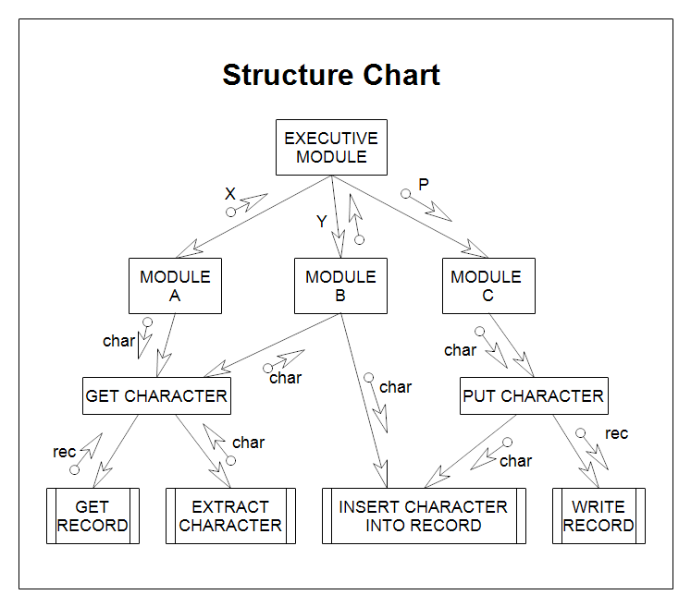

Slide 9
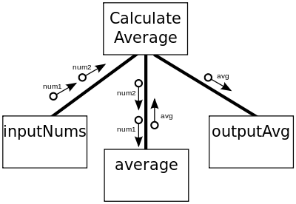
Dr. Abraham will develop a structure chart in class for you for a small project.

