Slide 1
UML
Dr. Abraham
Taken from Wikipedia

Slide 2
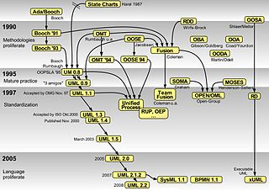

Slide 3
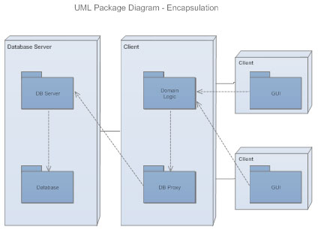
UML is a way of visualizing a software program using a collection of diagrams
Unified Modeling Language
Class diagram
Package diagram
Object diagram
Component diagram
Composite structure diagram
Deployment diagram

Slide 4
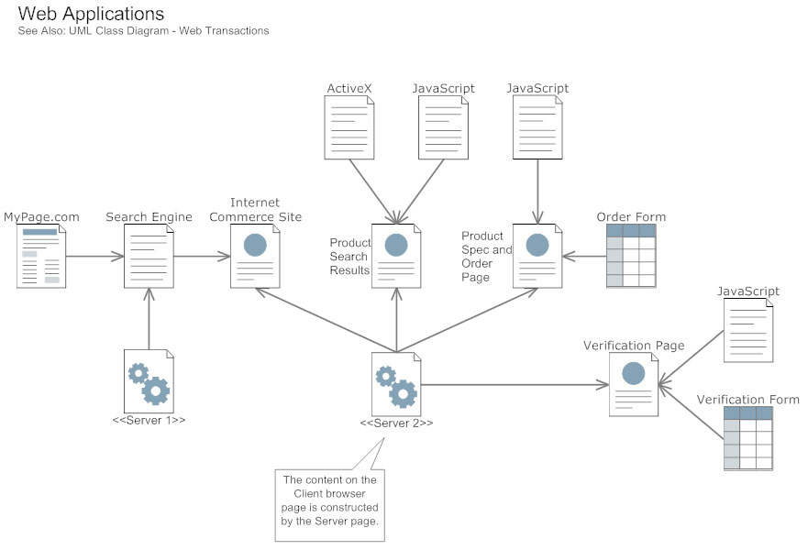

Slide 5
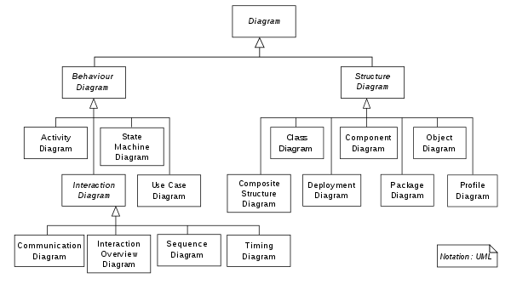
Two categories of UML diagrams

Slide 6
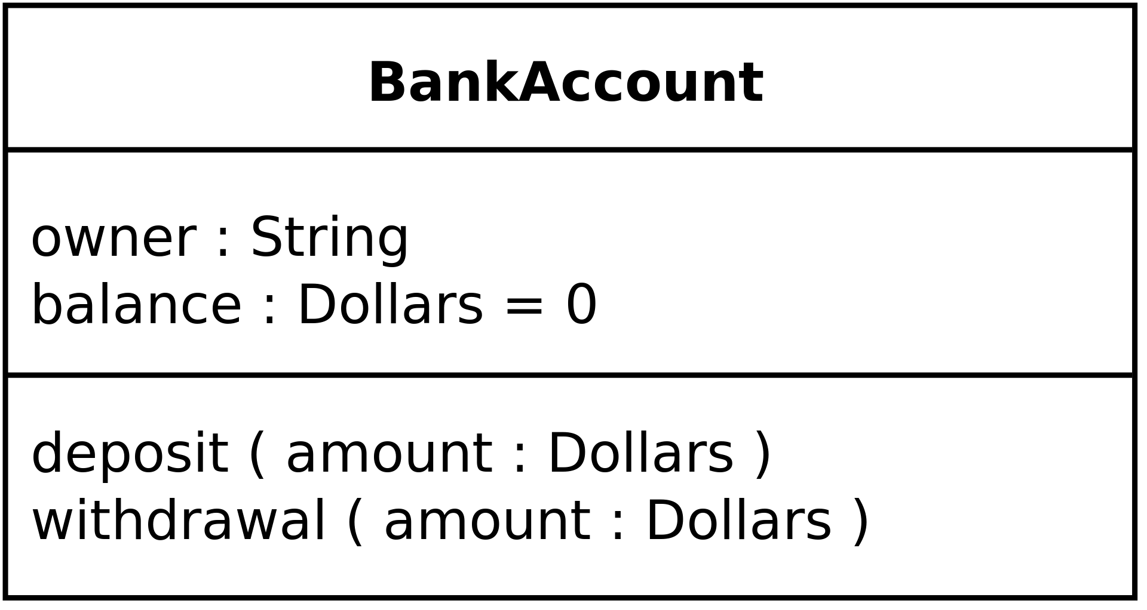
Structural diagrams

Slide 7
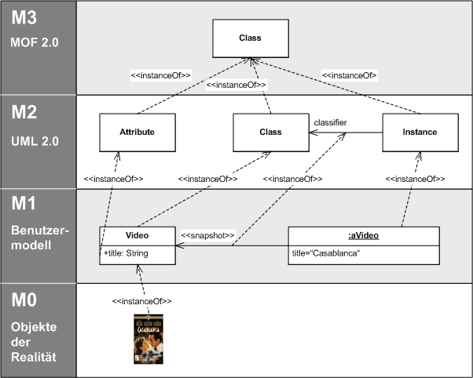
Meta modeling

