Slide 1
E-Commerce
Login & administration page

Slide 2
Login and administration page
A section of our Shopping Cart that allows the system to identify who the users are and what functions can be accomplished by them.

Slide 3
Login process
SELF-SERVICE
Login
Create, modify and delete user accounts
Retrieve user ID
Reset passwords
Sign-in/Sign-out
Admnistrative tasks
Assign privileges
View/Modify inventories
View financial information
Regular user tasks
View order history
Track an order
View items in shopping cart

Slide 4
Security levels
0 – Regular User. Users has the ability to inquire about their own transactions, track packages, maintain payment methods, update personal information, etc.
1 – Administrator. Users with administrative privileges can set parameters for the system, view financial information, adjust inventory levels, etc.
More security levels can be added if required

Slide 5
Guidelines
User account information must be stored on a SQL table (i.e. MySQL).
This table must have at least the following fields
  User ID (Unique, Primary Key)
  First Name
  Last Name
  Password
  Security Level
Passwords must be encrypted prior to storing them on the database

Slide 6
Knowledge required
HTML/PHP
CSS
MySQL

Slide 7
deliverables
Milestone Report (Word Document)
  Screenshots of login page (Before and after login)
  Screenshot of Admin page showing a username and security level assigned
  Screenshot of MySQL table where user credentials are stored
  Source code

Slide 8
Resources
Dynamic Web Programming and HTML5
  Chapter 8 – Server-Side Programming with PHP
  Chapter 9 – Database-Driven Websites
Login System Tutorial with PHP and MYSQL Database (https://youtu.be/Pz5CbLqdGwM)
How to create a complete login system in PHP | PHP tutorial | Learn PHP programming (https://youtu.be/xb8aad4MRx8)
User Registration Form with PHP and MySQL (https://youtu.be/FgSysHTsb6A)

Slide 9
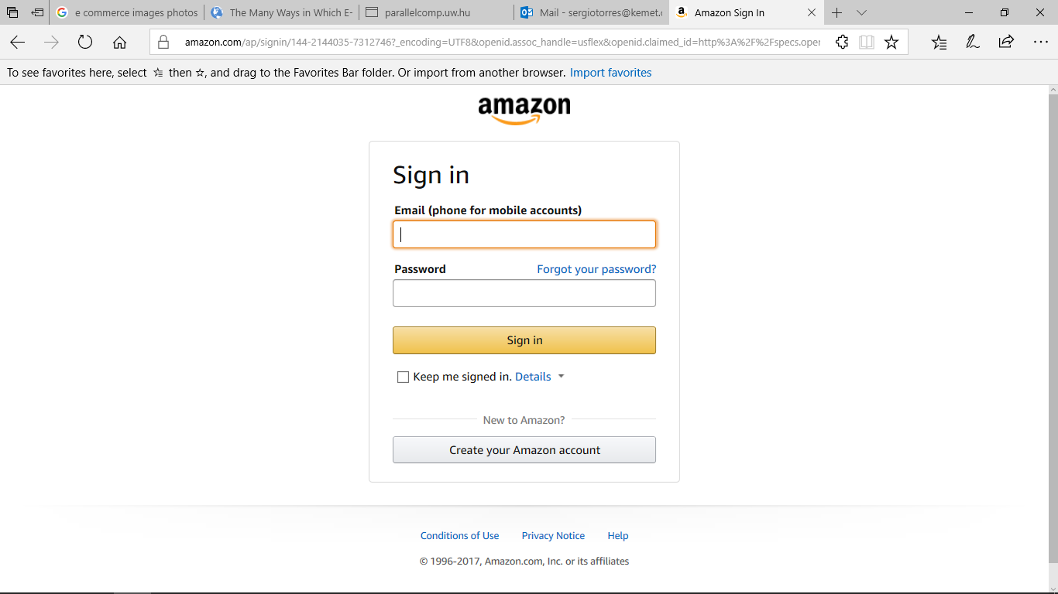
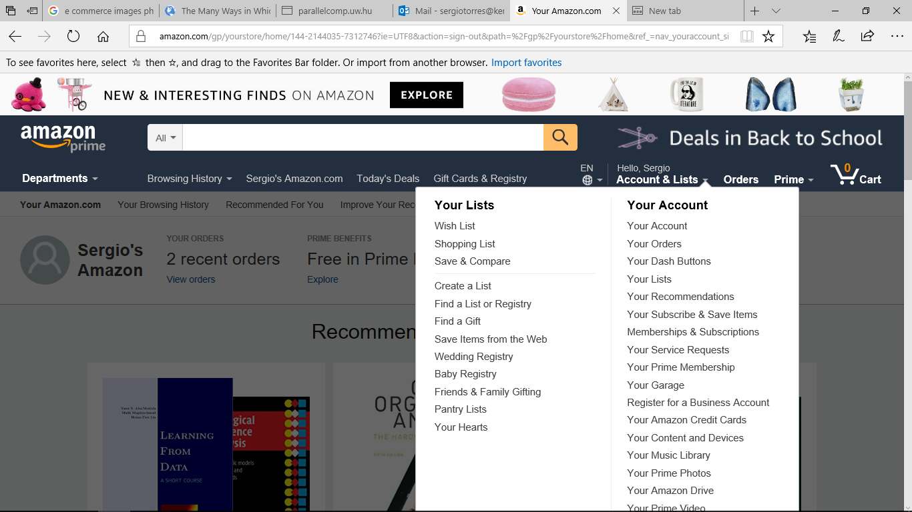
E-commerce login page examples
AMAZON.COM

Slide 10
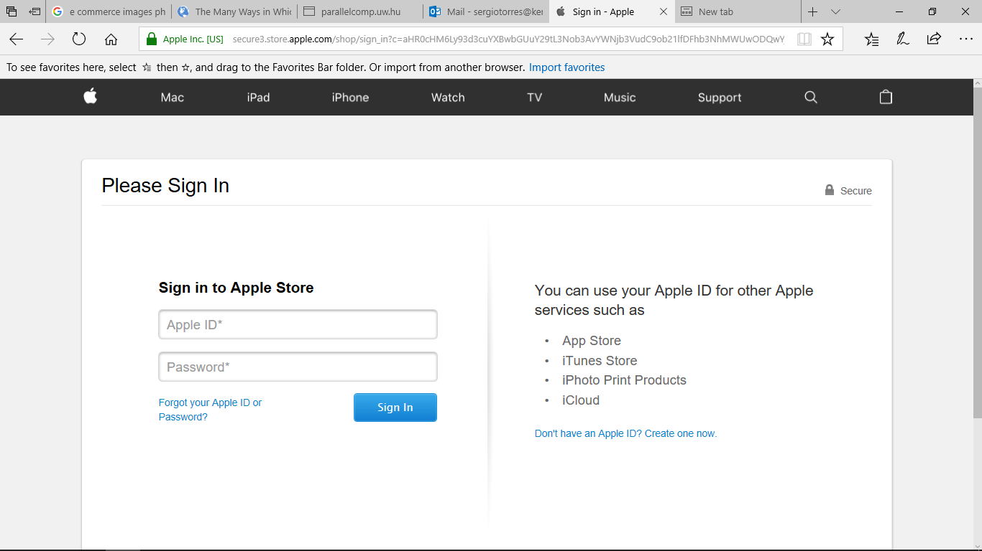
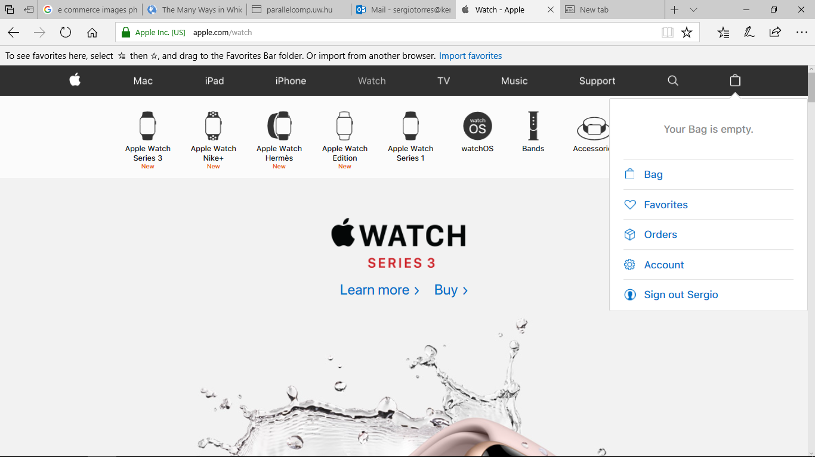
E-commerce login page examples
apple.COM

