Slide 1
E-Commerce
Shopping cart Item selection

Slide 2
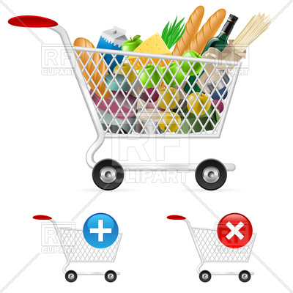
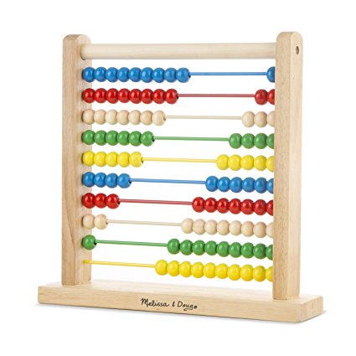
Adding and removing items from shopping cart

Slide 3
KNOWLEDGE AND TOOLS REQUIRED
Webpage Markup with HTML5
Styling with CSS
Javascript
Forms, PHP and Form Processing
Server side programming with PHP
AJAX and Web Services

Slide 4
DELIVERABLES
Word document containing screenshots of items being added or removed from shopping cart.
Source Code.

Slide 5
Guidelines
Displayed items must show price and current inventory
Items with no stock should not be displayed. If they are displayed, users should not be allowed to add them to the shopping cart
Selected items must be stored in the Session if user is not logged in. If user is logged in, selected items must be stored on the MySQL database
Shopping cart must be updated as items are added/removed

Slide 6
Resources
Dynamic Web Programming and HTML5
Webpage Markup with HTML5 (Chapter 2)
Styling with CSS (Chapter 4)
Forms, PHP and Form Processing (Chapter 5)
Dynamic User Interface with Javascript (Chapter 6)
Server Side Programming with PHP (Chapter 8)
Ajax and Web Services (Chapter 11)

