Slide 1
E-COMMERCE
Checkout and Electronic Payment Processing

Slide 2
The Checkout Process
The checkout process is the process that a customer must go through when checking out the items in the cart. This is what the user sees at the frontend.

Slide 3
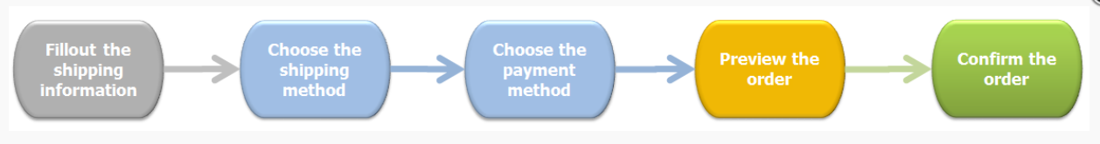
The Checkout Process Flow

Slide 4
Checkout Cont’d
When a customer wants to check out the items in the shopping cart, the following process must be completed:
The checkout process starts when the customer clicks Checkout button in the Shopping Cart or the Shopping Cart Summary, or the Buy Now button.
If you do not allow anonymous shopping, a user who is not logged in will be taken to the specified login page.
The Shipping address fields appear.
If the user is a returning customer the shipping address will appear prefilled with the information that was last specified by the user.
If the billing address differs from the shipping one, the user must deselect the Billing address is the same as the shipping address checkbox.
The Billing address fields appear.
The customer is redirected to choose a shipping method.
Shipping methods that you have defined for the customer’s location appear in a radio button group.
Display the Order summary.
Display the current order: Taxes and tax classes and the Overview: Discounts and Coupons that apply to the subtotal.
The customer must choose how to pay for the items.
All Overview: Payments methods that you have defined appear in a radio button group.
NOTE: Payment options are not displayed when the order’s total is zero. In this case, the Payment step only notifies the user that the order is Free.
Preview the order details, the shipping and payment methods.
The customer must confirm by clicking Place this order button.
The order is confirmed, the confirmation page is displayed to the user, and an email is send by the store to the customer.

Slide 5
Payment Methods
Your Ecommerce store can offer several optional ways for customers to pay for their purchases.
Bank payments
PayPal
Paymentwall
Google Wallet
Mobile Money Wallets

Slide 6
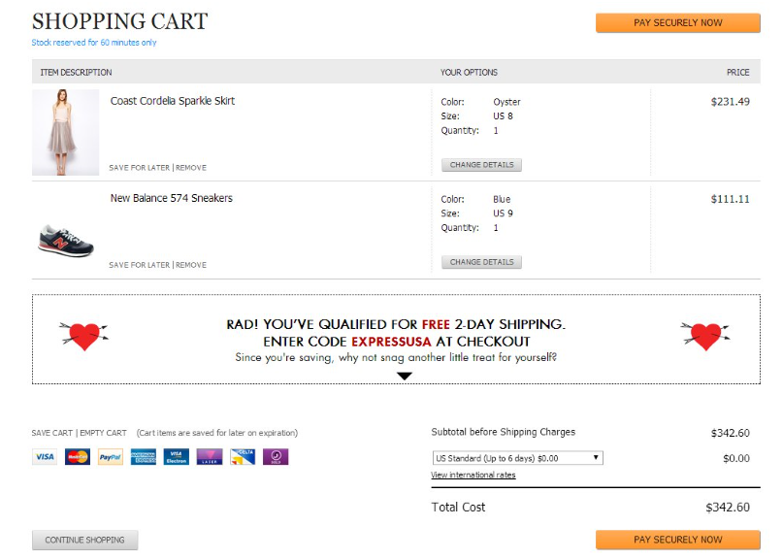
Checkout Example
Shopping Cart Features
Product photos
Product name & price
Ability to remove, save for later, change details like size
Show the kind of payments they accept
Show total price with the option to change shipping
Clear call to action
Even an attempt to get you to add more items in the cart

Slide 7
Task Description
Implement the Checkout flow for your shopping cart
Setup your shopping cart for electronic payment processing

Slide 8
Deliverables
Word document showing:
  The check out of an order step by step
  Bi-directional communication with the Electronic Payment service provider (Paypal, Google Wallet, etc.)
  Source Code

Slide 9
Guidelines
Revenue generated by the sale must be added to the balance of the test account provided by your electronic payment service provider
At the end of the transaction, sold items must be discounted from the MySQL database

Slide 10
Resources
PayPal Payments: Accept Instant Payments With PayPal (https://www.youtube.com/watch?v=BD1dOWIABe0)
Paypal Sandbox Accounts (https://developer.paypal.com/developer/accounts/)
Creating Paypal Sandbox Test Account Account(https://www.youtube.com/watch?v=e4uOIrfuw5o)
PHP implementation of the Google Wallet Instant Buy API (https://github.com/android-pay/instantbuy-sample-php)
Google Wallet Objects API: PHP Quickstart (https://www.youtube.com/watch?v=NmEjkT_r9CE)

