Slide 1
Webpage Markup with HTML 5
By
Carlos Trevino

Slide 2
Markup Language
Markup languages are designed for the processing, definition and presentation of text. The language specifies code for formatting, both the layout and style, within a text file. The code used to specify the formatting are called tags.
HTML is a Markup Language

Slide 3
HTML History
Tim Berners Lee
  1989
  Network based system to share documents via text browsers
HTML 3.2 (1997)
HTML 4.01 W3C approved
  Style, style sheets
XML
  Can be used by other XML documents
XHTML 1.0 (2000) HTML written using XML
HTML 5 combines XHTML, HTML 4, CSS3
  APIs, MathML, SVG

Slide 4
HTML5 Page Structure
<!DOCTYPE html>
<html xmlns = “http://www.w3.org/1999/xhtml” lang = “en” xml: lang = “en”>
<head>
<meta charset=”utf-8”/>
<title> Whatever Title” </title>
<!– whatever comments you need →
</head>
<body>
….
</body>
</html>

Slide 5
HTML5 Page Structure
<!DOCTYPE html>
<html xmlns = “http://www.w3.org/1999/xhtml” lang = “en” xml: lang = “en”>
<head>
<meta charset=”utf-8”/>
Page is coded in html 5
Html language set to English
Xmln namespace
Character encoding for Unicode

Slide 6
HTML5 Page Structure
<title> Whatever Title” </title>
<!– whatever comments you need →
</head>
<body>
….
</body>
</html>
Child Elements
  Head
    Meta information is found keywords, title, page description, etc
  Body
  Page Content that user will see
  Start and End Tags
  Void Elements have no End Tag
    Ex: Line Break <br />

Slide 7
What's new HTML5
New Semantic Elements: Examples <header>, <footer>, and <section>.
Forms 2.0: Improvements to HTML web forms where new attributes have been introduced for <input> tag.
Persistent Local Storage: Can be done without resorting to third-party plugins.
WebSocket: Next-generation bidirectional communication technology for web applications.
Server-Sent Events: HTML5 introduces events which flow from web server to the web browsers and they are called Server-Sent Events (SSE).
Canvas: This supports a two-dimensional drawing surface that you can program with JavaScript.
Audio & Video: You can embed audio or video on your web pages without resorting to third-party plugins.
Geolocation: Now visitors can choose to share their physical location with your web application.
Microdata: Can create web pages with custom semantics.
Drag and drop: Drag and drop the items from one location to another location on a the same webpage.

Slide 8
Webpage Syntax
<tag attribute1 = “value” attribute 2 = “value”>
start tags consist of the following parts, in exactly the following order:
A "<" character.
The element’s tag name.
Optionally, one or more attributes, each of which must be preceded by one or more space characters.
Optionally, one or more space characters.
Optionally, a "/" character, which may be present only if the element is a void element.
A ">" character.
end tags consist of the following parts, in exactly the following order:
A "<" character.
A "/" character
The element’s tag name.
Optionally, one or more space characters.
A ">" character.

Slide 9
Elements
Elements are marked up using start tags and end tags. Tags are delimited using angle brackets with the tag name in between.
The difference between start tags and end tags is that the latter includes a slash before the tag name.
Example
  <p>...</p>

Slide 10
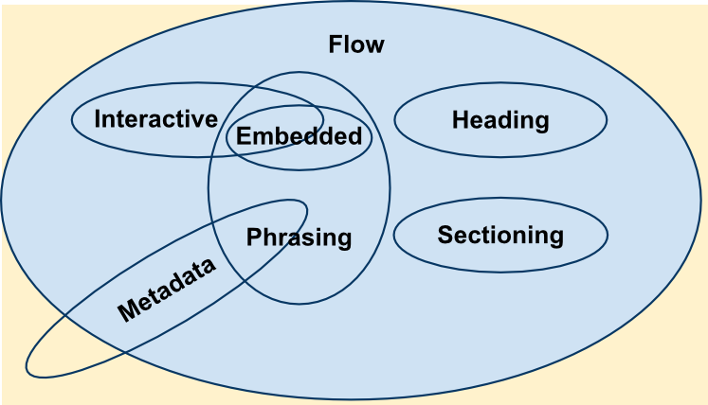
Types of elements

Slide 11
Type of elements
Metadata Elements
  Modify the presentation or the behavior of the rest of the document and set up links to others documents
  Ex: <base>, <command>, <link>, <meta>, <noscript>, <script>, <style> and <title>.
Flow Elements
  Contain text or embedded content
  Ex: <article>, <aside>, <blockquote>, <br>, <button>, <canvas>
Sectioning Elements
  Define the scope of <header> elements, <footer> elements, and heading content.
  Ex: <article>, <aside>, <nav> and <section>.
Heading Elements
  Ex: h1,h2,etc
Phrasing Elements
  Defines the text and the mark-up it contains
  Ex: <audio>, <button>, <img>, <strong>, <time>, <q>
Embedded Elements
  imports another resource or inserts content from another mark-up language
  Ex: <audio>, <canvas>, <object>
Interactive Elements
  Designed for User interaction
  Ex: <canvas>, <button>, <audio>
Form-Associated Elements
  Ex: <button>, <input>, <label>

Slide 12
Attributes
Elements may contain attributes that are used to set various properties of an element.
Some attributes are defined globally and can be used on any element, while others are defined for specific elements only.
Example
<div class="example">...</div>

Slide 13
Webpage Styles
Style rules to elements
Style sheets
<style> in head
Attribute
Foreground and Background Colors
  (background-color) – foreground
  (background) – background
Text Alignment
  Text-alning: left ,right, etc
Font Size
  <style = “font-size: small”>

Slide 14
Webpage Style
Style Length Units
  Em – font size of current font
  Ex – x-height of the current font
  Ch – the size of 0 of the current font
Absolute lengths – not sensitive to changes of font size of screen resolution
  Units: cm, in, mm, px, others

Slide 15
Colors
150 color names in CSS
RGB and HSL (he-saturation-lightness)
Examples
  #rrggbb (#0ace9f)
  #rgb (#03c stands for #0033cc)
  Rgb(r%,g%,b%)
  etc

Slide 16
Text Fonts
Properties of font
  Style, variant, weight, and size
  font-family: Times
  font-family: Arial, Helvetic, sans-serif
Font weight
  Normal, bold, bolder, lighter
Font size
  Xx-small, x-small, small, medium, large, x-large, xx-large

Slide 17
Itemized Lists
Flow (block) elements
Bullet list ( <ul> )
Ordered list ( <o1> )
Definition list ( <d1> )
  <dt> and <dd>
Lists Styles
  List-style-type
    Disc, circle, square, none, decimal, lower-roman, lower-alpha, and many more
  List-style-image: url – custom list markers
  List-style-position

Slide 18
Links in Webpages
Embedded links provide users routes to other webpages
  < a href = “URL”>anchor</a>
  <a … target = >”_blank”> Website Link </a>
Local Elements
  < a href = “folder/pic.jpg” type = image/jpeg>
Link to Specific point
  <h3 id=“id=products”>Products</h3>
  <a href= ”URL#products”> … </a>
  id identifies an element in a page error will occur for none-unique ids
Table of contents
  <article> … </article>

Slide 19
Linking to Services
Email
  <a href=“mailto:email-address?SUBJECT=line”> Mail </a>
Download Links
  <a href = “ftp: host:port/path-to-file”>
Display style for links
  Hover, active, visted

Slide 20
Navigational Bars
Navigational Bars are usually horizontal on the left side or vertical at the top of the page
Allows for a easier way to look through a webpage
Syntax
  <nav> … </nav>

Slide 21
Pictures and Images
Clickable image links
Embedded images
  <img src=“hot.jpg” alt=“Nice Hat” style=”width: 100px; height: 200px” />
Image size is Important
  Photoshop
  Gimp
Thumbnails
Text around Images
  Style = “float: left”
    left, right, margin-left, margin-top, etc
  Allows text along side image

Slide 22
Figures
Use <figure> to separate it from flow of you webpage
For caption use <figcaption>

Slide 23
Image Types
Graphics Interchange Format (Gif) 256 colors (8bit)– suitable for icons, logs, cartoons, lined drawings
Joint Photo Experts Group (JPEG) 16.8M colors (24bit) – digital camera pictures
Portable Network Graphics (PNG) – format designed to replace Gif
  Alpha channels, gamma correction, dimenstional interlacing

Slide 24
Image Map
Image with active areas when clicked
Example
  <map name=“sample”> … </map>
  <area shape = rect” coords=“0,0,100,100” href=“some-url” alt = “item 1” />
alt – are requires the attribute
Use Photo shop or Gimp or other software to obtain coordinates

Slide 25
Help resources
W3Schools
  http://www.w3schools.com/html/html5_intro.asp
Tutorials Point
  http://www.tutorialspoint.com/html/index.htm
W3C Working Group
  http://www.w3.org/TR/html-markup/
Google
  www.google.com

Slide 26
Class lab assignment
Design a basic webpage with content of your choice but with the at least the following of elements.
  Links different Webpage
  Blockquote
  H1
  Style
  Nav
  Table
  Figure
  Canvas or Image Map
A list of elements with description was provided for reference

Slide 27
QUESTIONS?

