Slide 1
Adding and subtracting inventory (table) using PHP
Jonathan Jackson
CSCI 6314
https://www.github.com/jjack703/Inventory-Presentation/

Slide 2
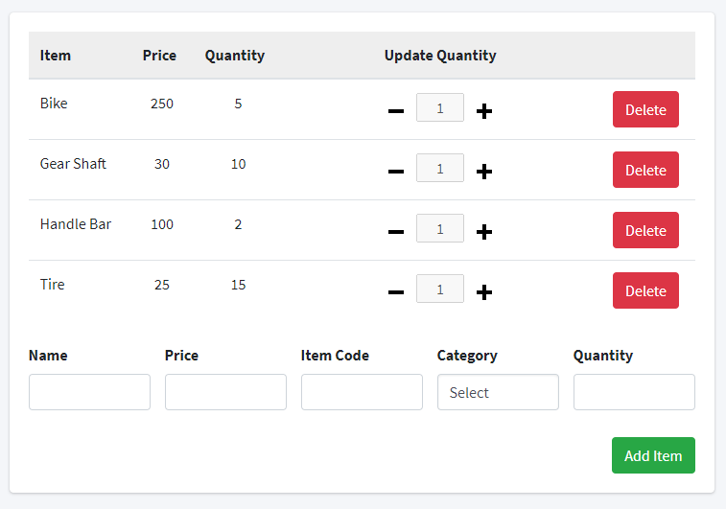
goal:
Display inventory table with the ability to add and remove inventory.
Extra:
Adjustable quantity
AJAX (Asynchronous JavaScript Code)
Sweet alerts

Slide 3
Steps required
Create a database
Create the database table(s)
Fill database with data
Create an HTML table
Fill table cells with database data (PHP)
Create backend routes to provide asynchronous view (optional)
Add table functionality (PHP)
Adding row from database
Removing row from database

Slide 4
database management tool

Slide 5
Creating table and filling with data
Notes:
--
-- Table structure for table `inventory`
--
DROP TABLE IF EXISTS `inventory`;
CREATE TABLE IF NOT EXISTS `inventory` (
`id` int(10) UNSIGNED NOT NULL AUTO_INCREMENT,
`name` varchar(45) DEFAULT NULL,
`price` varchar(45) DEFAULT NULL,
`item_code` varchar(45) DEFAULT NULL,
`category` varchar(45) DEFAULT NULL,
`in_stock` int(10) DEFAULT NULL,
PRIMARY KEY (`id`)
) ENGINE=InnoDB AUTO_INCREMENT=4 DEFAULT CHARSET=utf8;
--
-- Dumping data for table `inventory`
--
INSERT INTO `inventory` (`id`, `name`, `price`, `item_code`, `category`, `in_stock`)
VALUES (1, 'Bike', '250', 'BK250IE','Bicicles & Parts',5),
(2, 'Tire', '25', 'TR25IE','Bicicles & Parts', 15),
(3, 'Handle Bar', '100', 'HB100ER','Bicicles & Parts',1),
(4, 'Gear Shaft', '30', 'GS30RT','Bicicles & Parts',10);

Slide 6
Creating a database connection
File - /php-files/db_connect.php

Slide 7
Create html table
HTML Elements:
<table></table>
<thead></thead>
<th></th>
<tr></tr>
<td></td>

Slide 8
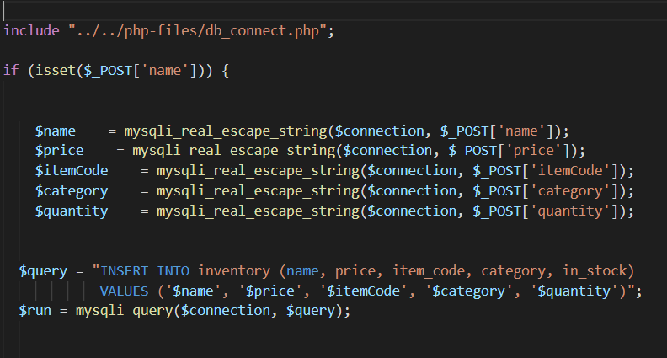
Add a new item to the table
HTML Elements:
Form
File - v1.0\new_inventory_item.php

Slide 9
Remove an item from the table
File - v1.0\delete_inventory_item.php

Slide 10
Download from GitHub and try for yourself
https://www.github.com/jjack703/Inventory-Presentation/

