Slide 1
Silverlight
Hector J Garza

Slide 2
Silverlight
Plug in
Microsoft version of Flash
Available from Microsoft website

Slide 3
What is a plug in
A plug in is downloadable software that extend the capabilities of a web browser
They allow for users to view content that the internet wasn’t originally designed to handle
Ex. Video, audio, pdf files, animations etc

Slide 4
What can you do with Silverlight
With Silverlight developer are able to create everything from animations to web pages to phone applications
Microsoft provides different development environments that utilize Silverlight to create content

Slide 5
How to create content
Content for Silverlight is done in in the Visual Web Developer 2010 express using XAML.
XAML is similar to HTML in which you have elements enclosed in braces.
These elements can be given attributes
Ex. <Rectangle x:Name="MovingRectangle" Height="100" Width="100" Fill="Blue">

Slide 6
What you will need
To begin creating content using Silverlight you will first need to download Visual Web Developer 2010 express from the Microsoft webpage.
Secondly download the Silverlight toolkit. It will prompt you to do so when trying to create a Silverlight project.

Slide 7
Visual Studio Web Developer

Slide 8
Silverlight

Slide 9
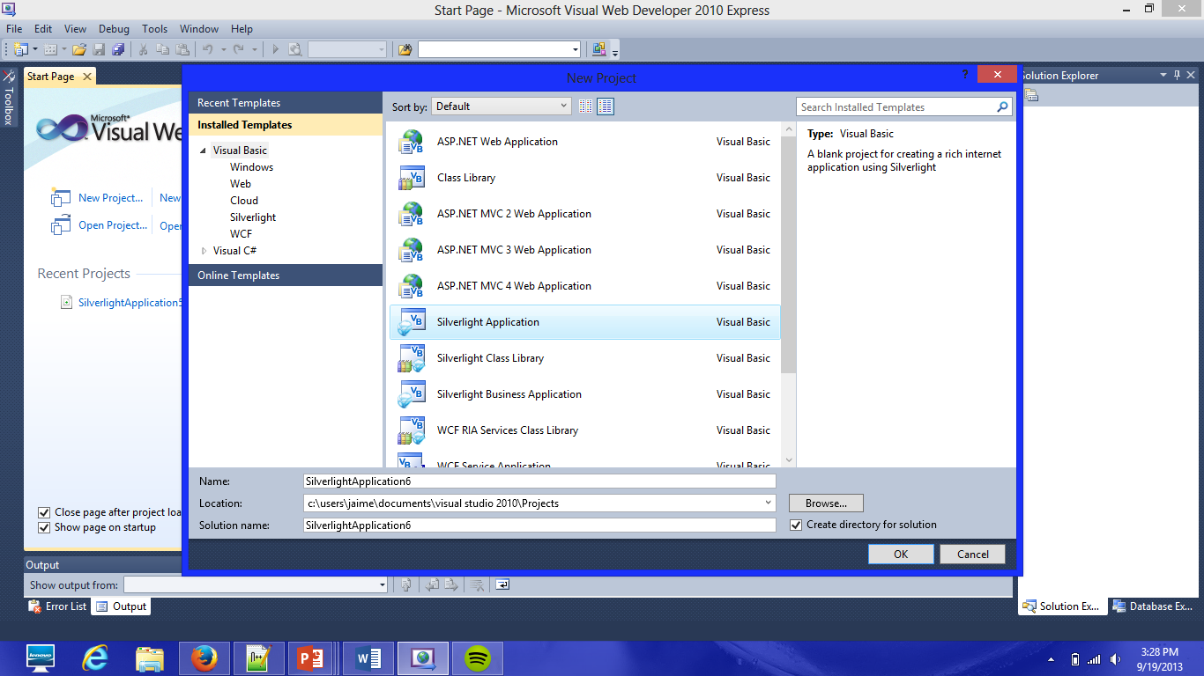

Slide 10
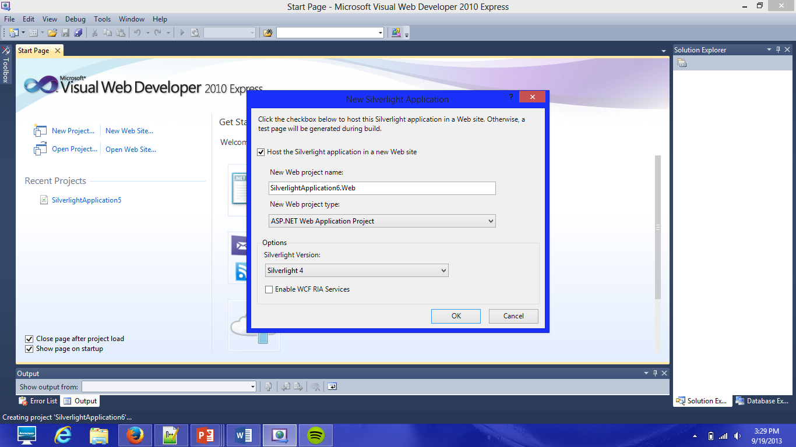

Slide 11
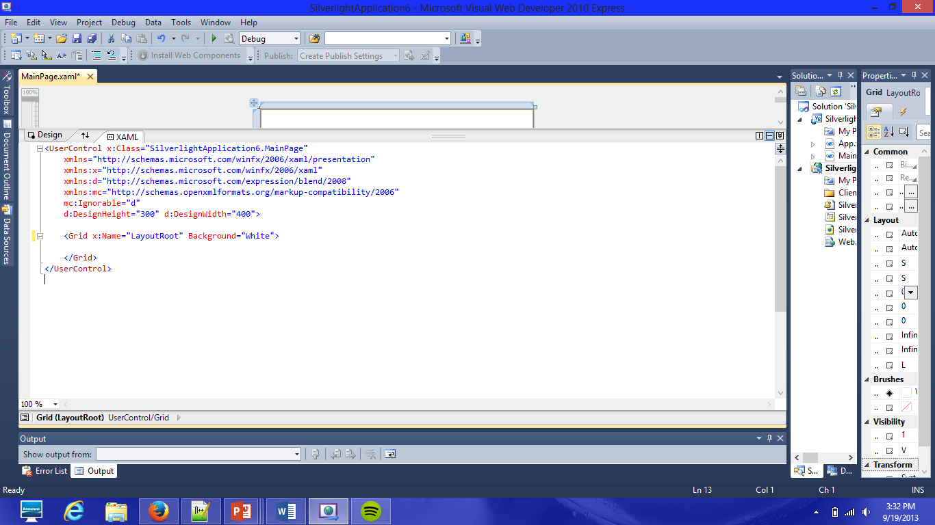

Slide 12
<UserControl x:Class="SilverlightApplication5.MainPage"
xmlns="http://schemas.microsoft.com/winfx/2006/xaml/presentation"
xmlns:x="http://schemas.microsoft.com/winfx/2006/xaml"
xmlns:d="http://schemas.microsoft.com/expression/blend/2008"
xmlns:mc="http://schemas.openxmlformats.org/markup-compatibility/2006"
mc:Ignorable="d"
d:DesignHeight="300" d:DesignWidth="400">
<Grid x:Name="LayoutRoot" Background="White">
<Rectangle x:Name="MovingRectangle" Height="100" Width="100" Fill="Blue">
<Rectangle.Triggers>
<EventTrigger RoutedEvent="Rectangle.Loaded">
<BeginStoryboard>
<Storyboard>
<DoubleAnimation Storyboard.TargetName="MovingRectangle" Storyboard.TargetProperty="Width" From="100" To="300" Duration="0:0:8" AutoReverse="False" RepeatBehavior="forever">
</DoubleAnimation>
</Storyboard>
</BeginStoryboard>
</EventTrigger>
</Rectangle.Triggers>
</Rectangle>
</Grid>
</UserControl>

Slide 13
Resources
Setting up
http://www.youtube.com/watch?v=8BGgHm00D3g
Homework
Download tools as in the tutorial listed above and create an animation…There are tutorials online

