Slide 1
XML and AJAX
Dave Salinas

Slide 2
What is XML?
XML stands for eXtensible Markup Language
Markup language, like HTML
HTML was designed to display data, whereas XML was designed to transport and store data
XML tags are not predefined
XML is designed to be self-descriptive
Can be stored as text files

Slide 3
XML Syntax
Same basic syntax as HTML, with some important distinctions
  All XML elements must have a closing tag
  XML tags are case sensitive
  XML elements must be properly nested
  XML documents must contain a root element
  Attribute values must be quoted

Slide 4
XML Example 1
<note date="10/01/2008">
<to>Tove</to>
<from>Jani</from>
<heading>Reminder</heading>
<body>Don't forget me this weekend!</body>
</note>

Slide 5
XML Example 2
<note>
<date>10/01/2008</date>
<to>Tove</to>
<from>Jani</from>
<heading>Reminder</heading>
<body>Don't forget me this weekend!</body>
</note>

Slide 6
XML Example 3
<note>
<date>
<day>10</day>
<month>01</month>
<year>2008</year>
</date>
<to>Tove</to>
<from>Jani</from>
<heading>Reminder</heading>
<body>Don't forget me this weekend!</body>
</note>

Slide 7
What is AJAX?
AJAX stands for Asynchronous JavaScript And XML
Technique for developing dynamic web pages
Allows web pages to be updated asynchronously by exchanging data with the server
Possible to update parts of a web page without reloading entire page

Slide 8
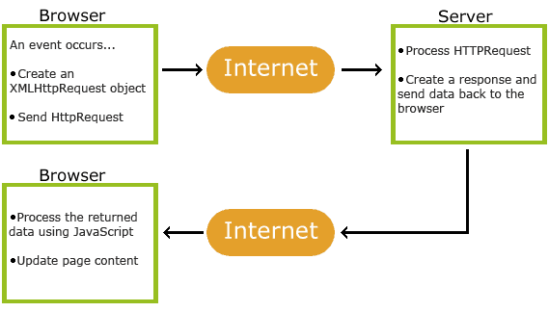
How does AJAX work?

Slide 9
XMLHttpRequest Object
All modern browsers support XMLHttpRequest object (IE5 and 6 use ActiveXObject)
Syntax for creating XMLHttpRequest object:
  Variable = new XMLHttpRequest();
Sending a request to a Server
  Variable.open(method, url, async);
  Varialbe.send();

Slide 10
Assignment
Create your own simple XML document
Display it dynamically on your own web page
You can look at http://dsalinasez.no-ip.biz/
for example source code
http://dsalinasez.no-ip.biz/cd_catalog.xml for example xml document.
Email me at dave_salinas@yahoo.com

