Slide 1
Web Services
Jose Gomez Zaballa
CSCI-6314
Notes:
This template can be used as a starter file for presenting training materials in a group setting.
Sections
Right-click on a slide to add sections. Sections can help to organize your slides or facilitate collaboration between multiple authors.
Notes
Use the Notes section for delivery notes or to provide additional details for the audience. View these notes in Presentation View during your presentation.
Keep in mind the font size (important for accessibility, visibility, videotaping, and online production)
Coordinated colors
Pay particular attention to the graphs, charts, and text boxes.
Consider that attendees will print in black and white or grayscale. Run a test print to make sure your colors work when printed in pure black and white and grayscale.
Graphics, tables, and graphs
Keep it simple: If possible, use consistent, non-distracting styles and colors.
Label all graphs and tables.

Slide 2
Today’s Overview
Background
WS Concepts
Example
Assignment
Notes:
Give a brief overview of the presentation. Describe the major focus of the presentation and why it is important.
Introduce each of the major topics.
To provide a road map for the audience, you can repeat this Overview slide throughout the presentation, highlighting the particular topic you will discuss next.

Slide 3
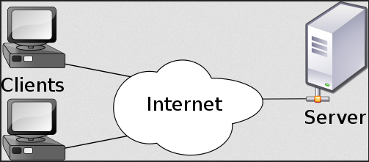
Background
Client / Server
Web Scraping
Reusability
Interoperability
Notes:
What will the audience be able to do after this training is complete? Briefly describe each objective how the audience will benefit from this presentation.

Slide 4
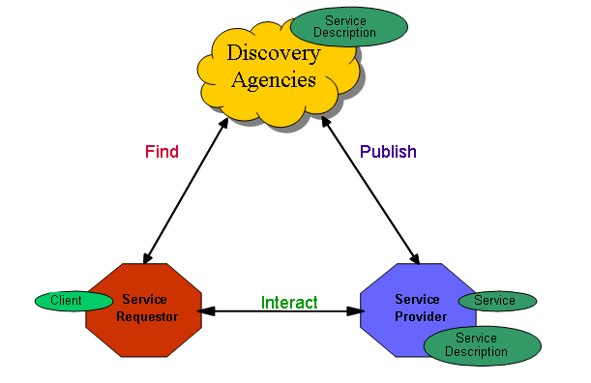
Service Oriented Architecture

Slide 5
Web Services
“Web services are a new breed of Web application. They are self-contained, self-describing, modular applications that can be published, located, and invoked across the Web. Web services perform functions, which can be anything from simple requests to complicated business processes...Once a Web service is deployed, other applications (and other Web services) can discover and invoke the deployed service.” *
“An application that provides a Web API”**
*From www.xml.com page
Notes:
Add a case study or class simulation to encourage discussion and apply lessons.

Slide 6
Web Services
Are application components
Communicate using open protocols
Self-contained and self-describing
Can be discovered using UDDI
Can be used by other applications
HTTP and XML is the basis
Notes:
Add a case study or class simulation to encourage discussion and apply lessons.

Slide 7
Web Services
Self-contained. On the client side, no additional software is required.
Self-describing. The definition of the message format travels with the message
Modular. Simple WS can be aggregated to form more complex WS
Platform independent. Based on a concise set of open, XML-based standards designed to promote interoperability.
Notes:
Add a case study or class simulation to encourage discussion and apply lessons.

Slide 8
Terminology
WSDL
SOAP
Simple Object Access Protocol
UDDI
Universal Description, Discovery and Integration
Web Services Description Language
Notes:
This is another option for an Overview slide.

Slide 9
WSDL Web Services Description Language
Written in XML
Used to describe Web services
Used to locate Web services
Specifies:
Location of the service
Operations (or methods) the service exposes
Notes:
Use a section header for each of the topics, so there is a clear transition to the audience.

Slide 10
WSDL Document Structure
Element | Description
<types> | Data Type Definitions
<message> | Data being communicated (parameters)
<portType> | Set of Operations (Library or Class)
<binding> | Protocol and Data Format for each port
Notes:
Keep it brief. Make your text as brief as possible to maintain a larger font size.

Slide 11
SOAP Simple Object Access Protocol
Communication protocol between applications
Format for sending messages
Platform and language independent
Based on XML
Simple and extensible
Allows you to get around firewalls
Notes:
Use a section header for each of the topics, so there is a clear transition to the audience.

Slide 12
UDDI Universal Description, Discovery and Integration
Directory service where companies can search for Web Services
Is described in WSDL
Communicates via SOAP
Notes:
Use a section header for each of the topics, so there is a clear transition to the audience.

Slide 13
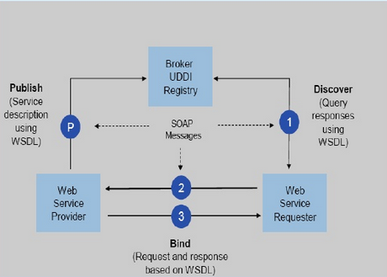
How Web Services Work?
Creating = Publishing
Using = Consuming
Notes:
This is another option for an Overview slides using transitions.

Slide 14
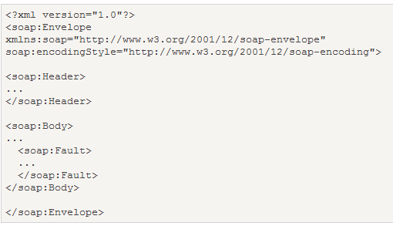
SOAP MESSAGES
Must
Use the SOAP Envelope namespace
Use the SOAP Encoding namespace

Slide 15
SOAP Message Elements
<envelope>
Required, defines XML as SOAP message
<header>
application-specific info (authentication, payment, optional.
<body>
SOAP message for the ultimate endpoint
Required
<fault>
Indicate error messages
Optional

Slide 16
Example (ASP.NET)
Create a new WebSite (empty)
Add New Item -> “Web Service”
Modify default method “HelloWorld”
ASP.NET automatically creates WSDL and SOAP .
Notes:
Summarize presentation content by restating the important points from the lessons.
What do you want the audience to remember when they leave your presentation?
Save your presentation to a video for easy distribution (To create a video, click the File tab, and then click Share. Under File Types, click Create a Video.)

Slide 17
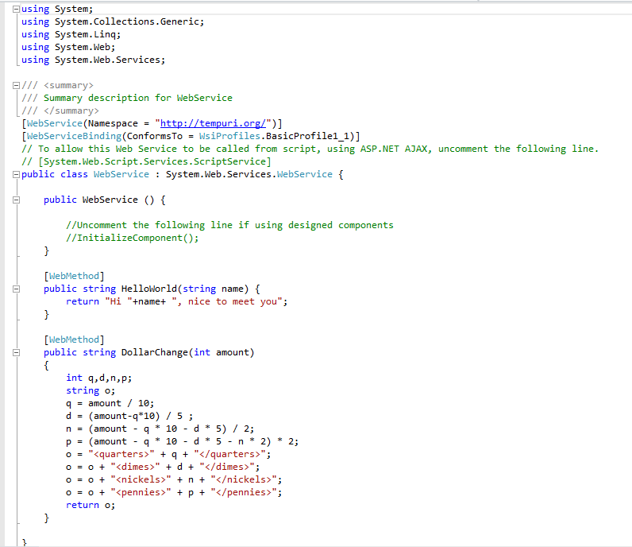

Slide 18
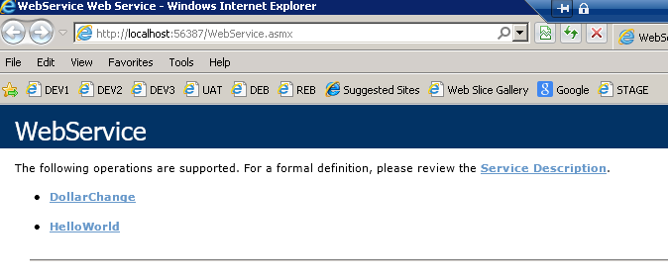
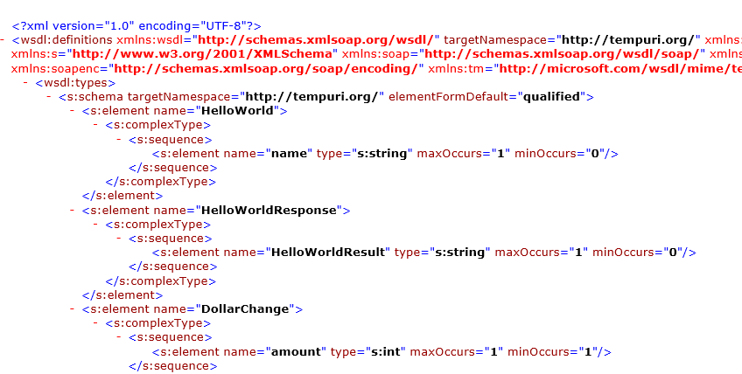
WSDL

Slide 19
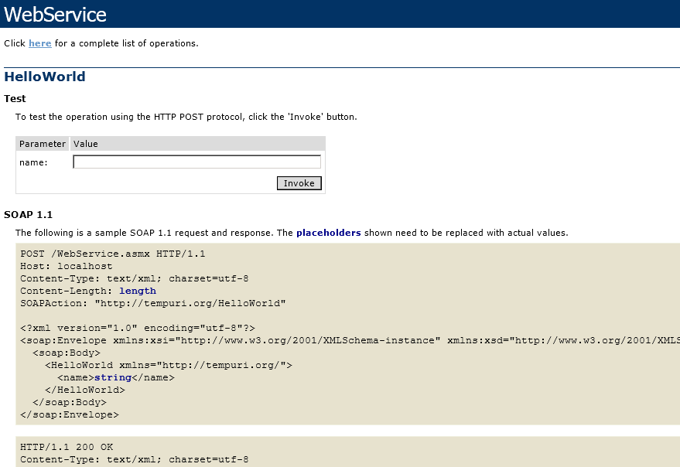
SOAP

Slide 20
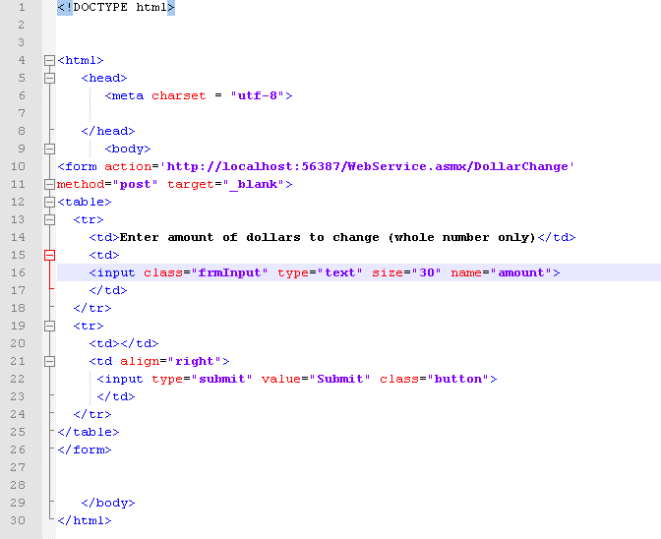

Slide 21
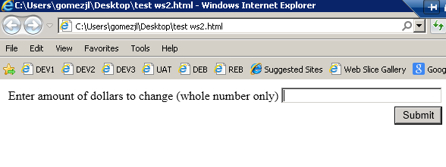

Slide 22
Resources
W3schools.com http://www.w3schools.com/webservices/
MSDN
http://msdn.microsoft.com/en-s/library/System.Web.Services.aspx
Iverson, Will. Real World Web Services. O'Reilly Media, Inc. 2004.
Guruge, Anura. Web Services: Theory and Practice. Elsevier Inc. 2004
**Manes, Anne Thomas. Web Services: A Manager's Guide. Addison-Wesley. 2003

Slide 23
Questions?

Slide 24
Assignment
Create a “HelloWorld” Web Service and call it from
your webpage .
Please send your results to gomezjl@broncs.utpa.edu
Notes:
Is your presentation as crisp as possible? Consider moving extra content to the appendix.
Use appendix slides to store content that you might want to refer to during the Question slide or that may be useful for attendees to investigate deeper in the future.

