Slide 1
Ruby on Rails
CSCI 6314
David Gaspar
Jennifer Garcia Avila

Slide 2
What is Ruby on Rails?
Popularly known as “Rails” – open source web application framework
“Opinionated” software – makes the assumption that there is the “best” way to do things, and encourages the use of that way
Full-stack framework – allows creating pages and apps that gather information from the web server, contact/query the database, and render templates out of the box
Features a routing system that is independent of the web server as a result

Slide 3
How Rails is similar to other frameworks
Emphasizes the use of well-known software engineering patterns and principles
Active Record Patter: software architectural program that stores its data in relational databases
Convention over Configuration (CoC): make the code simpler without losing flexibility (decrease # of decisions for developers)
Don’t Repeat Yourself (DRY) principle: reducing repetition of information of all kinds (Single Source of Truth)
“Every piece of knowledge must have a single, unambiguous, authoritative representation within a system” (Andy Hunt and Dave Thomas”)
Model-View-Controller (MVC): separates the representation of information from the user’s interaction with it

Slide 4
History of Rails
David Heinemeier Hansson released Rails as open source in July 2004
October 2007 – Apple shipped Rails with Mac OS X v10.5 (Leopard)
Current version - 4

Slide 5
Notable sites that use Ruby on Rails

Slide 6
Version | Date | Notable Enhancements
1.0 | 12/13/05
1.2 | 1/19/07
2.0 | 12/7/07
2.1 | 6/1/08
2.2 | 11/21/08
2.3 | 3/16/09 | Major new developments in templates, engines, Rack, and nested model forms
3.0 | 8/29/10 | Merb merged with Rails
3.1 | 8/31/11 | Reversible DB Migrations, Asset Pipeline, Streaming, jQuery, CoffeScript and Sass (added to stack)
3.2 | 1/20/12 | Faster development mode and routing engine (Journey), Automatic Query Explain, and Tagged Logging
4.0 | 6/25/13 | Introduces Russian Doll Caching (nesting fragment caches to maximize cache hits), Turbolinks (don’t have to recompile JS and CSS between each page change only replacing body and title in the head) and Live Streaming

Slide 7
Security vulnerabilities to note
Previous versions of Rails suffer from a vulnerability that allows hackers to hijack user accounts through the use of session cookies
RoR uses CookieStore as its default session storage mechanism
CookieStore contains a user’s entire session hash on the client side in the form of a web browser cookie
No information about the session is stored in the ‘sessions’ database table on a log out event and this effectively makes the cookies valid for life (not best practice)

Slide 8
CookieStore vulnerability, cont.
Rails issues a new empty cookie to the user’s browser in order to overwrite the initial one that was authenticated.
New cookie is used from that point forward, BUT:
There is no way to invalidate the old cookie!
Possible attacks:
XSS (inject client-side scripts into Web pages)
session sidejacking (attacker uses packet sniffing to read network traffic between two parties to steal session cookie)

Slide 9
Mitigating the vulnerability
Ruby 4 can now encrypt the cookie value – upgrade to 4 from current version
Enforce a TTL on a session by providing a TTL value within the session; validate it when the session is read, then update the TTL value when the session is written
Don’t use CookieStore

Slide 10
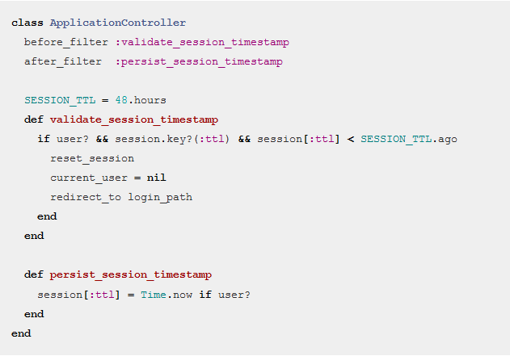

Slide 11
Setup
Ruby can be installed from http://rubyinstaller.org/
Ruby on rails is installed and executed on the ruby command line.
“$ gem install rails” installs rails
“$ rails new <project name>” creates a project
“$ rails server” starts rails

Slide 12
Model-View-Controller
Ruby on Rails uses Model-View-Controller architecture.
Controllers receive and process the request from the user.
Models are objects that are used to create and edit the database.
Views send viewable html back to the user.

Slide 13
Controller
Controller are created this command in the ruby command line:
“$ rails generate controller <controller name> <action name>”
This command creates multiple files used by the controller including the view which has the action’s name
This command also creates the routing that sends the controller the user requests.

Slide 14
View
Views are created along with the controller or can be created separately.
Views include html and ruby code
Ruby is embedded inside “<%=“ and “%>” tags

Slide 15
Model
Models are used to create and edit database tables.
“$ rails generate model <model name> (attribute name: attribute type … )”
Eg “$ rails generate model Post title:string text:text”
“$ rake db:migrate” Must be run to create the table.

Slide 16
Model Example
Saving data using a model
def create @post = Post.new(params[:post].permit(:title, :text)) @post.save redirect_to @post end

Slide 17
Assignment
Go to http://tryruby.org and work through the tutorial
Screenshot the last page with your code to create the popup with your blog entries
Email screenshot to jenniferleegarcia@gmail.com.

