Slide 1
<?php
Echo ‘Hector garza’;
Echo ‘Andrea cantu’;
?>

Slide 2
PHP is a scripting language that brings websites to life in the following ways:
PHP is a scripting language that brings websites to life in the following ways:
Sending feedback from your website directly to your mailbox
Uploading files through a web page
Generating thumbnails from larger images
Reading and writing to files
Displaying and updating information dynamically
Using a database to display and store information
Making websites searchable

Slide 3
PHP Basics
PHP: Hypertext Preprocessor
Reduces all the clutter and commands of HTML by embedding codes that do specific tasks
Start and end processes are <? php ?>
Allow you to jump in and out of php mode
Code executed on server side and sent to client
The client receives the results but doesn’t know the underlying code
Like a hidden code embedded into HTML page

Slide 4
PHP History
Started as Personal Home Page Tools (PHP Tools) in 1995 with a goal to create a guestbook by gathering information from an online form and displaying it on a web page.
The ability to communicate with a database was later added. With v3 in 1998, the name dropped since it sounded more of a hobbyist’s term. As of Sep. 19, 2013 the latest version is PHP 5.5.4. PHP 5 now supports object-oriented programming (OOP).
Easy scripting language with no need of learning lots of theory.

Slide 5
PHP is the language that drives the highly popular Content Management Systems (CMSs)
Drupal
Joomla!
WordPress
Also some of the most heavily used websites:
Facebook
Wikipedia

Slide 6
How PHP makes pages dynamic
PHP was originally designed to be embedded into the HTML, which is still used as so.
For Example:
Display current year in a copyright notice, you place this in the footer.
<p>&copy; <?php echo date(‘Y’); ?> PHP Copyright</p>
Code is automatically processed in the server
After your New Year’s party, you won’t worry because it will automatically be changed.
Unlike JavaScript to display date, the processing is done on the web server, so it doesn’t rely on JavaScript being enabled in the user’s browser.
Date is calculated by web server, not affected by user’s clock on computer.

Slide 7
What Software do I need to write PHP?
What to look for:
PHP syntax checking
PHP syntax coloring
PHP code hints
Line numbering
A “balance braces” feature (parentheses, brackets, curly braces)
General Purpose Web Development Tools
Dreameweaver CS5+ (adobe.com)
Expression Web (Microsoft.com)
Dedicated script editors
Zend Studio (zend.com)
PhpED (nusphere.com)
PHP Development Tools (eclipse.org)

Slide 8
What Software do I need to write PHP? (continued)
What you need:
Web server (Apache)
PHP
MySQL
All-in-one Package
XAMPP for Win (apachefriends.org)
WAMP for Win (wampserver.com)
MAMP for Mac (mamp.info)

Slide 9
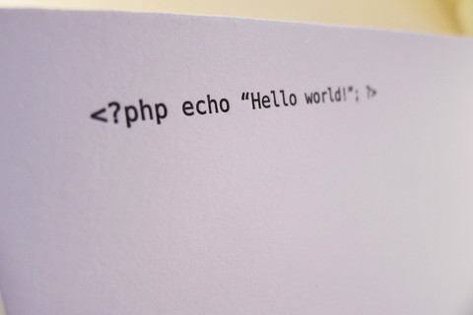
How to Write PHP Scripts
PHP is a server-side language. Meaning the webserver processes your PHP code and sends only the results, usually in HTML, to the browser.
Every page must have a PHP filename extension: filename.php
Enclose all PHP code within PHP tags. Opening tag: <?php and closing is ?>
<?php
echo ‘Hello World!’;
?>

Slide 10
A typical PHP page will use some or all of the following elements:
Variables to act as placeholders
Arrays to hold multiple values
Conditional statements to make decisions
Loops to perform repetitive tasks
Functions or objects to perform preset tasks

Slide 11
Naming variables
$variable = value; $name = ‘Pancho’; $year = 2013;
Always begin with a dollar sign ($)
First character after dollar sign cannot be a number
No spaces or punctuation marks, except for underscore (_)
Case-sensitive: $thisYear and $thisyear are not the same
PHP predefined variables (superglobal arrays) begin with an underscore ($_GET, $_POST)

Slide 12
Making Decisions
<?php
$time = date(“H”);
If ($time < “20”)
{
echo “Have a good day!” ;
}
else
{
echo “Have a good night!” ;
}
?>

Slide 13
Using Loops
while (condition is true) {
do something
}
for ($i = 1; $i <= 100; $i++) {
echo “$i<br>”;
}

Slide 14
Advanced PHP
PHP Arrays Multi
PHP Date
PHP Include
PHP File
PHP File Upload
PHP Cookies
PHP Sessions
PHP E-mail
PHP Secure E-mail
PHP Error
PHP Exception
PHP Filter
PHP Database

Slide 15
Includes… ¿¿que??
The ability to include the contents of one file inside another is one of the most powerful features of PHP.
Every page shares common elements
Header
Footer
Navigation

Slide 16
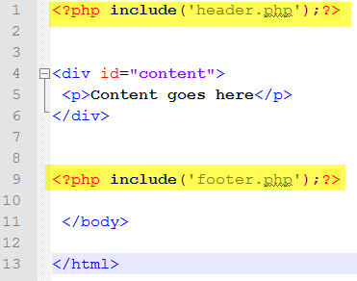

Slide 17
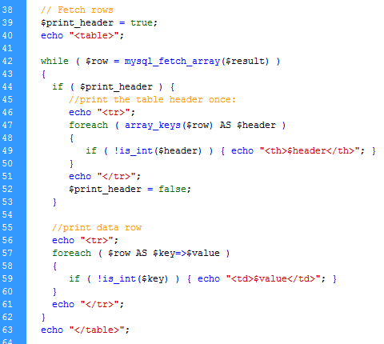
Connecting to MySQL with PHP

Slide 18
Assignment
Create a PHP page with two PHP includes.
Your submission should have at least the following or similar.
Index.php
Add header.php using PHP’s include
Add footer.php using PHP’s include
Header.php
Navigation links
Horizontal image/banner
Footer.php
Navigation links
Copyright info (example: Pancho Villa © 2013)
Submit in Zip/Rar file to:
Email assignment to: hsgarzaz@broncs.utpa.edu

Slide 19
Helpful PHP links
http://www.w3schools.com/php/
http://www.w3schools.com/php/php_includes.asp
http://php.about.com/od/tutorials/ht/template_site.htm
http://www.youtube.com/watch?v=qRaz1CRMGEg

