Slide 1
Adobe Flash
By Tammy Armani

Slide 2
Choosing a Document Type

Slide 3
Choosing a Document Type continued
ActionScript 3.0 vs 2.0—do not communicate well together
Air –packages up the Flash content and makes it something you install onto your desktop
Published product is .air file containing Flash content to be installed on the PC like any other program
FlashLite—also for portable devices
ActionScript File .as
when you want a user to interact/take user input to make logical decisions (entering data—email, phone, etc.)
Button click needs AS—listens for the click, something happens
Counting/Math needs
Flash JavaScript File .jsfl-extends regular JavaScript to include the Flash DOM. Use it to write commands that can automate events and workflows within Flash
Flash Project—group multiple related files together when creating complex applications. It kind of acts like an index to multiple files that you may have in different locations on your computer
ActionScript Class—robust object oriented language
ActionScript Interface—collection of method declarations that allows unrelated objects to communicate with one another

Slide 4
Flash Targets the Player
Looks the same in all browsers

Slide 5
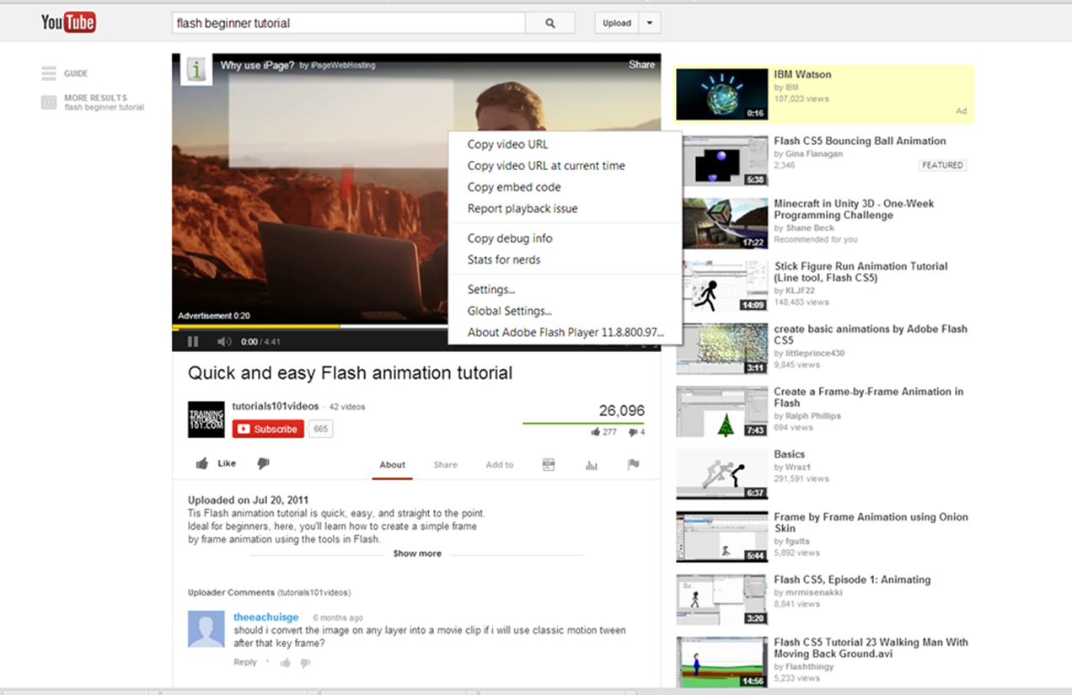
Build with the player that is used
Right click on video to see version running

Slide 6
Flash for Desktop Browsers
Authoring Tool – This will be the source file. Save As will create the .fla file extension

Slide 7
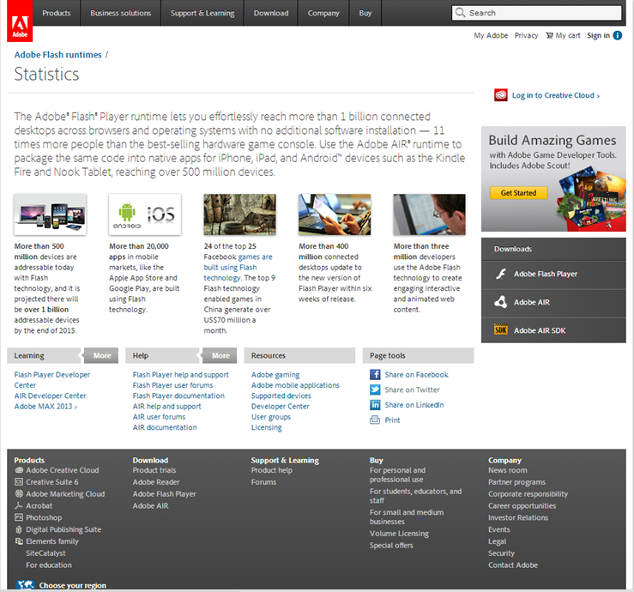
Ready to Publish
Alt + Enter or Cmd + Enter will create SWF file
Can be published unlimited times for test and preview
No longer in authoring tool—SWF is deployed on the web
For a user to be able to view the SWF file, they must have the Flash Player plug in installed(most versions already have)

Slide 8
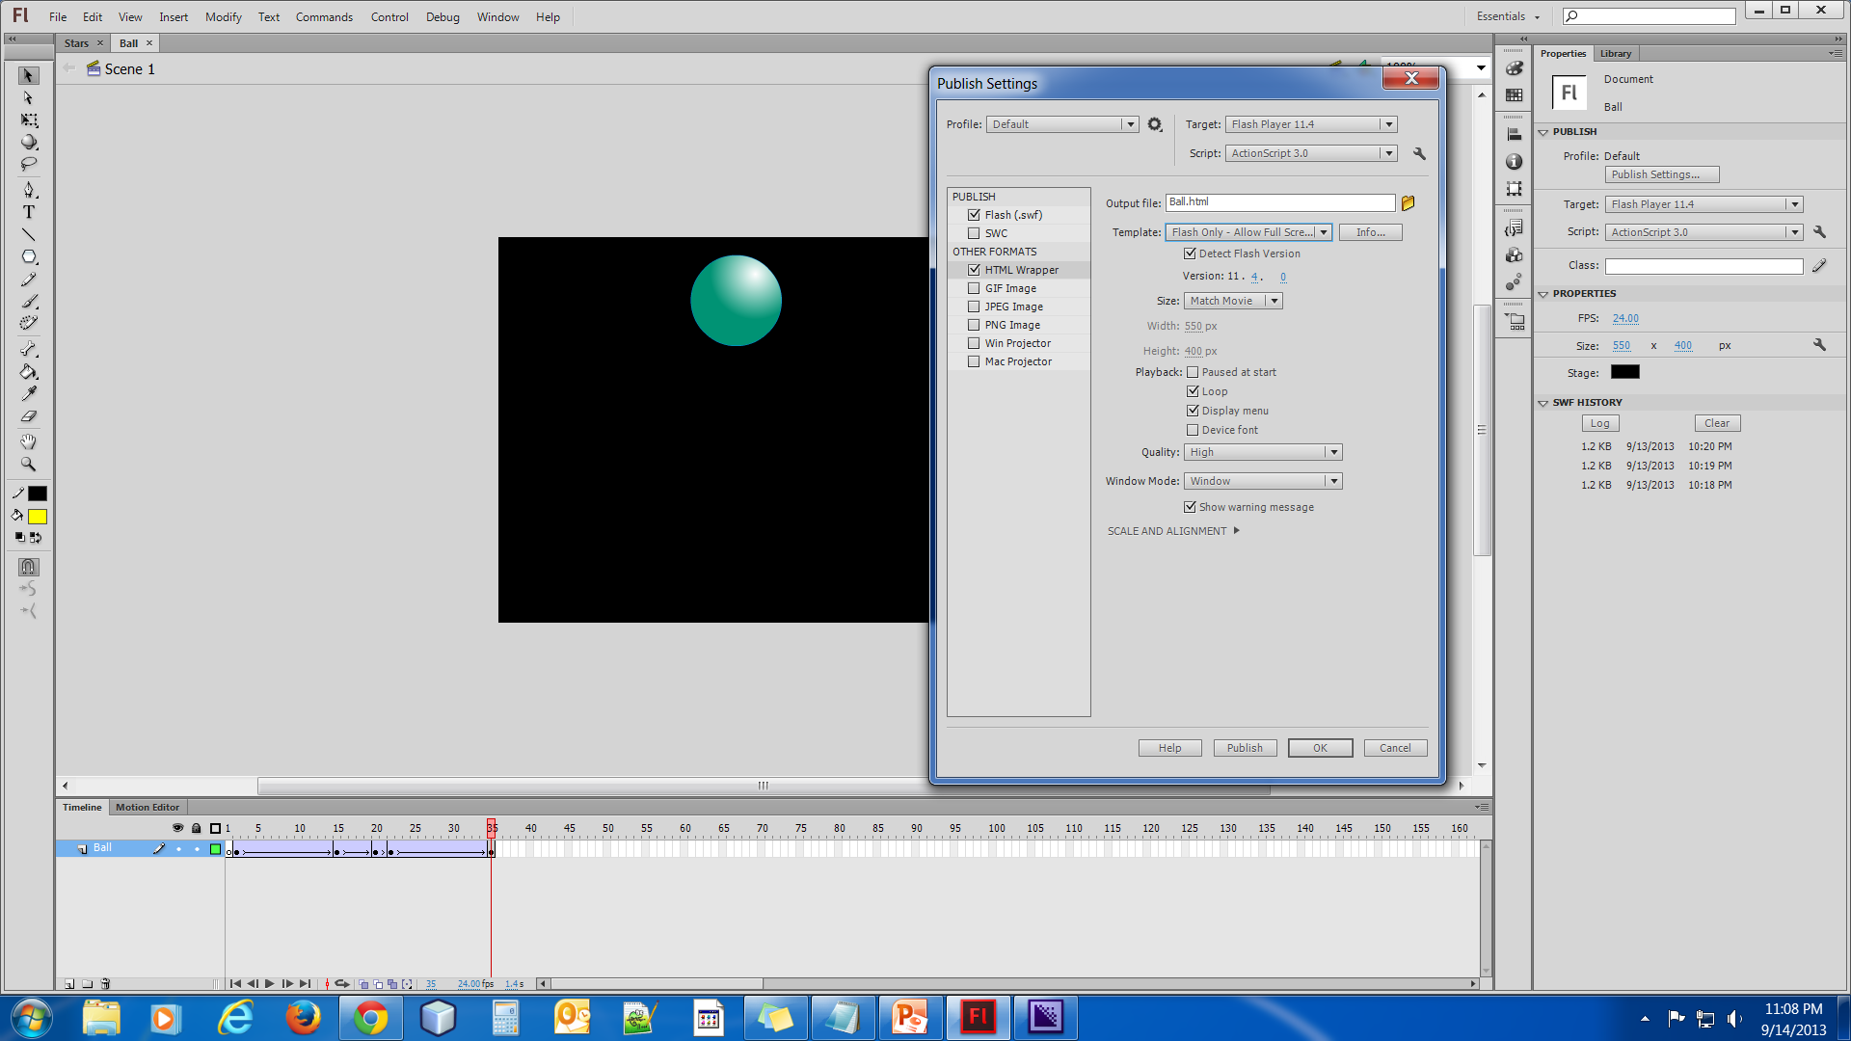
Publish Settings

Slide 9
ActionScript—Pragramming language for Flash
.as file is a text document that contains ActionScript
can be written directly in .fla file, or as an external document that has .fla call out to it
For ActionScript to be able to interact with something on the Stage, the item needs to have a unique instance name—given in the properties inspector
CODE Snippets can write ActionScript—they are actually little pre-built snippets of working code
After giving a unique instance, go to Window to choose Code Snippets—clicking on the specified object loads the URL in a new browser window
You can preview code before applying by clicking the show code button
Must be targeted with Player 9 or higher
Animation does NOT require ActionScript

Slide 10
ActionScript example code
If you want to use AS, search for tutorials on how to use CodeSnippets or ActionScript Coding
http://www.youtube.com/user/flashvideotutorials

Slide 11
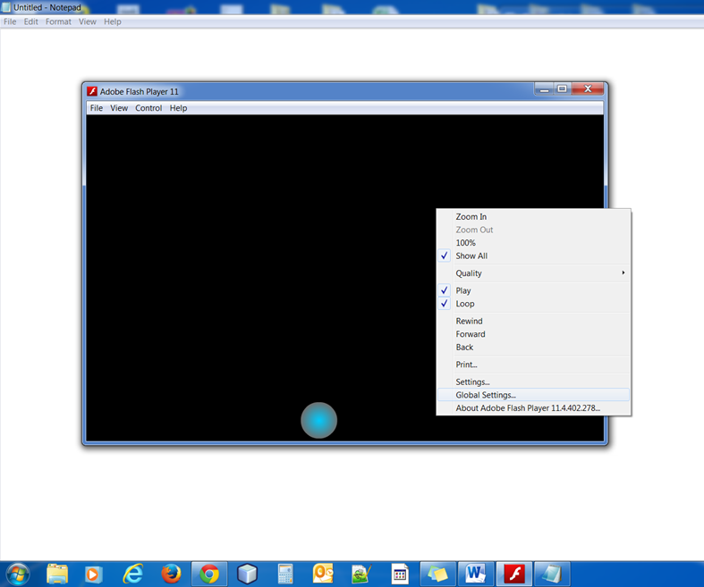
Local File Permissions and Flash Security Issues
Flash does not like when local files try to communicate with the internet—prevents personal data from being transferred from the PC without consent
Flash has stopped a potentially unsafe operation
Right click on SWF file and choose Global Settings to open the Flash Player Settings Manager

Slide 12
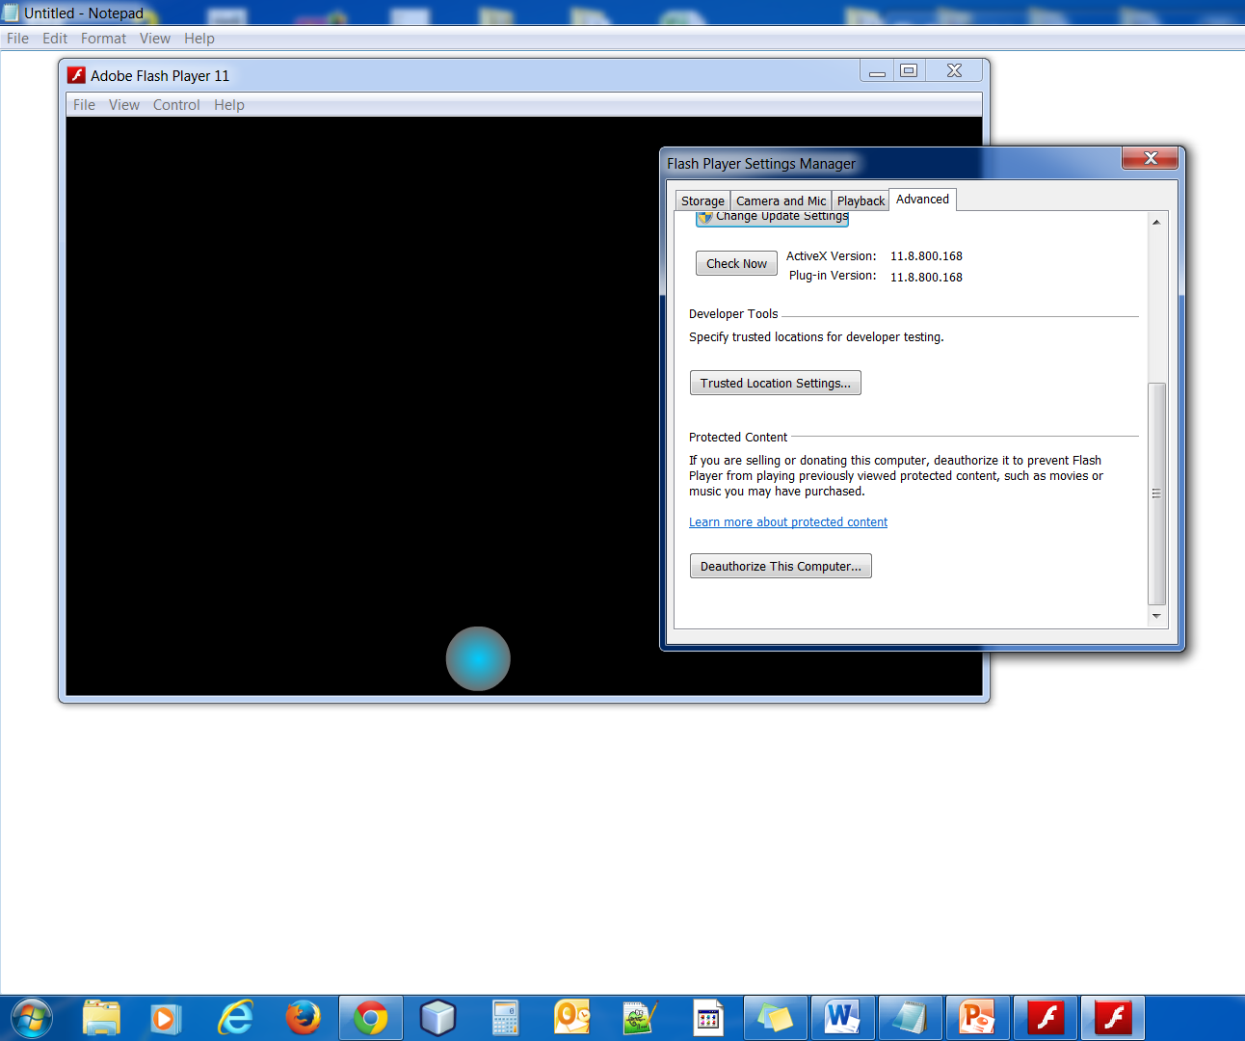
Flash Player Manager
Select the Avanced Tab
Choose Trusted Location Settings
Select Add
Add Folder
Browse for your folder
Confirm

Slide 13
Importing Graphics
Library
Bitmaps do not scale up and down easy—best to have them sized before importing W550 H400
Vector uses mathematical equations to describe curves—resizable because it just recalculates

Slide 14
Tools for manipulating beyond basic shapes
Deco and Spray Brush
Paint Bucket and Ink Bottle
Eraser Tool
Eyedropper for sampling color
Color and Swatches
Gradients and Grandient Transform Tools
Lock Fill modifier
Pen Tool for creating shapes
Lasso Tool

Slide 15
Symbols
Have their own Timeline
Using a blueprint of the same instance in the library will save HUGE file size
Movie Clip Symbols—can be manipulated by AS
Graphic Symbols—cannot be directly manipulated by AS
Button Symbols—inserting buttons for mouse hits or making text HOT with invisible buttons
Apply 3D—can apply only to movie clips and TLF text
Color Transformation—can apply to all symbols

Slide 16
Motion Tweens
Create animations for movie clip & graphic symbols, TLF text
Defining playhead determines the number of key frames—will determine how fast object moves
Basic workflow—tell Flash where the tween starts, apply motion tween, tell Flash where to end
Shape Tweens
Can’t use symbol or grouped objects—must use shapes
Adjusting shapes in key frames can morph objects such as squishing ball or moving sun rays to animate
Shape Hint tells Flash how to match up the edge of the object at the start of the tween to the edge of an object at the end of a tween—this gives a morphing effect

Slide 17
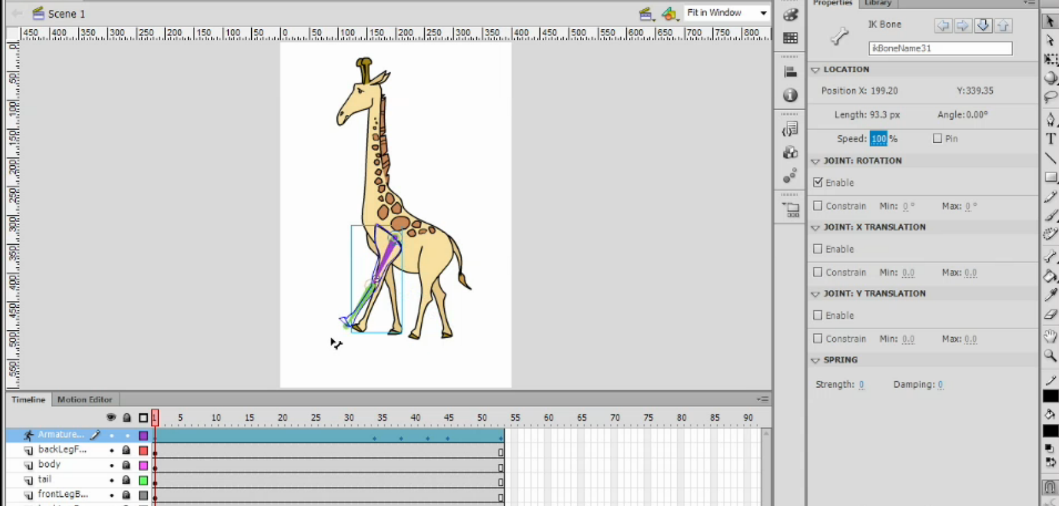
IK (Inverse Kinematics) motion
Good for animating with joints—a person walking
Bone tool is used for IK animation
Property Inspector is used to control the armature movements
Speed refers to stickiness or stiffness of a joint, low speed value will be sluggish, high—more responsive

Slide 18
TLF (Text Layout Framework)
Requires Player 10 or higher
Uses larger file size
TLF text depends on a specific external ActionScript library to function properly—SWZ file
Control text at the character level with advanced Typography and Formatting

Slide 19
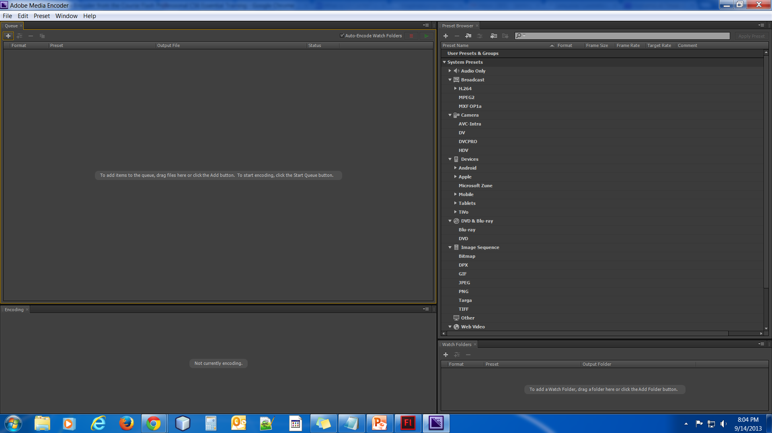
Video Format
.flv
.f4v(supports H.264 High Definition)
Adobe Media Encoder for working with video's not in .flv or .f4v (comes with purchase of Flash Professional) also converts MOV, AVI, WMV to Flash video

Slide 20
Audio
Import MP3, WAV, AU, and other files
Flash comes with a library of free sounds
Audio editing to control volume
Audio Compression Settings—to decrease file size

Slide 21
Homework
Go to the following link on the Adobe site for
https://creative.adobe.com/products/flash?promoid=KHTVG
Create anything you like in Flash—there are many tutorials out there. I used the ball and tree from YouTube.
Ball
http://www.youtube.com/watch?v=QLfdo4rz2Qs
Tree
http://www.youtube.com/watch?v=QEQBMzudkfY
http://www.adobe.com/cfusion/search/index.cfm?term=flash+tutorials&loc=en_us&siteSection=home

