Slide 1
Cascading style sheets (CSS)
Carlos A. TIJERINA IBARRA

Slide 2
History of css
Cascading Style Sheets were developed as a means for creating a consistent approach to providing style information for web documents.
In 1994, nine style sheet languages were proposed to the World Wide Web Consortium (W3C) to improve web presentation capabilities.
Of the nine proposals, two were chosen as the foundation for what became CSS: Cascading HTML Style Sheets (CHSS) proposed by Håkon Wium Lie, and Stream-based Style Sheet Proposal (SSP) proposed by Bert Bos.
CSS1 was published in 1996, CSS2 in 1997, and CSS3 in 1998. There is no single CSS4 specification, but there are ‘level 4’ modules.
Notes:
World Wide Web Consortium (W3C) is the main international standards organization for the World Wide Web.

Slide 3
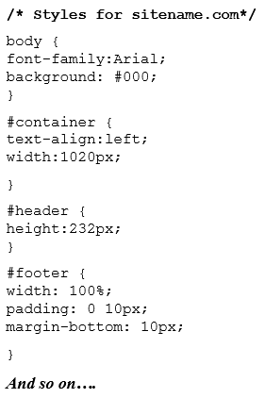
What is css?
Definition
Cascading Style Sheets (CSS) – is a rule based language that applies styling to your HTML elements. You write CSS rules in elements, and modify properties of those elements such as color, background color, width, border thickness, font size, etc.
Basically, it defines how to display HTML elements.

Slide 4
Benefits of using css
Separates structure from presentation
Provides advanced control of presentation
Easy maintenance of multiple pages
Faster page loading
Better accessibility for disabled users
Easy to learn

Slide 5
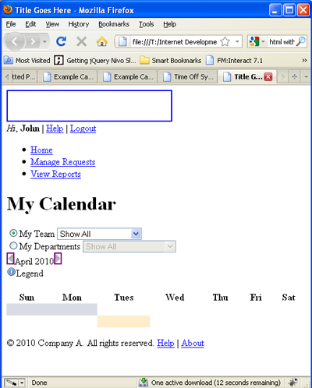
Html without css
Without CSS, HTML elements typically flow from top to bottom of the page and position themselves to the left by default.
With CSS help, we can create containers or DIVs to better organize content and make a Web page visually appealing.
HTML = Structure, CSS = style

Slide 6
CSS & The box model
CSS works on the box model. A typical Web page consists of many boxes joined together from top to bottom. These boxes can be stacked, nested, and can float.
In the picture, there are 4 boxes (from top to bottom): Header, Navigation, Content, Footer.

Slide 7
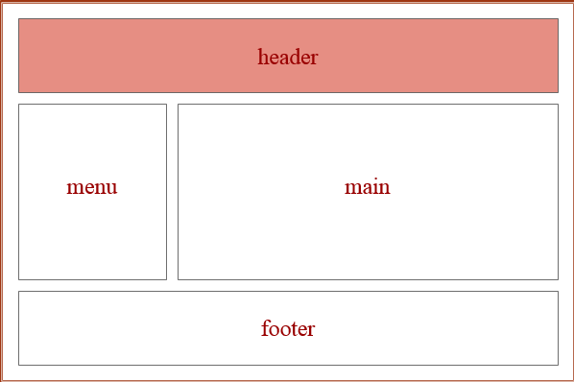
Typical web page LAYOUT (BOX MODEL)

Slide 8
Css syntax
The CSS syntax is made up of 5 parts:
Selector
Property/value
Declaration
Declaration block
Curly braces

Slide 9
selector
Definition:
Identifies the HTML elements that the rule will be applied to, identified by the actual element name, e.g. <body>, or by other means such as class attribute values.
In other words, the selector is the HTML element you want to style.
Example:

Slide 10
Property & value
Definition:
The property is the style attribute you want to change. Each property has a value.
Properties are separated from their respective values by colons ( : )
Pairs of properties are separated from each other by semicolons ( ; )

Slide 11
Declaration & Declaration block
Declaration Definition:
Each CSS line that includes property and value.
Each declaration consists of a property and a value.
Declaration block:
Multiple declaration lines including the curly braces.

Slide 12
Curly braces
Definition:
The curly braces contain the properties of the element you want to manipulate, and the values that you want to change them to. The curly braces plus their content is called a declaration block.

Slide 13
Class & id selectors
In addition to setting a style for a HTML element, CSS allows you to specify your own selectors called "id" and "class".
id - The id selector is used to specify a style for a single, unique element.
The id selector uses the id attribute of the HTML element, and is defined with a "#".
The style rule below will be applied to the element with id = “example":
#example {text-align:center; color:red;}

Slide 14
Class & id selectors
Class - The class selector is used to specify a style for a group of elements. Unlike the id selector, the class selector is most often used on several elements.
This allows you to set a particular style for any HTML elements with the same class.
The class selector uses the HTML class attribute, and is defined with a "."
In the example below, all HTML elements with class="center" will be center-aligned:
.center {text-align:center;}

Slide 15
Attaching a css style sheet to a webpage
You can attach a style sheet to a page by adding the code to the <head> section of the HTML page. There are 3 ways to attach CSS to a page:
Inline style sheet*
Internal style sheet
External style sheet

Slide 16
Inline style sheet*
Applies styles directly to the elements by adding declarations into the style.
CSS is not attached in the <header> but is used directly within HTML tags.
For Example:
<p style=“color: red;”> This is a simple paragraph and the inline style makes it red.</p>

Slide 17
Internal style sheet
Applies styles to HTML by placing the CSS rules inside the tag <style> inside the document tag <head>.
Best used to control styling on one page.
For Example:
<head>
<title>my page</title>
<style type=“text/css”>p{color:red}</style>
</head>
<body>
<p>this is a simple paragraph</p>
</body>

Slide 18
External style sheet
Applies styles as a separate file with a .css extension. The file is then referenced from inside the <head> element by a link to the file.
You can create an external style sheet in your text editor.
Best used to control styling on multiple pages.
For Example:
<head>
<title>my external style sheet page</title>
<link rel=“style sheet” type=“text/css” href=“my-external- stylesheet.css”>
</head>
<body>
<p>this is a simple paragraph</p>
</body>

Slide 19
Which style sheet is the best option?
Web developers rarely use inline CSS. Since they prefer to not mix content with presentation. And it is not efficient since you have to declare the style individually for every component.
Internal and External style sheets are more popular because you can style multiple elements with one rule.
External style sheets are the best ones because they allow you to save all the style information on a separate file from the content. You can then modify a style for a site and it will update all of the pages in a site.

Slide 20
Colors & formatting in css
KEYWORDS
Using the keywords like: red, fuchsia, yellow, blue, green you can specify what color you would like the CSS rule to display.
There are 17 of these keyword colors you can use in CSS.
HEXADECIMAL VALUES
Hex values are the most common way of specifying colors for web pages.
For example: p{color: #000000;}
They can represent a total of 96 colors (16 values times 6 slots).

Slide 21
Colors & formatting in css
RGB (RED GREEN BLUE)
It has the possibility of 256 colors for each (16x16)
(R)256 x (G)256 x (B)256 = 16,777,216 or 16.7 million color values
You can specify RGB in either whole numbers or percentages
CSS example: h1{color: rgb(0,0,0) }
HSL - Hue Saturation Lightness
Similar to RGB but based on saturation and lightness of a color
CSS example: h1{color: hsl(0,100%,40%) }
HSL accepts a number between 0 to 360 in value, it also accepts percentage between 0-100%

Slide 22
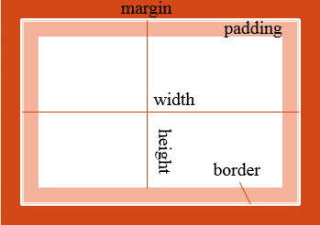
Common css layout properties
Width & Height: They can be specified in pixels, ems, percentages or set to auto.
Float: It makes elements float to the right or left of the screen, positioned where they are in the HTML.
Clear: When elements are floated, they wrap around each other to form a “caravan.” The clear property detaches an element from the “caravan” and allows it to start on a new line.
Border: You can define the entire border or only the top, bottom, left, or right. You can also define the border using one declaration.
Padding: The space between the text/content and the border. You can use padding for all around the element or specify each side of the rectangle separately.
Margin: The space outside the text/content and the border. You can use margin for all around the element or specify each side of the rectangle separately.

Slide 23
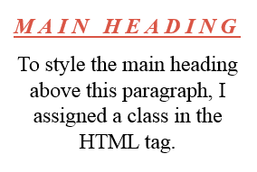
Text properties
.mainHeading { color: red; letter-spacing: 5px; text-transform: uppercase; word-spacing: 15px; text-align: left; font-family: Times; text-decoration: underline; font-size: 12px; font-style: italic; font-weight: bold; }
<h3 class=“mainHeading”>Main Heading</h3>

Slide 24
Other visual properties of css
Styling Links: The links property defines how inactive, hovered, active, and visited link states appear to the user.
Layering: Background colors and images are layered like sheets of paper one on top of the other.
Background – Image: The background-image property sets an image in the background of an element.
Background – Repeat: The background-repeat property sets an image in the background of an element and tiles, or repeats, it. Tiling is the default.
Image Positioning: The background-position property positions the image using either combined keywords (top, bottom, left, right, and center); length values; or percentage values.

Slide 25
Inheritance in css
Inheritance is the process by which CSS properties applied to one tag are passed on to nested tags.
For example, the paragraph tag will inherit the same styling as the body tag because <p> is always located inside <body>.
<body style=“font-family: Arial”>
<p>This text will be Arial as well</p>
</body>
So, instead of styling each paragraph separately, you can define the font color in the <body>, and everything inside will have that color.

Slide 26
resources
http://w3schools.com/css/
http://www.csszengarden.com/
http://w3schools.com/cssref/default.asp
http://en.wikipedia.org/wiki/Cascading_Style_Sheets

Slide 27
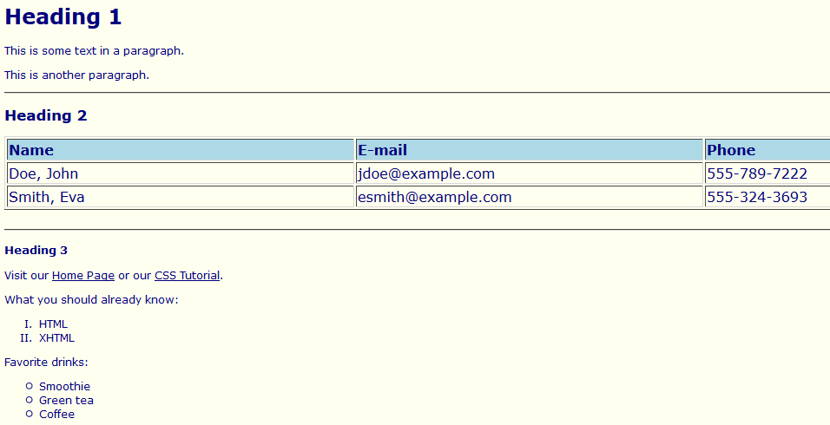
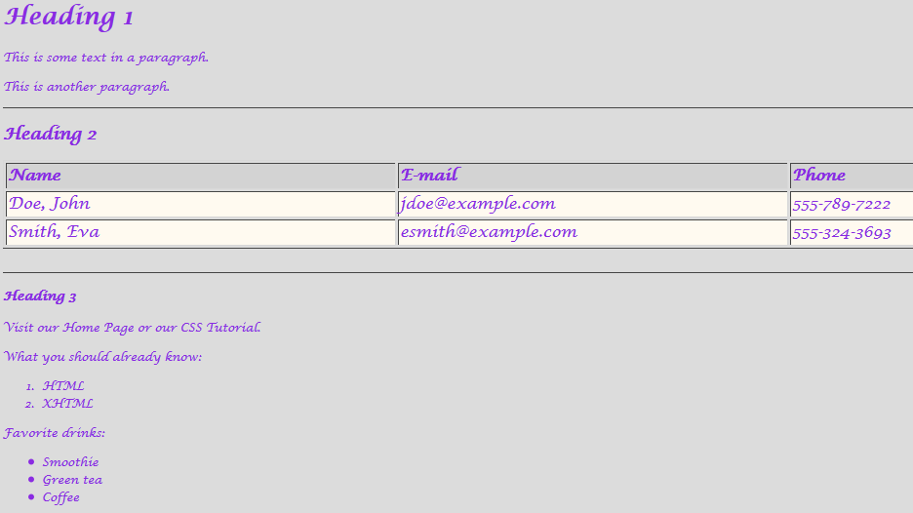
assignment
Create at least two HTML-based web pages with the same content and structure, but with different styles defined with CSS.
Reference: http://w3schools.com/css/demo_default.htm
Submit your assignment in class or to catijerniaibarra@utpa.edu

