Slide 1

Haritha Dasari
Josue Balandrano Coronel - balandranocoronej@utpa.edu

Slide 2
What is ASP.NET?
ASP.NET is a development framework for building web pages and websites with HTML, CSS, Java Script and server scripting.
We can develop ASP.NET web based applications in any .NET complaint languages such as Visual Basic, Visual C# and Jscript.NET .
It was first released in January 2002 with version 1.0 of the .NET Framework and is the successor to Microsoft's Active Server Pages(ASP) technology.

Slide 3
Advantages
ASP.NET is part of the .NET Framework.
    We can use the classes in the .NET Framework to develop any type of applications.
ASP.NET pages are compiled.
    ASP.NET Web pages and code files are compiled dynamically when users first request a resource, such as an ASP.NET page (.aspx file), from a Web site. After pages and code files have been compiled the first time, the compiled resources are cached, so that subsequent requests to the same page are extremely efficient.

Slide 4
Continued…
The source code is compiled and executed on the server. This provides a lot of power and flexibility to the web pages, as well as early error detection.
Being language-independent, it allows you to choose the language that best applies to your application or partition your application across many languages.

Slide 5
Tools for building ASP.NET Websites
Microsoft created a Visual Studio tool, which is an IDE (Integrated Development Environment).
With the help of this tool you can create different web applications and test them locally, since it comes with a small web server and also different database servers (e.g. MSSQL, SQL Express, …).
There is also Web Matrix, it is mainly used to create ASP.NET Web Pages, it is a simpler IDE and can be used to create simple html files.

Slide 6





Websites using the framework
Many of the daily websites we use/follow are built using the ASP.NET Technology…

Slide 7
ASP.NET Development Models
ASP.NET supports three different development models:
    Web Pages
    Web Forms
    MVC (Model View Controller)

Slide 8
Web Pages
  Web Pages is the simplest programming model for developing ASP.NET applications.
  Pros:
  Easy to learn, understand, and use
  Built around single web pages
  Similar to PHP and Classic ASP
  Server scripting with Visual Basic or C#
  Full HTML, CSS, and JavaScript control
  Web Pages is easy extendable with programmable Web Helpers, including database, video, graphics, social networking and much more.
Cons:
  Server code can be inserted inline with HTML code, creating “spaghetti code”.
  Code can get really hard to maintain.
  Not recommended for complex sites.

Slide 9
Web Forms
  Is the oldest ASP.NET programming model, with event driven web pages written as a combination of HTML, server controls, and server code.
  Are compiled and executed on the server, which generates the HTML that displays the web pages.
  comes with hundreds of different web controls and web components to build user-driven web sites with data access.

Slide 10
Web Forms
Pros:
  Simple development, like ASP.NET Web Pages.
  Provides look and feel through UI elements, i.e. controls.
  Development resembles that of creating a Windows Forms application.
  Graphical interface to create the UI.
  Since it renders the controls on the server side the Cross-Browser compatibility is less of an issue.
Cons:
  ViewState can get really bloated.
  Unable to use multiple <form> tags on the same page.
  The entire page gets sent to the server.
  Can get hard to maintain.
  Performance issues on complex pages.

Slide 11
Controls
HTML server controls :
  <input type="text" size="40">
  It could be converted to a server control, by adding the runat and id attribute:
  <input type="text" id="testtext" size="40" runat="server">
Web server controls :
  Buttons,TextBoxes,Radio Buttons….
  <asp:Button id="button1" Text="Click me!" runat="server" OnClick="submit" />
  Or they can be created by using HTML Helpers. e.g.:
  @HTML.Editor(“test_input”)
Validation controls :A Validation server control is used to validate the data of an input control.

Slide 12
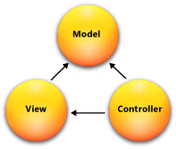
Model View Controller (MVC)
The MVC model defines web applications with 3 logic layers:
  The backend layer (Model logic)
      Model objects are the parts of the application that implement the logic for the application's data domain, i.e. an abstraction layer for the database.
  The display layer (View logic)
      Views are the components that display the application's user interface (UI), i.e. what the user “sees”.
  The business layer (Controller logic)
      Controller will react to user input and decide if it needs to do a CRUD action to the database or some other logic, as well as which view to return.

Slide 13
Model View Controller (MVC)
Pros:
  Separation of the different parts of an application, i.e. modularization of the code.
  Suitable for more complex sites.
  Designers and Developers can work in parallel.
  Easier to maintain.
  URLs are mapped to controller’s functions, this means faster processing.
  More secure, since we create a layer for different parts of the application.
Cons:
  Might involve a learning curve.
  Code can get very complicated.

Slide 14
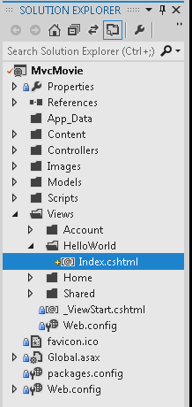
Views
+ Layouts or Master Pages.
- Define the skeleton of the design.
- Could also be used to create a universal look & feel.
- Shared folder.
Shared/_Layout: http://hastebin.com/xamiwofapi.xml
+ Regular views.
- Views are called by controller’s functions.
- Strong typed views.
- ViewBag object.
Views/Home/Index: http://hastebin.com/lafiridila.xml
Views/Store/Index (strongly typed view): http://hastebin.com/korahirufa.xml

Slide 15
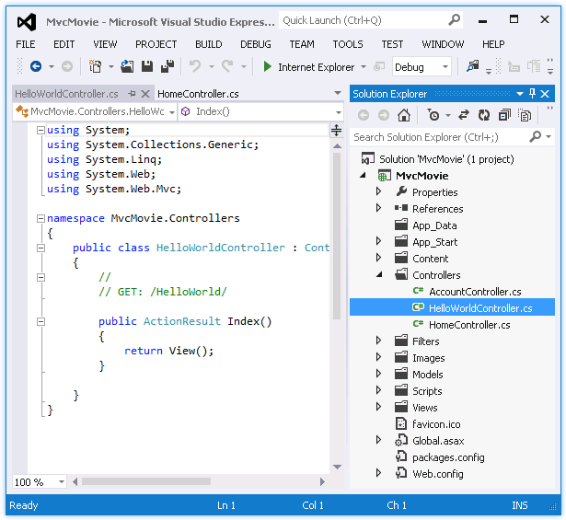
Controllers
- URLs are mapped to controller’s functions.
- Controllers are classes.
- Sanitize user input, process user input, call views, call CRUD functions to models, etc…
Controllers/HomeController: http://hastebin.com/luqisekoro.avrasm
Controllers/CartController: http://hastebin.com/mulomemahu.cs
Controllers/StoreController: http://hastebin.com/voxosemere.avrasm

Slide 16
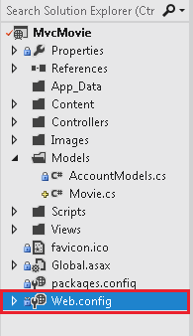
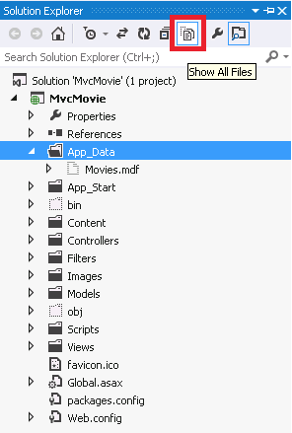
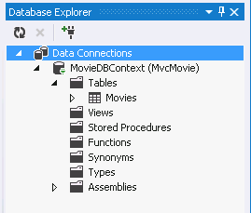
Models
- Objects to map out your databases.
- Abstraction layer for databases.
- Should handle any action done to a single row or a table as well as any errors and/or logging.
Models/Products.cs: http://hastebin.com/somiboniwe.vala
Web.config: http://hastebin.com/gufovanapa.xml

Slide 17
Assignment
For your assignment you shall…
Create a simple form that will send an email with the information inputted by the user. You may user any ASP.NET Model (e.g. Web Pages, MVC or Web Forms).
Here’s an example on how to use System.Net.Mail to get you started. http://forums.asp.net/t/971802.aspx
Here’s an example on how to setup ASP.NET with your gmail acc: http://www.mycsharpcorner.com/Post.aspx?postID=33

Slide 18
Helpful Resources
Class Material:
Simple project using ASP.NET 4.0 and VS 2010: http://goo.gl/QAJiMr
Simple project using ASP.NET 4.5 and VS 2012: http://goo.gl/UAwmTs
Lots of cool tutorials: http://www.asp.net/mvc/tutorials
Download Visual Web Developer 2012 (Win Vista and up): http://www.microsoft.com/web/handlers/webpi.ashx?command=getinstallerredirect&appid=VWDOrVs11AzurePack
Download Visual Web Developer 2010 (Wind XP): http://www.microsoft.com/web/gallery/install.aspx?appid=VWDorVS2010SP1Pack

