Slide 1
AJAX

Slide 2
What is Ajax?
Asynchronous
JavaScript
And
Xml
Notes:
Most attention to asynch- when you create something syn, you wait for it to finish before moving on to another task, with asynchronous you can move on to the other task before it finishes.
Javascript- scripting language used to make static html pages more dynamic and eventful. Examples yahoo and msn
Xml – data extensible markup language, defines a set of rules for encoding documents in a format that is both human and machine readable

Slide 3
Intro to AJAX
AJAX is not a new programming language, its
an architectural pattern that uses existing web standards in new ways.
AJAX is the art of exchanging data with a server, and updating parts of a web page - without reloading the whole page

Slide 4
Who Invented it?
No one, but a guy names Jesse James Garret gave it its name.
He used the combined web design approach in his applications and called it Ajax.
Google is believed to have used it first for Gmail and Google map interface on day to day basis.

Slide 5
What is AJAX?
AJAX is a technique for creating fast and dynamic web pages.
AJAX allows web pages to be updated asynchronously by exchanging small amounts of data with the server behind the scenes. This means that it is possible to update parts of a web page, without reloading the whole page.
Classic web pages, (which do not use AJAX) must reload the entire page if the content should change.
Examples of applications using AJAX: Google Maps, Gmail, Youtube, and Facebook tabs.

Slide 6
What’s Ajax in a nutshell
Ajax isn’t a technology
Ajax is an approach to Web application development that uses client-side scripting to exchange data with the Web server
Ajax is also more of a pattern -- a way to identify and describe a useful design technique
Ajax is new in the sense that many developers are just beginning to be aware of it, but all of the components that implement an Ajax application have existed for several years
Ajax can incorporate many development languages

Slide 7
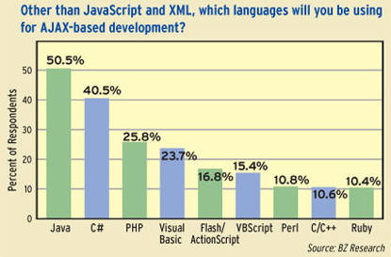
Development languages used

Slide 8
What’s Ajax in a nutshell cont.
Asynchronous requests allows the
updating of a web page without doing a page
reload this creates much nicer user experience
Examples geek example , cool example

Slide 9
What spawned AJAX
Starts with web pages
Static web pages
Static html page is loaded
No interaction with user
Dynamic web pages
Html page is generated dynamically
Interaction with user
Becomes slower as functionality increases
Speed becomes intolerable, so AJAX has been born

Slide 10
Alternative Technologies
Technologies with similar tasks: URLConnection, ASP and JSP
Other technologies returns whole page and client loads it.
In Ajax only necessary data is returned and that part is updated

Slide 11
A Purpose for AJAX
Prevents unnecessary reloading of a page.
When we submit a form, although most of the page remains the same, whole page is reloaded from the server.
This causes very long waiting times and waste of bandwidth.
AJAX aims at loading only the necessary innformation, and making only the necessary changes on the current page without reloading the whole page.

Slide 12
A Few Ajax Examples
Google Suggest
Microsoft Live
Examples
From the Web
Gmail

Slide 13
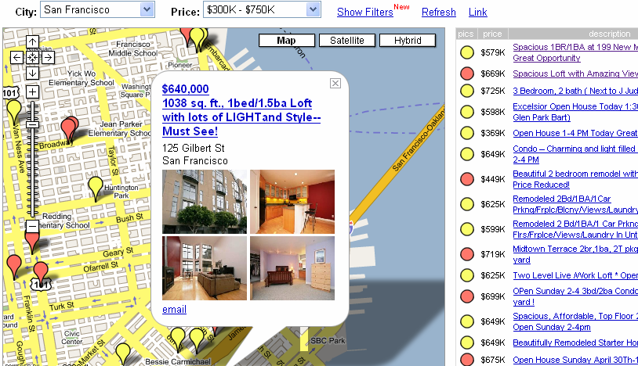
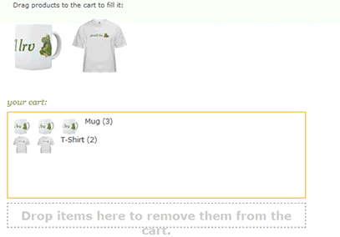
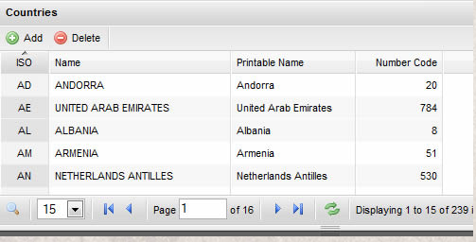
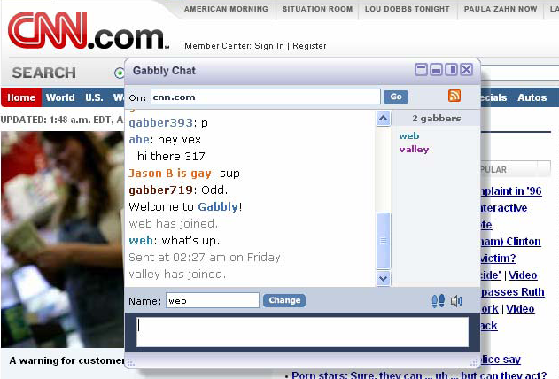
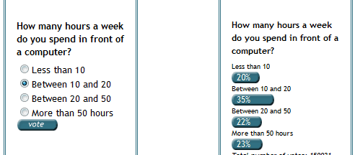
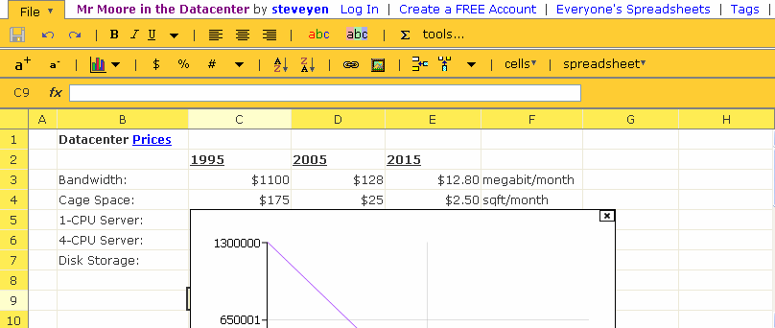
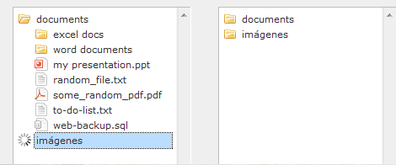
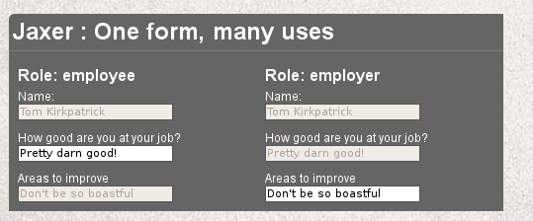
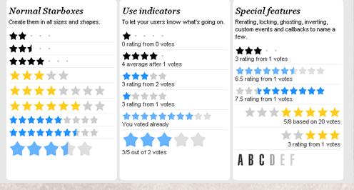
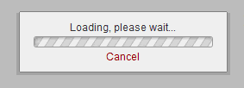
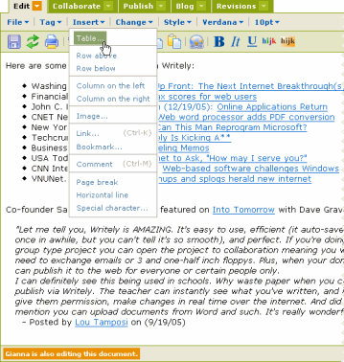
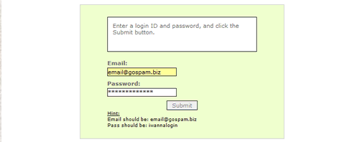
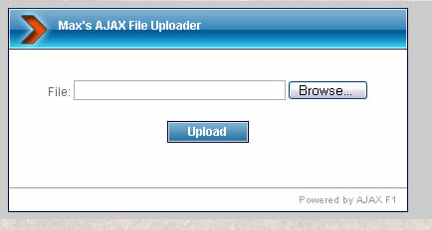
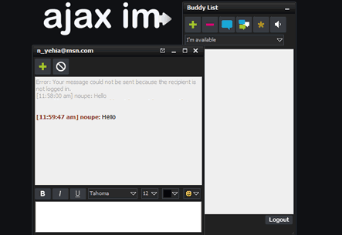
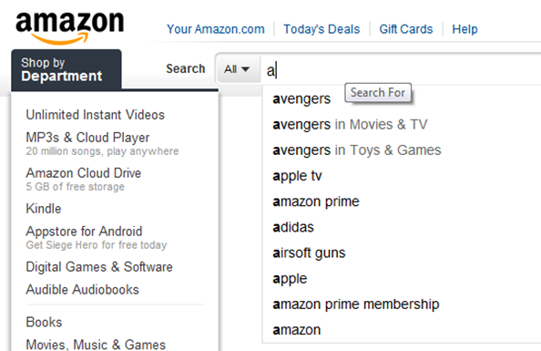
Looks boring, is it worth exploring?
Notes:
DropDown: Javascript array or Server trip

Slide 14
AJAX is Based on Internet Standards
AJAX is based on internet standards, and uses a combination of:
XMLHttpRequest object (to exchange data asynchronously with a server)
JavaScript/DOM (to display/interact with the information)
CSS (to style the data)
XML (often used as the format for transferring data)
AJAX applications are browser- and platform-independent!

Slide 15
Central Point
A client script asynchronously calls a server side function. That’s it.

Slide 16
So how does it work?
AJAX is based on Javascript, and the main functionality is to access the web server inside the Javascript code.
We access to the server using special objects; we send data and retrieve data.
When user initiates an event, a javascript function is called which accesses server using the objects.
The received information is shown to the user by means of the Javascript’s functions.

Slide 17
Data Exchange in AJAX
In AJAX:

Slide 18
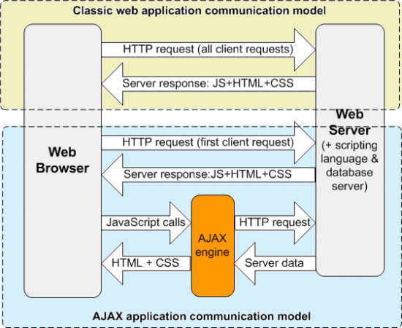
New VS Old
Notes:
Ajax Engine emphasis

Slide 19
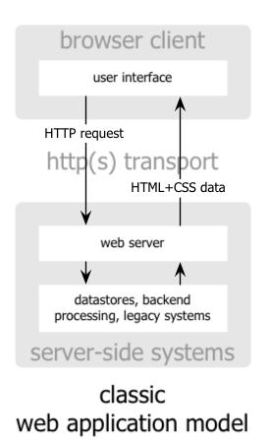
Classic Model
The classic web application model works like this:
Most user actions in the interface trigger an HTTP request back to a web server.
The server does some processing — retrieves data, crunches numbers, talks to various legacy systems
And then returns an HTML page to the client
Notes:
Stat with: Who doesn’t own a cellphone? Say that it is different than anything we knew until today.

Slide 20
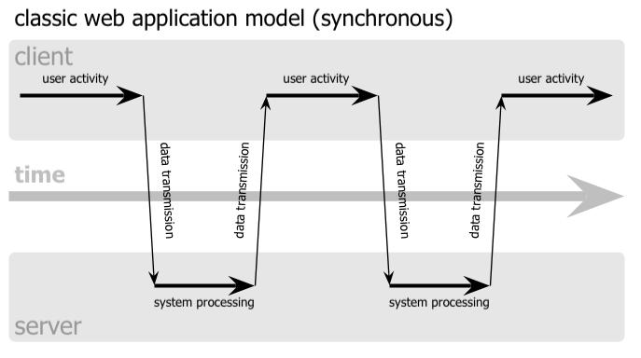
Classic Model
This approach makes a lot of technical sense, but it doesn’t make for a great user experience.
At every step in a task, the user waits.
The user sees the application go to the server
Notes:
Stat with: Who doesn’t own a cellphone? Say that it is different than anything we knew until today.

Slide 21
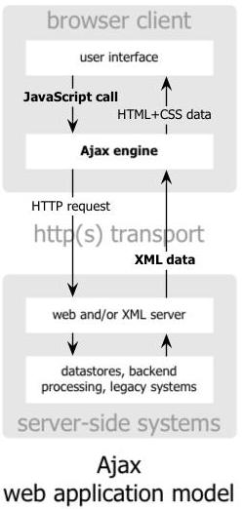
Ajax Model
An Ajax application eliminates the start-stop-start-stop nature of interaction on the Web
It introduces an intermediary, an Ajax engine, between the user and the server.
Instead of loading a webpage, at the start of the session, the browser loads an Ajax engine, written in JavaScript and usually tucked away in a hidden frame.
The Ajax engine allows the user’s interaction with the application to happen asynchronously, independent of communication with the server
Notes:
Stat with: Who doesn’t own a cellphone? Say that it is different than anything we knew until today.

Slide 22
Ajax Model
Any response to a user action that doesn’t require a trip back to the server — such as simple data validation, editing data in memory, and even some navigation — the engine handles on its own.
If the engine needs something from the server in order to respond — if it’s submitting data for processing, loading additional interface code, or retrieving new data — the engine makes those requests asynchronously, usually using XML, without stalling a user’s interaction with the application.
The user is never staring at a blank browser window and an hourglass icon, waiting around for the server to do something.
Notes:
Stat with: Who doesn’t own a cellphone? Say that it is different than anything we knew until today.

Slide 23
What does this mean?
In traditional JavaScript coding, if you want to get any information from a database or a file on the server, or send user information to a server, you will have to make an HTML form and GET or POST data to the server. The user will have to click the “Submit” button to send/get the information, wait for the server to respond, and then a new page will load with the results.
Because the server returns a new page each time the user submits input, traditional web applications can run slowly and tend to be less user-friendly. With AJAX, your JavaScript communicates directly with the server, through the JavaScript XMLHttpRequest object.
With an HTTP request, a web page can make a request to, and get a response from a web server, without reloading the page. The user will stay on the same page, and he or she will not notice that scripts request pages, or send data to a server in the background.

Slide 24
The XMLHttpRequest Object
The keystone of AJAX is the XMLHttpRequest object.
All modern browsers support the XMLHttpRequest object (IE5 and IE6 use an ActiveXObject).
The XMLHttpRequest object is used to exchange data with a server behind the scenes. This means that it is possible to update parts of a web page, without reloading the whole page.

Slide 25
Create an XMLHttpRequest Object
All modern browsers (IE7+, Firefox, Chrome, Safari, and Opera) have a built-in XMLHttpRequest object.
Syntax for creating an XMLHttpRequest object:
variable=new XMLHttpRequest();
Old versions of Internet Explorer (IE5 and IE6) uses an ActiveX Object:
variable=new ActiveXObject("Microsoft.XMLHTTP");

Slide 26
Create an XMLHttpRequest Object
To handle all modern browsers, including IE5 and IE6, check if the browser supports the XMLHttpRequest object. If it does, create an XMLHttpRequest object, if not, create an ActiveXObject:
var xmlhttp; if (window.XMLHttpRequest) {// code for IE7+, Firefox, Chrome, Opera, Safari xmlhttp=new XMLHttpRequest(); } else {// code for IE6, IE5 xmlhttp=new ActiveXObject("Microsoft.XMLHTTP"); }

Slide 27
Send a Request To a Server
To send a request to a server, we use the open() and send() methods of the XMLHttpRequest object:
xmlhttp.open("GET","ajax_info.txt",true);
xmlhttp.send();

Slide 28
Send a Request To a Server
Open(method,url,async): Specifies the type of request, the URL, and if the request should be handled asynchronously or not. method: the type of request: GET or POST url: the location of the file on the server async:true (asynchronous) or false (synchronous)
Send(string): Sends the request off to the server.
string: only used for POST requests.

Slide 29
Structure of System
Client/Server architecture
XMLHTTP object is used to make request and get response in Client side
Request can be done via “GET” or “POST” methods
“GET”: parameters are attached to the url used to connect.
“POST”: parameters are sent as parameters to a function

Slide 30
Method: GET or POST request
GET is simpler and faster than POST, and can be used in most cases.
Always use POST requests when:
A cached file is not an option (update a file or database on the server)
Sending a large amount of data to the server (POST has no size limitations)
Sending user input (which can contain unknown characters), POST is more robust and secure than GET

Slide 31
The url - A File On a Server
The url parameter of the open() method, is an address to a file on a server.
The file ca be any kind of file, like .txt and .xml, or server scripting files like .asp and .php (which can perform actions on the server before sending the response back).

Slide 32
Asynchronous - True or False
AJAX stands for Asynchronous JavaScript and XML, and for the XMLHttpRequest object to behave as AJAX, the async parameter of the open() method has to be set to true.
Sending asynchronous requests is a huge improvement for web developers. Many of the tasks performed on the server are very time consuming. Before AJAX, this operation could cause the application to hang or stop.
With AJAX, the JavaScript does not have to wait for the server response, but can instead:
execute other scripts while waiting for server response
deal with the response when the response ready

Slide 33
Server Response
To get the response from a server, use the responseText or responseXML property of the XMLHttpRequest object.
responseTxt: gets the response as a string
responseXML: get the response as XML data

Slide 34
The onreadystatechange event
When a request to a server is sent, we want to perform some actions based on the response.
The onreadystatechange event is triggered every time the readyState changes.
The readyState property holds the status of the XMLHttpRequest.

Slide 35
The onreadystatechange event (Cont.)
Three important properties of the XMLHttpRequest object:
In the onreadystatechange event, we specify what will happen when the server response is ready to be processed.
When readyState is 4 and status is 200, the response is ready.
onreadystagechange | Stores a function (or the name of a function) to be called automatically each time the readyState property changes
readyState | Holds the status of the XMLHttpRequest. Canges form 0 to 4: 0: request not initialized 1: server connection established 2: request received 3: processing request 4: request finished and response is ready
status | 200: “OK” 404: Page not found

Slide 36
Example 1
We want to input data into a textbox.
We want the textbox to have intellisense property; guess entries according to input.
http://www.w3schools.com/ajax/ajax_example.asp
Only the ‘span’ part of the html code is changed.

Slide 37
Example(2)
Another example:
http://www.w3schools.com/ajax/ajax_database.asp
Therefore, by using AJAX, unnecessary exchange of data is prevented, web pages become:
More interactive
Faster
More user friendly

Slide 38
Server side vs client side
There are two types of scripting languages : client side scripting and server side scripting languages. Javascript, VBscript, etc are client side scripting languages. If you write code in these, the code is downloaded on client's computer and executed there. PHP, ASP etc are server side scripting languages, they execute on the server and only the output is downloaded on the client's computer.
This way a user visiting a website made in PHP or ASP cannot view the code but only the output generated by the scripting code.

Slide 39
JavaScript
JavaScript is one of the world's most popular programming languages
Its popularity is due entirely to its role as the scripting language of the WWW along with VBScript
JavaScript has a syntax similar to Java but:
It is not a real programming language (it is script)
It was developed at Netscape and not Sun.
It was originally called LiveScript, but that name wasn't confusing enough.
Notes:
Stat with: Who doesn’t own a cellphone? Say that it is different than anything we knew until today.

Slide 40
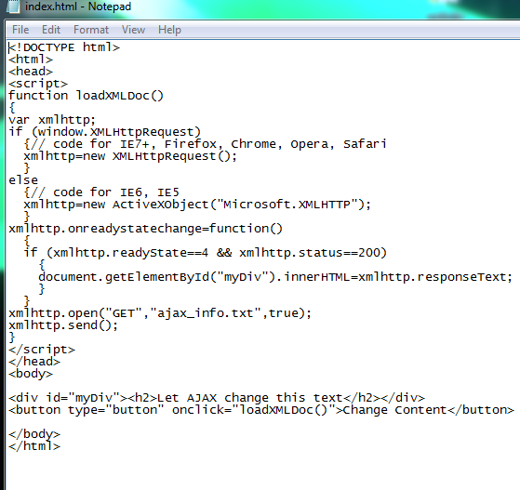
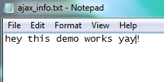
DEMOS
Using only a single .html and .txt file

Slide 41
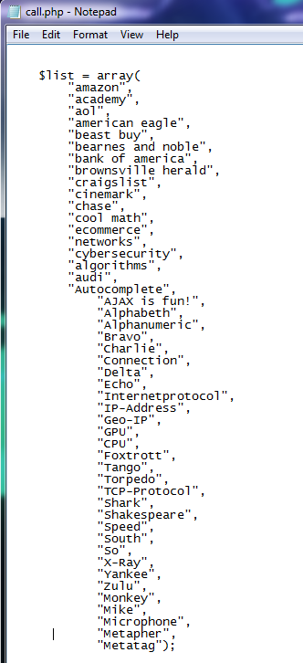
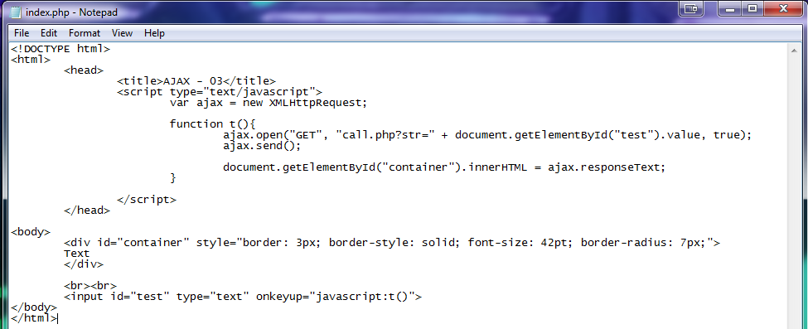
Demo2 auto suggest

