Slide 1
Memory primer
Dr. John P. Abraham

Slide 2
RAM
  Random access memory
    every word can be accessed within the same amount of time
  Three buses to each RAM chip
    unidirectional address bus
    bidirection data bus
    Control lines
  Organized using high-order or low order interleave
    interleaved so that each byte is stored in pair of chips

Slide 3
Types of memory
  RAM – SRAM, DRAM
  ROMs - switches are set, can not be alterd
  PROMs - high current can burn fuses manufactured into chips. Can not be altered once programmed.
  EPROM - can be erased using UV light. May reprogram numerous times (<100)

Slide 4
SRAM (STATIC RAM)
  Bistable latch circuitary stores a bit. No capacitor needed. It rewrites itself in a continuous fashion. Takes lot more physical space than DRAM
  Once written, the value remains in memory
    no need to refresh
    It is not destructive upon read
  Used in CPU registers and other highspeed storage devices
    May be used for cache memory in high end systems
  Currently the fastest and most expensive

Slide 5
DRAM (DYNAMIC RAM)
  Takes less physical space than SRAM
  A capacitor holds charge and a transistor
  Capacitor will drain charge so must be recharged every few milliseconds
  Slower and cheaper than SRAM
  Destructive reads. When reading DRAM the current is discharged. The circuitry on the chip automatically restores the value after the read. (SRAM is not destructive).

Slide 6
Main Memory System
  When small memory was available we used overlays.
    Talk about overlays
  Virtual Memory
    Main memory and secondary memory are considered to contiguous
    The OS maintains special tables that keep track of where each part of the program reside in main memory and in external storage

Slide 7
Memory hierarchy of multilevel storage system
  Registers
  internal cache (in CPU-SRAM)
  external cache (outside CPU-SRAM or DRAM)
  Main Memory
  Secondary Memory
Fastest to the slowest, most expensive to least expensive, and least to the most quantity

Slide 8
Program relocation and Memory Protection
  Crucial features needed for multiprogamming:
    program relocation
    memory protection
    privileged modes of operation
    timer interrupts

Slide 9
Program relocation
  ability of OS to move the program by providing a RELOCATION OFFSET
  initial program relocation
    where the operating system first places the program using the offset
  dynamic program relocation
    program is moved after starting execution

Slide 10
Memory protection
  protecting memory allocated to one program from being used by another.
  The operating system may assign a value (access key) for each executing program.
  The hardware also holds this access key in the psw (program status word)
  When a device initiates memory access, the memory protection hardware compares the access key of the requesting program to the access key associated with the memory.

Slide 11
Privileged mode
  When operating system takes control, it is in the privileged mode
    during privileged mode the user has no access to privileged instructions
  when the control is transferred to an application program, it is in the unprivileged mode

Slide 12
Cache Memory
  during a memory read, it also reads adjacent memory locations and places the data in the cache
  cache entries include address tags to indicate where the data came from.

Slide 13
Fixed-partition multiprogramming
  OS partitions main memory into partitions
  In the fixed-partition the size and locations do not change with time.
  Physical address = logical address + partition address

Slide 14
Variable-partition multiprogramming
  OS can maintain partitions with variable boundaries
  the idea is to establish a partition only when a job is loaded into memory
  The size of the memory can exactly match the size of the job.
  When a job stops execution, that memory is freed. This freed memory is called a hole (causing fragmentation).
  holes are filled when OS allocates them to another program.

Slide 15
Memory Hierarchy
Everything read by CPU should be in the RAM
CPU is faster than memory. (see next slide); I gave you relative speeds in the last lecture.
Cache within the CPU is slower than the register.
Register, s-ram, dram, hard drive (from least amount to most, from fastest to slowest)
Secondary memory→primary memory→levels of cache→register

Slide 16
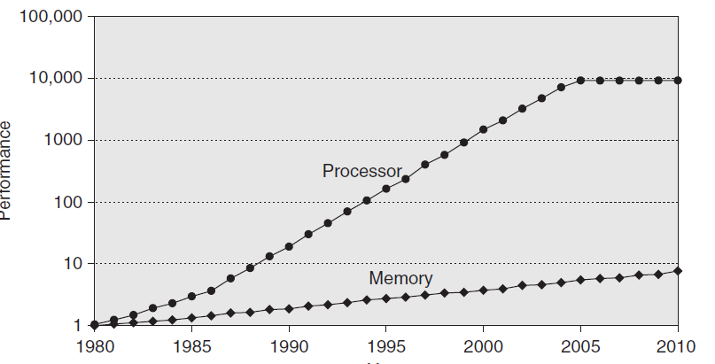

Slide 17
Hit and Miss
Cache hit and miss.
Hit rate = #hits/#accesses
Miss rate = #misses/#access or 1-hitrate.
A miss may have a penalty of 100 cpu cycles or more. If a page fault, this penalty can be over a million cpu cycles.
Hit latency is time it takes to find out if required data is in cache.
Average memory access time (AMAT). Each miss will cost 100 times or more penalty.

Slide 18
Hierarchy continued
From secondary memory to primary memory works similarly. But it is called paging. There is a page table which will be discussed later
Page fault is when required data is not in the primary memory.

Slide 19
Bits and memory
32-bit and 64-bit are commonly used to describe a processor.
32-bit CPU can only address 2³² or 4,294,967,296 values. 4 Gig max memory. ‭
A 64-bit processor includes a 64-bit register, which can address 2⁶⁴ or 18,446,744,073,709,551,616 values. 16 exabytes.

Slide 20
Cache fields
Need to calculate Tag, Index and offset fields
Step1: Calculate number of bits needed for given memory
Step2: Calculate bits needed for offset. This depends upon number of bytes (provided it is byte addressable) in a block of memory. If 8 bytes, we will need 3 bits. Explain this.
Step 3: calculate bits needed to represents lines in cache. 64 lines will need 6 bits, 32 lines will need 5 bits and so on. 64 kbytes of cache will need 15 bits. This is the number of bits needed for the Index.
Step 4: remaining bits from step 1 will be the Tag. Bits in Tag + Index will make up the total number of blocks in the RAM.

Slide 21
Explanation of Cache
All modern CPUs contain varying amounts of level 1 cache memory and all motherboards contain varying amounts of level 2 cache memory. Some have level 3 cache.
Each level of memory is larger than the previous one and retrieves data from the immediate lower level.
The cache memory works on the principles of spatial locality and temporal locality.
Spatial locality states that data that are physically close together are accessed close together
and temporal locality states that recently accessed data will be accessed again in the near future.
Based on these principles, when one datum is requested by the CPU, reading data all around it and keeping it closer to the CPU for fast access makes sense.
Also, once a datum (or program code) is used by the CPU, keep it closer to the CPU for further use.
The principle of locality is also true for program code.
A program spends 90% of the execution time in only 10% of the code such as in case of loops and function calls.
After the CPU registers that takes one-half clock cycle to read or write,
the internal cache is the fastest memory available and clocks data into and out of it with each clock cycle.

Slide 22
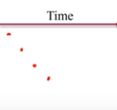
Spacial locality with a program
For (i=0; i<200; i++) {
Sum = sum+grades[i]
}
Grades[1]
Grades[2], etc.
SPACIAL LOCALITY.
Next data element will be more than likely used next.
Bring nearby data into cache
See that sum is the hotspot used over and over again

Slide 23
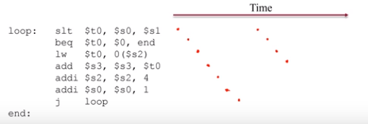
Temporal locality with the same program
Convert the program to assembly so you can see what actually happens. If data used recently, likely will be used again soon. Keep recently accessed data in the cache.

Slide 24
Example of cache and memory
Direct associative mapping is the simplest and the most inexpensive to implement of the three. Continuing with the example of 256K cache, 256Meg RAM and 64 byte block/line, the direct associative maps every 1024th block into a particular line. This can be easily determined by modulo arithmetic. If a
memory access takes place as a word or more. For the example here we use a word as a byte, so it is byte accessible. In order to examine how cache memory works, let us take a computer configuration with 256K cache and 256Meg of RAM, a 1 to 1024 ratio.

Slide 25
Example of cache and memory continued. 256 Meg RAM, 256 K of cache
The RAM is divided into blocks of certain bytes each (for this example, we will use 64 bytes blocks) and cache will be divided into lines of same number of bytes (64 bytes) as in each block.
In this scenario, there will be 4096 lines of cache (256Kx1024/64)
And 4,194,304 blocks of RAM (256Meg x 1024 x 1024 / 64).
Total lines (4096) of cache should hold data from 4,194,304 blocks of memory, a physical impossibility. However, it is possible to hold one out of the 1024 blocks of data in a single cache line at any given time.
There are three different ways to map the blocks of memory to lines of cache: direct, fully associative, and set-associative mapping.

Slide 26
Example continued. Direct mapping
In order to access a memory, check if it exists in the cache.
To make this verifying process easy and fast, the memory address issued by the CPU is divided into three fields, tag, index, and offset.
The tag and the index fields together make up the block address and the offset indicates the byte number in the block.
The tag of every cache line contains information to check if that line contains the block address requested by the CPU.
The memory address issued by the CPU (to address 256 Meg (268,435,455K) of RAM, bin 1111,1111,1111,1111,1111,1111,1111) require 28 bits to represent it if the architecture is byte addressable.
In order to indicate which of the 64 (0 to 63) bytes of a block is desired we need 6 bits (2⁶ = 64), and the offset field requires 6 bits. The remaining 22 bits are required for the block address (2²² =4,194,304). Since we have 4096 lines of cache (0-4095 or 1111,1111,1111), we would need 12 bits to indicate which line will hold the data. The final (28-6-12)10 bits are used for the tag field, (2¹⁰ = 1024), which is checked to see if the appropriate block is found in that line.

Slide 27
