Slide 1
ILP (instruction level parallelism)
Dr. John P. Abraham
Professor
UTRGV

Slide 2
ILP
Potential overlap among instructions.
Handled by
Hardware: Processor – exploits parallelism dynamically
Most modern cpus including Intel use this approach
Software: Compiler – determined at compile time.
The value of the CPI (cycles per instruction) for a pipelined processor is the sum of the base CPI and all contributions from stalls:
3.1 Instruction-Level Parallelism: Concepts and Challenges
Pipeline CPI Ideal pipeline = CPI + Structural stalls + Data hazard stalls + Control stalls

Slide 3
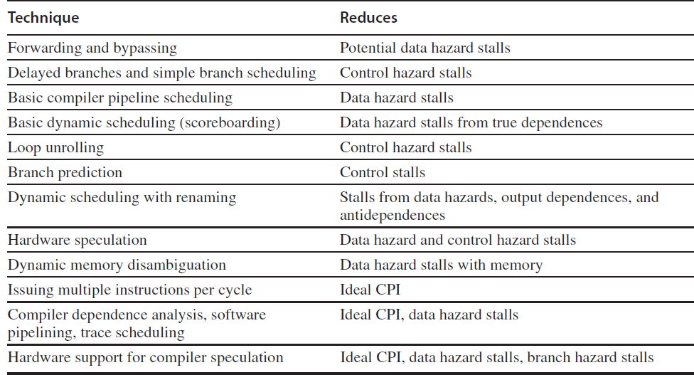

Slide 4
Common way to increase ILP
Exploit parallelism among iterations of a loop (loop-level parallelism)
unroll the loop either statically by the compiler or dynamically by the hardware
for (i=100; i !=0; i--)
a[i] = a[i] + s;
If two instructions are dependent, they are not parallel and must be executed in order

Slide 5
LOOP UNROLLING ONCE
for (i=100; i !=0; i--)
a[i] = a[i] + s;
for (i=100; i !=0; i-2)
a[i] = a[i] + s;
A[I-1]=A[I-1]+S;

Slide 6
Write in MIPS
LOOP: LW R2, 0(RL) ADD R2,R2,R3 SW R2,0(R1) LW R2, -4(R1) ADD R2,R2, R3 SW R2,-4(R1) ADDI R1,41,-8 BNE R1,R5, LOOP
LOOP:
LW R2, 0(RL)
ADD R2,R2,R3
SW R2, 0(R1)
ADDI R1,R1, -4
BNE R1,R5, LOOP

Slide 7
Data dependencies
There are three different types of dependences: data dependences (also called true data dependences), name dependences, and control dependences. An instruction
j is data dependent on instruction i if either of the following holds:
■ Instruction i produces a result that may be used by instruction j.
■ Instruction j is data dependent on instruction k, and instruction k is data dependent on instruction i.

