Slide 1
Instruction Set
Dr. John Abraham

Slide 2
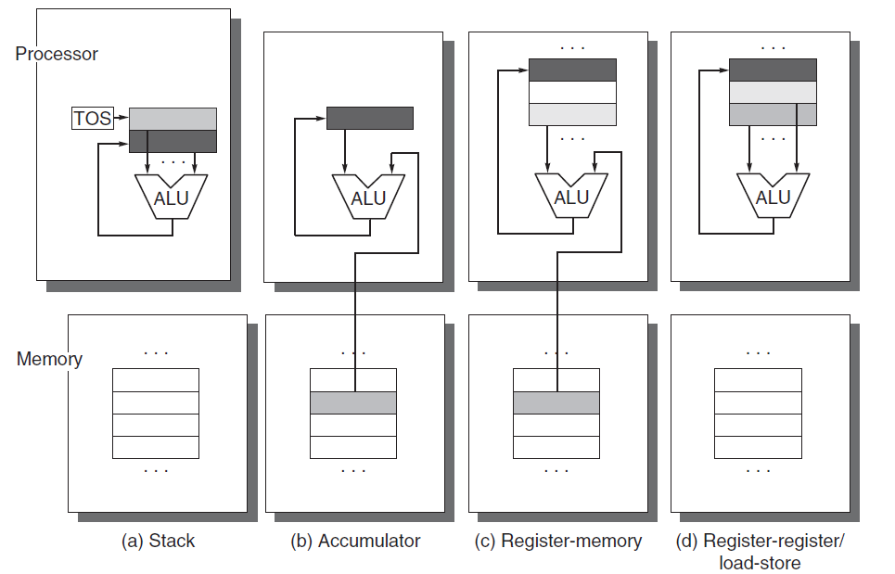
3 types
stack, an accumulator, or a set of registers. Operands may be named explicitly or implicitly. C = A + B shown below. Lighter shades indicate inputs, and the dark shade indicates the result.
Notes:
Figure A.1 Operand locations for four instruction set architecture classes. The arrows indicate whether the operand
is an input or the result of the arithmetic-logical unit (ALU) operation, or both an input and result. Lighter shades
indicate inputs, and the dark shade indicates the result. In (a), a Top Of Stack register (TOS) points to the top input
operand, which is combined with the operand below. The first operand is removed from the stack, the result takes
the place of the second operand, and TOS is updated to point to the result. All operands are implicit. In (b), the Accumulator
is both an implicit input operand and a result. In (c), one input operand is a register, one is in memory, and
the result goes to a register. All operands are registers in (d) and, like the stack architecture, can be transferred to
memory only via separate instructions: push or pop for (a) and load or store for (d).
Stack Accumulator

Slide 3
Code

Slide 4
How many registers are sufficient?
The answer, of course, depends on the effectiveness of the compiler. Most compilers reserve some registers for expression evaluation, use some for parameter passing, and allow the remainder to be allocated to hold variables. Modern compiler technology and its ability to effectively use larger numbers of registers has led to an increase in register counts in more recent architectures.
In the three-operand format, the instruction contains one result operand and two source operands. In the two-operand format, one of the operands is both a source and a result for the operation.
The number of memory operands supported by a typical ALU instruction may vary from none to three

Slide 5
How is a memory address interpreted?
byte addressed and provide access for bytes (8 bits), half words (16 bits), and words (32 bits). Most of the computers also provide access for double words (64 bits).
Little Endian ordering fails to match the normal ordering of words when strings are compared. Strings appear “SDRAWKCAB” (backwards) in the registers.
A second memory issue is that in many computers, accesses to objects larger than a byte must be aligned. An access to an object of size s bytes at byte address A is aligned if A mod s = 0.

Slide 6
Addressing modes
Notes:
RISC computers use displacement addressing to simulate register indirect with 0
for the address and to simulate direct addressing using 0 in the base register. In our measurements, we use the first
name shown for each mode.

Slide 7
Addressing modes
we would expect a new architecture to support at least the following addressing modes: displacement, immediate, and register indirect.

