Slide 1
Memory Continued Associate Cache
Dr. John P. Abraham
UTRGV

Slide 2
CPU is unaware of cache
CPU issues a memory address and expects a result back. Each RAM address does not need a label, simply wired to each block.
The request is intercepted by the cache hardware that sits between the CPU and the memory. 64 byes blocks usually.
Cache is not unique to memory; there is a cache between hard drive and RAM (4 KB page size)

Slide 3
Intel processor I7 with multicore
Has Level 1 instruction cache and level 1 data cache for each core (32K), takes about 4 cycles.
instructions don’t need to be written back to RAM
data may need to be written back, so use a dirty bit (next slide)
Has level 2 cache for each core (256K), takes about 11 cycles.
Also has a common level 3 cache for the entire CPU (8 M), takes about 40 cycles.
RAM is generally 16 G, takes about 50 to 200 cycles.

Slide 4
Associative Memory (cache)
Each block is identified by a key or tag (recall from slide 1, RAM does not have need a tag). This tag goes along with the contents of the memory.
https://miniwebtool.com/log-base-2-calculator/ good for cache calculations.
Given RAM size of 128 K, cache memory size 16 K, block size 256 bytes and byte addressable.
To address 128 K memory it requires 17 bits. So tag and offset should be 17 bits
Offset for 256 bytes is 8 bits
The remaining bits (17-8=9) will be used for the Tag in a fully associative.
So in addition to the contents of the memory, each line of cache should contain tag information, a dirty bit, and a valid bit

Slide 5
Valid bit and dirty bit
When computer boots cache is not populated with valid data. So the bit should be set to 0.
When a block is brought in the valid bit should be set to 1. This should happen also when processes are swapped in.
When a data is updated, the new value can be written directly to cache and memory immediately (write-through), or it can just update the cache anticipating further changes; and set the dirty bit to 1.
Before evicting the line to bring another line, if it has a dirty bit, it should be written to the RAM (this is called Write-Back)

Slide 6
Another fully associative example
Given RAM of 4GB, cache 4MB, and block size 1KB.
Bits required to address RAM is 32
Total number bits required to address cache is 22
Number of cache lines is 22-10 = 12 so we need this many comparisons.
Required bits for block offset is 10
Tag for fully associative is 32-10 = 22
The tag will indicate where in RAM this address can be found.
Tag__22___Offset 10
Cache hardware need to do parallel comparisons of 2^12 and do OR operations on all of them to determine if there is a Hit or Miss.

Slide 7
Same memory but different block size
RAM 4 GB. Block Size 64 bytes. Requires 32 bits
64 bytes require 6 bits
26 6
Tag Offset

Slide 8
4-way associative cache using the same numbers
Given RAM of 4GB, cache 4MB, and block size 1KB.
Bits required to address RAM is 32
Total number bits required to address cache is 22
Number of cache lines is 22-10 = 12, but these are divided into 4 lines per set, giving us 2^10 sets
Required bits for block offset is 10
12 10 10
Tag SetNo Offset

Slide 9
Reads from the RAM - Cache hit and miss
CPU issues an address, cache hardware intercepts it and extracts tag field.
Compares the cache tags (if direct mapping it is easy, only need to check one line). If found and if the valid bit is on, we have a hit. Return the value to the CPU
Otherwise it is a miss. Cache must get the block from the RAM.
Before retrieving the data one line must be evicted. If it is direct mapped, we know which one. But before evicting, check dirty bit, if it is on, write the content back to the RAM and then replace
If not direct mapped, use an algorithm such as LRU, random, FIFO or LIFO to determine which line to be evicted then check dirty bit, and such.

Slide 10
Writes to the RAM
CPU issues the memory address and data to be written
Compare address with cache tag, same as previous slide
If cache has the block, then use one of the following:
Write-through. Update the cache and the RAM immediately
Write-back. Update the cache only and turn on the dirty bit. Only writes to the RAM when that line is evicted.
If cache does not have the block use one of the following:
Write-allocate: Read the block from RAM into the cache and update the cache with CPU instruction and set dirty bit to 1. Only written to RAM when the block is evicted.
No-Write-allocate (or write around): Send the write on through to memory, do not load into cache.
Write-through may be better with write-hits and no-write allocate with write misses.

Slide 11
Your Textbook – Appendix B
What I covered is mostly from Appendix B.
Cache performance: Avg mem access time =
Hit time + miss rate x miss penalty
The access time can be further dived into instruction hit and data hit.
In out of order executions, instruction may not be in the cache

Slide 12
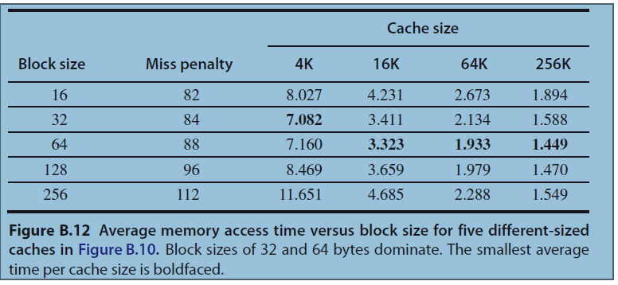
Six basic cache optimizations
Larger block sizes reduce miss rate
Larger cache

Slide 13
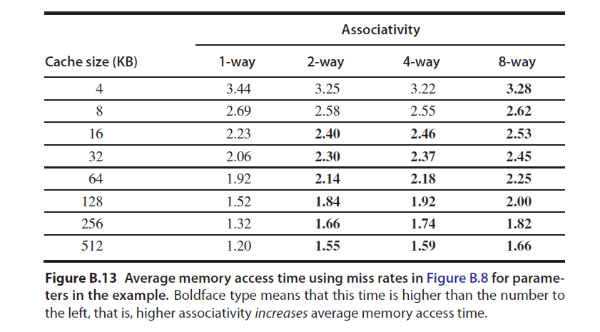
continued
3. Higher associativity

Slide 14
Continued
Multilevel caches
Give priority to reads before writes
Avoid address translation during indexing of cache
This is due to virtual machines and virtual caches. Not explained here in this class.

Slide 15
Chapter 2: Memory Hierarchy Design
We already discussed this.
Text gave 10 optimizations to improve cache performance, many of these won’t make sense to you until I cover pipelining and ILP.
Book also discussed memory protection and virtual machines when using cache.
Coherency of cache when multiple cores or CPUs are used also discussed as data will be distributed to several caches.

