Slide 1
TCP/IP Protocol Suite
Oscar del Angel

Slide 2
“TCP IS A SET OF PROTOCOLS THAT DEFINES THE RULES GOVERNING HOW MESSAGES ARE EXCHANGED IN A COMPUTER NETWORK”

Slide 3
-History
Mid 1960s, Advance Research Project Agency. Part of the Department of Defense.
In 1967, at an Association for Computing Machinery (ACM), ARPA presented ARPANET.
In 1969, Four Nodes was connected successfully: UCLA, UCSB, SRI, UA, using Network Control Protocol.
In 1972, Cerf and Kahan, collaborated in Internetting Project. Encapsulation, datagram, gateway.
Shortly after , authorities decided to split TCP into TCP and IP.
In 1981, UC Berkeley modified UNIX to include TCP/IP.
In 1983, ARPANET split into two networks: MILNET for military users and ARPANET for nonmilitary uses. TCP/IP becomes the official protocol for ARPANET.
In 1991, three companies, IBM, Merit, and MCI formed a nonprofit organization called Advanced Network and Services (ANS), to build a new, high-speed Intenert backbone called ANSNET.
Internet today

Slide 4
-Internet Today

Slide 5
-ISO-OSI Model
OSI MODEL
In the late 1970s, the International Standards Organization (ISO) introduced the Open Systems Interconnection (OSI) model.
7 Layers
The OSI Model is not a protocol; it is a model for understanding and designing a network.

Slide 6
Open System Interconnection (OSI) Reference Model

Slide 7
-TCP/IP MODEL

Slide 8
-Physical and Data-Link Layer
TCP/IP does not define any specify protocol.
Support all the standard and proprietary protocols.
A network can be a LAN, MAN, or WAN.
Different technologies: Ethernet, Token Ring, etc….

Slide 9
-Ethernet
It is the most widely used area network protocol.
It was designed by Xerox in 1973.
Today has a data rate of 100 Mbps and 1000 Mbps.
It is formally defined by IEEE 802.3 standard.
Every Ethernet interface (NIC) has a unique 48 bit address (6-byte), normally written in hexadecimal notation. Ex: 07-01-02-01-2C-4B
Access Method: CSMA/CD (Carrier Sense Multiple Access with Collision Detection).
Bus Topology.

Slide 10
-Bus Topology

Slide 11
-Connecting Devices
-HUB
Operates in OSI layer 1
Center of star topology
In Ethernet, multiport repeater or concentrator.
HUB

Slide 12
Bridges
Operates in OSI layer 2
Connect two networks of the same technology
Filters and forwards based in MAC
Bridge

Slide 13
Switch
Operates on OSI layer 2.
Occasionally, switches are also referred to as multiport bridges.
Reduces Collisions
Switch

Slide 14
Router
Routers operate in OSI Layer 3
Forwards packets based on network layer (IP)
Routers are able to connect networks of different topologies.
Routers are used to connect local networks over wide over networks.
Routers

Slide 15
-Network or Internet Layer
Primarily consists of the Internet Protocol (IP).
Contains four supporting protocols.
Address Resolution Protocol (ARP)
Reverse Address Resolution Protocol (RARP)
Internet Control Message Protocol (ICMP)
Internet Group Message Protocol (IGMP)

Slide 16
Encapsulation and Header Files
Each layer adds a header file to the datagram before it pass to the next layer.
A data is being sent from one computer
It will pass from the top layer to the bottom.
The transport layer will append a UDP or TCP header.
The resulting UDP or TCP segment is passed to network layer and IP header is appended.
The last header is attached by physical layer.
On the receiving end, the data will then be rebuilt from bottom to top layer
Data encapsulation allows devices to communicate

Slide 17
-Analogy: Russian Dolls

Slide 18
-The data encapsulation process

Slide 19
-Packet Switching
The fundamental technology that makes the Internet work is called packet switching.
A packet is similar to a letter, it contains a portion of the data and the recipient’s address.
Each packet is transmitted individually over the Internet.
After the packets arrive at the destination, they are reassembled to form the complete message.
**Analogy: highways and cars.

Slide 20
-Internet Protocol (IP)
IP Addressing
Internet addresses are 32 bits in length
Every host has a UNIQUE IP address
IP addresses are assigned by a central authority (IANA and RIRs)
It contains two parts: Network Identifier and Host Identifier
The first bits identify what class the address belongs to
There are three common notations to show an IP address: binary notation, dotted-decimal notation, and hexadecimal notation
Address space of IPv4 is 2³² or 4,294,967,296

Slide 21
-Internet Protocol
Binary Notation
10000000 00001011 00000011 00011111
Decimal Notation
128.11.3.31
Hexadecimal Notation
10000000 00001011 00001011 11101111 = 0X810B0BEF
= 810B0FBEF₁₆

Slide 22
Classfull Addressing
FIRST BYTE
0 TO 127
128 TO 191
192 TO 223
224 TO 239
240 TO 255
Network ID is assigned by global authority, and HostID is assigned by System Administrator

Slide 23
-Internet Protocol
Addresses per Class
Class A. First byte zero. 50% address space. 2³¹. 8-bit Network.24 bit host.
Class B. First byte 10. 25% address space. 2³⁰. 16 bit network. 16 bit host.
Class C. First byte 110. 12.5% address space. 2²⁹. 24-bit network. 8-bit host.
Class D. First byte 1110. 6.25% address space. 2²⁸. Multicasting.
Class E. Fist byte 1111. 6.25% address space. 2²⁸. Reserved addresses.
**Inefficient use of address space, for example class B

Slide 24
-Subnetting
An organization can subdivide it’s host address space into groups called subnets.
The subnet ID is generally used to group hosts based on the physical network topology.
Subnets can simplify routing.
It is possible to have a single wire network with multiple subnets
Example:

Slide 25
-Subnetting
Creation of five subnets. Best Network is Class C.

Slide 26
Internet Control Message Protocol (ICMP)
Represents a protocol used to convey control messages.
It is a set of messages that ride in IP datagram and can report errors in the delivery of other IP datagram.
If two hosts cannot communicate, ICMP messages can usually help diagnose the problem.
Types of errors: Destination Unreachable, Source Quench, Time exceeded, Parameter Problem, Redirection.
Common utilities in ICMP:

Slide 27
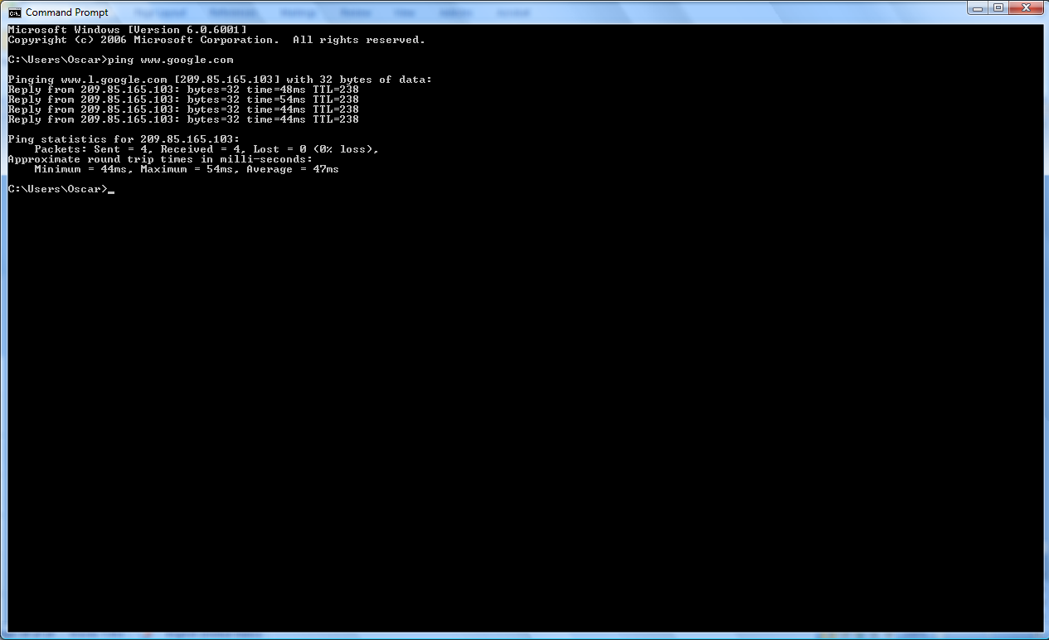
Internet Control Message Protocol (ICMP)
Packet internet groper utility (PING)

Slide 28
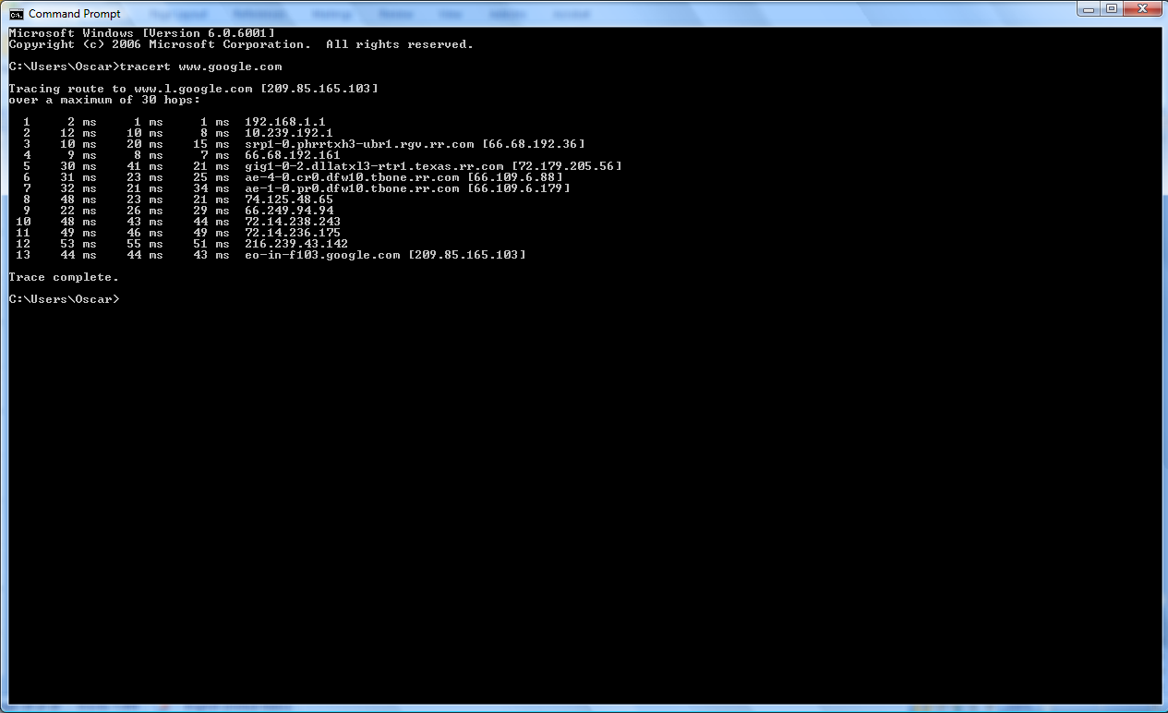
Internet Control Message Protocol (ICMP)
Tracert

Slide 29
-Address Resolution Protocol (ARP)
In the physical layer, the hosts and routers are recognized by their physical address (48-bit)
ARP facilities replacement and addition of new devices to the existing network.
It performs a conversion between data link layer addresses (48-bit) and IP addresses (32-bit)
ARP is a broadcast protocol.
All the hosts receive the message, but only the right one responds.

Slide 30
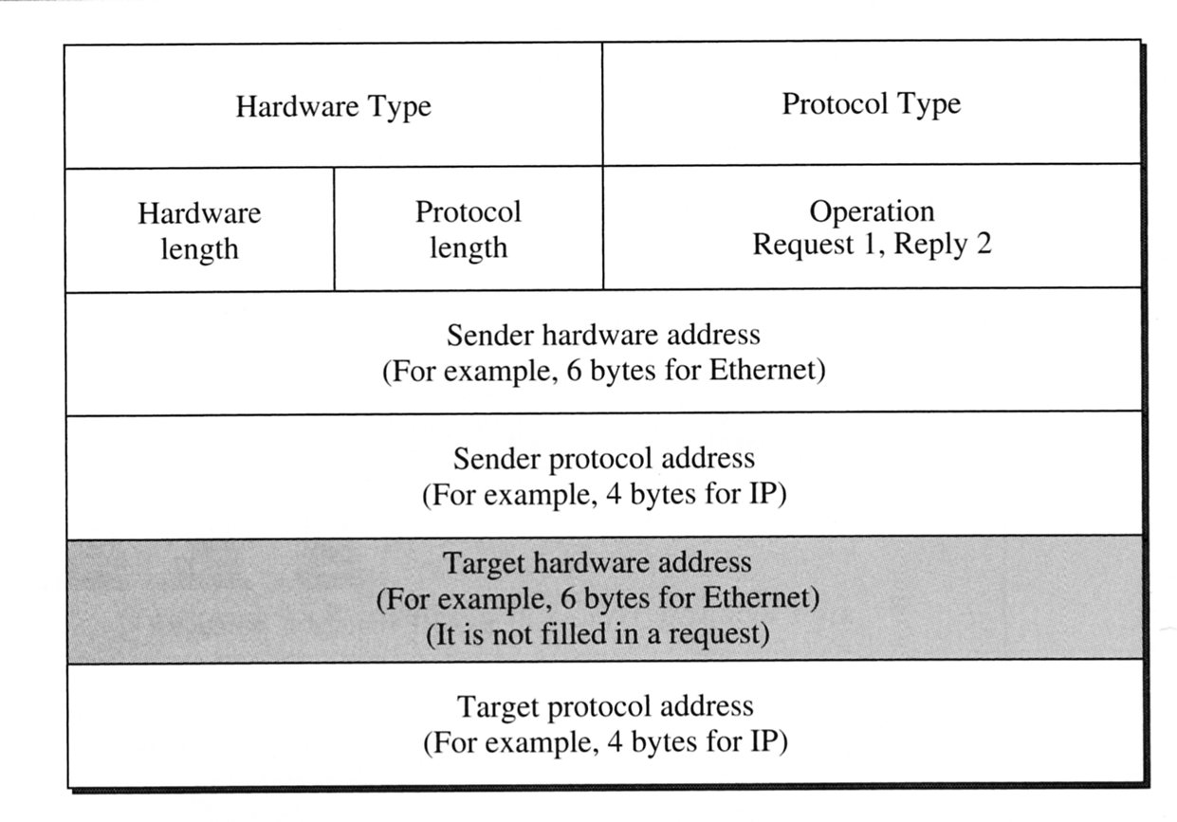
-Reverse Address Resolution Protocol (RARP)
The reverse process of ARP, is made by RARP.
This protocol finds a IP address, given a MAC address.
A diskless computers uses RARP to obtain its IP addresses from a server.
Use the same frame format than ARP

Slide 31
-Internet Group Management Protocol (IGMP)
IGMP allows a host (application) to join or leave a multicast group.
IGMP has three types of messages: the query, the membership report, and the leave report.
The message format is:

Slide 32
Routing Protocols
Routers are special purpose machine on the Internet that determine the path for packets from source to destination.
Routing Information Protocol (RIP)
Describe how routes exchange routing table information
Uses hop-count as the metric of path’s control
Open Shortest Path Protocol (OSPF)
More robust, scalable protocol than RIP
It does not exchange entire tables, only updates changed links.

Slide 33
Transport Layer Protocols
Type of Services:
Connection-Oriented. It first makes a connection with the network layer protocol at the remote site before sending a packet. The packets are sent on the same path in sequential order.
Connectionless. It treats each packet independently, with each packet having no relationship to any other packet. The packets in a message may or may not travel the same path to their destination.

Slide 34
-Transport Layer Protocols
Provide logical communication between application processes running on different hosts.
There are two protocols in this layer: User Datagram Protocol (UDP) and Transmission Control Protocol (TCP)
More than one transport protocol available to applications. Ex: Internet uses TCP and UDP.

Slide 35
-User Datagram Protocol (UDP)
No connection establishment
Small segment header.
No congestion control
Used for multimedia applications
It is used when speed and efficiency are more important than reliability
UDP uses ports to provide communication services to individual processes

Slide 36
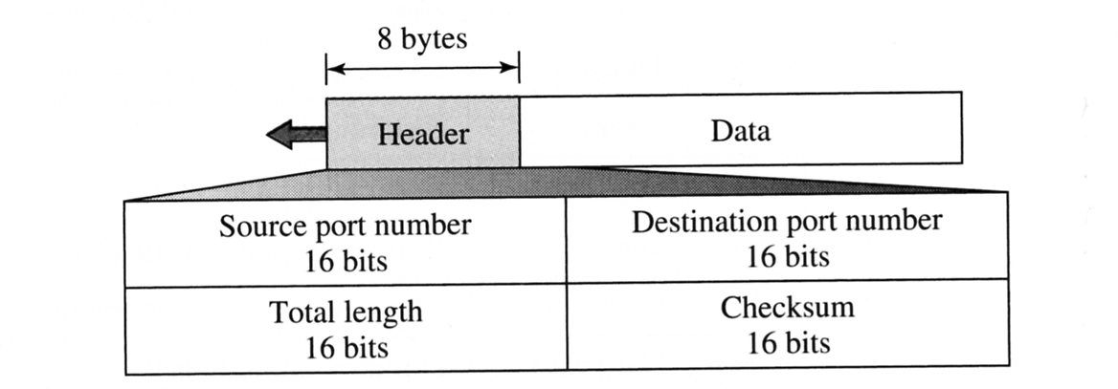
-User Datagram Protocol (UDP)
UDP Datagram

Slide 37
-Transport Control Protocol (TCP)
Connection-oriented
Flow Control. Keep sender from overrunning receiver
Congestion Control. Keep sender from overrunning network.
Once the connection is established, data can be transferred in both directions between two hosts (Full Duplex).
To establish a connection between two processes on different hosts, the following identification sources are required: Port number, TCP sockets.
A TCP connection is always between a single sender and a single receiver, called point-to-point connection.
UDP ports have no relation to TCP ports (different name spaces).

Slide 38
-Transport Control Protocol (TCP)
TCP Connection:
Host A sends a segment to announce its wish for connection and includes its initialization information about traffic from A to B.
Host B sends a segment to acknowledge (confirm) the request of A.
Host B sends that includes its initialization information about traffic from B to A.
Host A sends a segment to acknowledge (confirm) the request of B.
This connection is called Three-way handshaking.

Slide 39
-Transport Control Protocol (TCP)

Slide 40
-Transport Control Protocol (TCP)
Closing Connection
Host A sends a segment announcing its wish for connection termination.
Host B sends a segment acknowledging the request of A. After this, the connection is closed in one direction, but no in the other. Host B can continue sending data to A.
When host B finished sending its own data, it sends a segment to indicate that it wants to close the connection.
Host A acknowledges to request of B.
This connection is called Four-way handshaking.

Slide 41
-Transport Control Protocol (TCP)

Slide 42
-Summary
IP is the basis of Internetworking
TCP builds on top of IP adds reliable, congestion-controlled, connection-oriented byte-stream.
UDP builds on top of IP allows access to IP functionality

Slide 43
-APPLICATION LAYER
Client-Server Architecture
Server always on host, permanent IP address.
Client communicate with server, Not always connected, permanent or dynamic IP, do not communicate directly with others clients.
Peer-to-Peer
Not always in server
Peers not always connected and can change the IP address. Ex: Torrent

Slide 44
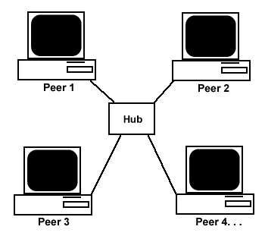
Client-Server vs. Peer-toPeer

Slide 45
-APPLICATION LAYER
Application Layer protocols examples:
Simple Mail Transfer Protocol (SMTP) is a TCP/IP protocol that handles the transfer of e-mails from one mail system to another.
File transfer protocol (FTP) is a set of rules that handle the transfers of files from one computer to another.

Slide 46
3. Domain Name Server (DNS)
People prefers names instead of addresses.
It is a system that can map a name to an address or an address to a name.
When the Internet was small, mapping was done using a host file.
Today, it is impossible to have one single file.
DNS solution:
Divide this huge amount of information into smaller parts and store each part on a different computer.
The host that needs mapping can contact the closest computer .
There are 13 root servers in the world.

Slide 48
4. HTTP
HyperText Transfer Protocol (HTTP) is an application-level protocol used to carry out all communications between the Web server and browsers.
HTTP steps:
Client initiates a TCP connection to server through a socket.
Server accepts connection
HTTP messages exchanged between client browser and Web server.
TCP connection closed.

Slide 49
Questions???

