Slide 1
Artificial Intelligence and Expert Systems
Leroy Garcia

Slide 2
Definition of AI
Artificial Intelligence is the branch of computer science that is concerned with the automation of intelligent behavior (Luger, 2008).
Notes:
Definition I like best. (Read aloud) But people have different interpretations of what AI is.

Slide 3
Different Approaches to AI
Systems that think like humans | Systems that think rational
Systems that act like humans | Systems that act rational
Notes:
The definitions on the top of this figure show the actual thought processes and reasoning of an Artificial Intelligence system,
and the definitions on the bottom deal with behavior.
The definitions on the left deal with the concept of human performance
and the definitions on the right deals with Artificial Intelligence in terms of rationality.
Rational Definition : having reason or understanding
-A human-centered approach must be an empirical science, involving hypothesis and experimental confirmation
-rationalist approach involves a combination of mathematics and engineering”

Slide 4
History
Aristotle
Rene Descartes
Frances Bacon
John Locke
David Hume
Ludwig Wittgenstein
Bertrand Russell
Rudolf Carnap
Carl Hempel
Alan Turing
Notes:
Aristotle was “the first to formulate a precise set of laws governing the rational part of the mind”
Rene Descartes (1596-1635) played an especially important role in Psychology, the study of the mind
An important theory by Descartes was the belief that the human brain is free from the physical laws known as dualism.
Other significant figures in the philosophical history of Artificial Intelligence include Francis Bacon who began the empiricism movement
John Locke, David Hume the initiator of Induction, Ludwig Wittgenstein, Bertrand Russell, Rudolf Carnap and Carl Hempel
And last but not least Alan Turing

Slide 5
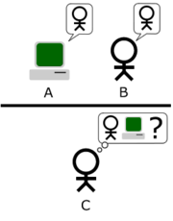
Alan Turing
Wrote “Computer Machinery and Intelligence”.
The Turing Test
Notes:
In the year 1950, a great mathematician by the name of Alan Turing wrote a progressively influential paper titled “Computing Machinery and Intelligence”.
Turing Test
. It involves a man (A), a woman (B), and an interrogator(C). The interrogator is separated from the man and woman in a closed room; however, he is allowed to ask them both questions using a terminal connection.
The main objective of this test is for the Interrogator to determine which subject is the woman.
Voice and pitch are eliminated
Once that is determined the man is replaced by the computer and the test is repeated.
if the computer tricks the interrogator into believing it is the women then the computer and the test have passed.
As a result of the Turing Test, scientist began exploring the idea of computers playing intellectual games such as chess or checkers against a human

Slide 6
Dartmouth 1956
Automatic Computers
How can computers be programmed to use a language?
Neuron Nets
Theory of the Size of a Calculation
Self-Improvement (Machine Learning)
Abstractions
Randomness and Creativity
Notes:
The conference at Dartmouth did not lead to any serious findings but it did define and give birth to subject of “Artificial Intelligence” and led it to be placed in its very own field of study.
In 1956, John McCarthy invited many of the leading researchers of the time in a wide range of advanced research topics such as complexity theory, language simulation, neuron nets, abstraction of content from sensory inputs, relationship of randomness to creative thinking, and learning machines
birth to subject of “Artificial Intelligence”

Slide 7
Acting Human
Natural Language Processing
Knowledge Representation
Automated Reasoning
Machine Learning
Notes:
natural language processing in order for the AI system to communicate a language successfully
in order for an AI system to act convincingly human it must fluently know a language.
It also must have a knowledge representational mechanism in order to store what it knows and hears.
Needs to store data somewhere
possess automated reasoning into order to process information and actually come up with a unique conclusion.
contain a machine learning mechanism so it may adapt to new circumstances and patterns
If it is an intellectual being it must be able to learn

Slide 8
Rational Agents
Anything that can be viewed as perceiving it’s environment through sensors and acting upon it’s environment through actuators.
(Russell & Norvig, 2003)
Notes:
Percepts- basically means what the agent percieves from its environment
Sensors-eyes ears, digital readers, smell detecors
provide input from an evironment
agent also contains actuator that allows it to act upon its environment
perform actions

Slide 9
Rational Agents cont.
Notes:
Ask you can see the sensors take in percepts from the enviroment.
Environment-the area the agent is designated to perform.
Actuators-perform actions on the environment.

Slide 10
PEAS
Performance Measure
Environment
Actuators
Sensors
Task Environment
Made up of PEAS.
Notes:
performance measures determine a decisive factor for success of an agent’s behavior.
Environment-the area the agent is designated to perform.
Actuators
Sensors
task environment can be known as the problem
What needs to be done or fixed
Agent is the solution

Slide 11
Examples of Agent Types and PEAS

Slide 12
Dimensions of a Task Environment
Fully Observable vs. Partially Observable
Deterministic vs. Stochastic
Episodic vs. Sequential
Static vs. Dynamic
Discrete vs. Continuous
Single Agent vs. Multiagent
Notes:
In order to better understand a task environment we must first analyze the different dimensions it contains

Slide 13
Fully Observable vs. Partially Observable
Fully Observable
Sensors must provide a complete state of environment.
Partially Observable
Usually due to poor an inaccurate sensors or if parts of the world are missing the sensor’s data.
Notes:
The advantage of having a fully observable agent is that it does not need to keep track of its internal state in order to operate effectively in the world.
When an agent is partially observable is mainly due to poor and inaccurate sensors or if parts of the world itself are missing the sensors data.

Slide 14
Deterministic vs. Stochastic
Deterministic
The action of the next state depends on the action of the previous state.
Stochastic
Actions do not depend on previous state.
Notes:
Deterministic Example
-janitor agent sweeps and then mops
Stochastic Example
-party clown agent makes balloon animals and then juggles objects

Slide 15
Episodic vs. Sequential
Episodic
Single actions are performed.
Sequential
Future decisions are determined by the current action.
Notes:
Episodic
episodic task environment an agent’s experience is essentially broken down into what is called atomic episodes. Only single actions are performed and do not depend on the previous actions that were performed.
-Are given initially
Episodic environments are much simpler then sequential environments because the agents does not have to think ahead
Sequential
-ex: a chess agent who is thinking moves ahead

Slide 16
Static vs. Dynamic
Static
Does not change during an agent’s deliberation.
Dynamic
Able to change during an agent’s deliberation.
Notes:
Static
-enviroment stays the same
Dynamic
-A dynamic environment is continuously asking the agent what it wants it to do
Changes continously

Slide 17
Discrete vs. Continuous
Discrete
Contains finite number of distinct states and a discrete state of percepts and actions.
Continuous
Contains a range of continuous values
Notes:
Discrete Environment
-Chess Game
-different states of the table
-table changes
Continuous
Automated Driver: driving Pan Am to Mall
it needs to go from here then to here then to here

Slide 18
Single Agent vs. Multiagent
Single Agent
One agent is needed to execute an action on a given environment.
Multiagent
More than one agent is needed to execute an action on a given environment.
Notes:
Single Agent
-crossword puzzle agent
Muliagent
-chess agent

Slide 19
Examples of Agents and Task Environments

Slide 20
Types of Agents
Simple Reflex Agent
Model Based Reflex Agent
Goal Based Agent
Utility Agent
Learning Agent
Problem Solving Agent
Notes:
There different types of agent for different solutions
These are various types of rational agents

Slide 21
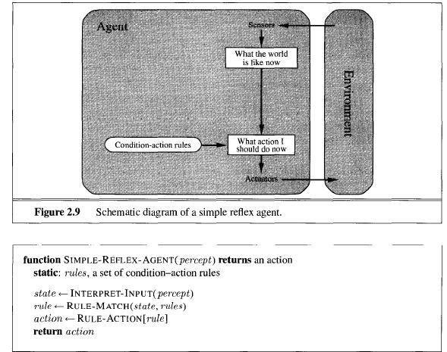
Simple Reflex Agent
Selects action based on the current percept and pays no attention to any previous percept.
Notes:
Simplest Form of an Agent
This agent basically selects action based on the current percept and pays no attention to any of the previous percept history.
An extreme downside to simple reflex agent is that they tend to get stuck in infinite loops when the environment is partially unobservable.
explain the condition-action rules

Slide 22
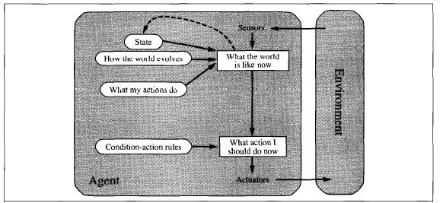
Model Based Reflex Agent
Maintains at least some form of internal state that depends on the percept history and thereby reflects some of the unobserved aspects of the current state.
Notes:
Aids the downside of having a partially observable environment
looks at the past in order to make decisions
It is basically like a human learning from life’s experiences.

Slide 23
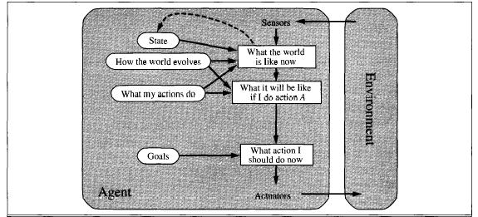
Goal Based Agent
Performs actions based on a specific goal.
Notes:
This specific type of agent needs a certain goal in order for it to work properly
-automated driver

Slide 24
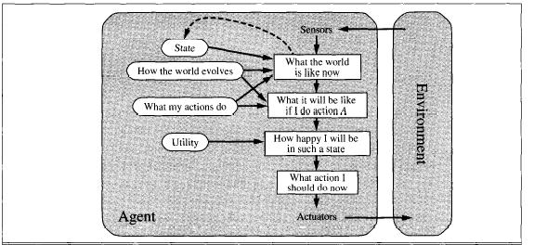
Utility Based Agent
Takes into account it’s current environment and decides to act on an action that simply makes it happier.
Notes:
Goals are Black and White
Happiness means how Rational
Just like a Human There are days that are extremely average and you do not feel any particular emotion or you might feel a general degree of happiness or unhappiness.

Slide 25
Learning Agent
Learning Element
Performance Element
Critic
Problem Generator
Notes:
The learning element is in charge of making relative improvements, and completely depends on the design of the performance element in order to perform effectively. It also takes advice from the critic in order to properly modify the element allowing it to make more rational decisions in the future.
The performance element is responsible for selected the external actions of an agent, it simply takes in the percepts and performs an action.
The critic tells the learning agent how well the agent is doing with respect to fixed performance standard
The problem generator is essentially in charge of generating new experiences for the agent that it deems to be new and informative.

Slide 26
Learning Agent cont.

Slide 27
Problem Solving Agent
State Space
Initial State
Successor Function
Goal Test
Path Cost
Notes:
Problem solving agents organize their behavior by using goals. Problem solving agents use goal formulation which is based on the present situation and the agent’s performance measure.
State Space- the areas in which the agent is allowed access
-automated driver
Initial State-state where agent begins
-parking garage
Goal Test- Test to see whether the agent has reached its goal
Path cost-how much it costs to get to a goal

Slide 28
Example of States
Notes:
Numbers are the actions
Which is the shortest distance
Arad to Bucharest
-distance:118, 111,70,75,120,138,101
-shortest distance 140, 99, 211

Slide 29
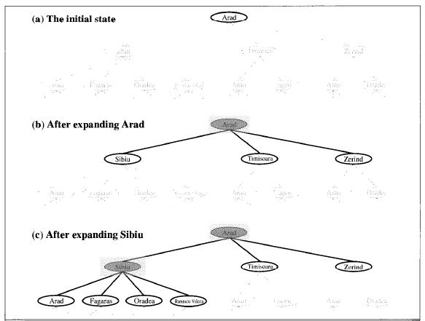
Searching for Solutions
Search Tree
States
Parent Node
Action
Path Cost
Depth
Notes:
Search Tree – visually displays how a solution is found
States: the state is the state space that displays where the node is.
Parent Node: The node in a search tree that provides new nodes.
Action: the action that was applied to the parent node to provide a brand new node.
Path Cost: The amount it cost to go from the current node to the new existing node which is indicated by the parent’s points.
Depth: the number of steps along the path from the initial state.

Slide 30
Evaluation of a Search
Completeness
Optimality
Time Complexity
Space Complexity
Notes:
There is only two forms of output in a problem solving algorithm, it is either a failure or a solution. An evaluation of the algorithm’s performance is done in four different ways:
Completeness: This checks to see if the algorithm is guaranteed to find a solution.
Optimality: This checks to see whether or not the optimal solution was found.
Time Complexity: This returns the time to see how long it takes the algorithm to find a solution.
Space Complexity: Measures how much memory is required to perform the search.
Time and space complexity are always considered with respect to some measure of the problem difficulty

Slide 31
Various Types of Searches
Breadth-First Search
Uniform-Cost Search
Depth-First Search
Depth-Limited Search
Iterative Deepening Depth-First Search
Notes:
Various search strategies used in a problem solving agent’s search tree.

Slide 32
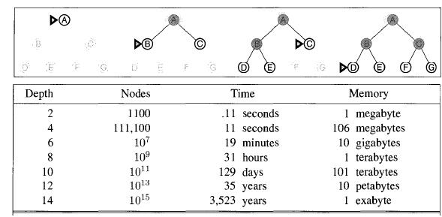
Breadth-First Search
Expands the root node first, then all the root node successors are expanded followed by other successors.
Notes:
All nodes must be at a certain level before they are capable of reaching the next level.
Breadth-first search can be implemented by calling the search tree with an empty fringe that is first-in-first-out (FIFO) queue, assuring that the nodes visited first will be expand.ed first

Slide 33
Uniform-Cost Search
Expands a node with the lowest path cost.
Only cares about the total cost and does not care about the number of steps a path has.
Notes:
Agent that worries about minimizing cost itself.
Example : automated car agent
gas cost as opposed to distance

Slide 34
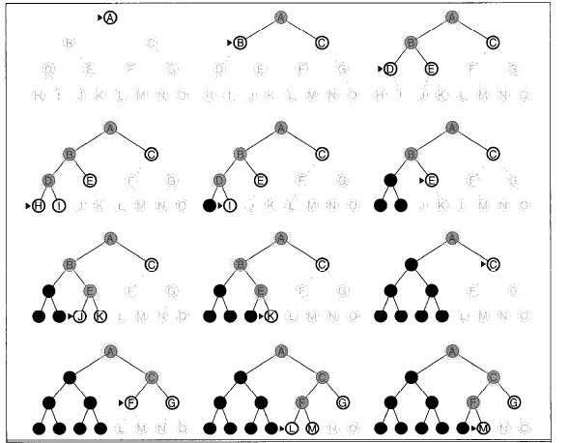
Depth-First Search
Expands the deepest node and the current fringe of the search tree.
Implements a last-in-first-out methodology.
Notes:
. The search moves to the lowest level of the search tree
This is where the nodes have no successors.
Works backwards to find solutions
Opposite of breadth-first search.

Slide 35
Depth-Limited Search
Solves infinite path problems and can be implemented as a single modification to the general tree search algorithm by setting a depth limit.
Notes:
The problem of unbounded trees can be alleviated by supplying Depth-first search with a pre-determined depth limit
This as far as the depth can go and that’s it.

Slide 36
Iterative Deepening Depth-First Search
Is used to find the best Depth Limit.
A goal is found when a Depth Limit reaches the depth of the shallowest node.
Notes:
This is done by steadily increasing the limit until a certain goal is found.

Slide 37
Iterative Deepening Depth-First Search cont.
Notes:
Starts and see if it’s a good depth if not its starts all over again
Iterative deepening search may seem wasteful, because states are generated multiple times…it turns out this is not very costly the reason is that in a search tree with the same branching factor at each level, most of the nodes are in the bottom level so it does not matter much that the upper levels are generated multiple times”

Slide 38
Questions?
Any Questions on AI?

Slide 39
Expert Systems
Definition
“An expert system is an interactive computer-based decision tool that uses both facts and heuristics to solve difficult decision problems based on the knowledge acquired from an expert.”(The Fundamentals of Expert Systems)
Notes:
Domain Specific
Takes expert knowledge.
Examples:
Doctor
Economic analyst
Computer configuring

Slide 40
Types of Expert Systems
Interpreting and Identifying
Predicting
Diagnosing
Designing
Planning
Monitoring
Debugging and Testing
Instructing and Training
Controlling

Slide 41
Creating an Expert System

Slide 42
Expert System Programming Languages
PROLOG
LISP
Notes:
Prolog is declarative: The program logic is expressed in terms of relations, and execution is triggered by running queries over these relations.
Lisp programs can manipulate source code as a data structure, giving rise to the macro systems that allow programmers to create new syntax or even new domain-specific programming languages embedded in Lisp.

Slide 43
Mandatory Characteristics
Efficient mix of integer and real variables
Good memory-management procedures
Extensive data-manipulation routines
Incremental compilation
Tagged memory architecture
Optimization of the systems environment
Efficient search procedures

Slide 44
Levels of an Expert System
Knowledge base
Problem-solving rules, procedures, and intrinsic data relevant to the problem domain.
Working memory
Task-specific data for the problem under consideration.
Inference engine
Generic control mechanism that applies the axiomatic knowledge in the knowledge base to the task-specific data to arrive at some solution or conclusion.
Notes:
Knowledge base example: Expterise given from an expert
Example: Doctor situation: Appendix
Working Memory: data enter by the user
Inference Engine : the actual computer hardware system itself

Slide 45
Expert Systems Organizational and Operating Environment

Slide 46
Data Flow of an Expert System

Slide 47
References
Expert Systems: Wikipedia. (n.d.). Retrieved October 18, 2008, from Wikipedia: wikipedia - http://en.wikipedia.org/wiki/Expert_system
Fogel, D. B. (2002). Blondie24: Playing at the Edge of AI. San Fransisco,CA: Morgan Kaufman Publishers.
Luger, G. F. (2008). Artificial Intelligence. Boston: Pearson Addison Wesley.
Russell, S., & Norvig, P. (2003). Artificial Intelligence: A Modern Approach. Upper Saddle River, NJ: Pearson Education Inc.
The Fundamentals of Expert Systems. (n.d.). Retrieved November 13, 2008, from http://media.wiley.com/product_data/excerpt/18/04712933/0471293318.pdf

Slide 48
The End
Any Questions?

