Slide 1
SQL and Databases

Slide 2
Assignment
Create the table, and insert the data, shown in the next slide.
Display the first name and age for everyone that's in the table.
Display the first name, last name, and city for everyone that's not from Payson.
Display all columns for everyone that is over 40 years old.
Display all columns for everyone whose first name equals "Mary".
Display all columns for everyone whose first name contains "Mary".
Mary Ann Weber just got married to Bob Williams. She has requested that her last name be updated to Weber-Williams.
Sebastian Smith's birthday is today, add 1 to his age.
All secretaries are now called "Administrative Assistant". Update all titles accordingly.
Display all names using “Lastname, Firstname”
What’s the average Age of employees in Arizona
Who is the oldest employee
Erica Williams just quit, remove her from the table
Display Firstname, Lastname, and age for people between 30 and 40 years old; and order them from youngest to oldest.
SHOW SCREENSHOTS FOR EACH STEP

Slide 3
Use this table to complete your assignment.
FirstName | LastName | ID (pk) | age | city | position | state
John | Jones | 100 | 45 | Payson | Sales Rep | Arizona
Mary | Jones | 101 | 25 | Payson | Secretary | Arizona
Eric | Edwards | 102 | 32 | San Diego | Sales Rep | California
Mary Ann | Weber | 103 | 32 | Phoenix | Bookkeeper | Arizona
Ginger | Howell | 104 | 42 | Mission | Secretary | Texas
Sebastian | Smith | 105 | 23 | Gila Bend | Warehouse Assistant | Arizona
Gus | Gray | 106 | 35 | McAllen | Supervisor | Texas
Mary Ann | May | 107 | 52 | Tucson | Secretary | Arizona
Erica | Williams | 108 | 60 | Show Low | Payroll | Arizona
Leroy | Brown | 109 | 22 | Pinetop | Technician | Arizona
Elroy | Cleaver | 110 | 22 | Globe | Technician | Arizona

Slide 4
Submit your assignment via BlackBoard

Slide 5
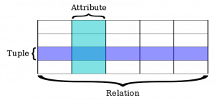
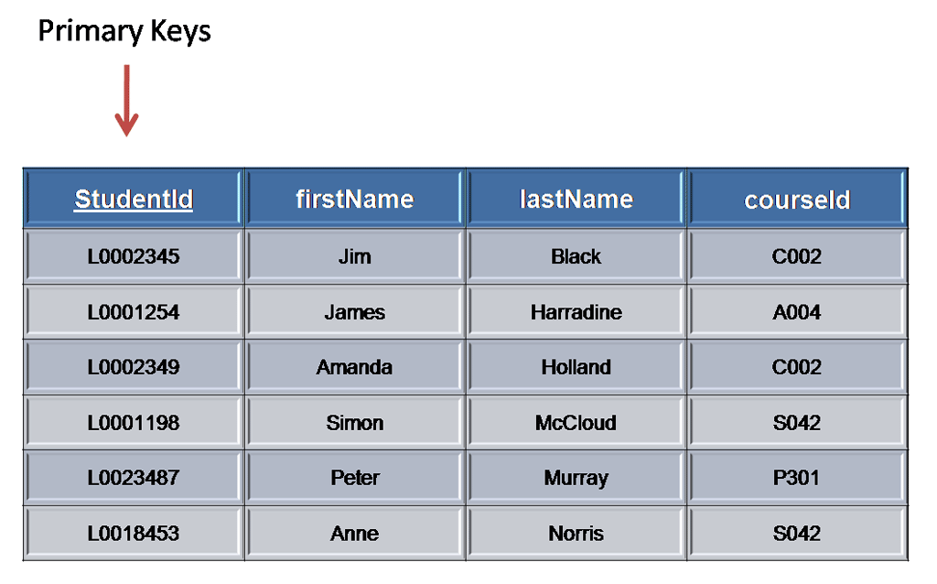
What is a Database?

Slide 6
SQL
Structured Query Language
Standard language for creating and manipulating a database.
DDL (Data Definition Language)- applies to the structure of the database schema
CREATE DATABASE - creates a new database
CREATE TABLE - creates a new table
DROP TABLE - deletes a table
DML (Data Manipulation Language) - apply to rows / records
SELECT - extracts data from a database
UPDATE - updates data in a database
DELETE - deletes data from a database
INSERT INTO - inserts new data into a database

Slide 7
A SQL SELECT statement can be broken down into numerous elements, each beginning with a keyword. Although it is not necessary, common convention is to write these keywords in all capital letters. In this article, we will focus on the most fundamental and common elements of a SELECT statement, namely
SELECT
FROM
WHERE
ORDER BY

Slide 8
Examples
SELECT column_name(s) FROM table_name
SELECT * FROM Persons WHERE FirstName='Tove' AND LastName='Svendson‘
SELECT column_name(s) FROM table_name WHERE column_name operator value

Slide 9
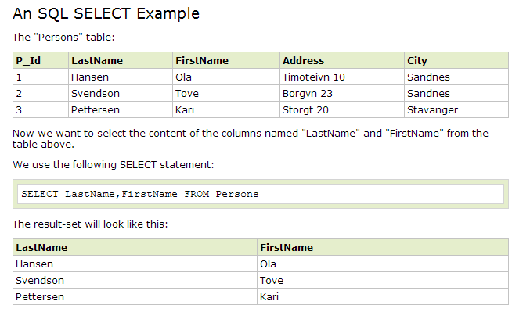

Slide 10
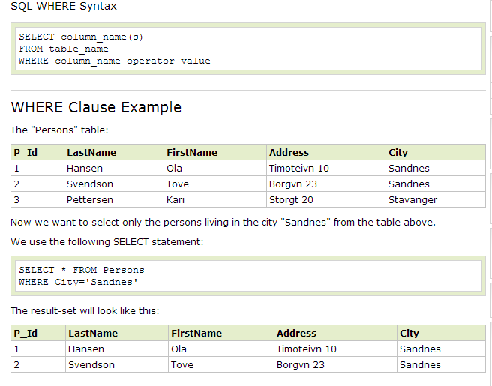

Slide 11
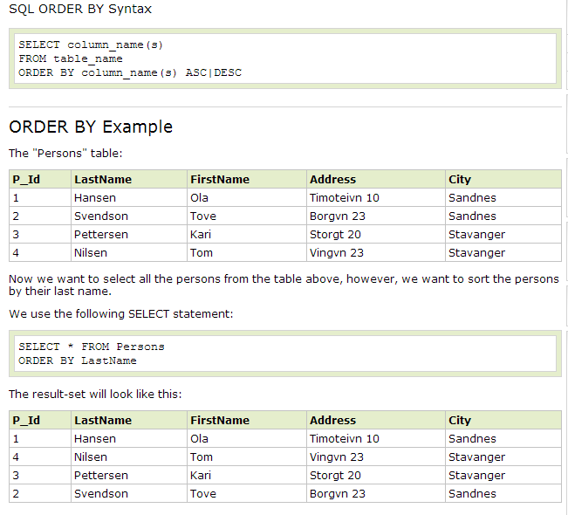

Slide 12
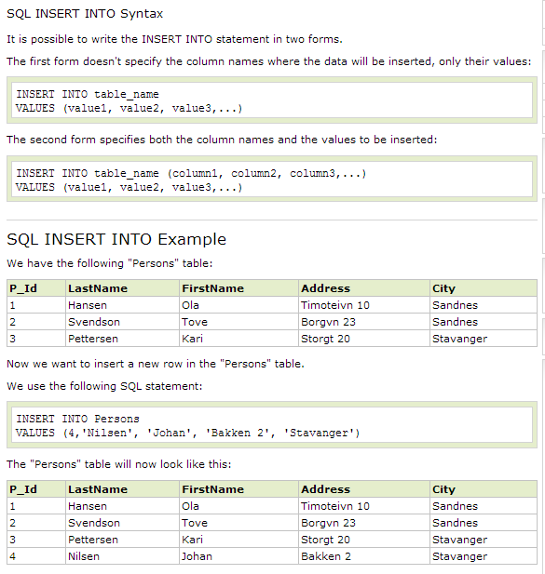

Slide 13
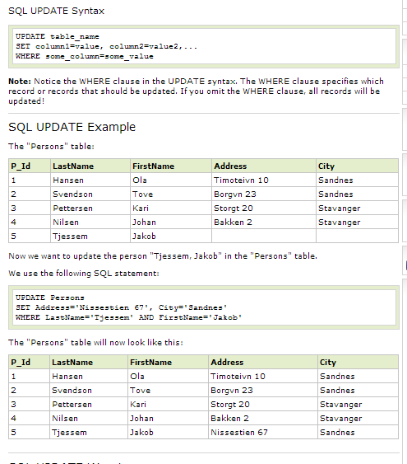

Slide 14
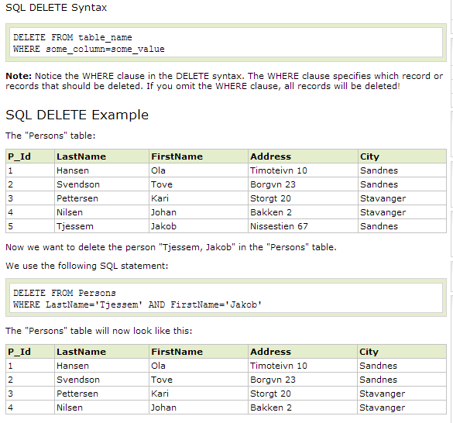

Slide 15
Useful aggregate functions:
AVG() - Returns the average value
COUNT() - Returns the number of rows
FIRST() - Returns the first value
LAST() - Returns the last value
MAX() - Returns the largest value
MIN() - Returns the smallest value
SUM() - Returns the sum

Slide 16
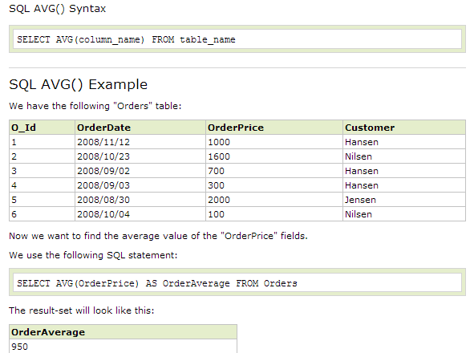
M`

Slide 17
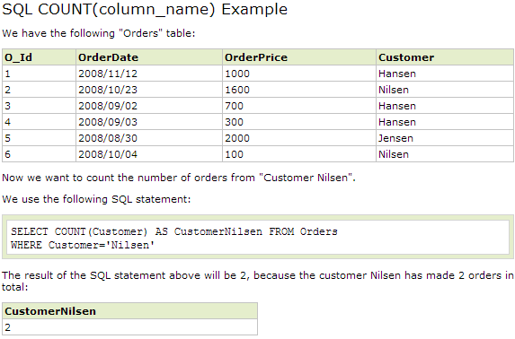
SQL COUNT
The COUNT(column_name) function returns the number of values (NULL values will not be counted) of the specified column:
SELECT COUNT(column_name) FROM table_name

Slide 18
WAMP
Download and install WAMP Server at their official website:
http://www.wampserver.com/en
Test your WampServery:
Open your favorite browser
Type, http://127.0.0.1/ OR http://localhost/
Hit Enter
You have successfully installed WampServer on your computer if you have seen the welcome screen of WampServer.

Slide 19
PHP myAdmin
You can launch phpMyAdmin console by one of the following means,
Click on phpmyadmin link on WampServer welcome screen
Type: http://127.0.0.1/phpmyadmin/ OR http://localhost/phpmyadmin/ in the browser address bar
Hit Enter
You will be at phpMyAdmin index to manage your MySql databases.

Slide 20
Useful Links
http://w3schools.com/sql -> This site will show you how to use SQL step by step
Search YouTube for video tutorials on installing WAMP

