Slide 1
Lab6 – Debug Assembly Language Lab
CSCI 6303 - Principles of I.T. Fall 2012

Slide 2
Lab Assignment - Questions
Write an Assembly command to add two numbers, 3 and 8, and save the result into Register BX. (show the screen shot of your complete code and results.)
Write an Assembly command using two registers AX and BX that adds 5 and 7 and saves the result into BX. (show the screen shot of your complete code and results.)
(student will need to do some research for this question) Write an Assembly program to display “Hello World”, compile it, save it to the disk and run it from the DOS prompt. (show the screen shot of your complete code and results.)

Slide 3
Check List
The first step in using debug is to check if you are using an operating system that is 32bits or 64bits.
32 bit operating systems still include debug and 64bit operating systems no longer support debug.
To work around this we will download a program called DOS Box which is free and easy to use for our debugging.

Slide 4
Lets Begin!!!
Download DOS Box from www.dosbox.com and then install it.
8086 files have already been pre-installed, these files will allow us to use DOS Box on our 64bit Windows 7 operating systems.
Once installed go ahead and click the DOSBox icon to start it up.

Slide 5
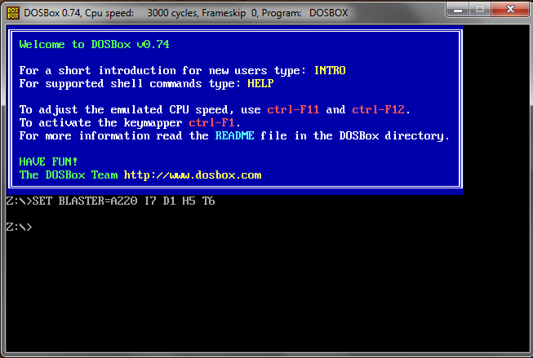
Let’s start writing Assembly code
DOSBox start up window

Slide 6
First we need to tell DOSBox where our 8086 folder that contains our microprocessing debug files.
Second we enter the following to direct DOSBox to get them. You will notice that DOSBox has this line already Z:\>…from here we enter the following.
mount c c:\8086 (we must first mount the c drive then point to the folder where 8086 files are at) then hit enter
Next enter
c: (to navigate to our c drive) then type the next
debug (now we are ready to start our assembly commands

Slide 7
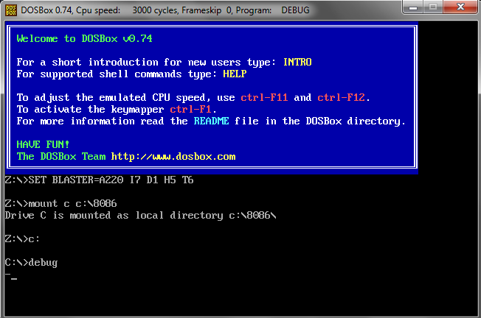
What your screen should look like

Slide 8
Debug Tutorial
Once your set up in debug type in ? After the -.
-? (this will show all of the debug command list)
On the following slide is the command list

Slide 9
Debug commands
A- Assembles 8086/8088 mnemonics. C- Compares two areas of memory. D- Displays the contents of memory locations. E- Enters data into specified memory locations. F- Fills memory locations with specified values. G- Runs an executable program from within debug. H- Performs Hexadecimal math on two Hex numbers. i- reads one byte of data from the specified port. L- loads the contents of a disk file or sectors into memory. M- moves or copies the contents of memory locations.

Slide 10
Commands continued
N- Names a file for the L or w command. (load or write) O- outputs one byte of data to the specified port. P- Executes a loop, a repeated string instruction, a software interrupt, or a subroutine. Q- Quits a debug session. R- Displays or modifies the contents of the cpu registers. S- Searches the contents of memory for the specified string of data. T- Executes one instruction at a time and dumps the contents of all the registers to the screen, then displays the next instruction to be executed. U- Disassembles machine code into the mnemonic form of the program. W- Writes the data in memory to the disk. The name given the file is the name entered with the n (name) command. The file size is given by setting the BX:CX register to the number of bytes to be saved. ?- Display a help screen on some versions of debug.

Slide 11
Tutorial – Example 1
For our first example we are going to add two numbers and save them into register AX. Type the following
mov ax,2 (moves the value 2 into register ax) hit enter.
add ax,2 (adds value 2 to what is already in register ax) hit enter. Then hit enter again to get the – line. Then type
r ( this will show us all the registers AX, BX, CX etc.) next type
t ( this will trace the values in the register AX)
t (again type this and you should notice a new value in AX).
Once finished you can type q to quit

Slide 12
Tutorial - Example 2
For our second example we are going to add two integers in separate registers and store the result.
As before type
a (which will give the next line we can use) hit enter and type
mov cx,2 (hit enter)
mov dx,2 (hit enter)
add dx, cx (hit enter) until you get the – then type
r ( to show the registers)
t (to trace the value in cx)
t (again to trace the value in dx)
t (to trace the result in cx)
Once finished you can type q to quit

Slide 13
What is Debug
Debug is a method of looking at portions of your computer and writing assembly code to perform certain tasks on your computer.
Debug can act as an assembler, disassembler, or hex dump program allowing users to interactively examine memory contents (in assembly language, hexadecimal or ASCII), make changes, and selectively execute COM, EXE and other file types.
The debug command is an external command and is available in the below Microsoft operating systems.

Slide 14
What is Debug available in
All Versions of MS-DOS, Windows 95, Windows 98 Windows ME, Windows NT, Windows 2000 ,Windows XP and 32 bit systems
Not available in 64 bit systems.

Slide 15
What is Assembly Language
assembly language is a low-level programming language for a computer, microcontroller, or other programmable device, in which each statement corresponds to a single machine code instruction.
Each assembly language is specific to a particular computer architecture, in contrast to most high-level programming languages, which are generally portable across multiple systems.

Slide 16
Assembly language continued
Assembly language is converted into executable machine code by a utility program referred to as an assembler; the conversion process is referred to as assembly, or assembling the code.
Assembly language uses a mnemonic to represent each low-level machine operation or opcode.
Some opcodes require one or more operands as part of the instruction, and most assemblers can take labels and symbols as operands to represent addresses and constants, instead of hard coding them into the program.

Slide 17
Assembler
An assembler creates object code by translating assembly instruction mnemonics into opcodes, and by resolving symbolic names for memory locations and other entities.
The use of symbolic references is a key feature of assemblers, saving tedious calculations and manual address updates after program modifications.
Most assemblers also include macro facilities for performing textual substitution—e.g., to generate common short sequences of instructions as inline, instead of called subroutines.

Slide 18
Assembler continued
Assemblers have been available since the 1950s and are far simpler to write than compilers for high-level languages as each mnemonic instruction / address mode combination translates directly into a single machine language opcode.
Modern assemblers, especially for RISC architectures, such as SPARC or POWER, as well as x86 and x86-64, optimize Instruction scheduling to exploit the CPU pipeline efficiently.

Slide 19
DEBUG/ASSEMBLY TUTORIAL
For an in depth tutorial go to the following link
http://www.armory.com/~rstevew/Public/Tutor/Debug/debug1.htm
This is a link to a complete list of assembly language commands
http://en.wikipedia.org/wiki/X86_instruction_listings

